Slide 1
Recording Mediums: Which is Best?
Cody Barras
Musical Acoustics Fall 2012

Slide 2
Vinyl, CD or MP3
There is quite a deal of debate among recording specialists and internet know-it-alls about the general quality of sound recordings over various mediums. Some say that the compression of an MP3 gives an over processed sound, others say the artifacts on a record make for an unclean recording, and still others say that the CD is not the happy medium it claims to be.
So which do people really prefer?

Slide 3
The Experiment
Three different songs were played over the three different formats for a test group of 15 individuals in a random order blind experiment.
Each test subject was asked to rank the tracks on a scale of 1-3, 1 being the best, 3 the worst, in order of how they “liked and enjoyed the sound.”
The question was left specifically vague, so as not to lead subjects toward a certain medium.

Slide 4
What They Didn’t Know
Two of the songs were originally recorded on Vinyl records, the third—Dog Days are Over—was originally recorded digitally.
One of the songs—Like a Rolling Stone—is in Mono format, the other two are in Stereo.
Thus, Here Comes the Sun served as a control.

Slide 5


Slide 6


Slide 7
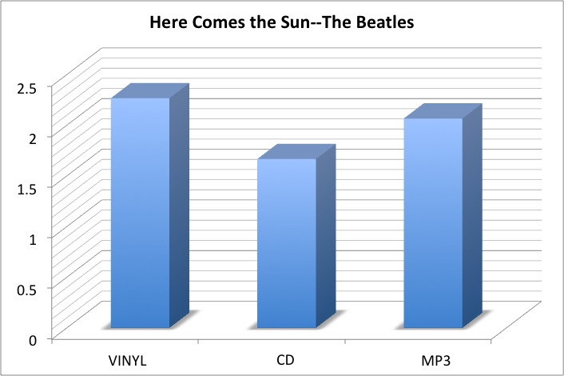

Slide 8
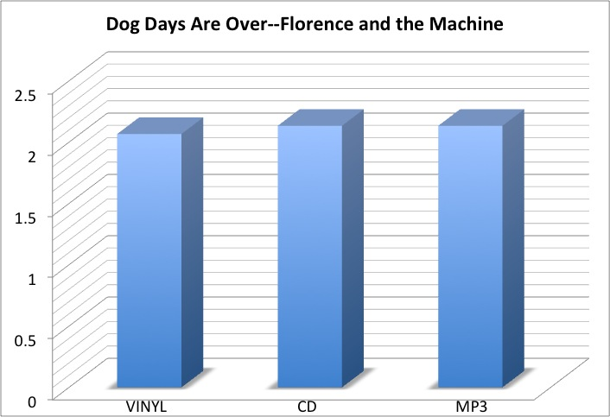

Slide 9
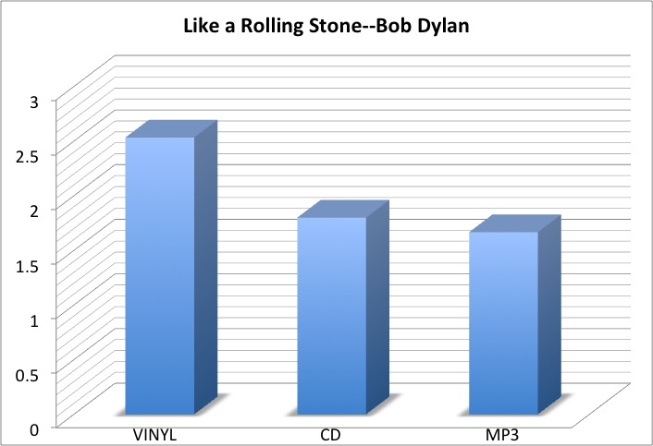

Slide 10
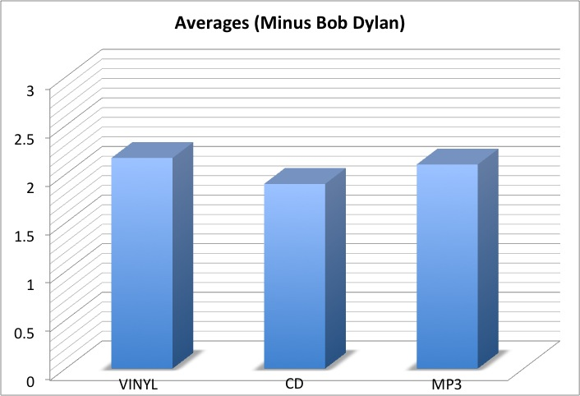

Slide 11
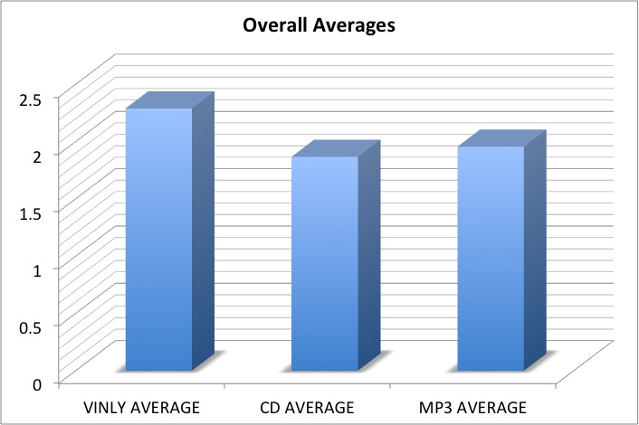

Slide 12
So…
The largest discernable difference between tastes was in the Bob Dylan “Like a Rolling Stone” recording, most likely because of its mono sound being most noticeable on the record.
Interestingly, the song orignally recorded for a digital audience was actually preferred on a record (just barely), while the stereo song recorded on analog equipment was preferred on CD.
The Beatles MP3 was the “middle” track, while in the Florence + the Machine test, the CD and MP3 averaged exactly the same.

Slide 13
Scientific Significance
The numbers are too close for the data to statistically have any significant value. Perhaps with a larger test group and a more controlled test atmosphere, the results may become more clear, but for now, the only safe conclusion to draw is that the average listener prefers the sound of a stereo recording to a mono recording on average.

Slide 14
The End

