Slide 1
Muon Physics around the world and at the Intensity Frontier
Peter Winter
Argonne National Laboratory

Slide 2





Myself
My funny accent is from the fact that I was born in Germany
Studied physics at Bonn University
PhD on meson production at the COoler SYnchrotron COSY at Research Center of Julich, Germany
Postdoc at University of Illinois Urbana-Champaign and University of Washington in Precision Muon Physics Group
Assistant Physicist at Argonne since August 2012 working on the New g-2 at Fermilab

Slide 3
Overview
The Muon and the Big Picture
Muon Beams
Recent Muon Experiments
  TWIST, Muon Spin Resonance, Lamb shift, MuLan, MuCap/MuSun
Muons at Fermilab and the Intensity Frontier
  CLFV: MEG (μ⁺ -> e⁺γ), μ3e, Mu2e, COMET
  New g-2
  Future Muon experiments with Project-X

Slide 4
Overview
The Muon and the Big Picture
Muon Beams
Recent Muon Experiments
  TWIST, Muon Spin Resonance, Lamb shift, MuLan, MuCap/MuSun
Muons at Fermilab and the Intensity Frontier
  CLFV: MEG (μ⁺ -> e⁺γ), μ3e, Mu2e, COMET
  New g-2
  Future Muon experiments with Project-X
PART 1
PART 2

Slide 5
Overview
The Muon and the Big Picture
Muon Beams
Recent Muon Experiments
  TWIST, Muon Spin Resonance, Lamb shift, MuLan, MuCap/MuSun
Muons at Fermilab and the Intensity Frontier
  CLFV: MEG (μ⁺ -> e⁺γ), μ3e, Mu2e, COMET
  New g-2
  Future Muon experiments with Project-X

Slide 6
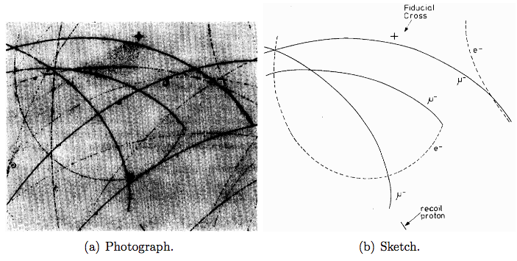
The Muon in a nutshell
Discovered in cosmic rays in 1936 by Anderson and Neddermeyer

Slide 7
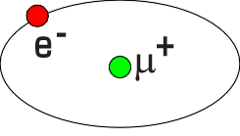
The Muon in a nutshell
Discovered in cosmic rays in 1936 by Anderson and Neddermeyer
Big brother of the electron, m_{μ} = 207∙m_{e}
Weak decay gives "long" lifetime (μs): beams and probe
Main decay μ → e ν_{e} ν_{μ} (parity violating)
Polarized muon beams from pion decay
Hydrogen-like states (μ⁻p, μ⁻d, muonium: μ⁺e⁻)
Enhanced sensitivity to new physics ~(m_{μ}/m_{e})²
Lepton number violation (μ→e) extremely small in SM
μ⁻
p

Slide 8
The Muon is part of the 2nd lepton family
S = 1/2
S = 1/2
S = 1/2
q = -1
e
q = -1
μ
q = -1
τ
0.511 MeV/c²
105.66 MeV/c²
1776.8 MeV/c²
S = 1/2
S = 1/2
S = 1/2
q = 0
ν_{e}
q = 0
ν_{μ}
q = 0
ν_{τ}
< 2 eV/c²
< 2 eV/c²
< 2 eV/c²
* Size of sphere represents mass of particle, neutrinos are still exaggerated!

Slide 9
Muon sources
So where do we get muons from?
Proton beam on a target to produce pions and other secondaries

Slide 10
Muon sources
So where do we get muons from?
Proton beam on a target to produce pions and other secondaries
Pions decay mainly into muons and (anti)-muon neutrino:
ν_{μ} π⁺ μ⁺
*
* From 4-momentum conservation for pion at rest:
p_{μ} = (m_{π}² – m_{μ}²) / 2m_{π} = 29.8 MeV/c

Slide 11
Muon sources
So where do we get muons from?
Proton beam on a target to produce pions and other secondaries
Pions decay mainly into muons and (anti)-muon neutrino:
Since pion has S=0 and neutrino has left-handed helicity, the decay muons are highly polarized
ν_{μ} π⁺ μ⁺
*
* From 4-momentum conservation for pion at rest:
p_{μ} = (m_{π}² – m_{μ}²) / 2m_{π} = 29.8 MeV/c

Slide 12
Muon sources
So where do we get muons from?
Proton beam on a target to produce pions and other secondaries
Pions decay mainly into muons and (anti)-muon neutrino:
Since pion has S=0 and neutrino has left-handed helicity, the decay muons are highly polarized
Collect decay muons in secondary beam channel to bring to experiment
ν_{μ} π⁺ μ⁺
*
* From 4-momentum conservation for pion at rest:
p_{μ} = (m_{π}² – m_{μ}²) / 2m_{π} = 29.8 MeV/c

Slide 13
Muon decay
μ
ν
Main decay channel: μ⁺ → e⁺ ν_{e} ν_{μ}
Due to V-A structure of leptonic current the decay is parity violating
γ_{α}(1-γ₅)
ν
W
e

Slide 14
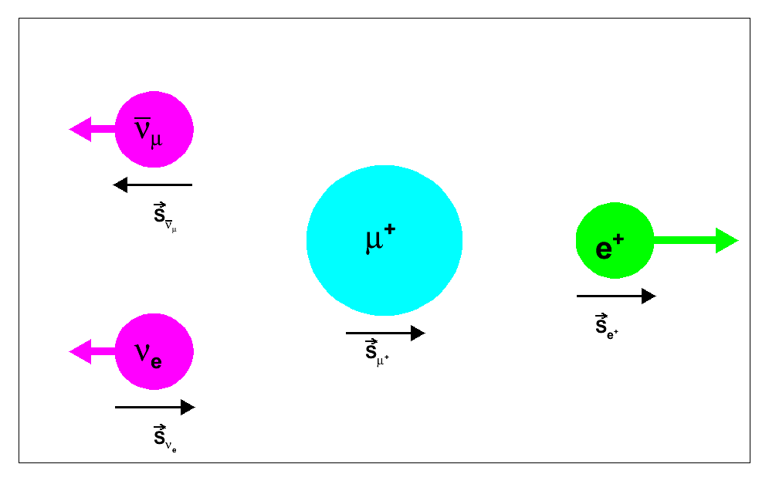
Muon decay
μ
ν
Main decay channel: μ⁺ → e⁺ ν_{e} ν_{μ}
Due to V-A structure of leptonic current the decay is parity violating
High energy positrons are emitted in direction of the μ⁺ spin
γ_{α}(1-γ₅)
ν
W
e
High energy electron
Spin

Slide 15
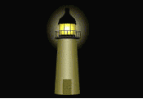
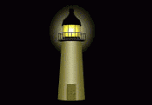
Muon decay
μ
ν
Main decay channel: μ⁺ → e⁺ ν_{e} ν_{μ}
Due to V-A structure of the weak leptonic current the decay is parity violating
High energy positrons are emitted in direction of the μ⁺ spin
The decay is „self-analyzing“ in the sense that the decay electrons incorporate the muon spin
γ_{α}(1-γ₅)
ν
W
e
High energy electron
Spin

Slide 16
Muon decay
μ
ν
*
ν
Fermi‘s Golden rule allows to deduce:
G_{F}
e
*
You can find derivations on the web: A lot of math and some assumptions and hours later...
Higher order corrections needed to make this an equality, see MuLan opening slides later

Slide 17


Muon decay #2
μ
ν
Fermi‘s Golden rule allows to deduce:
Differential decay spectrum (parametrized by Michel parameters):
ν
G_{F}
e
In the Standard Model:
ρ = 0.75 η = 0
P_{μ}ξ = 1 δ = 0.75
θ
Angle with respect to (positive) muon spin

Slide 18
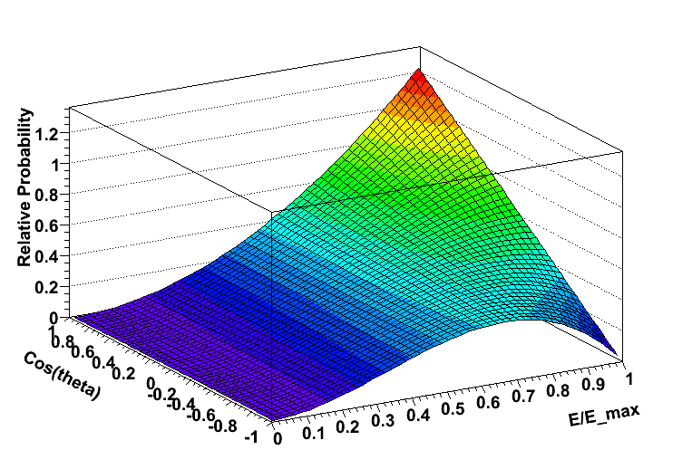
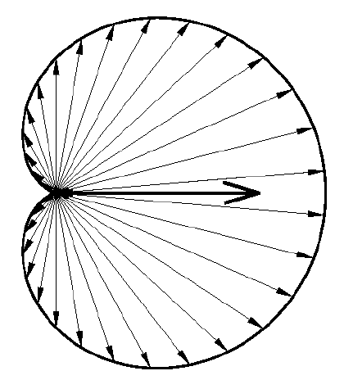
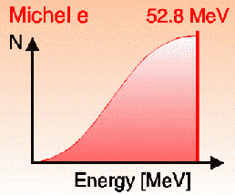
Muon decay
Differential decay spectrum simplifies in SM to:

Slide 19
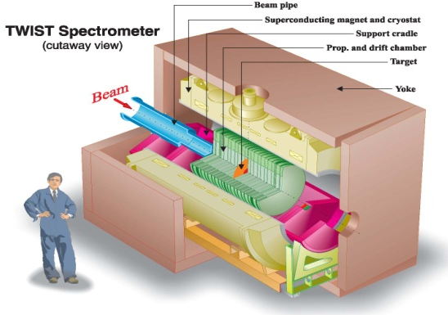
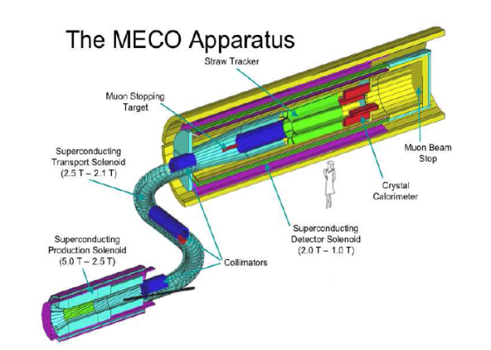
Muon Physics: Worldwide Effort
Lifetime – Fermi constant
  2 “precision” experiments: MuLan & FAST at PSI
Decay parameters
  TWIST at Triumf: Michel parameters ρ, δ, η, P_{μ}ξ
Muon Capture
  MuCap at PSI: g_{P}, pseudoscalar coupling
  MuSun at PSI: basic EW interaction in 2N system
Lepton Flavor Violation
  μ->eγ – MEG at PSI taking data now
  μe conversion Mu2e at FNAL
  COMET at JParc, Japan
  μ3e at PSI
Anomalous magnetic moment (g-2)
  E821 at BNLand new g-2 E989 at FNAL
Search for Electric Dipole Moment
  E821 at BNL and new g-2 E989 at FNAL
Lorentz / CPT violation tests
  E821 at PSI: precession vs. sidereal day
Proton charge radius
  Muonic Lamb shift at PSI experiment
  MuSE at PSI
TWIST
Mu2e

Slide 20
Different categories of muon experiments
Measurement of Standard Model parameters:
  Masses: M_{Z} M_{W} M_{H} m_{b} m_{t} m_{e} m_{u} m_{v} …
  Couplings: α_{QED} α_{Strong} G_{F} G_{grav}
  Structure of interactions: SU(3)_{C} x SU(2)_{L} x U(1)_{Y}

Slide 21
Different categories of muon experiments
Measurement of Standard Model parameters:
  Masses: M_{Z} M_{W} M_{H} m_{b} m_{t} m_{e} m_{u} m_{v} …
  Couplings: α_{QED} α_{Strong} G_{F} G_{grav}
  Structure of interactions: SU(3)_{C} x SU(2)_{L} x U(1)_{Y}
Search for Physics Beyond the Standard Model:
  TWIST: Michel Parameters ρ, δ, η, P_{μ}ξ
  Charged Lepton Flavor violation MEG, Mu2e, μ3e
  Physics Beyond the SM: Muon g-2, μEDM

Slide 22
Different categories of muon experiments
Measurement of Standard Model parameters:
  Masses: M_{Z} M_{W} M_{H} m_{b} m_{t} m_{e} m_{u} m_{v} …
  Couplings: α_{QED} α_{Strong} G_{F} G_{grav}
  Structure of interactions: SU(3)_{C} x SU(2)_{L} x U(1)_{Y}
Search for Physics Beyond the Standard Model (BSM):
  TWIST: Michel Parameters ρ, δ, η, P_{μ}ξ
  Charged Lepton Flavor violation MEG, Mu2e, μ3e
  Physics Beyond the SM: Muon g-2, μEDM
Applied material research:
  Muon spin Resonance (muSR) to probe magnetic properties

Slide 23
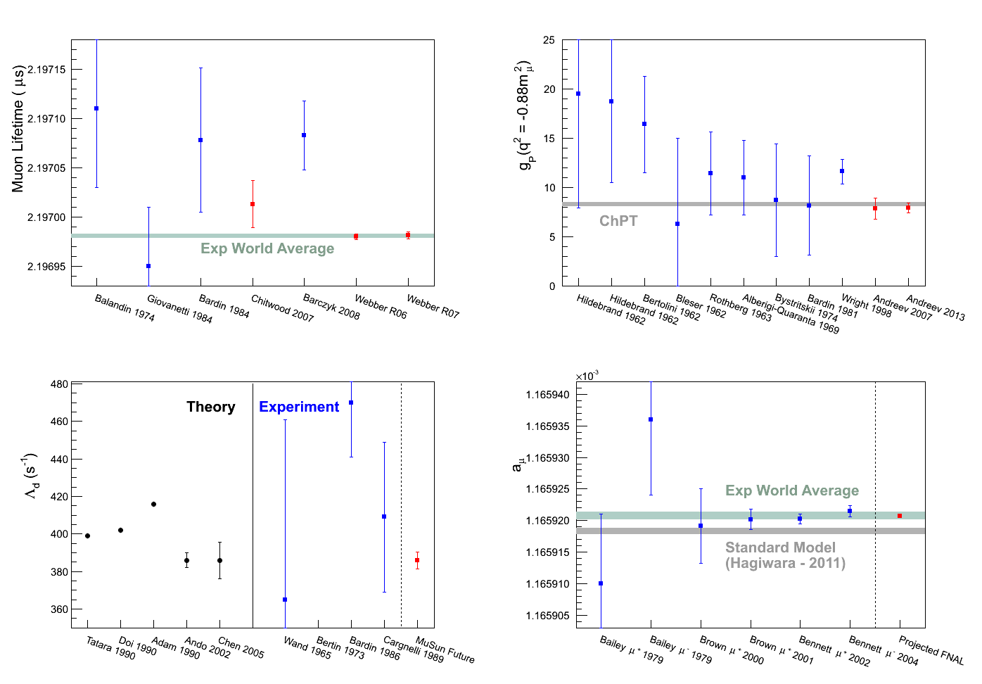
Precision Muon Physics at the Parts-Per-Million Level
Time
MuCap
MuLan
New g-2
MuSun

Slide 24
Overview
The Muon and the Big Picture
Muon Beams
Recent Muon Experiments
  TWIST, Muon Spin Resonance, Lamb shift, MuLan, MuCap/MuSun, MEG (μ⁺ -> e⁺γ)
Muons at Fermilab and the Intensity Frontier
  CLFV: MEG (μ⁺ -> e⁺γ), μ3e, Mu2e, COMET
  New g-2
  Future Muon experiments with Project-X

Slide 25
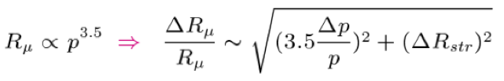
Muon beams: Surface muons (p_{μ} = 29.8 MeV/c)
muons
target
stopping
target
pion
proton
A fraction of pions come to rest near surface
Decay surface muons have momenta of ~29.8 MeV/c
Well defined source
High polarization of close to 100%
No negative surface muons (π⁻ undergo nuclear capture)
Positron contamination might require separator
Short range R_{μ} allows thin muon stopping targets:
A.E. Pifer et al., NIM 135, 39

Slide 26
Muon beams: Cloud muons
muons
target
stopping
target
pion
proton
Decay of pions in flight
Cloud muons have wide range of momenta
Usually low muon polarization
Beam contaminated with π± and e±
Stopping target needs to be thicker with higher momentum
A.E. Pifer et al., NIM 135, 39

Slide 27
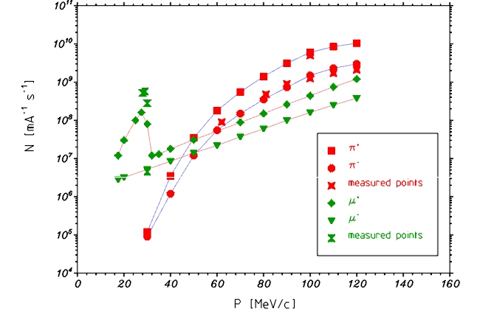
Muon production yields
http://aea.web.psi.ch/beam2lines/
πE5 beamline PSI
N_{μ} [mA⁻¹ s⁻¹]
p_{μ} [MeV/c]

Slide 28




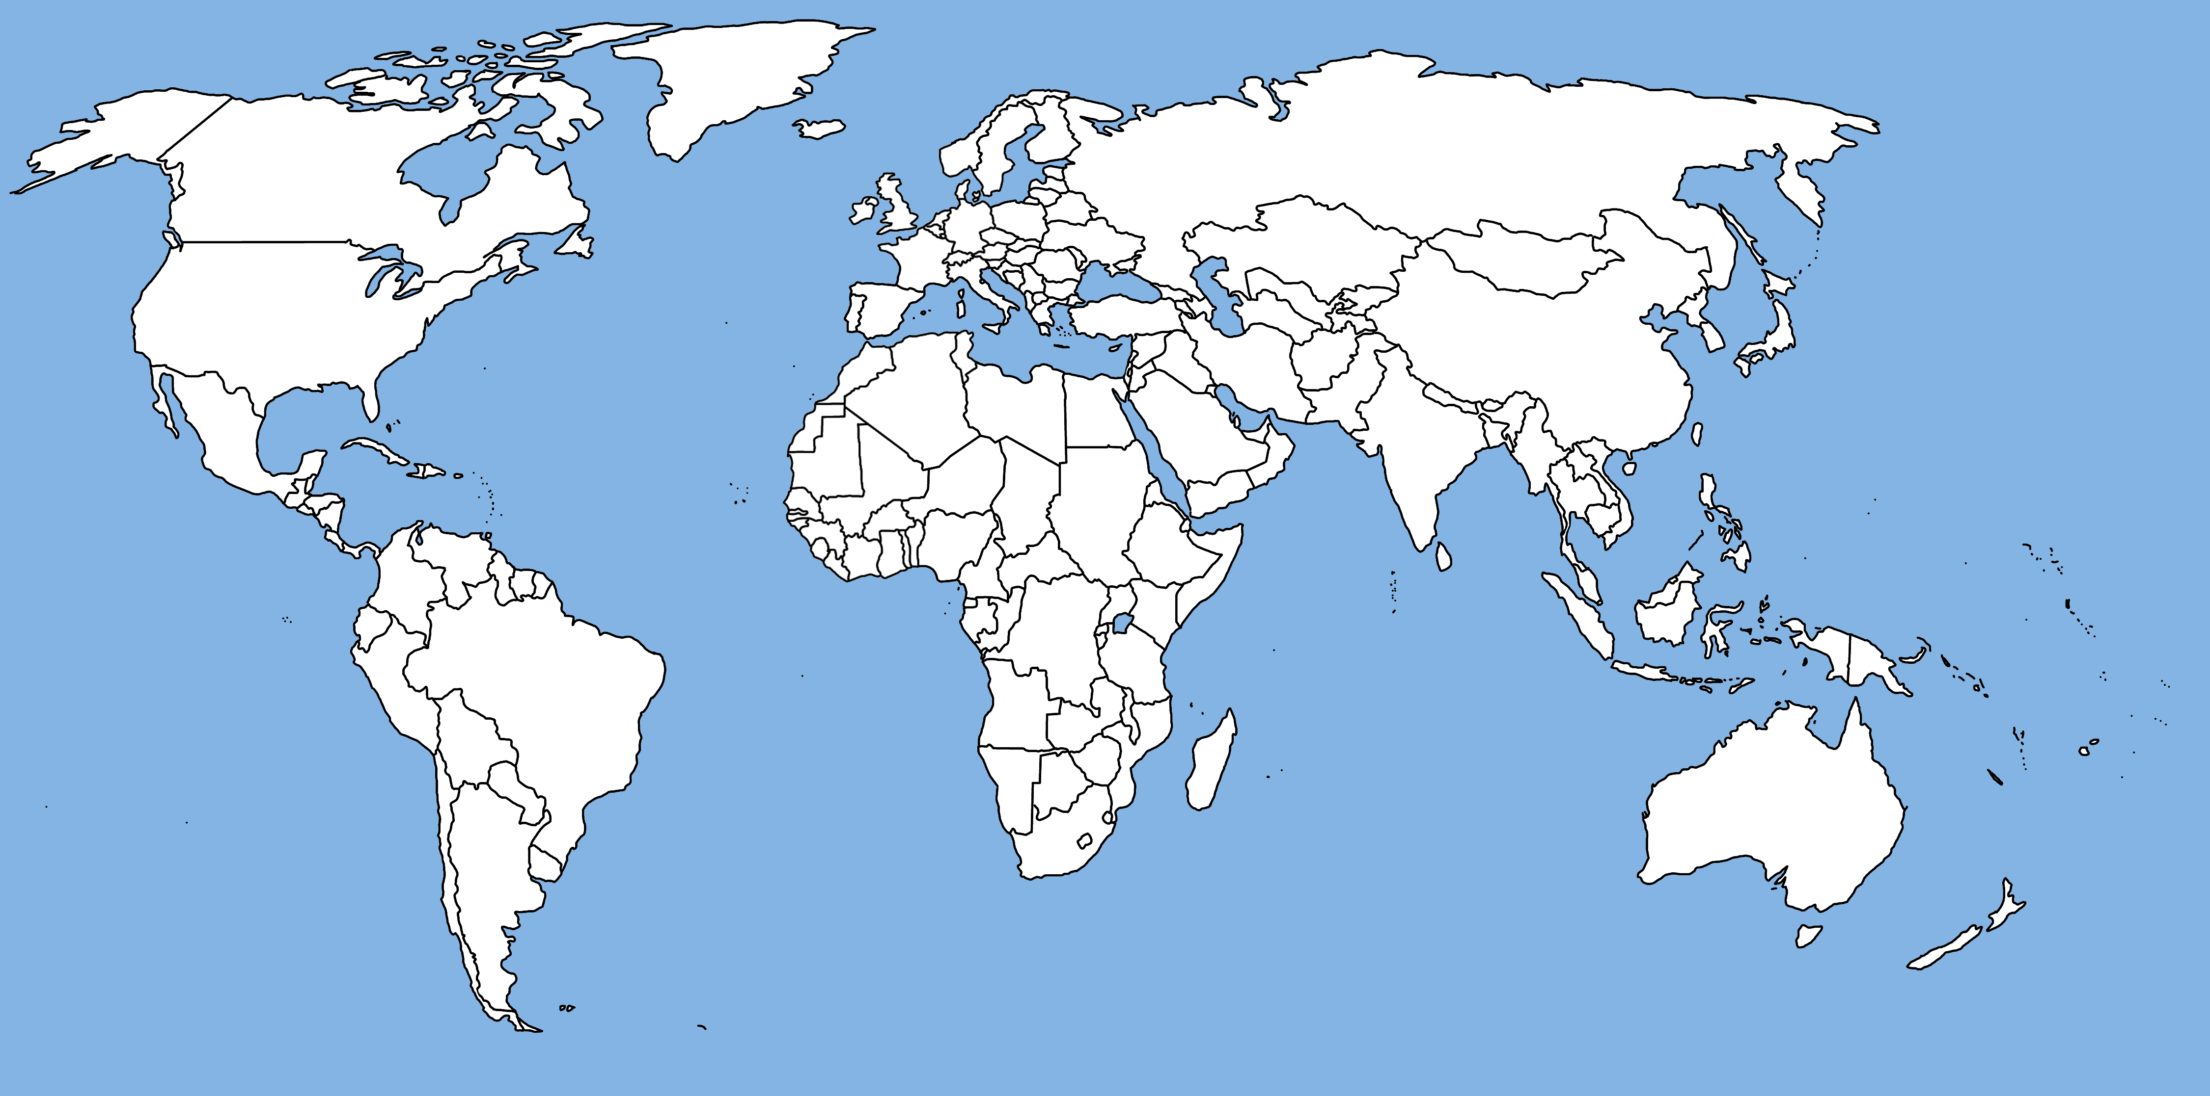



Muon facilities

Slide 29
Throughout my talk
Small indicator of the facility
where the experiment is located.

Slide 30
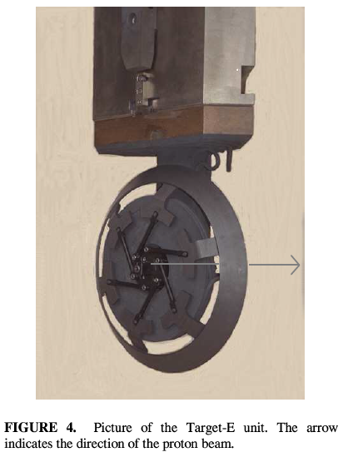
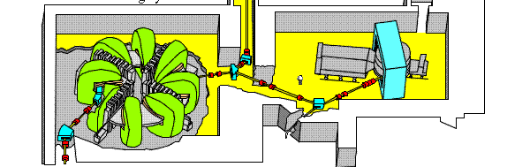
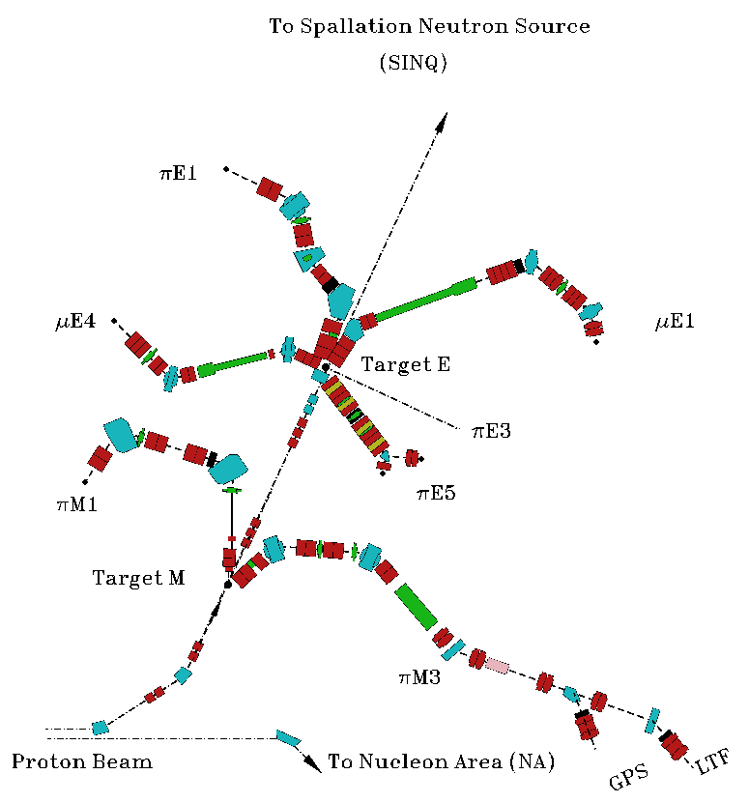
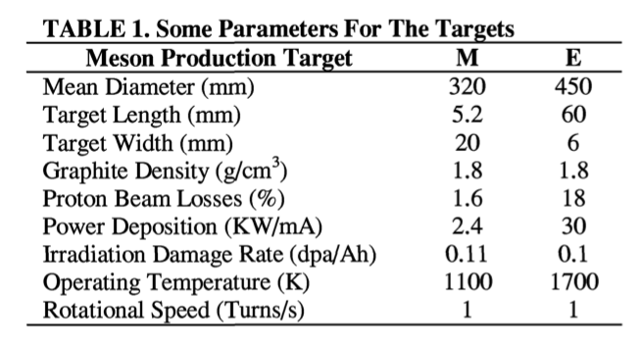
Two types of proton targets
Proton target upstream of end users (here neutron spallation source SINQ)
Can use only fraction of proton beam
Usually many beamlines viewing proton target with a small solid angle
Beamlines typically use classic focussing elements with small apertures
proton

Slide 31
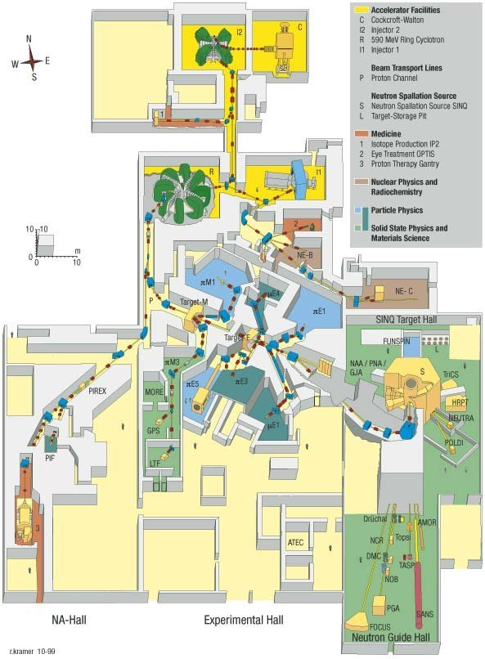
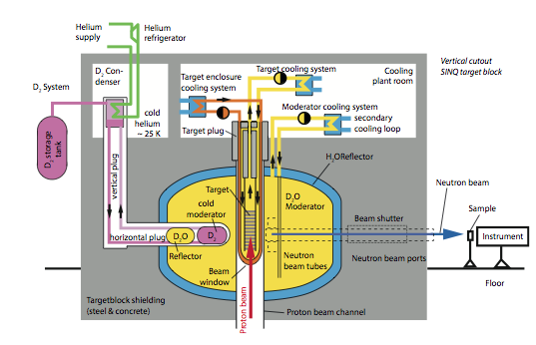
Two types of proton targets
Proton target at end of beamline where all of the remaining beam can interact
PSI invesigates a new muon beamline at neutron spallation target
Use large aperture capture solenoid to increase muon flux

Slide 32
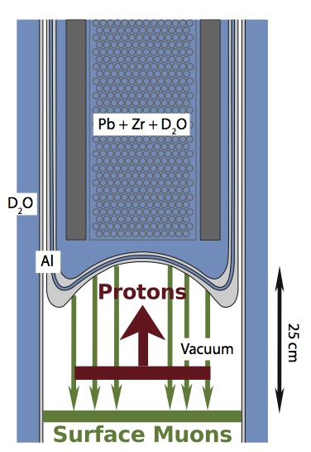
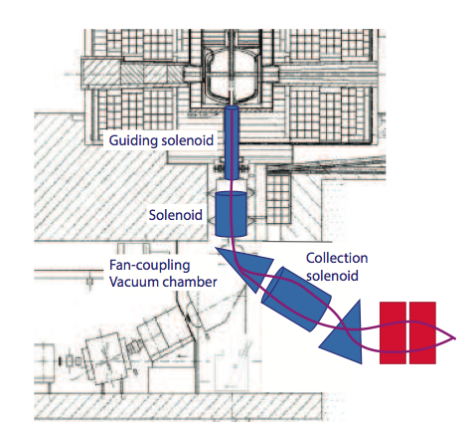
Proposal: High intensity muon beam

Slide 33
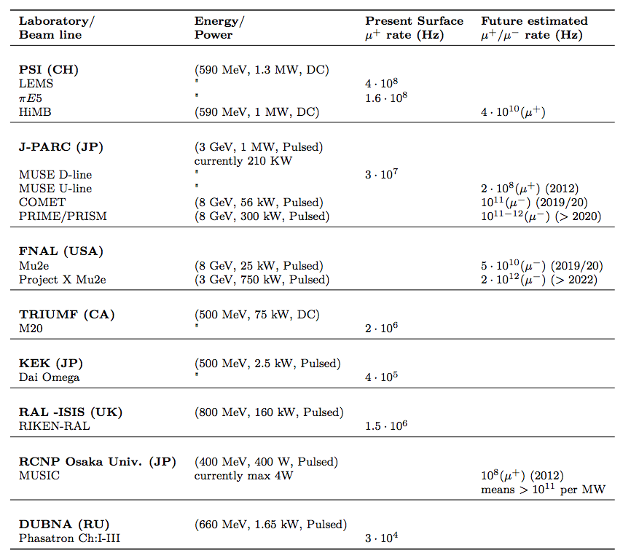
Muon beams

Slide 34
Muon experiments: Beam rates
Experiment | Beam | Momentum | Rates [1/s] |  | Beamline
TWIST | μ⁺ | 29.8 MeV/c | <5 * 10³ |  | TRIUMF
Muon lamb shift | π⁻ μ⁻ | 100 MeV/c ~1 MeV/c | ~10⁸ ~2.5 * 10² |  | πE5 @ PSI
MuLan | μ⁺ | 29.8 MeV/c | 8 * 10⁶ |  | πE3 @ PSI
MuCap / MuSun | μ⁻ | 34 MeV/c | 1 * 10⁵ |  | πE3 @ PSI
MEG | μ⁺ | 29.8 MeV/c | 3 * 10⁷ |  | πE5 @ PSI
MEG upgrade | μ⁺ | 29.8 MeV/c | 7 * 10⁷ |  | πE5 @ PSI
μ⁺ -> e⁺e⁻e⁺ (Ph. I) | μ⁺ | 29.8 MeV/c | <1 * 10⁸ |  | πE5 @ PSI
μ⁺ -> e⁺e⁻e⁺ (Ph. II) | μ⁺ | 29.8 MeV/c | 2 * 10⁹ |  | HIMB @ PSI
Mu2e | μ⁻ | ~40 MeV/c | 10¹⁰ |  | FNAL

Slide 35
Overview
The Muon and the Big Picture
Muon Beams
Recent Muon Experiments
  TWIST, Muon Spin Resonance, Lamb shift, MuLan, MuCap/MuSun
Muons at Fermilab and the Intensity Frontier
  CLFV: MEG (μ⁺ -> e⁺γ), μ3e, Mu2e, COMET
  New g-2
  Future Muon experiments with Project-X

Slide 36
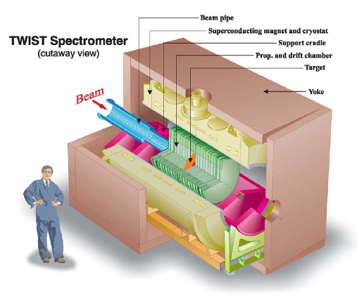
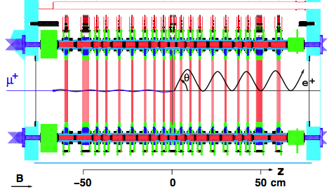
TWIST: Triumf Weak Interaction Symmetry Test
Precise measurement of the Michel parameters
Compare to SM predicition:
ρ = 0.75 η = 0
P_{μ}ξ = 1 δ = 0.75
Sensitive to contributions from
weak right-handed particles
Highly polarized μ⁺ beam stopped in Ag or Al target in a very symmetric detector
Track e⁺ in well-known, uniform field
Analysis relies on comparison with detailed simulations

Slide 37
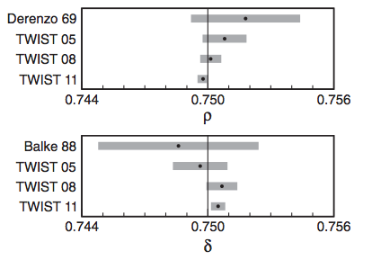

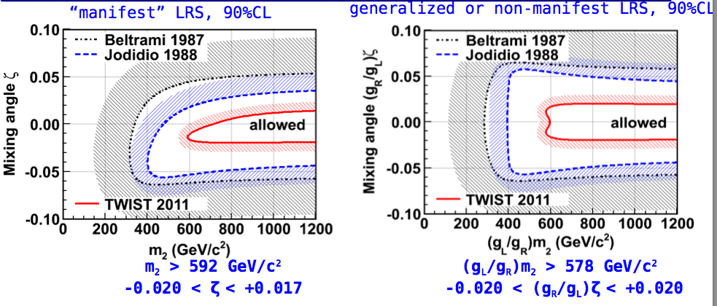
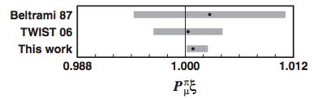
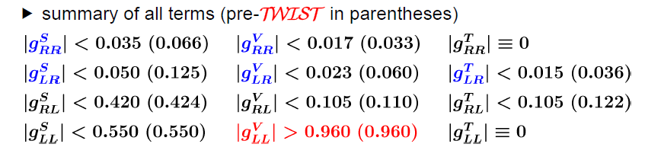
TWIST: Results
J.F. Bueno et al., Phys. Rev. D 84, 032005 (2011)
This puts limits on specific Left-Right-Symmetric (LRS) models
A. Hillairet et al., Phys. Rev. D 85, 092013 (2012)

Slide 38
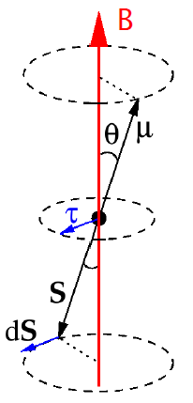
Muon Spin Resonance
Basic principle:
  Stop low energy polarized μ⁺ in sample
  Muon spin precesses in internal or external magnetic field (Larmor precession)
  Observe this precession via decay electron time spectrum (remember light house effect)
*Plots taken from colloquium by A. Suter at Fermilab

Slide 39
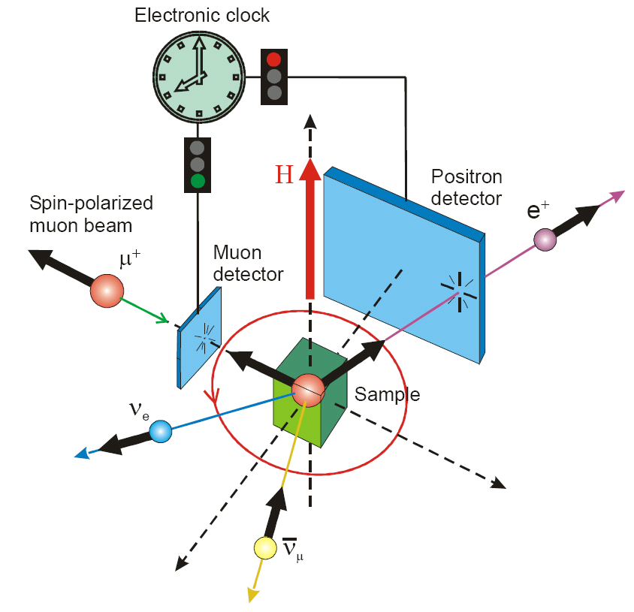
A typical MuSR experiment
B_{μ} internal or external field
B_{µ}
G(t) contains the physics
Muon momentum selects different sample depth (sub-mm down to nm)
Study properties related to sample magnetism, superconductivity, chemistry and semiconductor physics
*Plots taken from colloquium by A. Suter at Fermilab

Slide 40
Muonic Hydrogen Lamb Shift – Proton Charge Radius
μ⁻
Muon forms hydrogen-like atoms
Bohr radius is 186 times smaller than in hydrogen
The muon overlaps much more with the proton and can probe
its charge structure
Energy levels are changed due to proton’s charge distribution
Measure the 2S – 2P transition in μ⁻p (muonic Lamb shift)
Extract proton charge radius r_{p} from this transition
Knowledge of the charge and magnetic
distributions inside the proton are needed
for precision tests of bound-state QED
p

Slide 41
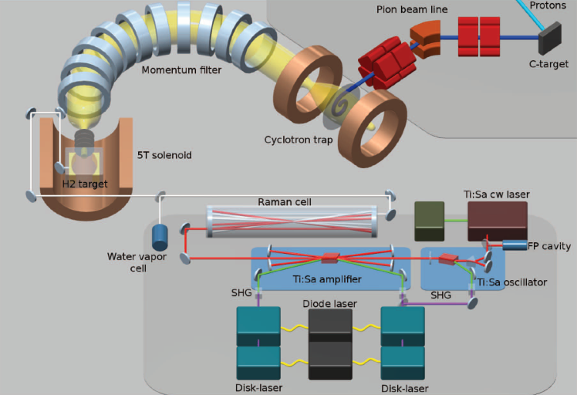
Muonic Lamb Shift – Experimental technique
Negative pions are captured in cyclotron trap and decay into MeV muons
Thin foil slows muons
Toroidal field guides keV muons to 1 mbar hydrogen target
Muons captured in excited μp atom (n≈14)

Slide 42
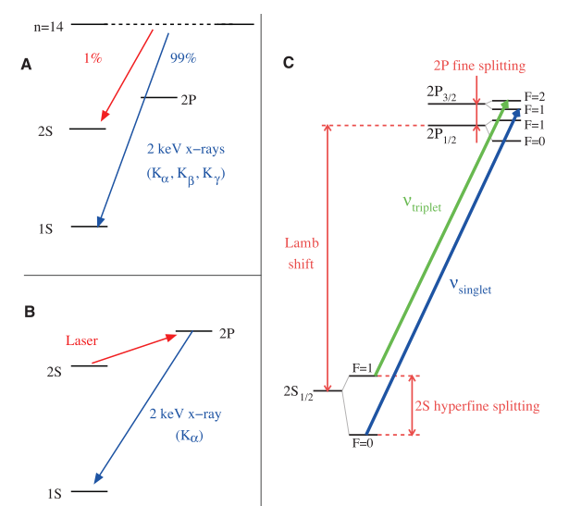
Muonic Lamb Shift – Experimental technique
Excited μp atoms deexcite to 1S ground state (99%) and meta-stable 2S (1%)
Delayed (0.9 μs) laser induces 2S – 2P transition followed by immediate deexcitation via 1.9 keV X-ray (2P – 1S) transition
Transitions measured: ν_{triplet} (6 μm) and ν_{singlet} (5.5 μm)
Laser calibration well known water absorption lines

Slide 43
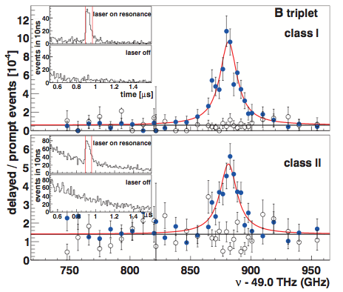
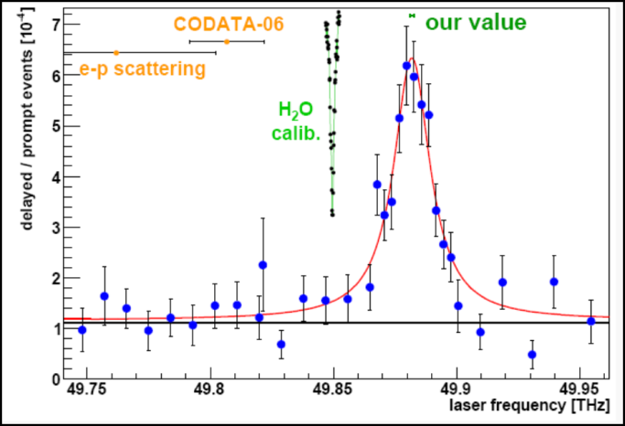
Muonic Lamb Shift – Results
Pohl et al., Nature 466 (2010)
Antonigni et al., Science 339 (2013)
Difference in the observed charge radius, r_{P}, compared to H spectroscopy and elastic electron scattering is now 7σ!
This proton radius puzzle is still unsolved and has triggered many papers
Several effects (both in the measurement and theory) were investigated but none could explain this large discrepancy
Lamb shift measurement in μ³He⁺ and μ⁴He⁺ will help to disentangle the origin of the puzzle

Slide 44
Precision muon lifetime measurements
MuLan: μ⁺ lifetime
MuCap: μ⁻ lifetime in hydrogen
MuSun: μ⁻ lifetime in deuterium
You will see that the motivation is however VERY different for the MuLan and MuCap/MuSun

Slide 45
Precision muon lifetime measurements
MuLan: μ⁺ lifetime
MuCap: μ⁻ lifetime in hydrogen
MuSun: μ⁻ lifetime in deuterium

Slide 46
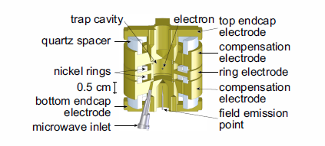
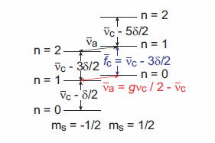
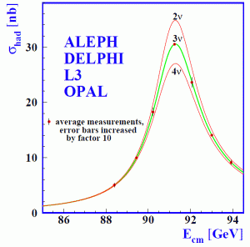
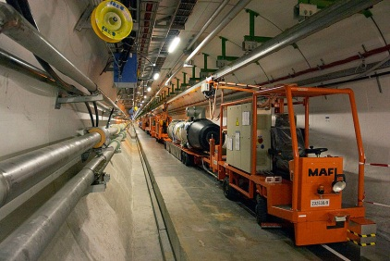
Electroweak Theory needs 3 input parameters
1. Fine structure constant α (0.00037 ppm)
Ultra precise penning trap: Hanneke et al. PRL 100 (2008) 120801
2. Neutral weak boson mass M_{Z} (23 ppm)
Phys. Rept. 427: 257—454, 2006
3. Fermi constant G_{F} (9 ppm)

Slide 47
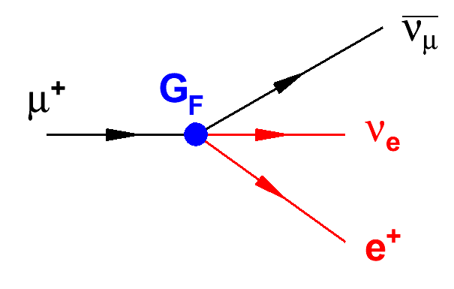
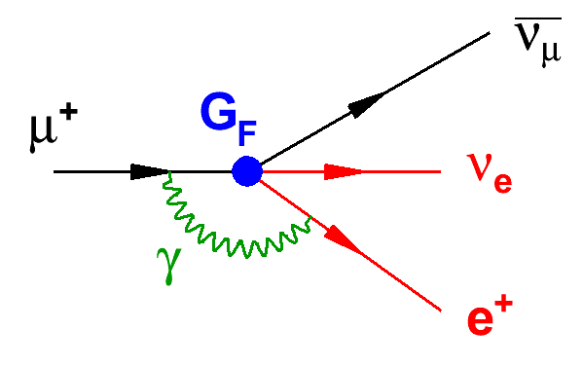
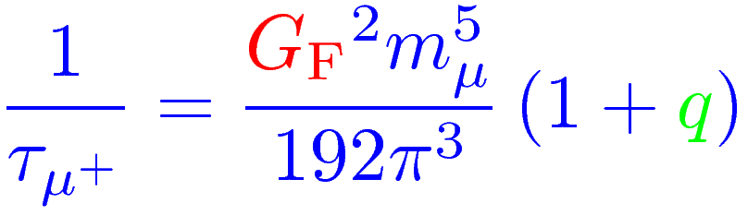
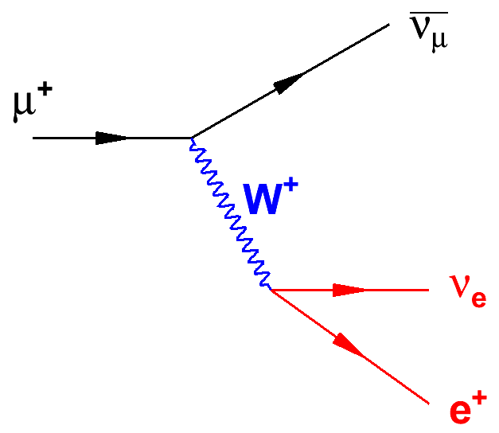
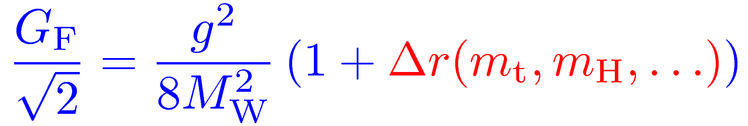
Fermi constant GF: weak interaction strength
Most precisely determined by muon decay
q
PS, QED and hadr. rad.
*
Implicit to all EW precision physics
t
b

Slide 48
Fermi constant GF: weak interaction strength
Mid 90s:
<0.3 ppm
MuLan:
17 ppm
0.5 ppm
18 ppm
1999:
9 ppm
1 ppm
0.09 ppm
30 ppm
<0.14 ppm
Lifetime error is the limit
van Ritbergen and Stuart:
2 loop QED corrections
Recently Pak and Czarnecki:
Finite electron mass (0.5ppm shift in G_{F})

Slide 49
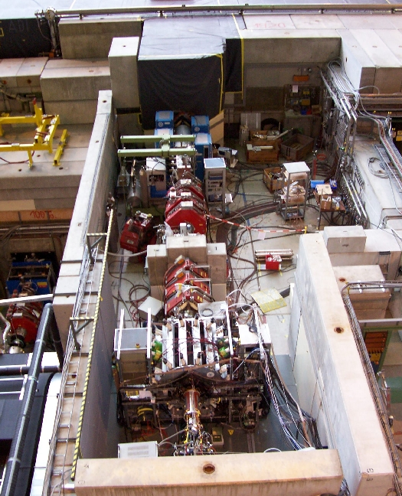
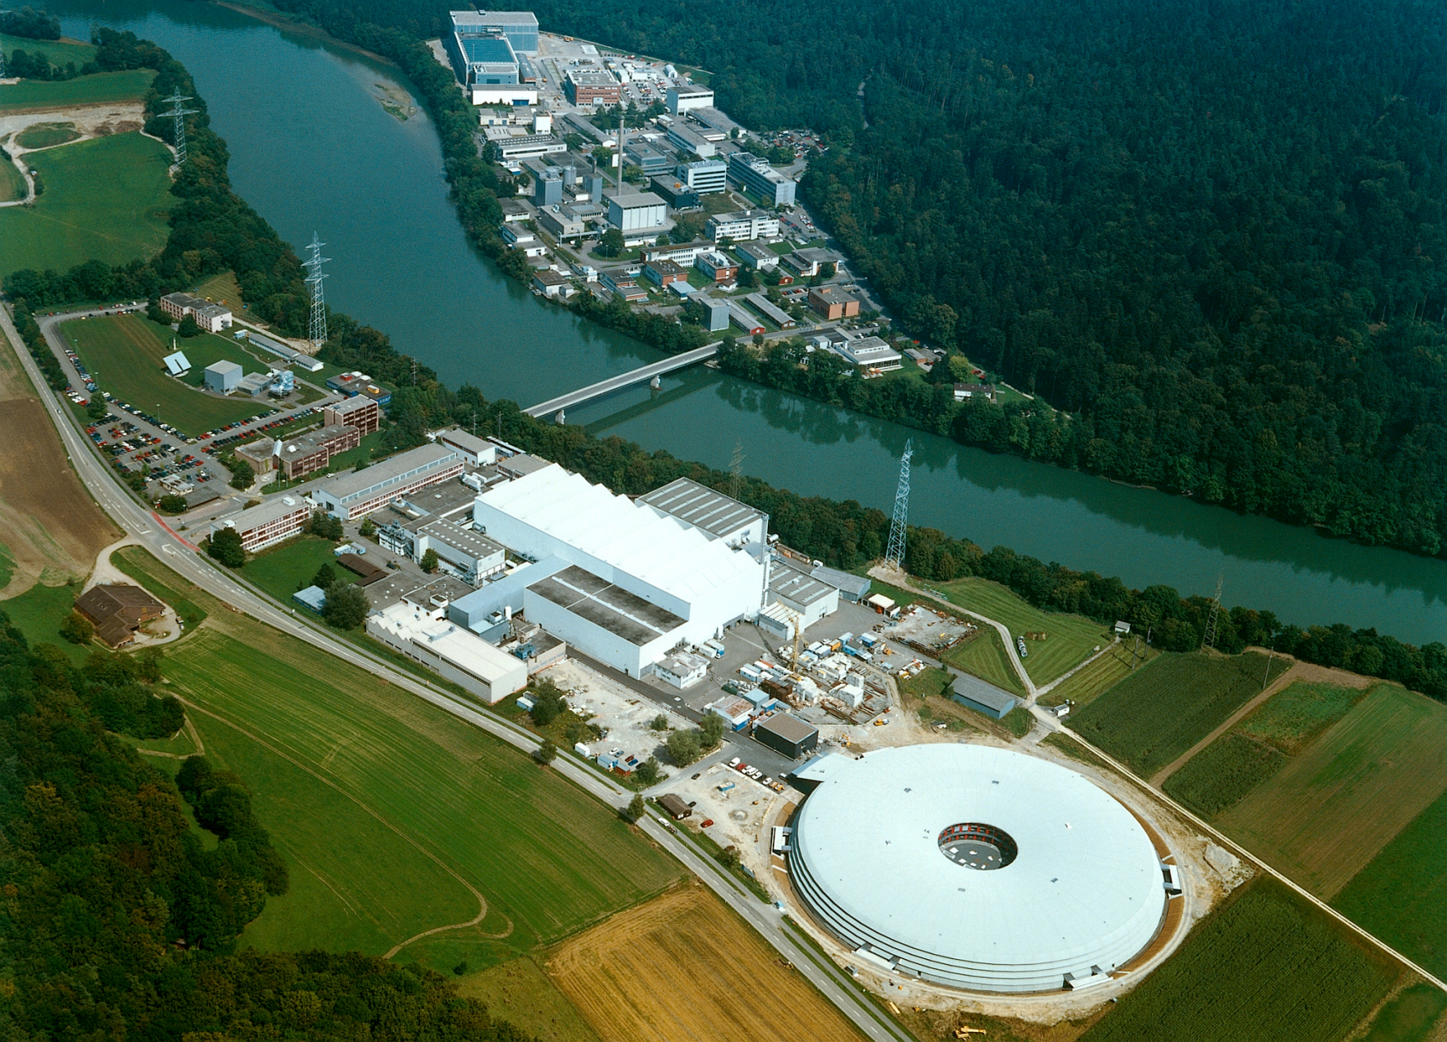

The facility: πE3 at PSI
590 MeV protons
2.2 mA beam current
1.3 MW beam power
http://www.psi.ch
Notes:
Different techniques, plot with more and more results

Slide 50
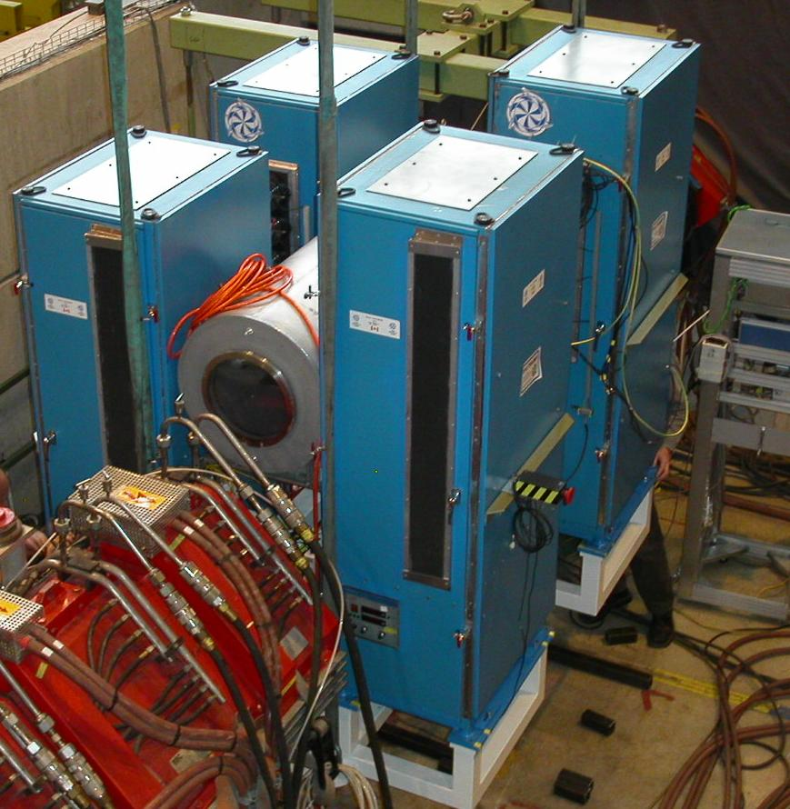
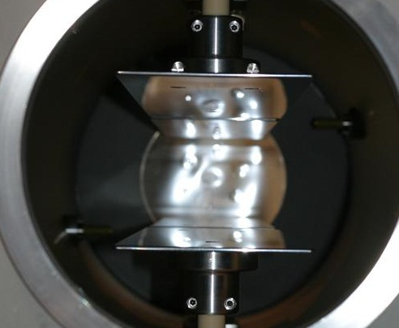
The electrostatic kicker
Design at TRIUMF
50 ns switching time
Kicker
25kV
Notes:
Different techniques, plot with more and more results

Slide 51
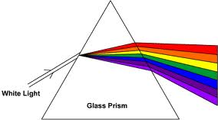
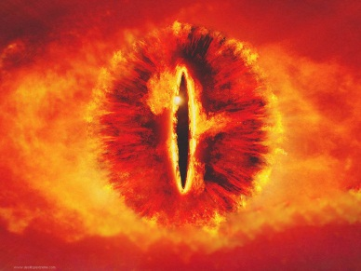
Other beamline elements
E x B
separation
of electrons
Separator
Quadrupoles
& slit
Detector
- MuLan
- MuCap
- MuSun
Notes:
Different techniques, plot with more and more results

Slide 52


The MuLan concept in one slide...
Real data
Kicker On
Measurement Period
Number (log scale)
time
Fill Period
-12.5 kV
12.5 kV

Slide 53

Final result for 2 x 10¹² muon decays
τ_{μ}(R06) = 2196979.9 ± 2.5 ± 0.9 ps
τ_{μ}(R07) = 2196981.2 ± 3.7 ± 0.9 ps

Slide 54

One example: Pileup systematic
A MuLan
detector
tile
Pileup pulses measurably distort the lifetime
Shadow and pileup pulses have the same probability distribution!
Normal Time
Distribution
1/τ − 2/τ
time
2/τ
Pileup Time
Distribution
Pulse
Resolving
Time
Shadow
window

Slide 55
It only takes one grad student and many months to figure it all out at the sub-ppm level...
uncorrected
Pileup terms at different orders …
R (ppm)
1 ppm
150 ns deadtime range
Artificial Deadtime (ct)

Slide 56




Important: Double blinding technique
500 MHz precise master clock
Detune clock
Hide from analyzers
Commonly used in most precision experiments
to prevent bias.
Analyzers add secret offset
Master secret offset only removed after all systematics evaluated!

Slide 57

G_{F} = 1.1663818(7) x 10-5 GeV-2 (0.6 ppm)
MuLan 2007 and 2011
D.B. Chitwood et al., Phys. Rev. Lett. 99, 03201 (2007)
D. Webber et al., Phys. Rev. Lett. 106, 041803 (2011)
V. Tishchenko et al., Phys. Rev. D. 87, 052003 (2013)

Slide 58
Precision muon lifetime measurements
MuLan: μ⁺ lifetime
MuCap: μ⁻ lifetime in hydrogen
MuSun: μ⁻ lifetime in deuterium

Slide 59
Nucleon form factors
μ⁻ + p → n + ν
μ⁻
p
μ⁻
ν
q² = -0.88m_{μ}²
p
n
M ~ G_{F}V_{ud} · ψ_{ν} γ_{α}(1-γ₅)ψ_{μ} · ψ_{n}(V^{α}-A^{α})ψ_{p}
Observable: Singlet capture rate Λ_{S}

Slide 60

Nucleon form factors
M ~ G_{F}V_{ud} · ψ_{ν} γ_{α}(1-γ₅)ψ_{μ} · ψ_{n}(V^{α}-A^{α})ψ_{p}
V^{α} = g_{V}(q²) γ^{α}
+ i g_{M}(q²) σ^{αβ}q_{β}/2M_{N}
ΔΛ_{S}
⇒
Δg_{P}
Λ_{S}
g_{P}
2.4% 13.6%
1.0% 6.1%
0.5% 3.8%
A^{α} = g_{A}(q²) γ^{α}γ₅
+ g_{P}(q²) q^{α}/m_{μ}γ₅
Note: Here, we neglected second class currents g_{S} and g_{T} that are small.
Well known, contribute only 0.45% uncertainty to Λ_{S}

Slide 61
Pseudoscalar form factor g_{P}
2m_{N}m_{¹}g_{A}(0)
μ
ν
2m_{N}m_{μ}g_{A}(0)
1
f_{π}
g_{P}(q²) = - - g_{A}(0)m_{N}m_{μ}r_{A}²
g_{P}(q²) = -
q²-m_{¼}²
q²-m_{π}²
3
π
PCAC pole term
(Adler, Dothan, Wolfenstein)
NLO (ChPT)
Bernard, Kaiser, Meissner
PR D50, 6899 (1994)
g_{P} = 8.26 ± 0.23
g_{πNN}
p
n
ChPT based on the spontaneous symmetry breaking
solid QCD prediction via ChPT (2-3% level)
basic test of chiral symmetries and low energy QCD
Recent review: Kammel, P. and Kubodera, K., Annu. Rev. Nucl. Part. Sci. 60 (2010), 327

Slide 62

So how do we measure the rate Λ_{S} of μ⁻ p → n ν ?
Direct method:
- Measure outgoing neutrons
- Typical experiments ~10% precision in Λ_{S}
Lifetime method:
Λ_{S} ≈ λ⁻ − λ⁺
Λ_{S} = 0.15% λ⁻ !
Quiz: How precise do you have to measure λ⁻ if you want to know Λ_{S} to 1%?
Note: λ⁺ is known to 1 ppm from MuLan, so negligible!
Correct: 15 ppm (1% * 0.15% = 0.000 015)

Slide 63

MuCap key elements
Lifetime method
Low gas density
Active gas target (TPC)
Ultra pure gas system with in-situ monitoring
Isotopically pure hydrogen gas

Slide 64
A muon in a hydrogen environment
φ: Hydrogen density, (LH₂: φ=1)
Λ_{T} ~ 12s⁻¹
pμ↑↑
p
φ>0.01
<100ns
μ-
pμ↑↓
Λ_{S} ~ 700s⁻¹

Slide 65
A muon in a hydrogen environment
ppμ
Λ_{OM} ~ ¾ Λ_{S}
φλ_{OF}
ortho (J=1)
pμ↑↓
λ_{OP}
φλ_{PF}
Λ_{S} ~ 700s⁻¹
ppμ
Λ_{PM} ~ ¼ Λ_{S}
para (J=0)
Molecular ppμ formation depends on density φ
Interpretation requires knowledge of λ_{OF} and λ_{OP}

Slide 66

A muon in a hydrogen environment
ppμ
Λ_{OM} ~ ¾ Λ_{S}
φλ_{OF}
ortho (J=1)
pμ↑↓
λ_{OP}
φλ_{PF}
Λ_{S} ~ 700s⁻¹
ppμ
Λ_{PM} ~ ¼ Λ_{S}
para (J=0)
MuCap solution: Low gas density φ (10 bar at room temperature) reduces molecular states!

Slide 67
Previous results suffer from molecular states
μ p → ν n @ SACLAY
μ p → ν n γ @ TRIUMF
g_{P}
μCap precision goal
ChPT
exp
theory
TRIUMF 2005
λ_{OP} (ms⁻¹)
No overlap theory, OMC & RMC
Large uncertainty in λ_{OP} ⇒ g_{P} ± 50%

Slide 68
A muon in a hydrogen environment
ppμ
Λ_{OM} ~ ¾ Λ_{S}
φλ_{OF}
ortho (J=1)
c_{d}λ_{pd}
pμ↑↓
λ_{OP}
μd
φλ_{PF}
Λ_{S} ~ 700s⁻¹
ppμ
Λ_{PM} ~ ¼ Λ_{S}
Λ_{d}
diffusion
para (J=0)
μ⁻d atoms can drift out of your hydrogen target due to a so-called
Ramsauer-Townsend minimum in the scattering cross section.

Slide 69

A muon in a hydrogen environment
ppμ
Λ_{OM} ~ ¾ Λ_{S}
φλ_{OF}
ortho (J=1)
c_{d}λ_{pd}
pμ↑↓
λ_{OP}
μd
φλ_{PF}
Λ_{S} ~ 700s⁻¹
ppμ
Λ_{PM} ~ ¼ Λ_{S}
Λ_{d}
diffusion
para (J=0)
MuCap solution: Distill deuterium out of gas: c_{d} < 6 ppb!!!
We should apply for world‘s cleanest gas record!

Slide 70
A muon in a hydrogen environment
μZ
Λ_{Z} ~ Λ_{S} Z⁴
ppμ
Λ_{OM} ~ ¾ Λ_{S}
φλ_{OF}
c_{Z}Λ_{Z}
ortho (J=1)
c_{d}λ_{pd}
pμ↑↓
λ_{OP}
μd
φλ_{PF}
Λ_{S} ~ 700s⁻¹
ppμ
Λ_{PM} ~ ¼ Λ_{S}
Λ_{d}
diffusion
para (J=0)

Slide 71


High-Z impurities in MuCap
Circulating H₂ Ultra-Purification System
Active target (TPC)
No materials in fiducial volume
Yes definitely the worlds cleanest gas now!
c_{N}, c_{H2O} < 10 ppb
Nucl. Instr. & Meth. A578 (2007), 485

Slide 72


A muon in a hydrogen environment
μZ
Λ_{Z} ~ Λ_{S} Z⁴
ppμ
Λ_{OM} ~ ¾ Λ_{S}
φλ_{OF}
c_{Z}Λ_{Z}
ortho (J=1)
c_{d}λ_{pd}
pμ↑↓
λ_{OP}
μd
φλ_{PF}
Λ_{S} ~ 700s⁻¹
ppμ
Λ_{PM} ~ ¼ Λ_{S}
Λ_{d}
diffusion
para (J=0)
So MuCap design ensures that we measure the rate Λ_{S} of the singlet state!

Slide 73

The experiment MuCap
e
t
μ

Slide 74
Novel technique: Hydrogen time projection chamber
10 bar ultra-pure H₂
No materials in fiducial volume
3D muon track reconstruction
μ⁻
E
e⁻
μ⁻p

Slide 75


A typical good stopped muon
TPC side view
Front face view
Fiducial volume
Fiducial volume
vertical direction
vertical direction
TPC active volume
TPC active volume
muon beam direction
transverse direction

Slide 76


Lifetime spectrum
Normalized
residuals

Slide 77




Perform many consistency checks
Rate versus run duration
Data run number (~3 minutes per run)

Slide 78
Precision measurements is all about systematics
Λ_{S} (MuCap) = 714.9 ± 5.4_{stat} ± 5.1_{syst} s⁻¹
Systematic errors | Run 2006 |  | Run 2007 |  | Comment
 | λ (s⁻¹) | δλ (s⁻¹) | λ (s⁻¹) | δλ (s⁻¹)
High-Z impurities | -7.8 | 1.87 | -4.54 | 0.93
μp scatter | -12.4 | 3.22 | -7.20 | 1.25
μp diffusion | -3.1 | 0.1 | -3.0 | 0.1
μd diffusion |  | 0.74 |  | 0.12
Fiducial volume cut |  | 3 |  | 3
Entrance counter inefficiencies |  | 0.5 |  | 0.5
Choice of electron detector def. |  | 1.8 |  | 1.8
Total | -23.3 | 5.14§ | -14.74 | 3.88§ | § = correlated

Slide 79



Impurity monitoring with data
Imp. Capture:
μ⁻ Z → (Z-1) n ν
drift time
2004 run: c_{N} < 7 ppb, c_{H2O}~30 ppb
2006 / 2007 runs: c_{N} < 7 ppb, c_{H2O}~10 ppb

Slide 80
Apply correction from linear extrapolation
Production Data
Calibration Data
(oxygen added to production gas)
λ
Extrapolated
Result
0
Observed capture yield Y_{Z}
This works since lifetime deviation is linear for small impurity contamination

Slide 81

Pecise and unambiguous MuCap result
Andreev et al., Phys. Rev. Lett. 110, 012504 (2013)
g_{P}(MuCap) = 8.06 ± 0.55
g_{P}(theory) = 8.26 ± 0.23

Slide 82
Precision muon lifetime measurements
MuLan: μ⁺ lifetime
MuCap: μ⁻ lifetime in hydrogen
MuSun: μ⁻ lifetime in deuterium

Slide 83


MuSun: Muon capture on deuterium μ⁻ d → n n ν
After MuCap, next step to measure two nucleon system
Effective field theory connects μ⁻d capture to pp solar fusion or νd scattering via a single low energy constant L_{1A}, d_{R}
L_{1A,} d_{R}
Experimental conditions optimized at 30 K, i.e. need cryo-TPC
Aim to measure doublet capture rate Λ_{d} to 1.5% precision
Many upgrades compared to MuCap setup (cryo-TPC, full waveform digitization, cryo-preamplifiers, ...)
Experiment aims to take full statistics end of this year and in 2014

Slide 84
Summary: Some lessons on muons
Muons have very useful properties:
  Long lifetime
  Polarized beams available
  Self-analyzing decay
Muon physics is rich:
  Measurement of SM parameters (e.g. MuLan, MuCap, Lamb shift)
  Search for BSM (e.g. TWIST and tomorrow CLFV, g-2, ...)
  Applied science (muSR)
It’s precision muon physics so it’s all about systematics!

Slide 85

TWIST: Michel parameters and coupling constants
Fetscher and Gerber coupling constants (see PDG)
SM
0.75
0
1
0.75
Deviations from the SM values would be due to right-handed scalar, vector and tensor couplings g_{RL}, g_{RR}, g_{LR}

Slide 86
Let’s ask a bit about you
How many are graduate students?
How many are postdocs?
Who is theoretical and who is experimental?
Who is working at the Energy Frontier?
Who is working at the Cosmic Frontier?
Who is working at the Intensity Frontier?
Is anybody working or has worked on a Muon Experiment?

