Slide 1
Search techniques
Alan Barr
CTEQ/MCnet summer school 2016
15 July 2016 DESY
Notes:
Collider phenomenology only

Slide 2
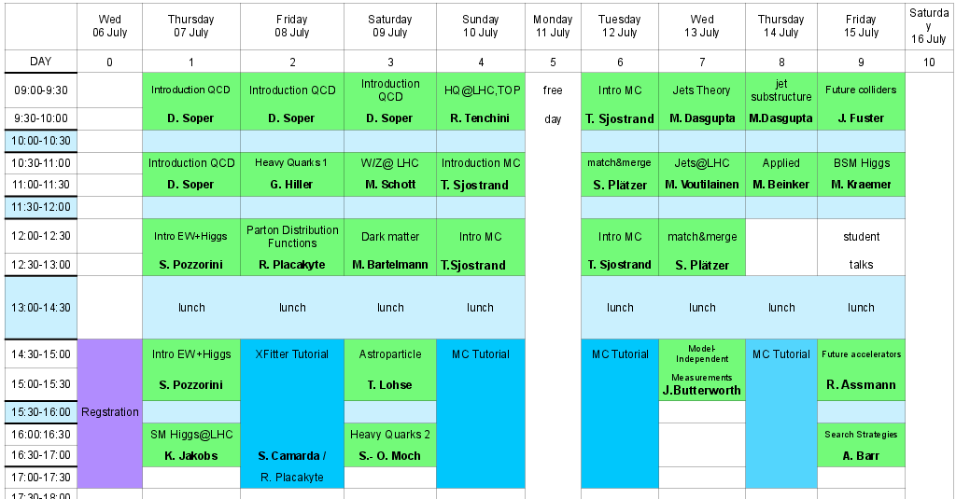
A very busy week

Slide 3
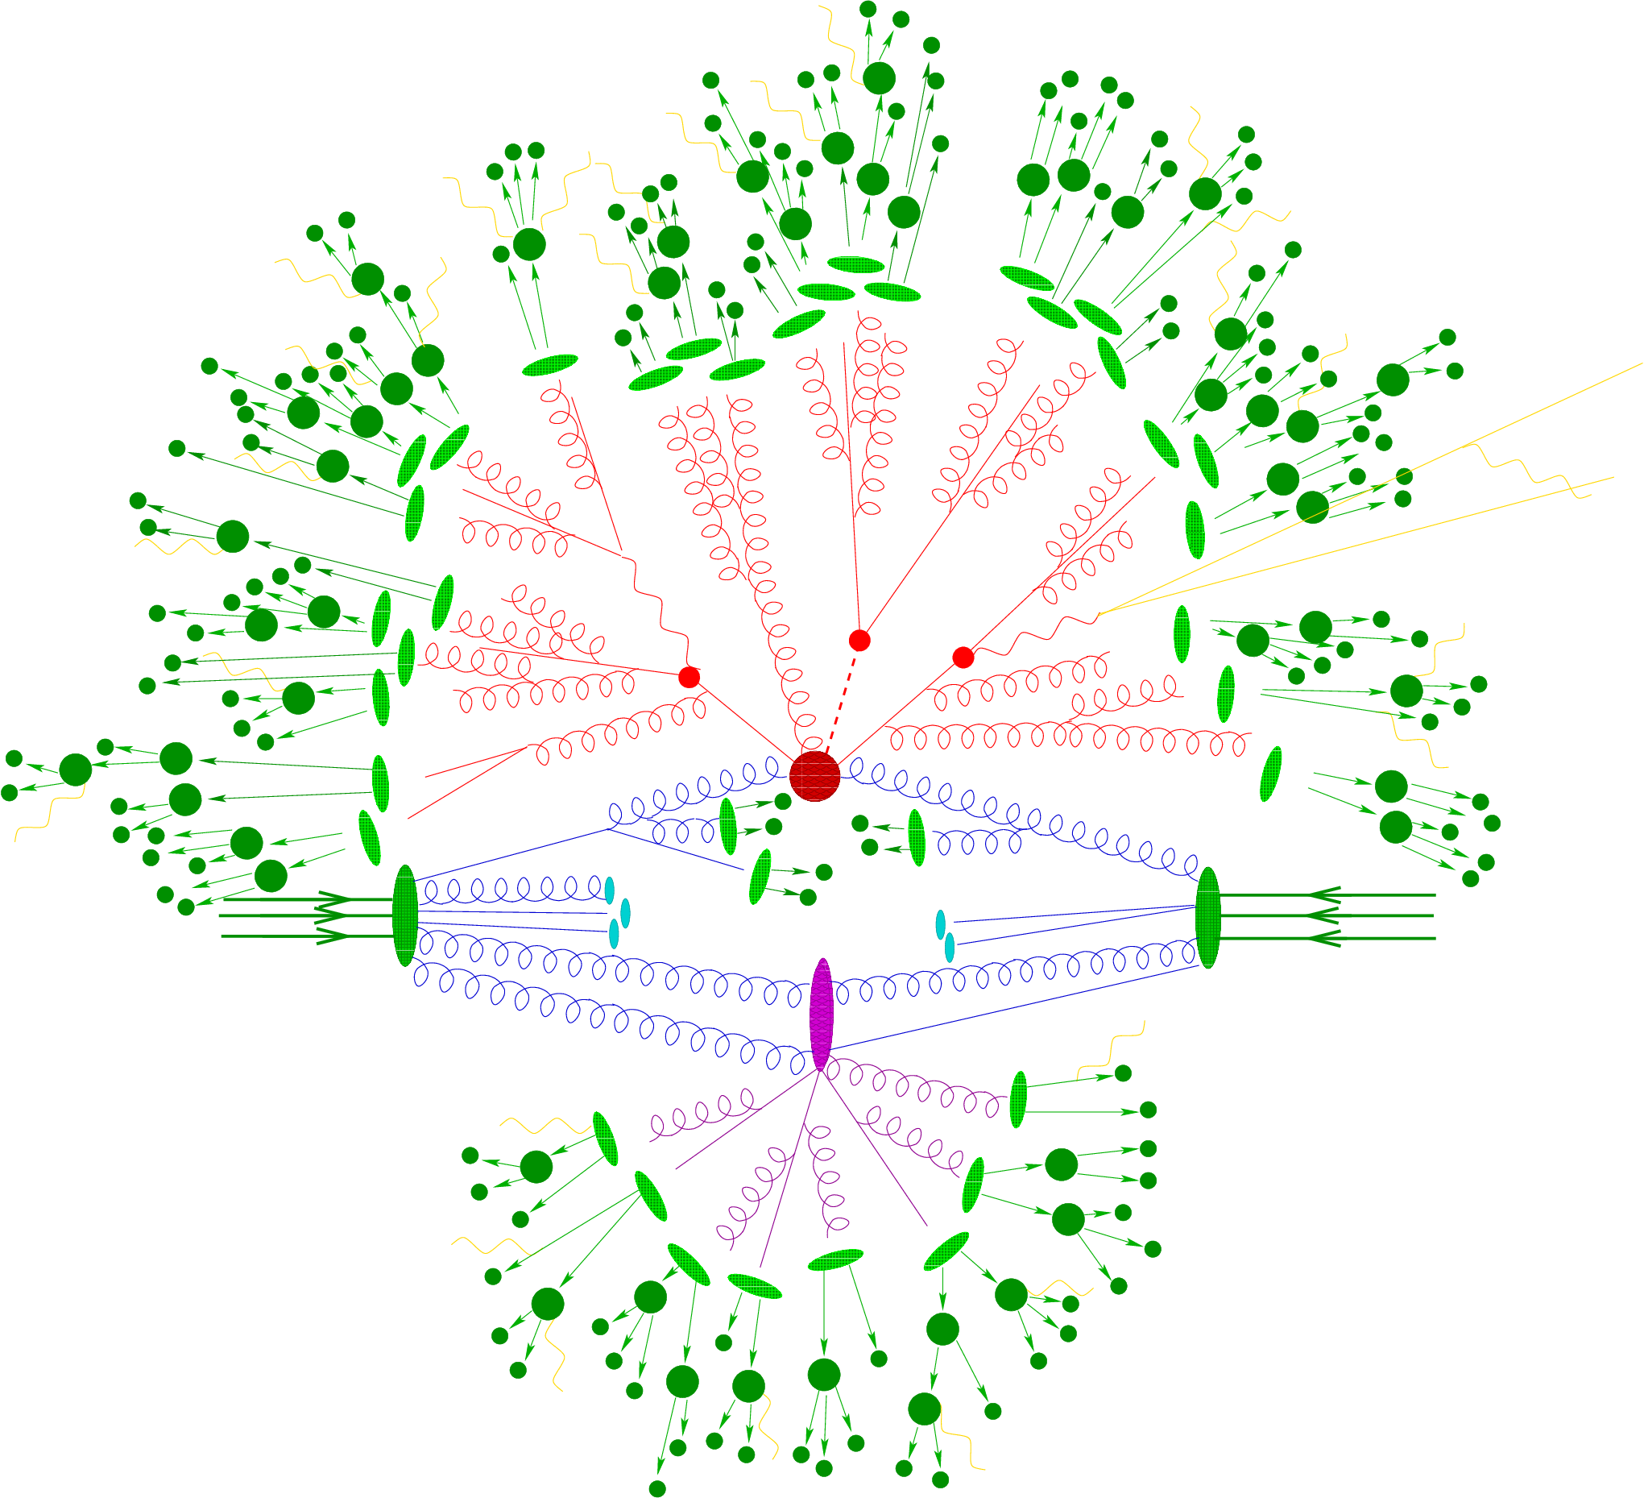
Much learned
QCD
Electroweak physics
Higgs
PDFs
Jets
Matching
Substructure
Notes:
Tool kit for physics
Helps with nitty-gritty of producing predictions
Equally important to see inside the saussage factory

Slide 4
Searches also rely on MC
Even for “data-driven” methods, MC often used to test assumptions
MC almost always used in analysis design and optimisation
MC central to interpretation

Slide 5
A brief retrospective
Notes:
The man who until recently we called prime minister in our country recently said “I was the future once”

Slide 6
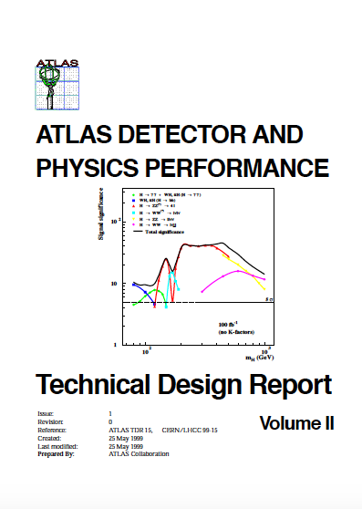
CERN/LHCC 99-15

Slide 8
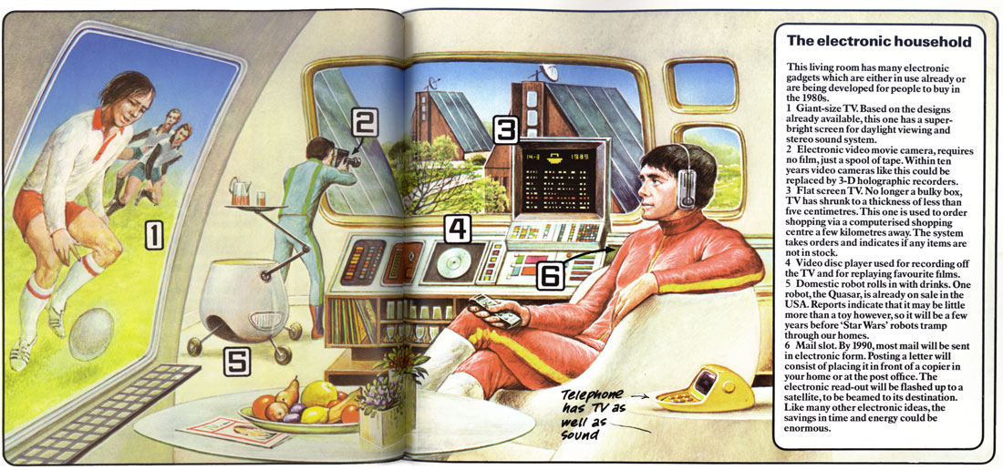

Slide 9
Our technology has also moved on…
ATLAS physics TDR 1999

Slide 10
Our technology has also moved on…
“the main background to SUSY is SUSY itself”
ATLAS physics TDR 1999

Slide 11
Our technology has also moved on…
“large MC samples of order 10,000 events”
ATLAS physics TDR 1999

Slide 12
Our technology has also moved on…
smeared truth as detector simulation
ATLAS physics TDR 1999

Slide 13
Our technology has also moved on…
2 -> 2 MC for jets backgrounds
ATLAS physics TDR 1999

Slide 14
Our technology has also moved on…
Boson + (Jets only from Parton Shower)
ATLAS physics TDR 1999

Slide 15
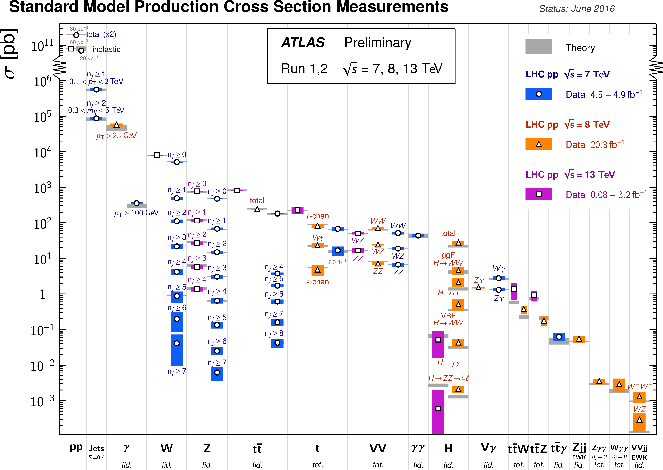
Notes:
MC is central to what we do on Hadron Colliders

Slide 16
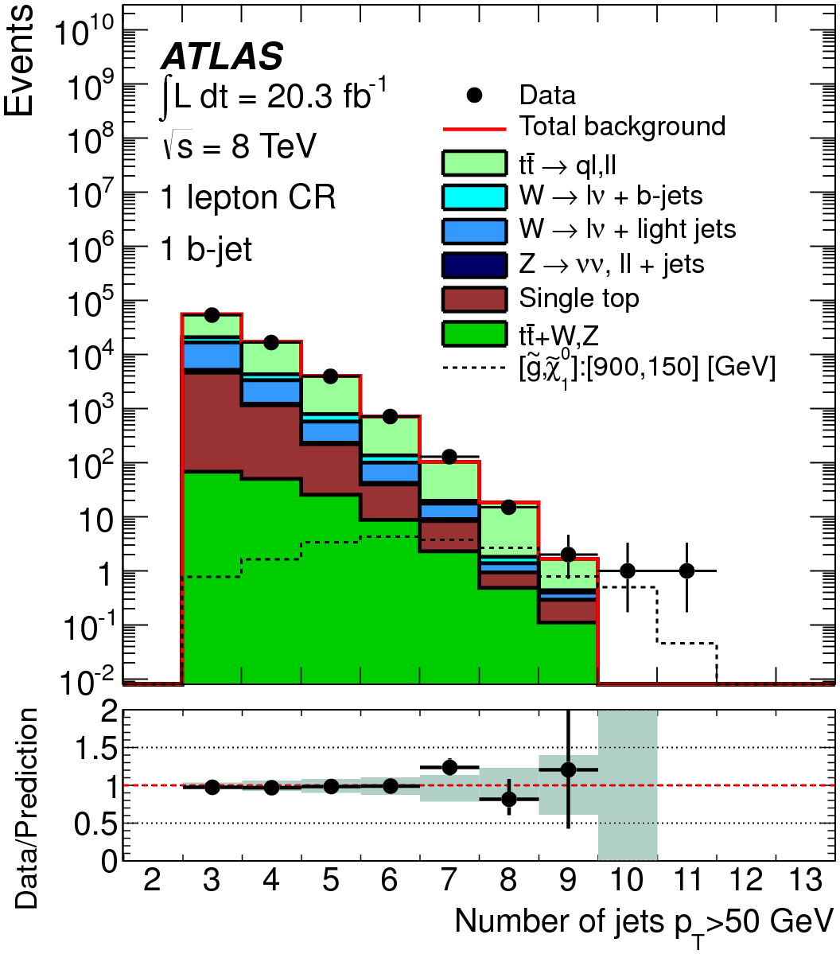
High multiplicity MC
arXiv:1308.1841
ttbar MC is Sherpa-1.4.1 with up to 4 additional partons

Slide 17
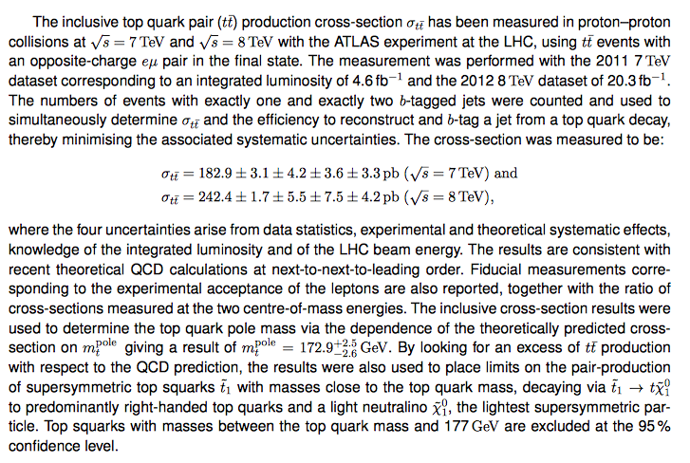
High Precision MC
http://arxiv.org/pdf/1406.5375v2.pdf
Scalar top mass around m(t)?

Slide 18
High Precision MC
http://arxiv.org/pdf/1406.5375v2.pdf
% level QCD calculations at NNLO

Slide 19
Technology is nothing. What's important is that you have a faith in people, that they're basically good and smart, and if you give them tools, they'll do wonderful things with them.
Steve Jobs

Slide 20
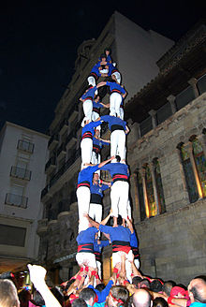
Notes:
The shoulders of giants

Slide 21
So what do I do…?

Slide 22
So what do I do…?
Be skeptical of your predecessors
… and …
Improve things!

Slide 23
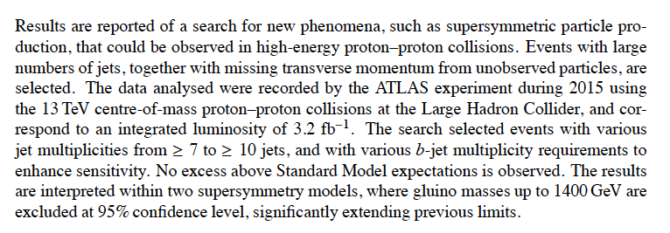
I never thought this would happen
Search with >=10 jets!
http://arxiv.org/pdf/1602.06194v3.pdf

Slide 24
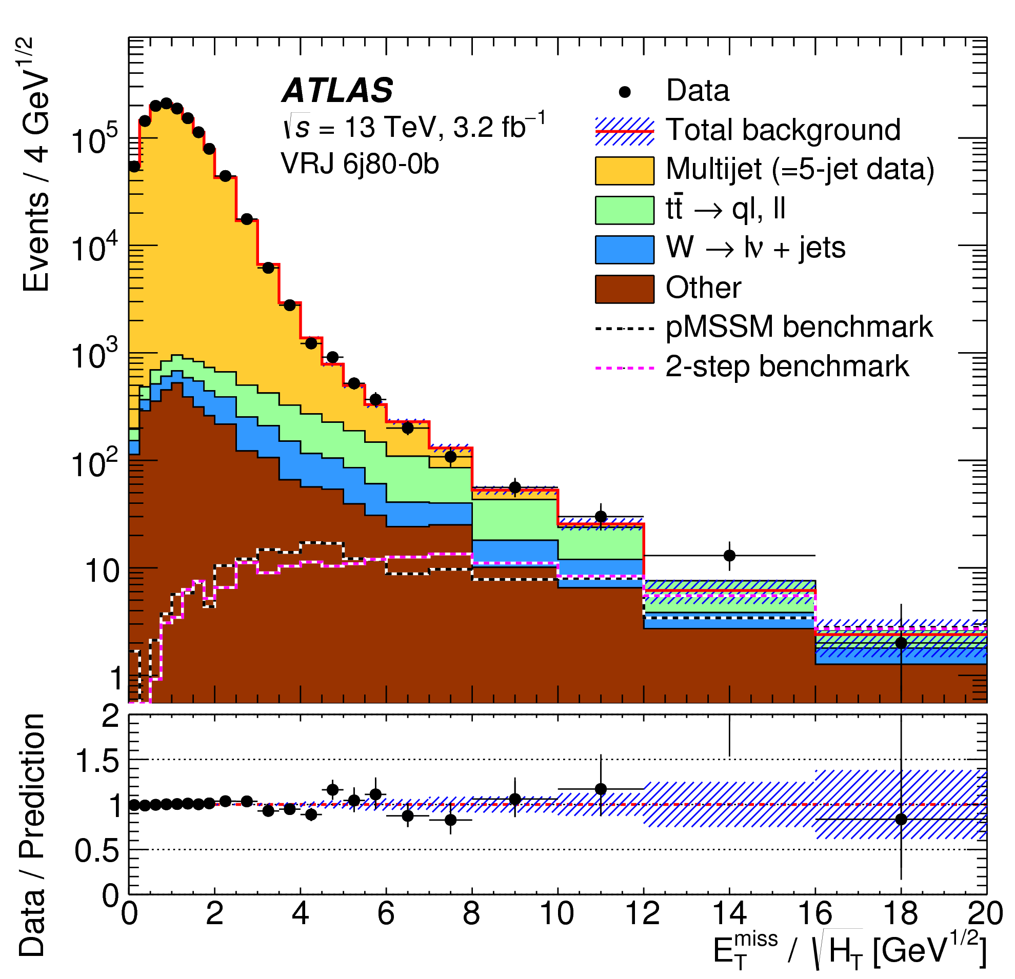
https://atlas.web.cern.ch/Atlas/GROUPS/PHYSICS/PAPERS/SUSY-2015-07/

Slide 25
Better kinematic variables?

Slide 26
http://arxiv.org/pdf/1105.2977.pdf

Slide 27
Philosophy behind these things
White board

Slide 28
So what do I do…?

Slide 29
So what do I do…?
Question your assumptions
… and …
Measure things!

Slide 31
JETS + MISSING MOMENTUM
The signal…
Jets
Jets
P_{T}^{miss}

Slide 32
JETS + MISSING MOMENTUM
Background?
Z → νν + jets
Jets
neutrino
Jets
P_{T}^{miss}
neutrino

Slide 33
JETS + MISSING MOMENTUM
Background?
Z → μμ + jets
Jets
muon
Jets
P_{T}^{miss}
muon

Slide 34
When does this break down?

Slide 35
JETS
From collisions
Jets:
Had. Calorimeter E.M. Calorimeter Tracks from vertex In-time
b,c quark jets ➔ can decay to neutrinos

Slide 36
JETS + MISSING MOMENTUM
Measurements
Jets:
Δφ cut
Reduce:
Had. Calorimeter E.M. Calorimeter Tracks from vertex
Measure remainder at small Δφ

Slide 37
JETS + MISSING MOMENTUM
From cosmics
Reduce by: (a) requiring tracks with jets
(b) look for muon hits
Measure remainder: (a) no beam
(b) timing

Slide 38
JETS + MISSING MOMENTUM
From beam halo
Reduce by requiring tracks with jets
Measure remainder with single beam / timing

Slide 39
JETS + MISSING MOMENTUM
Calorimeter noise
Reduce by requiring tracks with jets
Measure remainder (a) no beam
(b) timing

Slide 40
It’s very easy to get it wrong…

Slide 41
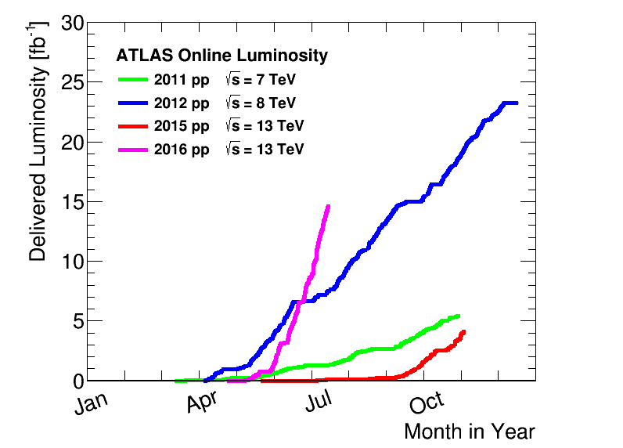
…and getting easier (to get it wrong)

Slide 42
A loose cable…

Slide 43
Something goes bump in the night…
W+ di-jet events @ Tevatron

Slide 44
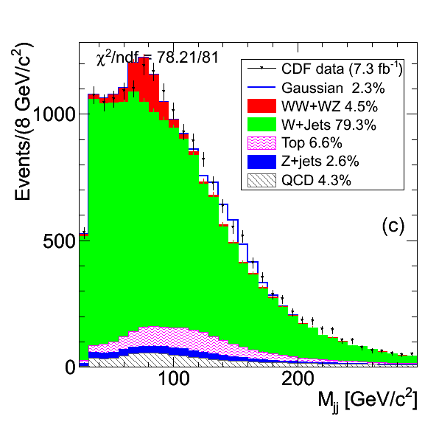
Notes:
How well do you understand your resolution?

Slide 45
http://arxiv.org/pdf/hep-ph/0201231v1.pdf

Slide 46
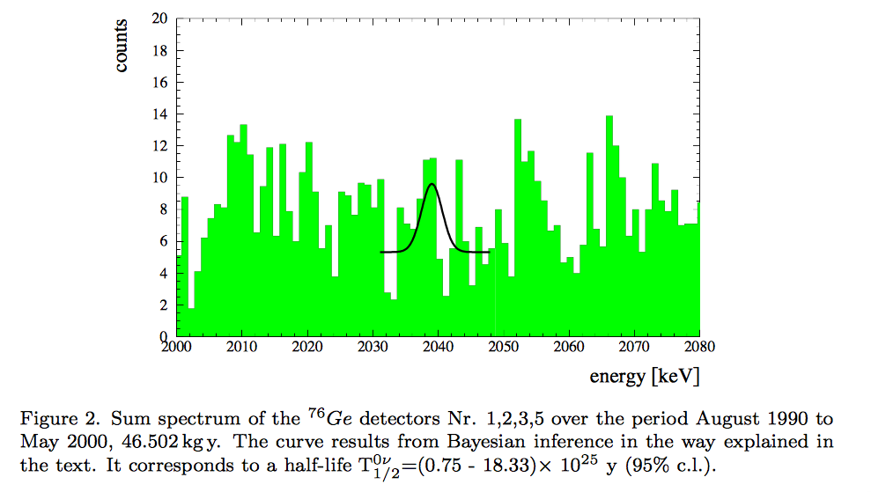
Lies, damn lies, and statistics…
Moscow Heidelberg experiment
http://arxiv.org/pdf/hep-ph/0201231v1.pdf

Slide 47
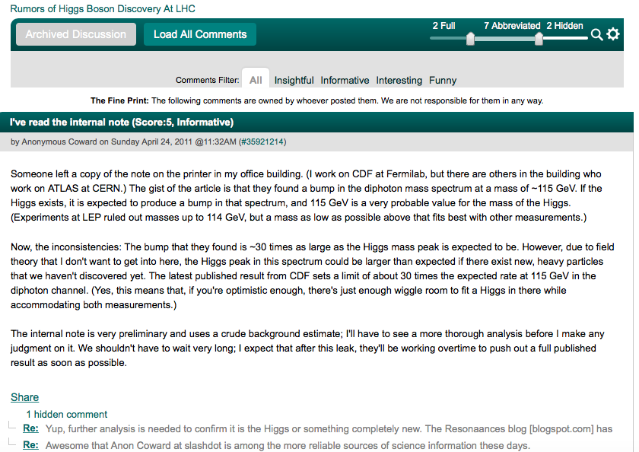
Unvalidated analysis

Slide 48
With great power…
Notes:
Great responsibility
PhD students and postdocs already have healthy skepticism
Rush to get out conference results should not short-circuit process of analysis, reflection, skepticism, challenge, checkings, …
6 copies at CERN library – contrary to rumours of being banned at CERN
http://cds.cern.ch/record/109431/holdings?ln=en

Slide 49
It has an impact…

Slide 50
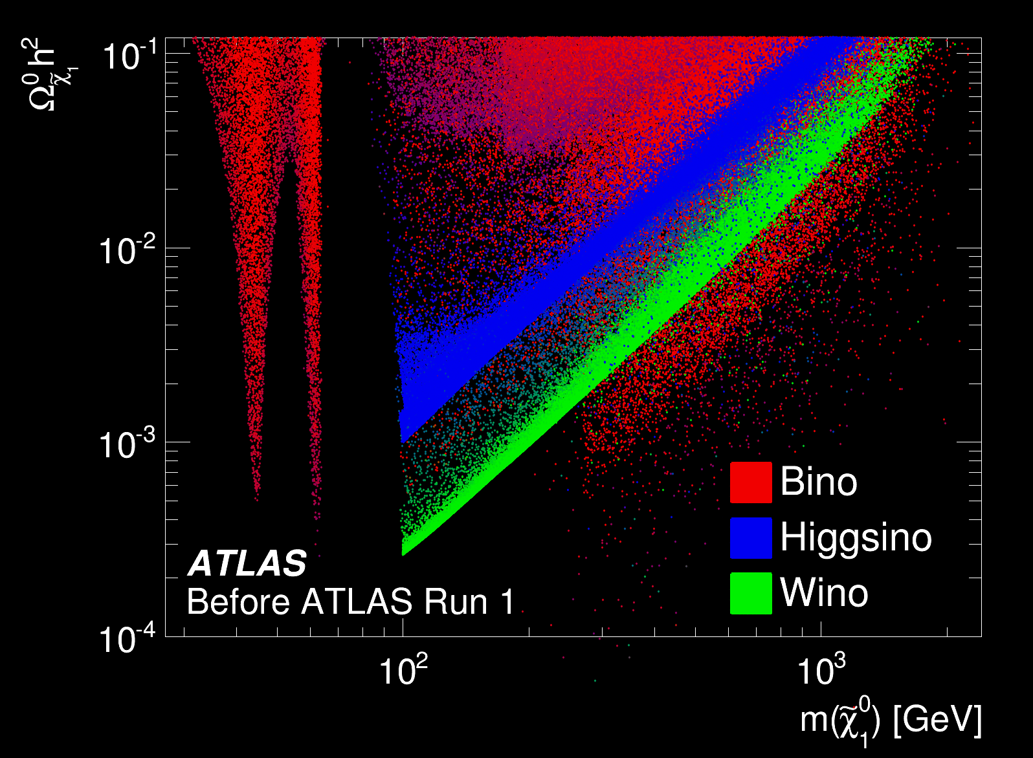
http://arxiv.org/abs/1508.06608

Slide 51
Unexpected things do happen

Slide 53
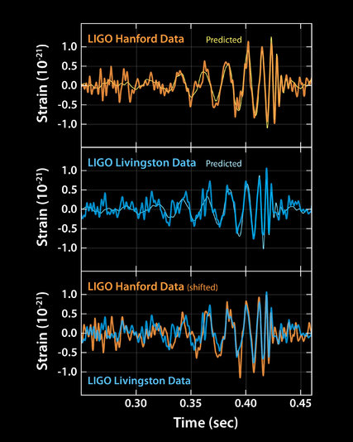
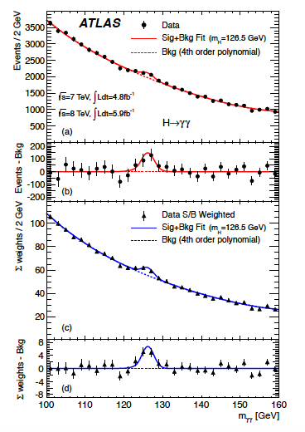
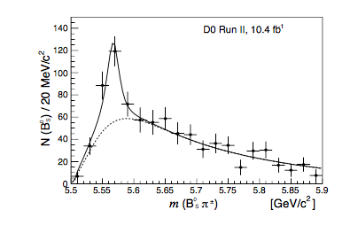
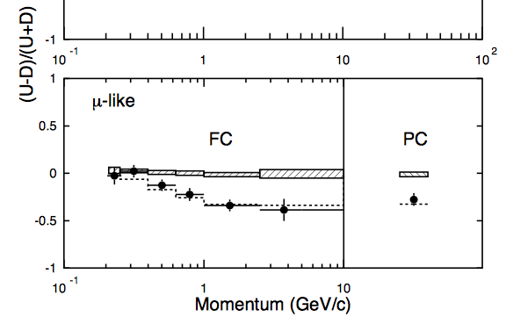
Higgs Boson
Gravitational waves
Neutrino Oscillations
Tetraquarks
Notes:
https://arxiv.org/pdf/1602.07588v3.pdf

Slide 54
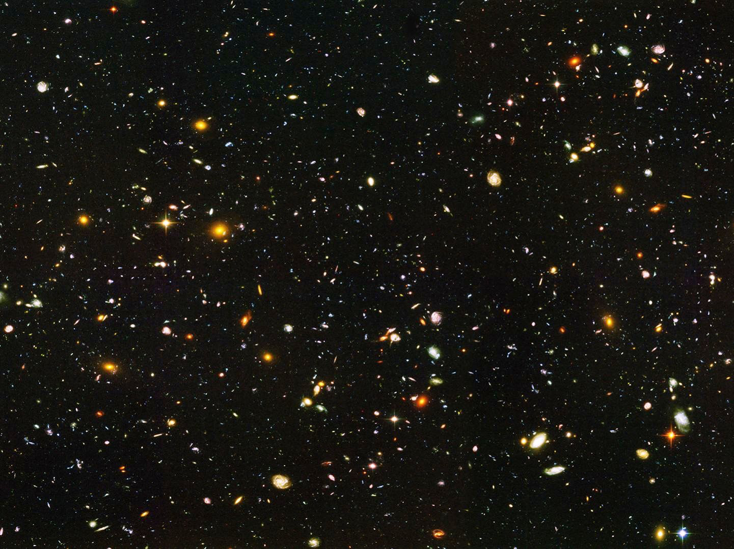
Lots of questions…
What is Dark Matter?
Why is it stable? Is it even stable?
What is Dark Energy?
What shapes the Higgs potential?
Are there more Higgs bosons?
Does SUSY solve the naturalness problem? If so, where are the sparticles hiding? If not, what does?
Are neutrinos their own anti-particles?
Are there other forces?
What causes the baryon asymmetry?

Slide 55
HAPPY HUNTING!

Slide 56
EXTRAS

Slide 57
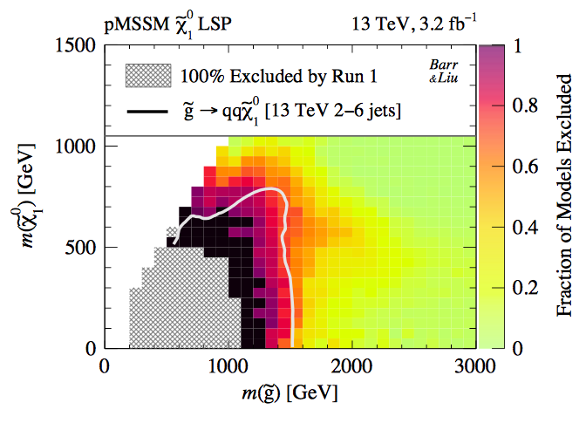
http://arxiv.org/pdf/1605.09502.pdf
Run-2 searches already expanding the reach of the LHC

Slide 58
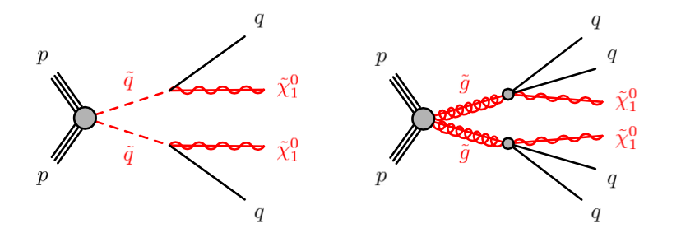
Select appropriate models

