Slide 1

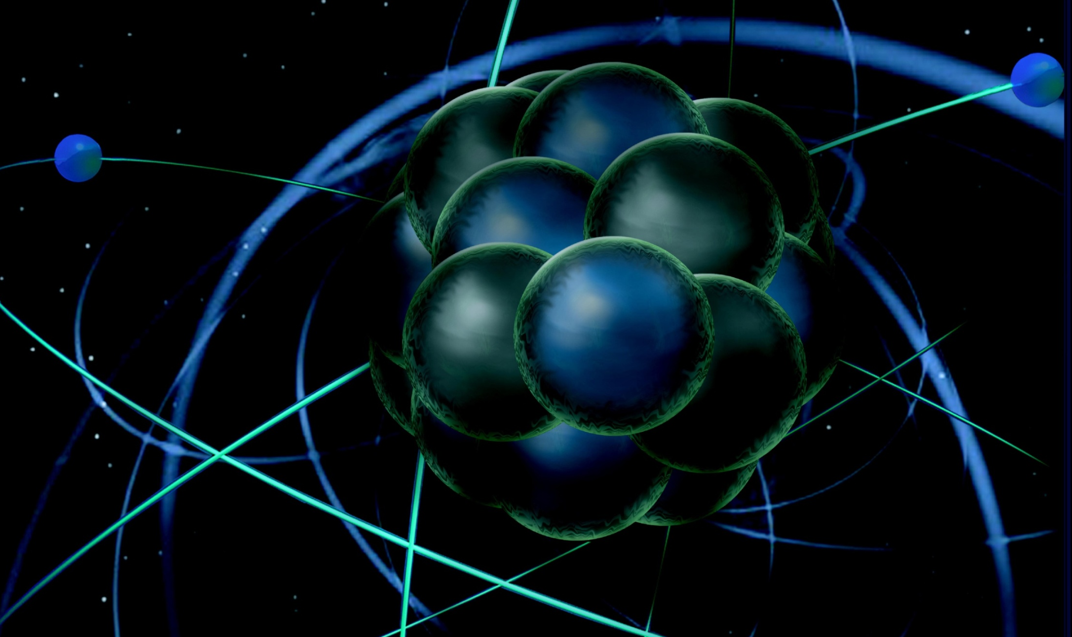
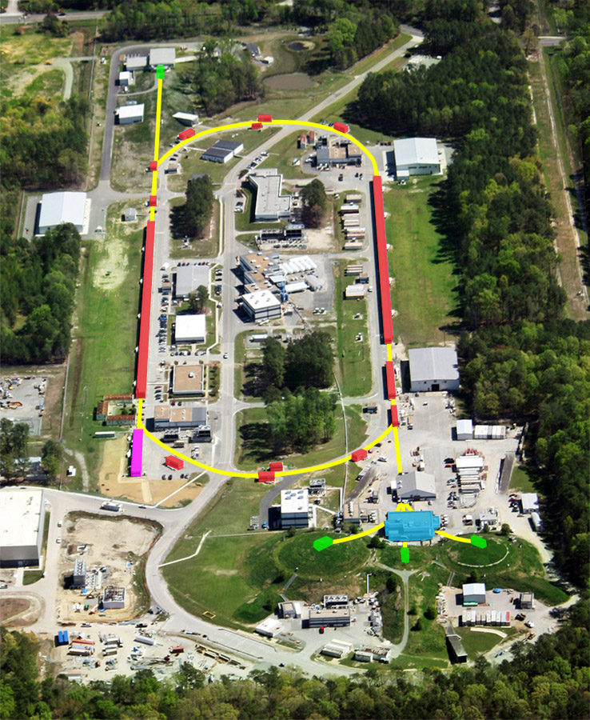
The Particle/Nuclear Interface - I
Thia Keppel
CTEQ Summer School
University of Pittsburgh
July 2017

Slide 2
Lecture Scheme
in·ter·face
ˈin(t)ərˌfās/ noun
1. a point where two systems, subjects, etc., meet and interact.
  DAY 1
  Introduction
  History and Basics of Electron Scattering – Some Reminders
  Jefferson Lab
  1D to 3D Nucleon Structure
    Form Factors and PDFs
    Large x
  Nucleons in the Nuclear Medium
  DAY 2
  Finish What I Didn’t Yet From Day 1!
  The Electron Ion Collider

Slide 3
Particle and Nuclear Physics - Related Questions
c
Nuclear Physics Seeks to:
Understand the fundamental structure of visible matter (quarks, gluons,..)
Understand how hadrons (mesons, nucleons,..) and nuclei are formed

Slide 4
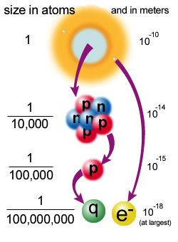
How to probe the nucleons / quarks?
Electron/lepton scattering experiments employ high momentum point-like leptons, + electromagnetic interactions, which are well understood, to probe hadronic structure (which isn’t).
High energy electrons are a great tool for the job!
short distance -> large momentum (Uncertainty Principle!)

Slide 5
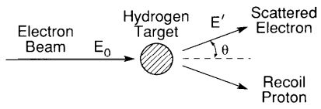
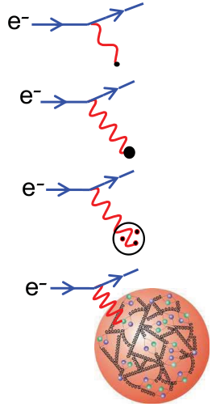
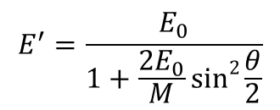
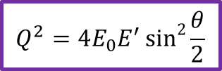




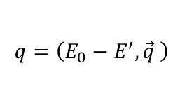
Simplest Nucleus: Is the Proton Point-Like?
Do protons have size?
1948-50 – Schiff, Rosenbluth: suggest use of elastic electron-proton scattering to probe the proton
$$q=\left(E_{0}−E^{′},\vec{q} \right)$$
$$E^{′}=\frac{E_{0}}{1+\frac{2E_{0}}{M}sin2{\frac{θ}{2}}}$$
electron is left with less energy after meeting the proton
$$Q^{2}=4E_{0}E^{′}sin2{\frac{θ}{2}}$$
square of four-momentum transfer: connected to the probe’s ability of resolving the structure of the proton
$$\sim \frac{ℏ}{Q}$$
probe’s ability of resolving structure
$$\frac{ℏ}{Q}$$
proton when >> than its size
same proton when $\sim$ its size
$$\frac{ℏ}{Q}$$

Slide 6
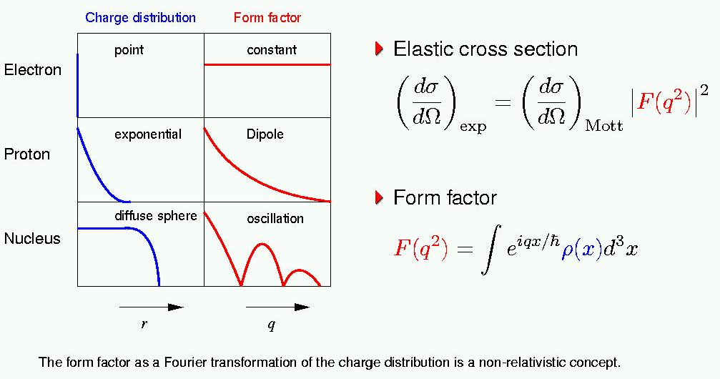

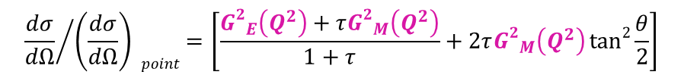
Charge and Magnetic Moment Distributions
Probability of elastic interaction:
$${\frac{dσ}{dΩ}}/{\left(\frac{dσ}{dΩ}\right) point}=\left[\frac{{G2}_{E}\left(Q^{2}\right)+τ{G2}_{M}\left(Q^{2}\right)}{1+τ}+2τ{G2}_{M}\left(Q^{2}\right)tan2{\frac{θ}{2}}\right]$$
$$τ=\frac{Q^{2}}{4M^{2}}$$
Form Factors are (in some limit) Fourier transforms of charge and magnetic moment distributions

Slide 7
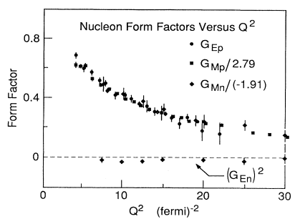
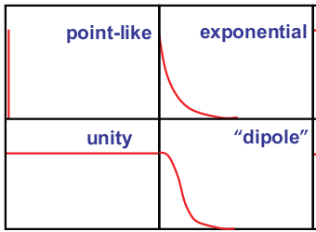
How Do the Charge and Magnetic Moment Distribute?
Probability of elastic interaction:
$${\frac{dσ}{dΩ}}/{\left(\frac{dσ}{dΩ}\right) point}=\left[\frac{{G2}_{E}\left(Q^{2}\right)+τ{G2}_{M}\left(Q^{2}\right)}{1+τ}+2τ{G2}_{M}\left(Q^{2}\right)tan2{\frac{θ}{2}}\right]$$
$$τ=\frac{Q^{2}}{4M^{2}}$$
The Q² dependence of form factors was measured…
Distribution of Charge or Magnetic Moment
dipole
1965
Q² = 1 GeV²
Caveat: The Form Factor as the Fourier transformation of a charge distribution is a non-relativistic concept.

Slide 8
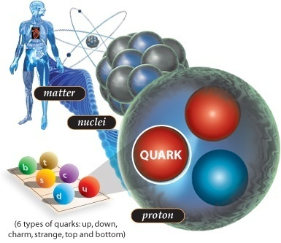
Actually, highly relativistic…
Protons and neutrons swirl in a heavy atomic nucleus with speeds of up to some ¾ c. More commonly, their speed is some ¼ the speed of light. They are “strong-forced” to reside in a small space.
Quarks (and gluons) are “confined” to the even smaller space inside protons and neutrons. Because of this, they swirl around with the speed of light.

Slide 9
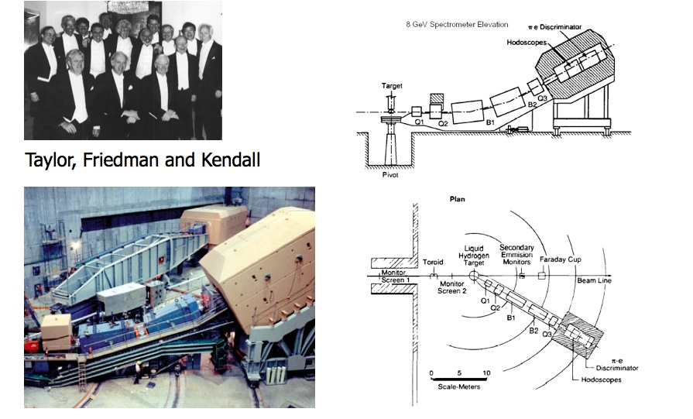

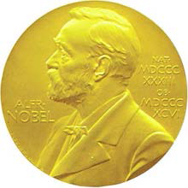
Higher energy e-p and e-d elastic scattering at SLAC
J. Friedman, H.Kendall, R.Taylor
Nobel Prize 1990

Slide 10
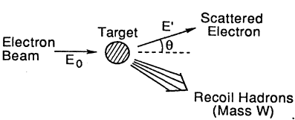
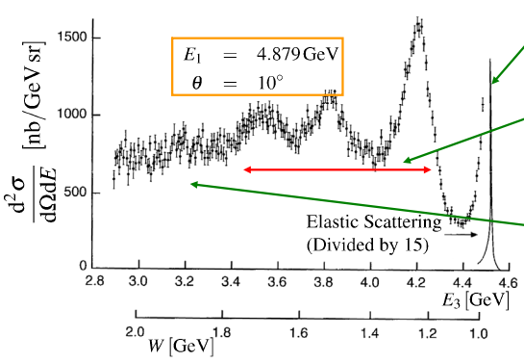

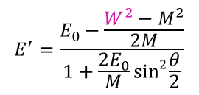




Matter Puzzle: What’s Inside the Proton?
Is the proton elementary?
$$\frac{ℏ}{Q}$$
To find out increase the probe’s ability of resolving structure (decrease )
$$E^{′}=\frac{E_{0}−\frac{W^{2}−M^{2}}{2M}}{1+\frac{2E_{0}}{M}sin2{\frac{θ}{2}}}$$
$$x=\frac{Q^{2}}{2Mυ}$$
$$ν=E_{0}−E^{′}$$
$$y=\frac{ν}{E_{0}}$$
$$W^{2}=M^{2}+2Mυ−Q^{2}$$
Elastic scattering: proton stays intact, W = M
E₀
Inelastic scattering: proton gets excited, produce excited states or proton’s resonances, W = M_{resonance}
Deep inelastic scattering: proton breaks up and we end up with a many particle final state, W = large
E’

Slide 11
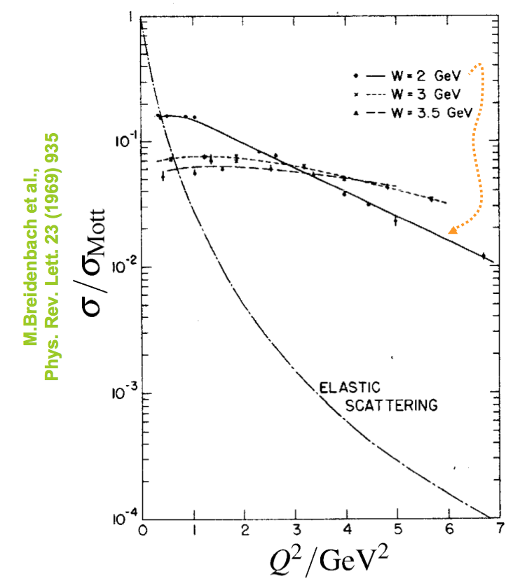
Looking deep inside the Proton
Deep Inelastic scattering cross sections almost independent of Q²!
i.e. “Form factor” ➔1
Scattering off point-like objects within the proton
Inelastic scattering cross sections only weakly dependent on Q²
Elastic scattering falls of rapidly with Q² due to the proton not being point-like (i.e. form factors)
Notes:
F1 and g1 are called parton distribution functions (pdfs) - they encode information about the proton’s deep structure
Emax = 20 GeV

Slide 12
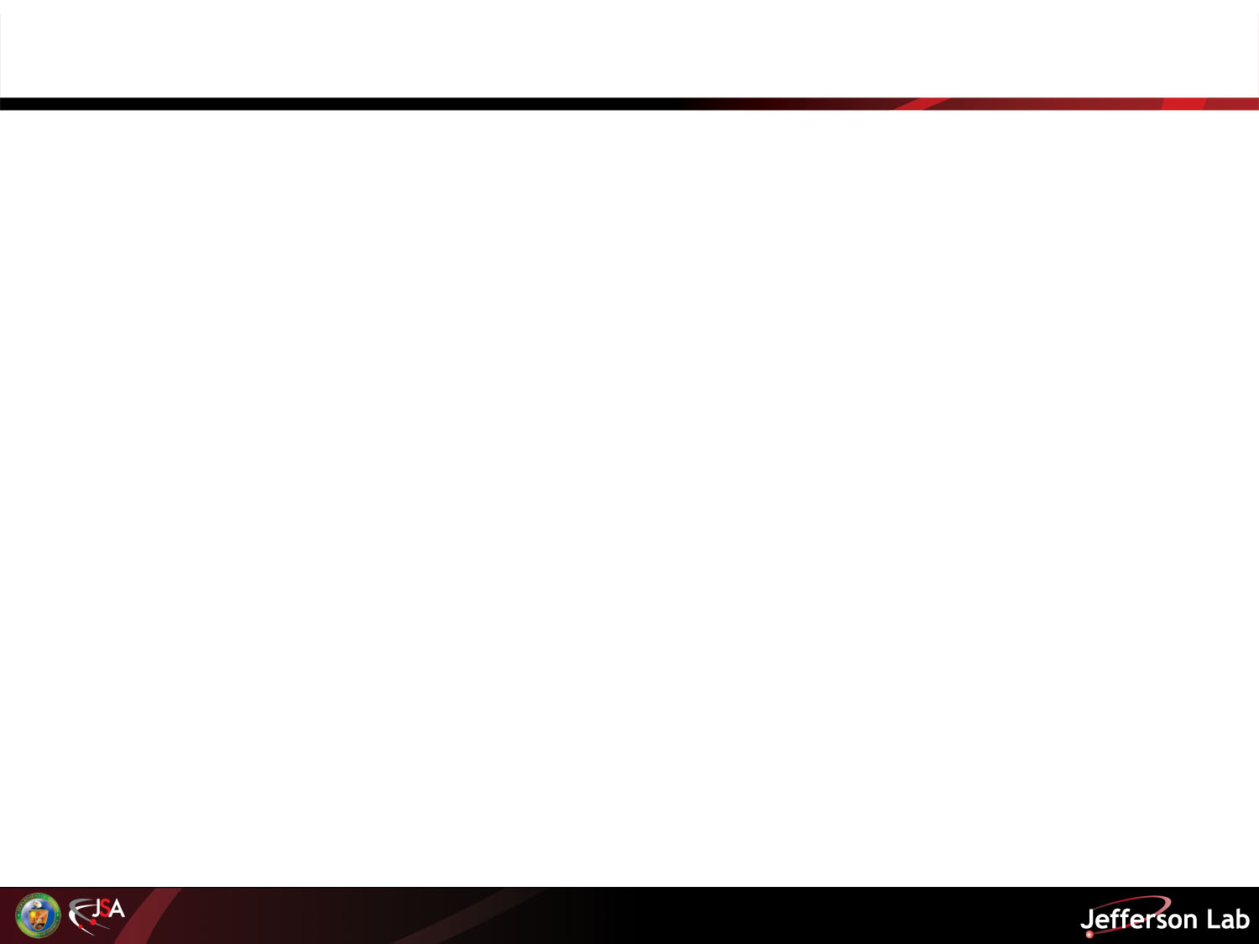
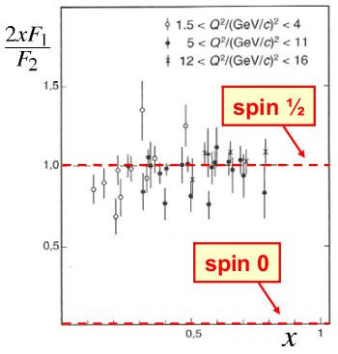

Structure Functions in Deep Inelastic Electron-Nucleon Scattering
Probability of inelastic interaction:
$$\frac{d^{2}σ}{dΩdE^{′}}=\frac{α^{2}}{4{E2}_{0}sin4{\frac{θ}{2}}}cos2{\frac{θ}{2}\left[\frac{1}{ν}F_{2}\left(x,Q^{2}\right)+\frac{2}{M}F_{1}\left(x,Q^{2}\right)tan2{\frac{θ}{2}}\right]}$$
Unpolarized “Structure Functions” F₁(x,Q²) and F₂(x,Q²):
Account for the sub-structure of the protons and neutrons
x = fraction of nucleon momentum carried by struck quark
Give access to partonic structure of the nucleon, i.e.
Comparing the DIS cross section formula with the Mott and Dirac elastic cross sections for particles of mass m = xM and spin 1/2
If point-like constituents were spin zero particles, we would expect F₁ to be zero
Same as if target was a free spin ½ particle: the photon is scattering on quasi-free quark !

Slide 13
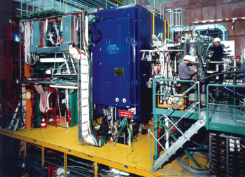
Fast forward….
30+ years of charged lepton Deep Inelastic Scattering at multiple laboratories including SLAC (to ~2000), CERN 80-90s EMC, NMC, BCDMS..), DESY (90s – 21st century H1, ZEUS,...), and more!
BCDMS
HERMES
H1

Slide 14
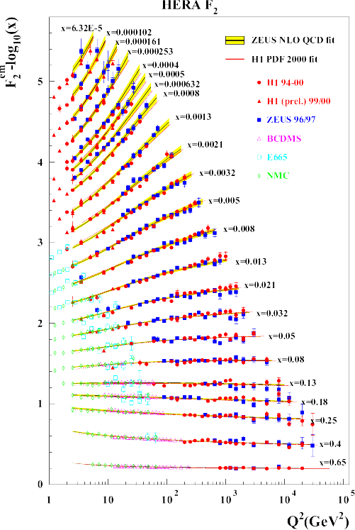
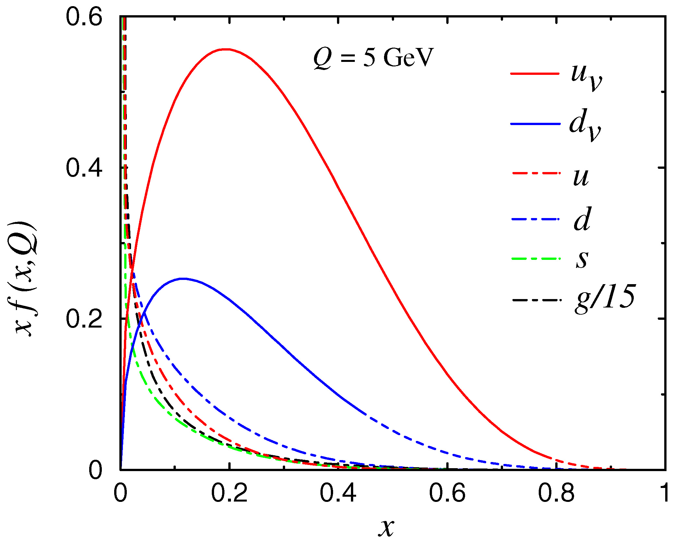
Q² Evolution of the F₂ Proton Structure Function
F₂^{p} Structure Function measured
over impressive range of x and Q²
Allows extraction of Parton Distribution Functions f(x,Q²) - think momentum distribution of quarks

Slide 15
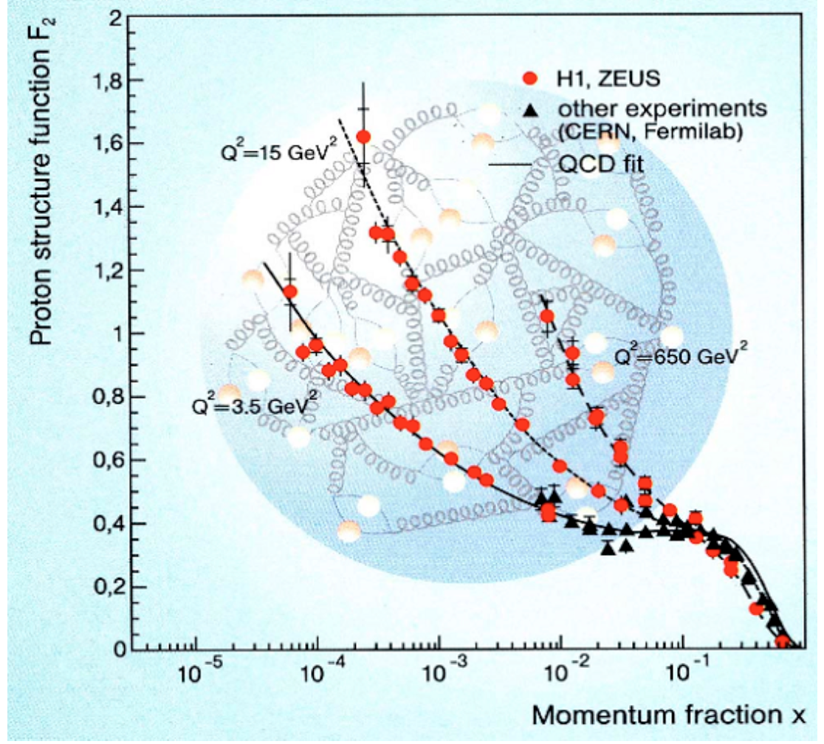
Scaling Violations
Scaling violation is due to the fact that the quarks radiate gluons that can "materialize" as q-qbar pairs (sea quarks)
Increasing Q² increases the resolution of the probe (~ħ/√Q²) and thus increases the probability of seeing these (abundant) low x partons
The parton distribution functions (PDFs) can not be calculated from first principle of QCD but their Q² dependence is calculable in perturbative QCD using the DGLAP evolution equations
Notes:
QCD evolution tells us how distribution evolves, but not original distributions

Slide 16
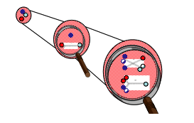
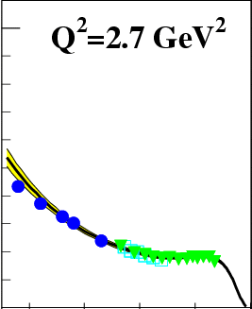
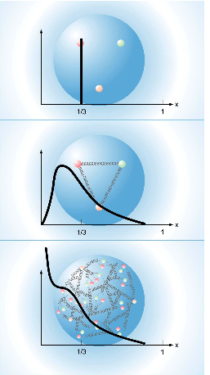

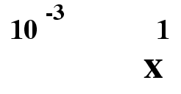
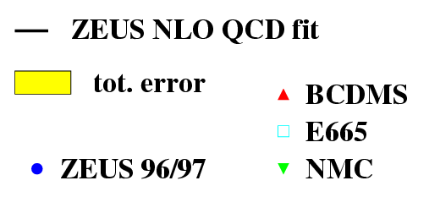
Proton Structure Function F₂
Q² dependence described by the Dokshitzer-Gribov-Lipatov-Altarelli-Parisi (DGLAP) evolution equations
Increasing Q²:
High x decrease
Low x increase
Allows extraction of Parton Distribution
Functions f(x,Q²) through Q² evolution
From high x, low Q to high Q, low x
F₂

Slide 17
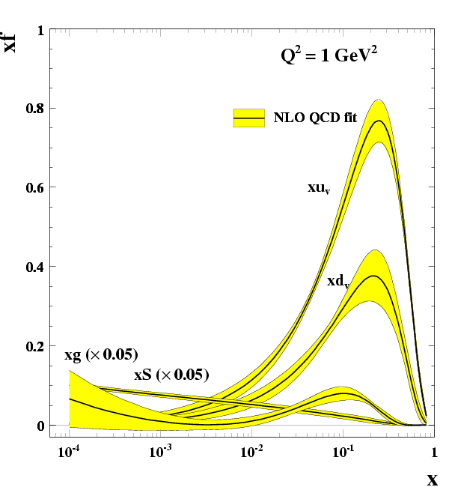
Parton Distribution Functions and QCD Evolution
q
q
q
q
Valence quarks maximum around x=0.2; f(x) →0 for x→1 and x→0
Sea quarks and gluons - contribute at low values of x

Slide 18
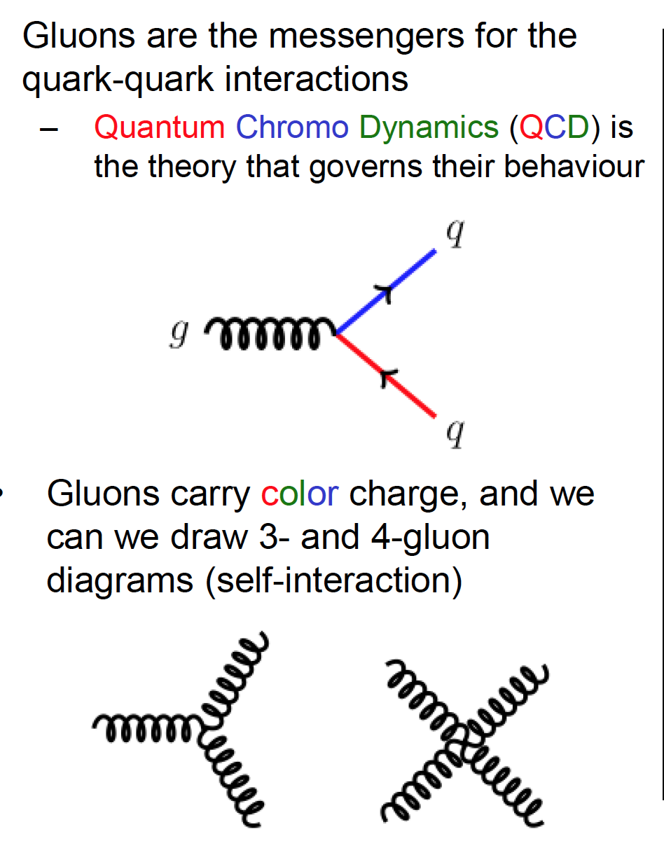
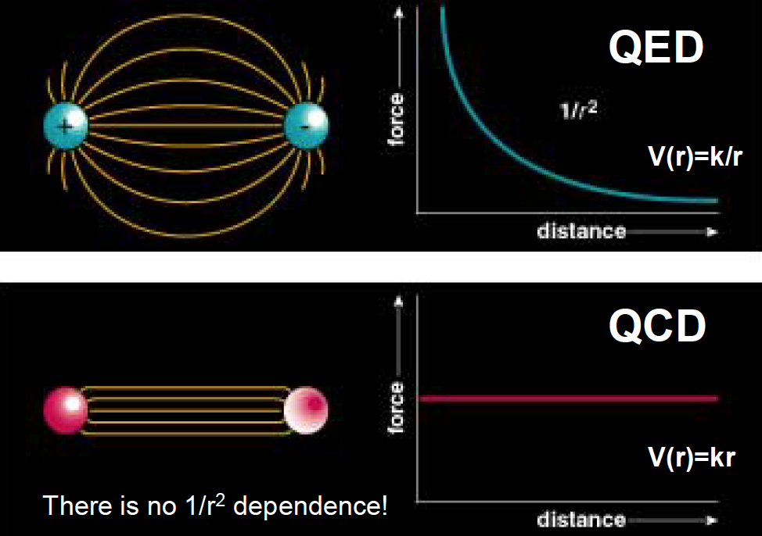
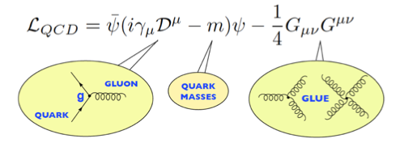
Quantum Chromo Dynamics
Gluons are the messengers for the quark-quark interactions
Quantum Chromo Dynamics (QCD ) is the theory that governs their behaviour
The strong force does not get weaker with large distances (opposite to the EM force) and blows up at distances around 10⁻¹⁵ m (the radius of the nucleon)
Gluons carry color charge, and we can draw 3- and 4- gluon diagrams (self-interaction)
18
Notes:
Quando parliamo di neutroni e protoni parliamo di forza forte. La teoria della interazione forte e’ la QCD. La costante di accoppiamento dell’interazione forte ha questo andamento ben noto in funzione delle’energia
Le proprietà del mondo reale della QCD (la teoria che descrive la forzaforte del modello standard) sono dominate da due fenomeni:
Confinamento – SLIDE - quark e gluoni non sono mai stati rilevati in isolamento e la rottura spontanea della simmetria chirale che e’ un meccanismo efficace per la generazione della massa
responsible per la massa di più del 98% di materia visibile nell'Universo.

Slide 19
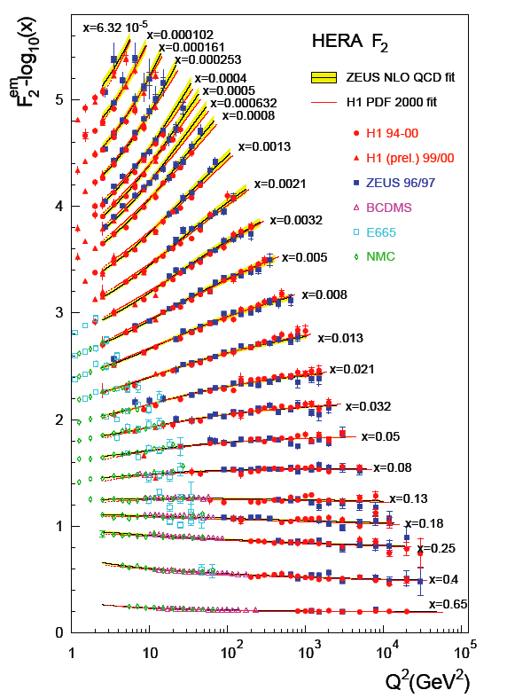
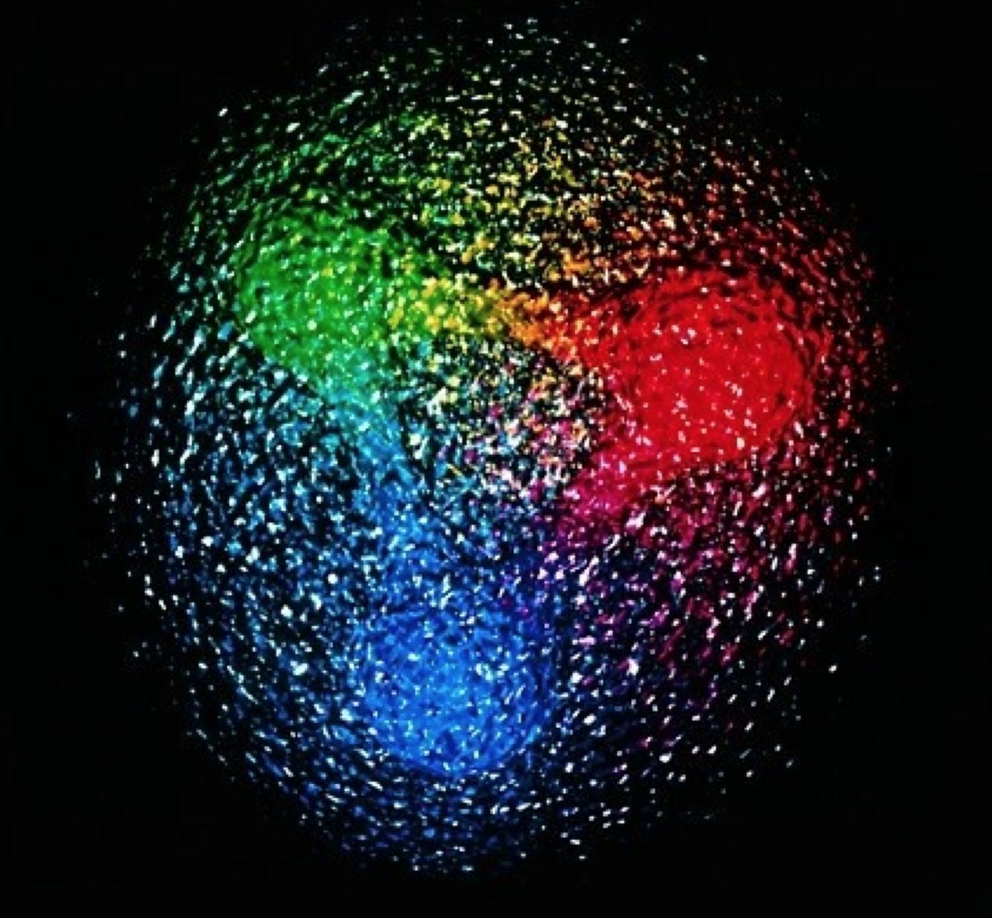
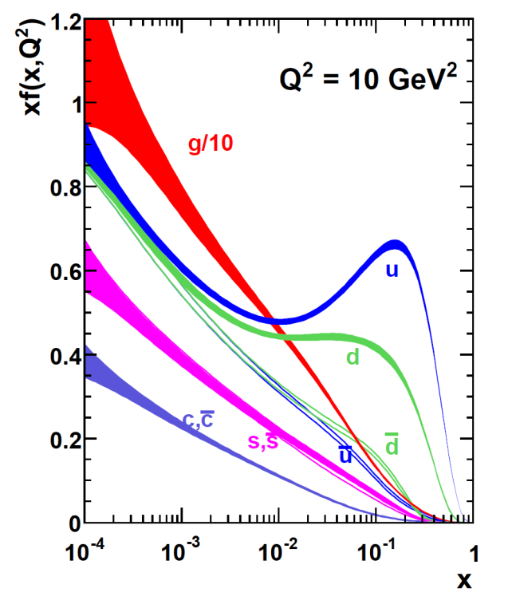
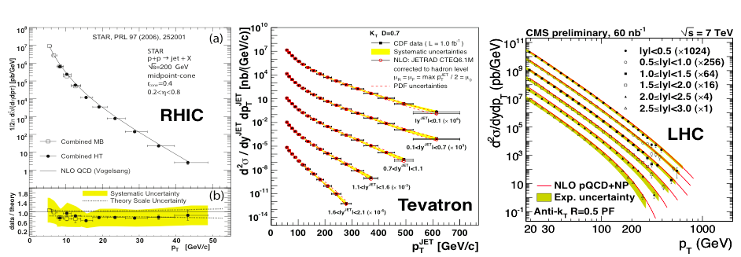
QCD Success !
Measure e-p @ 0.3 TeV (HERA)
p-p and p-p at 0.2, 1.96, and 7 TeV
19
Notes:
La QCD in regime asintotico e’ stato un grande successo! Le funzione di struttura F2 misurata ad HERA…e dalle quali abbiamo ricavato la distribuzioni di impulso dei quark e gluoni all’interno del nucleone, ben descrivono le sezioni d’urto di pp in un range ben + ampio di energie

Slide 20

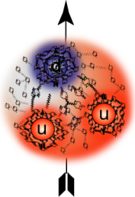
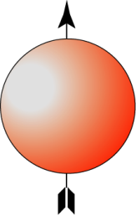
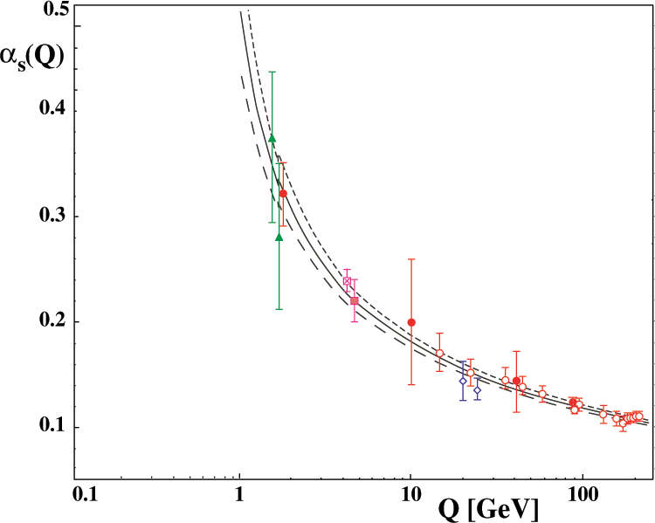
Quantum ChromoDynamics
At short distances
quarks move as though they are free → Asymptotic freedom
Physics at short distance is understood through perturbation theory - α_{s}(m_{Z})= 0.1189(10)
Perturbative QCD tested up to 1% level
2004 David Gross, David Politzer
and Frank Wilczek
At longer distances Confinement ensures that only hadronic final states are observed
Quarks can be removed from the proton, but cannot be isolated!!!
We never see a free quark
QCD still unsolved in non-perturbative region
Insights into soft phenomena exist through qualitative models and quantitative numerical (lattice) calculations
20
Notes:
Quando parliamo di neutroni e protoni parliamo di forza forte. La teoria della interazione forte e’ la QCD. La costante di accoppiamento dell’interazione forte ha questo andamento ben noto in funzione delle’energia
Le proprietà del mondo reale della QCD (la teoria che descrive la forzaforte del modello standard) sono dominate da due fenomeni:
Confinamento – SLIDE - quark e gluoni non sono mai stati rilevati in isolamento e la rottura spontanea della simmetria chirale che e’ un meccanismo efficace per la generazione della massa
David J. Gross, H. David Politzer and Frank Wilczek
responsible per la massa di più del 98% di materia visibile nell'Universo.
La scoperta della liberta asintotica ha permesso di effettuare previsioni precise riguardo ai risultati di molti esperimenti ad alte energie utilizzando le tecniche della teoria perturbativa della meccanica quantistica.
L'esistenza dei gluoni e’ stata dimostrata nel 1979 as HERA.
Il confinamento e’ un postulato della QCD che e’ stato verificato per mezzo di calcoli di QCD su reticolo ma non e’ stato mai matematicamente provato

Slide 21
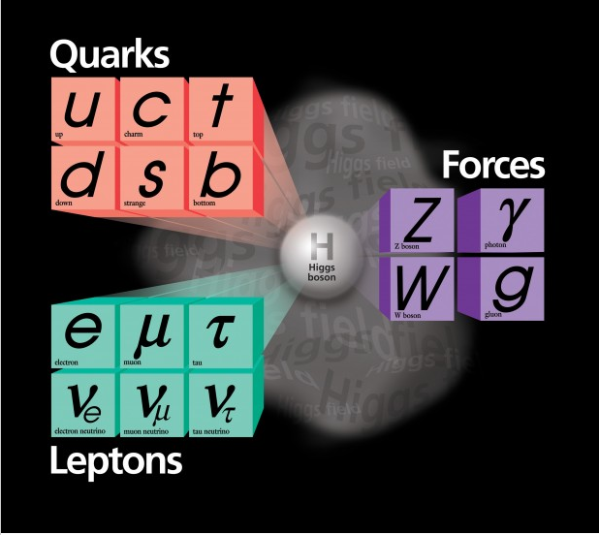
From the D. Gross Nobel Lecture (2004):
“It is sometimes claimed that the origin of mass is the Higgs mechanism that is responsible for the breaking of the electroweak symmetry that unbroken would forbid quark masses. This is incorrect.
Most, 99%, of the proton mass is due to the kinetic and potential energy of the massless gluons and the essentially massless quarks, confined within the proton.”
21
Notes:
Molto importante ma non completa la nostra conoscenza della materia che ci circonda…
Si sostiene che l'origine della massa è il meccanismo di Higgs, che è responsabile della rottura della simmetria elettrodebole che ininterrotta vieti masse dei quark.

Slide 22
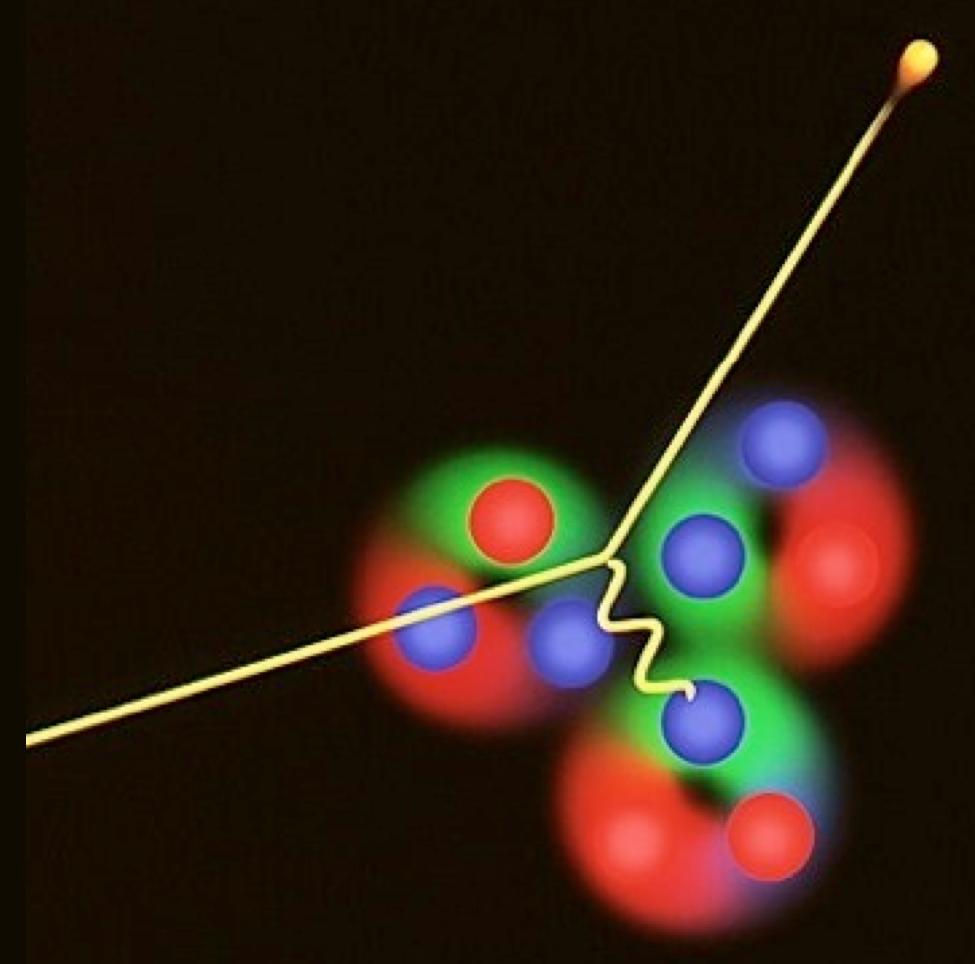
Lepton Scattering: a Powerful Tool
The best evidence we have for what the nucleon looks like comes from electron scattering experiments
→
E’ = (E’, k’)
SUCCESS
CHALLENGES
Clean probe of hadron structure
Electron (lepton) vertex well-known from QED
One can vary the wave-length of the probe to view deeper inside the hadron
The interaction is weak
→ small cross sections
Small cross sections also in large x “valence” regime
Would also like coincidence measurements with struck/created hadrons
γ*
→
Hadrons
E = (E, k)
→
p = (M, 0)

Slide 23
Jefferson Lab Continuous Electron Beam Accelerator Facility
D
1995 - 2012…
Energy 0.4 ─ 6.0 GeV
200 μA, polarization 85%
Simultaneous delivery 3 halls
500+ PhDs completed
On average 22 US PhDs per year, roughly 25-30% of US PhDs in nuclear physics
1530 users in FY2016, ~1/3 international from 37 countries
~2016 - …..
Energy 0.4 ─ 12.0 GeV
150 μA, polarization ~85%
Simultaneous delivery 4 halls
FY18: First try simultaneous delivery to 4 halls – A, B, C, D
A
C
B

Slide 24
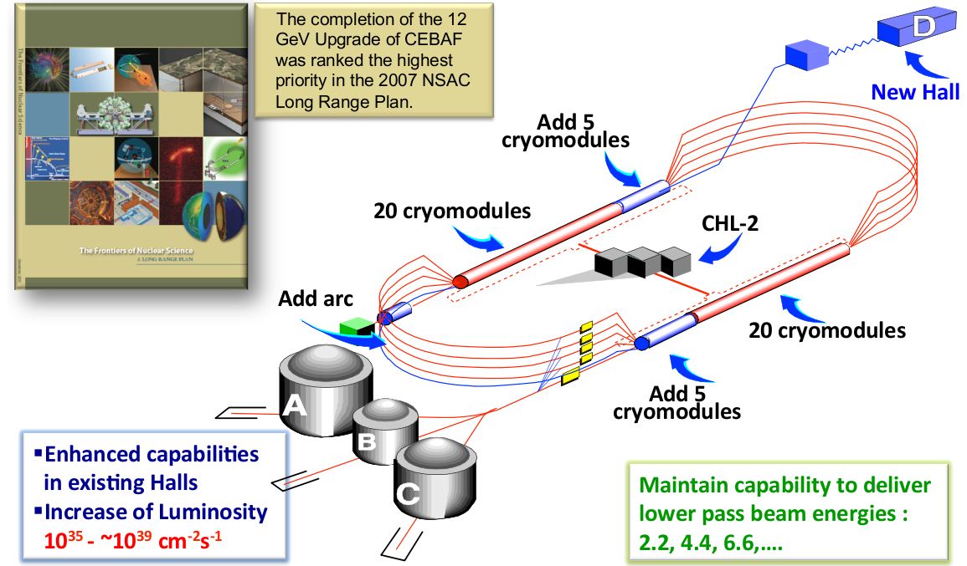
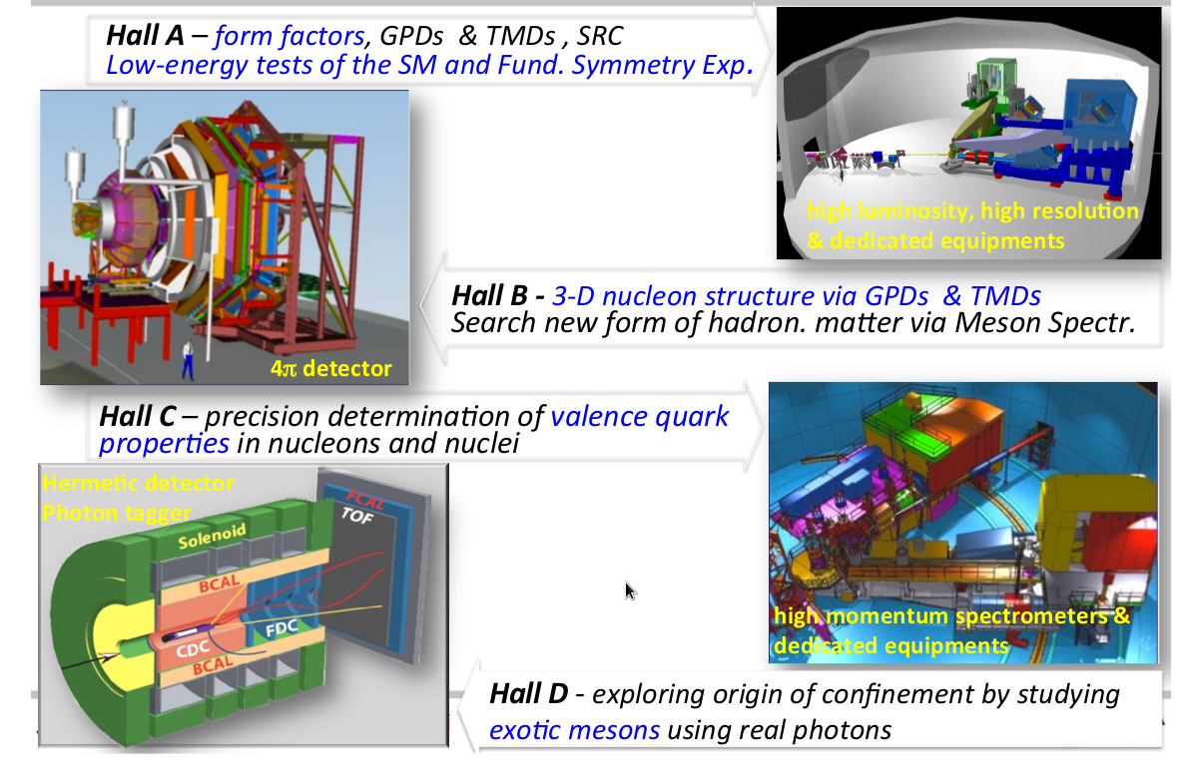
Jefferson Lab: What Are We After?
Jefferson Lab Mission: mechanism of confinement, partonic structure of nucleon, quark and gluon dynamics in the nuclear medium, nucleon spin decomposition, role of gluonic excitations in mesons…
Hall D
Hall A
Hall C
Hall B

Slide 25
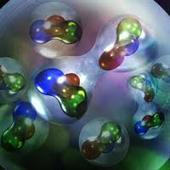
“Part of what we will tell you this semester is wrong.
The problem is that we do not know what part.”
- Multiple sources
“True wisdom is knowing what you don't know”
- Confucius

Slide 26
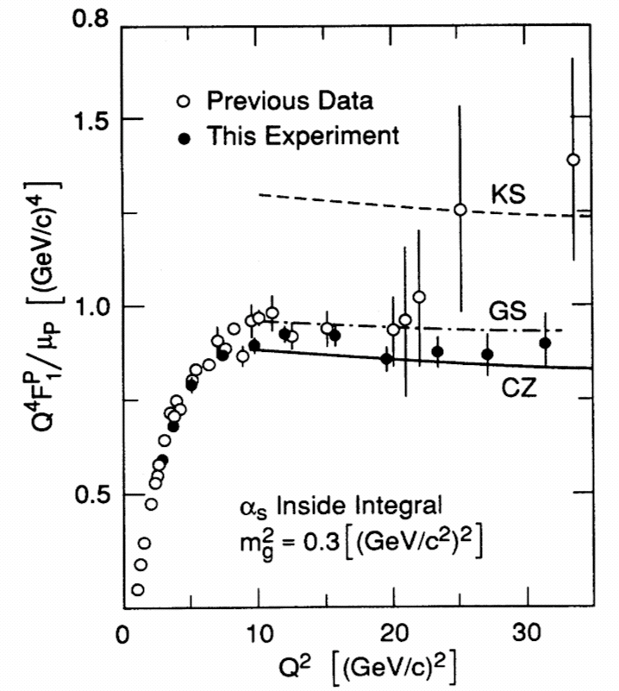
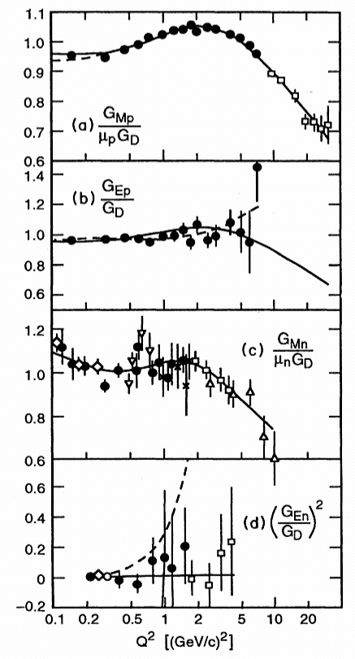
Pre-JLab Results for the Form Factors
Sill et al,1993
Bosted et al,1995
Note log scale!
Notes:
The scaling for F1 looks very good.
However it is time to repeat measurement of the absolute cross section at JLab.
The scaling fit stays well for GMp, GMn. For GEN the accuracy was not sufficient.

Slide 27
How Do the Charge and Magnetic Moment Distribute?
Probability of elastic interaction:
$${\frac{dσ}{dΩ}}/{\left(\frac{dσ}{dΩ}\right) point}=\left[\frac{{G2}_{E}\left(Q^{2}\right)+τ{G2}_{M}\left(Q^{2}\right)}{1+τ}+2τ{G2}_{M}\left(Q^{2}\right)tan2{\frac{θ}{2}}\right]$$
$$τ=\frac{Q^{2}}{4M^{2}}$$
The Q² dependence of form factors was measured…
Distribution of Charge or Magnetic Moment
dipole
1965
Q² = 1 GeV²
Caveat: The Form Factor as the Fourier transformation of a charge distribution is a non-relativistic concept.

Slide 28
Pre-JLab Results for the Form Factors
Sill et al,1993
Bosted et al,1995
Note log scale!
Notes:
The scaling for F1 looks very good.
However it is time to repeat measurement of the absolute cross section at JLab.
The scaling fit stays well for GMp, GMn. For GEN the accuracy was not sufficient.

Slide 29

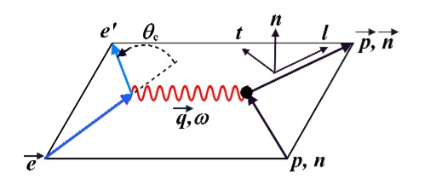
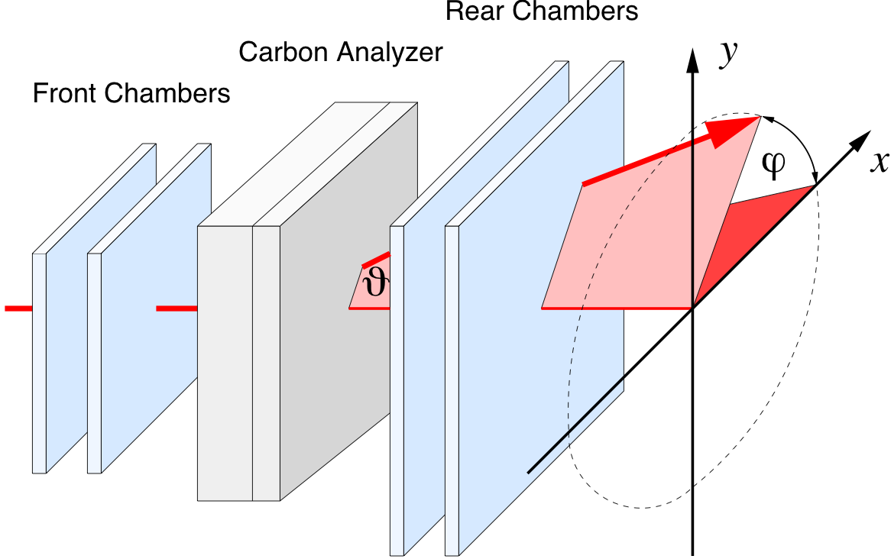
Polarization Transfer in Elastic Electron-Proton Scattering
The double-polarization approach obtains the FF ratio by measuring two polarization components simultaneously.
Employ a combination of spin precession in a magnetic spectrometer and a proton polarimeter.
A single measurement of the azimuthal angular distribution of the proton scattered in a secondary target gives both the longitudinal, Pl, and transverse, Pt, polarization.
Longitudinally polarized electron beam
JLab Hall A HRS spectrometer

Slide 30
Surprising Result for the Form Factors…
Jefferson Lab polarization transfer results!!
First paper 800+ citations!
1) e + p → e’ + p
G_{E}^{p}/G_{M}^{p} constant
2) e + p → e’ + p
G_{E}^{p}/G_{M}^{p} drops with Q²
What is going on?...
Notes:
The scaling for F1 looks very good. However it is time to repeat measurement
Of the absolute cross section at JLab.
The famous Bosted fit stay well for GMp, GMn.
For GEN the accuracy was not sufficient.

Slide 31

Dramatic discrepancy!
Q²
In general, polarization observables are rather insensitive to radiative corrections, as they are by definition a ratio of a polarized cross section to an unpolarized one.

Slide 32
Proton Charge and Magnetization
e + p → e’ + p
G_{E}^{p}/G_{M}^{p} drops with Q²
Charge & magnetization distributions in the proton are different
charge depletion in interior of proton
smaller distance →
Orbital motion of quarks play a key role
(Belitsky, Ji + Yuan PRL 91 (2003) 092003)
Notes:
32
Note BSM not included in project

Slide 33



Also.. G_{E}^{n} is not zero…
Hall A
Neutron has no charge, but does have a charge distributions: n = p + π⁻, n = ddu. Use polarization to access. “Guarantee” that electron hits a neutron AND electron transfers its polarization to this neutron.
(Polarization Experiments only)
Combining proton and neutron: down quark has more extended spatial charge distribution. Could be due to significant influence of di-quarks?

Slide 34


12 GeV G_{E}^{n} experiment
JLab Hall C SHMS
Polarized ³He Target Cell for Hall A
Notes:
The electrical neutron from factor will be investigated via
Double polarization asymmetry in quasi-elastic neutron
Knockout from the He-3 nuclei. Large acceptance setup
And the novel polarized target are under preparation.

Slide 35


12 GeV G_{M}^{n} experiment
JLab Hall B CLAS12
JLab Hall A SBS
Notes:
The Magnetic form factor of the neutron will be measured via a ratio method
By detection of the neutron and proton knockout from the deuteron
Currently approved measurements cover the range up to 14 GeV2
However, the Hall A setup could extend the study up to 18 GeV2.

Slide 36

12 GeV G_{E}^{p} experiment
JLab Hall A SBS
Also measuring at low Q²…
Notes:
This experiment is a flagship of our program as it will provide
Very significant improvement of the GEp knowledge and extend
Data up to 12 GeV2

Slide 37



Muonic Hydrogen Data
High precision results from Muonic Lamb shift data give a proton radius of 0.84 fm.
This result contradicts many other extractions - dominantly from electron scattering - which have determined the proton radius to be ~0.88 fm.
E_{2p} – E_{2s} = 209.98 – 5.2262 r_{p}² + 0.0347 r_{p}³ MeV

Slide 38

Some Of The Possible Explanations
μH experiment wrong ?
eH theory wrong ?
Beyond Standard Model
Lamb shift difference of
310 ± 2 μeV
eH experiment
+ ep scattering wrong ?
- R∞
- 2γ corrections
- low-Q² extrapolation
μH theory wrong ?
- 2γ corrections
- missing QED or EW corrections
- soft hadronic corrections
List of possible explanations from Franziska Hagelstein, University of Mainz

Slide 39

Need the Slope of G_{E}(Q²) Using Low Q² Data
What is going to be what function to use for the fitting & extrapolating?
The answer to this question STRONGLY effects the answer!
  Q² < (1/0.88 fm)² < 1.2 fm⁻² to get the radius of the proton
  (equivalent to ~0.05 GeV² )

Slide 40





Plotting Published Results & Standard Functions
- These are NOT regressions, just the data as published and standard curves. -
0.88 fm radii
Closed Circles Mainz 1980 results and open circles Saskatoon 1974 results.

Slide 41

Plotting Published Results & Standard Functions
- These are NOT regressions, just the data as published and standard curves. -
0.84 fm radii
0.88 fm radii
Note how for a fixed radius, all functions come together as Q² gets < 0.4 fm⁻².
Need precision data at very low Q²!

Slide 42


PRad: JLab Hall B Proton Radius Experiment
Small angle and small Q² to minimize the effects of G_{M} and provide best measurement of G_{E}
Gas Target (the proton) and GEM Detectors (scattering angles)
The Collaboration & Hall B staff managed to get this experiment ready while installing CLAS12
The first completed experiment for the upgraded CEBAF accelerator.

Slide 43

Expected Precision of PRad Data

Slide 44


Other Form Factors – Testing QCD in the Confinement Regime
Pion FF – first quantitative access to hard scattering scaling regime?
CLAS
Hall A
Hall C
MAMI
Bates
Meson-
Baryon
cloud
monopole
pQCD: ~1/Q⁵
Hard QCD obtained with the PDA appropriate to the scale of the experiment
bare quark core
Hard QCD obtained with φ_{π}^{asy}(x)
P₁₁(1232) Magnetic Dipole Transition Form Factor
CLAS12 will map numerous Resonances!
Low t = four-momentum transfer squared at the nucleon vertex

Slide 45

QCD and the Mechanism for Confinement
q
q
Field theory for strong interaction:
  quarks interact by gluon exchange
  quarks carry a ‘colour’ charge
  exchange bosons (gluons) carry
  colour ⇒ self-interactions (cf. QED!)
Hadrons are colour neutral:
  RR, BB, GG or RGB
  leads to confinement:
Can also have gluonic excitations….
g
g
q
q

Slide 46


Hall D: Gluonic Excitations and
the Mechanism for Confinement
QCD predicts a rich spectrum of as yet to be discovered gluonic excitations - whose experimental verification is crucial for our understanding of QCD in the confinement regime.
With the upgraded CEBAF, a linearly polarized photon beam, and the GlueX detector, Jefferson Lab will be uniquely poised to: - discover these states
- map out their spectrum
- measure their properties
12 GeV electrons
States with Exotic Quantum Numbers
Dudek et al.
γ
beam
Excited Glue

Slide 48
Extracting the (e,e’) cross section
N_{N} (cm⁻²)
e'
N_{e}
e
(ΔΩ_{e}, Δp_{e})
Scattering probability or cross section

Slide 49


e-p and e-d elastic scattering
Protons have charge distribution

