Slide 1

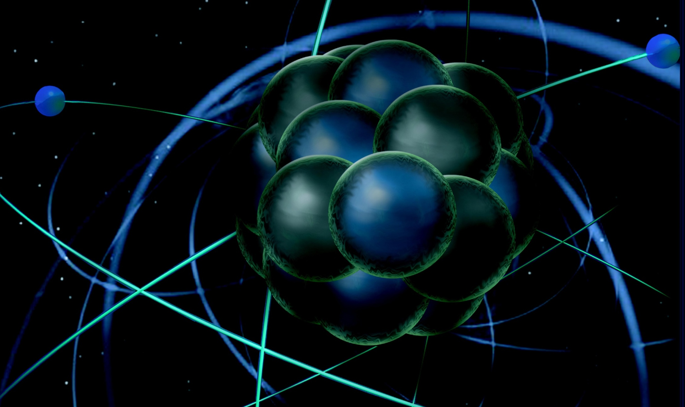
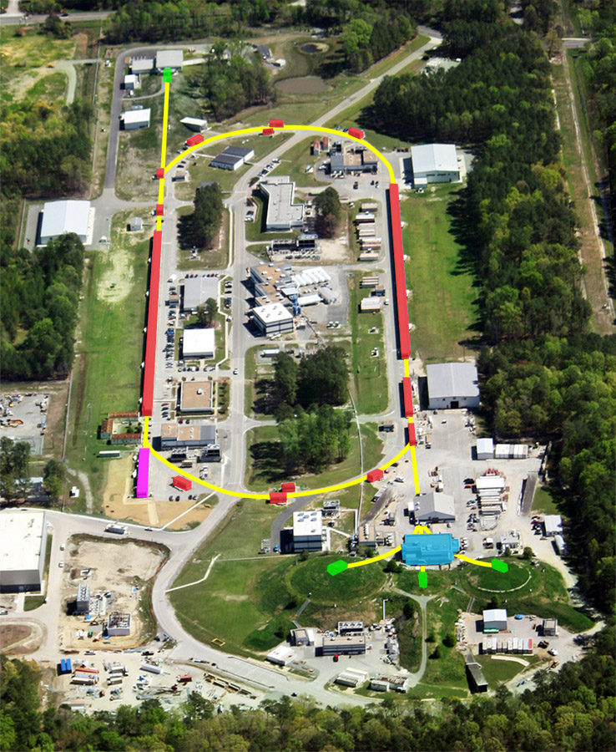
The Particle/Nuclear Interface - II
Thia Keppel
CTEQ Summer School
University of Pittsburgh
July 2017

Slide 2
Lecture Scheme - I
in·ter·face
ˈin(t)ərˌfās/ noun
1. a point where two systems, subjects, etc., meet and interact.
  DAY 1
  Introduction
  History and Basics of Electron Scattering – Some Reminders
  Jefferson Lab
  1D to 3D Nucleon Structure
    Form Factors and PDFs
    Large x
  Nucleons in the Nuclear Medium
  DAY 2
  Finish What I Didn’t Yet From Day 1!
  The Electron Ion Collider

Slide 3
Lecture Scheme - II
  DAY 1
  Introduction
  History and Basics of Electron Scattering – Some Reminders
  Jefferson Lab
  1D to 3D Nucleon Structure
    Form Factors and PDFs
    Large x
  Nucleons in the Nuclear Medium
  DAY 2
  Finish What I Didn’t Yet From Day 1!
  The Electron Ion Collider

Slide 4
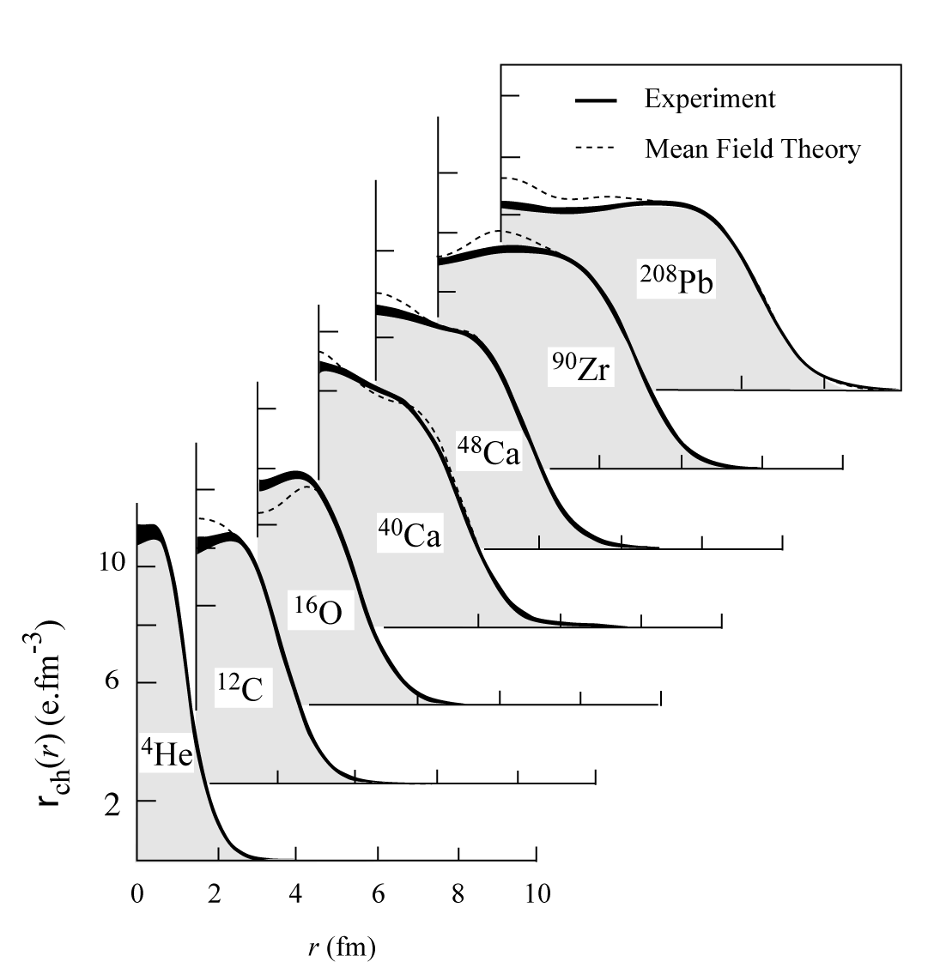
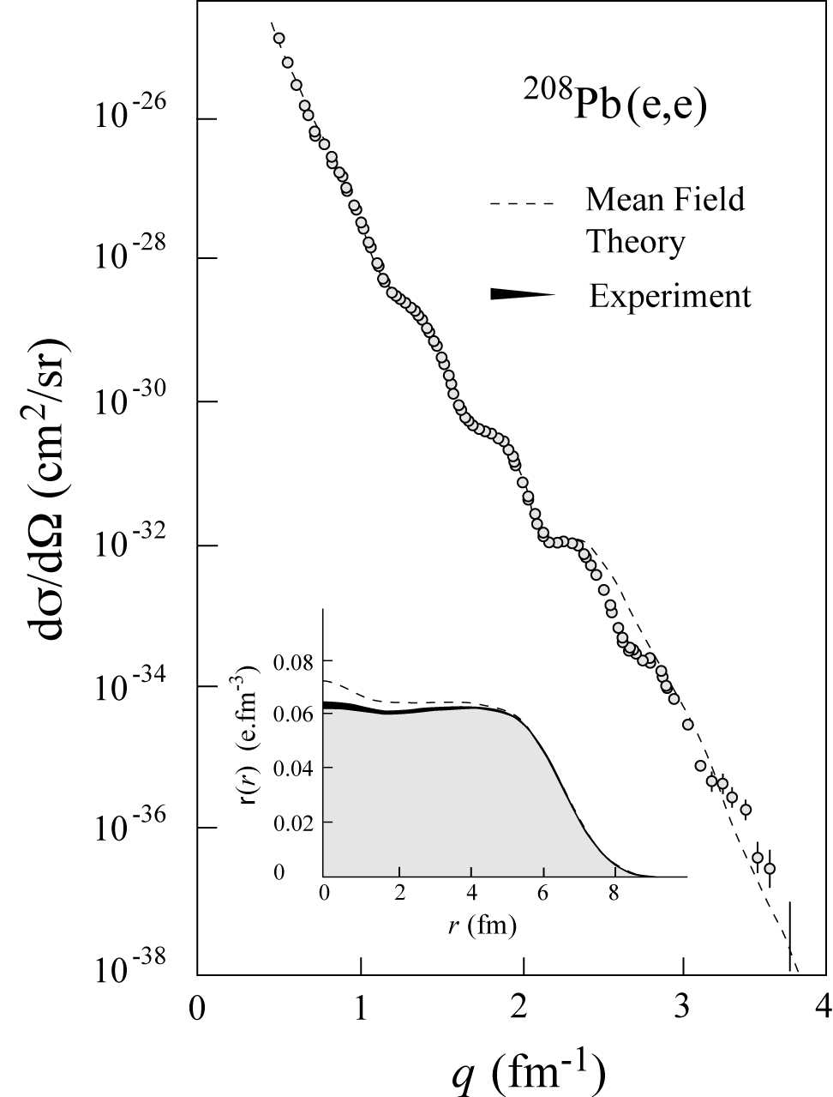
Inclusive Electron-Nucleus Scattering – historical example
Elastic Scattering
Charge Distributions
4

Slide 5
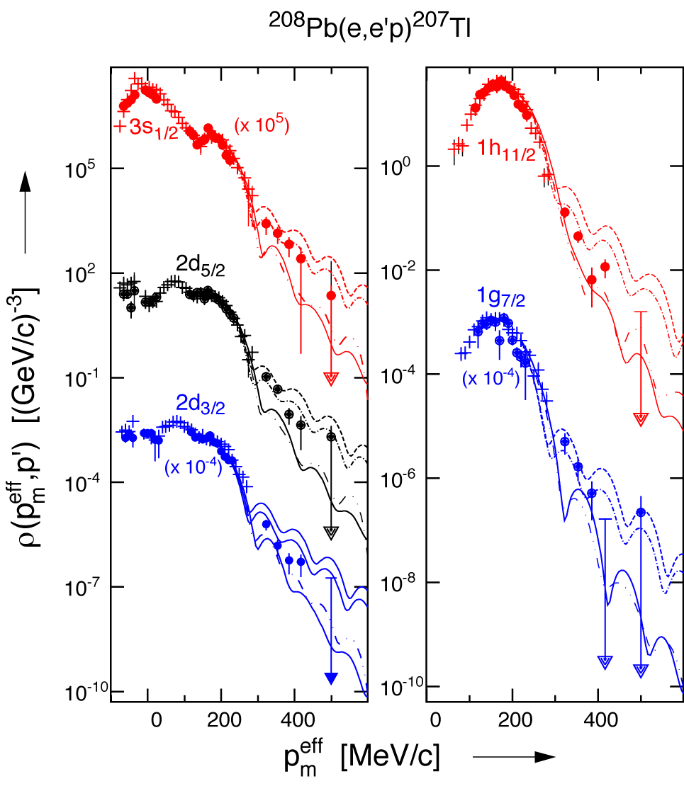
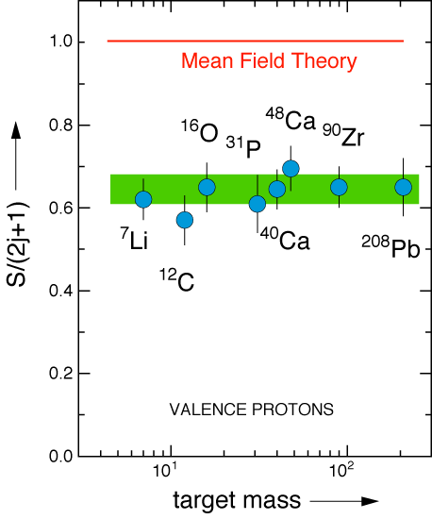
The Classic A(e,e’p)A-1 Problem
Independent-Particle Shell-Model
is based upon the assumption that
each nucleon moves independently
in an average potential (mean field)
induced by the surrounding nucleons
SPECTROSCOPIC STRENGTH
The (e,e'p) data for knockout of valence and deeply bound orbits in nuclei gives spectroscopic factors that are 60 – 70% of the mean field prediction.

Slide 6
Possible Answer: Short-Range Correlations
2N-SRC
ρ ≈ 5ρ_{o}
1.7fermi
ρ_{o} = 0.17 GeV/fermi³
Nucleons
Nucleons are made up of quarks, so does NOT violate Pauli exclusion principle

Slide 7
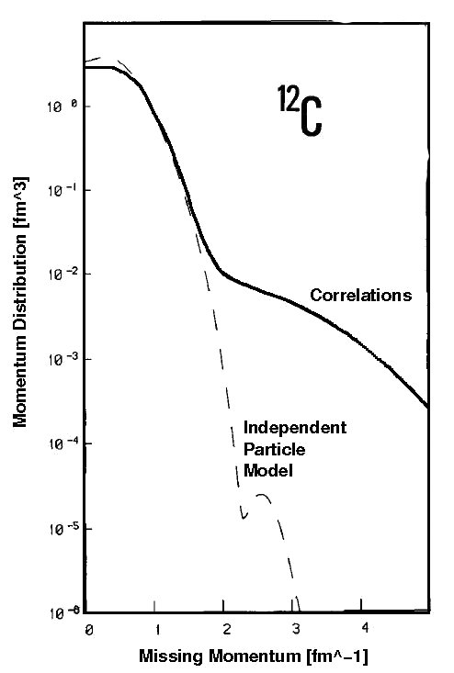
If Correct Raises More Questions
Benhar et al., Phys. Lett. B 177 (1986) 135.
What fraction of the momentum distribution is due to 2N-SRC?
What is the relative momentum between the nucleons in the pair?
What is the ratio of pp to pn pairs?
Are these nucleons different from free nucleons (e.g. size)?
Measure out here…!...

Slide 8
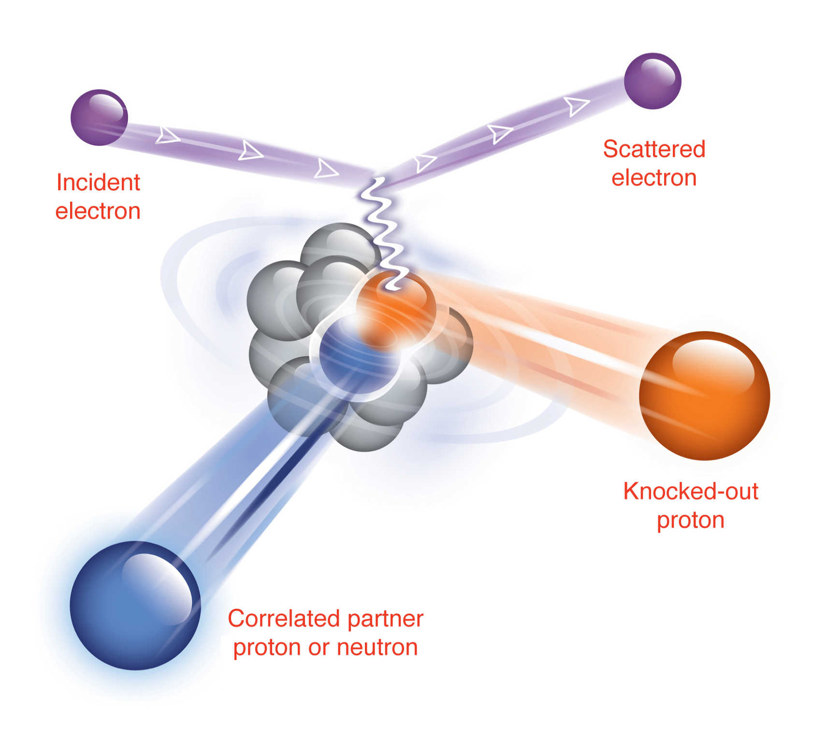
Coincidence (e,e’pN) Exclusive Measurement
Study nucleon pairs and the fraction that contribute to momentum tail.
x > 1 , Q² = 1.5 [GeV/c]² and missing momentum of 500 MeV/c

Slide 9
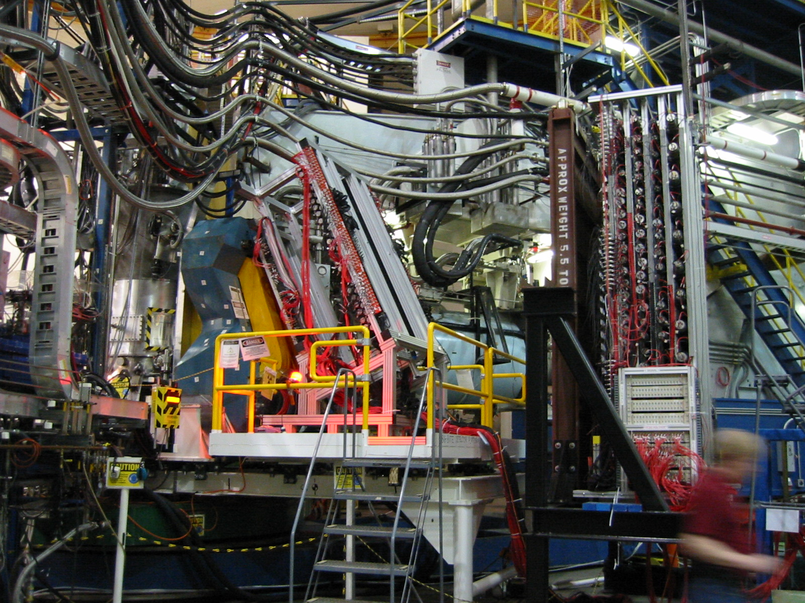
BigBite and Neutron Detector in Hall A
First step along the way to many successful high luminosity, large acceptance measurements.

Slide 10
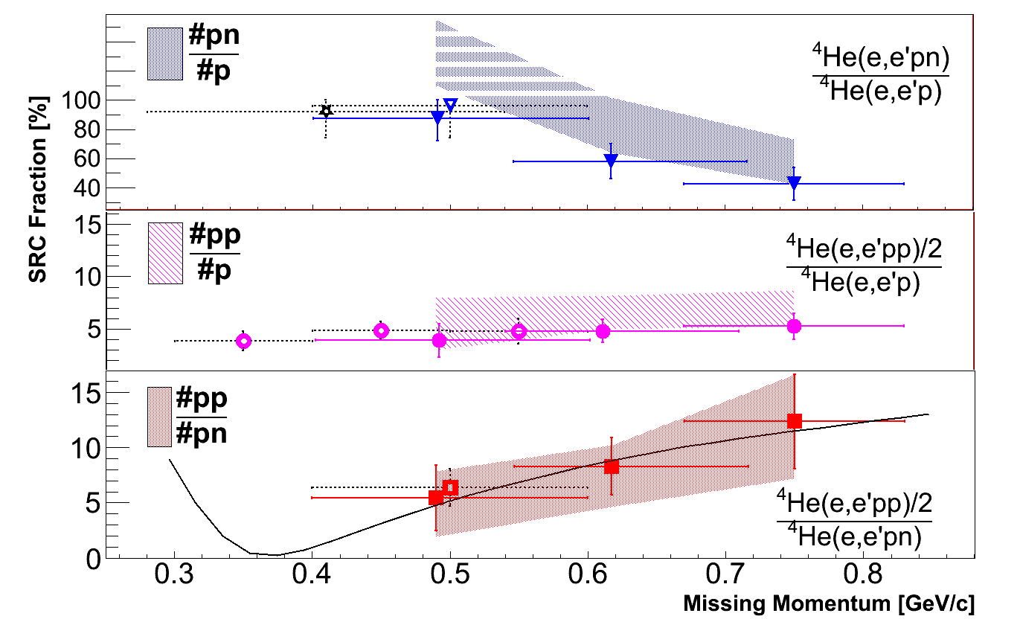
⁴He(e,e’pN) Results – recoiling neutrons favored
I. Korover et al., Phys. Rev. Lett. 113 (2014) 022501.

Slide 11
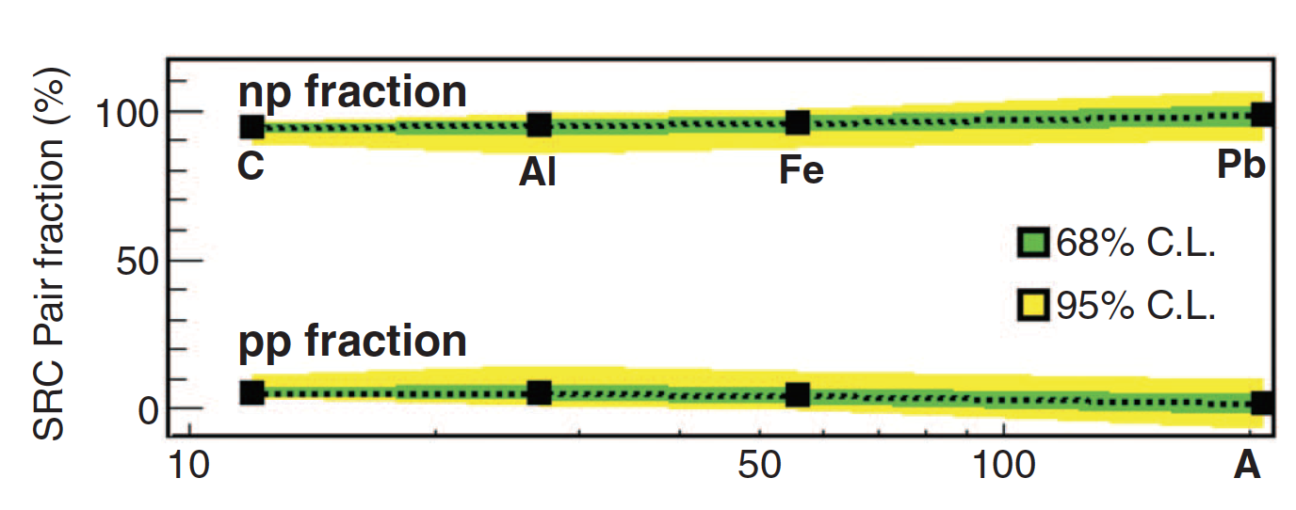
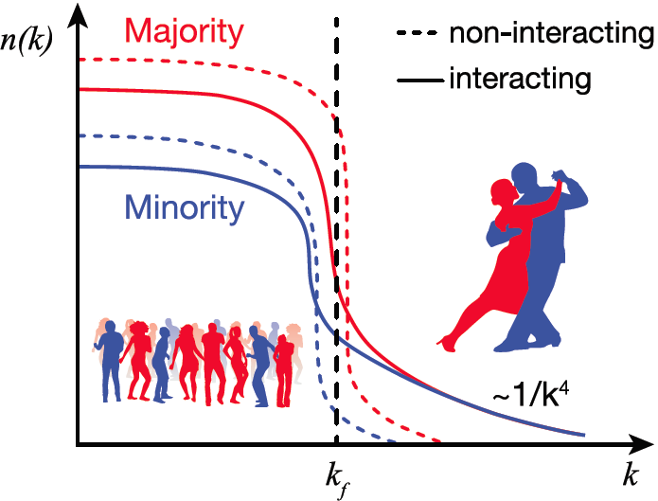
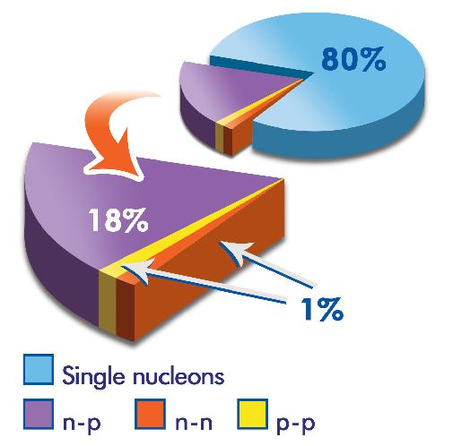
Proton-Neutron Pairing In All Nuclei
Or Hen et al. (Jefferson Lab CLAS Collaboration) Science 346 (2014) 614.
The minority particle will have a higher average kinetic energy then the majority particle.

Slide 12
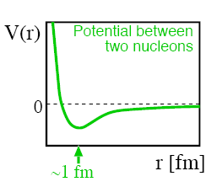
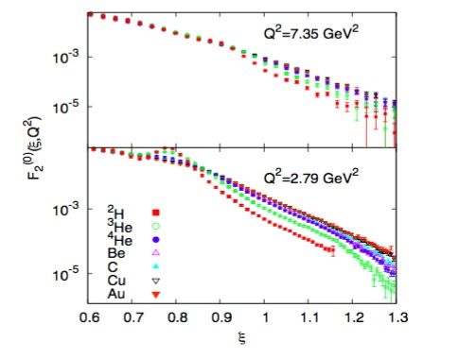
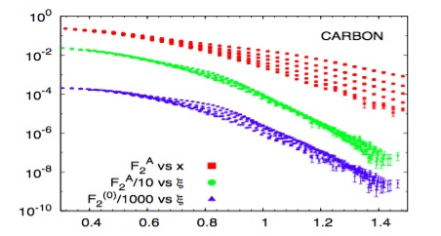
Precision (e,e’) x>1 Cross Sections
N. Fomin et al., Phys. Rev. Lett. 105 (2010) 212502 – JLab Hall C
Electron-nucleus scattering allows for F₂ structure functions above x = 1
Nucleons are close together and interact via the (poorly-constrained) repulsive core of the N–N interaction, yielding high momentum nucleons.
Deuteron limited to x < 2, etc.
Deep inelastic probe of very high momentum “superfast” quarks

Slide 13
Precision (e,e’) x>1 Cross Section Ratios
N. Fomin et al., Phys. Rev. Lett. 108 (2012) 092502.
Plateaus seen in the ratio (σ_{A}/A)/(σ_{D}/2)
Roughly A independent
Understood as evidence for 2N short range correlations

Slide 14
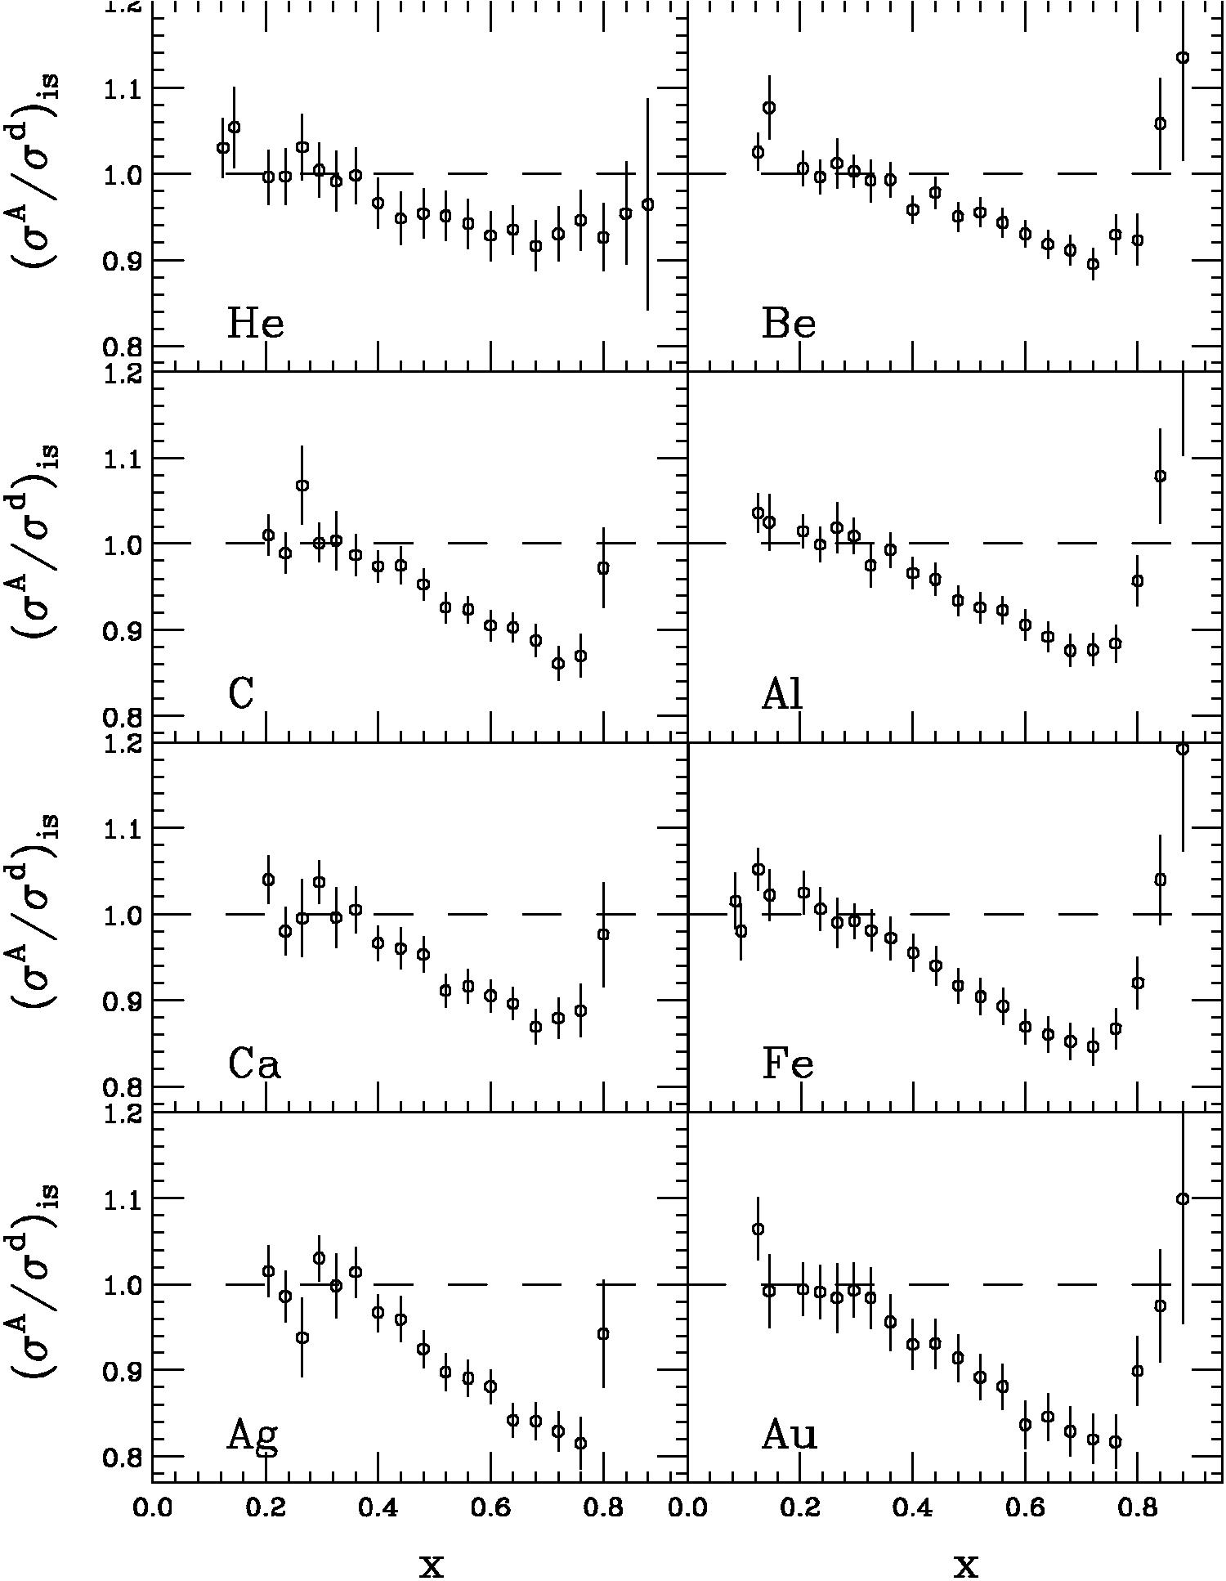
The Deep Inelastic EMC Effect
The EMC effect is the observation that the ratio of nuclear DIS cross sections to deuterium is not one
  EMC paper: J.J. Aubert et al. PLB 123 (1983) 275
  Simple Parton Counting Expects One
  MANY Explanations, multiple experiments
Behavior
  Q²-independent
  Universal x-dependence (shape)
  Magnitude varies with A – a density effect?....

Slide 15
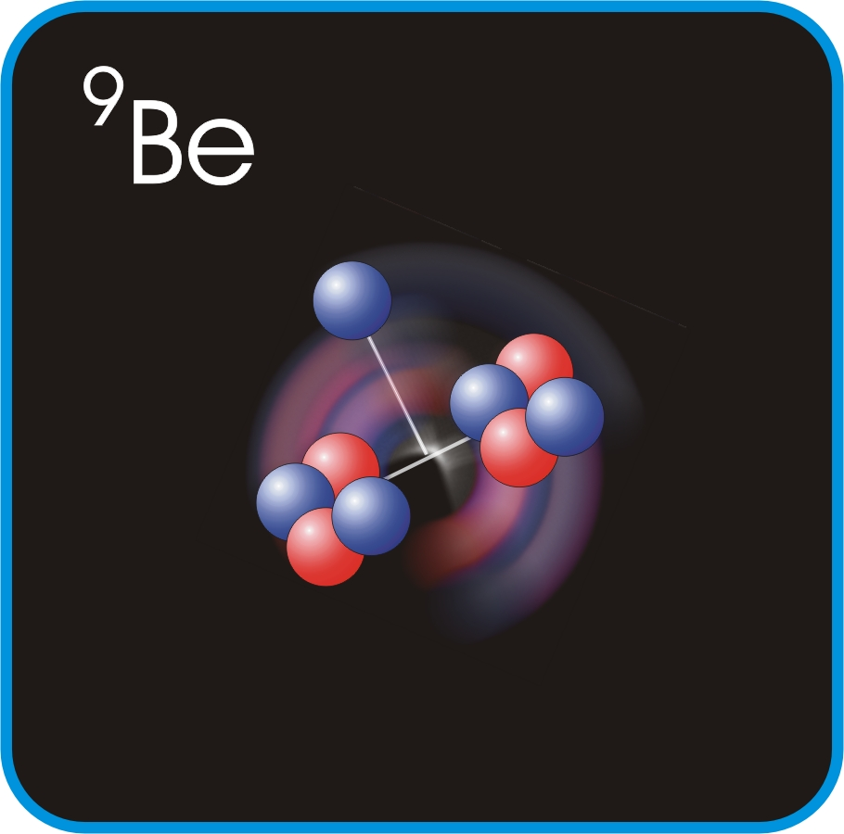
Jefferson Lab EMC Effect Data
J. Seely et al., Phys, Rev. Lett. 103 (2009) 202301.
Slope of ratio σA/σD at EMC region.
EMC effect correlated with local density not average density.

Slide 16
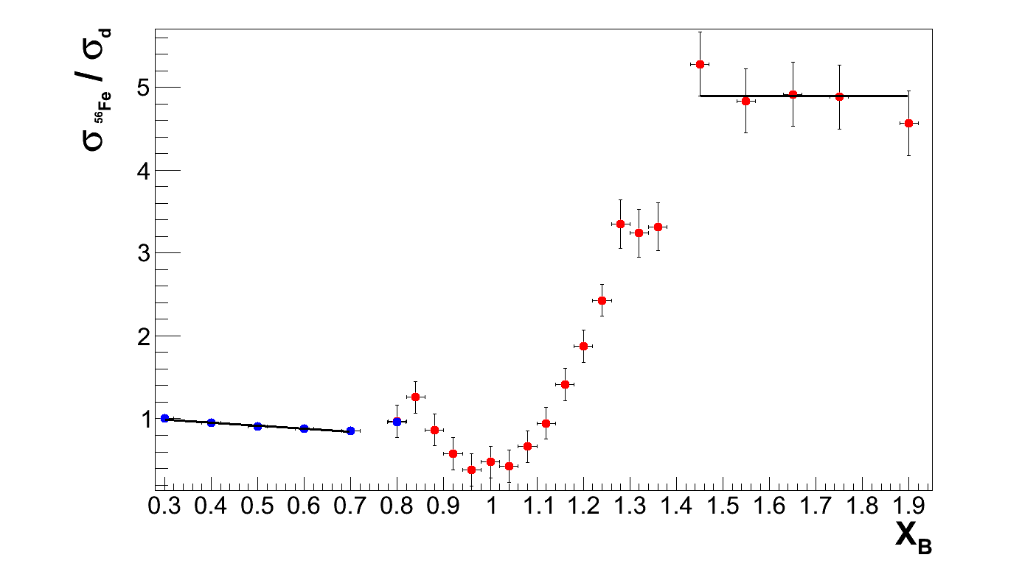
Holistic View of inclusive EMC & SRC Data
S. Malace, D. Gaskell, D.H., I. Cloet, Int. J. Mod. Phys. E 23 (2014) 1430013
Q² = 2.5 [GeV/c]²
SRC Plateau
Fermi Motion
EMC Slope
Scaling plateaus are likely due to proton-nucleon local density correlations
So could the EMC slopes (x_{B}<0.7) and SRC plateaus (x_{B}>1.5) correlated?!

Slide 17
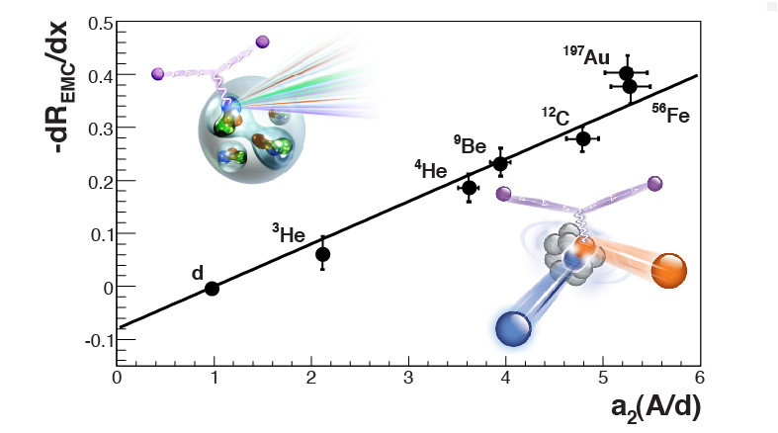
x>1 Ratios and EMC Slope Correlation
L. Weinstein, E. Piasetzky, DH, J. Gomez, O. Hen, and R. Shneor, Phys. Rev. Lett. 106 (2011) 052301.
L. Weinstein et al., Phys. Rev. Lett. 106 (2011) 052301.
Origin of the EMC effect? Not a smoking gun, but highly suggestive….

Slide 18
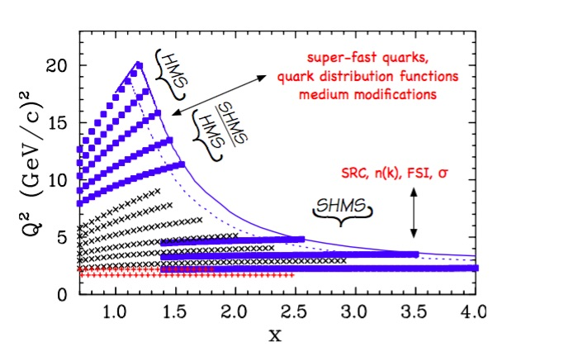
EMC, x>1 experiments to run in JLab Hall C this Fall!
3N plateau?
Also ³H, ³He (e,e’p) in Hall A
More!
Black = 6 GeV Hall C
Red = 6 GeV Hall B
Blue = 12 GeV Hall C!!
(push up in x, Q², range of A)

Slide 19
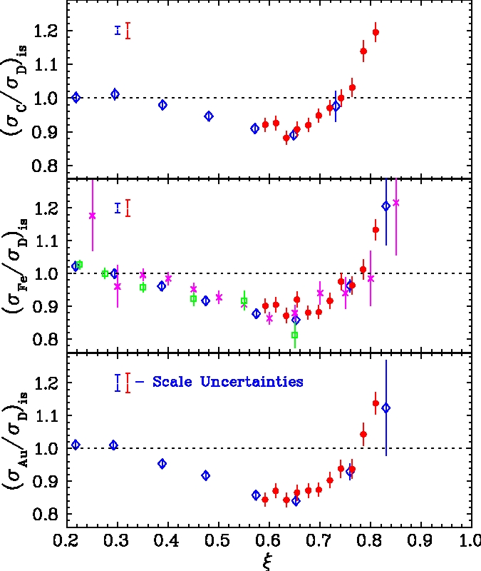
Duality and the EMC Effect (Neutrino friends take note!)
See S. Malace lectures for duality!
Red = resonance region data
Blue, purple, green = deep inelastic data from SLAC, EMC
Medium modifications to the structure functions are the same in the resonance region as in the DIS
Duality observed in nuclei
C/D
Fe/D
Au/D
J. Arrington, R. Ent, CK, J. Mammei, I. Niculescu, Phys.Rev. C73 (2006) 035205

Slide 20
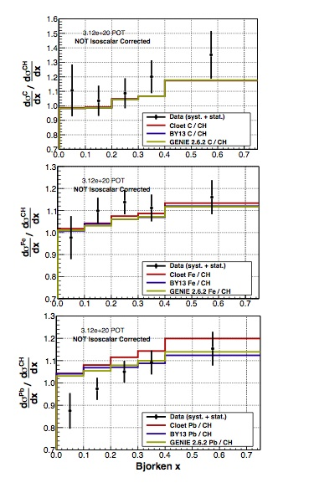
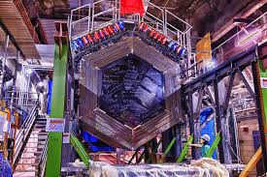
Experimental Studies of Nuclear Effects with Neutrinos: until recently essentially NON-EXISTENT
kT detector systems – nuclear effects can matter!
Data now coming from MINERvA experiment at Fermilab:
Neutrino-nucleus scattering
Cross section measurements possible
Nuclear ratios
Note A-dependence at lowest x-bin
A drop in x for Pb?
Data at low Q² (< 1 GeV²)
Not yet isoscalar corrected
More and higher energy data en route
J. Mousseau et al., PRL 112 231801 (2015)
20

Slide 21
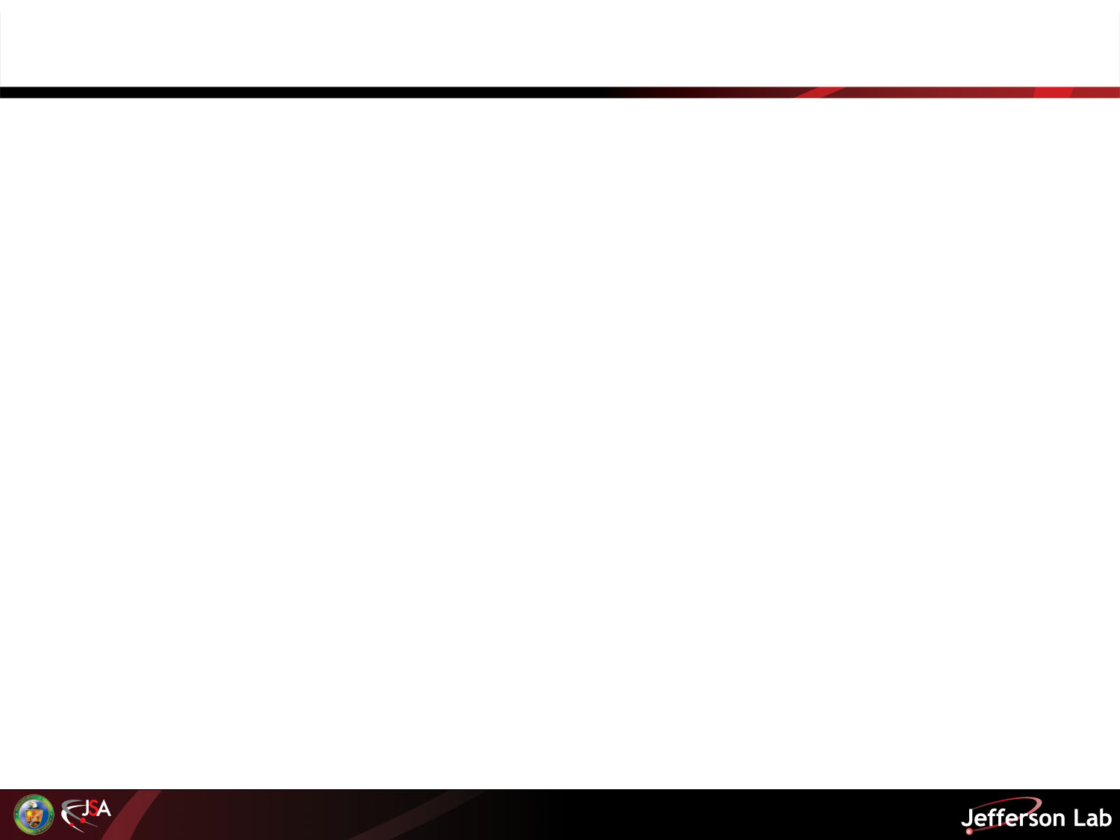
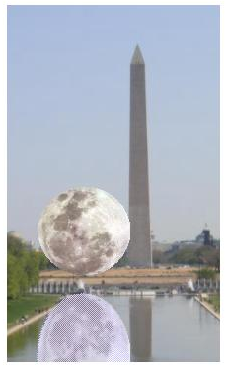
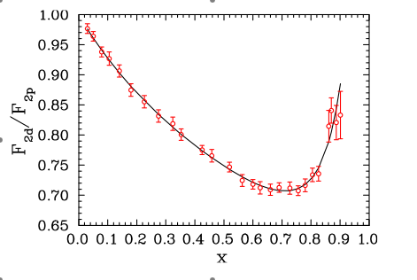
Important alert: the deuteron is also a nucleus!
Neutron structure is typically derived from deuterium target data by subtracting proton data
…..but…..
Large uncertainty in unfolding nuclear effects (Fermi motion, off-shell effects, deuteron wave function, coherent scattering, final state interactions, nucleon structure modification (“EMC”-effect),………..
F₂^{d}/F₂^{p}

Slide 22
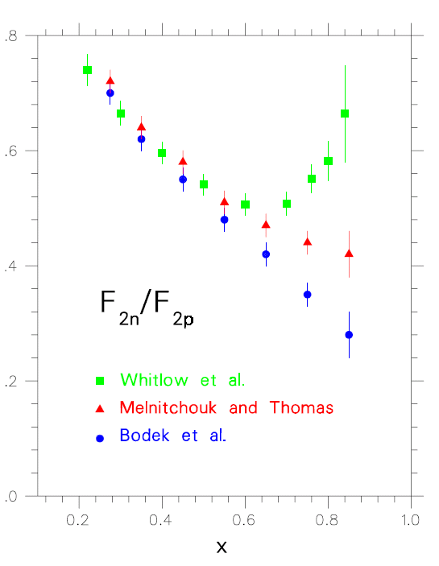
F₂^{n}/F₂^{p} (and, hence, d/u) is essentially unknown at large x:
- Conflicting fundamental theory pictures
- Data inconclusive due to uncertainties in deuterium nuclear corrections
SU(6) symmetry
pQCD
DSE: 0⁺ & 1⁺ qq
0⁺ qq only
Review Articles:
N. Isgur, PRD 59 (1999),
S Brodsky et al NP B441 (1995),
W. Melnitchouk and A. Thomas PL B377 (1996) 11,
R.J. Holt and C. D. Roberts, arXiv:1003.4666 [nucl-th],
Cloet et al, Few Body Syst. 46 (2009) 1.
Your textbook may be lying…

Slide 23
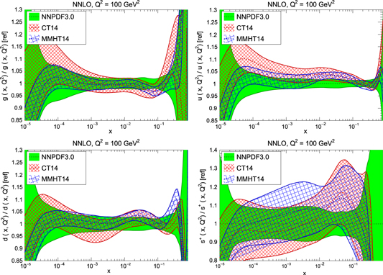
Large Uncertainties on Large x Valence pdfs
g(x)
u(x)
d(x)
s(x)

Slide 24
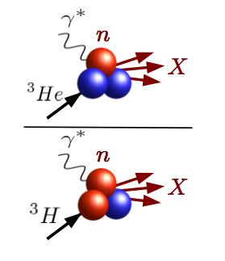

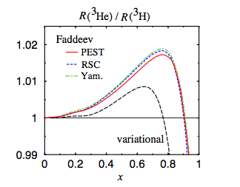
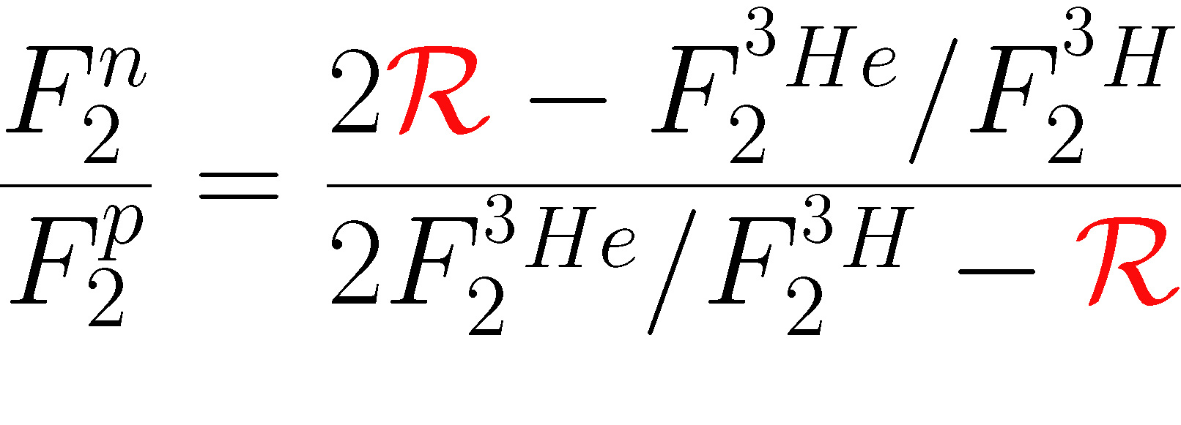
DIS from A=3 Mirror Nuclei (E12-10-103)
Mirror symmetry of A=3 nuclei
  Extract F₂^{n}/F₂^{p} from ratio of measured ³He/³H structure functions
R = SUPER ratio of ”EMC ratios” for ³He and ³H
- Relies only on difference in nuclear effects in ³H, ³He
- Calculated to within 1%
- Most systematic and theoretical uncertainties cancel

Slide 25
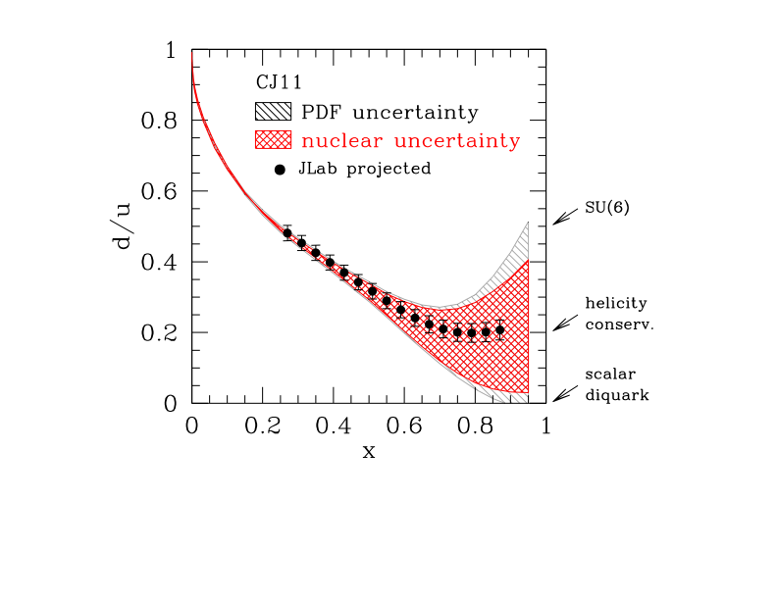
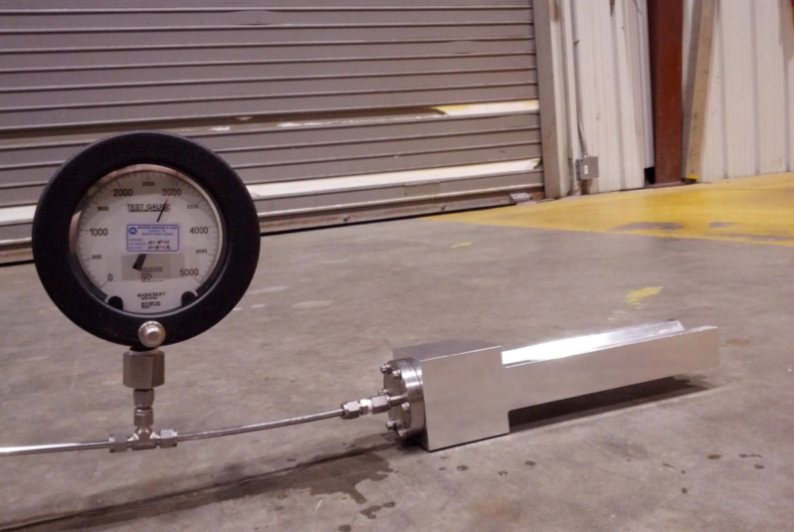
Tritium Experiment Group Preparations in Jlab Hall A
Four experiments approved
  2 PAC 40 “high impact”
Preparing for Fall 2017 run
Installation currently underway
  Target vent system
  Target and safety systems
  Scattering chamber rotation
  Target installation platform
6

Slide 26
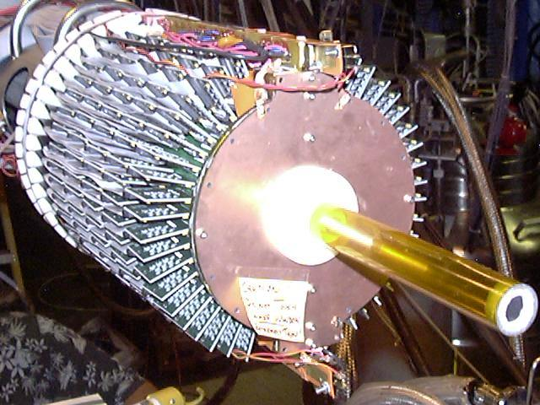
Other 12 GeV era experiments will also access d/u at large x…
Tagged deep inelastic scattering
Parity violating deep inelastic scattering
Polarized structure functions can provide d/u theory guidance
Nucleon Model | F₂^{n}/F₂^{p} | d/u | Δu/u | Δd/d | A₁^{n} | A₁^{p}
SU(6) | 2/3 | 1/2 | 2/3 | -1/3 | 0 | 5/9
Valence Quark | 1/4 | 0 | 1 | -1/3 | 1 | 1
pQCD | 3/7 | 1/5 | 1 | 1 | 1 | 1

Slide 27
Hmmm… nuclear medium modifications are interesting...
But, let’s check out polarized partons….

Slide 28
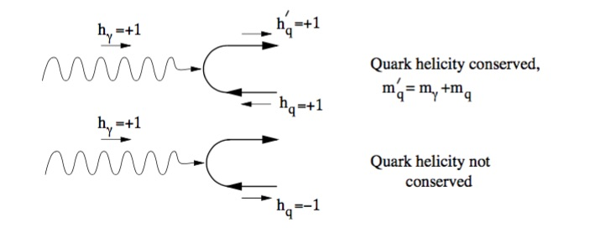
Polarized DIS
Consider the case when the beam electron and target nucleon are both polarized along the scattering axis….
Helicity conservation - the virtual γ inherits some of the incident lepton helicity
The electromagnetic interaction will conserve helicity. So…
A + (-) helicity quark can only absorb a + (-) helicity photon.
Study the difference under reversal of electron/photon helicity (or equivalently reversing the target spin)….
Determine the probability that the struck quark has the same helicity as the incident lepton for a fixed spin orientation of the proton.

Slide 29
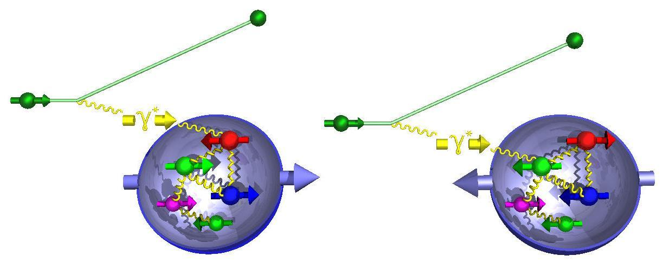
Polarized Structure Functions
Polarized
deep
inelastic
electron
scattering
Parallel electron & quark spins
Anti-parallel electron & quark spins
Measure yield asymmetry:
In the Quark-Parton Model:
Spin-dependent Structure Function
Notes:
QCD predicts the Q2 dependence of unpolarized and polarized structure functions measured in DIS.
.g1/F1 : In any given x bin, there is no experimental evidence of a strong Q2 dependence
The exchanged virtual photon inherits the helicity of the beam lepton, to a
degree that depends on the lepton kinematics. Due to conservation of helicities in hard
or short-distance interactions, only quarks with the opposite spin direction (i.e. same
helicity) as the spin-1 photon can absorb it in the leading-order process γ∗q → q (see
figure 2). Hence the ‘polarized virtual-photon beam’ selects quarks of one helicity

Slide 30
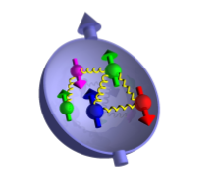
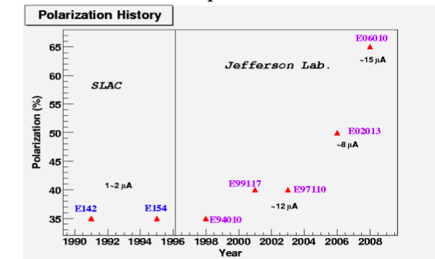
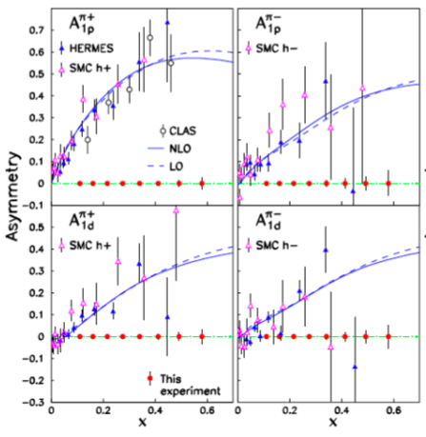
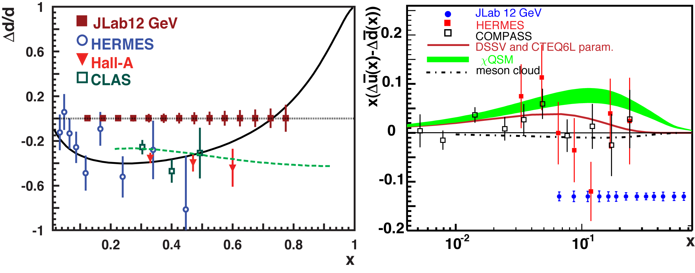
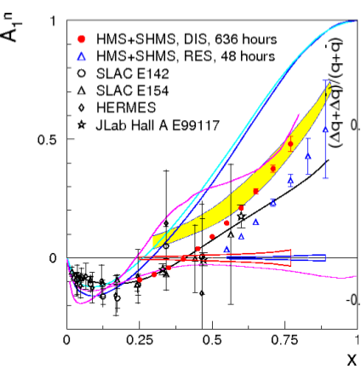
Measuring High-x Structure Functions - polarized
REQUIRES:
High beam, target polarization
High electron current
Large solid angle spectrometers
Polarized PDF efforts – JAM
Broad JLab12 program!
3He target

Slide 31
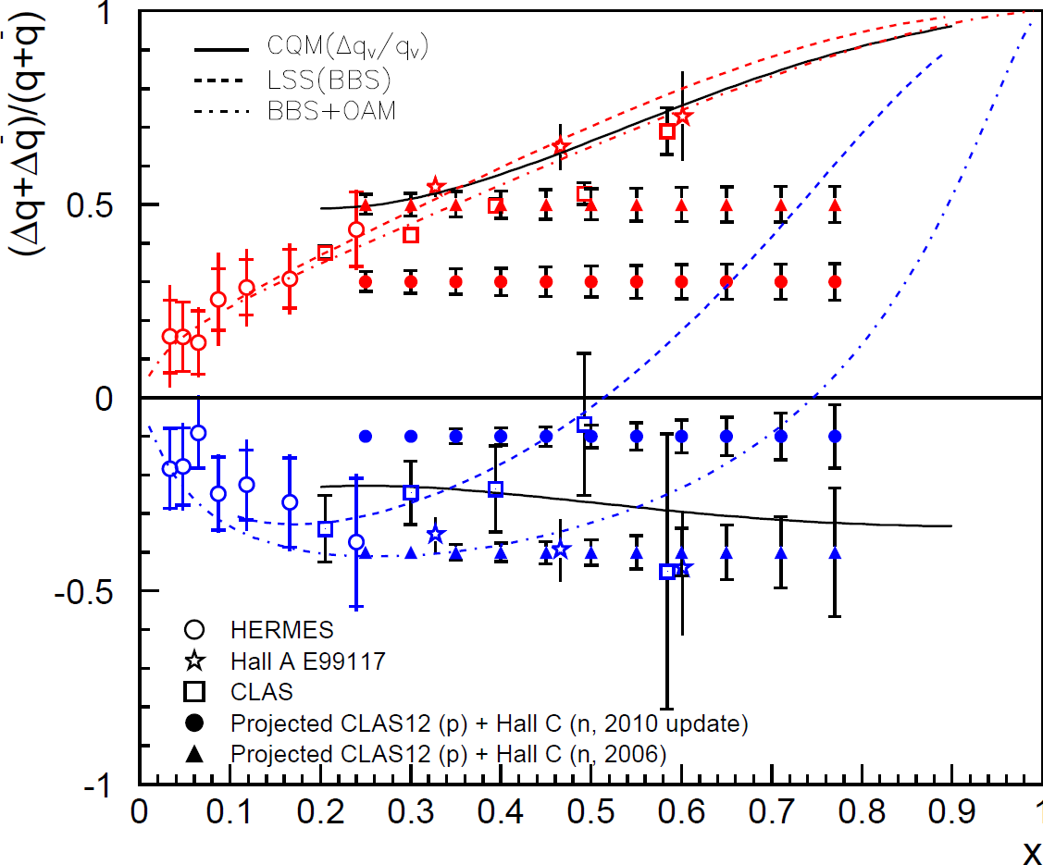
12 GeV Era Polarized PDFs
Combine Hall B A₁^{p} and Hall C A₁^{n} → extract Δu/u and Δd/d
12 GeV will access the regime (x > ~0.3) where valence quarks dominate
Δu/u
Δd/d

Slide 32
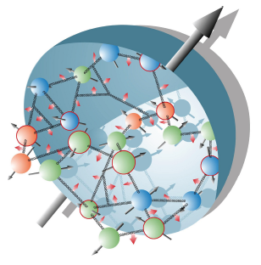
The Incomplete Nucleon: The Spin Puzzle
1
1
ΔΣ
+
L_{q}
+
J_{g}
=
2
2
Proton has spin-1/2
Proton is a composite system consisting of spin-1/2 quarks and spin-1 gluons
But…
Can this puzzle maybe be solved by orbital angular momentum?
ΔS ~ 0.25 (world DIS)
ΔG small ~ 0.1 (RHIC+DIS)
L_{q}??
Try a cross-product or something three-dimensional….
Classical: ~ r x p

Slide 33
I’ve got to move on, but there are a couple more things that deserve a last fast look…..

Slide 34
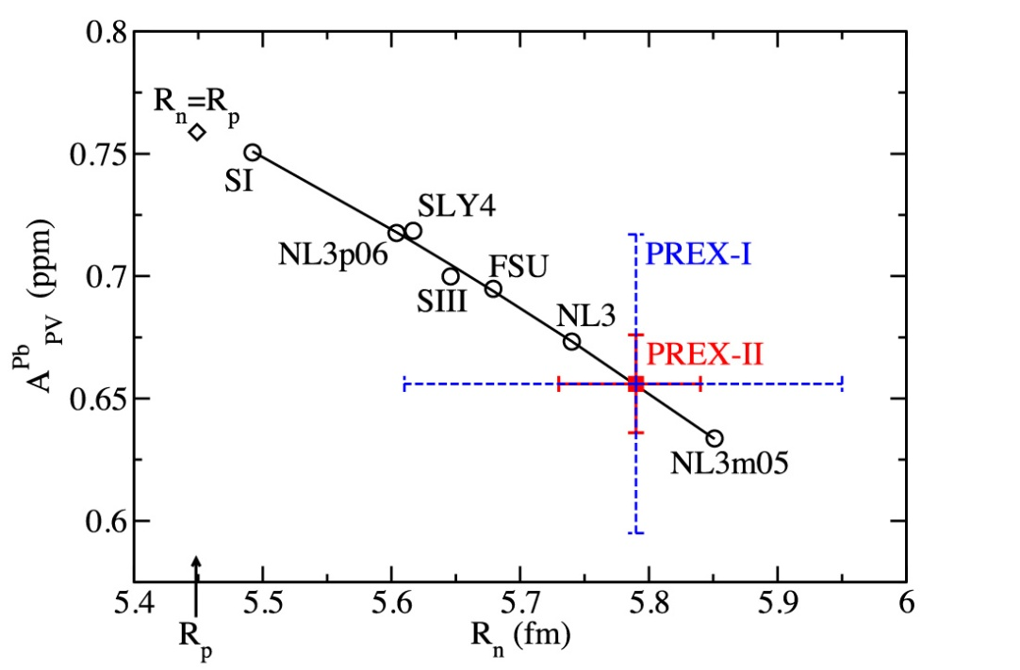

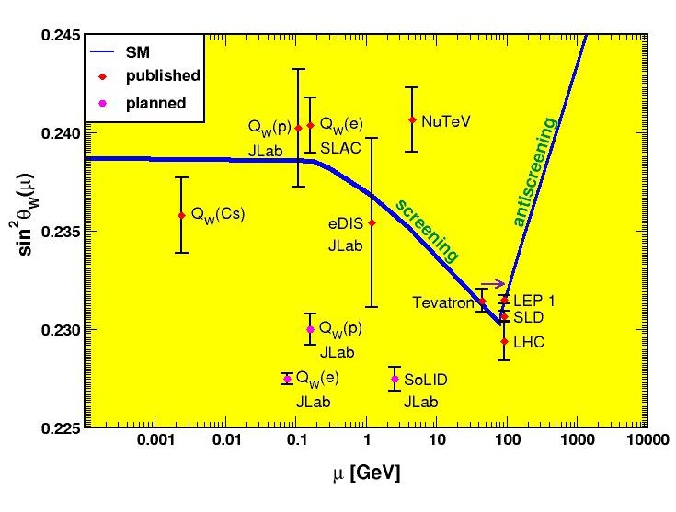
Parity Violation Program at JLab
Strangeness Form Factors (complete)
HAPPEX (Hall A)
G0 (Hall C)
PREX neutron skin
first PREX (²⁰⁸Pb) experiment completed
PREX-II and CREX (⁴⁸Ca) preparation ongoing
Qweak (to be released)
proton weak charge
lepto-quark couplings
MOLLER
electron weak charge
purely leptonic
BSM physics at 38 TeV scale!
SoLID
  lepto-quark couplings
  lepto-phobic Z’
  d/u, higher-twist
Luminosity, polarization

Slide 35
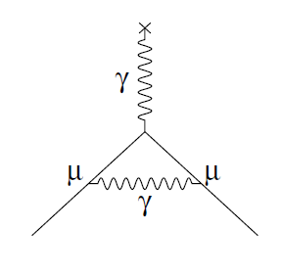
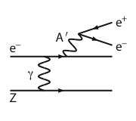
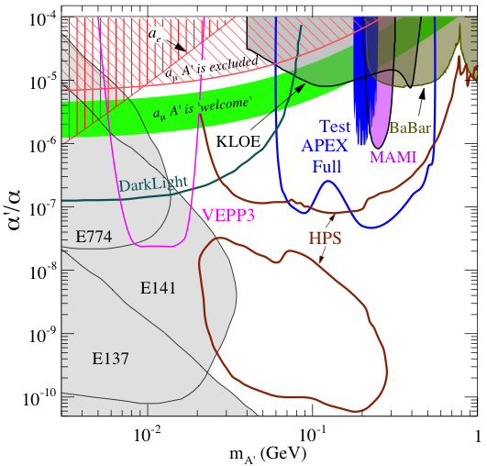
New Opportunity: Searches for A’ at Jefferson Lab
BNL “g-2” expt: Δa_{μ}(expt-thy) = (295±88) x 10⁻¹¹ (3.4 σ)
No evidence for SUSY at LHC (yet)
Another solution: A’, a massive neutral vector boson
- also useful for dark matter models
3 Jefferson Lab proposals:
g – 2 preferred!
APEX test run (Hall A) – published
HPS test run (Hall B) – complete
HPS engineering/1st physics run – complete
DarkLight test run (FEL) – complete

Slide 36
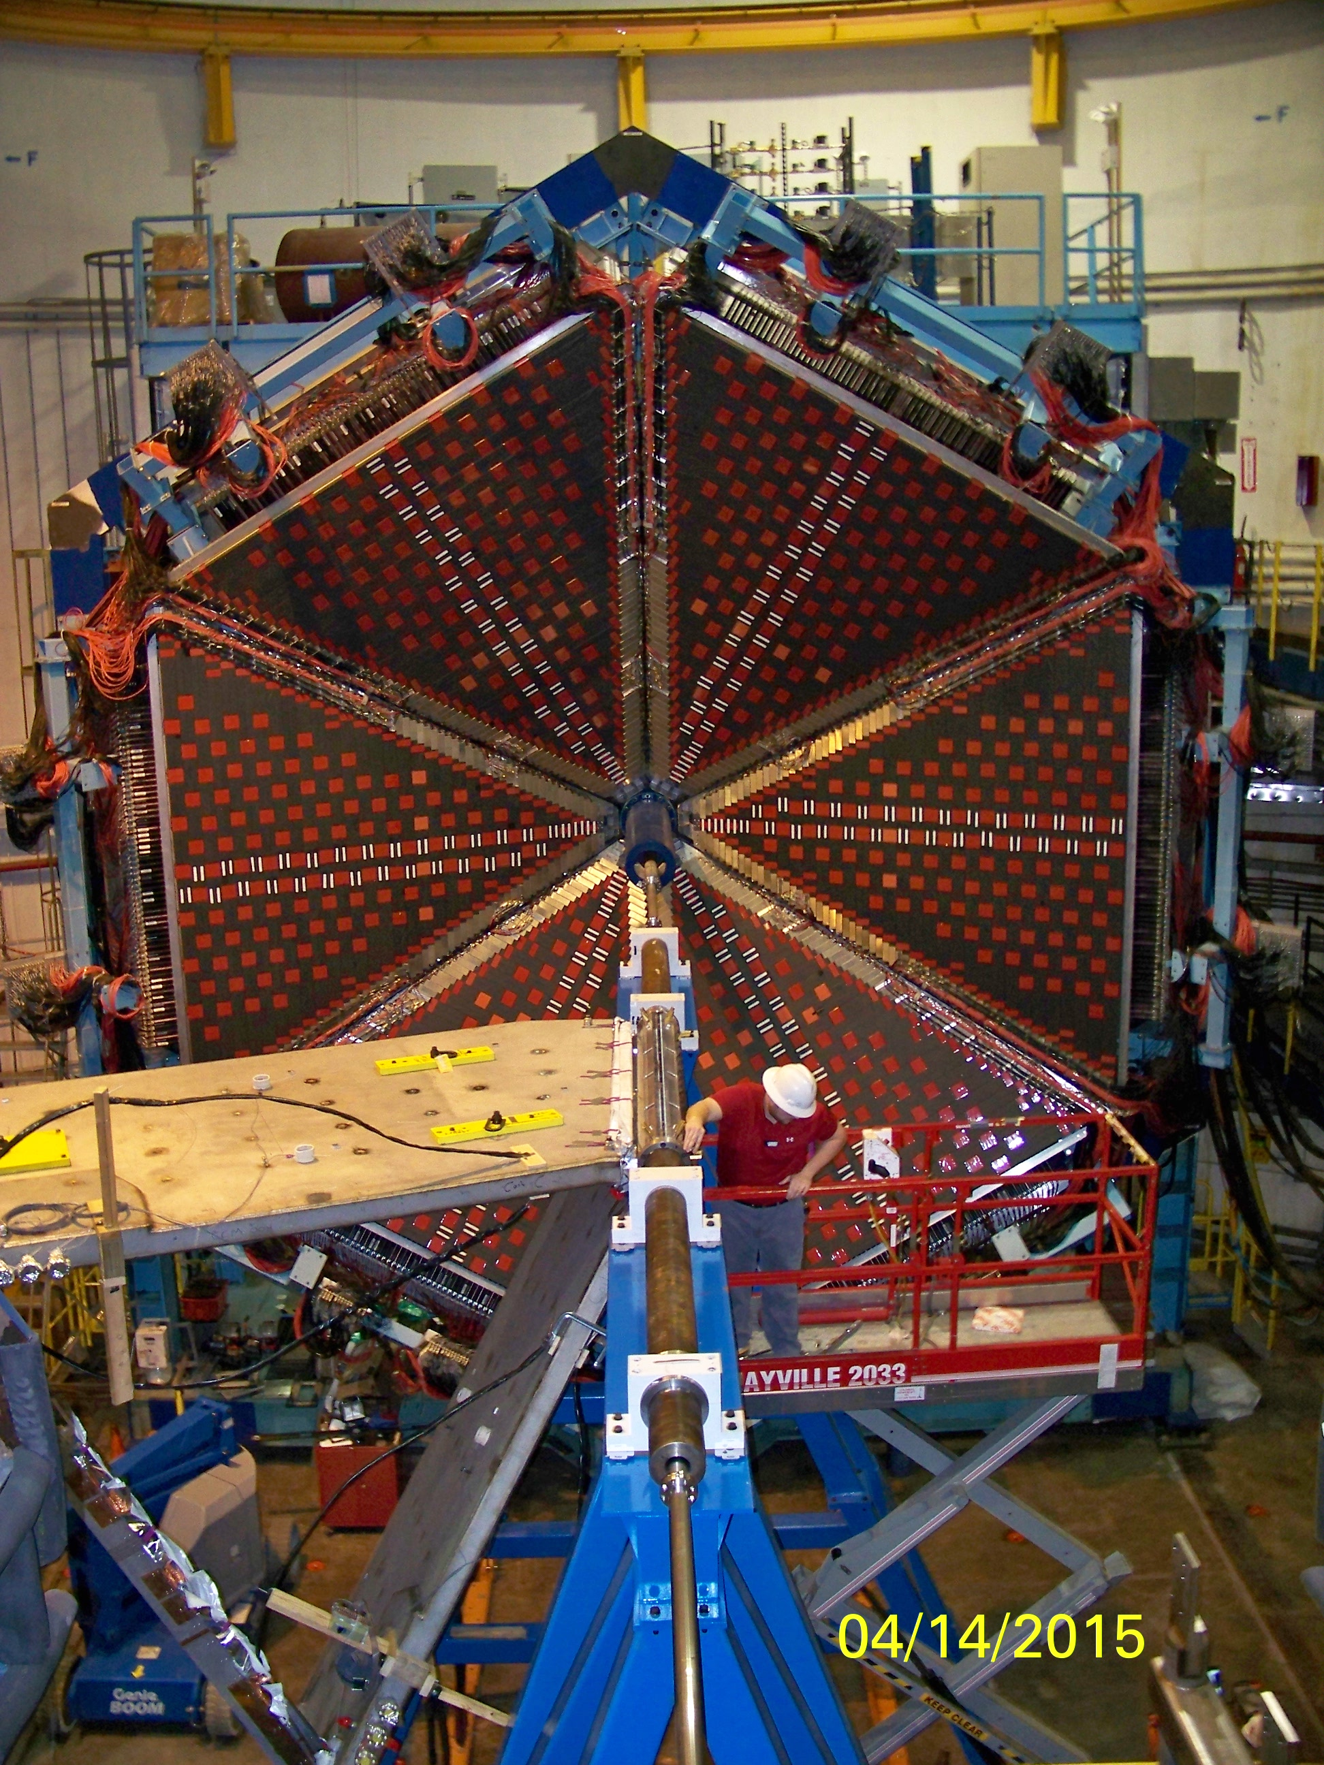






12 GeV JLab - Broad Scientific Capabilities
Hall B – understanding nucleon structure via generalized parton distributions
Hall C – precision determination of valence quark properties in nucleons/nuclei
Hall A – polarized 3He, future new experiments (e.g., SBS, MOLLER and SoLID)
Notes:
36
Note BSM not included in project

Slide 37
Orbital angular momentum….into the (not so distant) future….

Slide 38
What are we missing?
We discovered that (nearly) massless quarks and gluons make up the nucleon and that QCD governs their interactions.
We had hoped to find out how quarks and gluons and their interactions give rise to the characteristics of the nucleons.
  Spin
  Mass
  Bulk
We also hoped that we would be able to find out how NN interactions work in terms of QCD.
  How nuclear forces arise.
  How nuclear characteristics come about
We were able to do this kind of things with EM and atoms.
So far we have failed…

Slide 39

What longitudinal factorization did
Function only of x (i.e. longitudinal momentum)
Our quarks and gluons as constituents of the proton only exist longitudinally.

Slide 40


Limits of Longitudinal Information
infinite
momentum
frame
What we know
Parton frozen transversely.
Framework does not incorporate any transverse
information.
But this was the only way to define quark-gluon structure
of proton in pQCD.
What is the quark and gluon structure of the proton?
-orbital motion?
-color charge distribution?
-how does the mass come about?
-origin of nucleon-nucleon interaction?

Slide 41

Progress in pQCD Theory (~1980-~2010)
Factorization II
(Q²)
Parton Distribution Functions:
Longitudinal only—
No way to interpret nucleon
partonic structure in rest frame
3D (Transverse) Structure
TMD’s, GPD’s—
Now we know what to measure to
understand the 3D structure of nucleons
Transverse Momentum Dependent Distributions (TMD): k_{t}
Generalized Parton Distributions (GPD): b_{t}

Slide 42

New Paradigm for Nucleon Structure
5D
TMDs
– Confined motion in a nucleon
(semi-inclusive DIS)
GPDs
– Spatial imaging
(exclusive DIS)
Requires
− High luminosity
− Polarized beams and targets
3D

Slide 43
3D Imaging of Quarks and Gluons
W(x,b_{T},k_{T})
Momentum
space
Coordinate
space
∫d²b_{T}
∫ d²k_{T}
f(x,k_{T})
f(x,b_{T})
Quarks
Gluons
Spin-dependent 3D momentum space
images from semi-inclusive scattering
Spin-dependent 2D (transverse spatial) + 1D (longitudinal momentum) coordinate space images from exclusive scattering
Notes:
43

Slide 44



SIDIS Observables Reveal Interesting Behavior of Quarks
Huang, et. al. PRL. 108, 052001 (2012)
Target:
transversely
polarized ³He ~ polarized neutron
A non-vanishing quark “transversal helicity” distribution, reveals alignment of quark spin transverse to neutron spin direction
Indicative of quark orbital motion
Foundation for future mapping in four kinematic dimensions (x, Q², z, p_{T}) of transverse-momentum dependent parton distributions
JLab measurements of ³He (neutron) single-spin asymmetries
X. Qian et al., PRL 107, 072003 (2011)
Notes:
Semi-inclusive deep inelastic scattering on a transversely polarized neutron (3He) target.
Curves from theory models:
WW-type: Wandzura-Wilczek, neglects higher-twist contributions, Kotzinian (2006).
LCCQM: light-cone constituent quark model, Boffi (2009), Pasquini (2008).
LCQDM: light-cone quark-diquark model, Zhu and Ma (2011).

Slide 45


Transverse SSA in Proton-Proton Reactions
p
p
p
In collinear picture, the QCD predict small SSAs with transversely polarized protons colliding at high energies
Klem et al. (1976)
Allgower et al. (2002)
Adams et al. (1991)
Arsene et al. (2008)
C. Aidala et al., Rev. Mod. Phys. 85, 655
Notes:
Following that result, there were several measurements done at later years with high precision
These results are from pp→ h+X when one of the proton is transverely polarized wrt to beam direction
Very large SSA AN from different measurements.
In collinear picture it was QCD predicts a small AN prop to quark mass, but the measurements show large AN
This discrepancy led to the whole field of tranverse spin and TMDs in nucleon

Slide 46





Much Data = Parton Distributions Functions
Example of global data set used to extract nucleon’s unpolarized, 1D PDFs (The NNPDFs Collaboration)
charged lepton DIS: CERN, SLAC, JLab
Drell-Yan: Fermi Lab
Will need to be true as well for ”3D” PDFs!
fixed target
ν
μ
neutrino DIS
collider
charged lepton DIS, high energy: HERA
ν
W⁻
Fermi Lab Tevatron

Slide 47
12 GeV JLab - Broad Scientific Capabilities
Hall B – understanding nucleon structure via generalized parton distributions
Hall C – precision determination of valence quark properties in nucleons/nuclei
SIDIS/DES cross-section factorization tests
TMDs and GPDs comprehensive study
Hall A – polarized 3He, future new experiments (e.g., SBS, MOLLER and SoLID)
Ultimate TMD statistical precision in valence region
Notes:
47
Note BSM not included in project

Slide 48
The Next Leap Forward: EIC

Slide 49
Experimental Challenge of the EIC
Q²=sxy, s=4E_{e}E_{p}
(Q²)
On one hand: need high beam energies
to resolve partons in nucleons.
Q² needs to be up to ~1000 GeV²
On the other: need to resolve
quantities (k_{t}, b_{t}) of order a few
hundred MeV in the proton. Limits
proton beam energy. High Lumi needed.
Electron-Ion Collider: Cannot be HERA or LHeC: proton energy (TeV) too high

Slide 50


Understanding the Nucleon at the Next Level
Nucleon: A many-body system with challenging characteristics
Relativistic (M_{proton} >> M_{quark})
Strongly Coupled (QCD)
Quantum Mechanical (Superposition of configurations)
Measure in the Multi-Body regime:
- Region of quantum fluctuation + non-perturbative
effects → dynamical origin of mass, spin.
For the first time, get (almost?) all relevant
information about quark-gluon structure of the nucleon
Designing EIC → Designing the right probe
Resolution appropriate for quarks and gluons
Ability to project out relevant Q.M. configurations

Slide 51




Parameters of the Probe
Q²
x
Ability to change x projects out
different configurations where
different dynamics dominate
Probe
Ability to change Q² changes the resolution scale
Q²= 400 GeV² => 1/Q = .01 fm

Slide 52



Where EIC Needs to be in x (Nucleon)
Saturation
Regime:
Needs to be
Accessed via Ions
(see later)
Collective
Regime
Many-body
Regime
Few-body
Regime
10⁻⁴
10⁻³
10⁻²
10⁻¹
1
X (for proton)
QCD Radiation Dominated
(Studied at HERA)
Hadron Structure Dominated
Main interest for EIC Nucleon/Nuclear Program
Spin,TMD, GPD…

Slide 53
Where EIC needs to be in Q²
X > 10⁻³,10⁻² to 1
Non-perturbative
Regime
Perturbative
Regime
Transition
Region
HERMES, COMPASS, JLAB 6 and 12
EIC
HERA high-x
Q²
10⁻¹
1
10
10²
10³
[GeV²]
Include non-perturbative, perturbative and transition regimes
Provide long evolution length and up to Q² of ~1000 GeV² (~.005 fm)
Overlap with existing measurements
Disentangle Pert./Non-pert., Leading Twist/Higher Twist

Slide 54

Measuring k_{t} and b_{t}
60-100 GeV
Q² up to 1000 GeV²
Ion beamline
5-10 GeV
Electron beamline
P_{t} wrt beam
P_{t}/P_{beam} < 10⁻³
~100 MeV
~100 MeV
P_{t} wrt scattering plane.
+ particle ID

Slide 55

Parameters of the Probe (Nuclei)
Q²
x
X > 0.1
Nuclear modification of nucleon. (“EMC effect”)
Probe
X ≈ 0.05
Probing the
nucleon interaction in the nuclei
(note this is different from correlation measurements)
Nucleon-Nucleon Interaction
1/Q
X ≈< 0.005
Multi-nucleon interaction
(“shadowing” eventually saturation)
Note: the x range for nuclear exploration is similar to the nucleon exploration

Slide 56


QCD at Extremes: Parton Saturation
HERA discovered a dramatic rise in the number
of gluons carrying a small fractional longitudinal
momentum of the proton (i.e. small-x).
This cannot go on forever as
x becomes smaller and smaller:
parton recombination must
balance parton splitting.
i.e. Saturation—unobserved at
HERA for a proton. (expected
at extreme low x)
In nuclei, the interaction probability enhanced by A^{⅓}
Will nuclei saturate faster as color leaks out of nucleons?

Slide 57

Luminosity/Polarization Needed
HERA
Central mission of EIC (nuclear and nucleon structure) requires high
luminosity and polarization (>70%).

Slide 58

Past, Existing and proposed DIS Facilities
EIC will be a unique facility.
No other machine, existing or planned, can address the physics of interest satisfactorily.
Studies underway
EIC Physics
range
1991-2007

Slide 59



EIC Parameters
US EIC Machine design aims from the EIC Whitepaper
  Highly polarized (~70%) electron and nucleon beams.
  Ion beams from deuterons to the heaviest nuclei (uranium or lead).
  Variable center of mass energies from ~20 - ~ 100 GeV, upgradable to ~140 GeV.
  High luminosity: ~10 ³³⁻³⁴ cm⁻² s⁻¹
  Possibility of having more than one interaction region.
Two proposed realization plans
  Jefferson Lab: building on the existing 12 GeV CEBAF. JLEIC Design.
  BNL: building on the existing RHIC. eRHIC Design.
  Recent review of acc. R&D
Similar performances, cost
US EIC will likely be down-selected from one of these proposals.
CD0 2018?
Jefferson Lab
Brookhaven Lab

Slide 60



US-Based EIC Proposals
Brookhaven Lab
Long Island, NY
JLEIC
Jefferson Lab
Newport News, VA
Notes:
60

Slide 61
Comparison JLEIC and eRHIC (Jan. 2017)
JLEIC 12T
JLEIC 3T
10³⁴
eRHIC Ultimate*
Luminosity [cm⁻²s⁻¹]
10³³
eRHIC low-risk*
(linac-ring)
eRHIC low-risk*
(ring-ring)
50
100
150
√s [GeV]
*eRHIC parameters taken from F. Willike slides (F. Pilat talk) from EIC opportunities meeting for INFN, Genova (17 January, 2017)
JLEIC parameters can be found at eic.jlab.org/wiki (January, 2017 update)

Slide 62


Worldwide Interest in EIC Physics
The EIC Users Group: EICUG.ORG
(no students included as of yet)
692 collaborators, 29 countries, 157 institutions... (June 7, 2017)
Map of institution’s locations

Slide 63






















EIC: A Portal to a New Frontier
Dynamical System | Fundamental Knowns | Unknowns | Breakthrough Structure Probes (Date) | New Sciences, New Frontiers
Solids
Electromagnetism
Atoms
Structure
X-ray Diffraction
(~1920)
Solid state physics
Molecular biology
1801
DNA
Universe
General Relativity
Standard Model
Quantum Gravity,
Dark matter, Dark
energy. Structure
Large Scale Surveys
CMB Probes
(~2000)
Precision
Observational
Cosmology
CMB 1965
Nuclei
and Nucleons
Perturbative QCD
Quarks and Gluons
Non-perturbative QCD
Stucture
Electron-Ion Collider
(2030)
Structural QCD
Nuclear Physics
2017

Slide 64
Questions?....

Slide 65
Backups!

Slide 66





Neutron Structure Function provides access to d(x) PDF
sea quark dominance F₂^{n}/F₂^{p} −> 1
Parton model:
u quark dominance,
d/u −> 0
F₂^{n}/F₂^{p} −> 1/4

Slide 67


Plan to run in first 1-2 years of Hall B CLAS12
E12-06-113 “BONUS12”
CLAS12
Central
Detector
Data taking of 35 days on D₂ and 5 days on H₂ with L = 2 · 10 ³⁴ cm⁻² sec⁻¹
Planned BoNuS detector DAQ and trigger upgrade
DIS region with
  Q ² > 1 GeV ²/c ²
  W *> 2 GeV
  p_{s} < 100 MeV/c
  θ_{pq} > 110°
Largest value for x* = 0.80 (bin centered x* = 0.76)
Relaxed cut of W *> 1.8 GeV
gives max. x* = 0.83
high
impact
Notes:
67

Slide 68


The technique works!
angle - momentum dependence
78 MeV/c
93 MeV/c
110 MeV/c
135 MeV/c
cosθ_{pq}
cosθ_{pq}

Slide 69


Slide 70


Slide 71
Flavor Disparity in the Nucleon
CJRW (u/d with new GEn data)
Phys. Rev. Lett. 106 (2011)
Qattan, Arrington (2-γ effects)
Phys.Rev. C86 (2012) 065210
M.Diehl and P.Kroll (GPDs)
Eur.Phys.J. C73 (2013) 2397
Using the D&K table of F^{u}, F^{d}
The down quark contribution
to the F₁ proton form factor is
strongly suppressed at high Q²
When the virtual photon of 3 GeV² interacts with the down quark
the proton more likely falls apart than in the case of the up quark
Notes:
The Q2 dependences of flavor contributions are of main interest. First, at low Q2 these are similar but about 1 GeV2
F1 for d quark is strongly deviates from u quark contribution Why the singly represented quark contributes less?
Some substructure exists which made an exclusive reaction with a leading down quark less likely than up quark at high Q2
One can recollect a reduction of the down quark pdf at high x. The GPDs offering a ready interpretation but the dynamic may
Includes substructure of scalar and axial di-quarks.

Slide 72


Implications for Collider Experiments
Uncertainty induced by nuclear corrections extends to rather small scales √s, and grows quickly above 5-10% as √s exceeds 1 TeV.
ﬁxed rapidity y = 1, 2, 3
Larger rapidity = more sensitive to large-x region for a given mass. For example, nuclear uncertainty becomes relevant at rapidity larger than 2 for W production at the Tevatron.
τ = Q²/S
The gg, gd, du luminosities impact the main channel(s) for Higgs production, jet production, “standard candle” cross section for W⁻ production, respectively.

Slide 73

Nucleon Structure: the 3D World
Generalized Parton Distributions: form factors of only those quarks in the nucleon carrying a certain fixed momentum fraction x
$$P=\frac{p+p^{′}}{2}$$
Deeply Virtual Compton Scattering (DVCS):
→ GPDs -- amplitude for “kicking out” a parton of the fast moving nucleon by the virtual photon and “putting it back” with a different momentum after radiating a real photon
$$Δ=p−p^{′}$$
$$x=\frac{k^{+}}{P^{+}}$$
$$ξ=−\frac{Δ^{+}}{2P^{+}}$$
→ 4 GPDs defined through matrix elements of quark and gluon operators:
$$H\left(x,ξ,t\right)$$
$$E\left(x,ξ,t\right)$$
$$\tilde{H}\left(x,ξ,t\right)$$
$$\tilde{E}\left(x,ξ,t\right)$$
$$=\int{dx H\left(x,ξ,t\right)}$$
$$=\int{dx E\left(x,ξ,t\right)}$$
→ Pauli, Dirac form factors lowest x-moments of H and E:
$$F_{1}^{}$$
$$F_{2}^{}$$
→ In the limit of p = p’ H become the usual PDF:
$$Hq\left(x,ξ=0,t=0\right)=q\left(x\right)=\frac{1}{2}\left(q↑\left(x\right)+q↓\left(x\right)\right)$$
$$\tilde{Hq}\left(x,ξ=0,t=0\right)=Δq\left(x\right)=\frac{1}{2}\left(q↑\left(x\right)−q↓\left(x\right)\right)$$

Slide 74


TMDs Accessible through Semi-Inclusive Physics
Separate Sivers and Collins effects
Sivers angle, effect in distribution function: (φ_{h}-φ_{s})
Or other combinations: Pretzelosity: (3φ_{h}-φ_{s})
Collins angle, effect in fragmentation function: (φ_{h}+φ_{s})
Naturally, two scales:
High Q: localized probe
to “see” quarks and gluons
Low P_{T}: sensitive to confining scale
to “see” their confined motion
+ Theory input: TMD QCD factorization
TMD QCD evolution
target angle
hadron angle
Scattering Plane

Slide 75
Collinear Parton Distribution Functions
In DIS nucleon structure is described
by three collinear PDFs:
Proton
collinear parton momentum
Momentum distribution – q(x, Q²)
Helicity distribution - Δq(x, Q²)
Transversity distribution - h(x, Q²)
P
proton momentum
k_{T}
The helicity dependent parton distributions
(“spin-dependent PDFs”) describe the number
density of partons with given longitudinal
momentum x and given polarization in a hadron
polarized longitudinally with respect to its motion.
The transverse momentum distributions (“TMDs”) describe the number density of
partons with given transverse momentum x in a hadron. We’ll come back to this….
xP
u-quark
d-quark
s-quark
Notes:
In general, in DIS one can think of proton as moving with infinite momentum.
All the partons have both collinear and transverse momentum
Usually, the transverse motion is integrated over , resulting in three collinear PDFs
Momentum
Helicity
Transversity
But there are non-trivial spin-kT correlations that cannot be ignored.

Slide 76










Features of 3D Distributions/TMDs
σ
f
Ex. TMD PDF for a given combination of parton and nucleon spins
quark polarization
U
L
T
transverse position and momentum of partons are correlated with the spin orientations of the parent hadron and the spin of the parton itself
transverse position and momentum of partons depend on their flavor
transverse position and momentum of partons are correlated with their longitudinal momentum
spin and momentum of struck quarks are correlated with remnant
quark-gluon interaction play a crucial role in kinematical distributions of final state hadrons, both in semi-inclusive and exclusive processes
T
U
f₁
h₁
Boer-Mulders
nucleon polarization
L
g_{1L}
T
h_{1L}
helicity
worm-gear
T
,
T
T
f_{1T}
g_{1T}
h₁
h_{1T}
Sivers
worm-gear
transversity
pretzelosity

Slide 77

Polarized Parton Distributions
From hyperon decays
Measurement of Γ₁^{p}, Γ₁^{n}
Constraint based on neutron and hyperon beta decay lifetimes
Assumption of SU(3) flavor symmetry
Global fit with DGLAP Q² evolution
arX:1209.2803
Only small fraction of the proton spin is carried by the quarks & antiquarks!!
Notes:
arXiv:0812.2208
½ (1-Sigma) = substantial!!

Slide 78







Gluon Helicity
STAR@BNL
Indication of small, but non-0 Δg from RHIC data, in particular STAR jet results
Notes:
individual π0 carries only a fraction of the scattered parton momentum (how the fraction is defined?)
<Δg/g =-0.06+/- 0.21+/ 0.08 (LO, <x>=0.11)
=-0.13+/-0.15+/-0.15 (NLO, <x>=0.2)

