Slide 1
DIS Lectures at CTEQ 2017 Summer School- Lecture 1
Simona Malace
Jefferson Lab

Slide 2
Overview
The Universe as an infinite source of puzzles
The world is large –
It contains multitudes.
I look with all-embracing eyes
And I tell you what I see.
Do I contradict myself?
Very well, I contradict myself.
If you are not bedazzled yet:
Look differently, and marvel.
Walt Whitman
The normal matter puzzle: from atoms to protons to quarks and gluons a wild ride that continues
“The basic building blocks of Nature are few and profoundly simple, their properties fully specified by equations of high symmetry.
The world of objects is vast, infinitely various, and inexhaustible.”
A Beautiful Question – Frank Wilczek
The strongly interacting normal matter puzzle: probing nucleons to understand the strong interactions

Slide 3
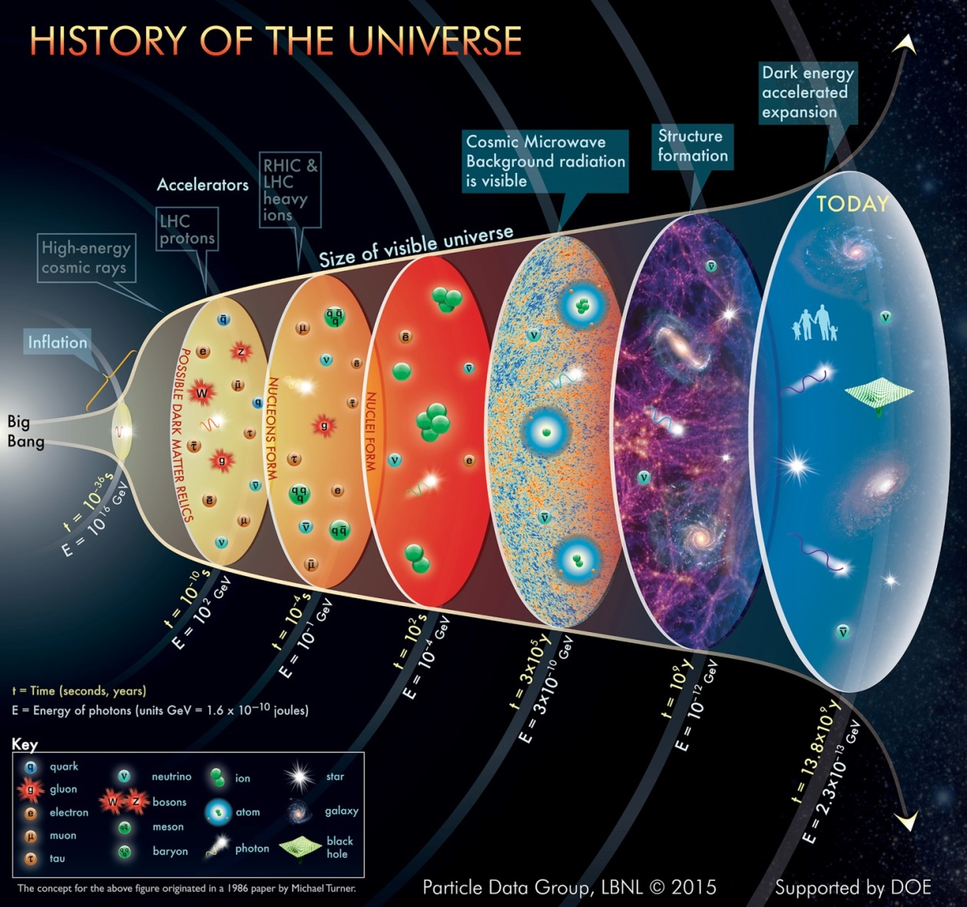
The Universe: Infinite Source of Puzzle
Big Bang Model with Inflation
Hadronic physics was born ~13.8 billion years ago
elementary particles
hadrons
nuclei
atoms

Slide 4
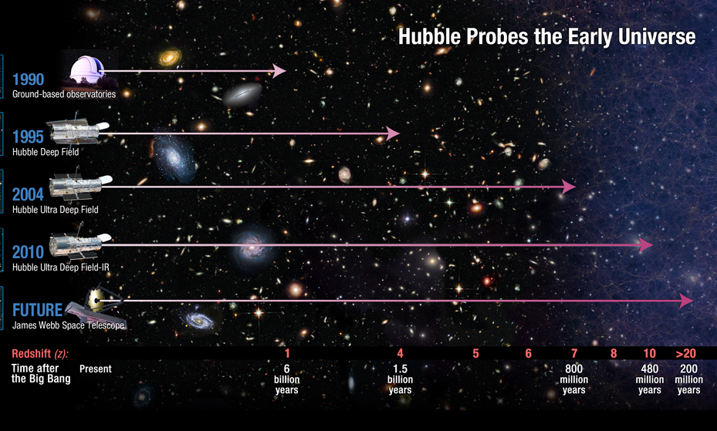
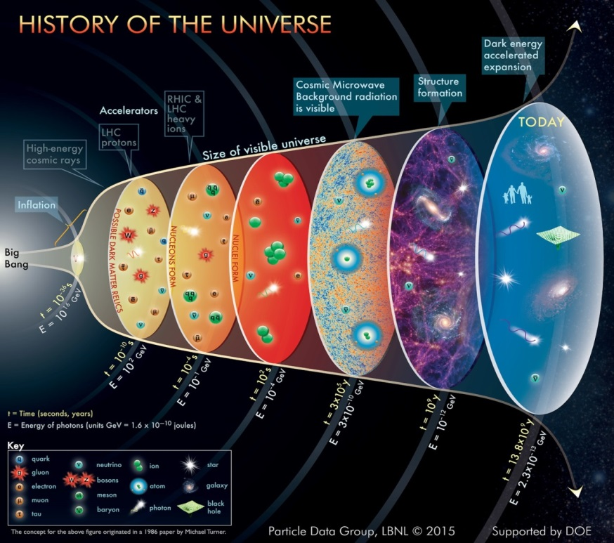
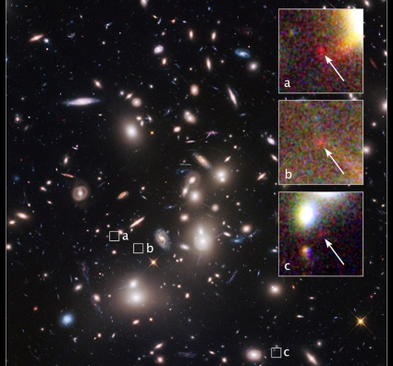
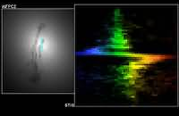
What Do We Do to Figure Out the Universe Puzzle?
Micro-cosm and Macro-cosm: with Space Telescopes (example)
Example:
Light: UV, near UV, Visible, near-IR, IR
James Webb Telescope (future)
Instruments: cameras, spectrographs, spectrometers
Hubble legacy
Hubble legacy
Black Hole’s Signature (1997)
Galaxy as it was 500 million years after Big Bang (2014)
With Hubble we go back in time ~13.3 billion years

Slide 5
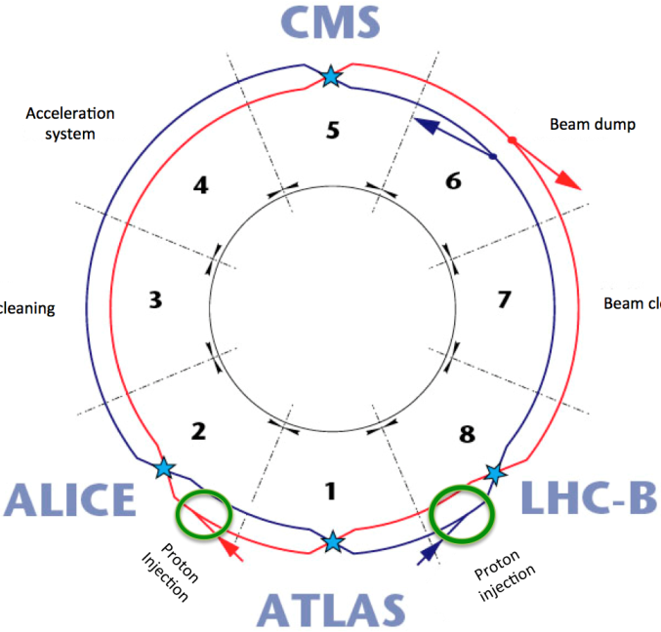
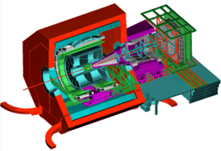
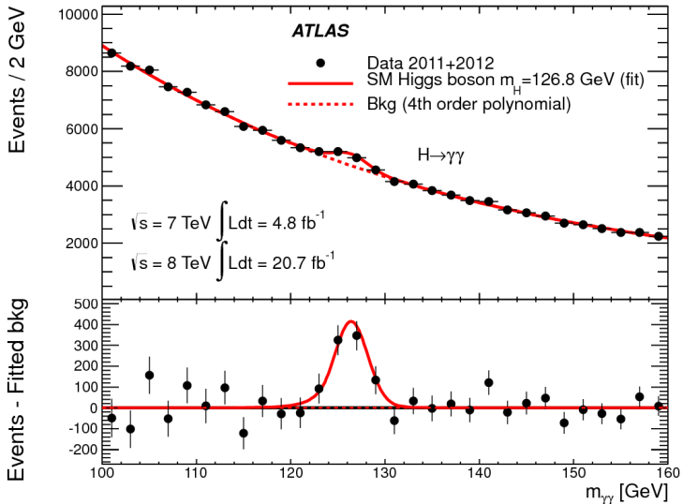
What Do We Do to Figure Out the Universe Puzzle?
Macro-cosm and Micro-cosm: with accelerators – colliders
Example
Large Hadron Collider
→ Study physics laws that governed the first moments after the Big Bang, ~10⁻¹⁶ s
to elucidate questions pertaining to:
ALICE
Origin of mass
Nature of dark matter
Primordial plasma
Matter vs antimatter
…
H → γγ

Slide 6
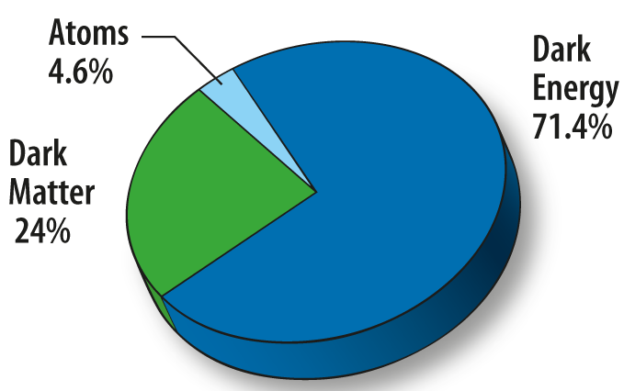
The Universe Today
Today we live in an expanding, cold Universe – 2.73 K (10⁻¹³ GeV typical energy) – populated by normal matter, dark matter and dark energy
matter

Slide 7
The Universe Today
Today we live in an expanding, cold Universe – 2.73 K (10⁻¹³ GeV typical energy) – populated by normal matter, dark matter and dark energy
matter
She, you and I are made of normal matter
The normal matter puzzle is not solved yet!

Slide 8
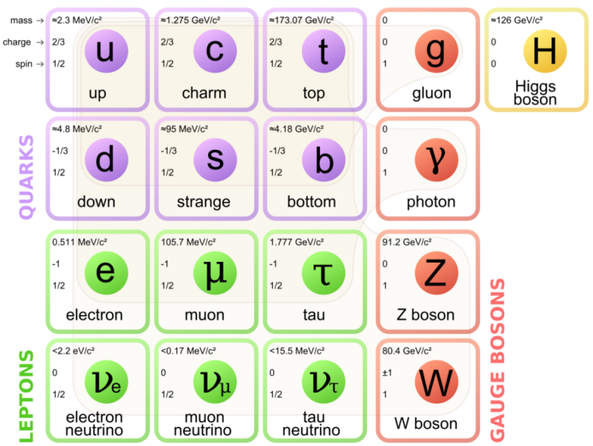
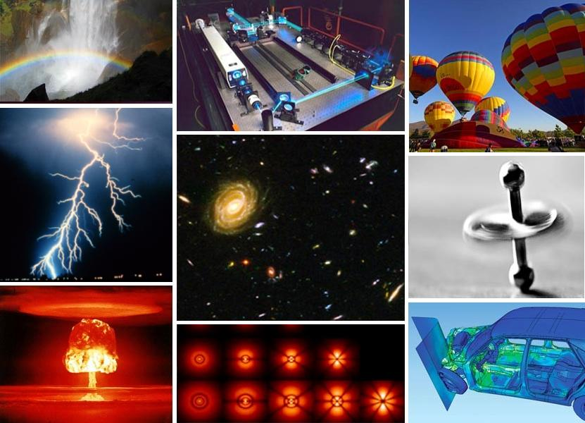
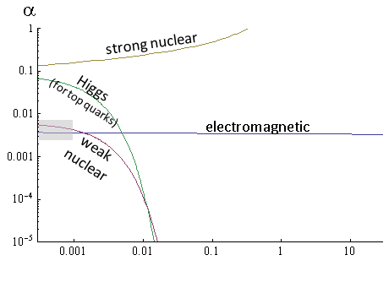
The Normal Matter Puzzle
How do we get from
here: Standard Model here?
to
This is a quest across fields of physics, chemistry, biology…
relative strength of forces acting on a top quark and top anti-quark
distance relative to proton’s radius

Slide 9
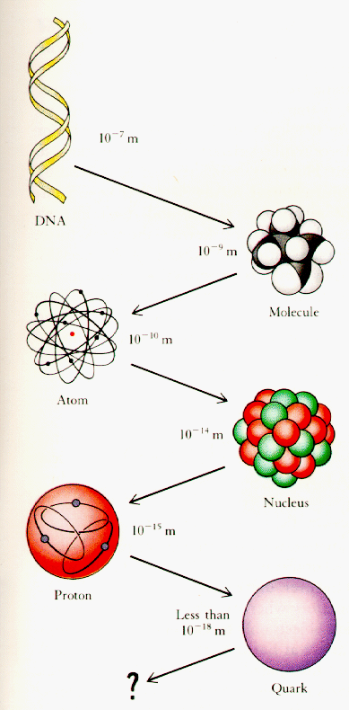
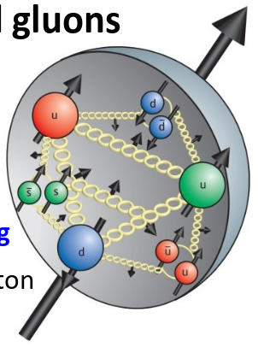
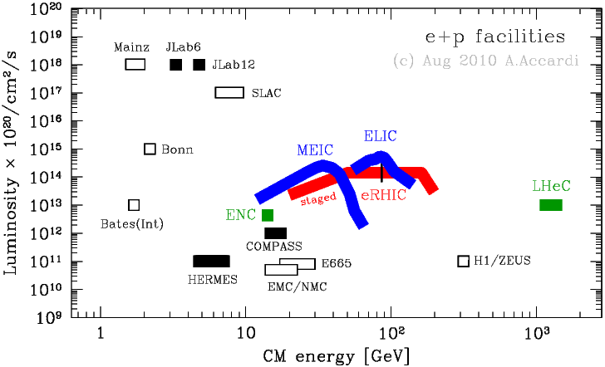
Essential Quest: The Strongly Interacting Normal Matter Puzzle
How are nucleons - protons and neutrons - made of quarks and gluons?
How are protons and neutrons modified by the nuclear medium?

Slide 10
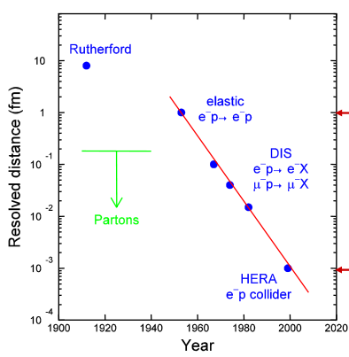
Nucleon Structure: Perspective
Nucleon structure has been and is a very active field of research of fundamental importance
By probing nucleons with electrons we learned:
→ Nucleons have size
→ Nucleons are NOT elementary but are instead made of point-like particles, partons – quarks and gluons
→ Quarks and gluons inside nucleons are engaged in a dynamics governed by a force which manifests like nothing else out there – QCD’s confinement and asymptotic freedom

Slide 11
Nucleon Structure: Perspective
Nucleon structure has been and is a very active field of research of fundamental importance
By probing nucleons with electrons we learned:
→ Nucleons have size
→ Nucleons are NOT elementary but are instead made of point-like particles, partons – quarks and gluons
→ Quarks and gluons inside nucleons are engaged in a dynamics governed by a force which manifests like nothing else out there – QCD’s confinement and asymptotic freedom
1. How did we get here?
2. What more there is to know?

Slide 12
1. How did we get here?
The Geiger-Marsden-Rutherford Experiments – defining the structure of the atom
Probing nucleons with leptonic probes – the “Geiger-Marsden-Rutherford Experiments” at a different scale
Modeling the structure of the nucleon: Ouark-Parton Model - a good start
Modeling the dynamics of the nucleon: parton distribution functions and pQCD
2. What more there is to know?
Parton distribution functions at large x
Modeling non-perturbative dynamics of hadrons (just mentioned)
Understand nuclear medium modifications of quarks and gluons (not covered)
Structure of hadrons beyond longitudinal momentum distributions (just mentioned)
….

Slide 13
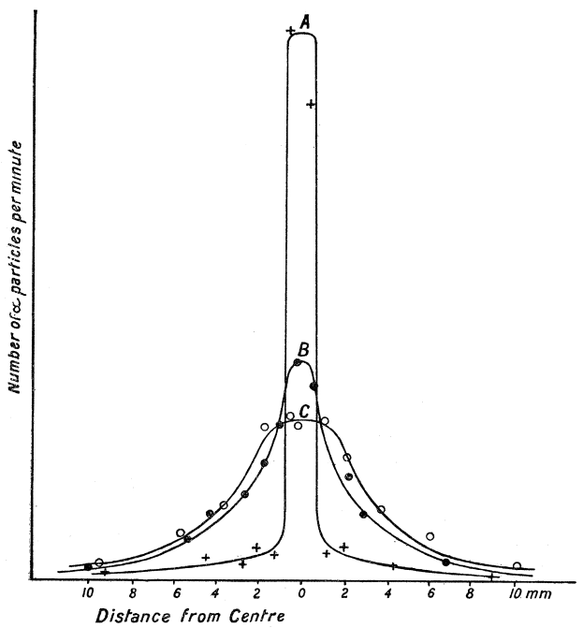
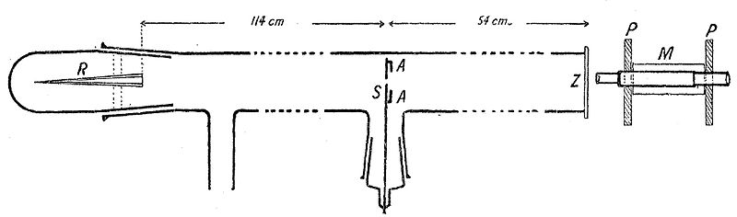
Not Too Long Ago: Atom NOT Like a Plum Pudding
How did we get to our current understanding of matter?
A: By experimenting and by modeling what we observe – in an iterative manner.
1908-1913: work by Geiger, Marsden, Rutherford points to the correct conclusion about the structure of the atom
nucleus
Experiment 1 →1908
Distribution of scintillations in vacuum
Distribution of scintillations after scattering off one gold leaf
Distribution of scintillations after scattering off two gold leaves
Radium bromide as source of α particles
scintillating zinc sulphide screen
slit: gold leaves could be placed here
microscope to count scintillations
“there is a very marked scattering of α particles in passing through matter, whether gaseous or solid … some of the α-particles after passing through very thin leaves were deflected through quite an appreciable angle”
Didn’t quite had the acceptance for backward angle detection…

Slide 14
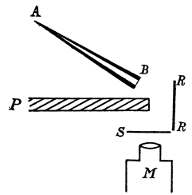
Not Too Long Ago: Atom NOT Like a Plum Pudding
How did we get to our current understanding of matter?
A: By experimenting and by modeling what we observe – in an iterative manner.
1908-1913: work by Geiger, Marsden, Rutherford points to the correct conclusion about the structure of the atom
nucleus
Experiment 2 →1909
backward angle detection
α-particles source
Lead
Gold
Platinum
Tin
Silver
Copper
Iron
Aluminum
“surprising that the α-particles can be turned within a layer of 6 x 10⁻⁵ cm of gold through angles of 90º, and even more”
… this was a rare event… 1 in 8000 α particles deflected through a large angle by Pt
P: lead to screen S from direct hits by α
Experiment 3 →1910
characterizes the most probable scattering
→ Most probable scattering happens via small angles
→ Can be explained assuming compound scattering: total deflection of α results from very small deflections as many atoms are encountered
Compound scattering cannot explain large angle deflections observed in 1909

Slide 15
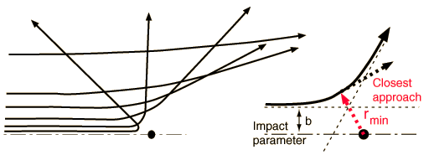
Not Too Long Ago: Atom NOT Like a Plum Pudding
How did we get to our current understanding of matter?
A: By experimenting and by modeling what we observe – in an iterative manner.
1908-1913: work by Geiger, Marsden, Rutherford points to the correct conclusion about the structure of the atom
nucleus
Theoretical prediction →1911
Coulomb force, Newton’s laws, conservation of linear and angular momentum
+
atoms consist of a + or – charge concentrated within a sphere of < 10⁻¹⁴ m radius surrounded by charge of the opposite sign distributed throughout the reminder of 10⁻¹⁰ m
Large deflection scattering – one single atomic encounter when α sufficiently close to center of atom
scattered α
number of α scattered at angle θ
$y=\frac{ntb^{2}Q\csc^{4}θ/2}{16r^{2}}$ , $b=\frac{2NeE}{mu^{2}}$
Experiment 4 →1913, verification of theoretical prediction and experimental determination of the “central charge” of Au: 197/2 +/- 20% → 98 +/- 20
charged center of atom

Slide 16
The Scientific Method
How did we get to our current understanding of matter?
A: By experimenting and by modeling what we observe – in an iterative manner.
→ Observe a pattern, may point to existence of “discrete units”: Dalton’s atoms
Probe “discrete units” to investigate for substructure:
→ scattering a probe off object under investigation: Geiger, Marsden, Rutherford’s scattering
→ measure probability of interaction probe - object (cross section) and its dependence on experimental parameters: helps with modeling
Model observation, this may:
→ involve drastic departure from current understanding – photon as particle
→ lead to very different view of the world: fields are primary while particles are derived concepts appearing after quantization - quantum field theories
Integrate it all in the BIG PICTURE
… and iterate

Slide 17
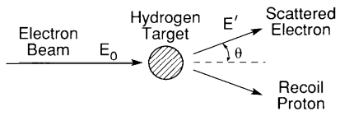
Matter Puzzle: Is the Proton Point-Like?
Do protons have size?
1948-50 – Schiff, Rosenbluth: use elastic electron-proton scattering to probe the proton
electron is left with less energy after meeting the proton
square of four-momentum transfer: connected to the probe’s ability of resolving the structure of the proton
$$\sim \frac{ℏ}{Q}$$
probe’s ability of resolving structure
$$\frac{ℏ}{Q}$$
$$\frac{ℏ}{Q}$$
proton when >> than its size
same proton when $\sim$ its size

Slide 18
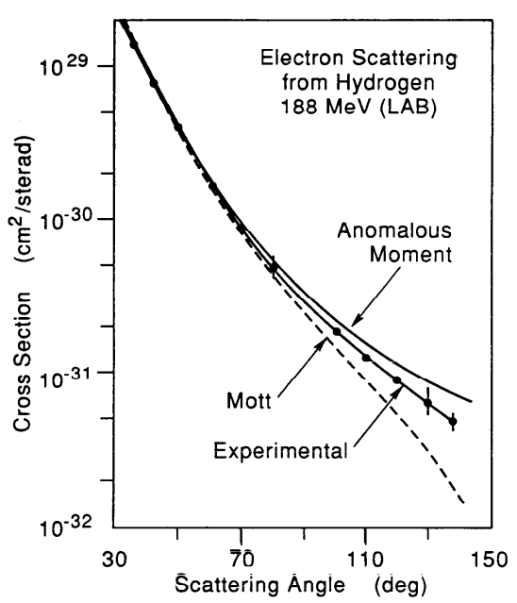
The Proton Is NOT Point-Like
Do protons have size?
Yes! from experiments at High Energy Physics Laboratory Stanford, 1955
Q² = 23 MeV²
point-like proton with spin
Probability of interaction less than expected from point-like proton with spin
point-like proton without spin
experiment
Q² = 87 MeV²
Probability of interaction more than expected from point-like proton without spin

Slide 19
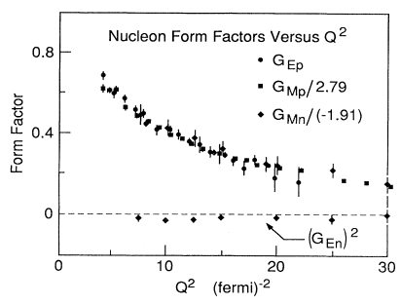
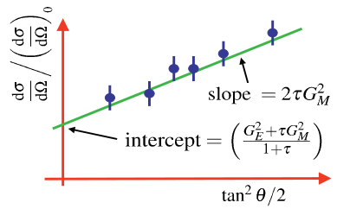
How Do the Charge and Magnetic Moment Distribute?
Probability of elastic interaction:
Form Factors are (in some limit) Fourier transforms of charge and magnetic moment distributions
Distribution of Charge or Magnetic Moment
Form Factor
Q² dependence
And the Q² dependence of form factors was measured…
Distribution of Charge or Magnetic Moment
Mott
1965
Q² = 1 GeV²

Slide 20
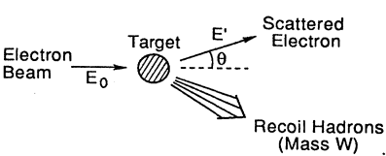
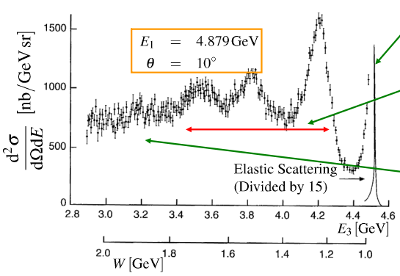
Matter Puzzle: What’s Inside the Proton?
Is the proton elementary?
$$\frac{ℏ}{Q}$$
To find out increase the probe’s ability of resolving structure (decrease )
$$E^{′}=\frac{E_{0}−\frac{W^{2}−M^{2}}{2M}}{1+\frac{2E_{0}}{M}sin2{\frac{θ}{2}}}$$
$$x=\frac{Q^{2}}{2Mυ}$$
$$ν=E_{0}−E^{′}$$
$$y=\frac{ν}{E_{0}}$$
$$W^{2}=M^{2}+2Mυ−Q^{2}$$
Elastic scattering: proton stays intact, W = M
E₀
Inelastic scattering: proton gets excited, produce excited states or proton’s resonances, W = M_{resonance}
Deep inelastic scattering: proton breaks up and we end up with a many particle final state, W = large

Slide 21
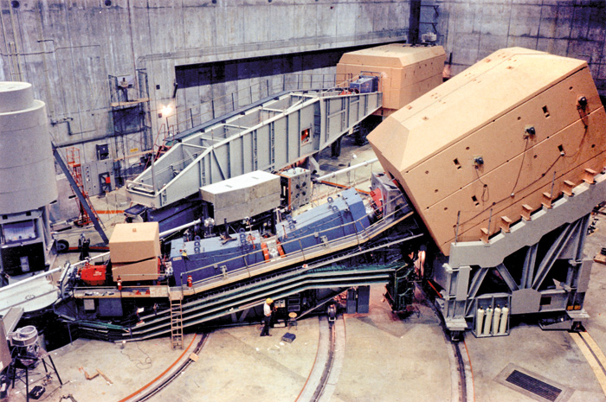
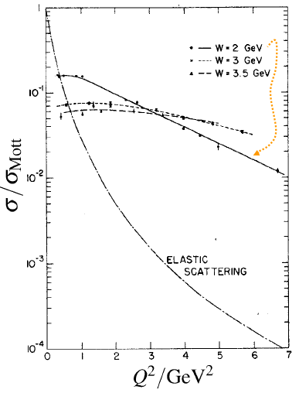
Point-Like Constituents Inside Proton
Is the proton elementary?
From SLAC, ~1969: No!
Map cross section when proton is probed deeper resulting in final states with higher W…
How about inelastic scattering?
point
Low-W Inelastic scattering: weakly dependent on Q²
Deep inelastic scattering: almost independent of Q² !
elastic scattering looked like this!
Scattering from point-like, charged objects in the proton

Slide 22
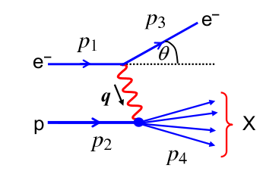
Point-Like Constituents Inside Proton: Formalism
Probability of inelastic interaction:
four-momentum transfer squared
invariant mass of produced hadronic system squared
Bjorken x
inelasticity
k’
k
What we measure:
γ*
P
Cross section for photoabsorption of Longitudinal γ* (helicity 0)
Cross section for photoabsorption of Transverse γ* (helicity +/- 1)

Slide 23
Point-Like Constituents Inside Proton: Formalism
Probability of inelastic interaction:
four-momentum transfer squared
invariant mass of produced hadronic system squared
Bjorken x
inelasticity
k’
k
What we measure:
Flux of transverse virtual photons
γ*
P
Cross section for photoabsorption of Longitudinal γ* (helicity 0)
Cross section for photoabsorption of Transverse γ* (helicity +/- 1)
Relative flux of longitudinal virtual photons

Slide 24
Point-Like Constituents Inside Proton: Formalism
Probability of inelastic interaction:
k’
k
In QFT we can calculate:
γ*
P
leptonic tensor
magnetic structure function
hadronic tensor
electromagnetic structure function
Connection between photoabsorption cross sections that we can measure and structure functions:

Slide 25
Point-Like Constituents Inside Proton: Formalism
The L & T contributions are separated by performing a fit of the reduced cross section dependence with ε at fixed x and Q²
slope
intercept
Γ = transverse flux
ε = relative longitudinal flux
Requirements for precise L/T extractions:
As many ε points as possible spanning a large interval from 0 to 1 →
as many (E, E’, θ) settings as possible
Very good control of point-to-point systematics → 1-2 % on the reduced cross section translates into 10-15 % on F_{L}
L/Ts needed in order to access F_{L}, F₁, F₂

Slide 26
Point-Like Constituents Inside Proton: Formalism
Probability of inelastic interaction:
There is another boson that could couple to point-like constituents inside nucleons
k’
k’
k
k
γ*
Ζ
P
P

Slide 27
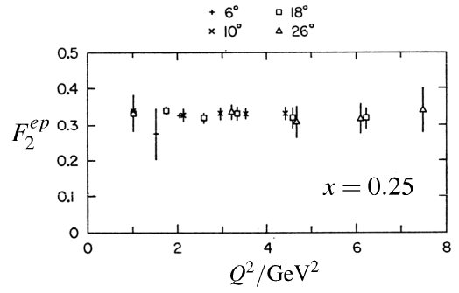
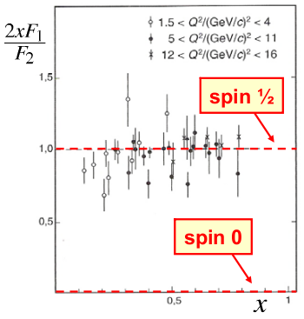
Point-Like Constituents Inside Proton with Spin ½
Is the proton elementary? No!
Going back to the early SLAC data…
F₁, F₂ account for the sub-structure of the protons and neutrons – structure functions
scaling: no Q² dependence
very similar behavior for F₁
Structure “looks the same” even as the probe’s resolution is increased more and more
If point-like constituents were spin zero particles, we would expect F₁ to be zero

Slide 28
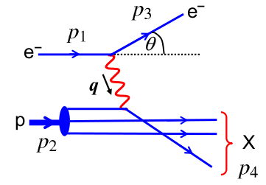
Model: Quarks/Partons Inside the Proton…
1969-1971, Feynman, Bjorken: Quark-Parton model interpreted the SLAC large momentum-transfer electron-nucleon scattering as scattering from quasi-free, point-like, spin ½ constituents – partons (elastic scattering off partons)

Slide 29
Model: Quarks/Partons Inside the Proton…
1969-1971, Feynman, Bjorken: Quark-Parton model interpreted the SLAC large momentum-transfer electron-nucleon scattering as scattering from quasi-free, point-like, spin ½ constituents – partons (elastic scattering off partons)
Infinite Momentum Frame:
Proton moves with infinite momentum: time it takes for virtual photon to couple to partons much smaller than interaction time between partons
We neglect the proton’s mass
We also neglect quark masses and any momentum that’s transverse to the direction of the proton
We can calculate the elementary cross section (QED) for elastic electron-quark scattering for a quark
We then need to introduce a quark/parton momentum distribution function to account for scattering off any quark inside the proton carrying a momentum fraction x of proton’s momentum
Finally we sum over all quarks in the proton

Slide 30
Model: Quarks/Partons Inside the Proton…
1969-1971, Feynman, Bjorken: Quark-Parton model interpreted the SLAC large momentum-transfer electron-nucleon scattering as scattering from quasi-free, point-like, spin ½ constituents – partons (elastic scattering off partons)
Infinite Momentum Frame:
Proton moves with infinite momentum: time it takes for virtual photon to couple to partons much smaller than interaction time between partons
→ electron scatters elastically off a parton:

Slide 31
Model: Quarks/Partons Inside the Proton…
1969-1971, Feynman, Bjorken: Quark-Parton model interpreted the SLAC large momentum-transfer electron-nucleon scattering as scattering from quasi-free, point-like, spin ½ constituents – partons (elastic scattering off partons)
Infinite Momentum Frame:
Proton moves with infinite momentum: time it takes for virtual photon to couple to partons much smaller than interaction time between partons
→ electron scatters elastically off a parton:
→ electron scatters off any one particular parton carrying a fraction x of proton’s total momentum
Parton distribution function
q(x)dx – number of quarks of type q inside the proton with momenta fractions between x and x + dx

Slide 32
Model: Quarks/Partons Inside the Proton…
1969-1971, Feynman, Bjorken: Quark-Parton model interpreted the SLAC large momentum-transfer electron-nucleon scattering as scattering from quasi-free, point-like, spin ½ constituents – partons (elastic scattering off partons)
Infinite Momentum Frame:
Proton moves with infinite momentum: time it takes for virtual photon to couple to partons much smaller than interaction time between partons
→ electron scatters elastically off a parton:
→ electron scatters off any one particular parton carrying a fraction x of proton’s total momentum
Parton distribution function
Q²>>M²y²
$$\frac{d^{2}σ}{dE_{3}dΩ}=$$
$$\frac{4πα^{2}}{Q^{4}}[(1−y−\frac{M^{2}y^{2}}{Q^{2}})\frac{1}{x}F_{2} +y^{2}F_{1}]$$

Slide 33
Model: Quarks/Partons Inside the Proton…
1969-1971, Feynman, Bjorken: Quark-Parton model interpreted the SLAC large momentum-transfer electron-nucleon scattering as scattering from quasi-free, point-like, spin ½ constituents – partons (elastic scattering off partons)
Infinite Momentum Frame:
Proton moves with infinite momentum: time it takes for virtual photon to couple to partons much smaller than interaction time between partons
→ electron scatters elastically off a parton:
→ electron scatters off any one particular parton carrying a fraction x of proton’s total momentum
Parton distribution function
Q²>>M²y²
$$\frac{d^{2}σ}{dE_{3}dΩ}=$$
$$\frac{4πα^{2}}{Q^{4}}[(1−y−\frac{M^{2}y^{2}}{Q^{2}})\frac{1}{x}F_{2} +y^{2}F_{1}]$$
F_{L}(x) = 0

Slide 34
What Can We Learn from This Simple Picture?
First of all, we KNOW there are gluons…
anti-quark
gluon
gluon
gluon
quark
gluon

Slide 35
What Can We Learn from This Simple Picture?
First of all, we KNOW there are gluons…
anti-quark
gluon
gluon
gluon
quark
gluon
→ Simple equations from the Parton Model:

Slide 36
What Can We Learn from This Simple Picture?
First of all, we KNOW there are gluons…
anti-quark
gluon
gluon
gluon
quark
gluon
→ Simple equations from the Parton Model:
isospin symmetry

Slide 37
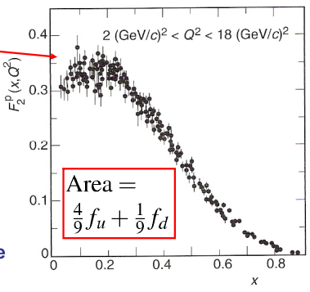
What Can We Learn from This Simple Picture?
First of all, we KNOW there are gluons…
anti-quark
gluon
gluon
gluon
quark
gluon
→ Simple equations from the Parton Model:
isospin symmetry
from data

Slide 38
What Can We Learn from This Simple Picture?
First of all, we KNOW there are gluons…
anti-quark
gluon
gluon
gluon
quark
gluon
→ Simple equations from the Parton Model:
isospin symmetry
Up quarks carry twice the momentum of down quarks in the proton and gluons carry half of the total proton’s momentum
from data

Slide 39
This Simple Picture, Does It Check Out?
This picture checks out when probing with a different probe: electrically neutral neutrinos
ν
-
F₁, F₂, F₃ – proton structure functions

Slide 40
This Simple Picture, Does It Check Out?
This picture checks out when probing with a different probe: electrically neutral neutrinos
ν
-
F₁, F₂, F₃ – proton structure functions
$$\frac{1}{2}\left(F_{νp2}+F_{νn2}\right)=x\left[u\left(x\right)+d\left(x\right)+\overline{u}\left(x\right)+\overline{d}\left(x\right)\right]$$
$$\frac{1}{2}\left(xF_{νp3}+xF_{νn3}\right)=x\left[u\left(x\right)+d\left(x\right)−\overline{u}\left(x\right)−\overline{d}\left(x\right)\right]$$

Slide 41
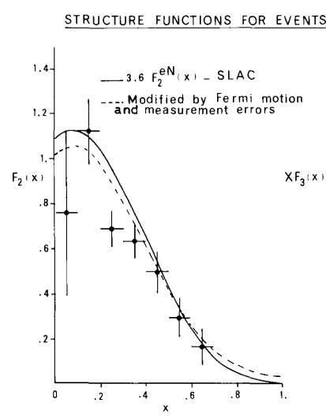
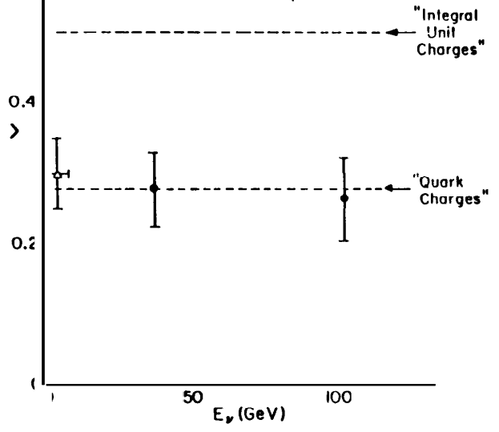
This Simple Picture, Does It Check Out?
This picture checks out when probing with a different probe: electrically neutral neutrinos
ν
-
F₁, F₂, F₃ – proton structure functions
$$\frac{1}{2}\left(F_{νp2}+F_{νn2}\right)=x\left[u\left(x\right)+d\left(x\right)+\overline{u}\left(x\right)+\overline{d}\left(x\right)\right]$$
$$\frac{1}{2}\left(xF_{νp3}+xF_{νn3}\right)=x\left[u\left(x\right)+d\left(x\right)−\overline{u}\left(x\right)−\overline{d}\left(x\right)\right]$$
18/5 F₂^{eN}(x) - SLAC
Integral Unit Charges
----- Modified by Fermi motion
and measurement errors
<Q²>
F₂(x)
Quark
Charges
$$\frac{\frac{1}{2}\int{\left[F^{ep}\left(x\right)+F^{en}\left(x\right)\right]dx}}{\frac{1}{2}\int{\left[F^{νp}\left(x\right)+F^{νn}\left(x\right)\right]dx}}=\frac{{e2}_{u}+{e2}_{d}}{2}$$
Q² > 1 GeV²
W² > 4 GeV²
E_{ν} (GeV)
Sum of quarks charges can be extracted from combination of proton’s structure functions in electron and neutrino scattering

Slide 42
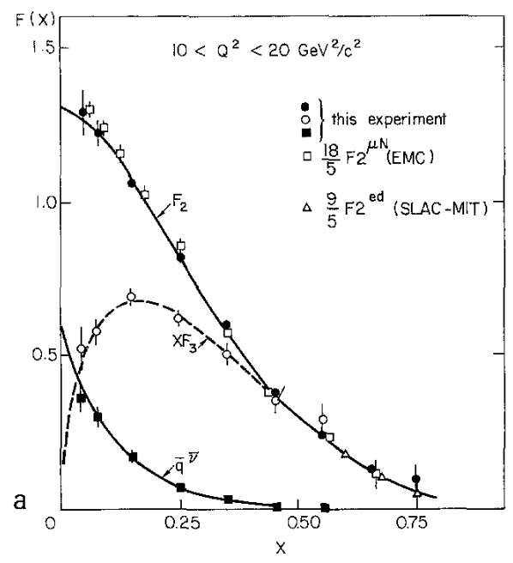
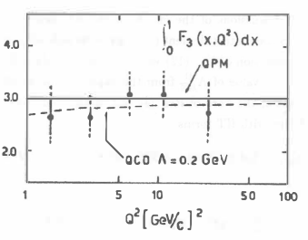
This Simple Picture, Does It Check Out?
This picture checks out when probing with a different probe: electrically neutral neutrinos
ν
-
F₁, F₂, F₃ – proton structure functions
$$\frac{1}{2}\left(F_{νp2}+F_{νn2}\right)=x\left[u\left(x\right)+d\left(x\right)+\overline{u}\left(x\right)+\overline{d}\left(x\right)\right]$$
$$\frac{1}{2}\left(xF_{νp3}+xF_{νn3}\right)=x\left[u\left(x\right)+d\left(x\right)−\overline{u}\left(x\right)−\overline{d}\left(x\right)\right]$$
Subtract the two equations to get the anti-quark parton distribution functions
Integrate F₃ to get the number of valence quarks
QPM
3 valence quarks
QCD Λ = 0.2 GeV
Q²
xF₃ goes to zero at very low x as sea dominates and q(x) = q(x)

Slide 43
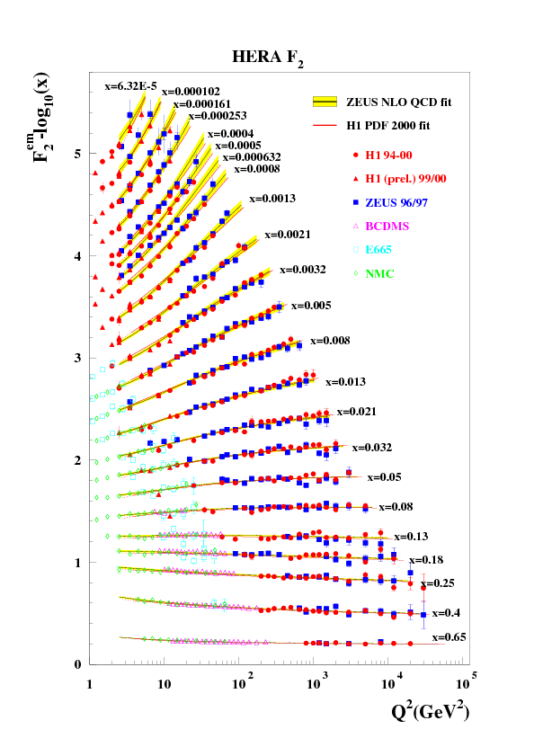
Matter Puzzle: Proton’s Rich Inner Life
After 50 years of exploration we found that the proton has a very rich inner life…
→ Structure functions do not scale with Q² after all but they exhibit a well defined pattern of Q² scaling violations
F₂ structure function
→ It is precisely this approach to exploring the proton that led to the development of the Quantum Field Theory of strong interactions – Quantum Chromodynamics
early SLAC measurements

Slide 44
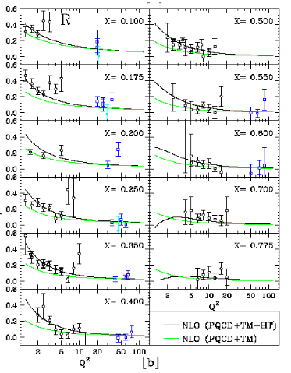
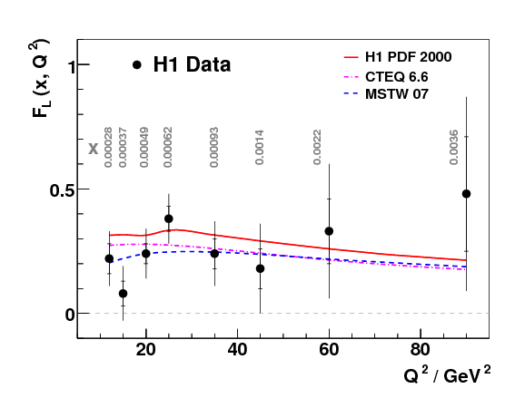
Matter Puzzle: Proton’s Rich Inner Life
And F_{L} and R are not zero!

Slide 45
Matter Puzzle: Proton’s Rich Inner Life
Parton distribution functions keep track of the dynamics of quarks and gluons inside nucleons
Three non-interacting quarks
Three interacting quarks
Three interacting quarks with sea of quarks,
anti-quarks and gluons
$$f_{q}\left(x\right)$$
$$f_{q}\left(x\right)$$
$$f_{q}\left(x\right)$$

Slide 46
Matter Puzzle: Proton’s Rich Inner Life
Parton distribution functions keep track of the dynamics of quarks and gluons inside nucleons
Three non-interacting quarks
Three interacting quarks
Three interacting quarks with sea of quarks,
anti-quarks and gluons
$$f_{q}\left(x\right)$$
$$f_{q}\left(x\right)$$
$$f_{q}\left(x\right)$$
Parton distribution functions are the initial state in searches for new physics within and beyond the Standard Model

Slide 47
Matter Puzzle: Proton’s Rich Inner Life
Parton distribution functions keep track of the dynamics of quarks and gluons inside nucleons
Three non-interacting quarks
Three interacting quarks
Three interacting quarks with sea of quarks,
anti-quarks and gluons
$$f_{q}\left(x\right)$$
$$f_{q}\left(x\right)$$
$$f_{q}\left(x\right)$$
Quantum field theory of strong interactions – Quantum Chromodynamics (QCD) – models the dynamics of parton distribution functions

Slide 49
DIS Lectures at CTEQ 2017 Summer School- Lecture 2
Simona Malace
Jefferson Lab

Slide 50
Matter Puzzle: Proton’s Rich Inner Life
Parton distribution functions keep track of the dynamics of quarks and gluons inside nucleons
Three non-interacting quarks
Three interacting quarks
Three interacting quarks with sea of quarks,
anti-quarks and gluons
$$f_{q}\left(x\right)$$
$$f_{q}\left(x\right)$$
$$f_{q}\left(x\right)$$
Quantum field theory of strong interactions – Quantum Chromodynamics (QCD) – models the dynamics of parton distribution functions

Slide 51
QCD Weaves the Story of Hadron’s Rich Inner Life
Quantum Chromodynamics? This is all there is to it… according to Frank Wilczek
gluon
self-interaction
→ In principle this Lagrangian gives a complete description of the strong interactions
mass and quantum field of the quark of j^{th} flavor
$$ℒ=\frac{1}{4g^{2}}{Ga}_{μν}{Ga}_{μν}+\sum_{j}{\overline{q_{j}}} \left(iγ^{μ}D_{μ}+m_{j}\right)q_{j}$$
coupling constant of strong interactions
color indices
SU(3) color (gauge) symmetry
$${Ga}_{μν}≡∂_{μ}{Aa}_{ν}−∂_{ν}{Aa}_{μ}+i{fa}_{bc}{Ab}_{μ}{Ac}_{ν}$$
$$D_{μ}≡∂_{μ}+it^{a}{Aa}_{μ}$$
gluon field
… in practice this Lagrangian leads to equations that are very hard to solve.
Ways have been found: perturbative QCD, lattice QCD,..

Slide 52
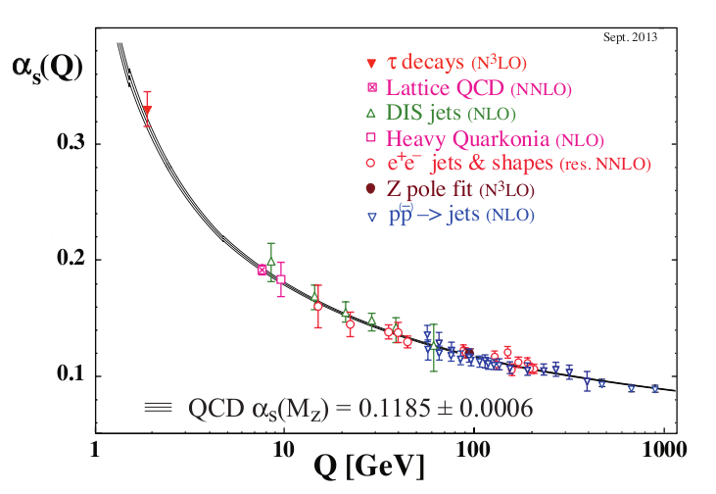
The QCD Story of Asymptotically Free Quarks
Energy scale dependence of strong interaction as predicted by Renormalization Group Equations (perturbative QCD) and confirmed by measurements is suggestive of barely interacting quarks at high energy scales - asymptotic freedom
→ QCD describes variation as a perturbative expansion in the coupling constant, α_{s}
→ The way the variation happens – decreases with increasing energy scale of interaction – is born by the fundamental properties of QCD: color, self-interacting gluon mediator
Just like QED if gluon replaced by photon
Propagator (gluon)
self-interaction – unique to QCD
→ QCD perturbative expansion valid for μ >> Λ ~400 MeV, beyond QCD predicts non-negligible non-perturbative effects (QED stays perturbative for μ << 10⁹⁰ GeV!!)

Slide 53
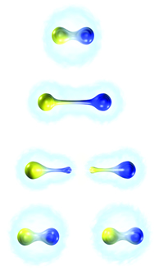
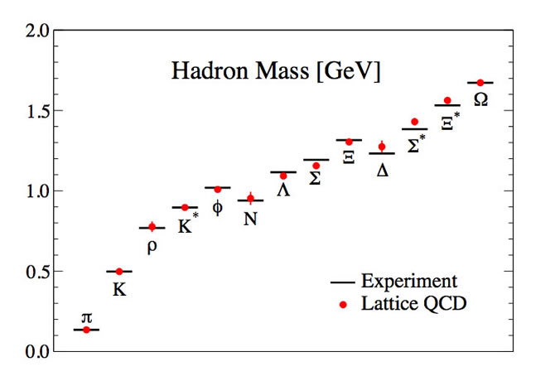
Confinement: An Even More Complicated Story…
Quarks and gluons are trapped in color-less hadrons which is all we can observe - confinement
Confinement is an experimental observation: so far we have not seen free quarks
Confinement which arises from highly non-perturbative processes is “postulated” in QCD
One approach:
→ Solving of equations derived from the QCD Lagrangian with minimal fundamental input: quark masses and strength of interaction

Slide 54
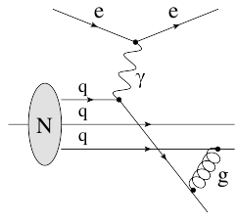
Going Back to Scattering Off Nucleons
Elastic scattering: proton stays intact, W = M
E₀
Inelastic scattering: nucleon excited, we produce excited states or resonances, W = M_{resonance}
Elastic and Resonance regions: highly non-perturbative quark-quark interactions that lead to confinement are dominant
To fully understand the behavior of the proton here we must understand confinement
Deep inelastic scattering: proton reveals its point-like structure, W = large
Dynamics of nucleon that arises from gluon emission at various energy scales is encoded in universal functions (parton distribution functions - PDFs) extracted from data within the framework of perturbative QCD
Having well constrained PDFs is still a challenge

Slide 55
Parton Distribution Functions: Extraction
In pQCD we can connect the DIS cross section to universal longitudinal momentum distributions of quarks and gluons inside nucleons via factorization
σ^{NLO} contains a collinear divergence which can be regulated by low-energy, non-perturbative physics
σ^{NLO} can be made finite if PDFs are redefined to absorb these collinear singularities
→ The cutoff λ is an infrared scale that regulates the collinear divergence
→ μ is the factorization scale

Slide 56
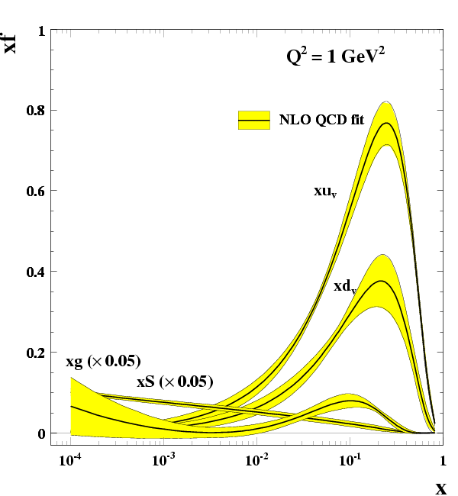
Parton Distribution Functions: Extraction
PDFs evolution equations (DGLAP) describe their dependence on the factorization scale
At large x u and d dominate but there is definitely gluon and some sea as well
At low x gluon and sea dominate; u ~ d
As scale changes and gluons are radiated:
Partons loose momentum because of gluon radiation so at large x quarks and gluons shift to the left
Gluons create quarks-antiquarks and gluon-gluon pairs so at small x sea and gluon increase and get steeper

Slide 57
Parton Distribution Functions: Extraction
Perturbative QCD gives the Q² dependence of PDFs, the x dependence must be extracted from fits to data
Example of data set used for PDFs extraction
Need to use a variety of processes to separate flavors
fixed target
Need data everywhere we want well-constrained parton distribution functions
collider

Slide 58
Parton Distribution Functions: Indeed Universal
Perturbative QCD gives the Q² dependence of PDFs, the x dependence must be extracted from fits to data
→Deep Inelastic Scattering on proton
→ Production of W^{+/-} bosons in proton-proton collisions at LHC
$d\overline{u}$→W⁻
$u\overline{d}$→W⁺

Slide 59
Parton Distribution Functions Extraction: Complicated Business
From A. Accardi

Slide 60
Parton Distribution Functions Extraction: Complicated Business
From A. Accardi
Will focus on this

Slide 61
Preamble: Parton Distribution Functions & Constraints from Data
Perturbative QCD gives the Q² dependence of PDFs, the x dependence must be extracted from fits to data
Example of data set used for PDFs extraction
fixed target
collider
Why stop here?

Slide 62
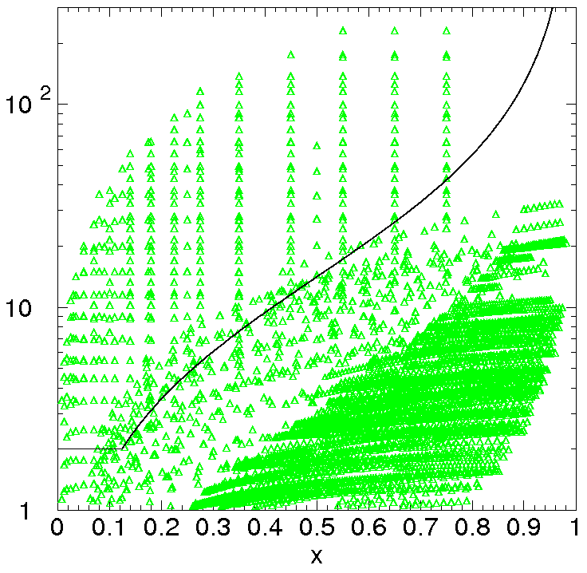
Parton Distribution Functions: Constraints from Data
Most PDF extractions not well constrained at large x! Why?
Typical kinematic coverage of data used in PDF fits (early 2000)
example
W² > 15
data not used
Q² > 2

Slide 63
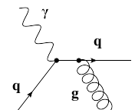
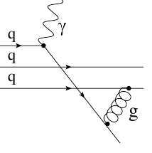
Parton Distribution Functions: Constraints from Data
At least 2 complications with low W and low Q² kinematic regime
Non-perturbative dynamical higher-twist contributions become large; process dependent, no prescription to treat them in a unified way across various processes – inclusion would spoil PDF universality
Operator Product Expansion: Expansion of F₂ moments in powers of 1/Q²
Twist = dimension - spin
A’s – matrix elements of operators with specific twist
$$\int_{0}^{1}{dxF_{2}\left(x,Q^{2}\right)=A_{2}\left(α_{s}\left(Q^{2}\right)\right)+\sum_{τ=4,6,…}^{∞}{\frac{A_{τ}\left(α_{s}\left(Q^{2}\right)\right)}{Q^{τ−2}}}}$$
Leading twist: calculable in pQCD
higher twist

Slide 64
Parton Distribution Functions: Constraints from Data
At least 2 complications with low W and low Q² kinematic regime
Non-perturbative kinematical higher-twist are large (Target Mass Corrections)
massless limit structure function calculated from PDFs
arXiv:1201.0576

Slide 65
Parton Distribution Functions: Constraints from Data
At least 2 complications with low W and low Q² kinematic regime
Non-perturbative kinematical higher-twist are large (Target Mass Corrections)
No universally agreed upon prescription to calculate TMCs

Slide 66
Parton Distribution Functions from CTEQ-JLab: Beyond the Perturbative Regime
Next-to-leading order (NLO) analysis of expanded data set on proton and deuterium
A. Accardi et al., Phys. Rev. D 81 (2010) 034016
→ Improve large-x precision of PDFs with larger DIS data set on both proton and deuterium by relaxing kinematic cuts to push to larger x; this leads to a factor of 2 increase in number of DIS data points used for fitting
stringent cut:
Q² > 4 GeV², W² > 12.25 GeV²
relaxed cut:
Q² > m_{c}² GeV², W² > 3 GeV²

Slide 67
Parton Distribution Functions from CTEQ-JLab: Beyond the Perturbative Regime
Next-to-leading order (NLO) analysis of expanded data set on proton and deuterium
A. Accardi et al., Phys. Rev. D 81 (2010) 034016
→ Improve large-x precision of PDFs with larger DIS data set on both proton and deuterium by relaxing kinematic cuts to push to larger x; this leads to a factor of 2 increase in number of DIS data points used for fitting
Include all relevant large-x / small-Q² theory non-perturbative corrections: dynamical and kinematic higher-twist (HT)
Include nuclear corrections: use of deuterium data requires careful treatment of nuclear corrections -- off-shell effects and sensitivity to the deuteron wave function

Slide 68
Parton Distribution Functions from CTEQ-JLab: Beyond the Perturbative Regime
Non-perturbative 1/Q² corrections: dynamical and kinematic higher-twist
dynamical HT
TMC here
1) The dynamical HT extraction depends on the TMC prescription used
2) Almost identical results for the d-quark distribution when different prescriptions of TMCs are used in conjunction with the dynamical HT → that’s great! We don’t want the PDF extraction to be affected by our imperfect knowledge of non-perturbative corrections

Slide 69
Parton Distribution Functions from CTEQ-JLab: Beyond the Perturbative Regime
Nuclear corrections: wave function & off-shell dependence
A. Accardi et al., Phys. Rev. D 81 (2010) 034016
A. Accardi et al., Phys. Rev. D 84 (2011) 014008
W. Melnitchouk DIS2015
Weak binding approximation:
y = deuteron’s momentum fraction carried by the struck nucleon
in the nucleus rest frame, virtual photon relative velocity

Slide 70
Parton Distribution Functions from CTEQ-JLab: Beyond the Perturbative Regime
Nuclear corrections: wave function & off-shell dependence
A. Accardi et al., Phys. Rev. D 81 (2010) 034016
A. Accardi et al., Phys. Rev. D 84 (2011) 014008
W. Melnitchouk DIS2015
→ greater wave function dependence at large y (and x)
→ more smearing for larger x and lower Q²

Slide 71
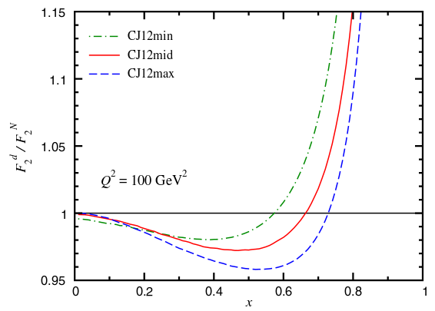
Parton Distribution Functions from CTEQ-JLab: Beyond the Perturbative Regime
Nuclear corrections: wave function & off-shell dependence
A. Accardi et al., Phys. Rev. D 81 (2010) 034016
A. Accardi et al., Phys. Rev. D 84 (2011) 014008
J. Owens et al., Phys. Rev. D 87 (2013) 094012
W. Melnitchouk DIS2015
→ Representation of a quark q in an off-shell nucleon with invariant mass p² in the off-shell covariant quark “spectator ” model
Scale parameter Λ(p²) which is related to the nucleon confinement radius (swelling of nucleon in nuclear medium) suppresses large-p² contributions
Off-shell rescaling parameter varied in fit to minimize chi²

Slide 72
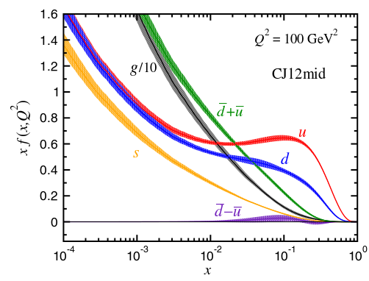
Parton Distribution Functions from CTEQ-JLab: Beyond the Perturbative Regime
J. Owens et al., Phys. Rev. D 87 (2013) 094012
Different combinations of wave functions and size of nuclear corrections
CJ12min: WJC-1 + small off-shell (λ = 0.3%)
CJ12mid: AV18 + medium off-shell (λ = 1.2%)
CJ12max: CD-Bonn + large off-shell (λ = 2.1%)
PDF uncertainties relative to the reference CJ12mid
→ Is it worth using deuterium data and dealing with nuclear corrections?

Slide 73
Parton Distribution Functions from CTEQ-JLab: Beyond the Perturbative Regime
J. Owens et al., Phys. Rev. D 87 (2013) 094012
Global fits without deuterium data show:
modest increase in the error band for u for x > 0.7
significant increase in error band for d
→ smaller error band for d if deuteron hence nuclear corrections included
Inclusion of more data at large x leads to better constrained PDFs

Slide 74
Parton Distribution Functions from CTEQ-JLab: Beyond the Perturbative Regime
Nuclear and high energy connection
→ W⁺⁻ asymmetries at large W-boson rapidity are sensitive to d/u PDF ratio at large x
Earlier CDF and more recent D0 W-asymmetry data “select” small but non-zero nuclear corrections
In CJ15 D0 W, lepton asymmetries constrain the d-quark in a free nucleon so that the deuteron data can be used to constrain nuclear corrections

Slide 75
Parton Distribution Functions from CTEQ-JLab: Beyond the Perturbative Regime
Nuclear and high energy connection
→ W⁺⁻ asymmetries at large W-boson rapidity are sensitive to d/u PDF ratio at large x
Deuterium data allow for precise determination of d/u
D0 asymmetries determines the “free nucleon” d-quark AND Deuterium data determine the off-shell correction
Marked improvement in the d/u uncertainty

Slide 76
Parton Distribution Functions from CTEQ-JLab: Beyond the Perturbative Regime
Next-to-leading order (NLO) analysis of expanded data set on proton and deuterium
A. Accardi et al., Phys. Rev. D 81 (2010) 034016
→ Improve large-x precision with larger DIS data set on both proton and deuterium: relaxing kinematic cuts to push to larger x leads to a factor of 2 increase in number of DIS data points used for fitting
stringent cut:
Q² > 4 GeV², W² > 12.25 GeV²
relaxed cut:
Q² > m_{c}² GeV², W² > 3 GeV²
Can we push below W² > 3 GeV² ?

Slide 77
Quark-Hadron Duality
What is Quark-hadron duality?
Quark-hadron duality = complementarity between quark and hadron descriptions of observables
$$\sum_{hadrons}{= \sum_{quarks}{}}$$
Description suitable for low-energy regime (confinement)
Description suitable for high-energy regime (asymptotic freedom)
resonance region
data (hadrons) – confinement in action
→ We can use either set of complete basis states to describe physical phenomena
PDF based extraction (quarks)
→ In practice, at finite energy we typically have access only to a limited set of basis states
Resonance region data average to PDF based curve: 1/Q^{2n} corrections small or cancel on average
→ Even so, quark-hadron duality shown to hold globally and locally in many observables
W. Melnitchouk et al., Physics Reports 406, 127 (2005)

Slide 78
Bloom-Gilman Duality
Duality in inclusive electron-proton scattering: Bloom-Gilman duality
Phys. Rev. Lett. 25, 1140 (1970)
$$ω^{′}=1+\frac{W^{2}}{Q^{2}}$$
→ ω’ allows comparison of high-W², high-Q² curves (fit to DIS data) to low-W², low-Q² resonance region data
The resonance region data:
- oscillate around and are on average equivalent to the scaling curve
- “slide” along the deep inelastic curve with increasing Q²
The Q² dependence of the proton’s resonances (hadrons) is strongly correlated with the dynamics of the proton in the DIS region where quark and gluon degrees of freedom take over

Slide 79
Quark-Hadron Duality in QCD
Duality in QCD via the Operator Product Expansion
Twist (= dimension - spin) expansion of F₂ moments in QCD
Perturbative leading twist results in shallow Q² dependence of integral
Non-perturbative higher twist would induce a strong Q² dependence to the integral
$$\int_{0}^{1}{dxx^{n−2}F_{2}\left(x,Q^{2}\right)={A(n)}_{2}\left(α_{s}\left(Q^{2}\right)\right)+\sum_{τ=4,6,…}^{∞}{\frac{A_{(n)τ}\left(α_{s}\left(Q^{2}\right)\right)}{Q^{τ−2}}}}$$
→ The total integral - moment of the structure function - exhibits a shallow Q2 dependence down to a Q² value of ~ 1 GeV²!
Quark-hadron duality = higher twist (leading to confinement) are small or cancel on average
The more remarkable as:
At fixed Q² resonances occupy the largest x
At lower Q² resonances occupy a larger x region of the total x interval than at higher Q²
For higher moments (n=4,…) the contribution from larger x (resonances) is even more enhanced

Slide 80
Quark-Hadron Duality: How Well It Works?
Global study of global and local Quark-hadron duality in F₂ structure function: averaged resonance region data vs PDF fits
local intervals in the resonance region
→ We define local W² intervals in the resonance region to verify local quark-hadron duality
→ We calculate integral to verify quantitatively how well duality holds when compared to PDF fits constrained at large x
$${\int_{x_{min}}^{x_{max}}{F^{data}\left(x,Q^{2}\right)}dx}/{\int_{x_{min}}^{x_{max}}{F^{param.}\left(x,Q^{2}\right)dx}}$$

Slide 81
Parton Distribution Functions from CTEQ-JLab: Beyond the Perturbative Regime
Next-to-leading order (NLO) analysis of expanded data set on proton and deuterium
A. Accardi et al., Phys. Rev. D 81 (2010) 034016
→ Improve large-x precision with larger DIS data set on both proton and deuterium: relaxing kinematic cuts to push to larger x leads to a factor of 2 increase in number of DIS data points used for fitting
stringent cut:
Q² > 4 GeV², W² > 12.25 GeV²
relaxed cut:
Q² > m_{c}² GeV², W² > 3 GeV²
Can we push below W² > 3 GeV² ?

Slide 82
Parton Distribution Functions from CTEQ-JLab: Beyond the Perturbative Regime
Next-to-leading order (NLO) analysis of expanded data set on proton and deuterium
A. Accardi et al., Phys. Rev. D 81 (2010) 034016
→ Improve large-x precision with larger DIS data set on both proton and deuterium: relaxing kinematic cuts to push to larger x leads to a factor of 2 increase in number of DIS data points used for fitting
We should so at least we can study quark-hadron duality in the framework of PDF fits!
stringent cut:
Q² > 4 GeV², W² > 12.25 GeV²
relaxed cut:
Q² > m_{c}² GeV², W² > 3 GeV²
Can we push below W² > 3 GeV² ?

Slide 83
Don’t Forget: Nucleon Structure Is Even More Complicated
Partons inside nucleons can have specific positions and momenta w.r.t. a defined center of the nucleon; GTMD contain the most general one-body information of partons
Symmetric Infinite Momentum Frame:
theoretical objects
GTMD$\left(x,k_{⊥},Δ\right)$
$$ξ=0$$
$$\int{d^{2}k_{⊥}}$$
C. Lorce
$Δ$=0
Transverse Momentum Dependent Distributions TMDs
Generalized Parton Distributions
GPDs
$$f\left(x,k_{⊥}\right)$$
$$f\left(x,Δ \right)$$
$$\int{d^{2}k_{⊥}}$$
$$\int{dx}$$
physical objects
Parton Distribution Functions
PDFs
Form Factors
FFs
$$f\left(x\right)$$
I only touched on this!
$$F\left(Δ\right)$$
→ Knowledge of distribution functions implies knowledge of nucleon dynamics based on the unique features of QCD: asymptotic freedom and confinement, factorization, and universality

Slide 84
Perspective: There Is Still So Much We Don’t Know
Nucleon structure has been and is a very active field of research of fundamental importance
A nucleon (e.g. proton) with spin 1/2 is made up of…
… three valence quarks which themselves have spin 1/2 but also of…
… gluons with spin 1 that mediate the strong interaction and…
… a sea of quark-antiquark pairs and more gluons.
Structure and dynamics of the nucleon in its state of ultimate confinement – elastic regime
How do quarks and gluons distribute according to their longitudinal momentum?
How do partons distribute according to their longitudinal momentum AND their transverse localization?
Connection between intrinsic motion of partons and their spin and the spin of the parent nucleon
How is the spin of the nucleon shared among its constituents?

Slide 85
THE END

Slide 86
THE END
W. Melnitchouk

