Slide 1
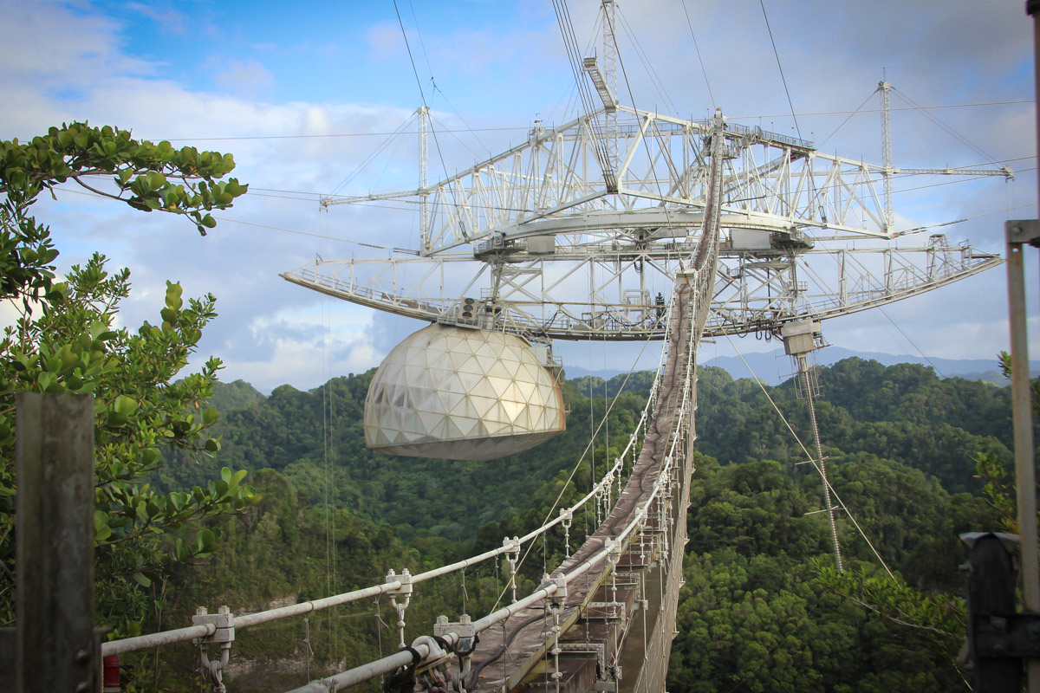
The Arecibo Observatory:
Exploring Space from Puerto Rico
Public lecture by
Dr. Alessandra Abe Pacini
Scientist at the Arecibo Observatory
Space and Atmospheric Sciences
(Florida Space Institute –
University of Central Florida)
CTEQ School
Monday - June 25, 2018
7:30 – 9:00 PM
Anfiteatro de Enfermería
Universidad de Puerto Rico-Mayagüez
Dr. Pacini is a Brazilian Space Physicist who moved to Puerto Rico to investigate the Sun and the Earth’s atmosphere using the Arecibo Observatory, the world’s most sensitive radar and largest-aperture telescope for astrophysical, planetary, and atmospheric studies. The lecture will include an overview of the history and status of Puerto Rico’s most famous scientific facility. Dr. Pacini will also discuss future opportunities for interdisciplinary research studies at the Arecibo Observatory and introduce the NEW Arecibo message.

