Slide 1


Top, ElectroWeak and QCD at the LHC
Lecture #1
MAYDA M. VELASCO
NORTHWESTERN UNIVERSITY & COFI INSTITUTE

Slide 2
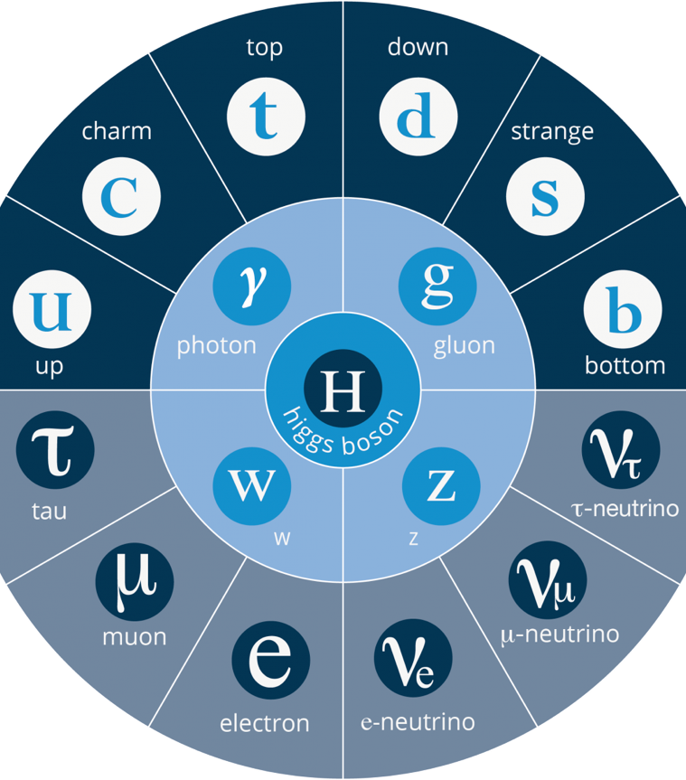
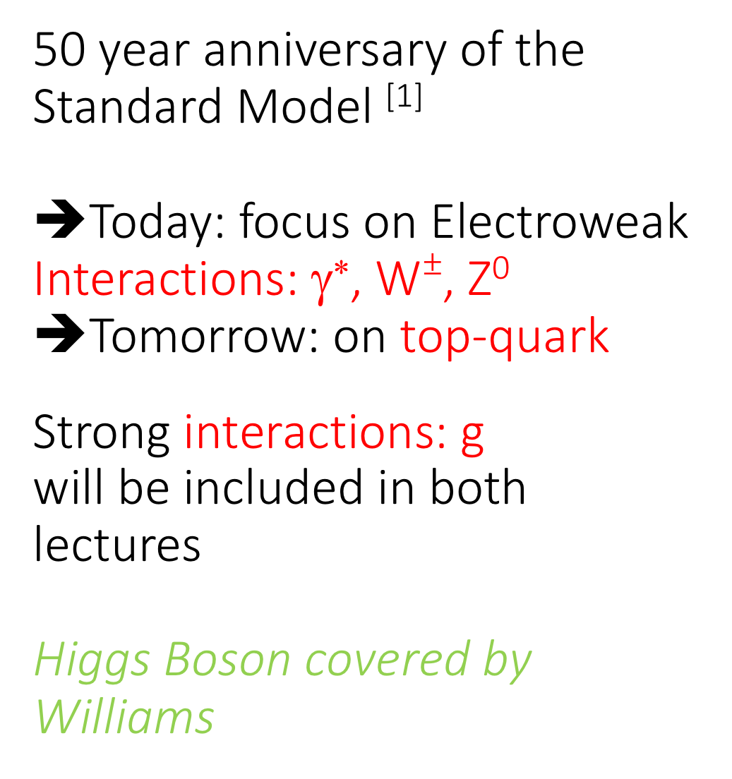
50 year anniversary of the Standard Model ^{[1]}
➔Today: focus on Electroweak Interactions: γ∗, W$±$, Z⁰
➔Tomorrow: on top-quark
Strong interactions: g will be included in both lectures
Higgs Boson covered by
Williams
1968 -- 1994
1955 -- 1977
2012
1900
1979
1983
1897 -- 1975
1956 -- 2000
[1] S. Weinberg, A Model of Leptons, Phys. Rev. Lett. 19, 1264 (1967)

Slide 3
Formal Description of elementary particles and forces given by the Standard Model of Particle physics
Standard Model: Nature described by the Symmetry Groups
LHC able to give us precision measurements of the relevant parameters
SU(3) x SU(2) x U(1)
Colour
Weak Hypercharge
Weak
Isospin
Electroweak
interactions
Strong interactions
3 symmetry groups
⇒ Interactions described by (only!) 3 coupling constants: g_{s}, g, g’
⇒ Universal fermion-boson couplings

Slide 4
ElectroWeak
Interactions act on all know particles
Decay t→ Wb
Higgs Yukawa coupling
Top quark
Massive “bare quark” couples strongly with all known forces
Single top production
M_{W}, sin²θ_{W}, m_{top},
M_{H}, α_{s}
Perturbative &
Non-perturbative regimes
Perturbative regime
Production
ttbar production
A lot to be
Covered… I will be selective
QCD
Interactions are only between gluons and quarks

Slide 5
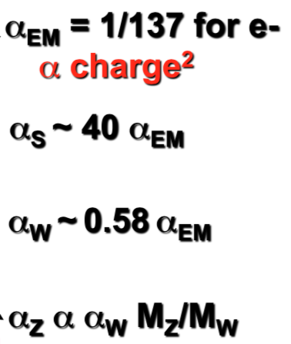
Weak charged current:
All particles
Flavour changes
Weak neutral current:
All particles
No change of flavour

Slide 6
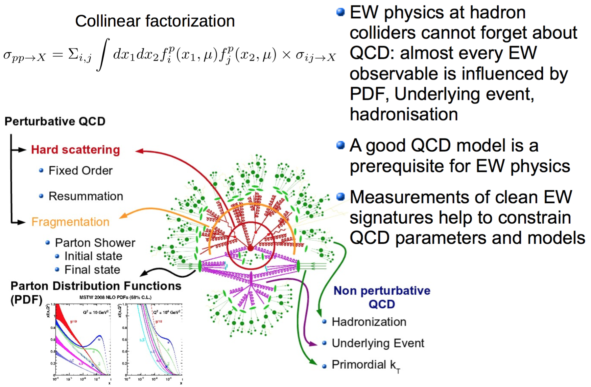
Precision in Quantum
Chromo Dynamics(QCD)

Slide 7
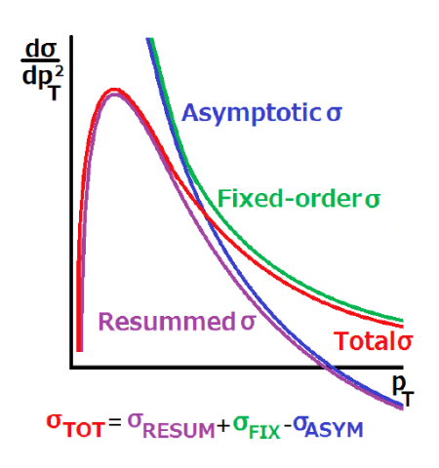
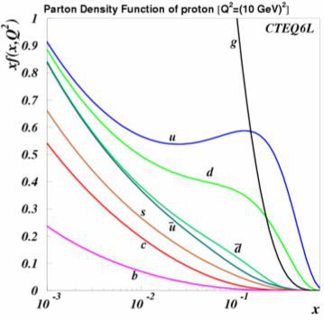
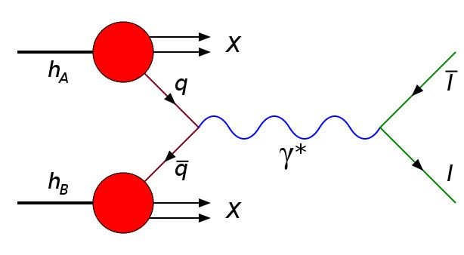
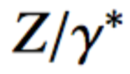
Example, Drell-Yan Process: pp→ Z or W
→ Predictions needed as input
→ Serious test of QCD with EWK processes
Main uncertainty in important EWK
precision measurements
High p_{T}: described at fixed-order of α_{s} by perturbative QCD predictions
Small p_{T}: described using resummation of multiple soft-gluon emissions. Non-perturbative part that has to be parametrised and extracted from the data.
➔ This is of great importance when calculating the W-mass
(W)
(ν)

Slide 8
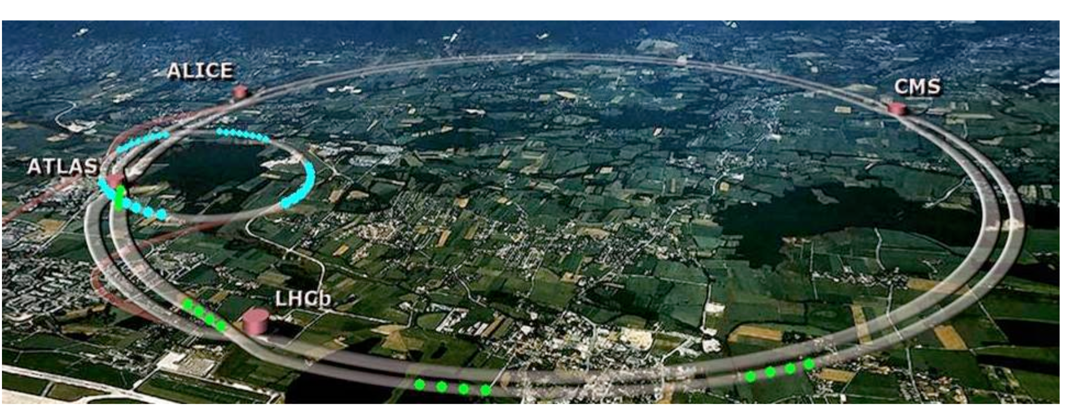
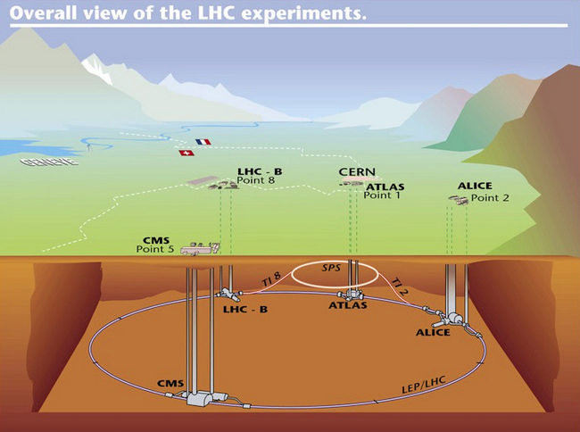

Large Hadron Collider
@ CERN
P+
or Pb
Energy Frontier
20 Year program to accumulate > 3000 fb⁻¹
P+
or Pb
High Luminosity achieved
with beams with
>10¹¹ protons/bunch &
> 2800 bunches
in the ring
25ns
Notes:
100x L Tevatron
S ➔ higher masses, hotter QGP
L ➔ smaller cross section

Slide 9
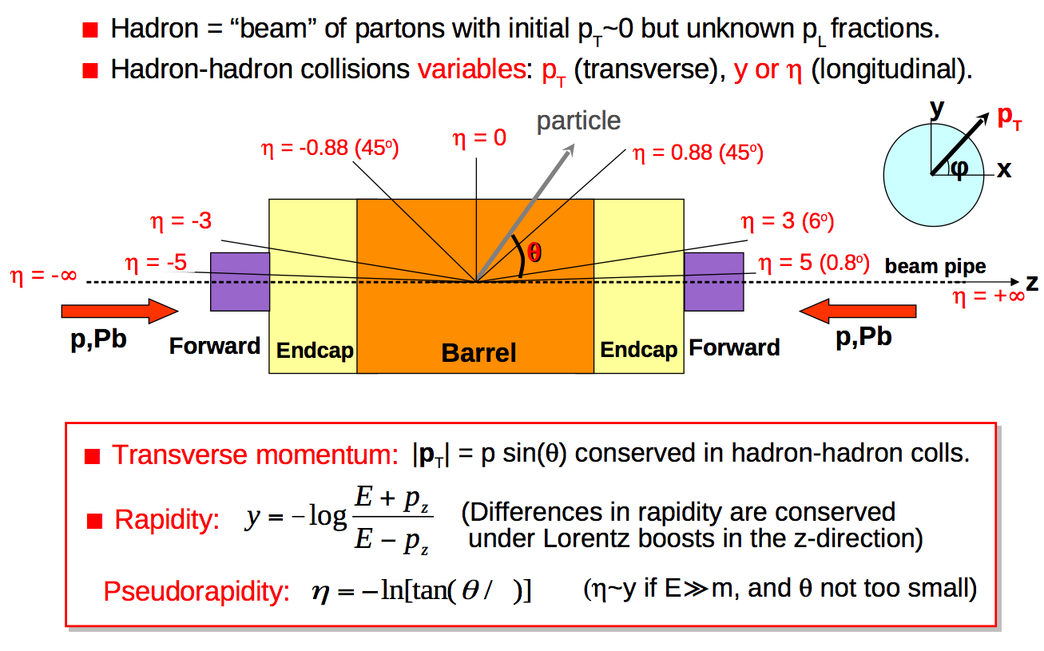
LHC collisions: kinematics
2

Slide 10
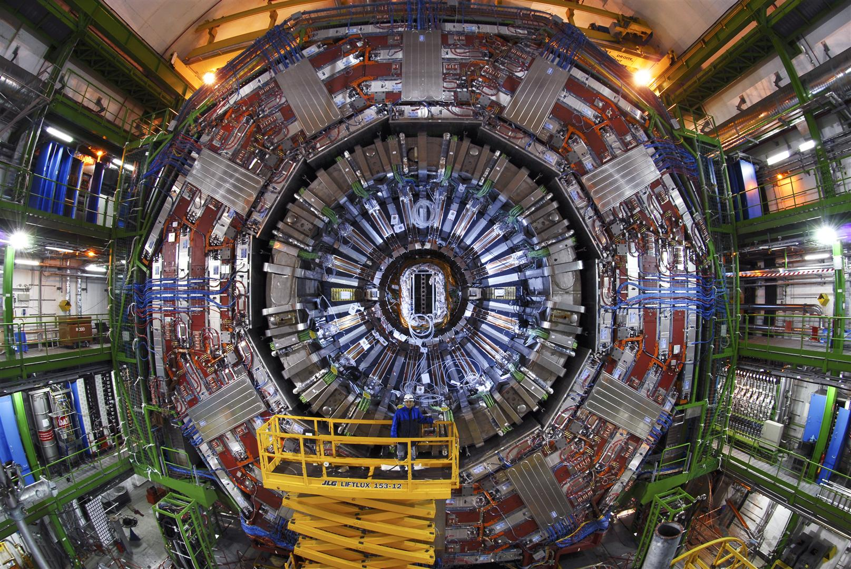
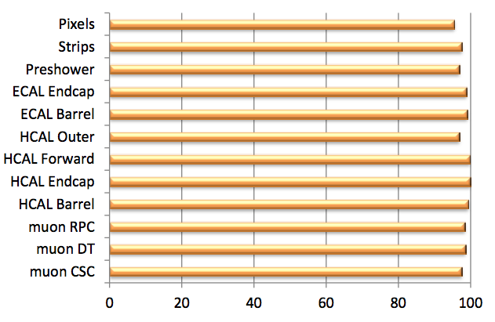
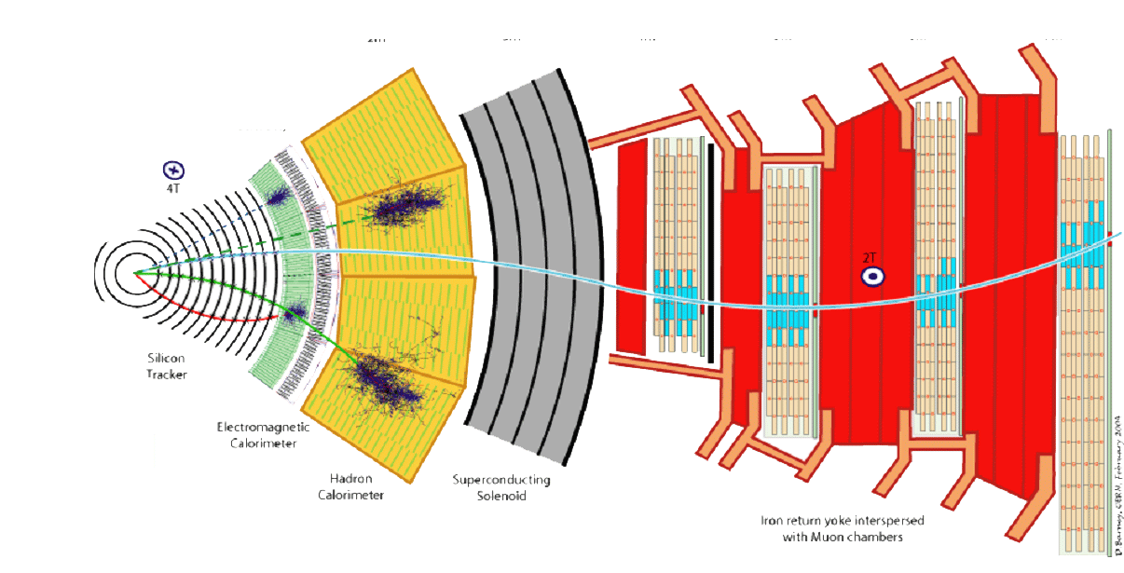
CMS
Transverse
view

Slide 11
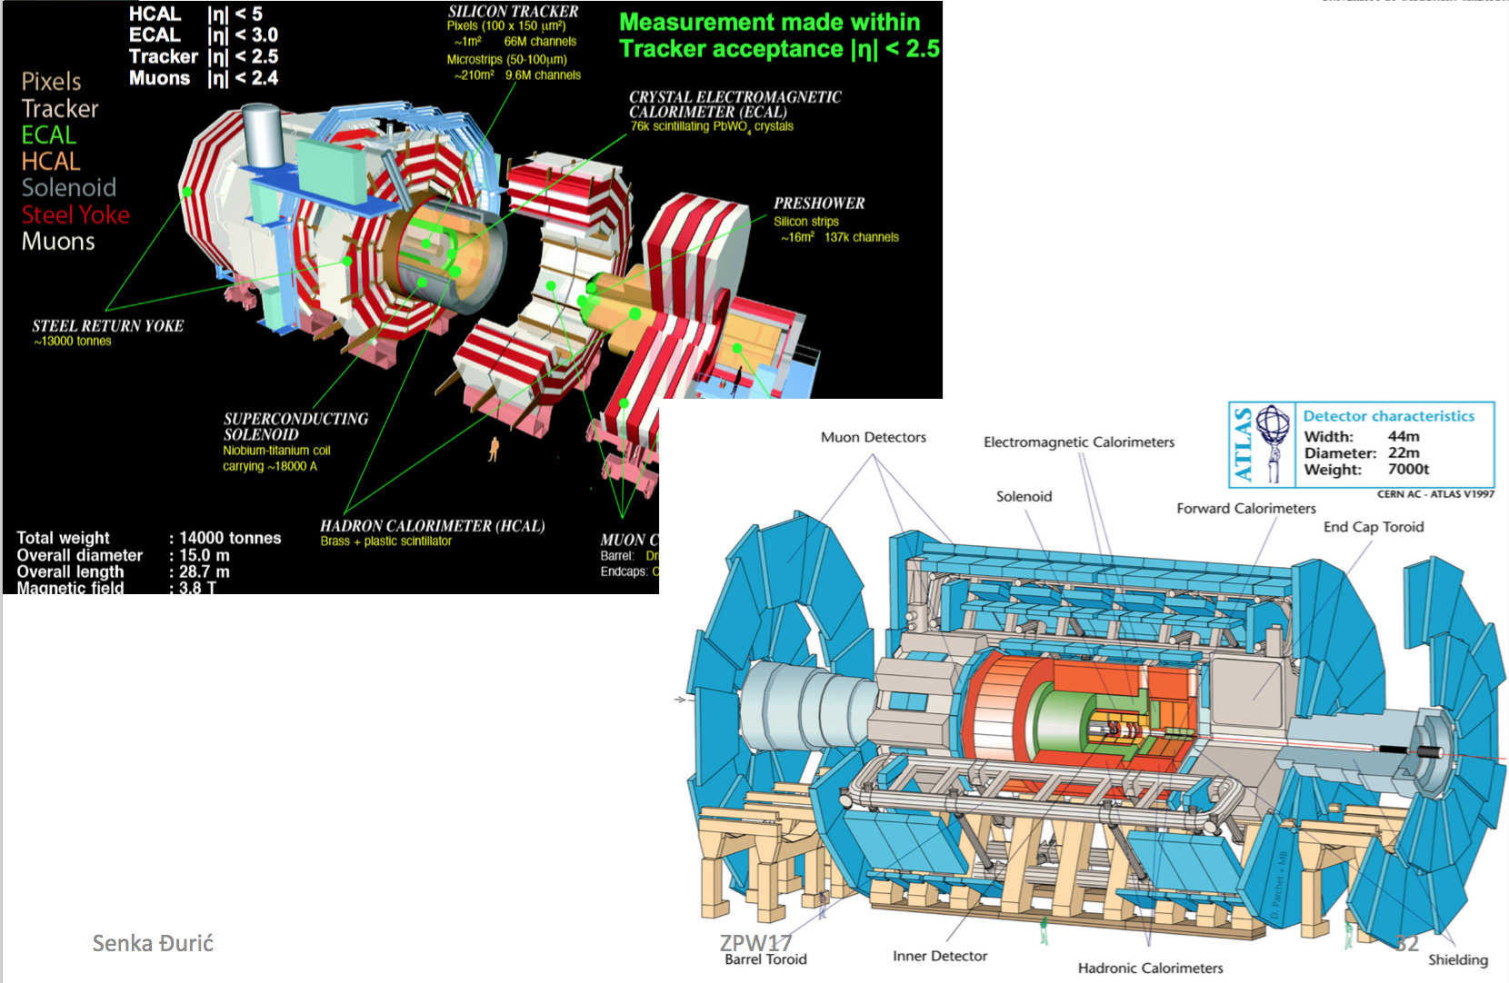

Slide 12
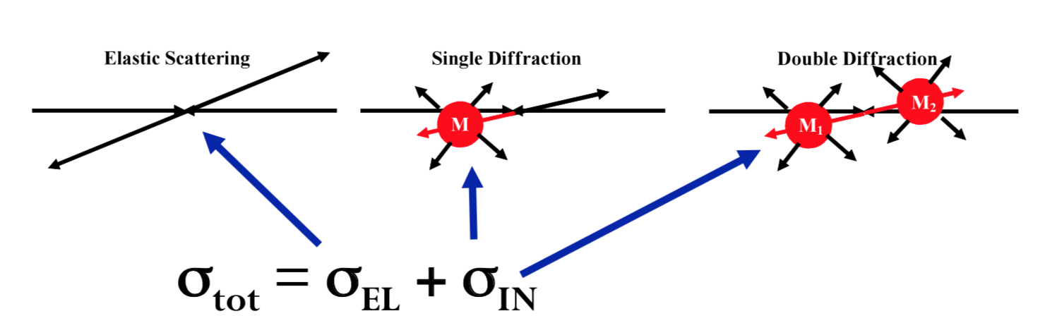
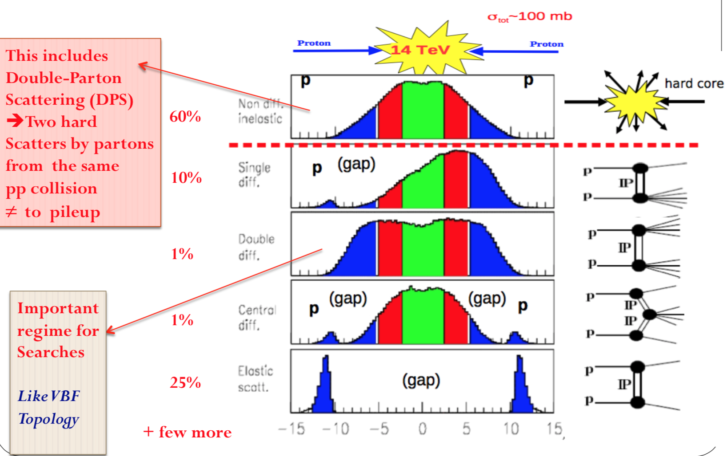
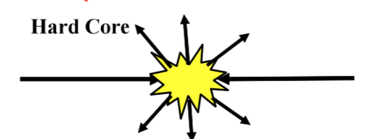

Proton – Proton
Collisions
13 TeV

Slide 13
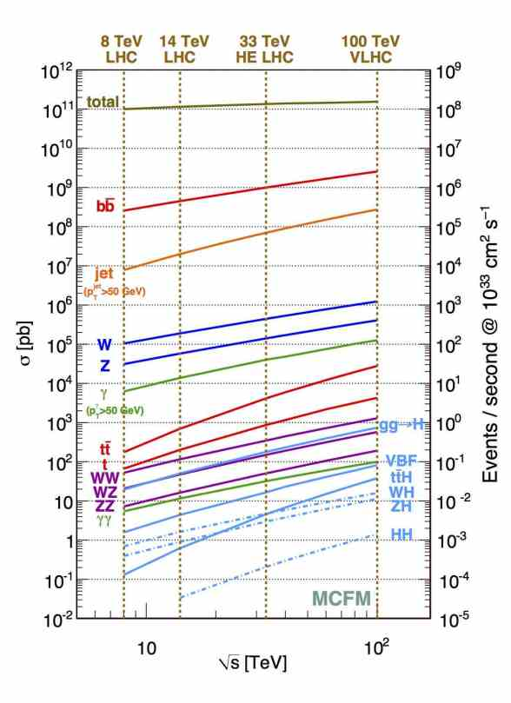
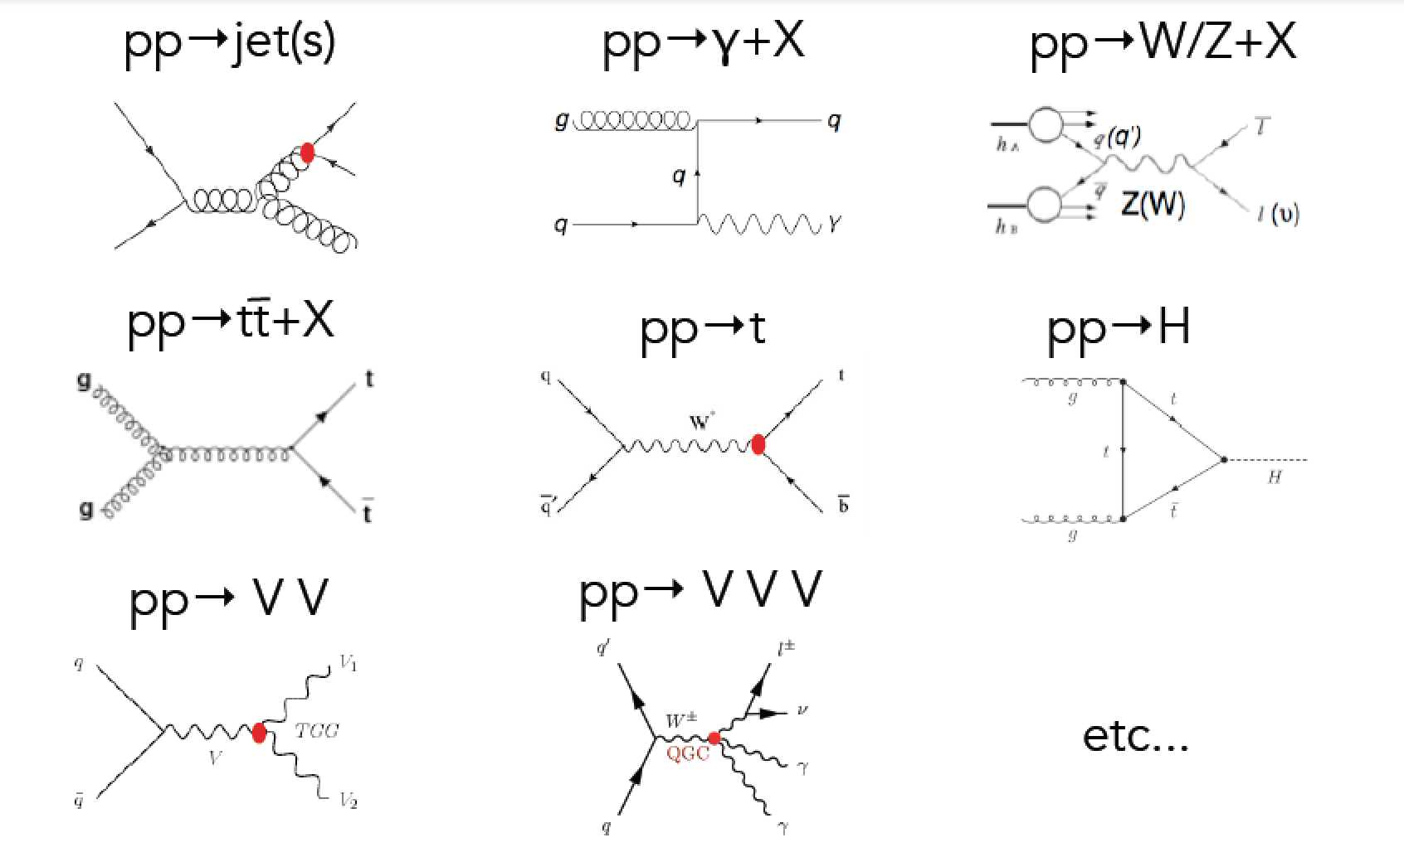
Many Hard Processes
N = L σ (acceptance) x (efficiency)

Slide 14
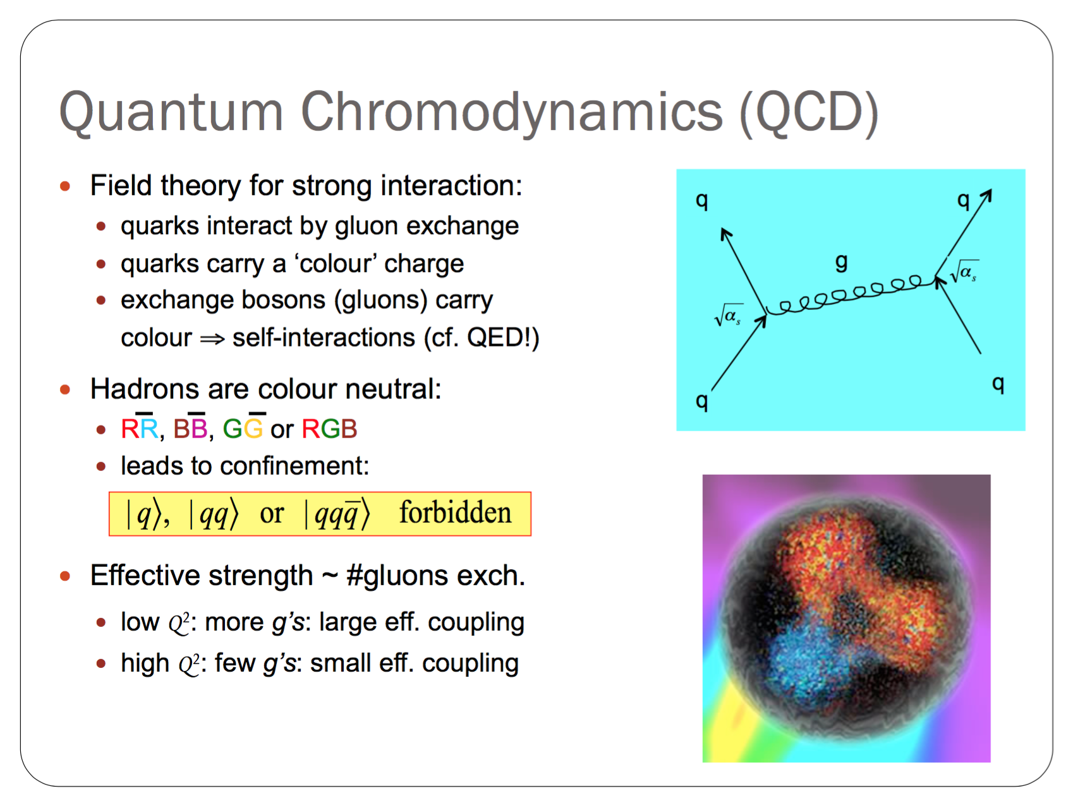
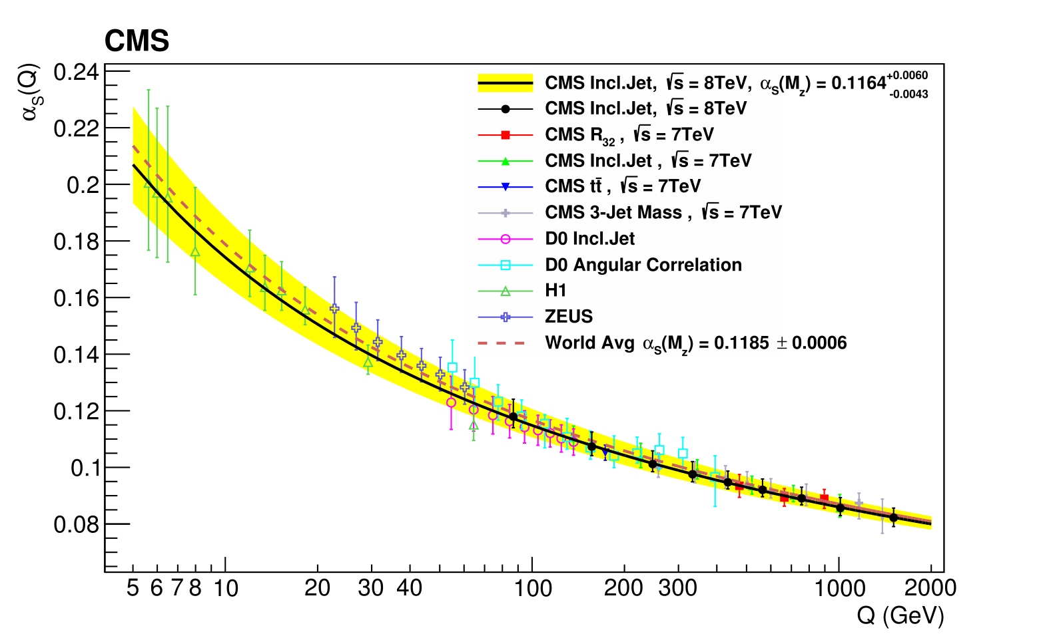
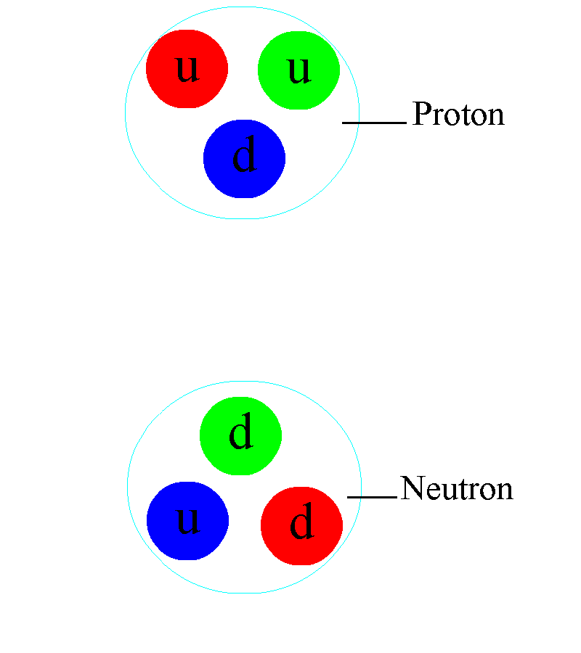
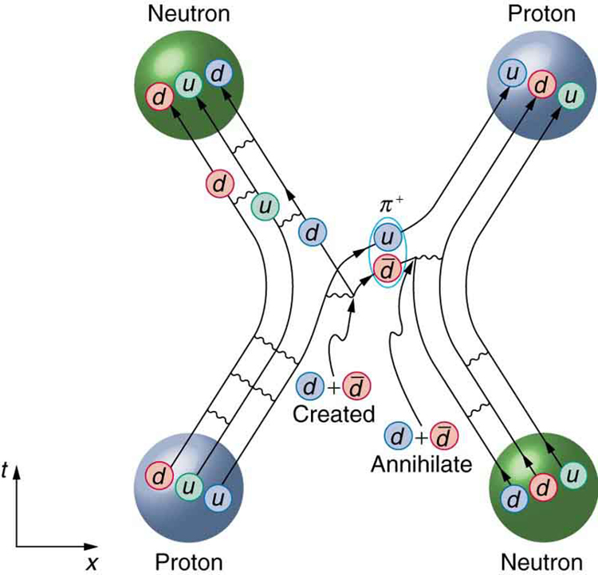
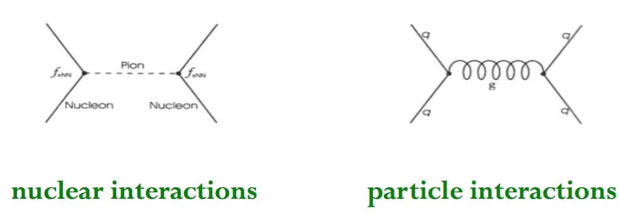
LHC: For “hard” processes strong Interactions is directly between quarks
Low energy
NUCLEON-NUCLEON
INTERACTIONS
3 valence quarks

Slide 15
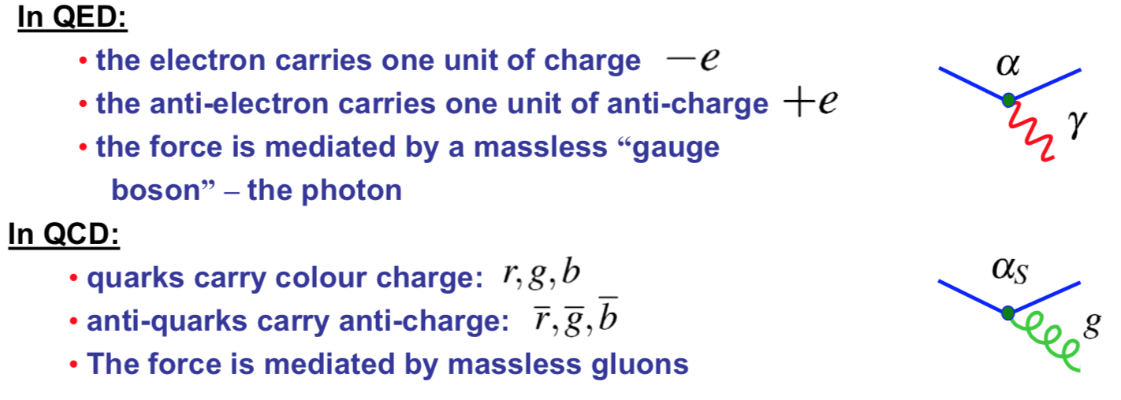
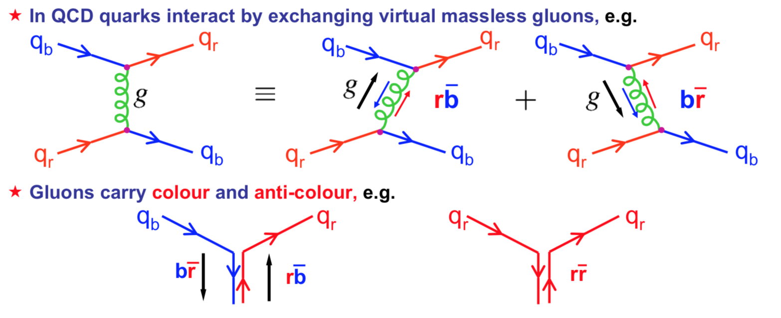
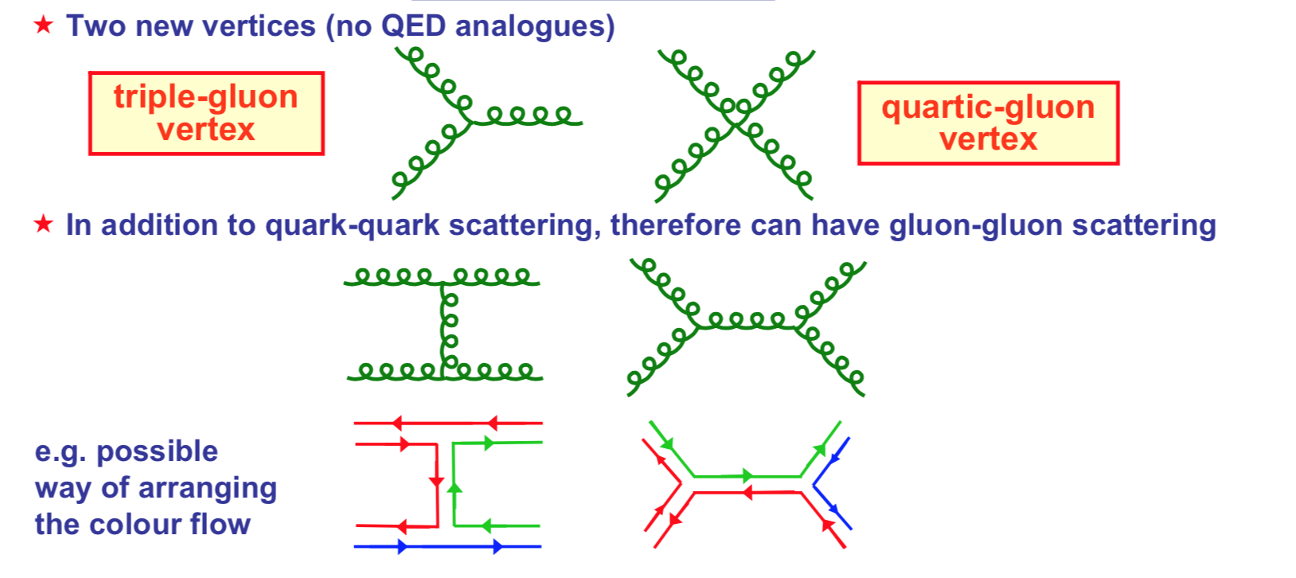
Few comments on QCD relevant when discussion hard scattering processes

Slide 16
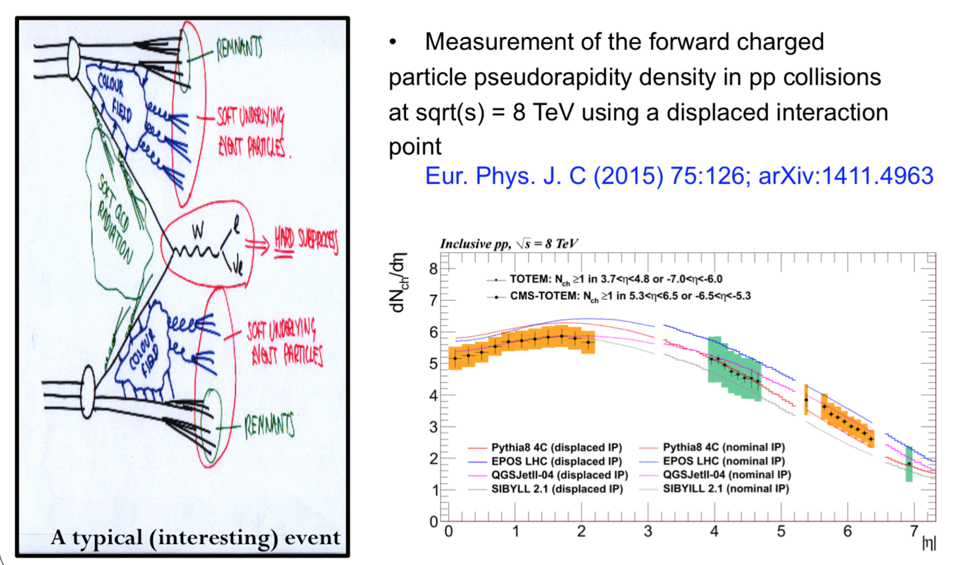
At the LHC we need to have under control both the soft (underlying event) & hard QCD
Will talk more about underlying event when
we discuss top-quark

Slide 17
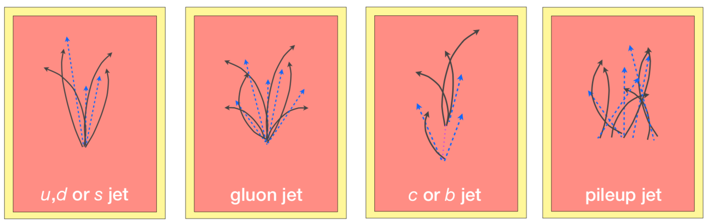
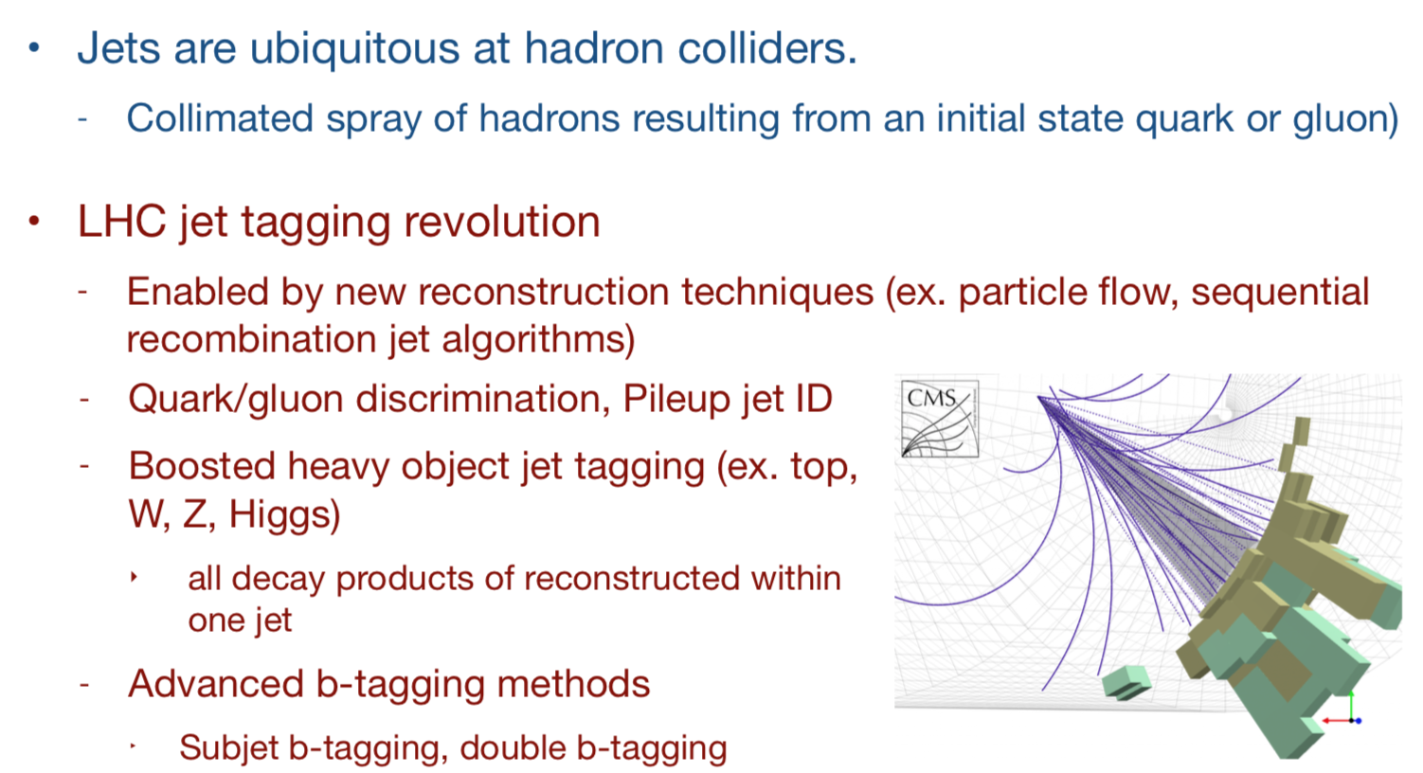
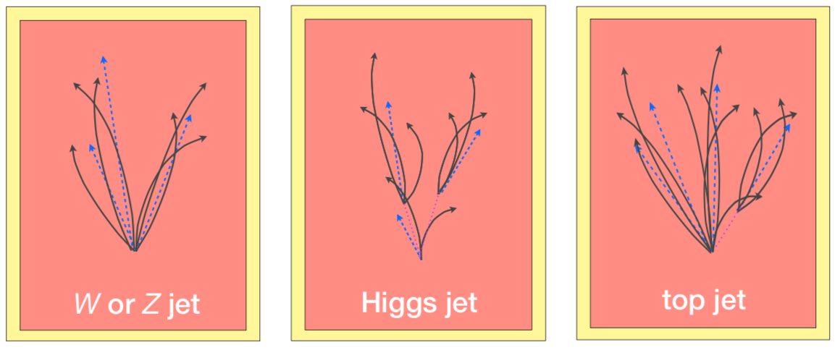
Before we continue…The hard processes very often produce jets. We are continuously improving our jet reconstruction

Slide 18
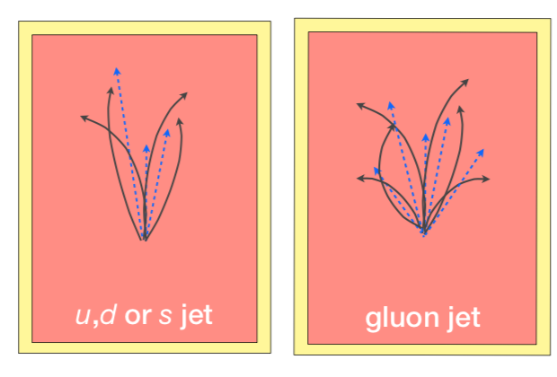
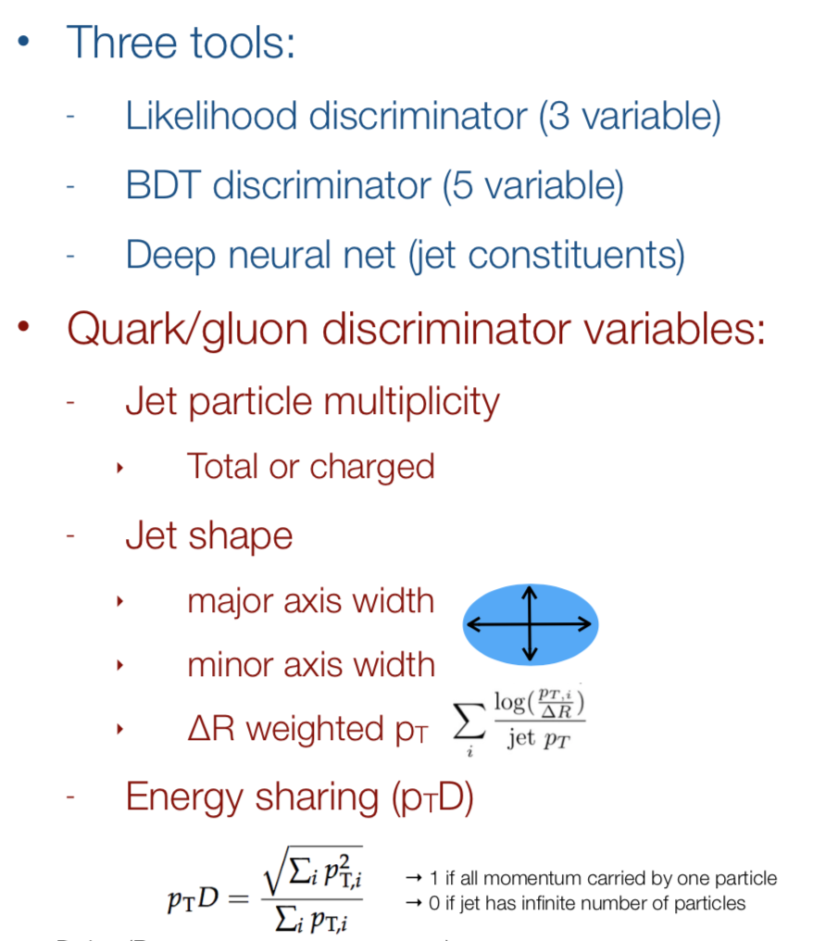
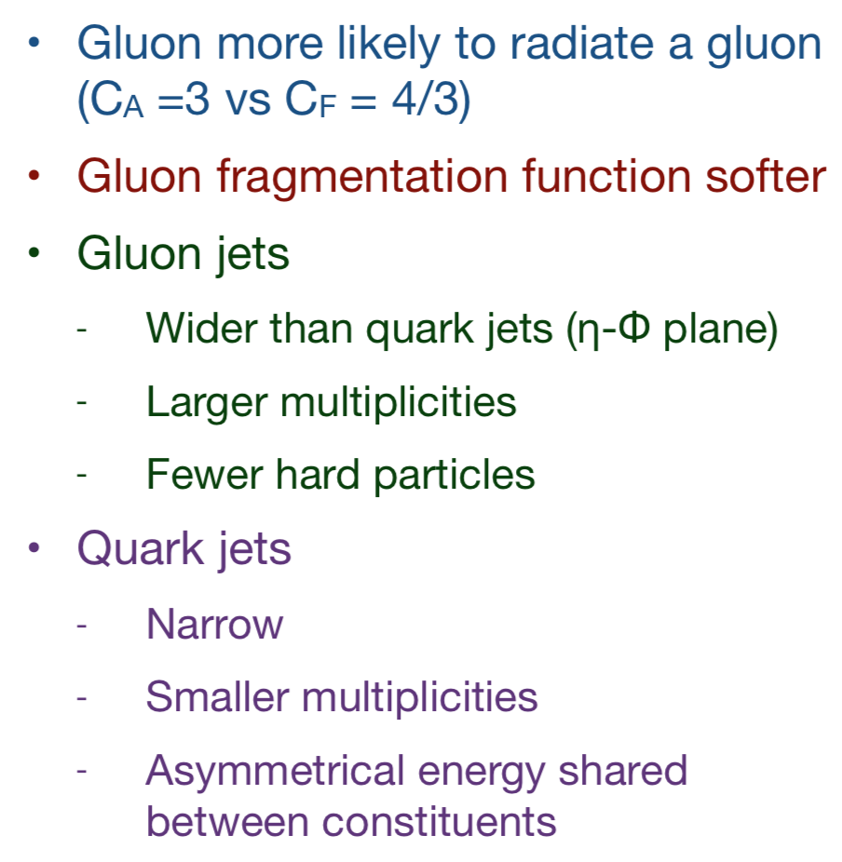
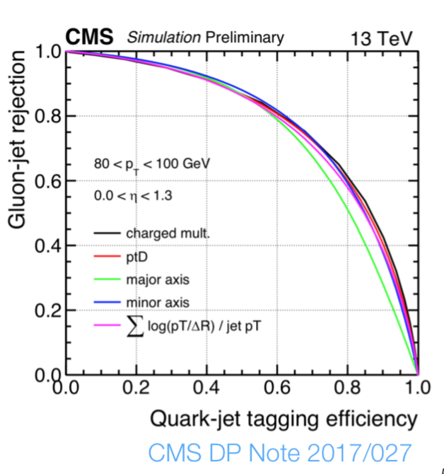
Identifying quark and gluon jets

Slide 19
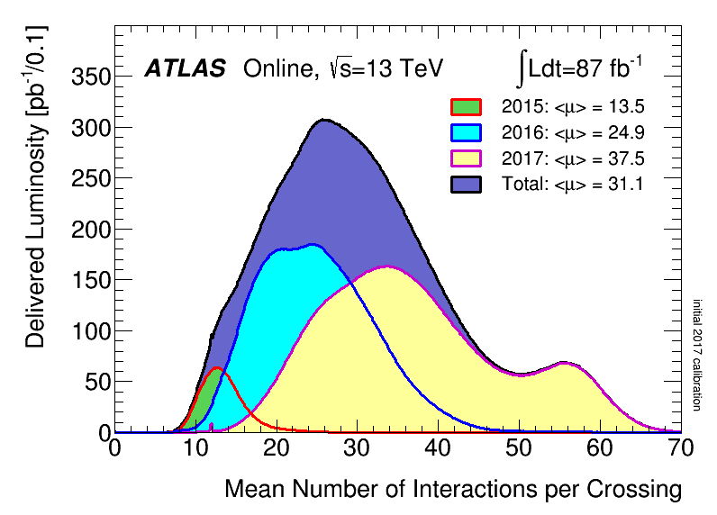
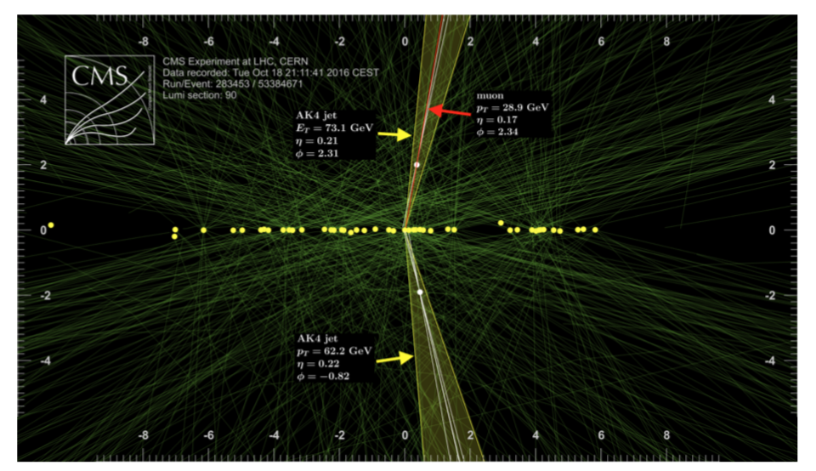
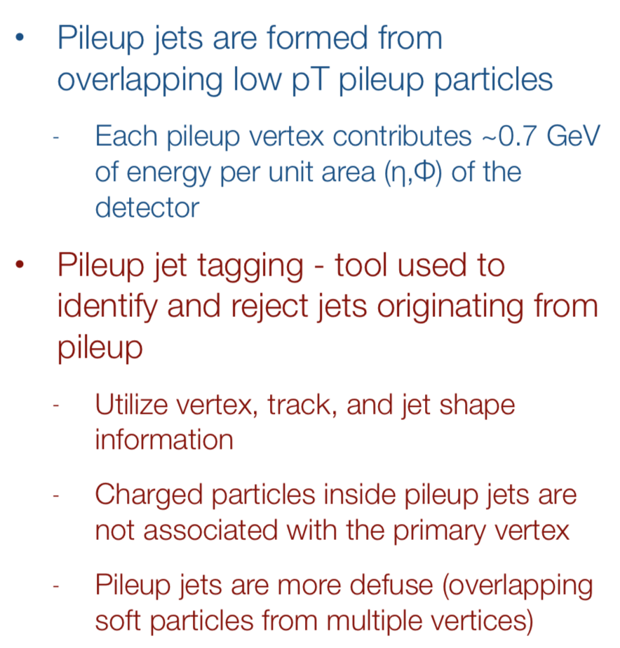
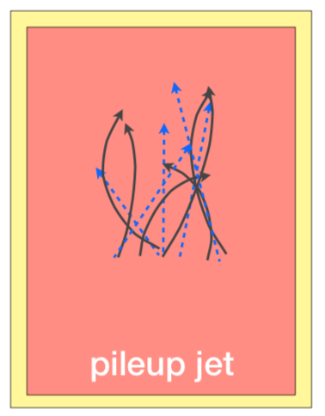
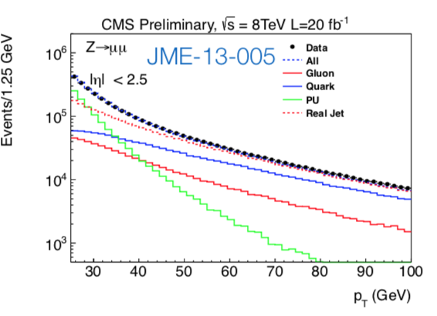
LHC Hostile environment

Slide 20
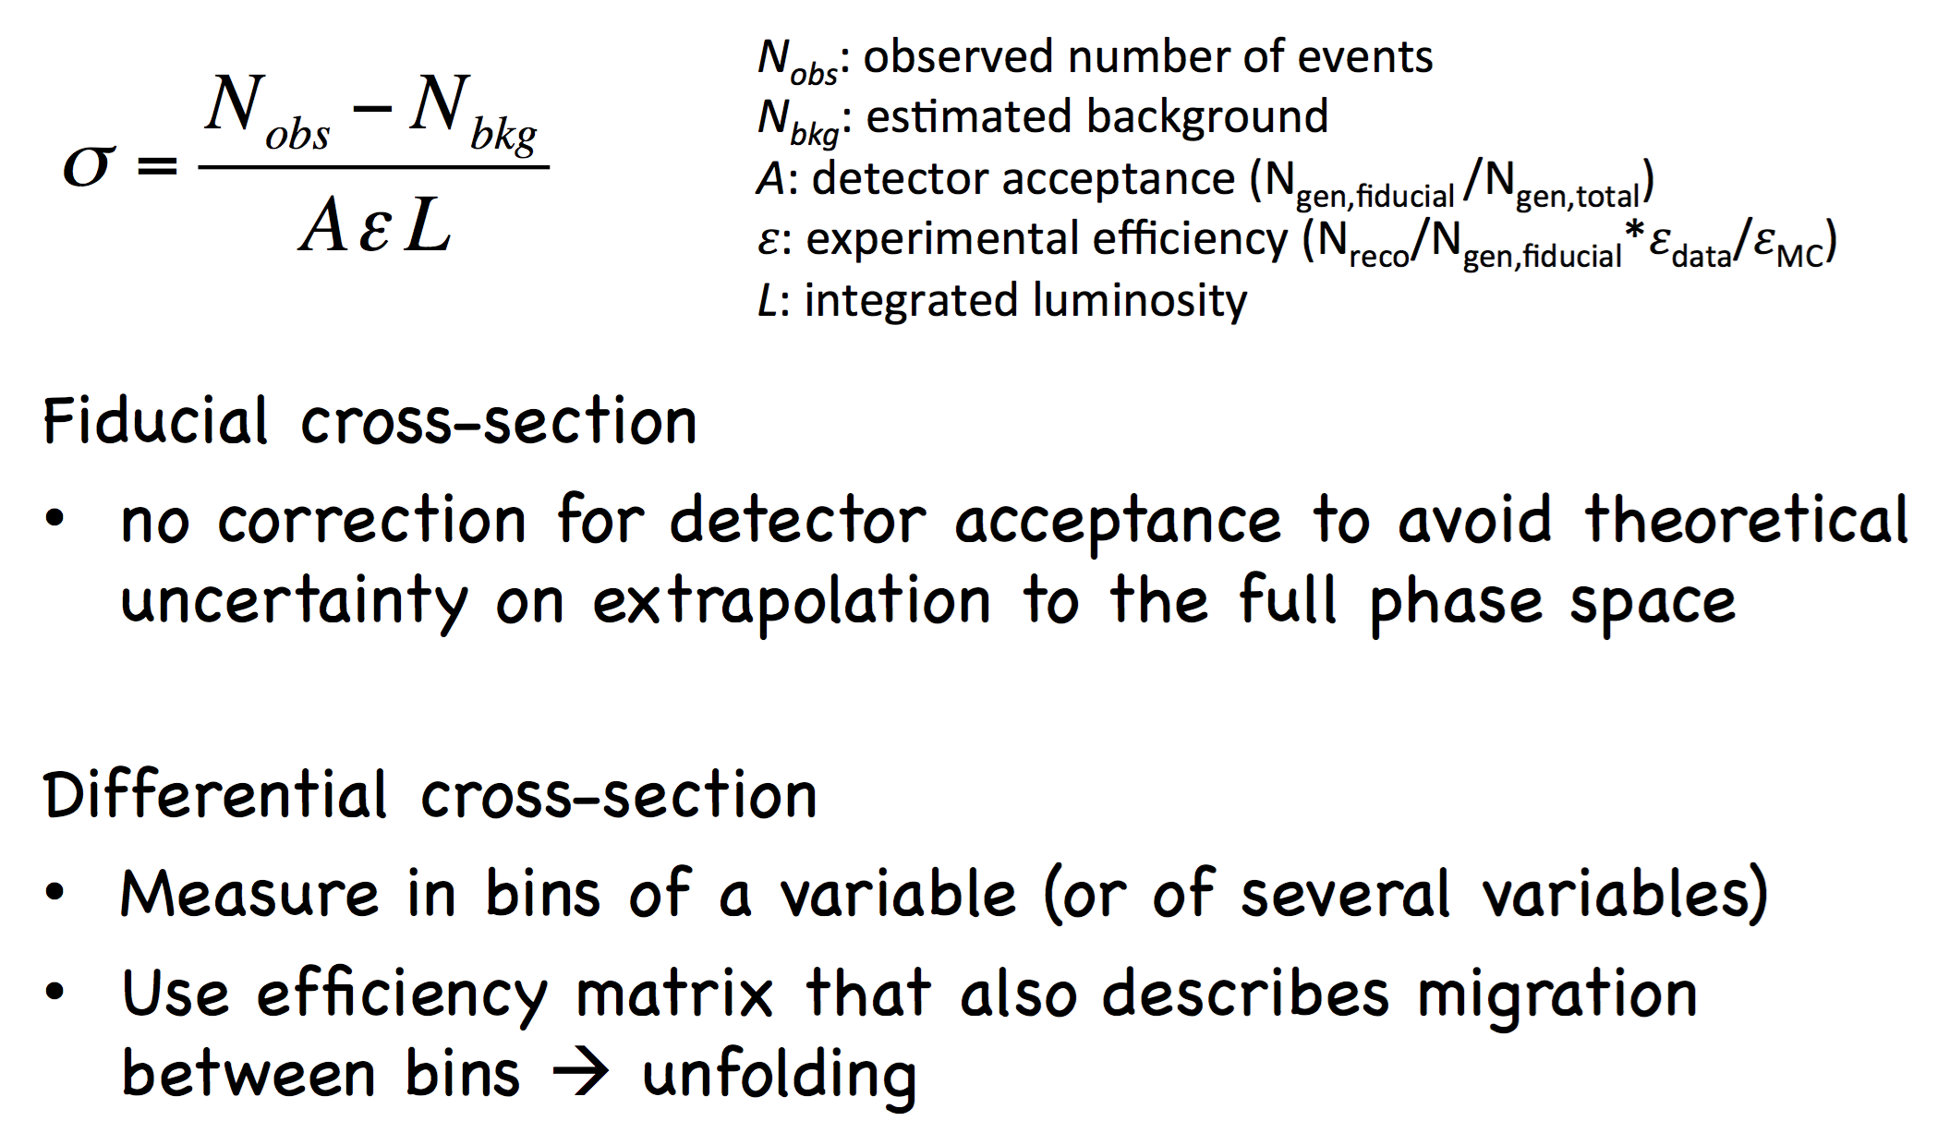
Aside… I am going to show several cross section measurements

Slide 21
V+ 2 jets
EW
Higgs
QCD
Top

Slide 22
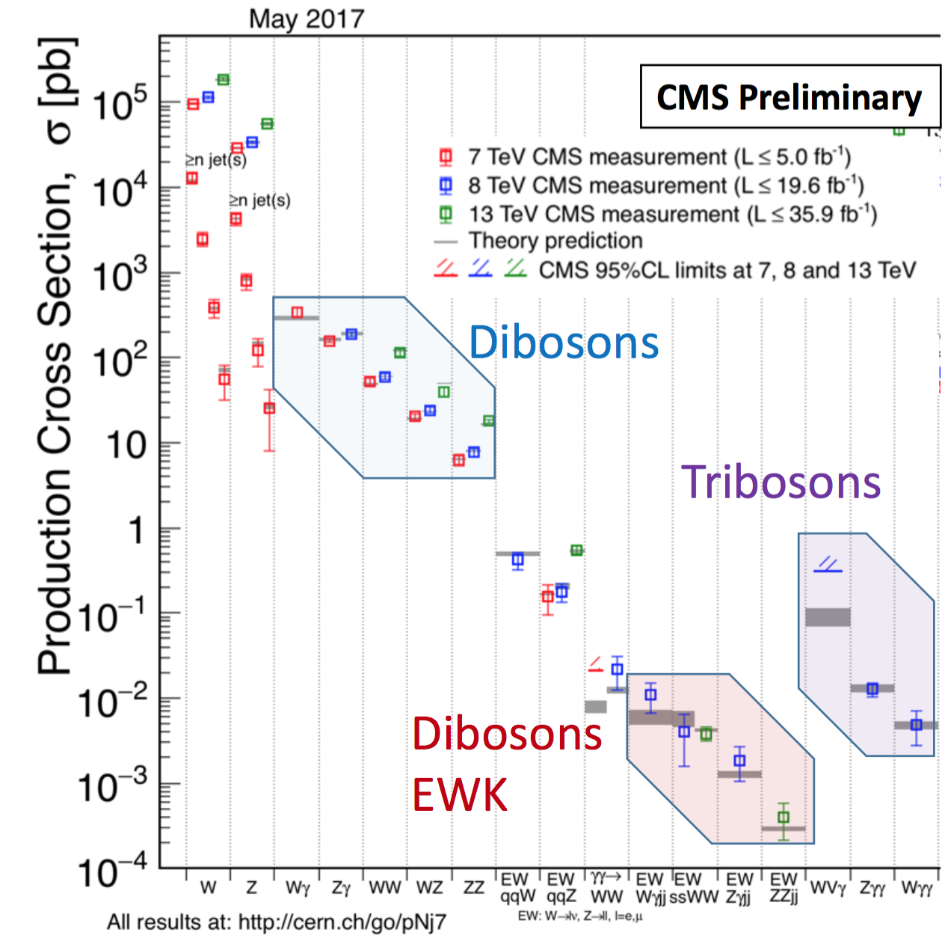
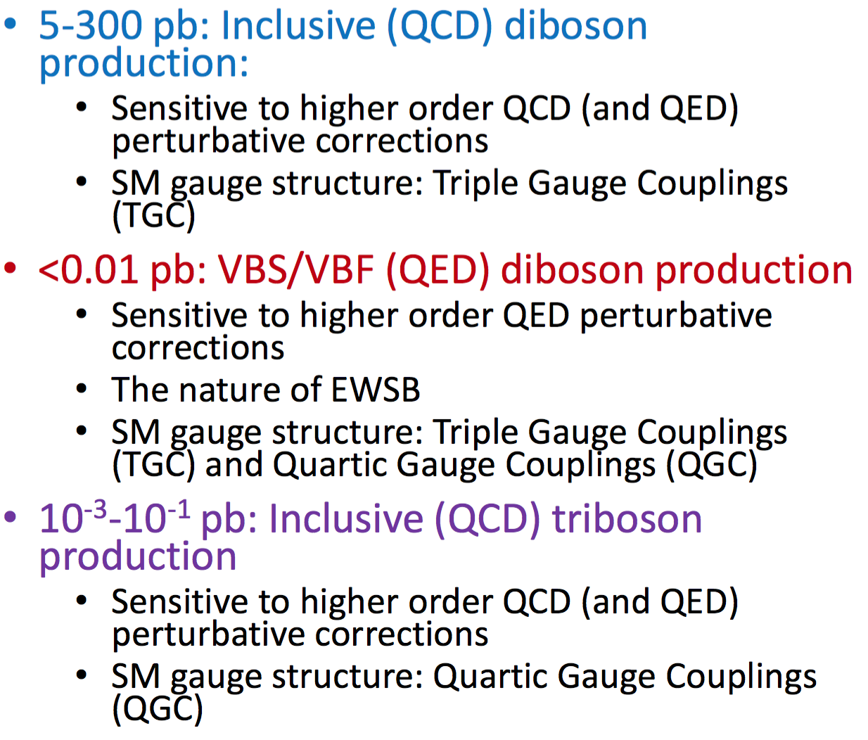
Focus 1st on EW production of single bosons and Multiboson
Huge range of production Cross Sections
Boson
EW
Dibosons
EW

Slide 23
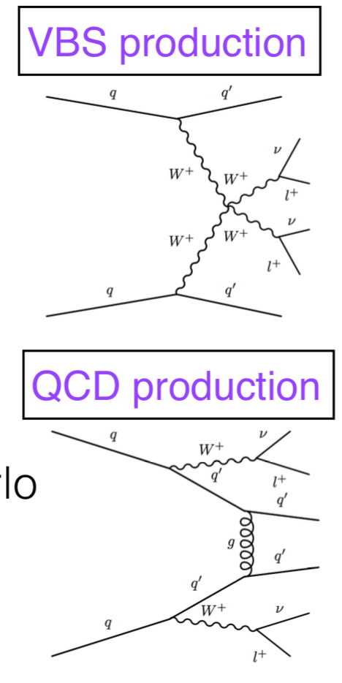
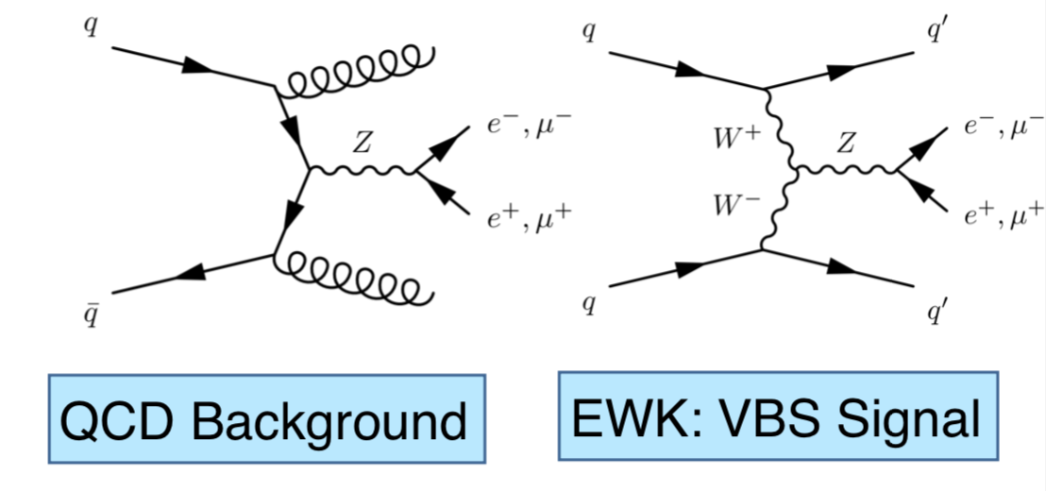
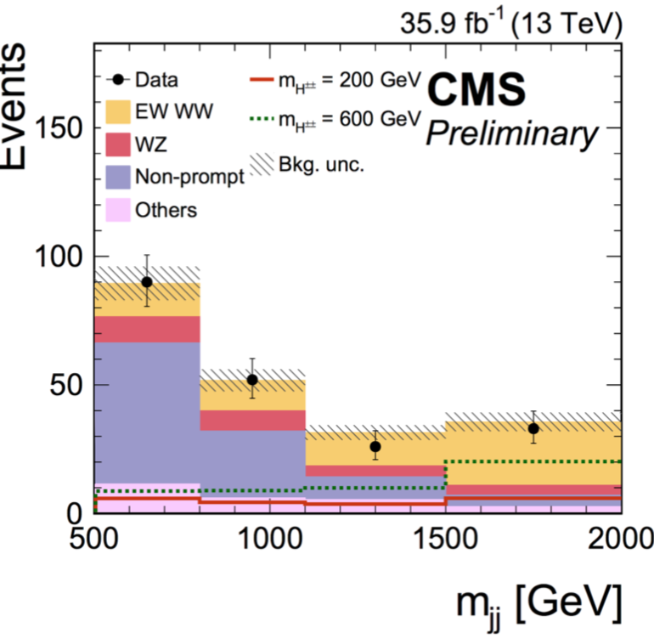
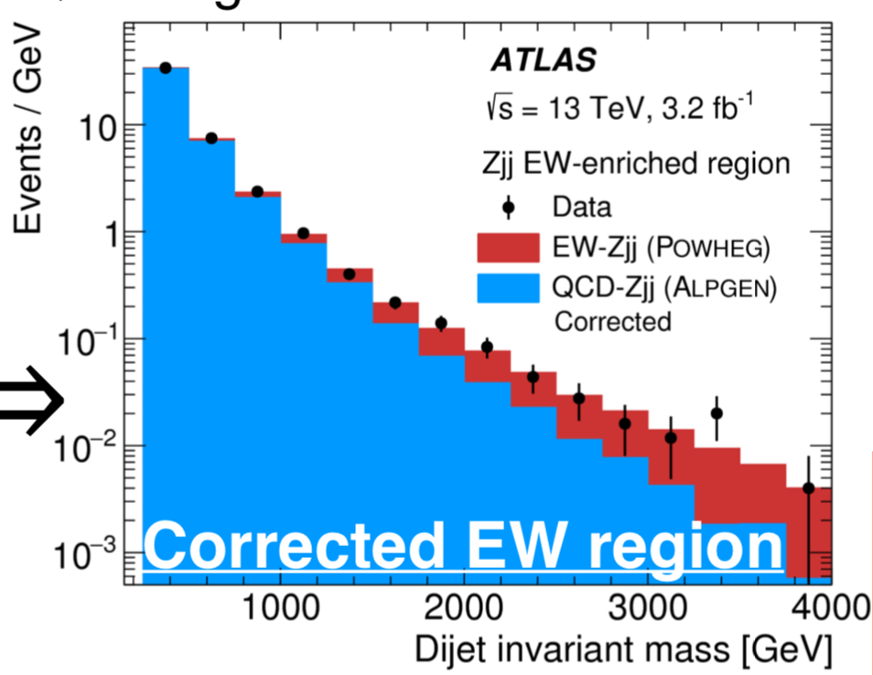
What do I mean by saying QCD or EW boson production ?
Many future analysis will have this topology
Notice that they all involve jets…
VBF: Vector Boson Fusion
VBS: Vector
Boson Scattering
EWK: VBF Signal
Future of the LHC
Great topology to search for new high mass resonances

Slide 24
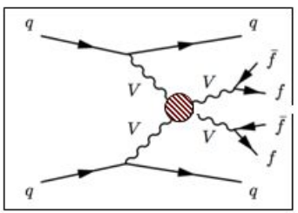
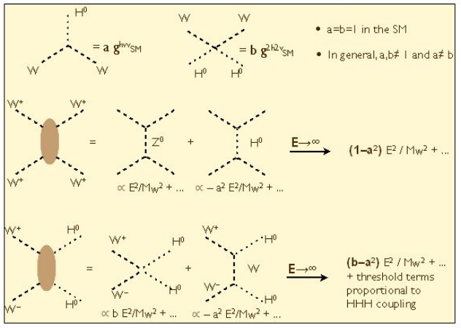


In SM, VBS crucial because (i) W_{L}W_{L} → W_{L}W_{L} vanishes, only (ii) W_{T}W_{T} → W_{T}W_{T} is present
M_{H}
(i) $≠0:$additional
particles are
Responsible for EWSB
M_{VV}
More on Higgs Lectures
V_{L} V_{L} scattering linked to the mechanism responsible for the EWSB:

Slide 25




We know how to reconstruct jets… therefore we can identify: pp→ qqV or qqVV
pp→ jj V
pp→ jj VV

Slide 26




Multibosons are also used to search for new physics via anomalous couplings

Slide 27


Anomalous couplings
Limiting factor: Observed statistics in the tail, systematics and statistical uncertainty on the S/B model ➔ Will improve as luminosity increases
Anomalous couplings result in an increase of cross sections at high energies
  Invariant mass of the diboson system and the boson p_{T} are particularly sensitive

Slide 28


Tribosons
First study by ATLAS of W±W±W∓ to
l±𝜈 +l± 𝜈+l± 𝜈 and l±𝜈+l± 𝜈+𝑗𝑗
More statistics will come @13 TeV
Access to quartic anomalous couplings

Slide 29





  Role of precision EWK measurements @ Hadron Colliders
  To provide precise measurements of fundamental parameters to tests the theory:
  Why? To have access to potential virtual new particles that might not be directly accessible at the current center of mass energy… just as we did for the Higgs before the actual observation
α_{s}
Some tension already in data … Better precision before we can conclude if significant

Slide 30




Precision measurements with W’s and Z bosons

Slide 31

W and Z Boson Production
Many detailed EWK studies possible – and done -- with the large Z,W samples
Here we will focus on
  sin²θ_{W}
  W-Mass
  Lepton Universality

Slide 32

Before we proceed…
Some historical & theoretical background of the ElectroWeak model
From: M.A. Thomson

Slide 33



SU(2)_{L} : The Weak Interaction – W boson

Slide 34



W Spin-1 – 3 possible polarizations:
W helicity affects the kinematics of the outgoing leptons
Both W+ and W− bosons produced with high pT at the LHC have a dominant left-handed polarization along their directionof flight
When left-handed W⁺ is produced in the transverse plane, its decay left- handed neutrino will be preferentially emitted along the flight direction
While for left-handed W⁻ , the charged lepton will fly preferentially in the same direction of the W, and the right-handed anti-neutrino will choose the other direction.

Slide 35


W helicity and best production mechanism of W with high momentum transfer
W⁻
ν
Dominates when starting from valence quarks

Slide 36


Polarization fraction depend not only on θ, φ,
but also PT and pseudorapitity y

Slide 37


But independent of the number of jets for W with high p_{T}

Slide 38


Aside: W helicity sensitive to the u & d fraction on the proton
A priori, the values of the f_{i} parameters are not expected to be the same for both charges, since for partons which carry a large fraction of the proton’s momentum, the ratio of valence u quarks to sea quarks is higher than that for valence d quarks
Asymmetry
is created

Slide 39








SU(2)_{L} : The Weak Interaction – Z boson
+

Slide 40






Slide 41


How to measure sin²θ_{W} at the LHC using pp→ Z ?

Slide 42



Interplay between $γ$& Z⁰ and the Vector and Axial-Vector nature of the Z⁰
Quantum Mechanical Effects

Slide 43



WORLD AVERAGE: Including LHC Results based on FB asymmetries in Z-decays
_{Reduction by} factor of 2 expected with 13 TeV data and by 4 at the HL-LHC

Slide 44

Motivation for precise measurement of the
W-mass
SM at LO the W boson mass depends on parameters known with high precision:
Beyond LO : corrections depending on m_{H} and m_{top}
Test of SM: compare measured m_{W} to prediction from SM EWK fit
SM fit without m_{W}: m_{W} = 80354 +/- 7 MeV (arXiv:1803.01853)
Previous combined measurements :
LEP m_{W} = 80376 +/- 33 MeV Tevatron m_{W} = 80387 +/- 16 MeV

Slide 45


W-Mass
Determination
Measurement based on 7 TeV data (4.6 fb⁻¹). It takes time to get the systematic uncertainties under control for precision!!
Included ~14.10⁶ W leptonically decaying W candidates
Technique uses template fits to the W- p_{T} and m_{T} predictions
Calibration of energy scale, recoil response and efficiency studies using the large Z sample. Modelling of helicity effects constrained by W and Z data.
arXiv:1701.07240

Slide 46


W Mass Measurement

Slide 47


Lepton Universality in W-decays
If anomalies in b-meson decays into τ’s (D*τν) persists, it becomes more important to revise our assumptions on Lepton Universality
No change
Since 2005…
BR ~2.7 σ
larger than e/μ

Slide 48


Possible because ttbar and tW are a great source of W$±$
Becoming harder to mantain low energy
thresholds for single lepton triggers level
@ the LHC
➔ Future requires new trigger schemes

Slide 49
More tomorrow…

Slide 50
Backup

