Slide 1


Top, ElectroWeak and QCD at the LHC
Lecture #2
MAYDA M. VELASCO
NORTHWESTERN UNIVERSITY & COFI INSTITUTE

Slide 2
ElectroWeak
Interactions act on all know particles
Decay t→ Wb
Higgs Yukawa coupling
Top quark
Massive “bare quark” couples strongly with all known forces
Single top production
M_{W}, sin²θ_{W}, m_{top},
M_{H}, α_{s}
Perturbative &
Non-perturbative regimes
Perturbative regime
Production
ttbar production
QCD
Interactions are only between gluons, quarks

Slide 3
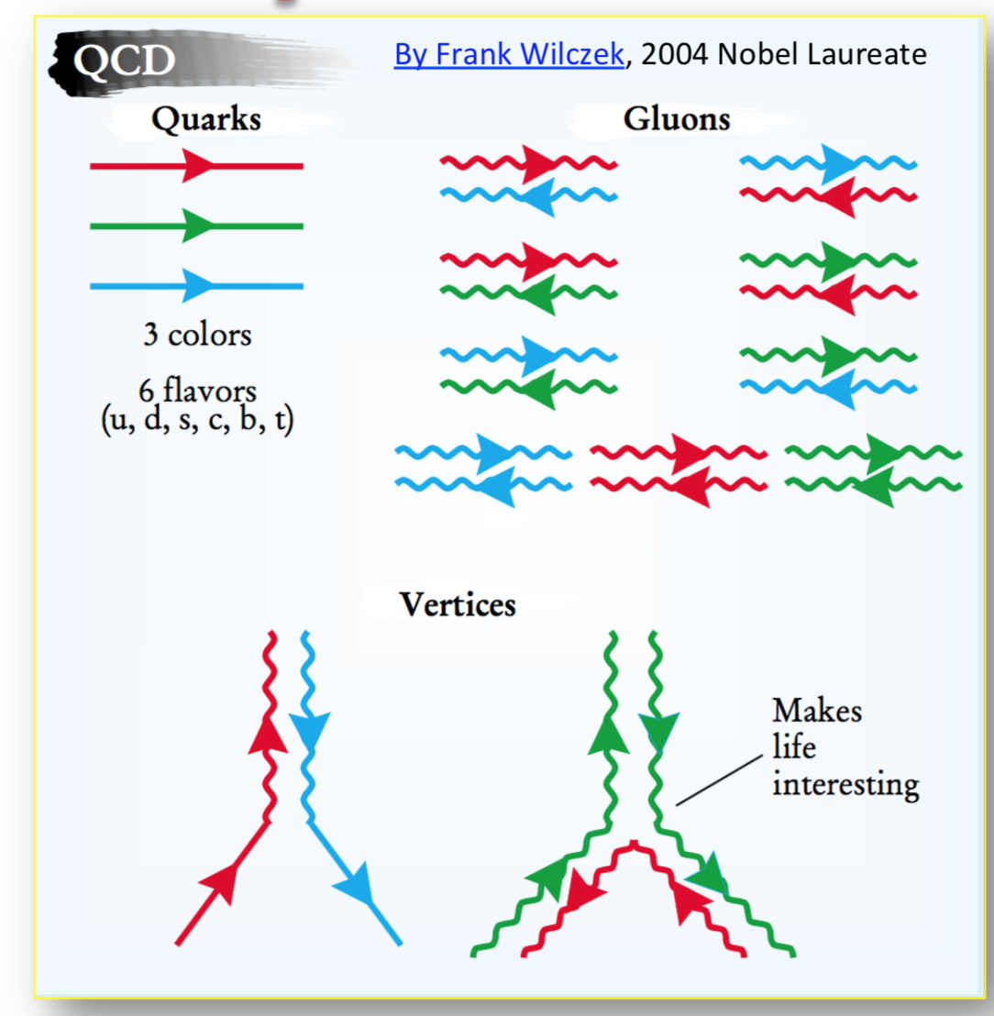
Quarks
Charged
leptons
Neutrinos
Weak charged current:
All particles
Flavour changes
Weak neutral current:
All particles
No change of flavour
➔ GIM mechanism

Slide 4
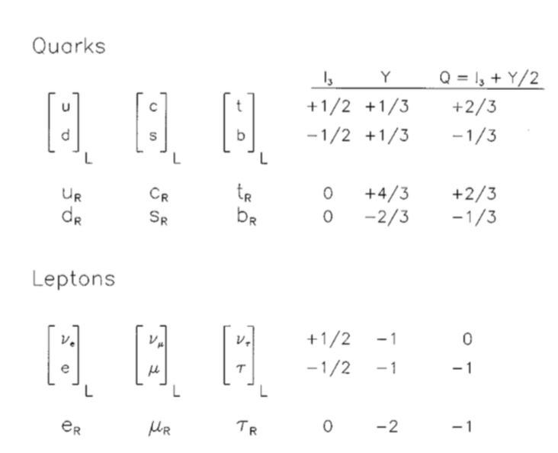
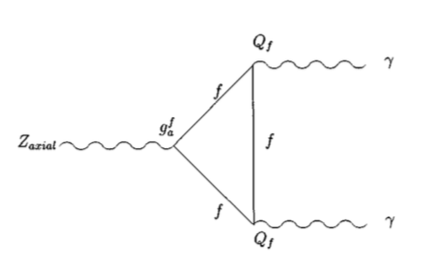
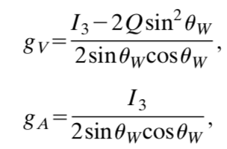

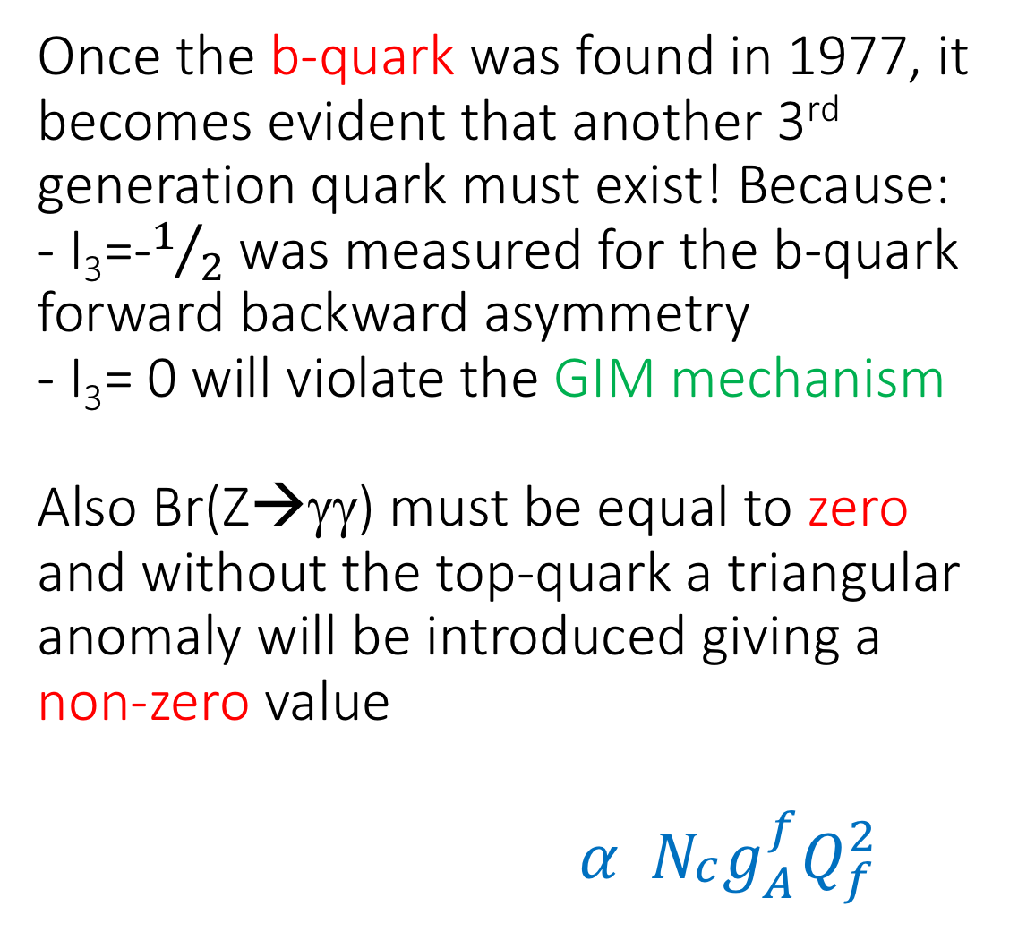
Once the b-quark was found in 1977, it becomes evident that another 3rd generation quark must exist! Because: - I₃=-$1/2$was measured for the b-quark forward backward asymmetry
- I₃= 0 will violate the GIM mechanism
Also Br(Z→γγ) must be equal to zero and without the top-quark a triangular anomaly will be introduced giving a non-zero value
$$α N_{\begin{aligned}c \\ \end{aligned}}g_{A}^{f}Q_{f}^{2}$$
Historical overview of the
top quark

Slide 5
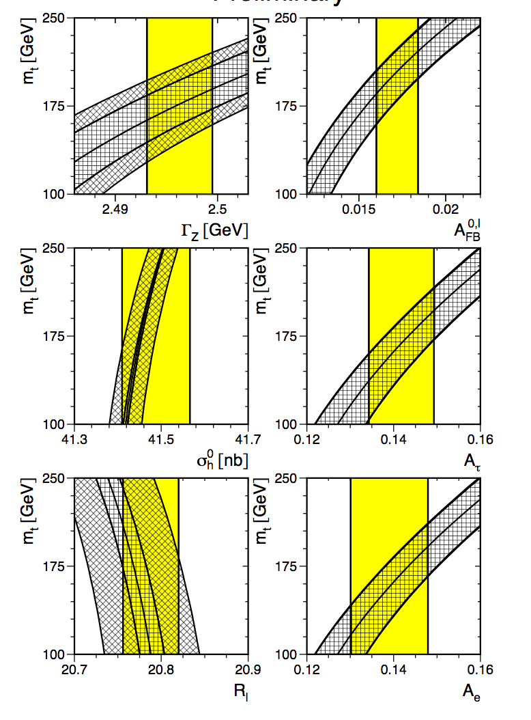
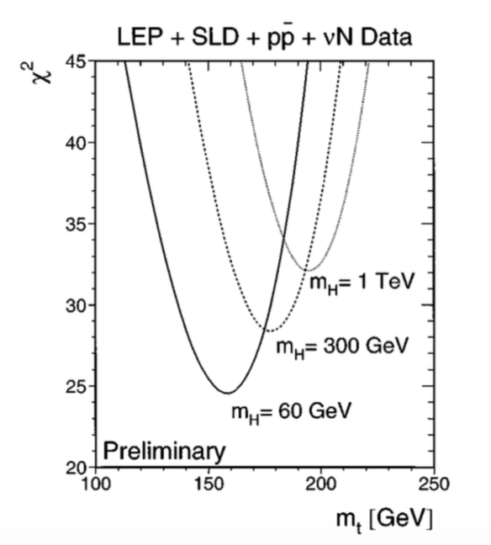
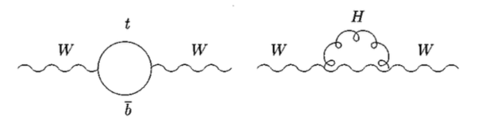
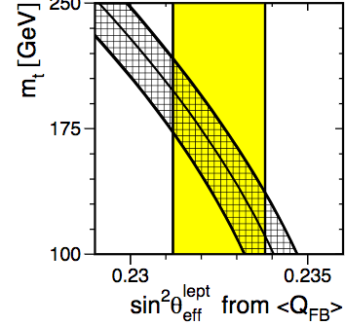
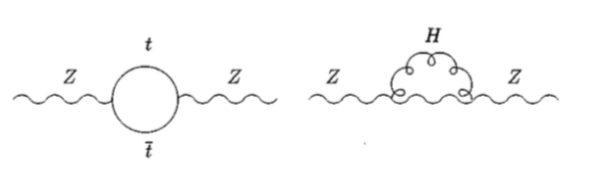
Our knowledge of ElectroWeak parameters in the early 1990’s allowed us to predict the top-quark mass as a function of the Higgs boson mass and other SM parameters
Historical overview
of the top quark

Slide 6
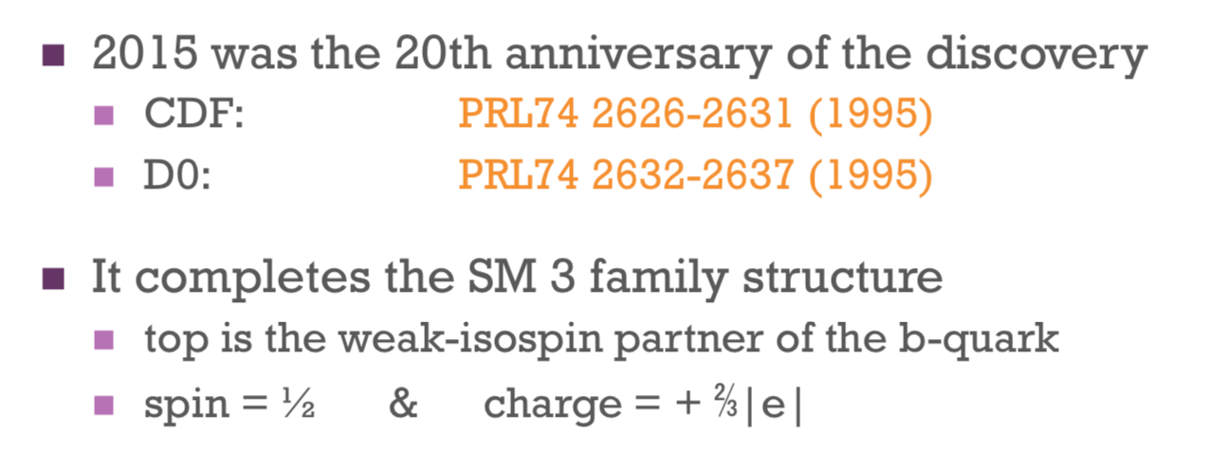
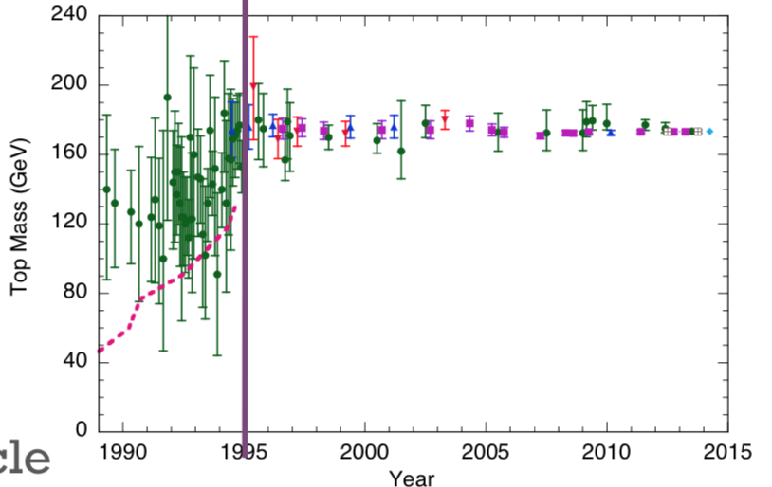
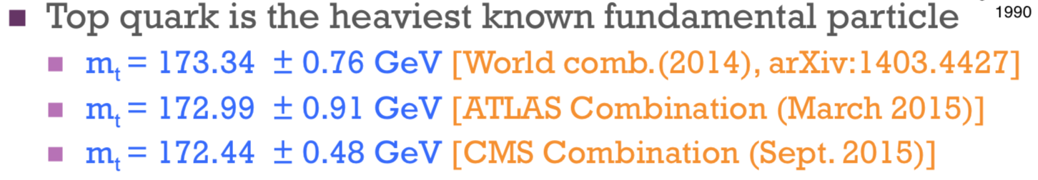
By now…Top quark is “old” enough to drinking

Slide 7
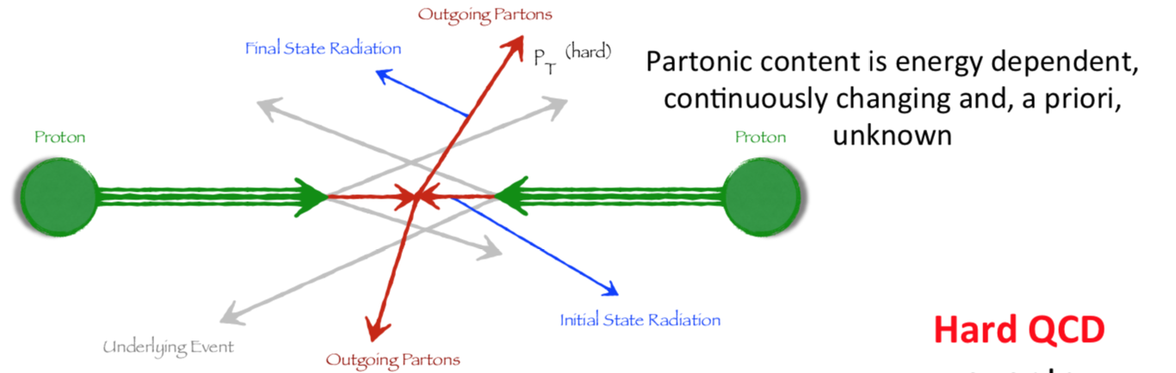
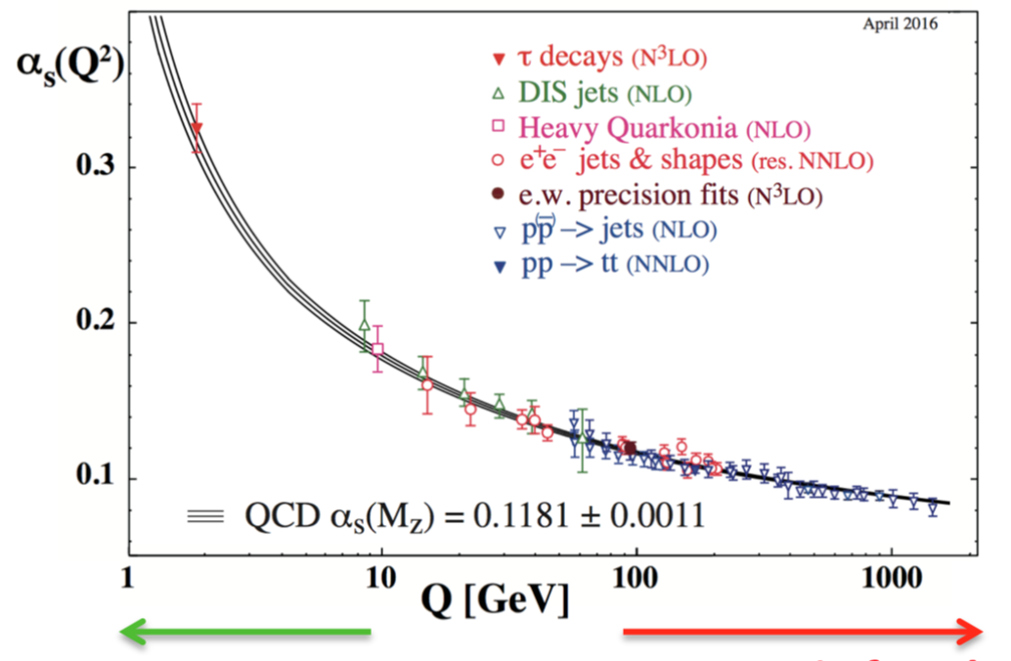
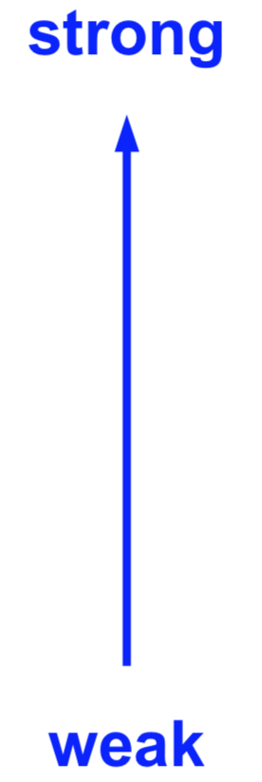



Top quark is providing a great opportunity to study both the Pertubative & Soft QCD regime
Compared to the electromagnetic force, which is infinite in range and obeys to the inverse square law, the strong force has a very short range. The restriction of the strong force to subatomic distances is related to two features called asymptotic freedom and confinement

Slide 8
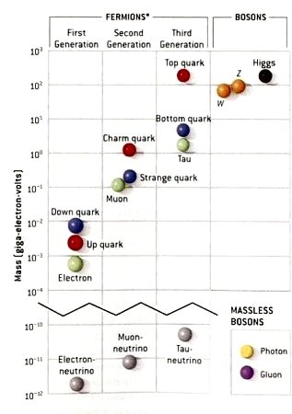
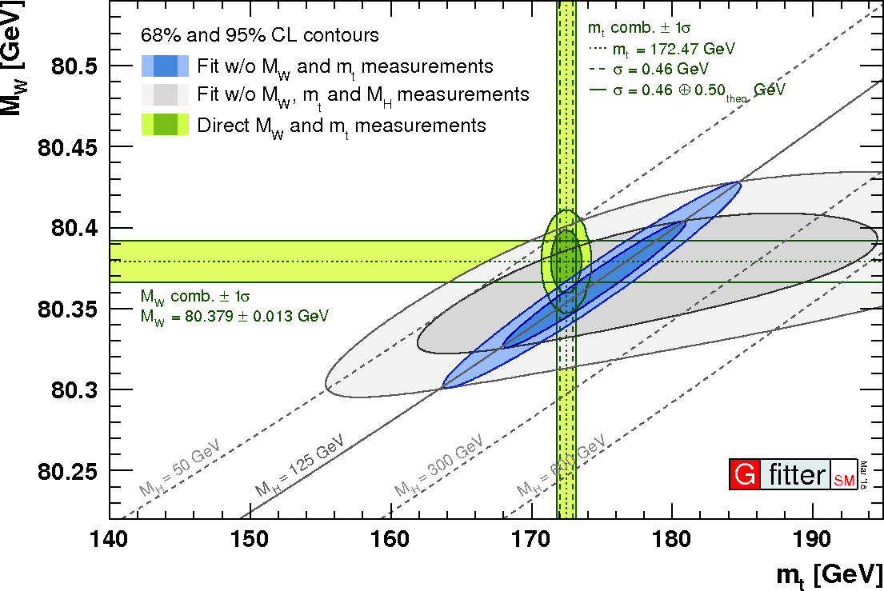
Other reasons to study the top
Top-quark is the most massive known constituent
of matter
M_{top} ~ M Gold Atom
Largest Yukawa coupling to the Higgs (recently measured…) providing more information on whether the Higgs Boson is truly a SM-like

Slide 9
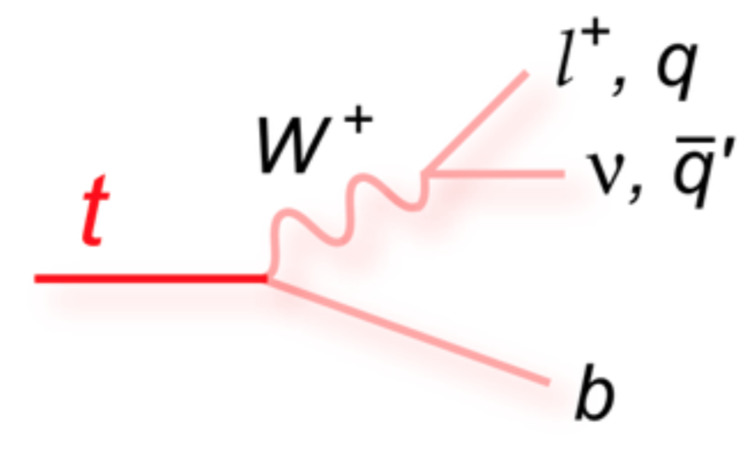
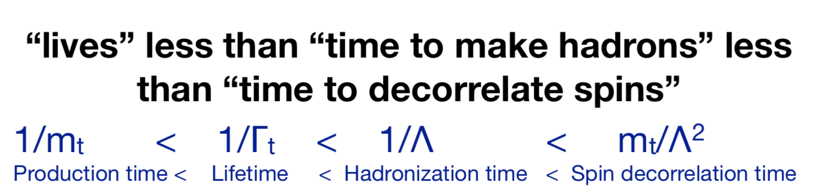
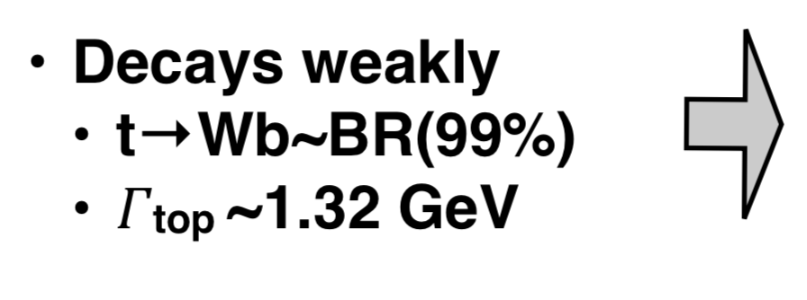
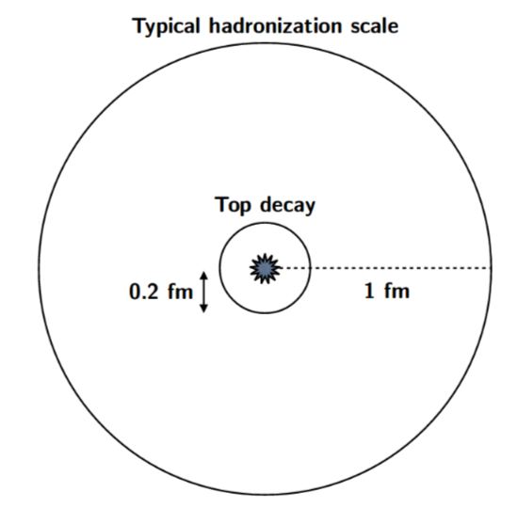
More reasons to study the top quark in detail
Mass of top-quark is so large that strong coupling is small that as already mentioned allows us to use perturbation theory , but more important is the fact that:
No top-antitop meson is observed , spin information is preserved in decay products

Slide 10
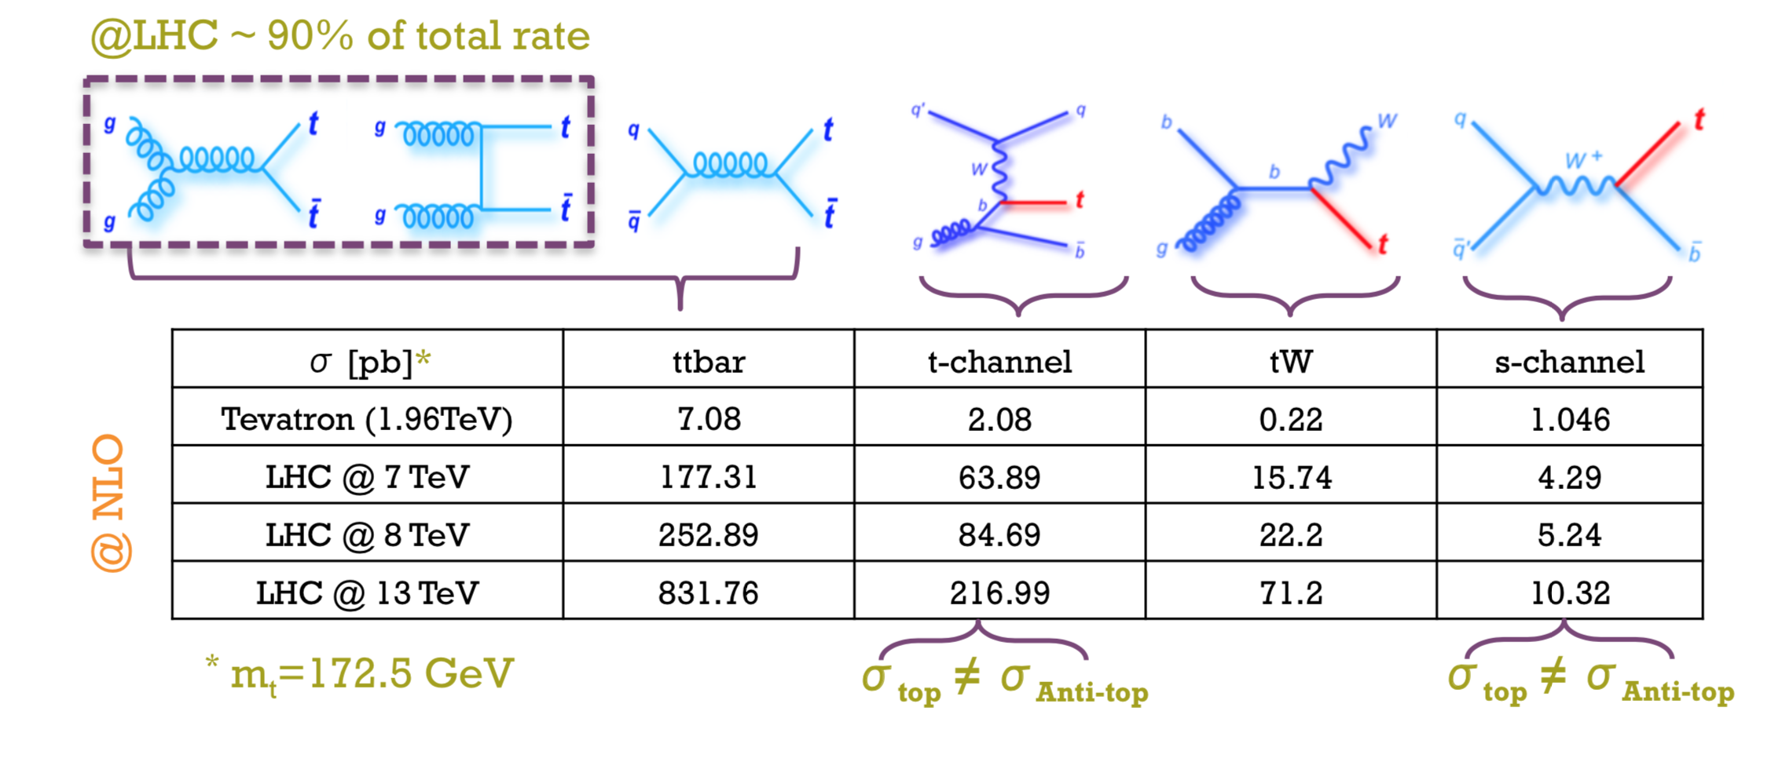
The LHC is a ”Top Factory”
At the LHC:
1 ttbar event per sec
top quarks are mainly produce in ttbar pairs
At a lower rate: single top quark
Strong Interactions
Weak Interactions

Slide 11
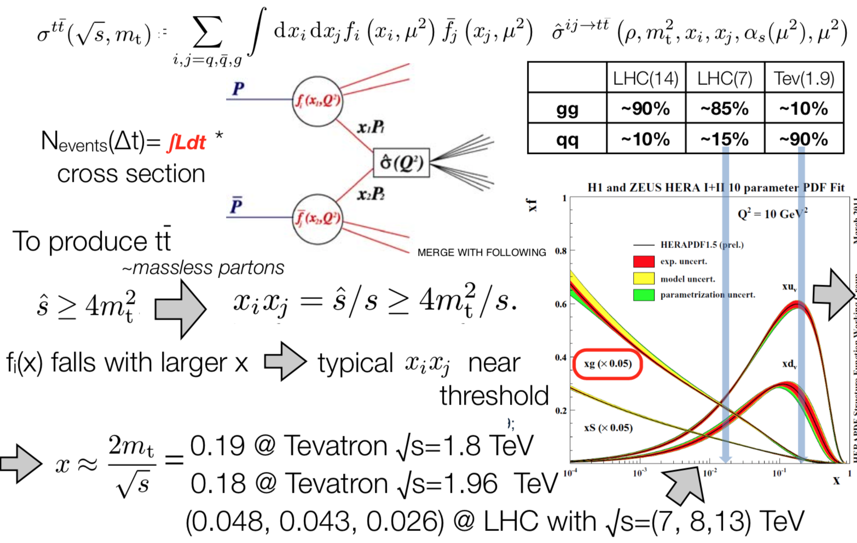
Additional information on ttbar cross section
ρ ≡ 4m²/s

Slide 12
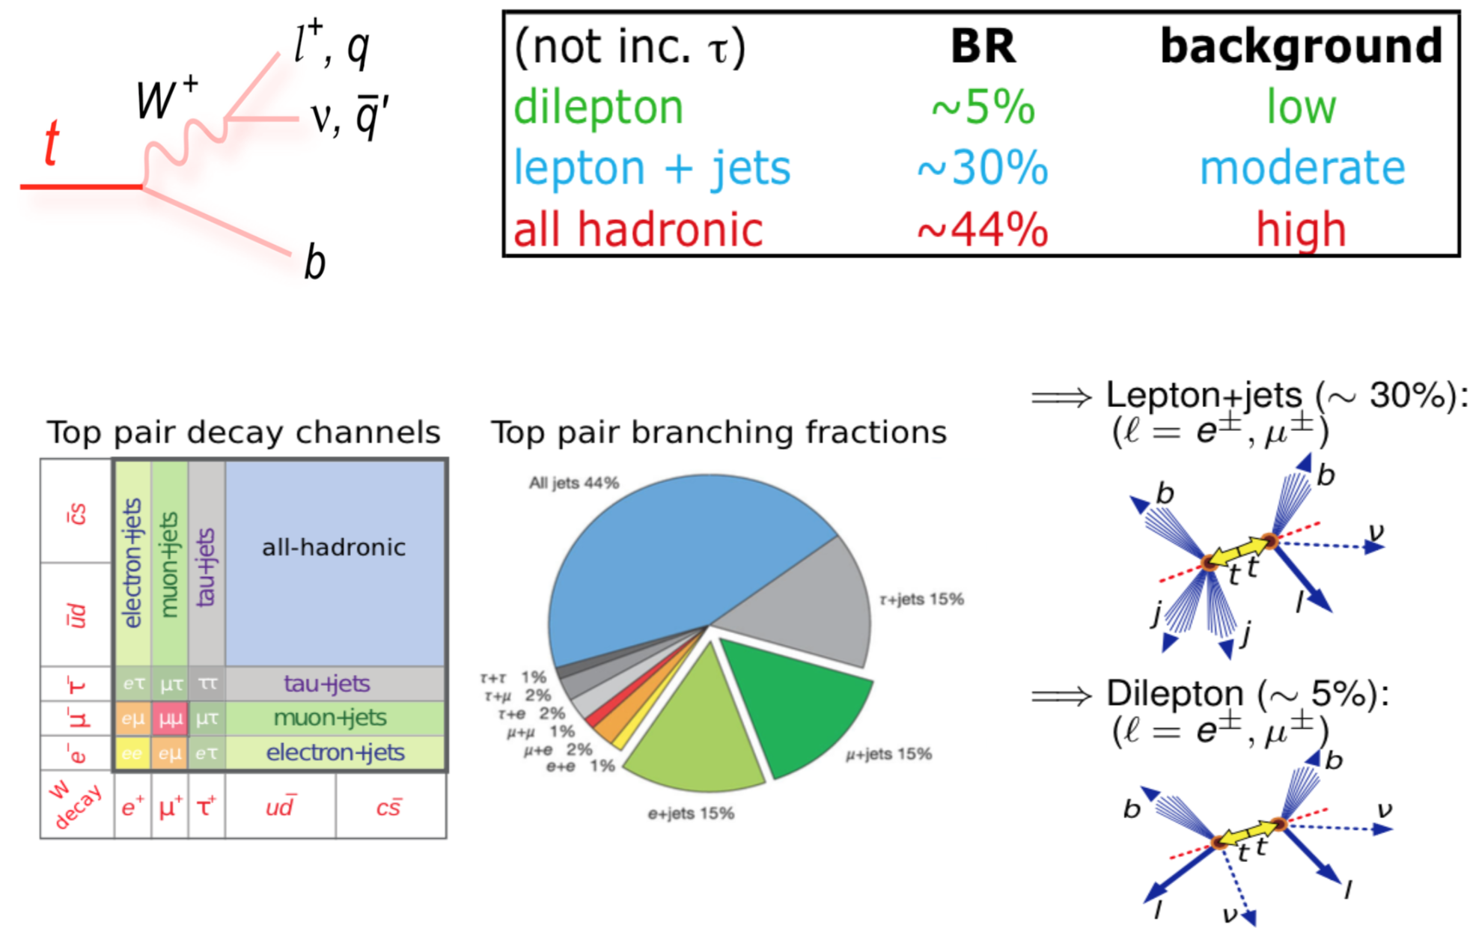
ttbar: Basic
Top – AntiTop topology

Slide 13
ttbar Cross Section
Measurements

Slide 14
ttbar Differential Cross Section
Measurements

Slide 15
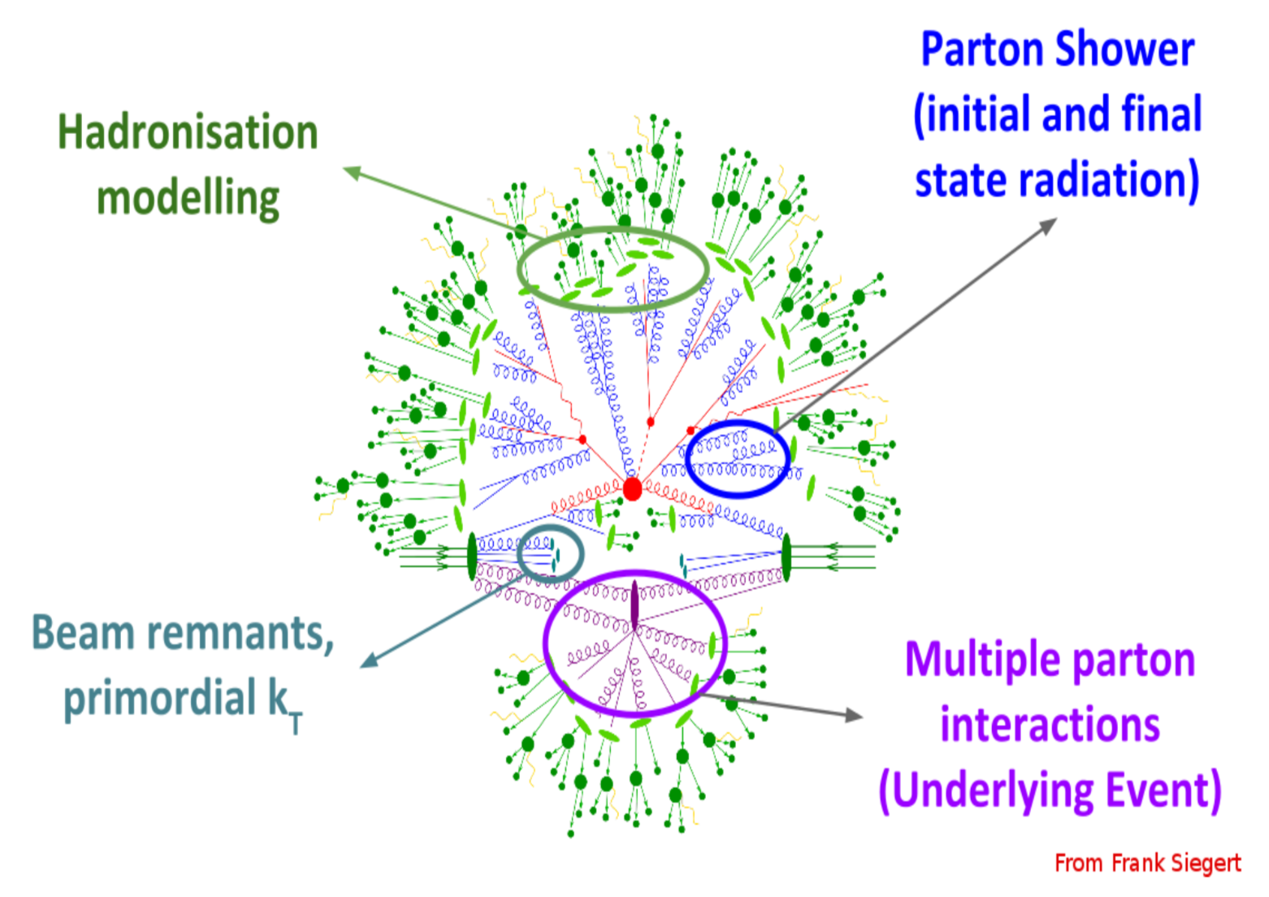

Underlying event at the LHC measured from data
Needs to be properly model in the simulation
A hard pp-collision at the LHC can be interpreted as a hard scattering between partons, accompanied by the underlying event (UE) consisting of the 4 components illustrated in this drawing… not just what is labeled as UE
Many processes are included in the nomenclature ”UE” at different scales
Double Parton Scattering (DPS), Diffractive processes,
Semi-hard multiparton interactions

Slide 16
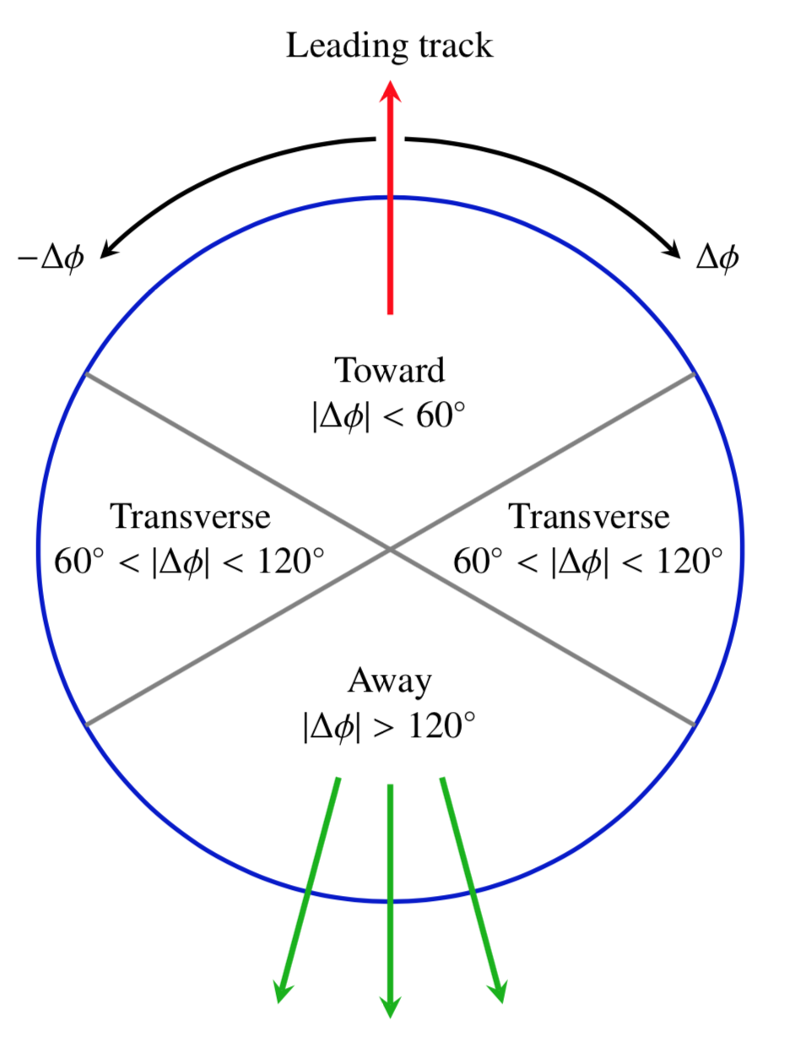
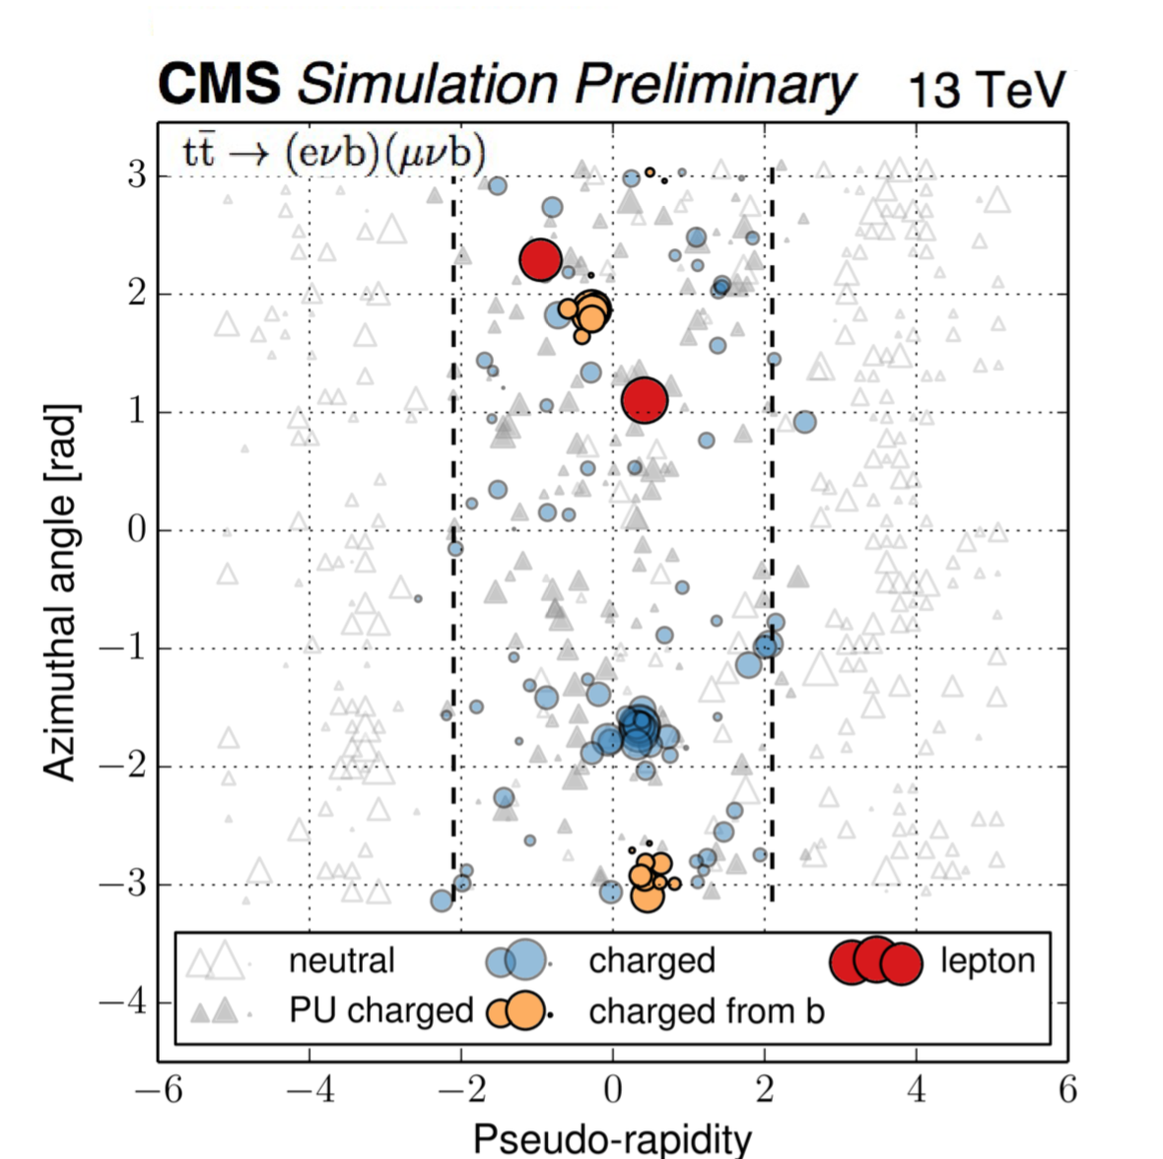
Measuring the “UE” at higher scales from tt → eνb + μνb (CMS-PAS-TOP-17-015)
Initial
measurements
from
Minimum bias,
DY, etc.
In event generators
a lot of parameters need to be adjusted (tuned) to describe data

Slide 17
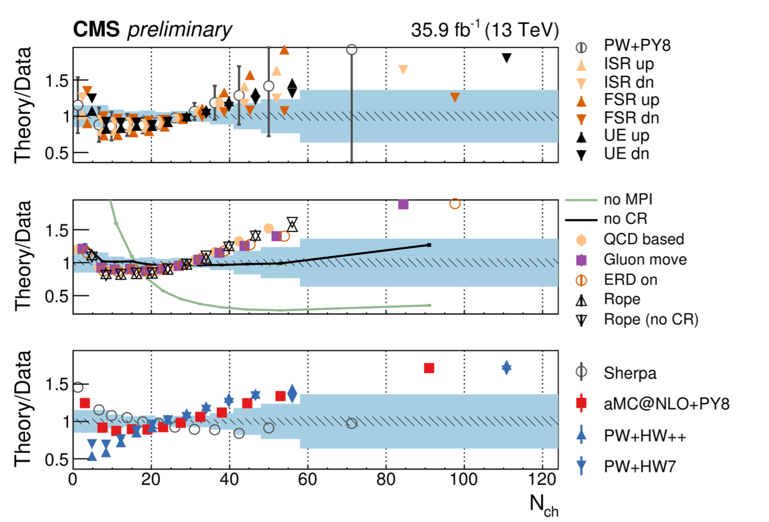
Measuring UE properties at μ_{R},μ_{F} ≈2m_{t}
Comparisons with a range of generators, tunes and settings

Slide 18
Top mass measurements
We still need to improve M_{top} :
the recent shift on the world average of the top mass resulted in a lowering of 3 GeV on the predicted Higgs mass

Slide 19
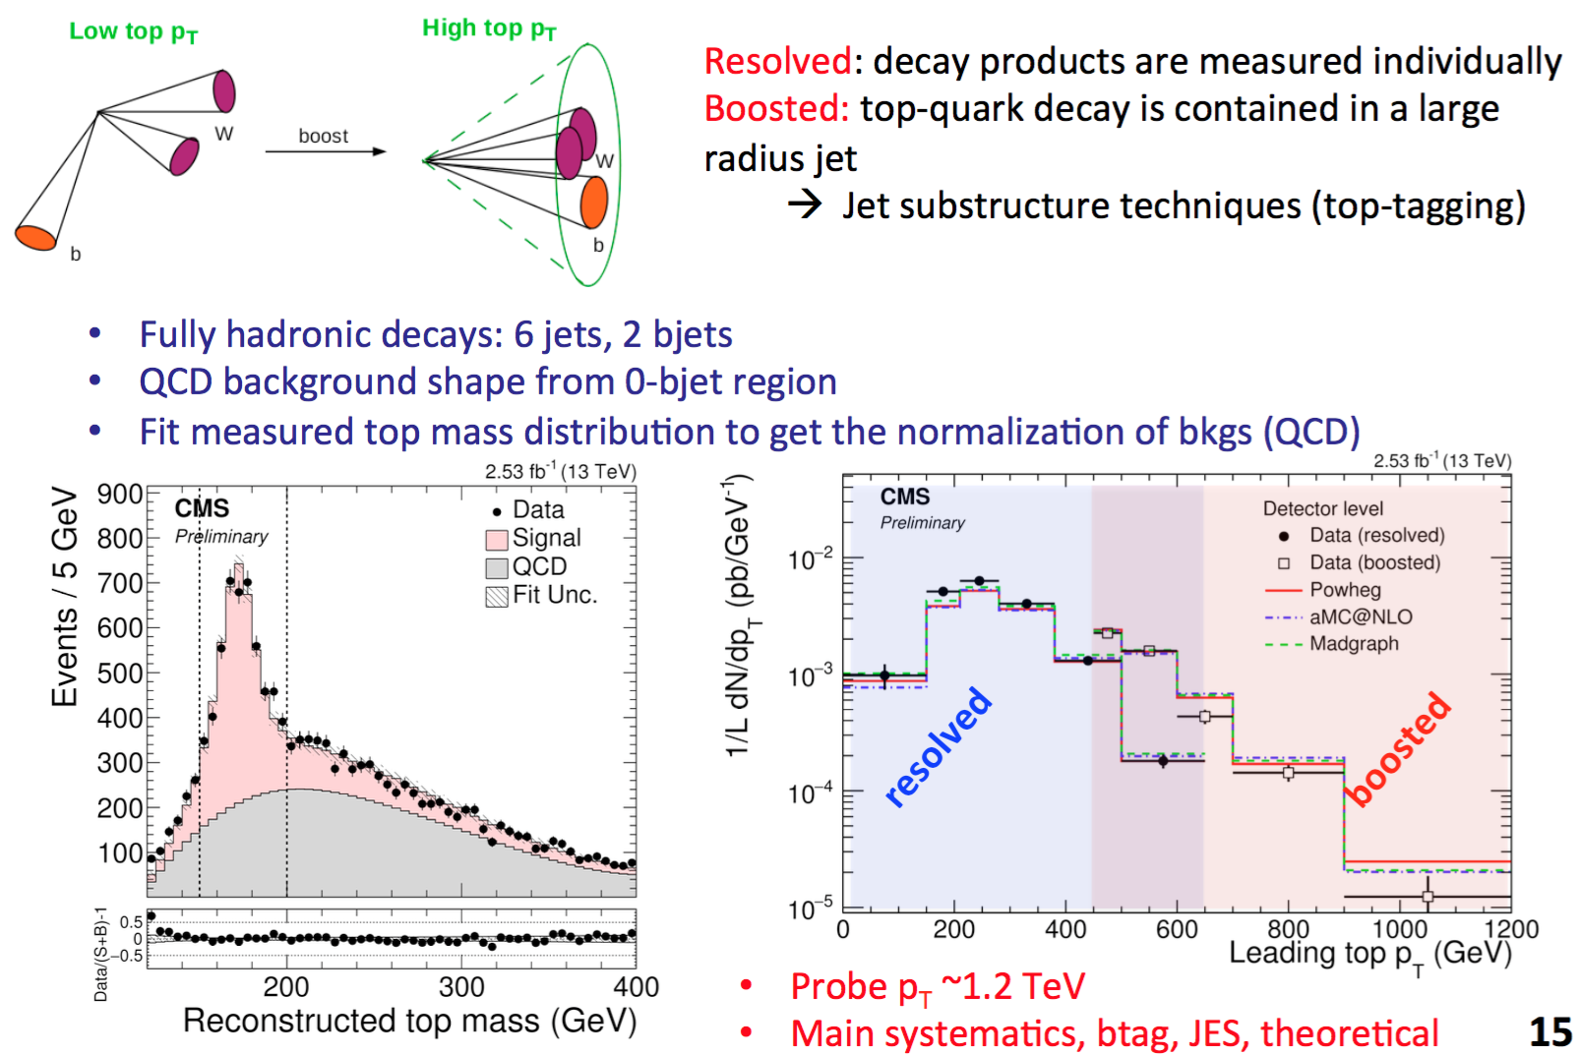
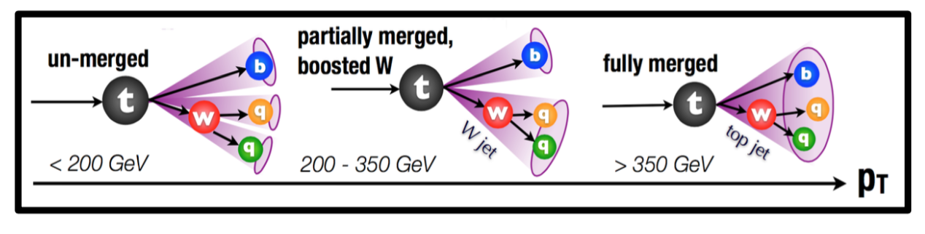
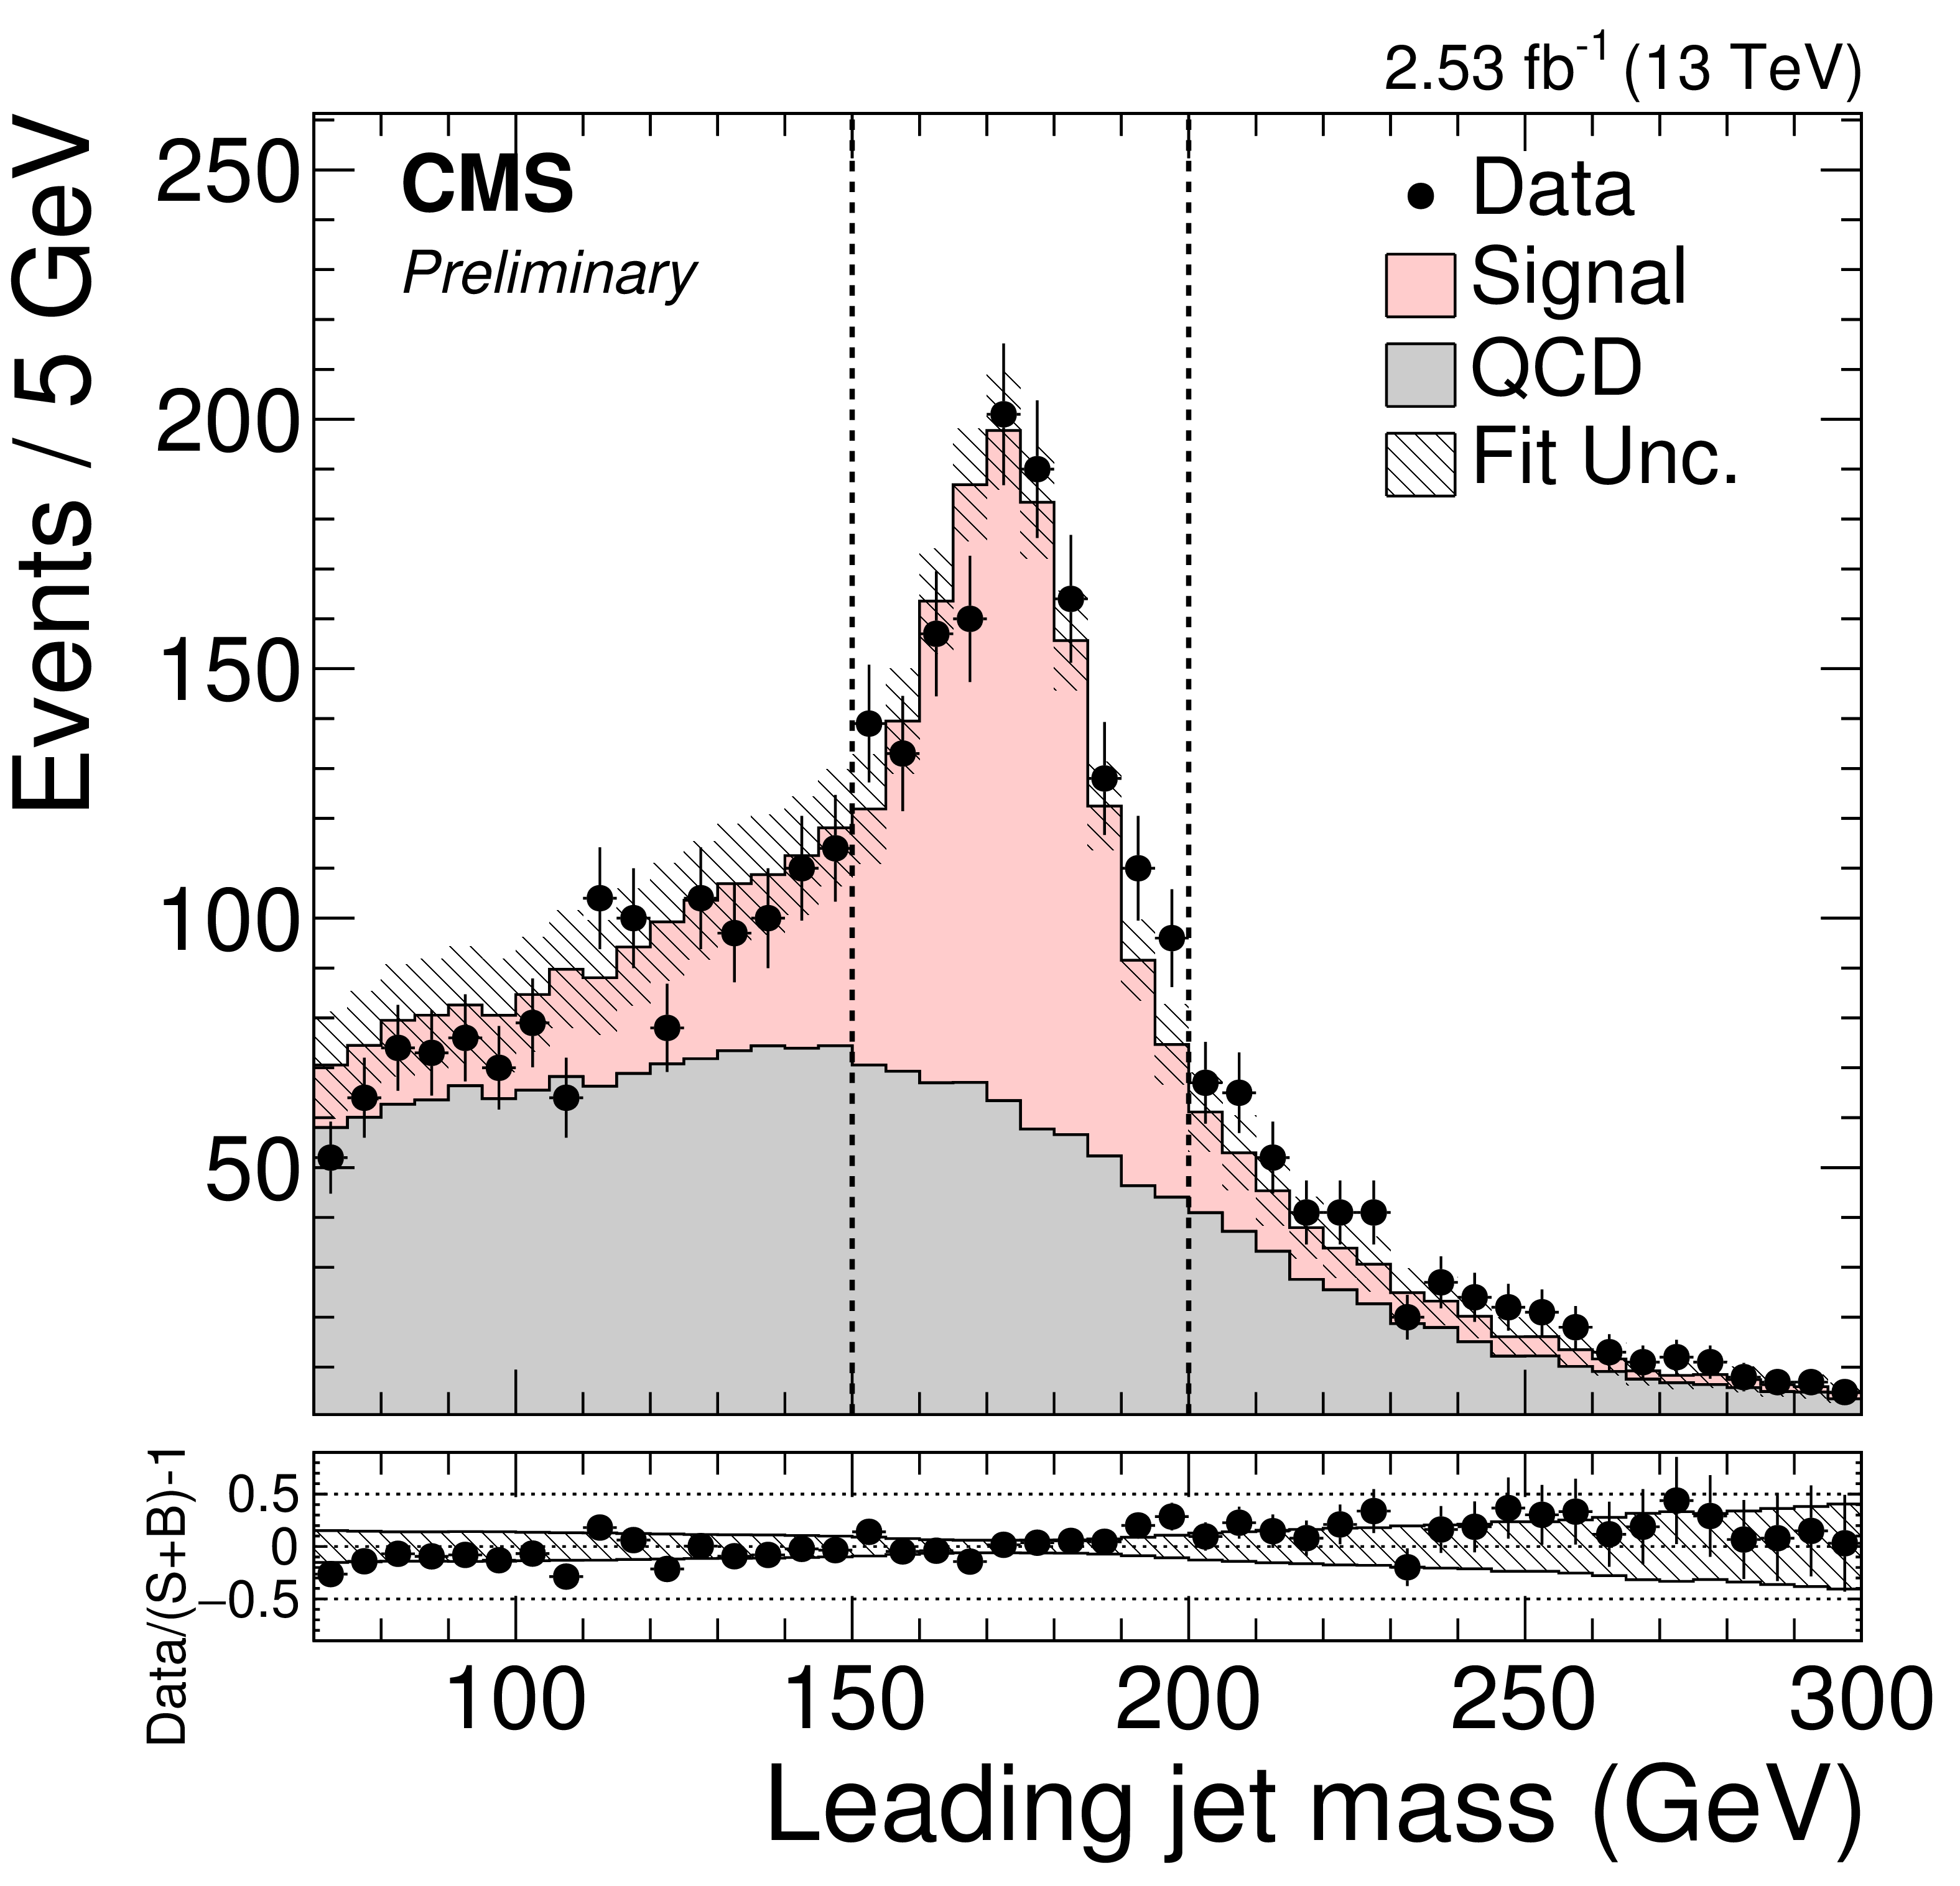
Future top mass measurements could come from the boosted topology with W’s decaying hadronically
Boosted
resolved
CMS-PAS-TOP-16-013

Slide 20
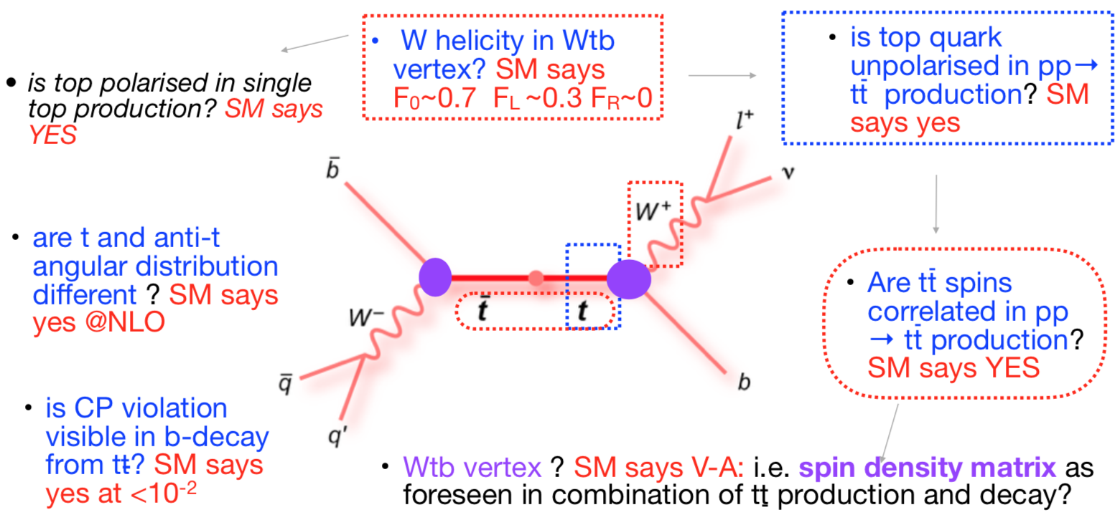
So far, all angular properties measured at the LHC are found to be consistent with SM

Slide 21
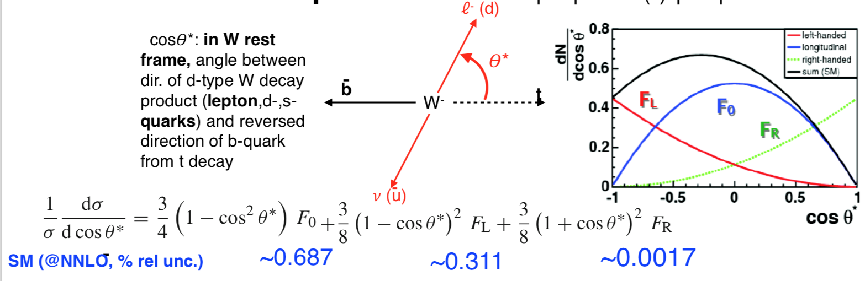
W polarization in Top Decays measurements
The longitudinal polarization state of the W is directly connected with the breaking of electroweak symmetry

Slide 22
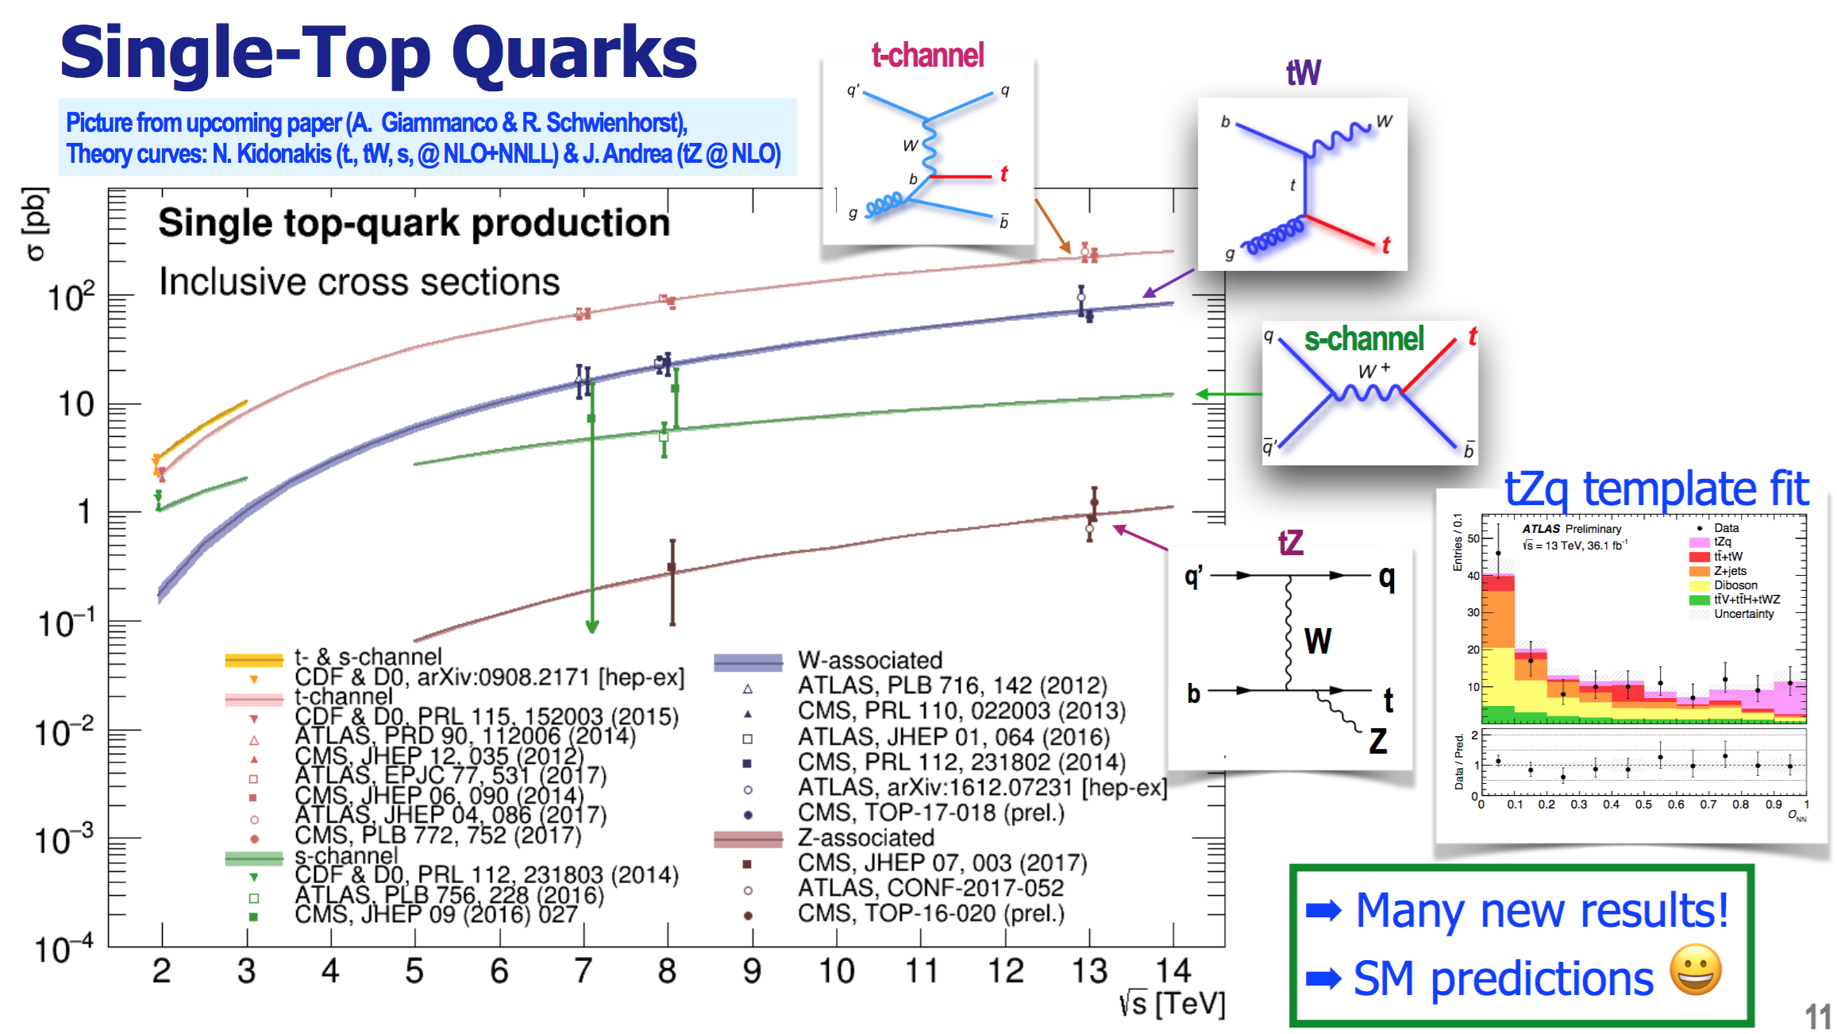

Slide 23
Single top ➔ V_{tb} at 1-2% level* will be possible with the full 13 TeV data compared to 4% at 8 TeV
* Assuming the theoretical error will go down

Slide 24
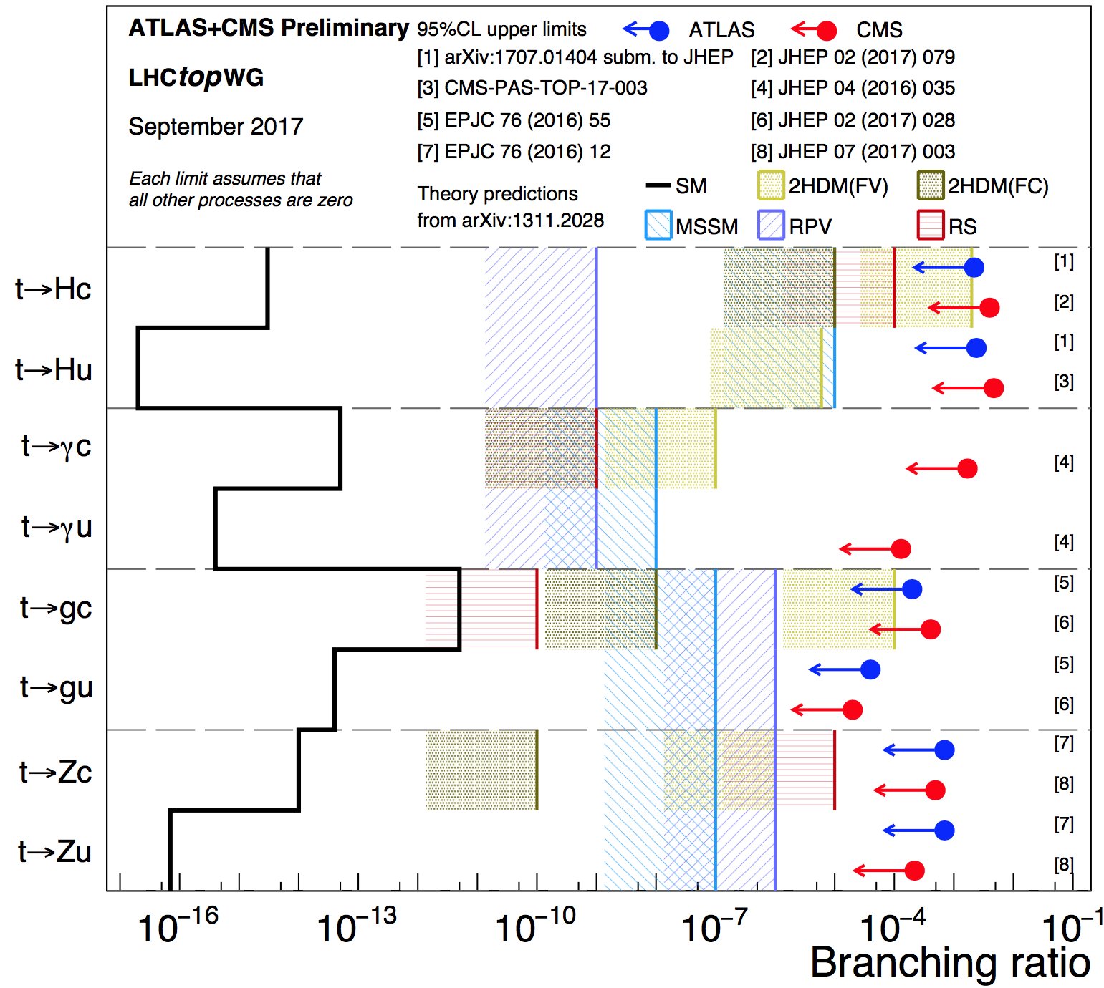
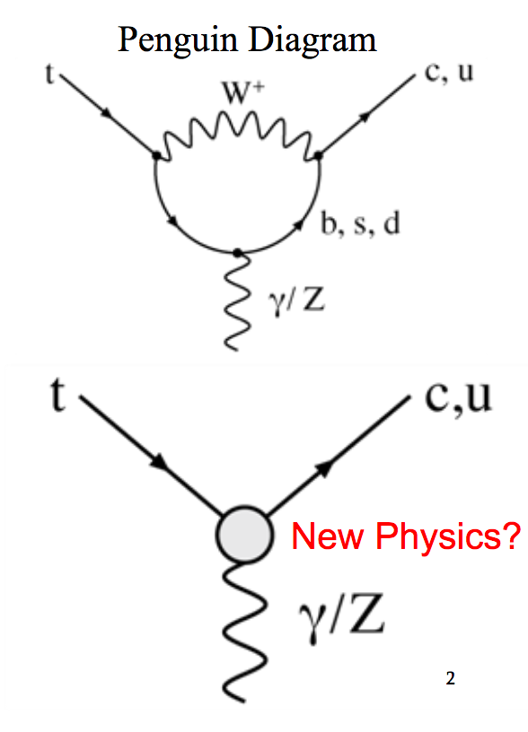
Searches for Flavor-Changing-Neutral Currents in top decays… Decay into real Z’s & Higgs boson kinematically possible
γ/g/Z/H
γ/g/Z/H

Slide 25
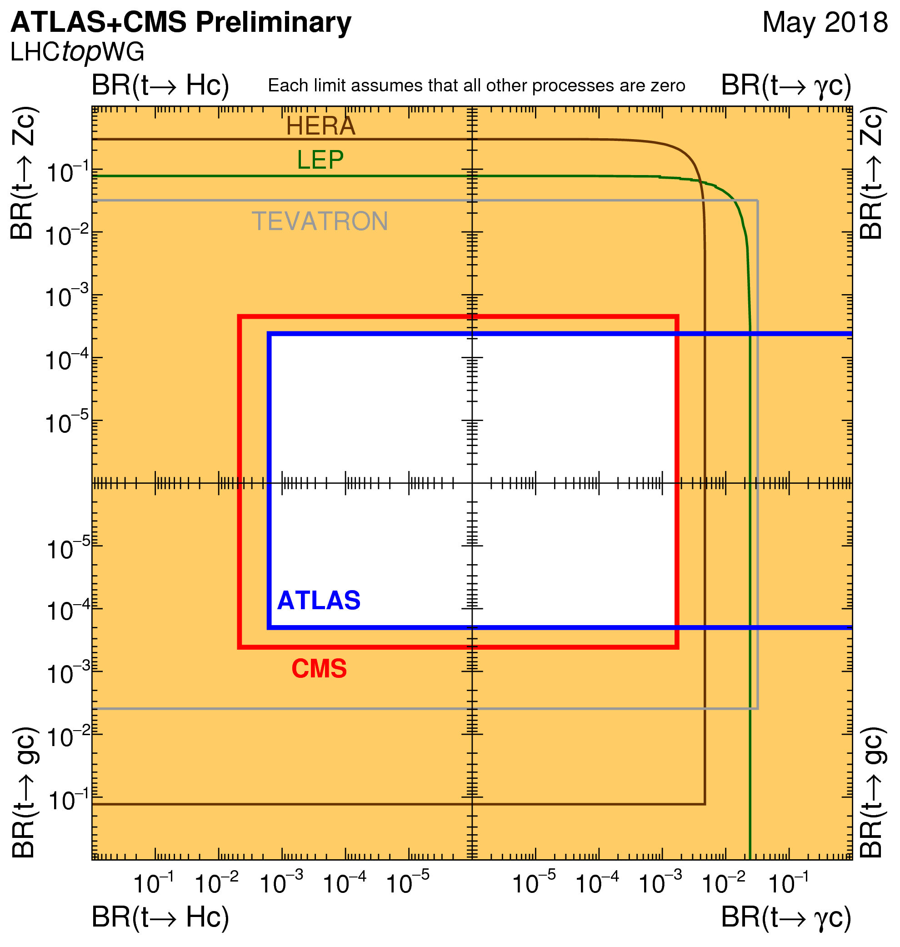
Reducing the allowed window with all channels combined
FCNC in top decays

Slide 26
Jet based measurements

Slide 27
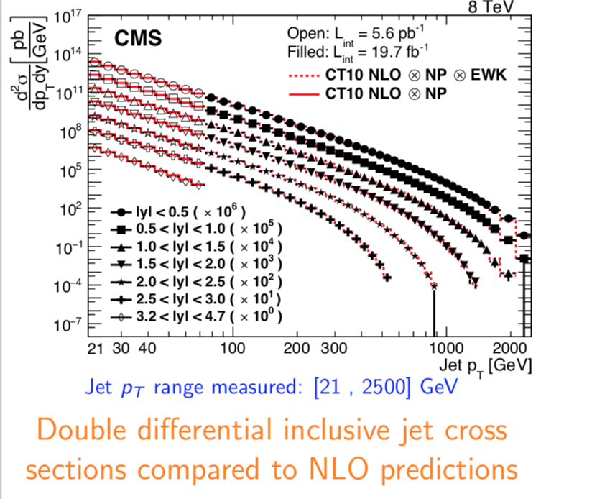
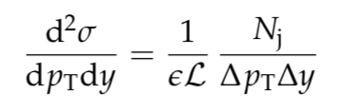
Inclusive Jet Cross Section Measurement
Predictions are in very good agreement with data!

Slide 28
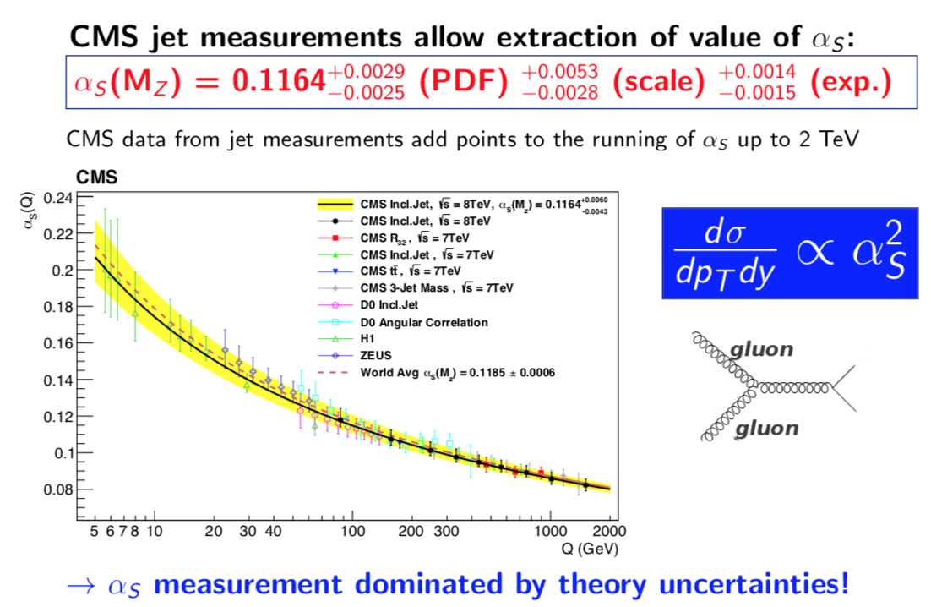
Examples of extraction of the strong coupling α_{s} from inclusive Jet Cross Section Measurement

Slide 29
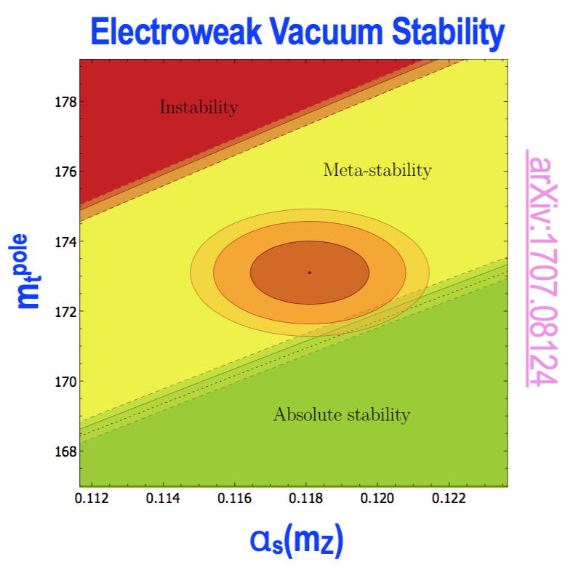
  Why are we obsessed with Top mass and Alpha S?

Slide 30
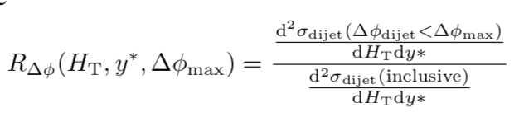
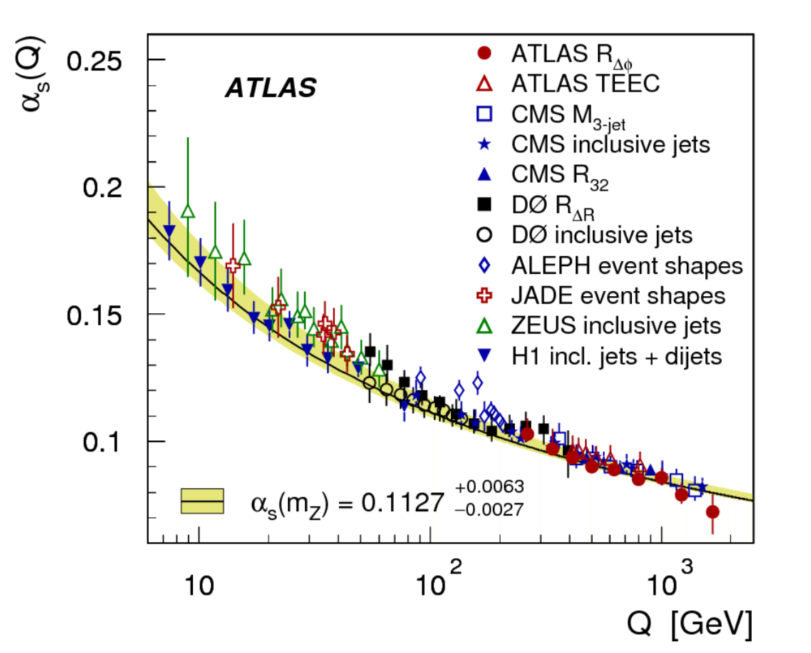
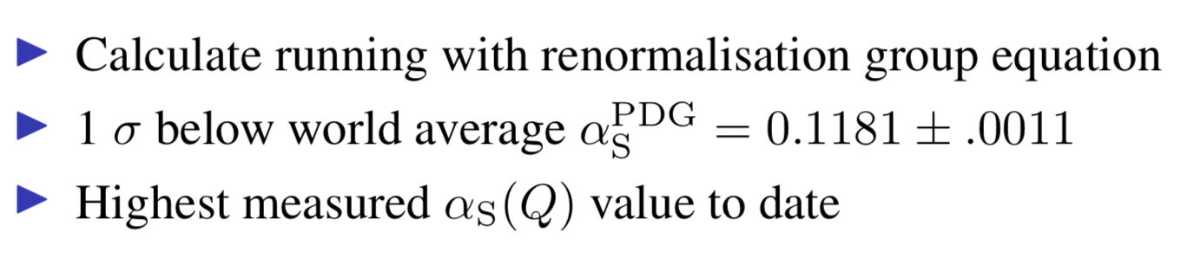
Similarly for ATLAS using decorrelations in dijet events
arXiv:1805.04691
PDF uncertainties cancel out

Slide 31
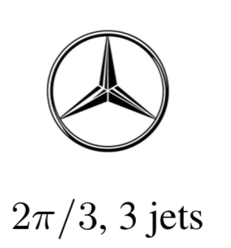
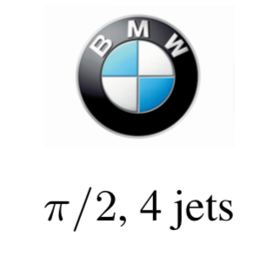
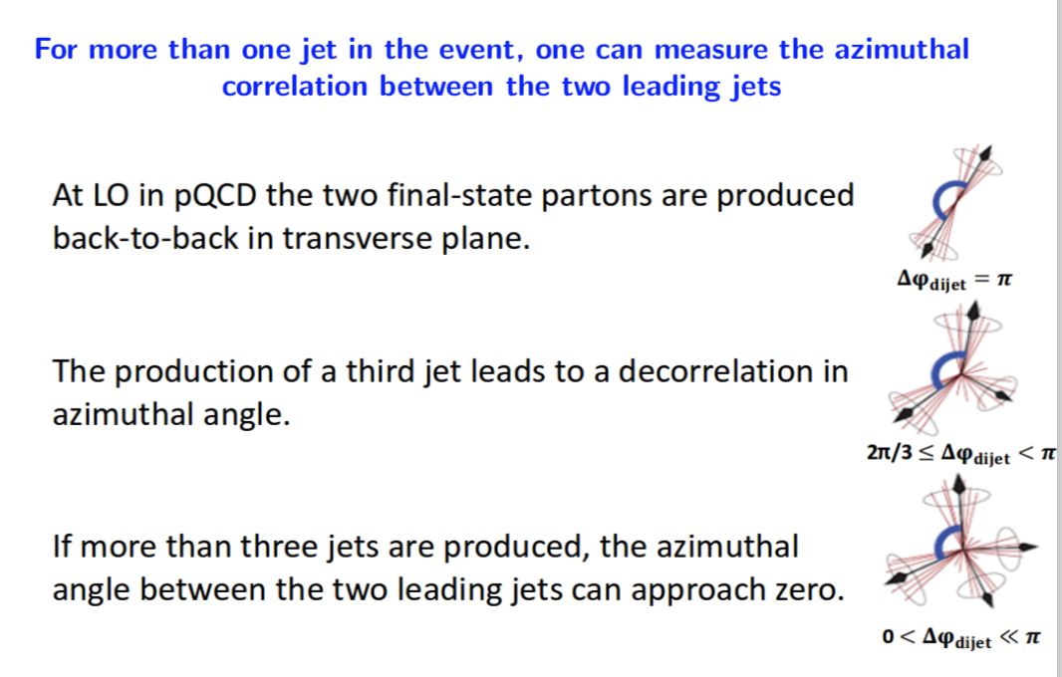
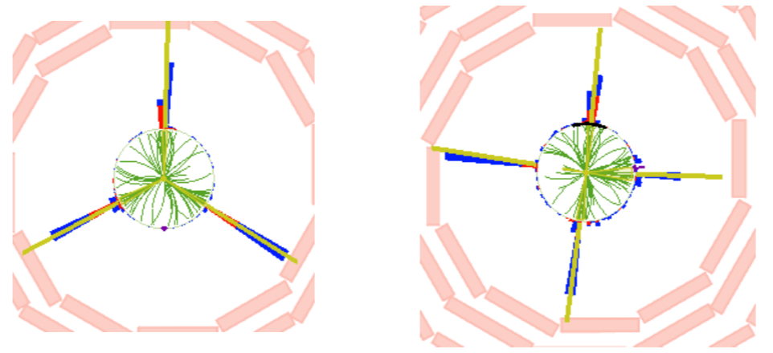
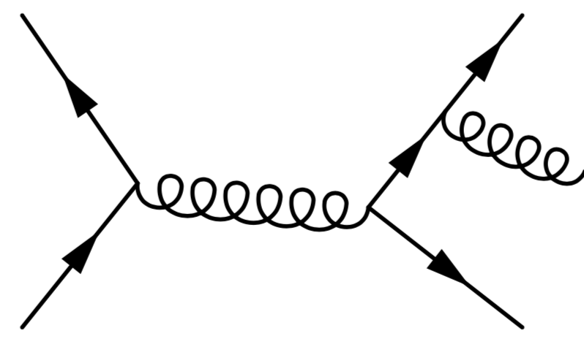

More on Multi-jet correlations

Slide 32




Azimuthal Correlations
Exclude ∆φ < π/2: large
tt ̄and W/Z + jet backgrounds
Best overall description
given by MC@NLO in Her

Slide 33

Azimuthal Correlations
arXiv:1712.05471

Slide 34






Some controversies to be solve… W+Charm

Slide 35




No evidence found for intrinsic charm in the nucleon from Z + c (b)
Possibility to look at Intrinsic Charm component in the nucleon would enhance Z+c production, in particular at high Z and c-jet pT

Slide 36

Preparing the ground for the scattering of longitudinal W’s
Already have 80 fb⁻¹/experiment

Slide 37


Conclusions
Top properties makes it a great probe … and jets too

