Slide 1
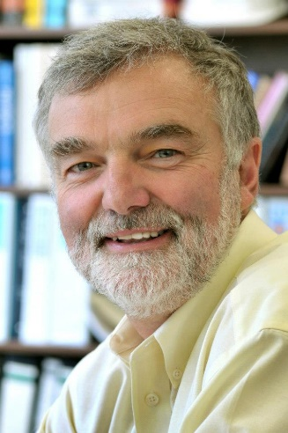
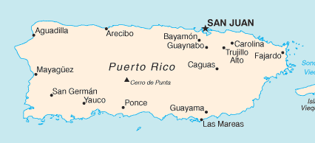
HEP as a career & Energy, Earth & HEP
Special lecture at the 2018 CTEQ school
Mayaguez, PR
Harry Weerts
Professor Emeritus Michigan State University &
Scientist Emeritus, Argonne National Laboratory
weerts@msu.edu or weerts@anl.gov

Slide 2
Intention of lecture
Tell a story & “entertainment” after heavy duty lectures
You are at beginning of career; I am at the end; give some perspective of a career in HEP (why, how), stepping outside of it and …..was it worth it ….
CTEQ school: inform & teach you
Two fold:
Discussion about “energy use in every day life”
production & storage;
how to discuss pollution;
a model for the future
what is impact of having the Standard Model on future energy sources
status in Puerto Rico,
Interest of mine, driven by living in Puerto Rico & concerns about future
Probably too much, so may just stop

Slide 3
The beginning
Career part
Intrigued by science fiction in early teens; read everything; wanted to travel the universe and explore…….. Anything is possible……
Reality started in high school, learned math & physics and beautiful connection between them….. Lots of possibilities, but also constraints on “traveling the universe”….. Optimism remained….
Netherlands
Do something about this ( enable space travel)…..
Seemed obvious to continue physics where the high school physics book ended………. With pictures of particles and bubble chambers and CERN…… physics undergraduate
A few boring years of math and physics deep dive i.e. under graduate physics courses
Finally an interesting course: “Structure Functions in Deep Inelastic Neutrino Nucleon scattering”…… lectures chaotic, more questions than answers, new research, so joined research group….
Aachen, Germany, 1970’s
Bubble chambers, neutrino interactions, computing, technology ( all unknown, new and exciting)

Slide 4
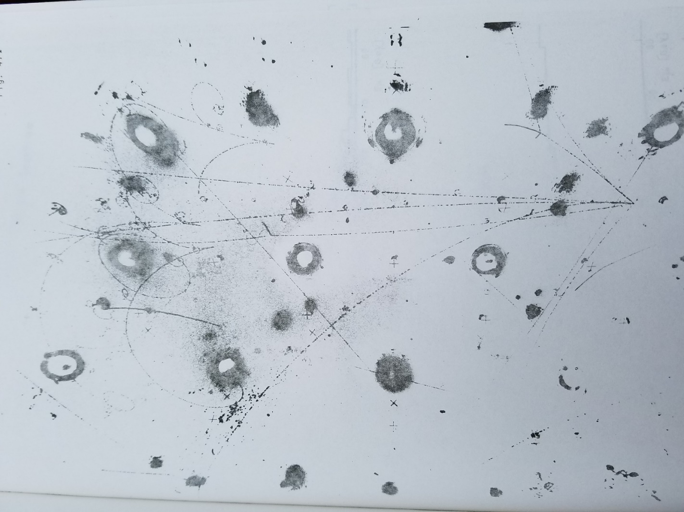
Neutrino physics with Gargamelle bubble chamber
Career part
Learn how to turn “bubbles” → tracks → particles
Measure them, reconstruct them online, build online systems, etc.
Learn a lot of new physics
Collect and measure sufficient neutrino and antineutrino events to measure structure functions F₂ and xF₃ (previous lectures)
Goal:
Pre PDFs and QCD
As many times before: experiment got side tracked by discovery of NC events
ν_{μ} Ν => μ X

Slide 5
Neutrino physics with Gargamelle bubble chamber
Career part
ν_{μ} Ν => μ X

Slide 6
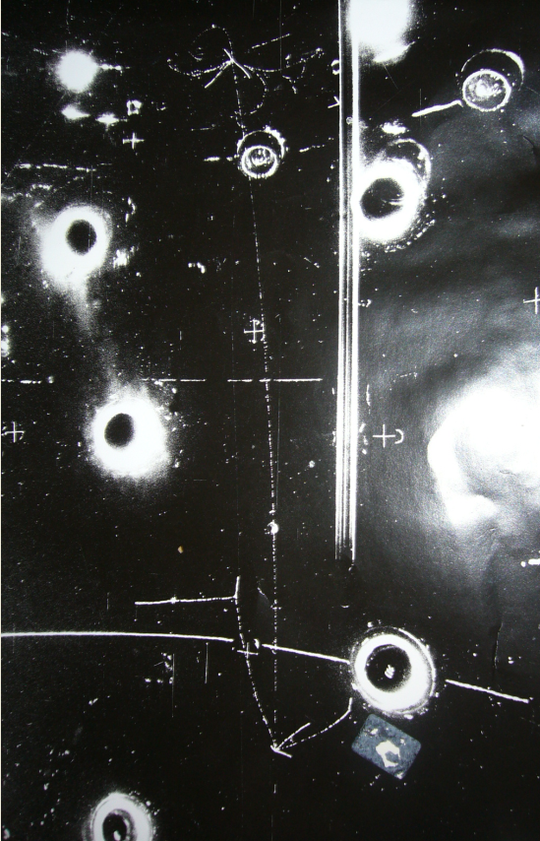
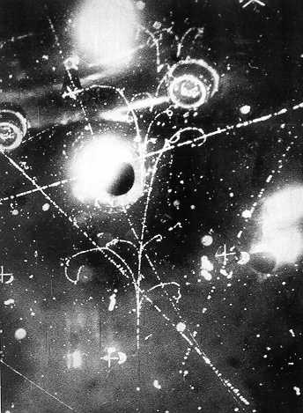
Career part
Initial purpose of experiment
Discovery of NC events became new focus
For HW:
Later PhD thesis… initial QCD
Master thesis on NC π⁰ production

Slide 7
The middle & end
Career part
Stumbling into the Gargamelle neutrino group at Aachen was one of best “steps” in science career
Great physics: ν nucleon scattering & discovery of NC
Being on discovery experiment was great
Technological/computing problems ( measuring events)
Created friends for life, one you know: J. Morfin ( still member of CTEQ)
Took for granted at the time
Continued ν physics at Fermilab with large electronic experiment
New environment, different approach/working style very stimulating
Physics not so great….
USA, 1980’s
Doing the same thing again & again in science is not the best way forward
Lesson:
Moved to proton-antiproton collider physics at Tevatron, took faculty position at Michigan State University.
Part of the Dzero experiment at Tevatron from start: responsibilities for large part of hardware; bringing up the detector and then QCD physics.
QCD physics interest led to CTEQ collaboration ( first school in 1991); theorists and experimentalists work together to make progress.
Twenty years on Dzero ( many also in CTEQ), from junior member to spokes person
~ 20 years
Had to go do something new; most asked why ??

Slide 8
The beginning & the middle
Career part
Being part of Dzero was a conscious choice for variety of reasons
Great physics potential of Tevatron (unique in world at the time)
Top quark discovery and many new, unique measurements
Technologically very challenging / cutting edge
Need of precision QCD at Tevatron was “my reason” for CTEQ
Established many personal relationships with colleagues worldwide
A unique experience
Twenty years on Dzero and towards end too much management and away from science.
Combination of teaching “old physics” and particle physics research not well suited for me; realized that I wanted to do research only.
USA, 2000’s
Lesson:
Doing the same thing for too long not good for me; need something new
Move to Argonne National lab; gave up tenure ( professor had seemed like the ultimate goal before); to lead High Energy Physics Division– able to direct and shape that program.
Continued effort on realizing ILC/CLIC ( e+e-) for ~8 years; still in the works
After ~10 years led all physical sciences at Argonne ( 400 people); incredible spectrum of science, but too much management i.e. no time for science
Lesson:
Being responsible for ~400 people & large DOE science budget…. too many rules

Slide 9
Some advice & possible lessons for you
Career part
Your are at beginning; I am at end => some advice, observations
Had several career paths and have seen a lot of science careers
You have something unique: have learned/are learning to formulate a question/problem and propose & execute an approach to get an answer ( experiment, theory etc.)
Possibilities are enormous and manifold
Change institution/environment; you learn new things & new ways to work
Most of you are students/postdoc.
Advice:
What are the career possibilities ?

Slide 10
Some advice & possible lessons for you
Career part
Some possibilities:
Environment we know & love; your advisor did that & there is tenure. Not for everybody & not enough positions
Most of us want to be “professor of physics”
I did this
( teach & research; research typically small efforts, problems; set your own pace, limited by funding)
Teach & research or teach
Students good influence
Scientist not university ( labs, facilities, industry, etc.)
Wide spectrum of possibilities/fields; perceived uncertainty ( no tenure), more group research & larger scale problems, no teaching.
( pressure from funding source to produce; able to do very large projects)
Other ( industry, finance, government, etc.)
Apply your skillset to other problems; leave what you “were born to do”…., many possibilities
( always pressure to produce; electronics, computing, modeling for many purposes( finance, insurance, other sciences), policy for science, etc
The tenure myth: “tenure is only at universities”. However if you are good everybody wants you to stay -- so you have “tenure”.

Slide 11
Career in physics -- summary
Career part
Use opportunities that come along
Be willing to take a risk (that is what science is about)
Be willing to make a change ( it is fun)
Be yourself; your new contribution adds to spectrum of opinions and ideas that drive science forward ( diversity)
Summary advice:
Not everybody agrees, but it was for me
Be part of a worldwide community that has a common science goal ( particle physics)
Be at the edge of science & technology
Work with great colleagues, get to know them, form relationships
Along the way did some great science i.e. made progress
Most rewarding for me:
Most disappointing for me:
Space travel not in reach with current knowledge
We are trapped on planet
If we are stuck on earth, we might as well make the best of it ➔ next topic

Slide 12
Career in physics -- summary
Career part
Talked about career part only
of course
there are many other aspects and sides to your life, which play an important role in your future, especially your personal life, which often dictates directions and/or sets boundary conditions.
It did in my case

Slide 13
Energy
We are in Puerto Rico & a lot of discussion about energy generation & distribution after Maria destruction in 2017
Argonne battery/energy storage research
What do we learn from SM -- now that we “know it all”
Why discuss ?
Availability of easy energy & everywhere enables modern world
Without it we would be in the middle ages…..
Everyone needs access for current lifestyle
Our need globally for “energy everywhere” will only increase
How do we use energy ?

Slide 14
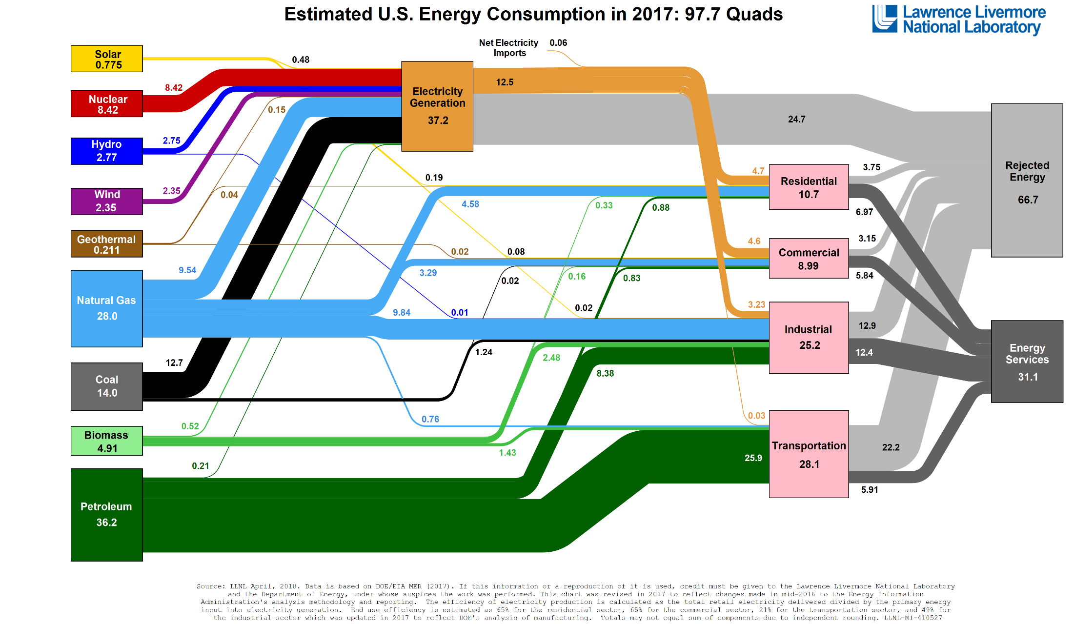
Energy use currently
Energy generation and use in the USA
1 Quad = 10¹⁵ BTU; 1 BTU = 1.055kJ = .293 Wh
97.7 Quads = 28600 TWh

Slide 15
Energy use currently
Lessons from previous energy use picture
Create energy on demand from fossil fuel mostly ( coal, oil, natural gas)
Most energy ultimate goes into heat. This energy currently lost
There is no recycling of energy ( once used it is gone)
Used to move things, processes, light. etc
We do not store energy to first order (generate on demand i.e. we have over capacity to make sure it is always available)
Evolving very slowly and mostly driven by “market”
Ultimately everybody on planet wants this much energy ( as the US consumes)

Slide 16
Energy use currently
Consequences
Burning fossil fuel seems innocent and there is no immediate consequence for individuals.
Most think that burning fossil fuels will have impact
Global warming data seem scientifically clear
Debate with non-scientific community about link of global warming & human cause
People who doubt/question link do not see connection for variety of reasons (all non scientific)
BIG debate about impact of exhaust products on planet eco-system
Many people doubt everything until “they experience it”….. personally
Amazing opinion NYT: “planet could be flat”………
Tried to think of way to illustrate in easy understandable way, the impact of burning fossil fuels…. to convince the “doubters” that there is a problem.
Nobody would put the exhaust of their running car into the living room and claim air quality is just fine
So came up with the “planet as our garage” model

Slide 17
Planet as our garage
Model
Planet earth is a closed system. This means energy from the sun can penetrate, heat it up, and some of that energy is radiated back into space.
However no “matter” can leave the planet.
So in that sense ( on a small scale) the planet is like your garage with doors closed. When doors are closed nothing can get in or out.
We all know that when garage doors are closed and we start car in garage it becomes unpleasant quickly after short time ( you can verify this your self….. and how long it takes)
Everybody agrees…
The atmosphere of earth is like a GIANT garage…….
So when we turn cars on “exhaust systems” go in the GIANT garage and stay there
when we turn all cars ( and other fossil burning entities) on and compare to our small garage with one car, how many minutes has the “car” been running ??
Question:
This can be calculated or modeled………

Slide 18
Planet as our garage
Model
Build a model where we turn on all cars and other fossil burning entities at some time and accumulate ( remember nothing escapes).
Get all information from the government or industry resources
Garage is 18ft long, 12 ft wide, 8 ft high and contains one car idling at 600RPM
This is the base unit in which everything is expressed
Atmosphere above us is 10km thick( troposphere)
A standard car & commercial vehicles get 25mpg, drives at 30mph at 2000RPM
A semi truck gets 6mpg.
#garages in atmosphere: ~10¹⁷
# cars ~ one billion , 10⁹
A personal car runs on average 2 hours/day ( 5 days/week)
Commercial vehicles run 8 hours/day ( 6 days/week)
Semi trucks run 7 hours/day ( 5 days/week)
Start running cars like this in 1950 and accumulate…..
planet absorbs exhaust gases ( especially CO2), so assume that 50% of exhaust gases produced each year are absorbed and do not stay in atmosphere ( garage does not absorb)
Assumption:

Slide 19
Planet as our garage
Model
Statistics on cars or better vehicles:
Cars used vs year

Slide 20
Planet as our garage
Model
Cars only
Cars used vs year
Impact of cars

Slide 21
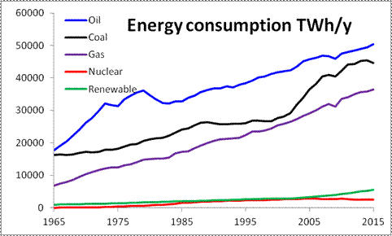
Planet as our garage
Model
A little tricky… but government has all the numbers
What about power plants…..
Worldwide consumption
Government tracks how many BTU ( British Thermal Units) are burned per kWh. Use to convert to “car idling in garage ( = 677 BTU/min)”.
BTU/kWh | Coal | Petroleum | Natural gas
 | 10432 | 10852 | 8120
Impact on our planet garage
1 TerraWatt = 10¹² Watt

Slide 22
Planet as our garage
Model
Cars and power plants
Impact of all
Air height: 10 km
If we keep going it will be ugly.
Do the experiment in your garage

Slide 23
Planet as our garage
Model
Cars and power plants
Impact of all
8.5 km
Air height: 10 km and for 8.5 km ( if density was uniform and equal to sea level)
10 km
Simple model of atmosphere ( no density variation)
No diffusion over time’ assume uniform across all atmosphere from start
Simple model for cars, trucks, power plants -- really bad ?
Bad & shortcomings
Everybody can relate to it and test at home
Can be used to do local models for cities for example ( next step)
Good

Slide 24
Energy use future
Things will not change very fast
Energy demand will continue to rise worldwide
Future vision:
Move from using the stored energy of the sun ( over millions of years i.e. fossil fuel) to using the energy of the sun now ( photovoltaic, wind) plus others: hydro, nuclear
Expressed by many; in one way or another
Fossil fuel & respond to demand
Renewable ( with large fluctuations) and energy storage

Slide 25














Current picture: everything starts from fossil fuels
Commercial, Industrial, Residential,
• Fossil fuel drives the system
• With all the consequences
Transportation, Heating, Industrial Processes

Slide 26


Disruptive Vision: A Fully Integrated and Decarbonized Energy Network
-
+
Commercial, Industrial, Residential,
Light Transportation
-
+
O₂
+
+
H₂O + CO₂
Battery
+
+
+
CO + H₂
HCOOH
CH₃OH + H₂O
CH₄ + H₂O
+
+
+
Electrochemistry
Emission-free combustion fuel
H₂, CH₄, liquid
• Unites separate electricity, natural gas and oil carriers
• Integrates existing pipeline infrastructure
• Levels load for generation
Long Haul Transportation, Heating, Industrial Processes
From G.Crabtree, UIC

Slide 27
Energy use future
Things will not change very fast
Energy demand will continue to rise worldwide
Future vision:
Move from using the stored energy of the sun ( over millions of years i.e. fossil fuel) to using the energy of the sun now ( photovoltaic, wind) plus others: hydro, nuclear
Expressed by many; in one way or another
Fossil fuel & respond to demand
Renewable ( with large fluctuations) and energy storage
Consequences:
Ultimate energy might be free i.e. no cost ….
Need electrical energy storage ( batteries)…. Cheap
Nearly everything that moves ( light duty) is powered electrically ( cars, SUV) and/or hybrid ( trucks, planes)
Adjust to local environment …….
Critical !!

Slide 28
Energy use future
Where are we with batteries and their use ?
Main technology for future batteries are Li-ion batteries (LIB, in your phone), but Pb acid (starts your car) continues to play role.
Can not do this justice; many aspects to field
Mainstream: Li-ion will power electric vehicles and possible battery for home energy storage, may be electric grid storage.
In next few slides will show:
Price of Li- ion batteries and forecasts
Where is the production in world
Growth of electric and hybrid car market i.e. are we changing ?
Give some sense of direction
Nissan Leaf 30kWh
Tesla Model S 90kWh
Future BMW 100kWh
My house to run for ~10 hours needs ~10kWh ( some air is on); worst day is 50kWh for one day. ( PR: ~$0.20/kWh from PREPA)
How much energy is needed in a battery ?

Slide 29
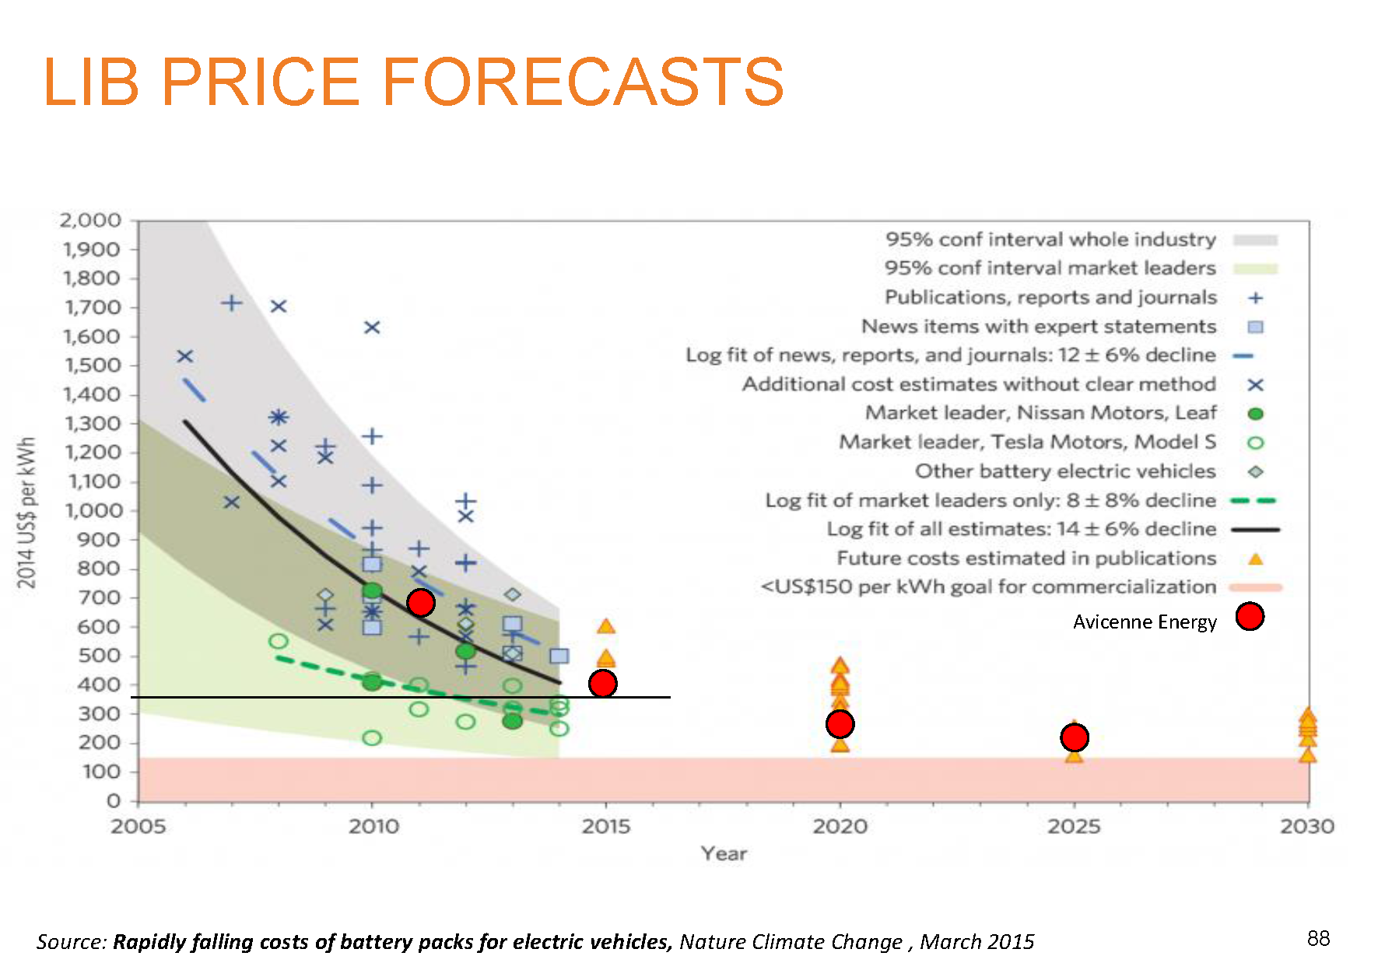
Price of LIBs
Overall goal: ~$150/kWh
From talk by C.Pillot; Avicenne Energy; AABC, June 2018

Slide 30
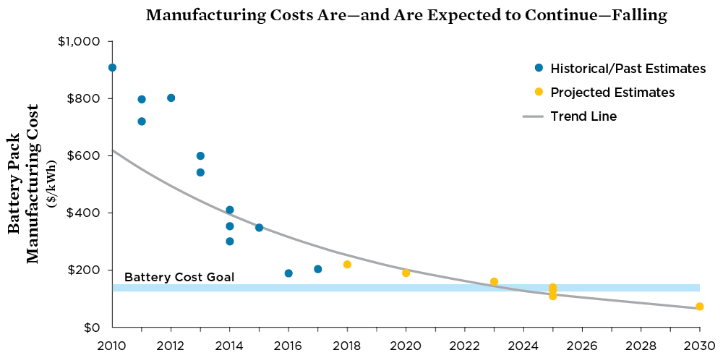
Price of LIBs
Overall goal: ~$150/kWh
Union of Concerned Scientists

Slide 31
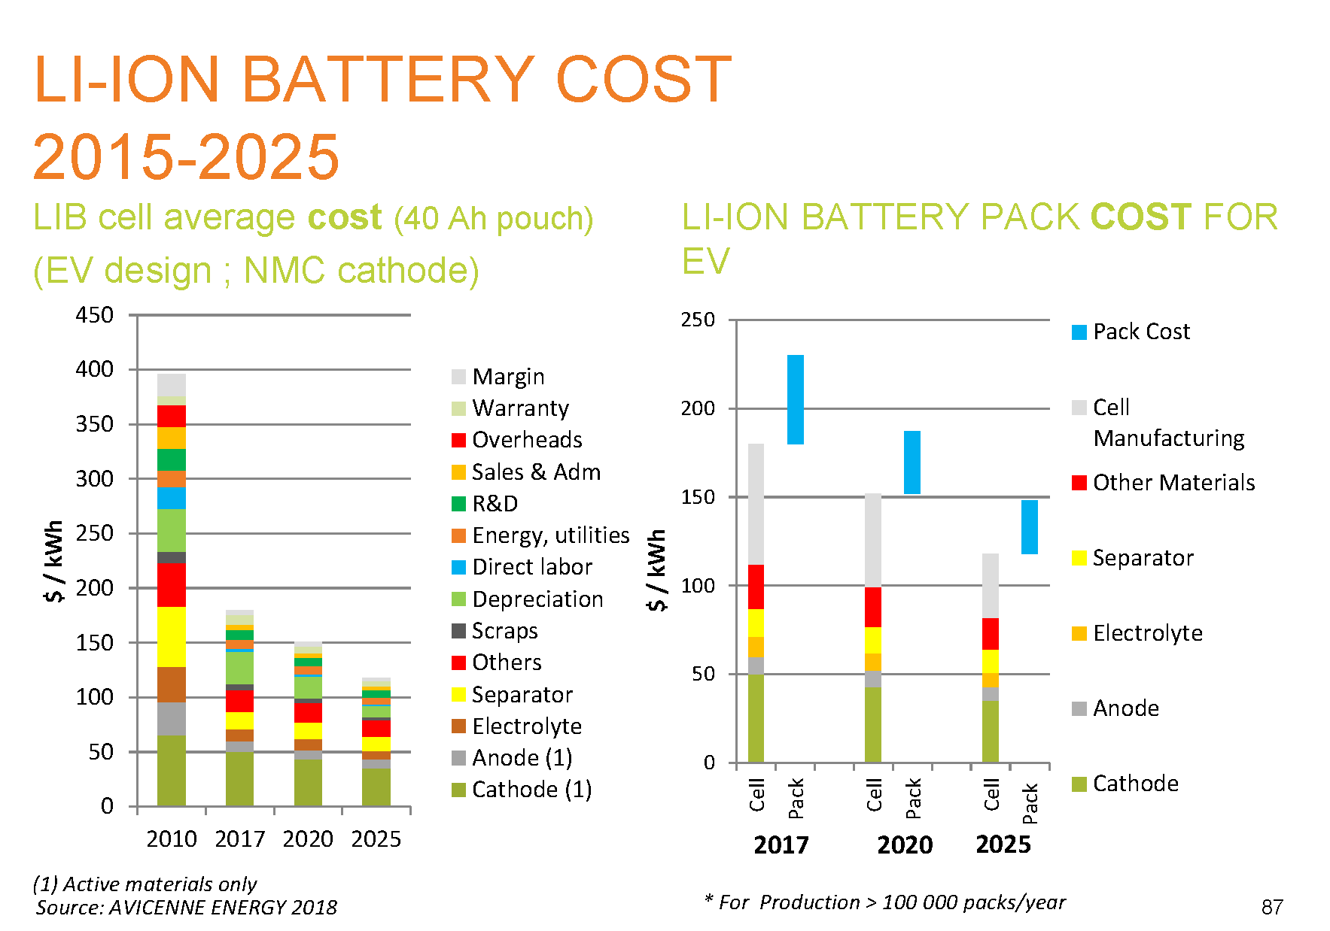
Where do costs come from ?
From talk by C.Pillot; Avicenne Energy; AABC, June 2018

Slide 32
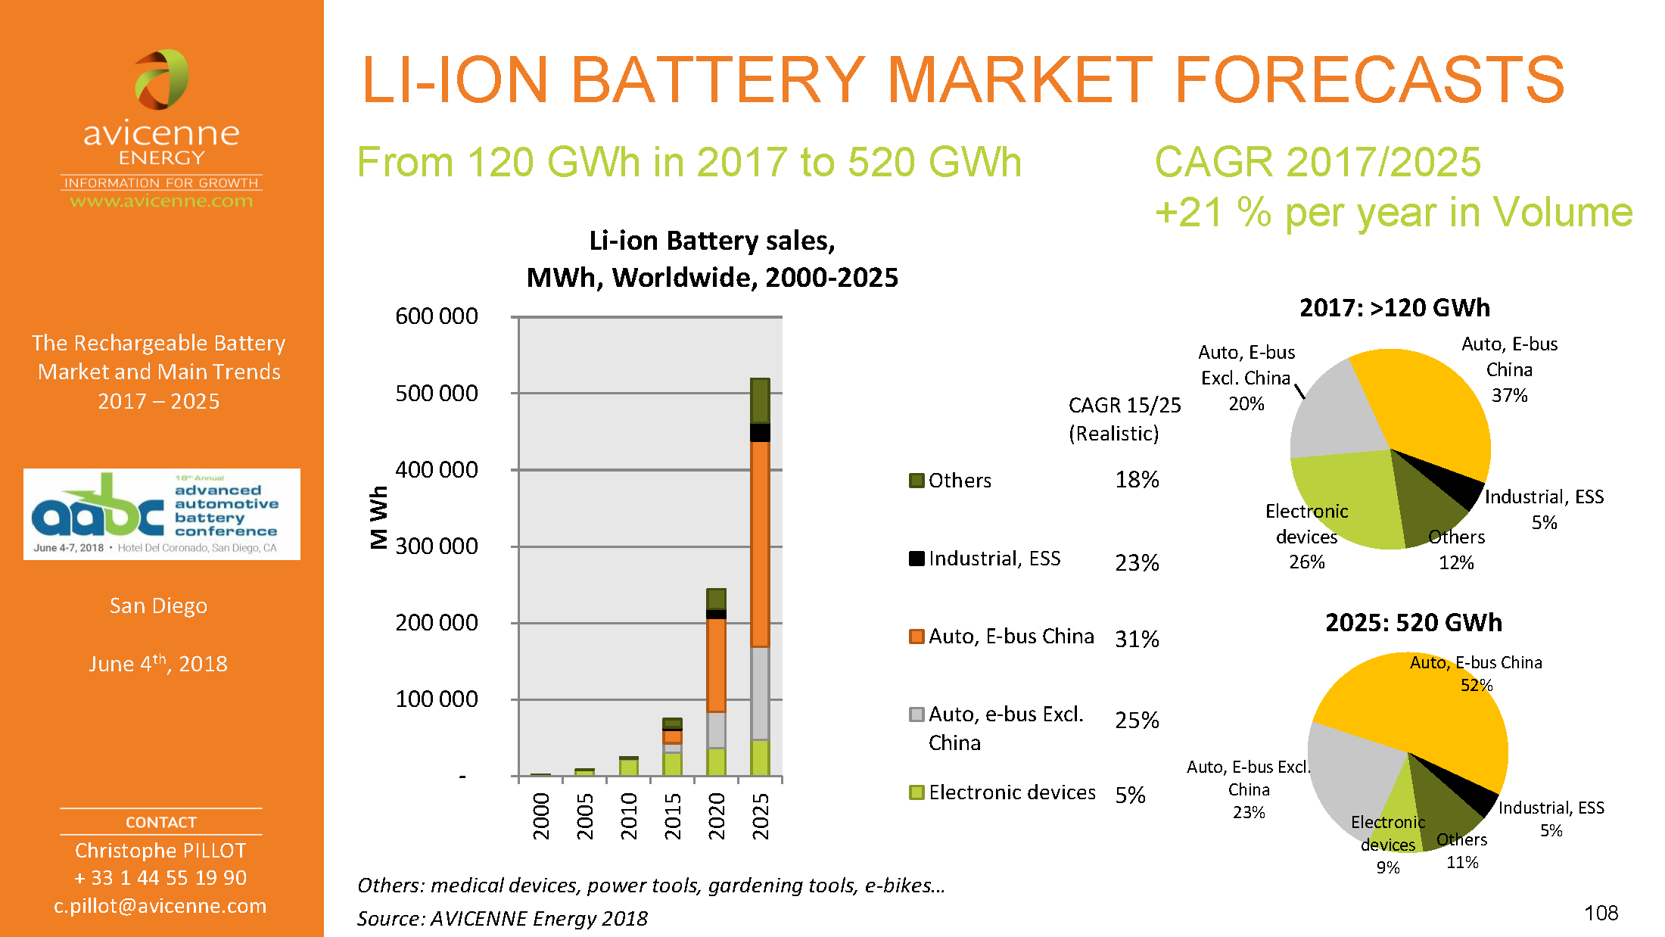
Growth of LIB market in MWh
CAGR= Compound Annual Growth Rate
From talk by C.Pillot; Avicenne Energy; AABC, June 2018

Slide 33
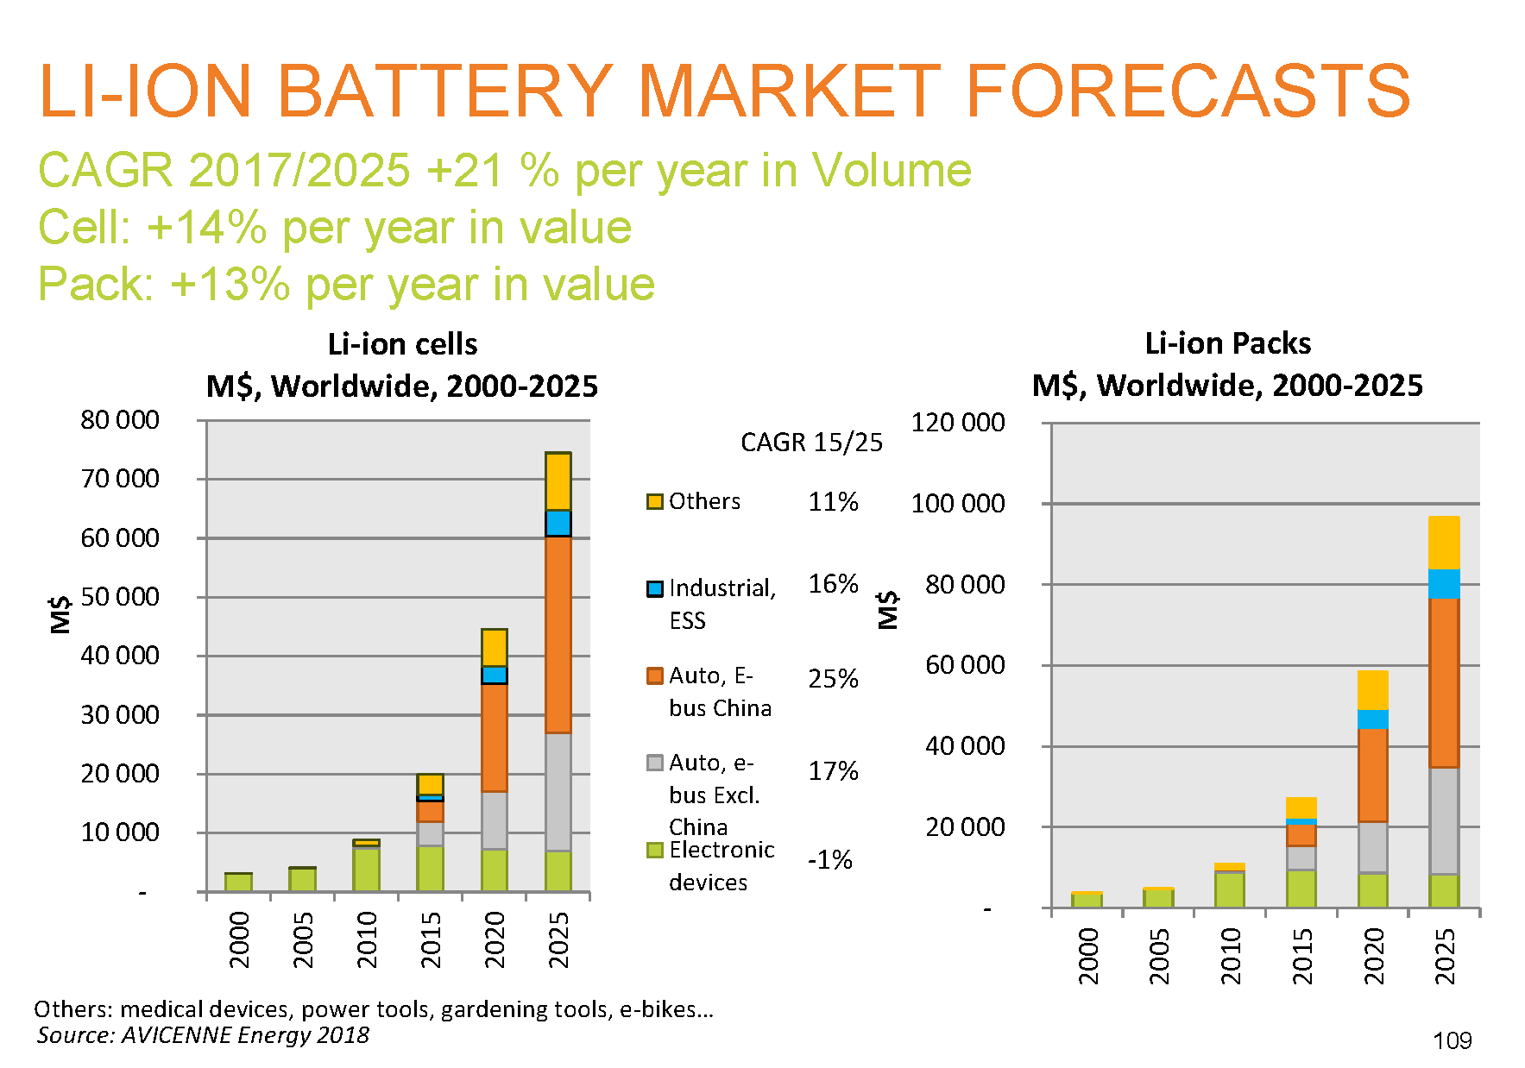
Growth of LIB market in $’s
From talk by C.Pillot; Avicenne Energy; AABC, June 2018

Slide 34
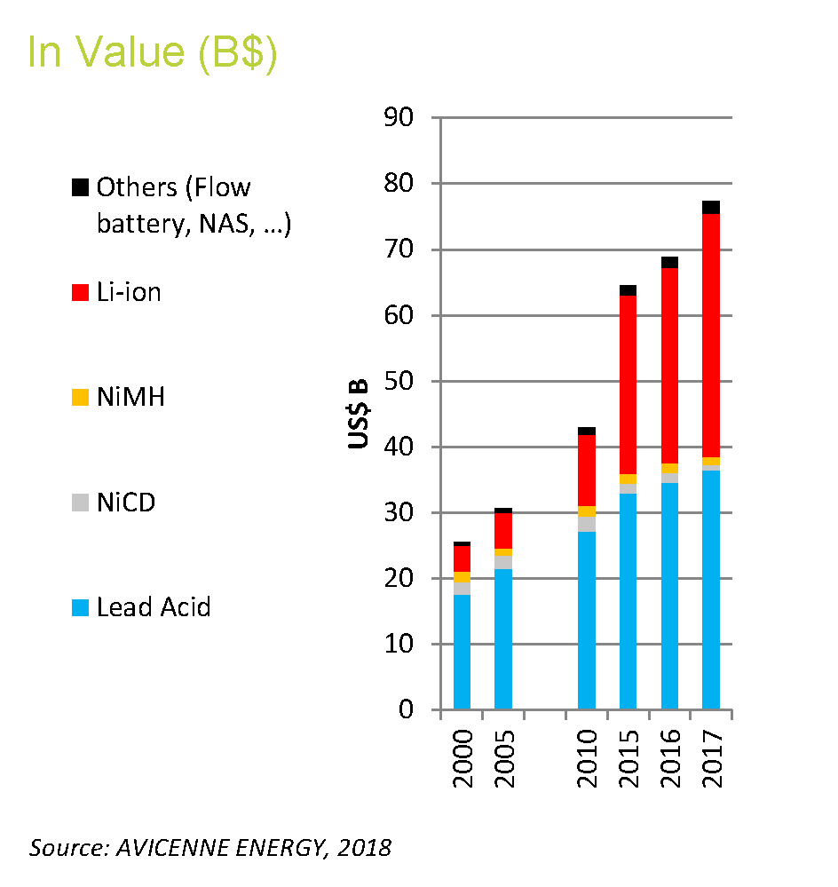
Growth of different battery technologies
Increase in Li-ion is clear
From talk by C.Pillot; Avicenne Energy; AABC, June 2018

Slide 35
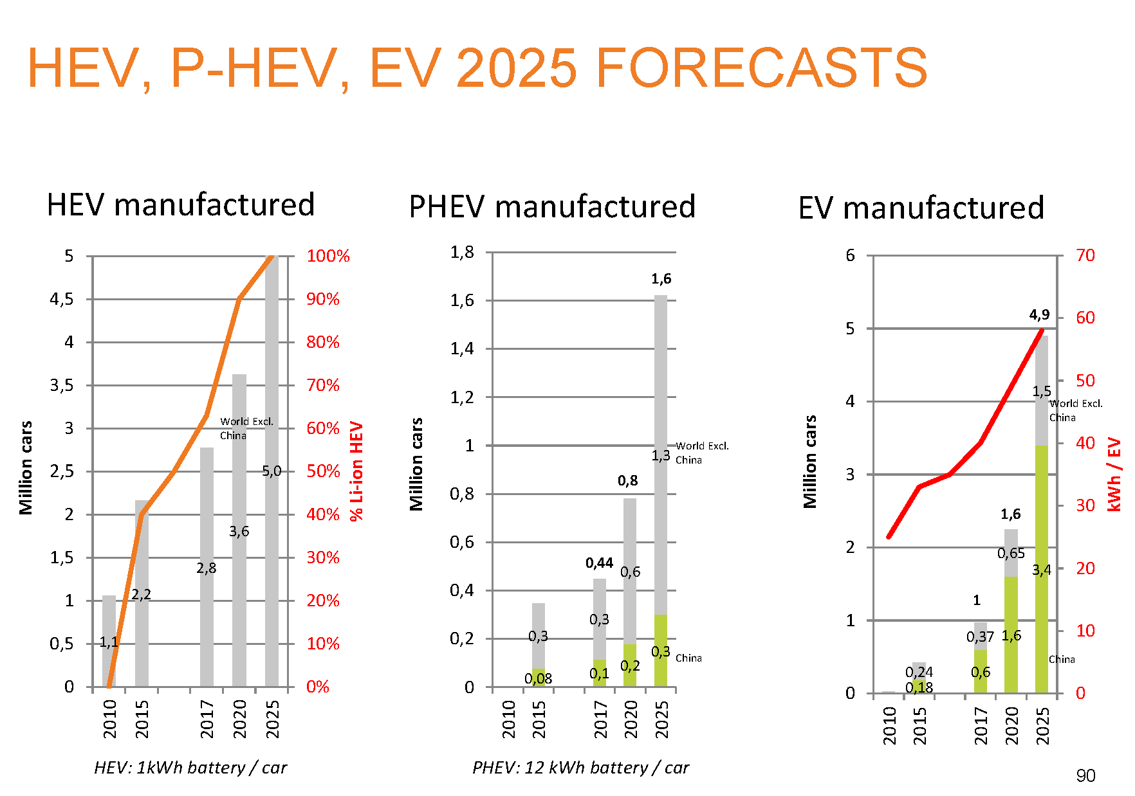
Forecasts for “electric vehicles” i.e. will we change ?
HEV = Hybrid
PHEV= Plug in Hybrid
EV= Electric
Estimated # cars on planet ~2025: 1.7 billion; XEV vehicles ~11 million is about 0.6%
Progress is slow
From talk by C.Pillot; Avicenne Energy; AABC, June 2018

Slide 36
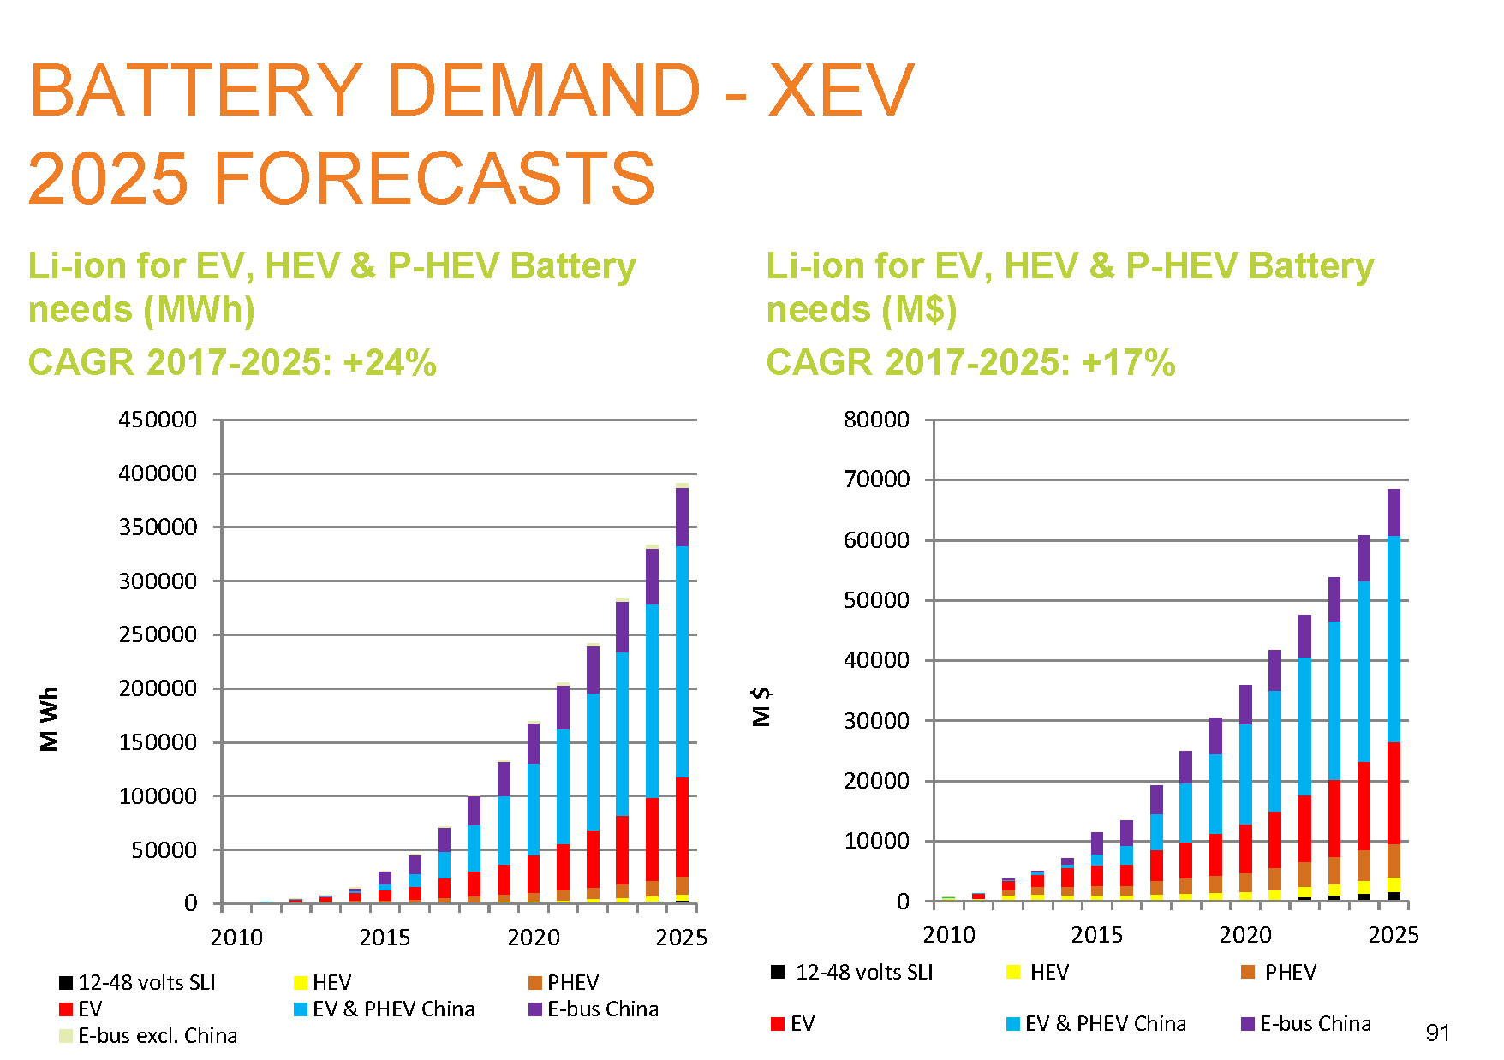
Battery demand by HEV, PHEV and EV’s.
China leads the world
From talk by C.Pillot; Avicenne Energy; AABC, June 2018

Slide 37
Production of LIB across the world

Slide 38
Energy system
Changes in our energy system going away from fossil fuel are sloooow.
Changes are slowed down by fact that large investments are needed and companies/economy is doing well using fossil fuel.
Large reluctance to change when things are still working……and $’s flow
This is not a mater of R&D, but willingness to change
May be in the end we will run out of fossil fuel and that will cause the world to act.
There seems to be plenty of energy from the sun available to fulfill the planets needs, but needs a different infrastructure ( not done that exercise)
Example China: forced to change because of extreme pollution; government has identified the problem
Ironic: sun energy is from fusion; a process we have not mastered yet on earth

Slide 39
The long term future
People do not ask that question for impact on our future
What does the SM tell us ?
There are four forces ( weak, electromagnetic, strong and gravity).
They are well understood by now… gravity may still have surprise
With our current knowledge (SM) it is clear that we are confined to planet earth.
So we better make it work for long haul
Given what we know now:
There is no space travel over long distances
So far we are alone (scary to think we are the only ones; public lecture Monday)
There is no magical new form of energy that can be tapped
A lot of technical innovation, understanding the world around us, but no new radical fundamental breakthroughs or discoveries
In my lifetime:
A bit provocative…… but my time is limited

Slide 40
Not the end, but will stop here for today
Two more slides on Puerto Rico electric power system

Slide 41
The PR electric power system
Status.pr gives the latest status on hurricane Maria recovery.
Electric system is at 95.2% ( June 19, 2018)
We were lucky: water back in October and power back end of October 2017 (depends on community)
High level overview of electric power & grid.
Total: 5.5 GigaW
All oil plants owned by utility
All others by companies
All fossil fuel is imported
OIl | LNG | Coal | Solar | Wind
5 | 1 | 1 | 5 | 2
# plants

Slide 42
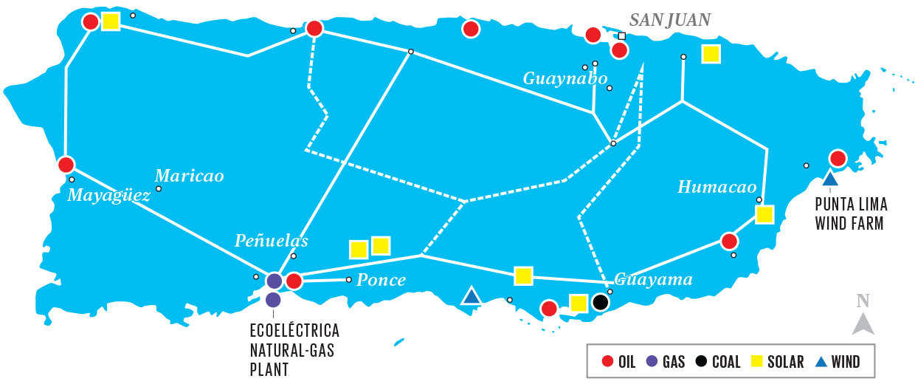
PR power plants & distribution -- geographically
Cambalache
Palo-Seco
San Juan
Costa-Sur
Aguirre
AES Corporation
Many power plants in south
Transmission lines across mountains; vulnerable to environment & access only from air
Recommendation for future: more local power generation/storage.
Many people installing home solar & storage; independent of PREPA
CTEQ School 2018, Mayaguez PR, H.Weerts
42

Slide 43
END

Slide 44
Backup slides

Slide 45
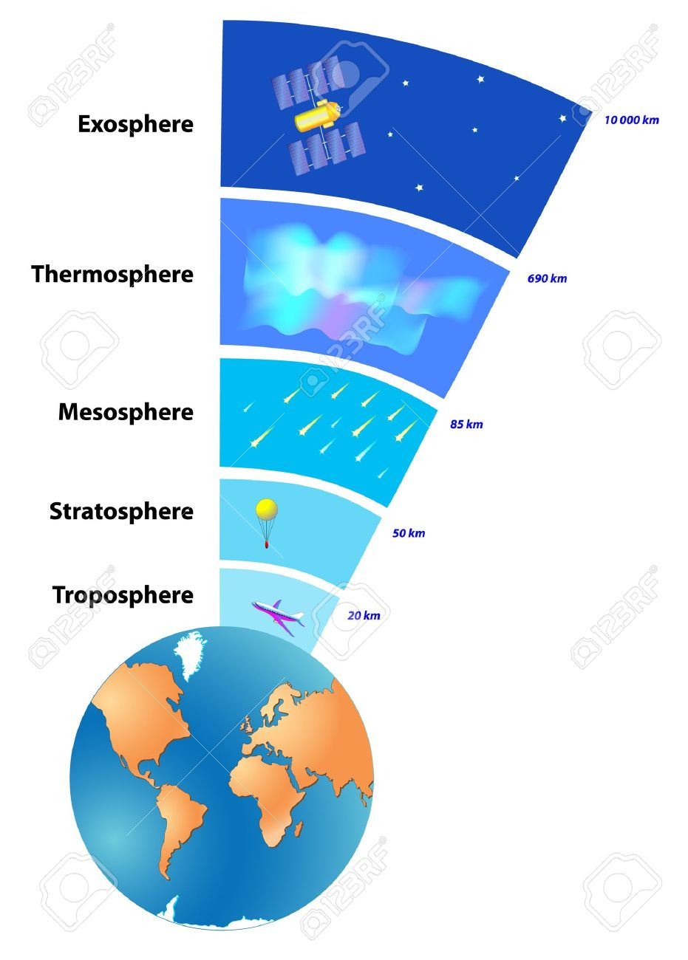
Earth atmosphere
Backup slide
Composition of “air”
N2 | O2 | Ar | other
78.09% | 20.95% | 0.93% | 0.04%
Troposphere varies from 9 km at poles to 17 km at the equator.
Total mass of atmosphere:
50% is below 5.6 km
90% is below 16km
99.99997% is below 100 km
Density drops by 50% roughly every 5.6km
In our model we assume it is uniform up 10 km. Probably too high.
If it had a uniform density ( equal to sea level), it would be 8.5km high.
Better value for height

Slide 46
Price of LIBs
Acknowledge C.Pillot

Slide 47
This map has a problem: the red dots are not just power plants, they seem to grid nodes. There is no oil power plant in Mayaguez or Isabela.

Slide 48
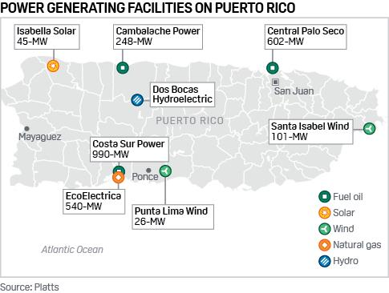
This map has a lot of information missing, like all the AES plants in Guayama.

Slide 49
The end
Career part
Always interested in technology…… cars, electronincs, computers
Able as a student to work on this….
Also interested in solving problems….. Not created by humans, but posed by nature
These things have been very imporstant in my life; main reasons for chosing experimental physics as direction

