Slide 1
Proton Decay
Bryson DeChambeAU

Slide 2
Overview
Proton History
About the proton
Why proton decay is important/GUT
Experiments/how to detect proton decay
Lower limits on proton lifetime
Future experiments

Slide 3
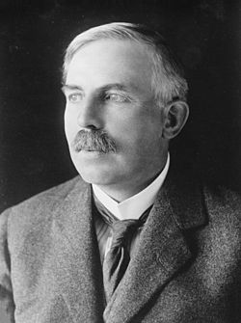
Proton History
William Prout in 1815 came up with the idea that atoms were composed of Hydrogen atoms based only on their atomic weight. Data proved this to be false but was really close to the accurate model.
In 1917 (wasn’t written about until 1919), Ernest Rutherford proved that there were other atoms made up of the hydrogen nucleus which corresponded to Prout’s theory.
(1917) He knew from shooting alpha particles into nitrogen gases that it created Hydrogen nuclei (later called proton) because of their unique penetration signature in the air and their appearance in scintillation detectors
¹⁴N + α → ¹⁷O + p.
A hydrogen atom (proton) was being knocked off from the collision of the alpha particle on the nitrogen.
Gave the hydrogen atom a special name since he believed it to be the lightest element
Called it proton from the Greek word protyle meaning first.
What is a proton?
Ernest Rutherford

Slide 4
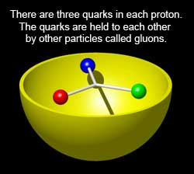
Proton Information
A subatomic particle that has a positive electric charge and has a mass that is slightly less than a neutron.
Proton and neutron together make up the nucleus of an atom.
The number of protons in the nucleus determines the atomic number of the particle
Standard model describes the proton as having two up quarks and one down quark with their rest masses accounting for only 1% of the total mass. The kinetic energy and energy from the gluon fields that bind them together.
Size of the proton is approximately .84-.87 fm
At high energy/velocity they make up 90% of the cosmic rays
Low temperatures free protons will bind to free electrons. Doesn’t change characteristics of proton

Slide 5
Proton Characteristics
Classification | Baryon
Composition | 2 up quarks, 1 down quark
Statistics | Fermionic
Interactions | Gravity, electromagnetic, weak, strong
Symbol | p, p+, N+
Antiparticle | Antiproton
Mass | 1.672621777(74)×10−27 kg[1] 938.272046(21) MeV/c2[1] 1.007276466812(90) u[1]
Mean lifetime | >2.1×10^29 years (stable)
Electric charge | +1 e
Spin | 1⁄2
Isospin | 1⁄2
Parity | +1

Slide 6
What’s the big deal
Electron Capture
Electron capture
Electron capture (K-capture) is the closest experimental proton decay we have seen (1934 theorized-1937 reported)
-Through absorption of an inner electron, a proton transforms into a neutron and an electron neutrino is emitted
-The atom loses a proton and gains a neutron changing into another element
$$p^{+} + e^{−}→ n { + v}_{e}$$
Stable and doesn’t decay/break down into other particles as far as we know
No experimental data to prove proton decay

Slide 7
Grand Unified Theory : The dependence on proton decay
Grand Unified Theories (GUTs), which can unify the fundamental forces of nature(weak, strong and electromagnetic), predict that the proton can decay into lighter energetic charged particles.
Some Grand Unified theories predict that proton should decay with lifetimes of the order of ${10}^{36}$
Supersymmetry required for these decays to be possible. That is where quarks and leptons can be interchanged equally. Right now we haven’t found anything that violates baryon conservation/lepton conservation numbers.
If proton decay is observed, it may be possible to prove the GUTs.
From GUE, there are a few different channels a proton is theorized to decay into

Slide 8
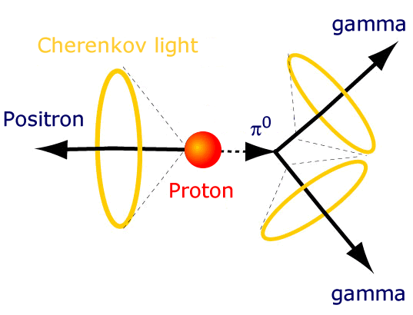
Possible Proton decay channels
From GUT these decays use supersymmetry where the hypothetical B-L number is conserved.
Quarks and leptons can be interchanged. In other words the protons quarks can be exchanged into leptons like the positron or muon vice versa
$p→e^{+}π^{0}$ a proton (B=1, L=0) decays into a positron (B=0, L=1) and a pion (B=0,L=0)
$p→μ^{+}π^{0}$
These different modes/theories are used to develop criteria for experimentation
Experiments have to then be developed to detect particle emissions like the one shown below

Slide 9
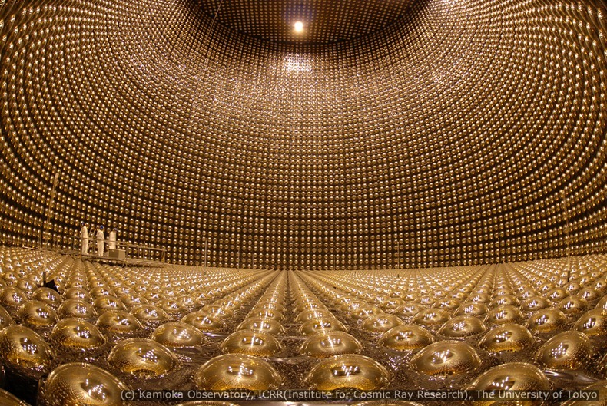
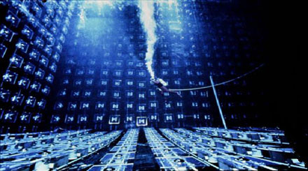
Experiments:
Superkamiokande
IMB
These experiments are designed to detect Cherenkov radiation emitted by particles

Slide 10
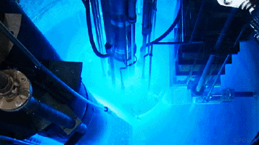
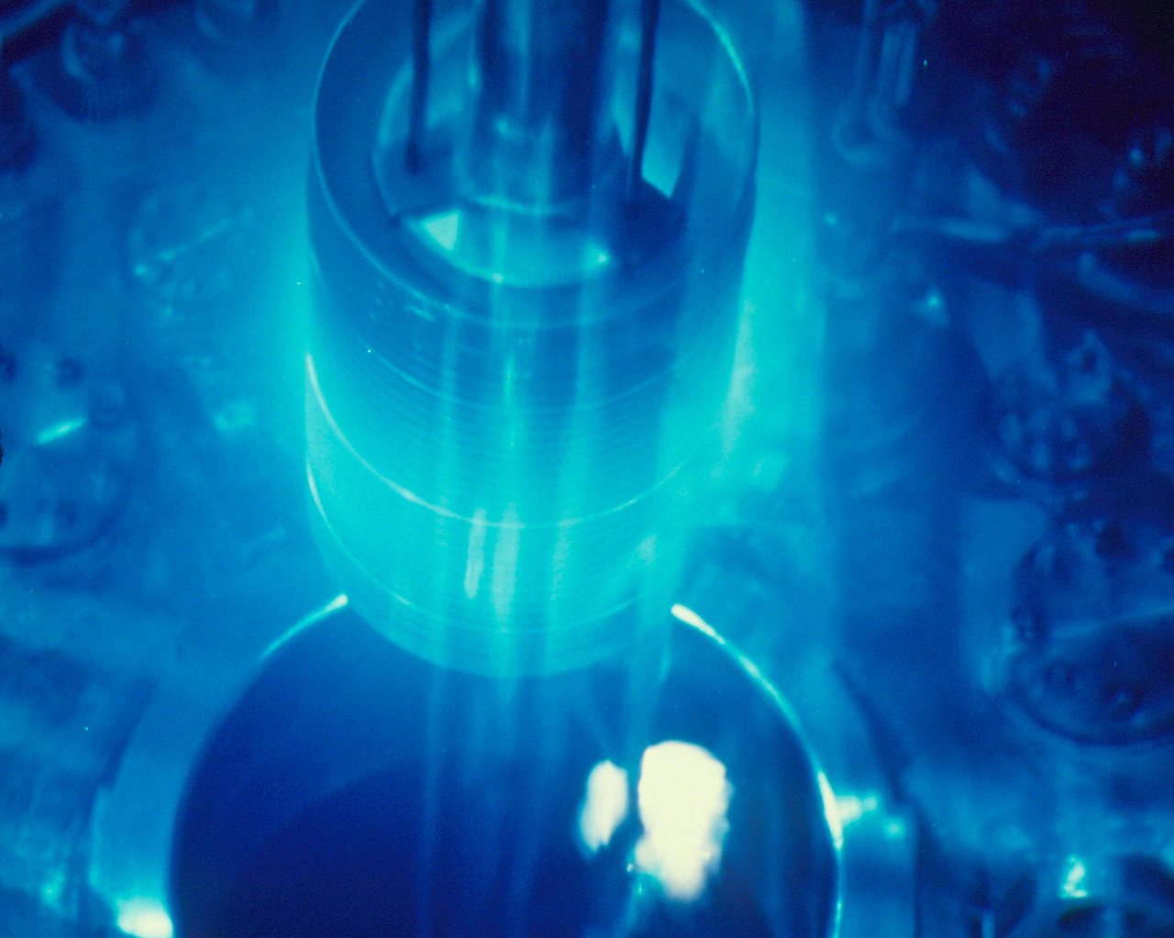
Cherenkov Radiation
Named after a Soviet scientist Pavel Cherenkov who won the Nobel Prize in 1958 for discovery of Cherenkov Radiation
Light emitted by relativistic particles traveling through water
When a charged particle passes through a dielectric medium at a speed greater than the phase velocity of light in that medium it produces electromagnetic radiation. Creates a blue hue in the medium (emission of photons).
The speed at which light travels through a medium can be significantly less than c. Particles can then be moving faster or radiated to faster speeds than light in that medium creating an emission of photons (light).
The emission is in the direction of the traversing particle and creates a Cherenkov cone. Similar to breaking the sound barrier.
Physicists then created a RICH or Ring Imaging Cherenkov Detector to track and analyze the characteristics of particles

Slide 11
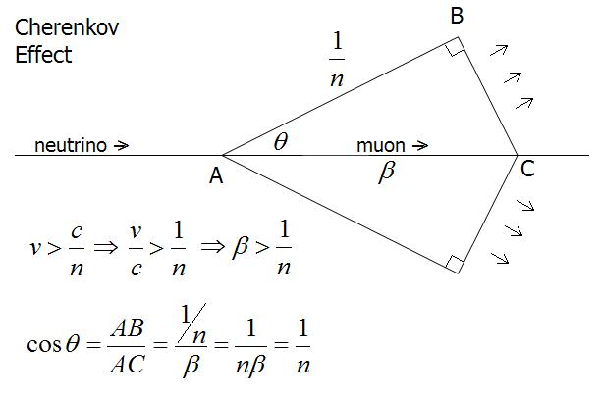
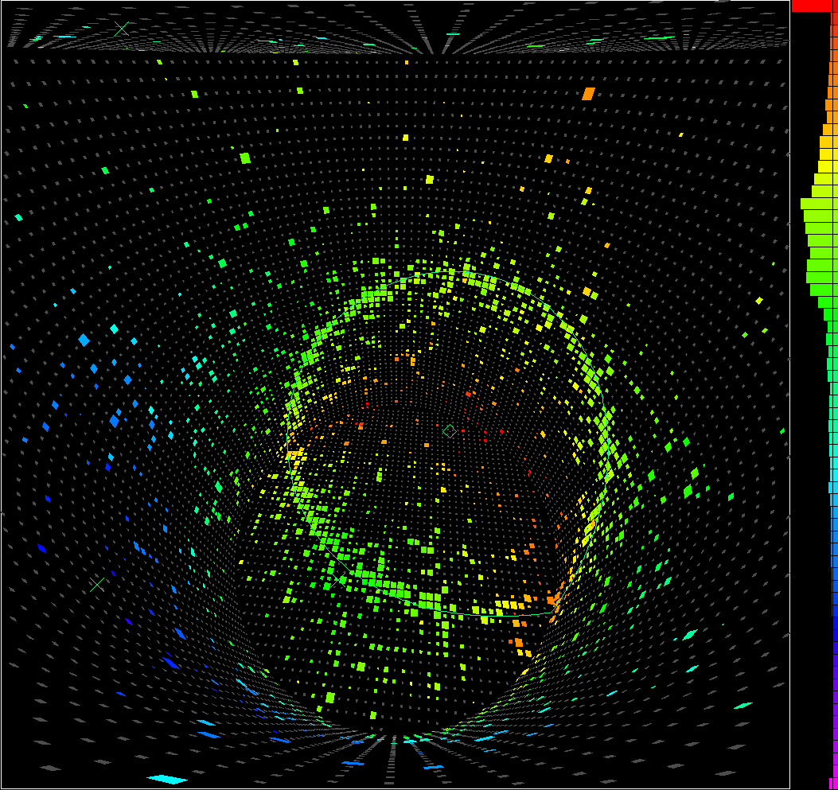
Ring imaging Cherenkov Detector
First proposed by Jacques Séguinot and Tom Ypsilantis, working at CERN in 1977.
RICH is a device that can track and ultimately identify electrically charged subatomic particles through Cherenkov radiation (emission of photons)
Tank with a certain shape lined with PMT’s and filled with water
Much cheaper per ton to build than iron calorimeters therefore more practical to build bigger detectors
The particle moving in a line emits photons along a certain ${\text{angle} θ}_{c}$ (emission angle)
Having knowledge of the particles momenta, direction and knowledge of the refractive index $n$, a prediction of $θ_{c}$ can be evaluated and compared to the emission angle of the detected Cherenkov Photons
Problem of background noise
Photons emitted from an electron

Slide 12
Background Noise
Cherenkov radiation can come from numerous particles in outer space as well as here on Earth (walls of cavern). Called background noise
So to create a useful detector, background noise has to be eliminated
Superkamiokande uses an outer detector to help reduce the number of events coming from outside the detector. Significant part of the data reduction process.
The events collected in the detector is upwards of 10 gigabytes so a data reduction process reduces the number of events relevant to proton decay to about 16 events of which ≈ 8 events are reconstructed for analysis

Slide 13
Particle Identification
Looking for particles predicted in GUTs
The sharpness of the ring/emission angle classifies the types of particles
Based off of charge distribution where e-like rings will tend to be less sharp than $μ$-like rings
$p→e^{+}π^{0}$ Emission angle greater than positive muon because of its smaller mass which generates a greater velocity in momentum conservation
$p→μ^{+}π^{0}$ Emission angle smaller because of the heavier positive muon (smaller velocity)
Protons are essentially at rest in the water and their decay must result in at least two new particles going in opposite directions. We use this feature to distinguish proton decays from neutrino interactions in the water.
E-like ring

Slide 14
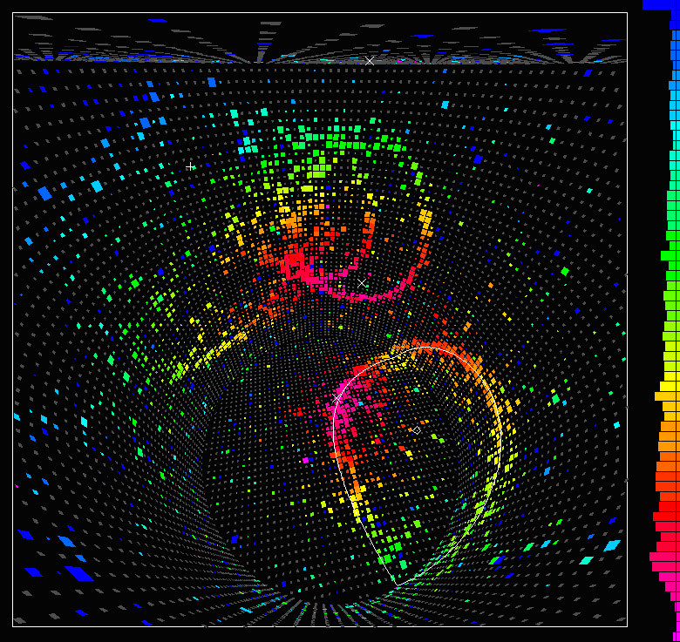
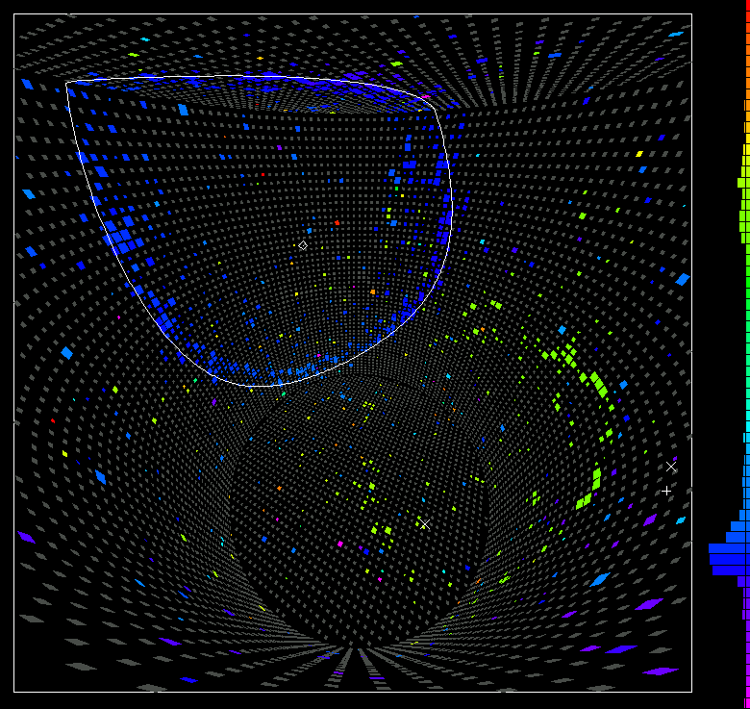

Slide 15
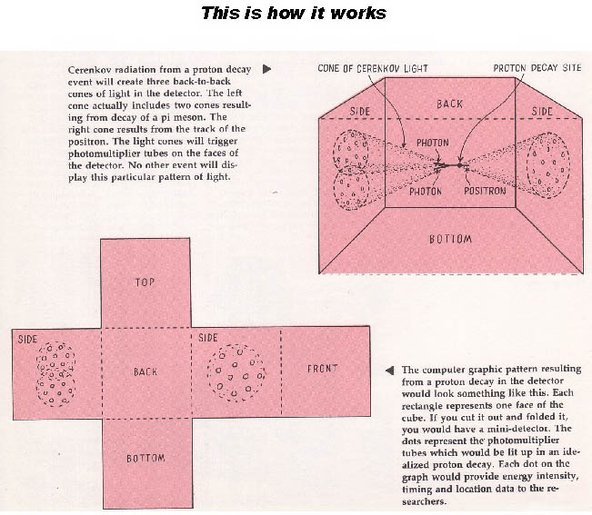
IMB (Irvine-Michigan-Brookhaven Detector)
Built 600m below ground near a salt mine in Cleveland (1982-1991)
Cubical tank (17 x 17.5 x 23 meters) filled with water
Set lower limits on proton lifetime to ${10}^{32}$
Notable achievements included observations of neutrinos from supernova along with the atmospheric muon neutrino deficit which was later confirmed to be evidence of neutrino oscillations

Slide 16
Superkamiokande Structure
Built in a salt mine in Gifu, Japan
Cylindrical tank made of stainless steel with a diameter of 39m and height of 42m (OD) with a 50 kiloton volume. Inside the volume is another cylindrical structure 34m in diameter and 36m tall (ID).
Below peak of Mt Ikenoyama under 1000m of rock shielding it from cosmic rays equivalent to 2700m of water
Inner structure lined with black plastic to isolate detector regions. Necessary to isolate experiment.
Main purpose for outer detector (OD) is to veto cosmic ray muons. 1885 outward facing PMT’s that are equipped with wavelength shifter plates. OD also lined with reflective material called Tyvek reducing the probability of muon interaction in the ID.

Slide 17
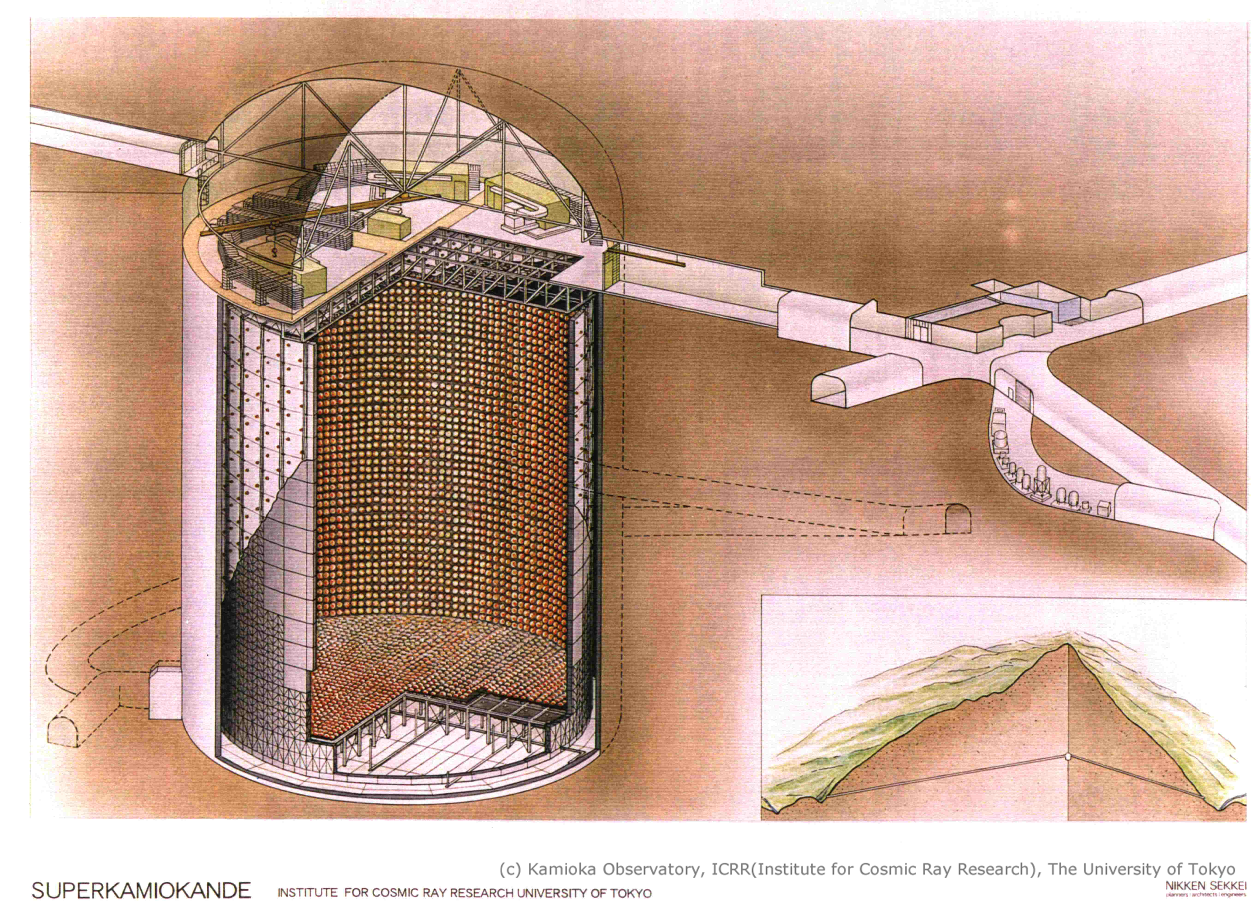
SK Structure

Slide 18
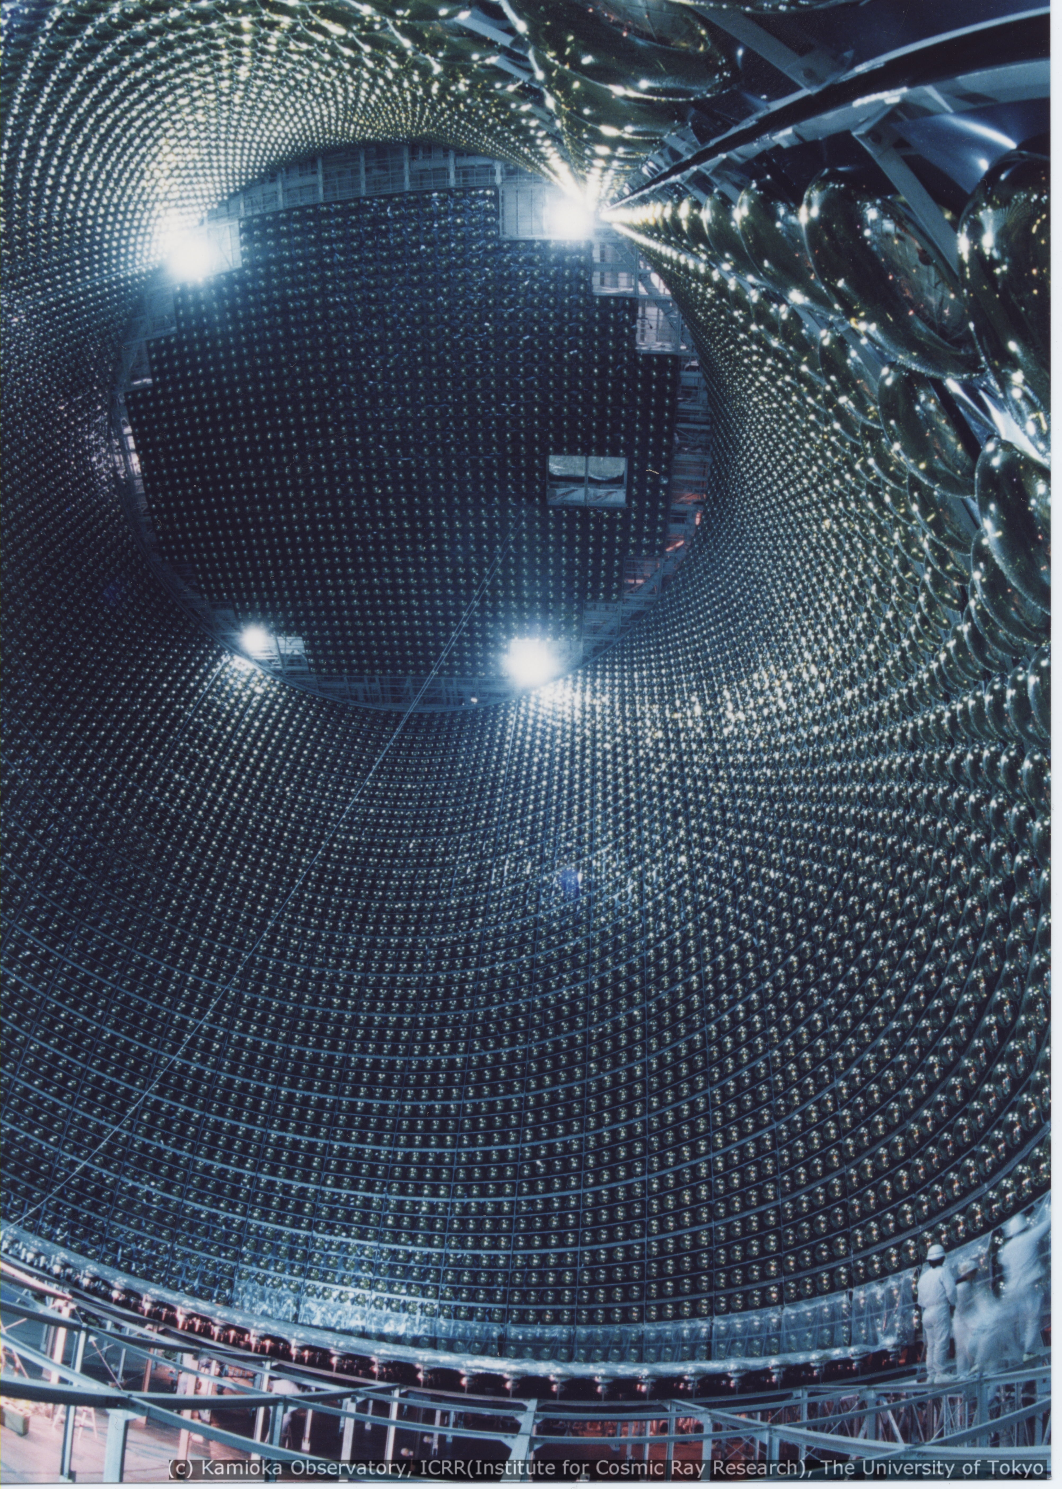
Superkamiokande Experiment
Began running in 1996 and went until July 2001 (SK-I)
In November 2001 while refilling the tank, a PMT imploded causing the water pressure to change (pressure wave) ultimately creating a chain reaction that blew up almost every PMT under water. Extensive repairs were needed
Super-K began operation again in January 2003 and ended data collection in October 2005 (SK-II)
SK-III (October 2006- August 2008) and SK-IV is ongoing today

Slide 19
Superkamiokande data/Results
Each day Super-K records about ten gigabytes of data. Most of the data comes from the background and provides no information to proton decay analysis.
Only concerned about high-energy fully-contained events are relevant to proton decay.
5 stage reduction process to try and clear out background noise and isolate the protons in the detector
Lower limits on proton decay come from Bayesian method
Since there is a set volume of water in the detector, you can figure out the amount of protons in the water. Through a certain time period of observation if you have not seen a proton decay and you know that one may decay, you can set a lower limit on its lifetime. By stating, there is so many protons in this volume of water and a proton has not decayed in a year time span you can set the lower limit on its lifetime.
Decay Channel
Partial Mean Lifetime (90% CI)
$p→e^{+}π^{0}$ 8 x ${10}^{33}$
$p→μ^{+}π^{0}$ 6.33 x ${10}^{33}$

Slide 20
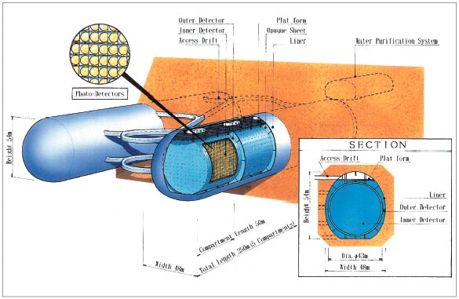
Future Experiment
Hyperkamiokande: a proposed experiment meant to be 25 times as big with two tubes that has approximately 99,000 PMT’s

Slide 21
Summary
Proton is stable and doesn’t decay to our knowledge
GUT needs to account for proton decay through hypothetical supersymmetry principles like B-L conservation
$p→e^{+}π^{0}$
$p→μ^{+}π^{0}$
Superkamiokande/IMB detectors
Lower limits of proton lifetime
Still haven’t seen proton decay
Future experiments being developed

Slide 22
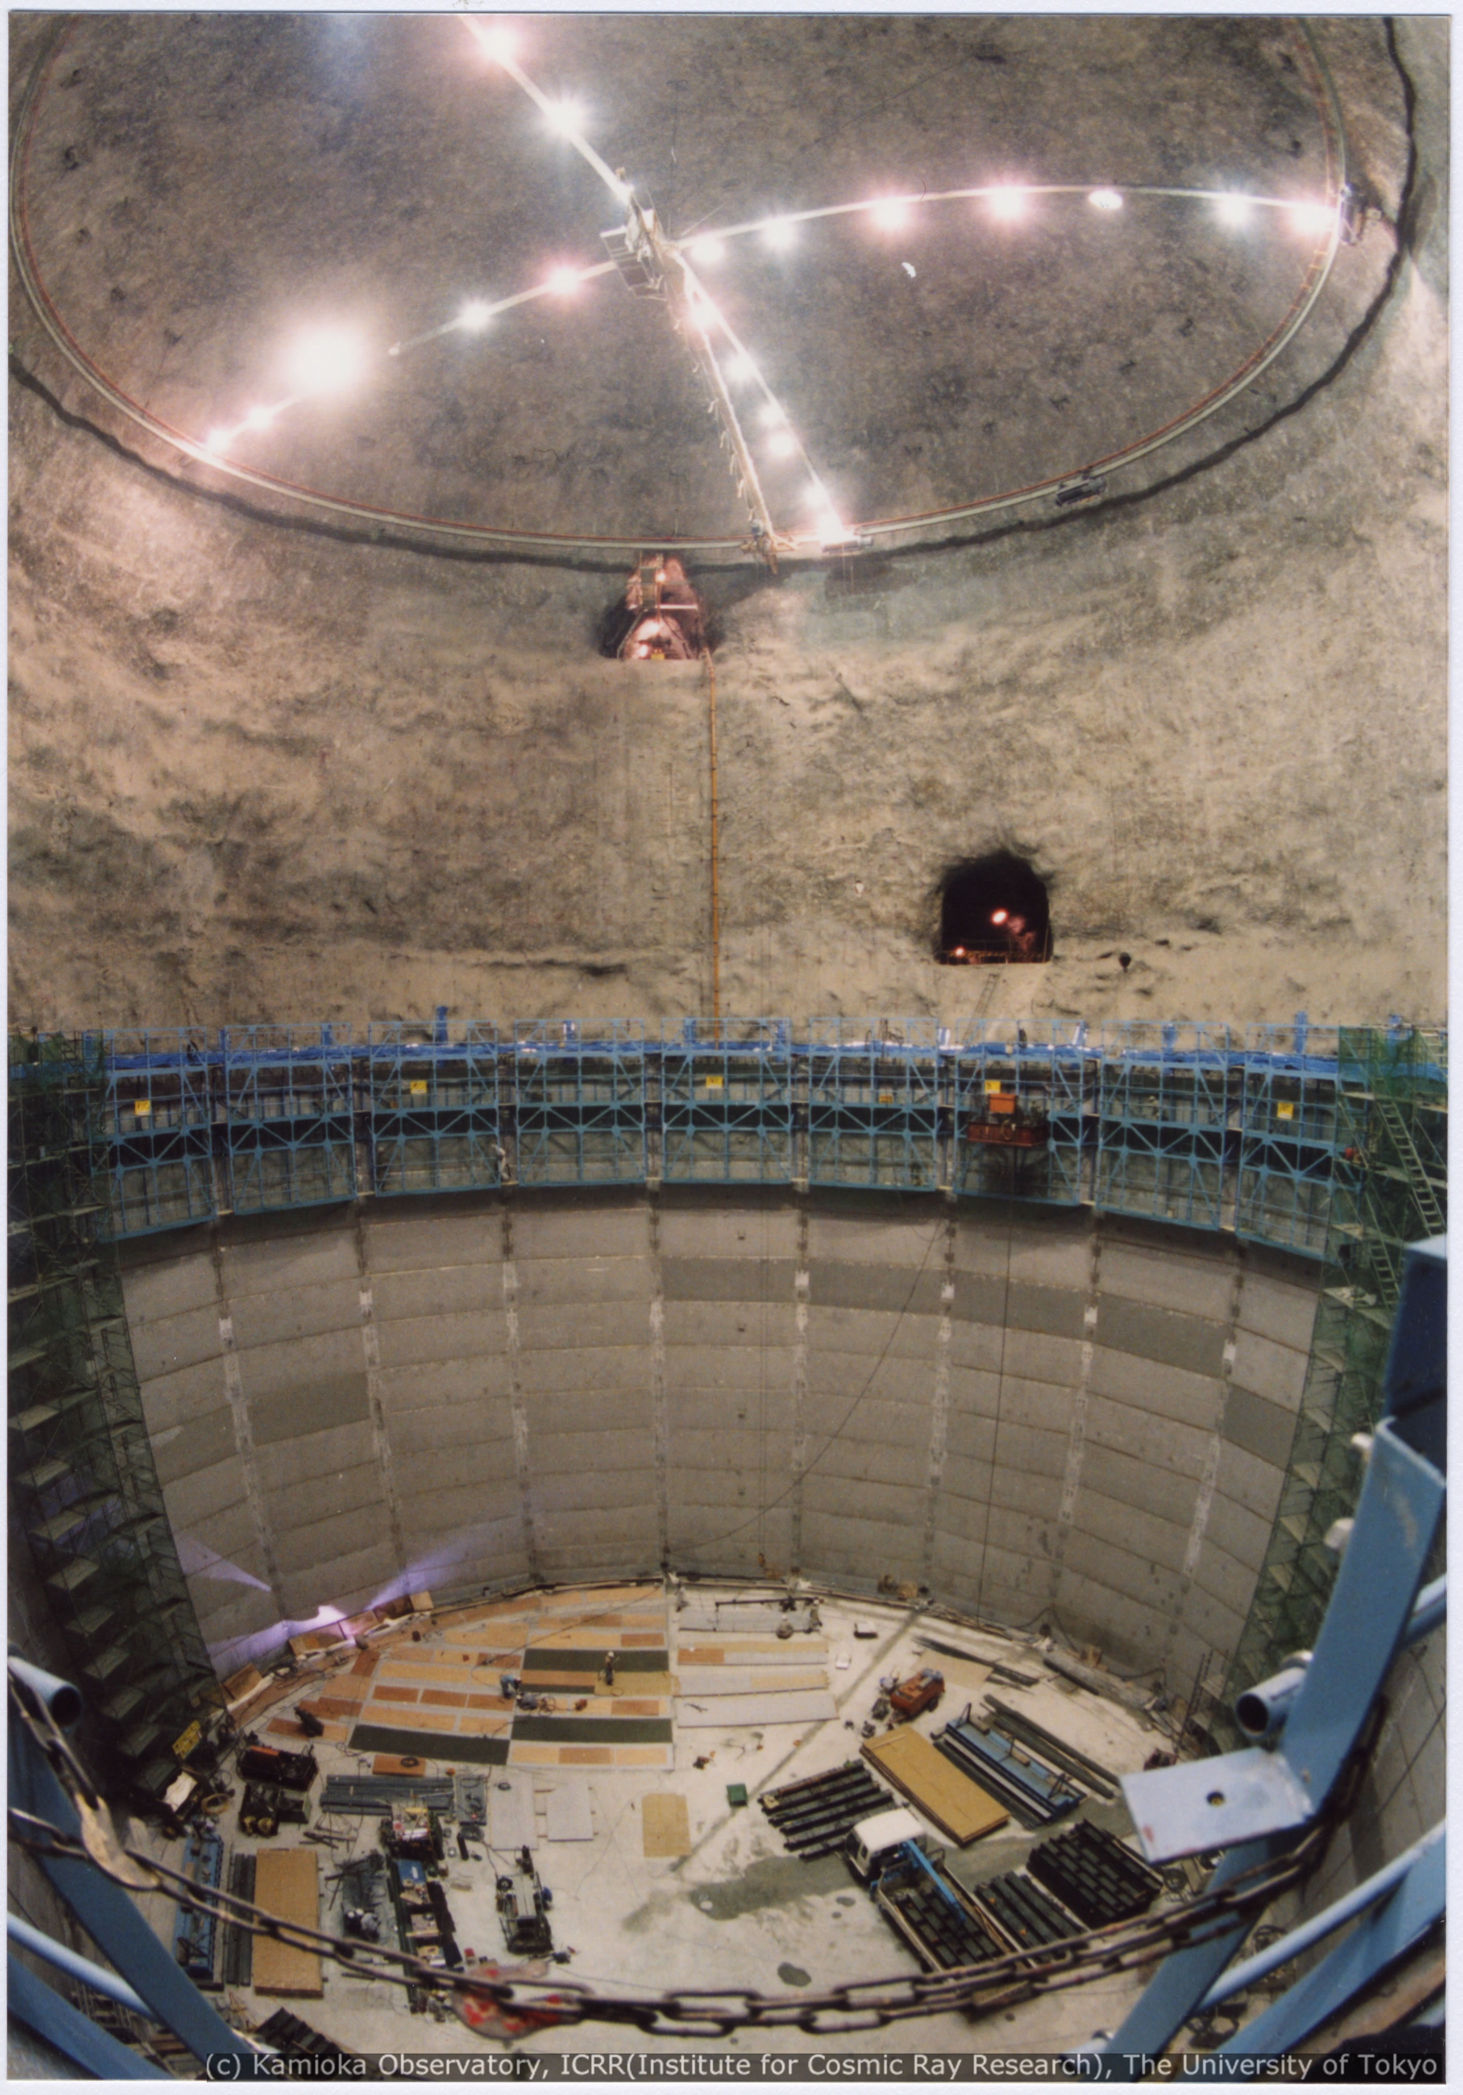
SK (1993-1996)

Slide 23
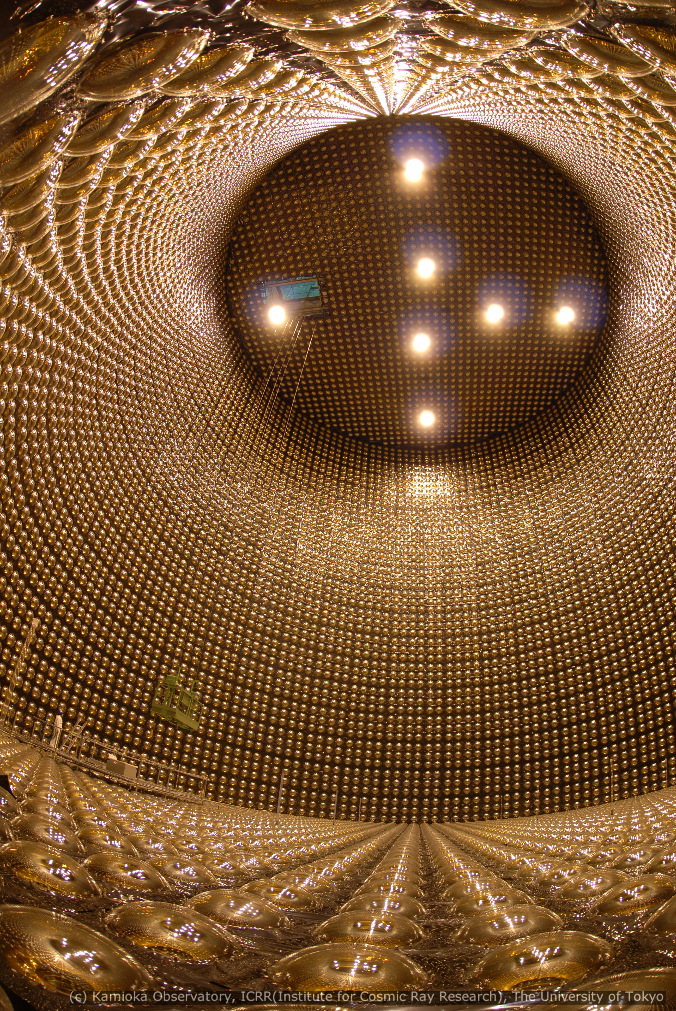
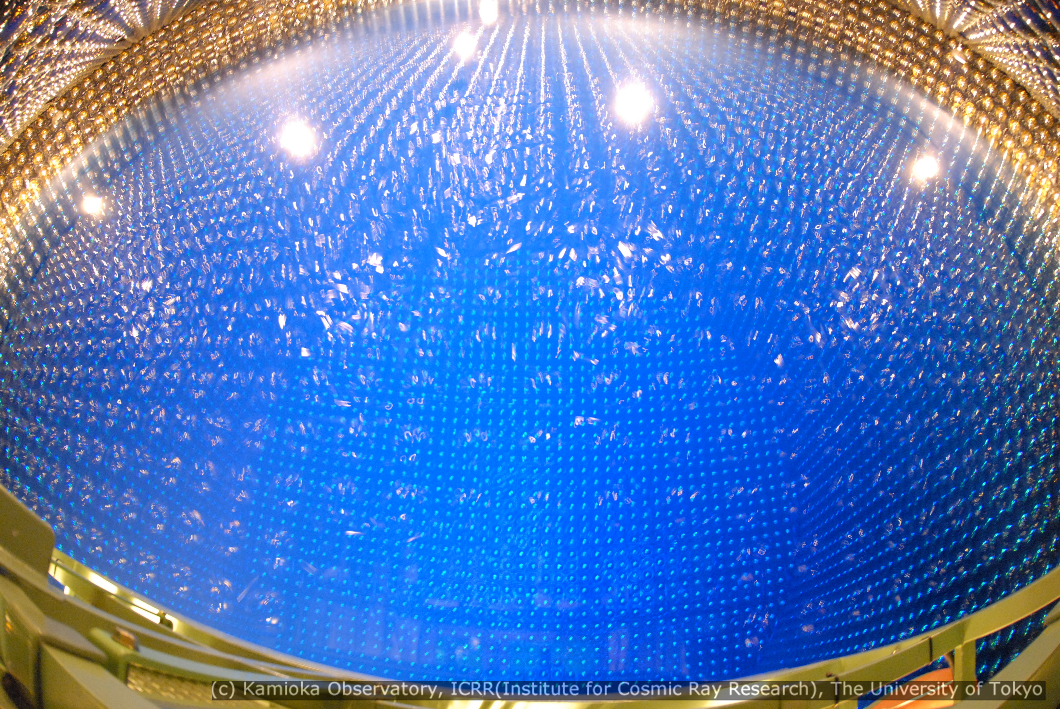
Full reconstruction (2006)
Almost fully filled

Slide 24
Bibliography
Gagnon, Steve. "Electron Capture." - Electron Capture. N.p., n.d. Web. 10 Nov. 2014. <http://education.jlab.org/glossary/electroncapture.html>.Clark, Scott T.
"Searches for Proton Decay with the Super Kamiokande Detector." (2007): 1+. John Butler. Web. <http://www-sk.icrr.u-tokyo.ac.jp/sk/pub/clark_thesis.pdf>.
"IMB Proton Decay Experiment." IMB Proton Decay Experiment. Physical Review Letters, n.d. Web. 10 Nov. 2014. <http://www-personal.umich.edu/~jcv/imb/imbp3.html>.
"Cherenkov Radiation." Wikipedia. Wikimedia Foundation, n.d. Web. 10 Nov. 2014. <http://en.wikipedia.org/wiki/Cherenkov_radiation#Particle_physics_experiments>.
"Irvine–Michigan–Brookhaven (detector)." Wikipedia. Wikimedia Foundation, 18 Oct. 2014. Web. 10 Nov. 2014. <http://en.wikipedia.org/wiki/Irvine%E2%80%93Michigan%E2%80%93Brookhaven_%28detector%29>.
"Proton Decay." Wikipedia. Wikimedia Foundation, 11 Oct. 2014. Web. 10 Nov. 2014. <http://en.wikipedia.org/wiki/Proton_decay>.

