Slide 1
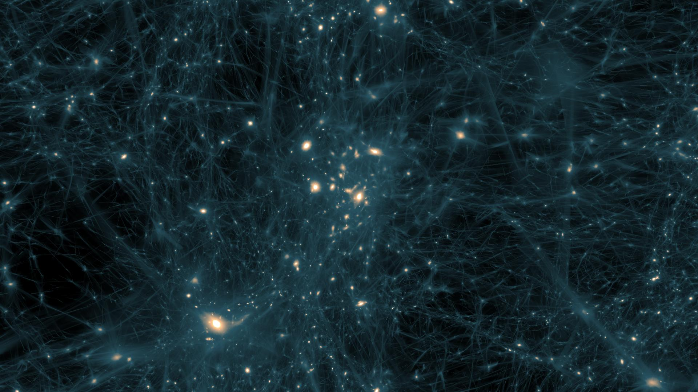
Dark Matter
Matthew Bruemmer

Slide 2
Observation
There are no purely observational facts about the heavenly bodies. Astronomical measurements are, without exception, measurements of phenomena occurring in a terrestrial observatory or station; it is by theory they are translated into knowledge of a universe outside.
Arthur S. Eddington
Notes:
Two parts of the lecture
Observations and some history
And then theory and predictions in the current era of dark matter

Slide 3
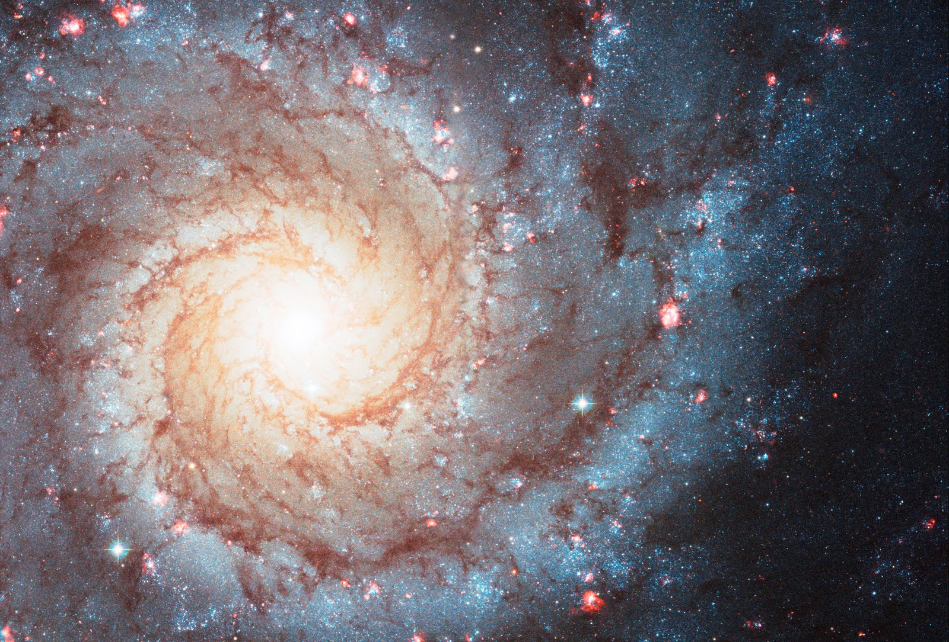
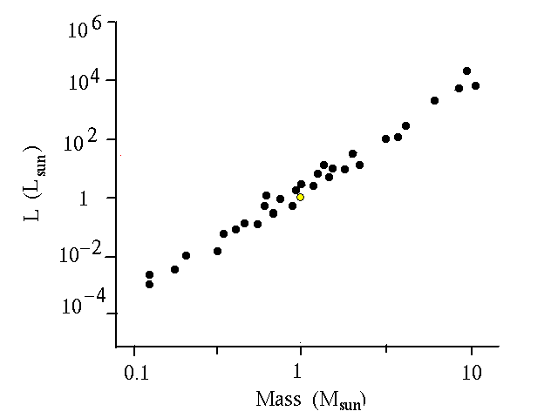
Necessity of Existence
Notes:
So why do physicists think dark matter is a required part of the universe?
Take a look at luminous mass
Luminosity versus mass

Slide 4
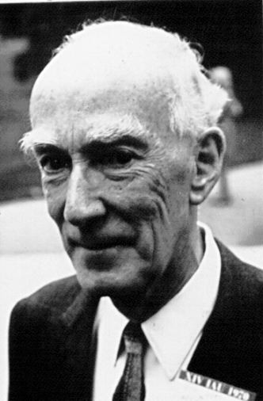
Jan Hendrik Oort (1900-1992)
1927: Gravitational Differential Rotation
1932: ‘Observed’ Disk Dark matter
Continued throughout the 1940s and 1950s
1988: Oort’s disk dark matter revealed to be erroneous by Konrad Kuijken
The disk of the Milky Way is confirmed to be more or less free of dark matter
Notes:
Inspiration to think about dark matter on galactic scales
Galaxies do not rotate like car wheels
Galaxy differential radiation represents the idea that every point in the galaxy rotates at a different angular velocity
Revealed to be wrong and was a lesson to not take any result as confirmation

Slide 5
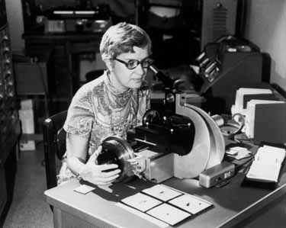
Vera Rubin
1954 – Discovered galaxies clumped together, rather than being randomly distributed
Spatial distribution of matter in an astronomical system (galaxies, clusters, etc.):
Velocity dispersion determines the cluster’s mass from the Virial theorem.

Slide 6
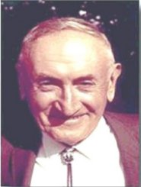
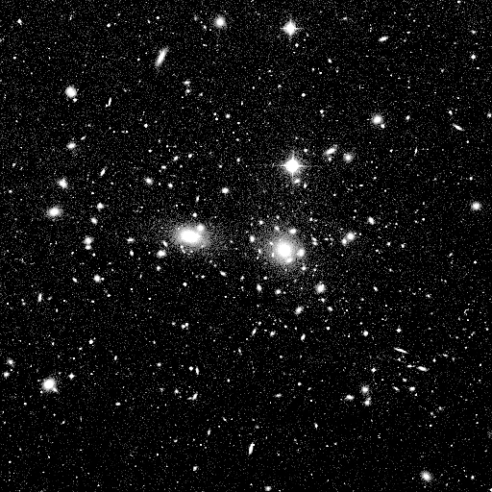
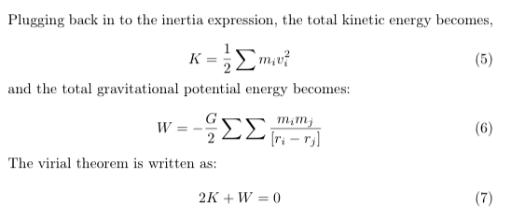
Fritz Zwicky (1898-1974)
Studies on the differences between novae and supernovae
Galaxy Clusters
1960-1968: Over 9,000 Galaxy Cluster discoveries
Cluster “Pressure”
Measuring velocities of stars
Virial Theorem
50:1 mass ratio in Coma Cluster
Direct evidence for dark matter
Notes:
Behavior of cluster represents a balloon.
Random motions of gas particles = random motion of stars
Relationship between kinetic and gravitational potential energy
Amount of systems kinetic energy due to motion of the components relating to the gravitational potential energy needed to prevent it from flying apart.

Slide 7
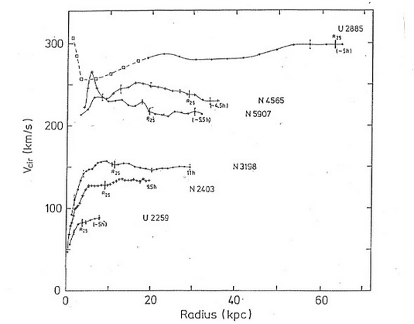
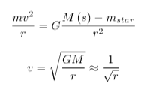
Velocity as a function of radius
The velocity of a star depends on the distance it is from the center of the galaxy

Slide 8
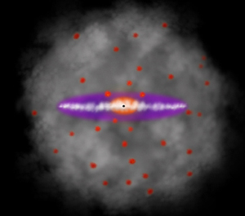
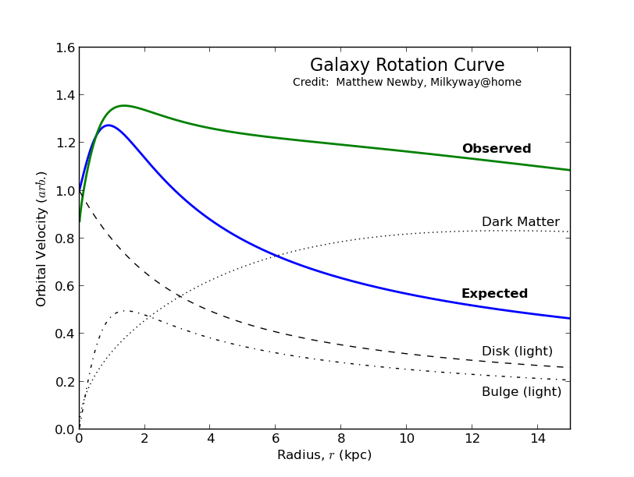
Dark Halos
The 21-cm hydrogen spectral line
Newtonian mechanics are wrong
Dark halos exist
Unknown shape
Known mass within radius
Combination of galaxies provides no results
It took 100,000 CPU hours on the ARSC Power4 to complete this simulation
Notes:
Change of energy state of neutral hydrogen atoms
21 cm for vacuum wavelength in free space (microwave radio region)

Slide 9
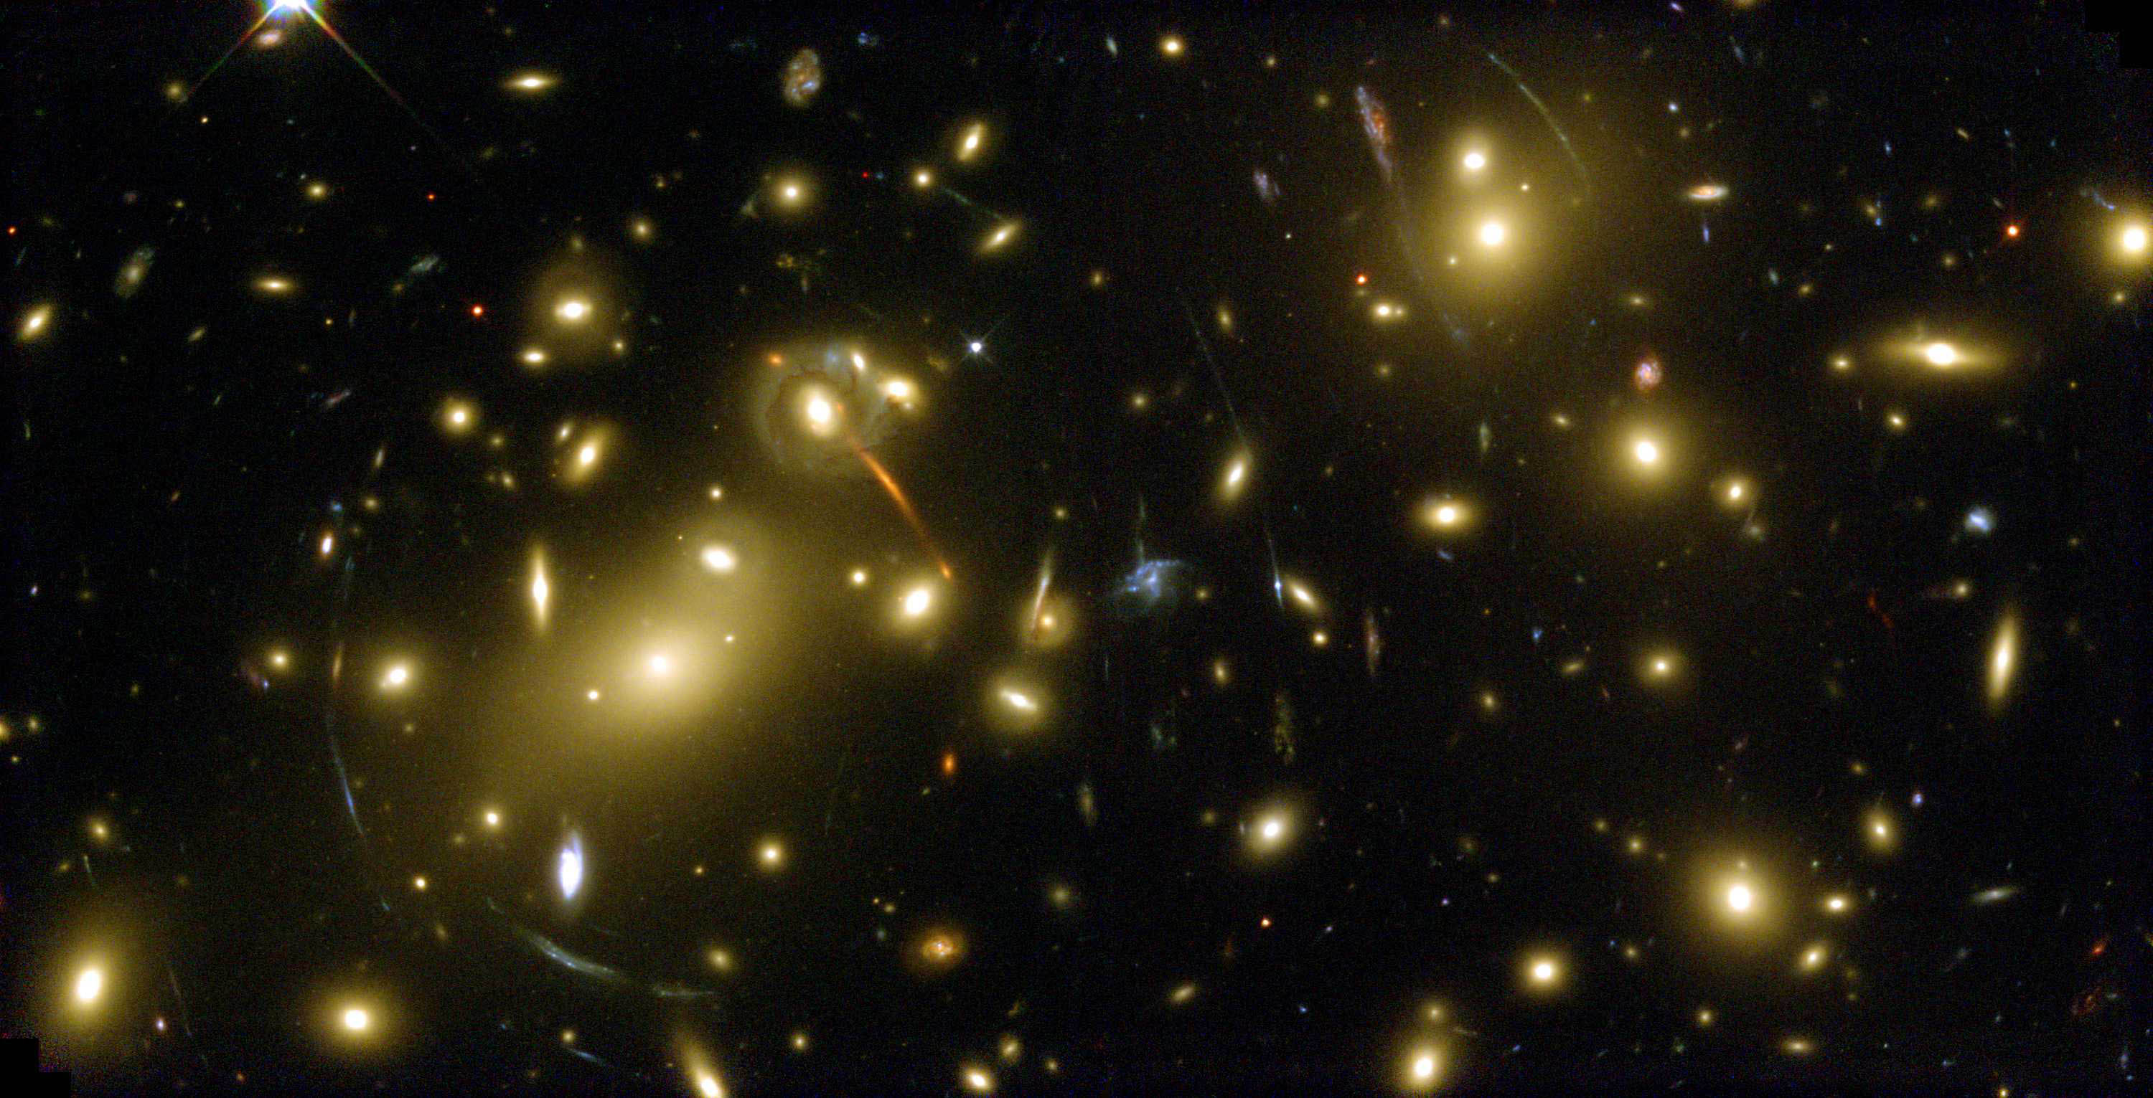
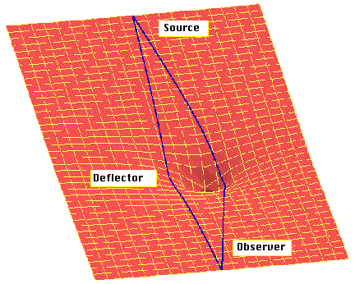
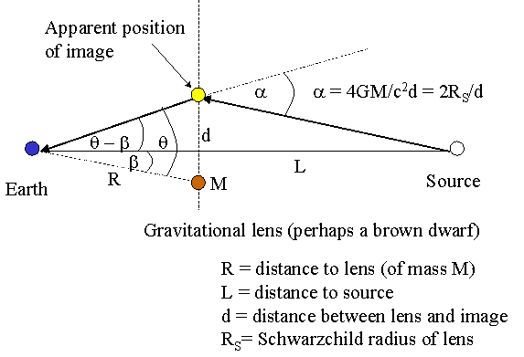
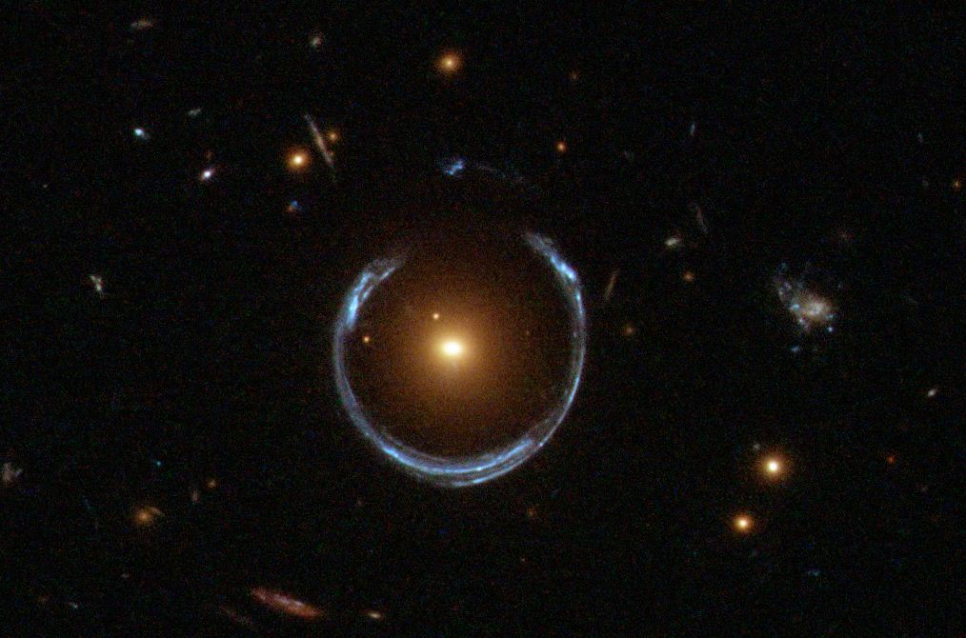
Gravitational Lensing
Massive objects and their ability to bend light
The Einstein Radius – Mass
Abell 2218 – A beautiful example
Notes:
Distribution of matter between a distant source and an observer that is capable of bending the light from the source
M mass with distance r

Slide 10
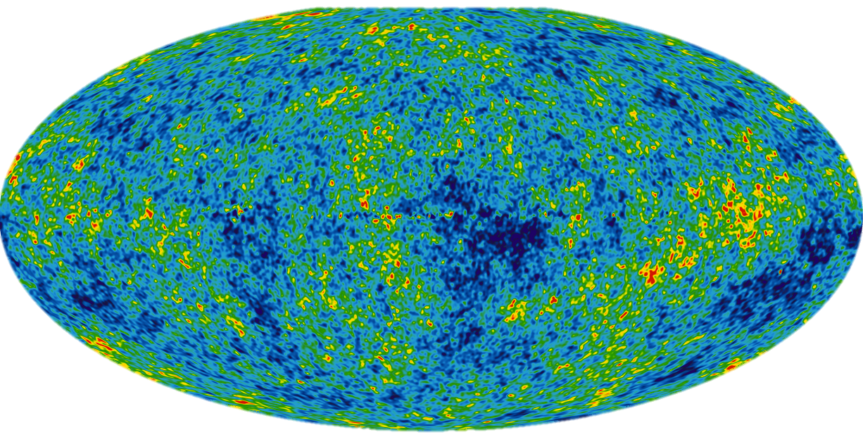
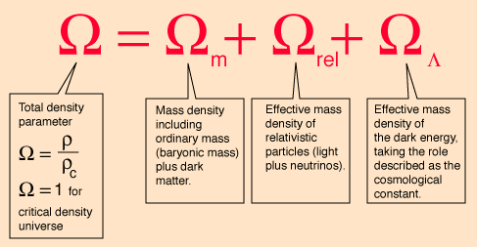
Density Parameter
Density Parameter
=1 Critical density
>1 Big Crunch
<1 Expansion
For the universe: 4% is baryonic matter
For clusters: 12% is baryonic matter
Are baryons more concentrated towards clusters?
Density parameter was assumed critical before cosmological constant
Notes:
Ratio between actual density (observed) and the critical density of the Freidmann universe
Critical density means the universe is flat
-0.5 atoms of monatomic hydrogen per cubic meter where as known matter is 0.2

Slide 11
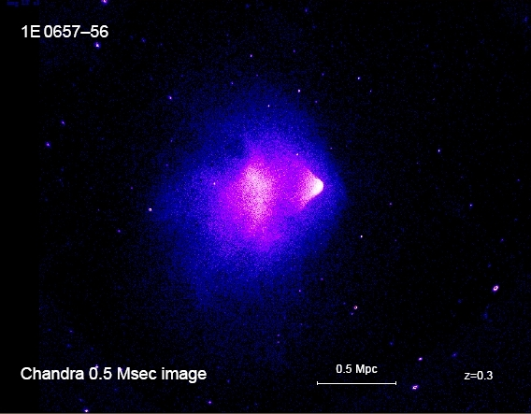
Bullet Cluster
Two colliding clusters of galaxies
Gravitational lensing studies provide one of the best evidences for dark matter
8σ statistical significance
Lensing is strongest in two separated regions (visible region) providing support for collision-less dark matter
May be evidence that the prevailing cosmological model is insufficient to describe mass of galaxies
Notes:
The gravitational lensing predicted is off from what is seen which is the proof
May indicate that the prevailing cosmological model… it may be that the shape of the universe is also incorrect

Slide 12
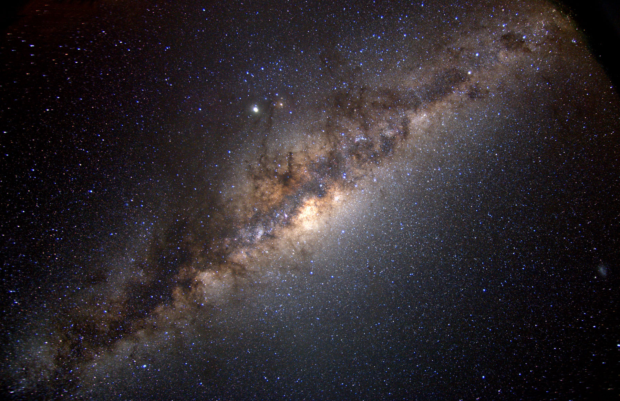
Dark Matter in our galaxy

Slide 13
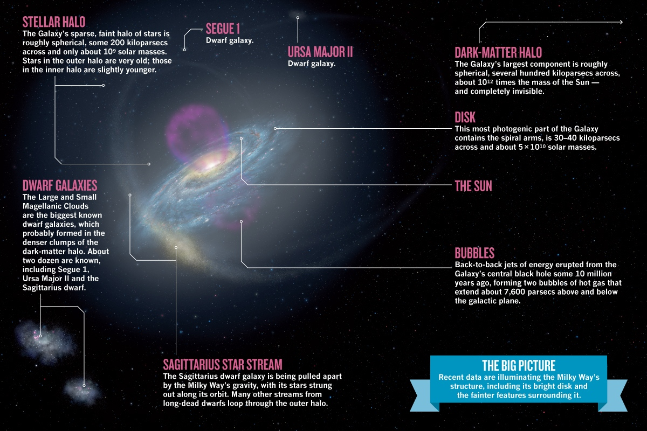
Calculating Dark Matter in the Milky Way
Distance from the center of the milky way to the Sun: 8 kiloparsecs (2E20 m)
Rotation curves applied: 20 kiloparsecs
200 billion solar masses (3:1)
Lower limit of escape velocity:
650 km/sec (observed)
300 billion solar masses
Halo stars
500 billion solar masses
Rotating galaxies: 20:1
D

Slide 14
Research
Intelligence is the ability to adapt to change.
Stephen Hawking

Slide 15
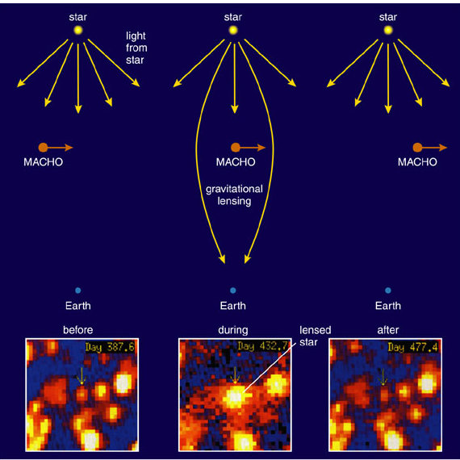
MACHOs
MAssive Compact Halo Objects
Any astronomical body that can explain dark matter
Baryonic matter
Black holes, brown dwarfs, planets
3 years, 3 billion observations
13 total MACHO events
Gravitational Microlensing

Slide 16
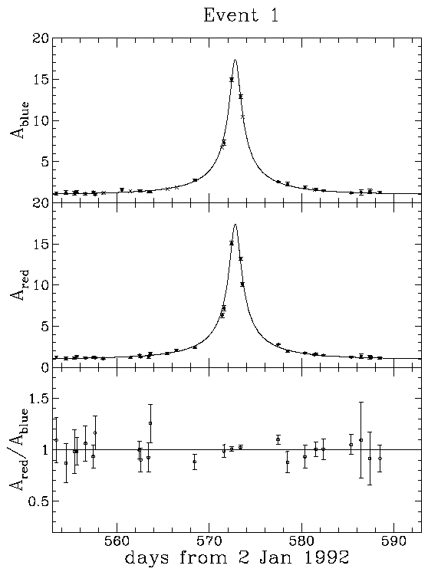
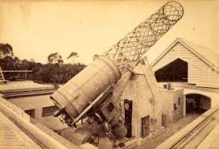
MACHOs
First MACHO event
Another 24 years of star observation would be needed to halve the statistical uncertainty
The Great Melbourne Telescope
“The Gold Plated Event”

Slide 17
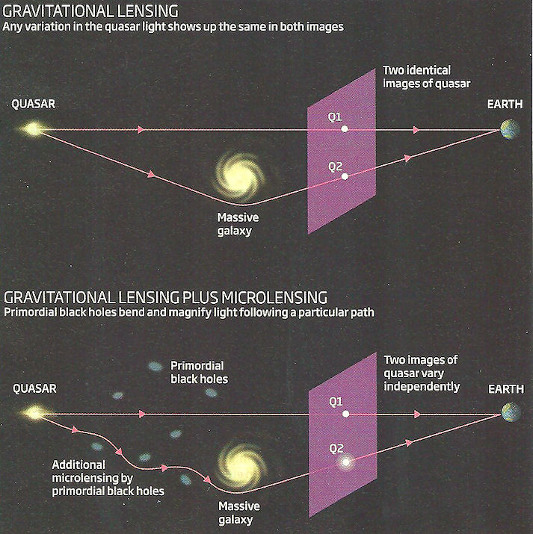
Primordial Black Holes
Formed from the extreme mass density of the early universe
0.5 Solar mass
Event horizon small since the radius of the universe was small
Quark-hadron transition

Slide 18
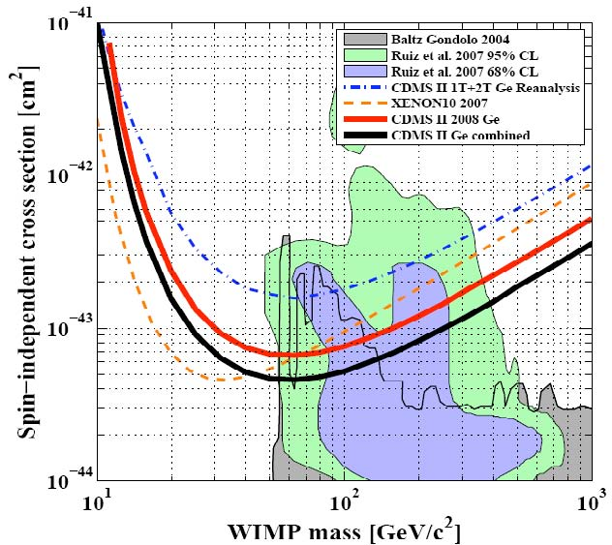
WIMPs
Weakly Interacting Massive Particles
Particle falling out of thermal equilibrium with the hot plasma of early universe
Common term for any dark matter candidate interacting with standard particles
Self-annihilation cross section expected for a new particle in the 100 GeV mass range
Failure of evidence for supersymmetry in the LHC has cast doubt on WIMPs

Slide 19
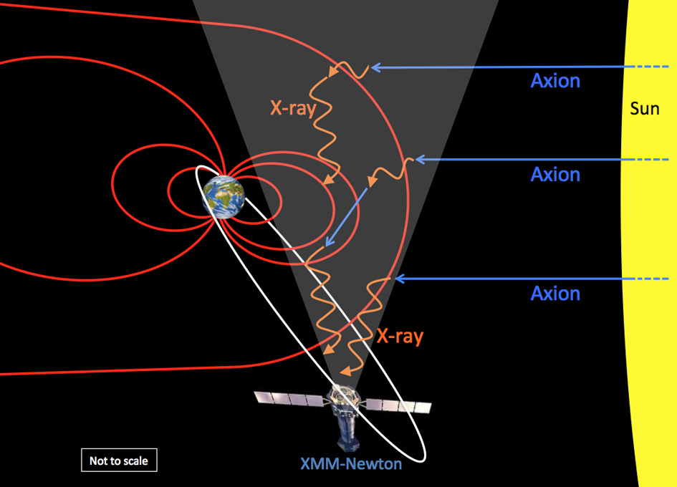
Axions
Theoretical particle with a mass in the 10⁻⁴-10⁻⁶ eV range
For halos, 10¹³ per m³ would need to exist
Boson particle produced during the QCD phase transition
Extremely difficult to detect
Inexistent detector with proper sensitivity
Recent Observation of Axions
e−+Z→e−+Z+a
Notes:
Sources

Slide 20
Sources
Einstein’s Telescope by Evalyn Gates
In Search of Dark Matter by Ken Freeman
Dark Matter in the Universe by John Bahcall
http://cdms.berkeley.edu/
http://www.astro.caltech.edu/~george/ay20/eaa-wimps-machos.pdf
http://en.wikipedia.org/wiki/Axion
http://motls.blogspot.com/2014/10/an-overlooked-paper-discovering-axions.html
http://adsabs.harvard.edu/full/1979A%26A....80..104N

