Slide 1
Gravitational Waves

Slide 2
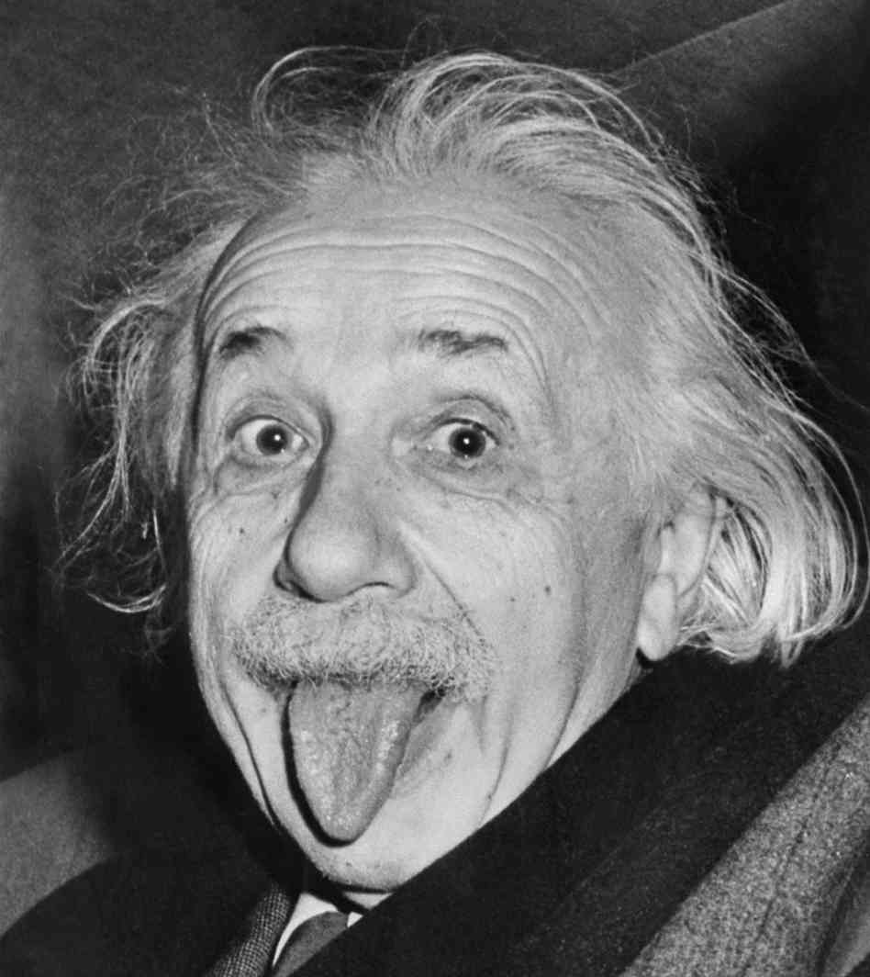
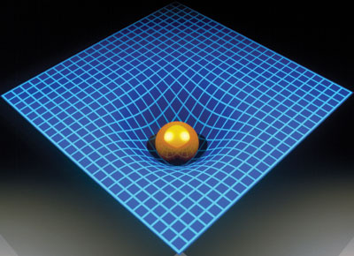
Gravitational Waves
Prediction
General Relativity – 1915
Gravity is not the pulling force envisioned by Kepler or Newton
Space warps around massive objects
Accelerating massive objects could radiate distortions like the wake of a boat
Notes:
Field equations
Vacuum solution

Slide 3
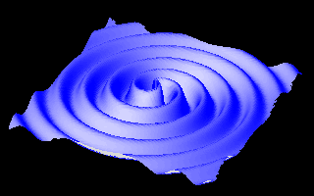
Gravitational Waves
Properties
Travel at the speed of light
Radiate energy
Polarization
Magnitude of the distortion falls off as 1/R

Slide 4
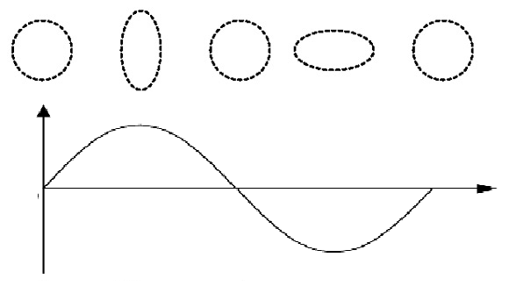
Gravitational Waves
Effect of a passing wave

Slide 5
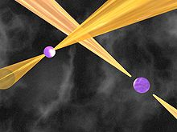
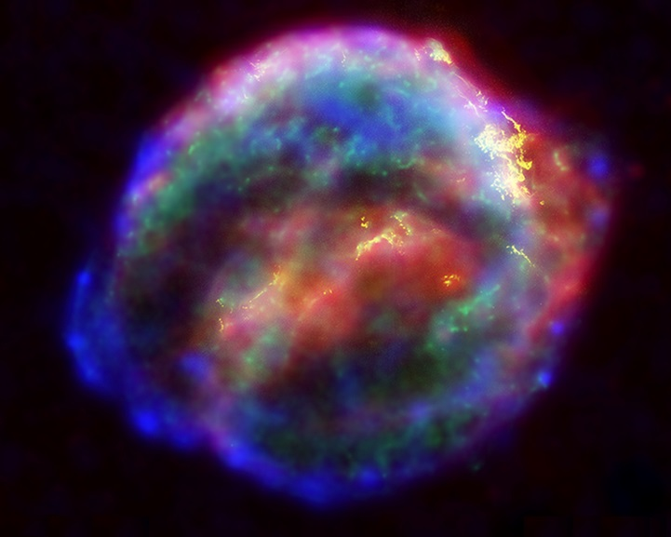
Gravitational Waves
Possible Sources
Looking for things that are massive and:
Accelerating - Binary systems of pulsars or black holes
or
Spinning – asymmetric bodies
or
Exploding - Supernovae

Slide 6
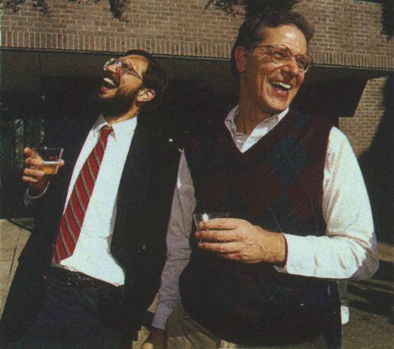
Gravitational Waves
Evidence
Hulse-Taylor Binary Pulsar
Russell Hulse and Joseph Taylor
1993 Nobel Prize
Measured the change in the period of revolution

Slide 7
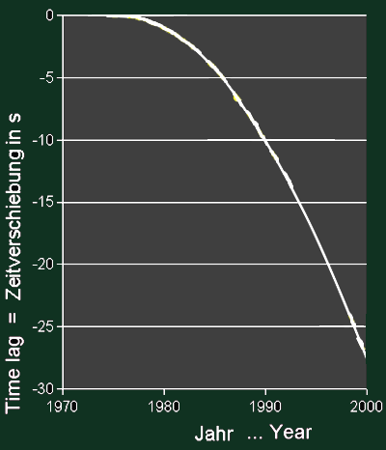
Gravitational Waves
Evidence
Hulse & Taylor discovered the binary pulsar and predicted the decay of the period of revolution if the system was radiating energy as gravitational waves

Slide 8
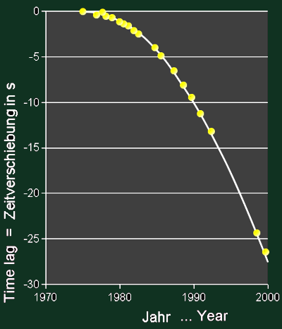
Gravitational Waves
Evidence
Hulse & Taylor discovered the binary pulsar and predicted the decay of the period of revolution if the system was radiating energy as gravitational waves

Slide 9
Gravitational Waves
Evidence
Hulse & Taylor discovered the binary pulsar and predicted the decay of the period of revolution if the system was radiating energy as gravitational waves
Good evidence, but only indirect

Slide 10
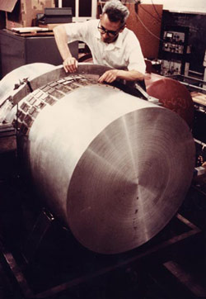
Gravitational Waves
Direct Evidence
Weber Bar
&
AURIGA
Attempts to detect the effect of passing waves by measuring the distortion of a bar.
Notes:
Joeseph weber, claimed results in the 1970s, numerous errors, no duplication
AURIGA (Italian) cools the bar to a few thousands of a degree above absolute zero and measures the dimensions with lasers

Slide 11
Gravitational Waves
Direct Evidence
LIGO
&
LISA
Laser Interferometry

Slide 12
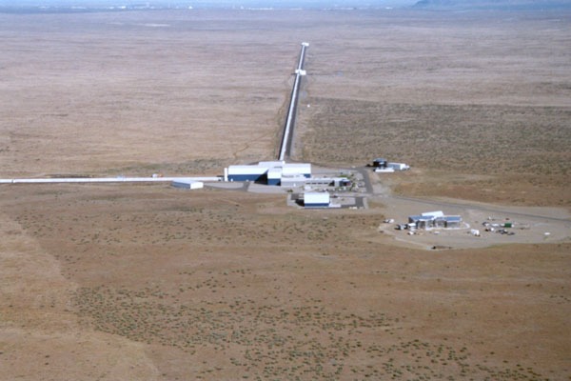
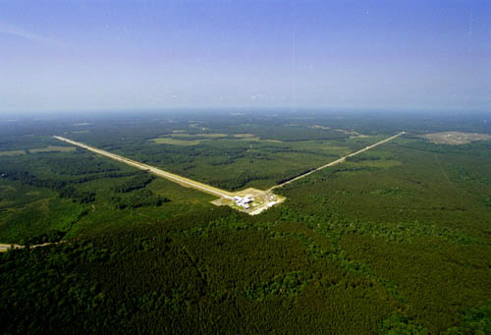
Gravitational Waves
Direct Evidence
LIGO
2 US Locations, Hanford WA and Livingston LA
4km arms; largest vacuum tubes in the country
$365m in 2002 USD; biggest NSF project so far

Slide 13
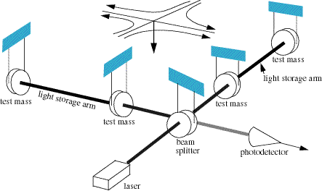
Gravitational Waves
Direct Evidence
LIGO
Laser Interferometer Gravitational-Wave Observatory
Notes:
Ran from 2002-2010, no results
Gearing up for advanced ligo in 2015
Big challenges, being attached to the ground – noise, vibrations, disturbances

Slide 14
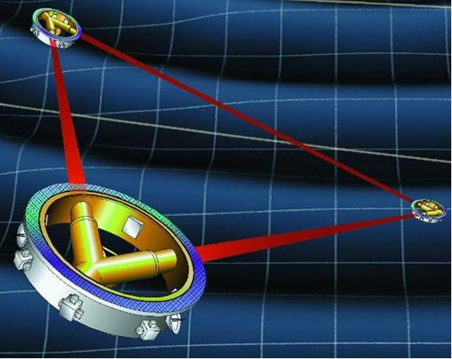
Gravitational Waves
Direct Evidence
LISA
LIGO in space
Solves some of the problems of being attached to the ground
Still a huge technical challenge
Notes:
Originally a USA + EU project, NASA dropped its support due to budget cuts, so the EU is looking into tweaking the plans for LISA to make it a viable ESA-only project

Slide 15
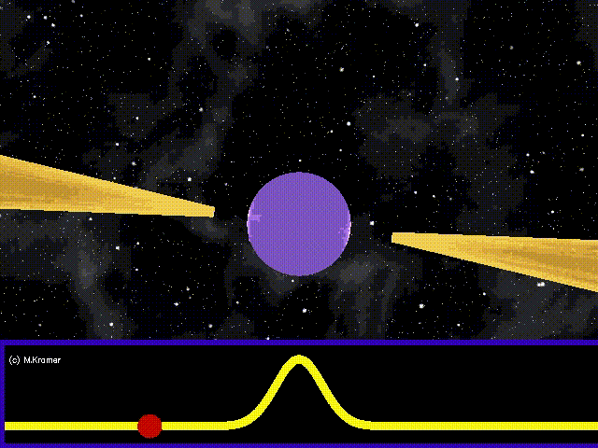
Gravitational Waves
Direct Evidence
Pulsar Timing Array
Measure the period of pulsars very precisely:
Spin today: 5.75745194212336 <--- +/-1 ms
Spin in a year: 5.75745194393018 <--- +/-1 ms
Spin in 50 years: 5.75745201913820 <--- +/-6 ms
Gravitational waves could disturb the pulses
A network of pulsars across the sky could be used to map a passing gravitational wave

Slide 16
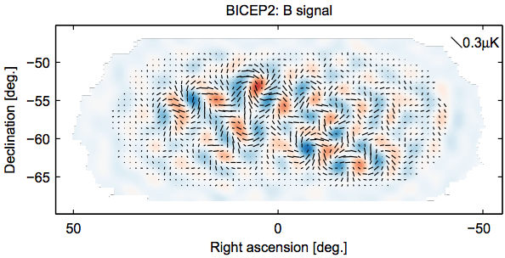
Gravitational Waves
Maybe Evidence
BICEP2
Possible indirect evidence of primordial gravitational waves
Maps polarization in the cosmic microwave background
Primordial gravitational waves theorized to have resulted from inflation (10^-35 s after BB)
Results called into question with discovery of excess dust – but GW still important to BB people
“Don’t put anything on slides you don’t understand”

