Slide 1
Neutrino Mixing
Rafael Sierra

Slide 2
What to Expect
1) A short review of the basic information about neutrinos.
2) Some of the history behind neutrinos and neutrino oscillations.
3) The Theory of Neutrino Mixing.
4) The NOvA experiment.

Slide 3
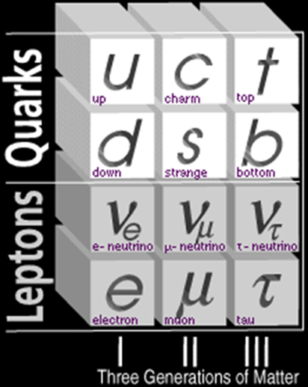
Neutrinos
Charge less complements to the charged electron, muon, and tau lepton.
Travel at nearly light speed with incredibly light, unknown mass.
Have spin ½.
Only interact through the weak interaction – and are thus highly non-interactive
Stable – even while the muon and tau are not.

Slide 4
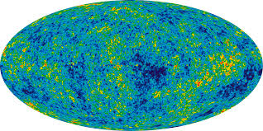
Sources
Big Bang – there is a neutrino cosmic background like there is a microwave background – but they are too low energy to detect.

Slide 5
Sources
Solar Neutrinos – neutrinos generated by the sun are a side effect of the fusion reaction at the core. They are expected to be electron-neutrinos.
Cosmic Rays – one of the major products of cosmic rays.
Nuclear Reactors – about 3% of the anti-neutrinos produced by nuclear reactors are visible.
Particle Accelerators – used in conjunction with neutrino detectors gives us the best way to study their properties.

Slide 6
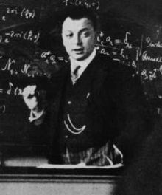
History
In order to reconcile the loss of energy and angular momentum in beta decay, Wolfgang Pauli conjectured the existence of neutrinos, hard-to-detect particles that would carry away the excess energy and momentum.
It must be uncharged.
None or very small amount of mass.

Slide 7
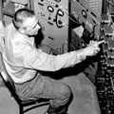
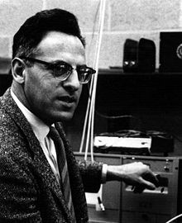
History
20 July 1956: The Cowan-Reines Neutrino Experiment verified the existence of neutrinos
They won the Nobel Prize for their discovery in 1995 – nearly 40 years later.

Slide 8

History
In 1962, the muon neutrino was detected. (1988 Nobel Prize)
In 1975, the tau, the third kind of lepton was discovered.
In 2000, the associated tau neutrino was discovered by the DONUT collaboration at Fermilab.

Slide 9
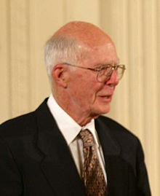
Solar Neutrinos
The Homestake (Davis) Experiment counted the number of electron neutrinos coming from the sun, and found 1/3 of the number that was theoretically predicted.
The conclusion is that neutrinos must change their flavor in between transit from the Sun to the Earth.

Slide 10
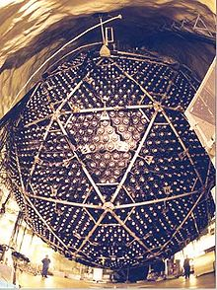
Direct Observation
Eventually, the Super-Kamiokande Collaboration detected neutrino oscillations for the first time in 1998.
On 18 June 2001, results from SNO (Sudbury Neutrino Observatory), proved that neutrinos change flavor on their way from the sun to the Earth.
So we must make sense of neutrino oscillations.

Slide 11
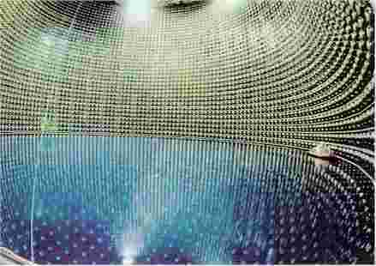
The picture above is of Super Kamiokande,
a solar and atmospheric neutrino detector in Japan.

Slide 12
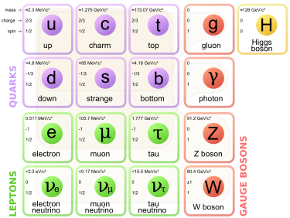
Theory
Since neutrinos can change flavor, we must conclude that they have mass – in other words, we are outside the realm of the standard model, which asserts that neutrinos have no mass.

Slide 13
Theory: Why Oscillations?
Neutrino Oscillations are a consequence of nonzero neutrino masses and the small spacing between the masses.
Each of the three neutrino states representing definite flavor are themselves a superposition of states of definite mass.
As the neutrino propagates, the slight differences in the masses of the neutrino states leads to different advances in the phases of the mass state – thus, a different mixture of mass states and the related flavor states.
Similar to neutral Kaon mixing.

Slide 14
General Derivation
Where are the flavor eigenstates , are the mass eigenstates with mass and is the neutrino analogue of the CKM matrix, i.e. the mixing matrix.
Gives the eigenstates at a later time t and position .

Slide 15
Intensity
Let us assume the neutrino interacts weakly at time t, and we tag it as a flavor eigenstate . Then we have an intensity:
We use the ultra-relativistic limit so that:

Slide 16
Mixing Equation
So that:
Which will serve as the standard mixing equation.

Slide 17
Two Generation Mixing
If only two generations (say, electron and muon) participate, then:
Setting for the initial state, there are two intensities, one for each value of related by:

Slide 18
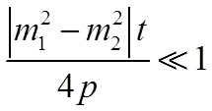
Two Generation Mixing
And,
Which has three important limits:
1)
When we are close to the source, no oscillations are noticeable.

Slide 19
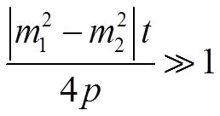
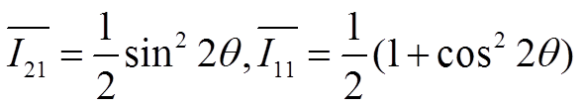
Other Cases
2)
A pattern is noticeable as t varies, so the precise calculation of is possible.
3) The experiment will average over the
rapid oscillations, resulting in
We have oscillations, but cannot measure the mass difference.

Slide 20
Three Generation Mixing
For three generation mixing, oscillations can be described in terms of four angles: on CP-violating phase and three differences of masses squared, only two of which are independent.
Experimental evidence suggests that two of the mass eigenstates are more degenerate with each other than they are with the third:

Slide 21
Three Generation Mixing
This simplifies the mixing equation so that:
Which can be rewritten as:

Slide 22
The Grand Finale
Where from experiment evidence.

Slide 23
Analysis
It seems from these equations that the electron neutrino’s tendency to oscillate is quite suppressed while the tau and muon neutrino oscillate between each other like the two-generation mixing we saw previously.
Nowhere in this derivation did we use knowledge of individual masses; we only used the differences of masses squared. This means that we also don’t know the mass hierarchy of the neutrinos. Only upper limits have been determined.

Slide 24
Analysis
The mixing matrix can be approximated by:
Where and is the CP violating phase, which is very hard to measure, as is very small (<10 degrees).

Slide 25
CP-Violation
To measure the violating phase, a terrestrial experiment would be needed where the source of the neutrinos is a particle accelerator and the design allows for a long baseline for its detectors and a high intensity beam of neutrinos.
Replacing neutrinos in the experiment with antineutrinos would make it possible to calculate the CP-violating phase.
Thus, comes in… NOvA.

Slide 27
The Intensity Frontier

Slide 28
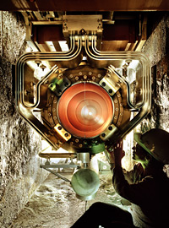
NOvA
A beam of neutrinos will be fired from the Fermi National Accelerator Laboratory in Illinois directly (through the earth) at the detector in Ash River, Minnesota, a 500 mile trip that is completed in 0.03 milliseconds.
A detector nearby the accelerator and the 14,000 ton detector at the far end will measure the neutrino type, hoping for some oscillation during the trip.
The NuMI horn.

Slide 29
Videos
http://www.fnal.gov/pub/presspass/press_releases/2014/NOvA-Running-20141006-images.html

Slide 30
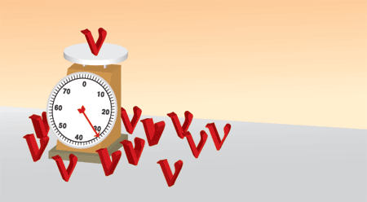
Goals
1) To detect the oscillation of muon neutrinos to electron neutrinos.
2a) To order the neutrino masses. What is the mass hierarchy?
2b) As neutrinos have no charge, are they their own antiparticle? (As in, are they Majorana or Dirac?)
3) To observe the extent of CP violation - as this could explain the matter-antimatter asymmetry of the Universe.

Slide 31
Conclusion
Neutrinos are one of the most common, and yet, least understood fundamental particle.
Neutrino mixing is how we can explain the deficit of electron neutrinos coming from the sun.
Understanding the physics of neutrino mixing allows us to understand some of the physics beyond the standard model.
NOvA should provide some explanations – and might even allow us understand the matter-antimatter asymmetry of the universe, and thus, answer an important open question in modern physics.

Slide 32
References
DONUT. Fermi National Accelerator Laboratory, 19 Nov. 2001. Web. 9 Nov. 2014. http://www-donut.fnal.gov/
Fermilab. Fermi Research Alliance, LLC, n.d. Web. 9 Nov. 2014. http://www.fnal.gov/
K. Nakamura, S.T. Petcov. “Neutrino Mass, Mixing, and Oscillations.” Particle Data Group (2014): n. pag. Web. 9 Nov. 2014.
Perkins, Donald H. Introduction to High Energy Physics. Addison-Wesley Publishing Company, Inc., 1987. Print.
Seiden, Abraham. Particle Physics: A Comprehensive Introduction. San Francisco: Pearson Education, Inc., 2005. Print.

