Slide 1
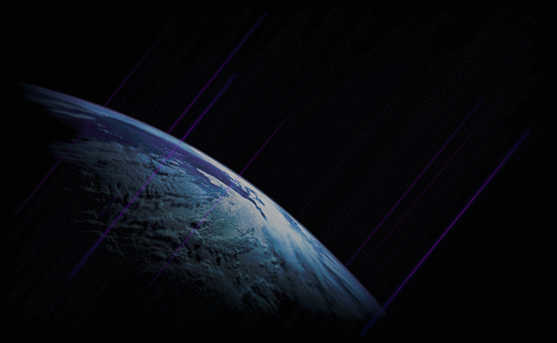
Cosmic Rays
Matt Stein - SMU

Slide 2
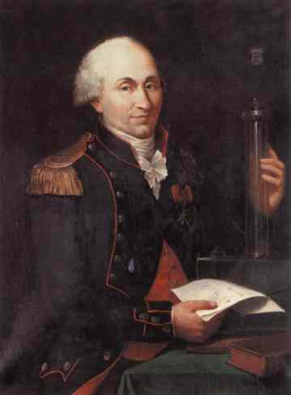
A long, long time ago…
1785: France
Charles Coulomb shows that charged metallic bodies gradually lose charge when placed in air
There will be conflicting opinions on this claim, and its causes, for the next ~100 years
In 1895, J.J. Thompson would speak on “ions” in the atmosphere
Charles-Augustin de Coulomb

Slide 3
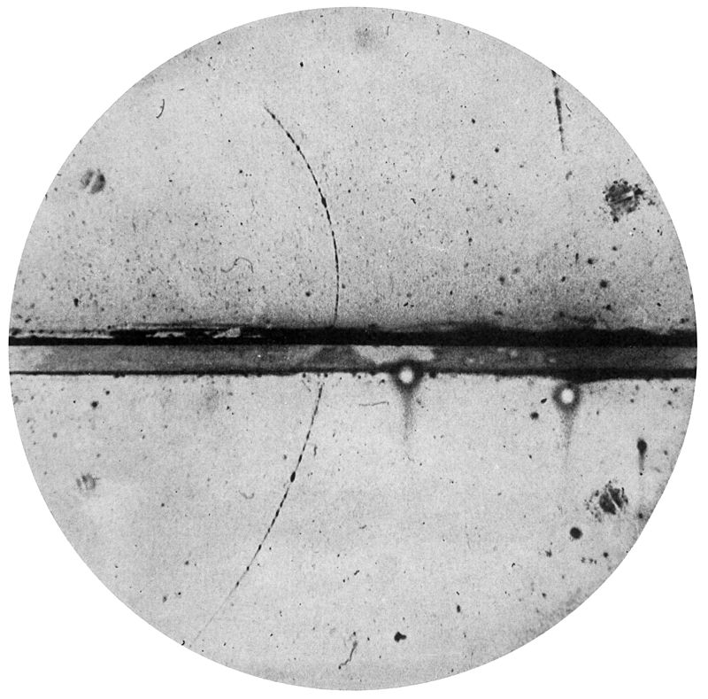
Why is the atmosphere ionized?
Radium in the Earth
Tests conducted overseas by Arthur S. Eve, 1907
1901: Charles Thomson Rees Wilson conducted experiments in deep tunnels and caves
Found no decrease in ionization no matter how much rock was overhead
“It is unlikely, therefore, that the ionization is due to radiation which has traversed our atmosphere; it seems to be a property of the air itself.”

Slide 4
1909 – Theodor Wulf
Ionization at different heights
Theorized that if Earth were the source of radiation, it should quickly diminish with increasing height
Took measurements from the base and top of the Eifel Tower (~300m)
Recorded 6 ions per cc per second at ground level, and 3.5 ions per cc per second on top
Expected to find only a few percent of the ionization at the top

Slide 5
The Gold-leaf Electroscope
Charge is applied to metallic wires
The static charge causes repulsion between the wires and they spread to form a “v” shape
Separation between the wires is measured and total charge on wires can be determined

Slide 6
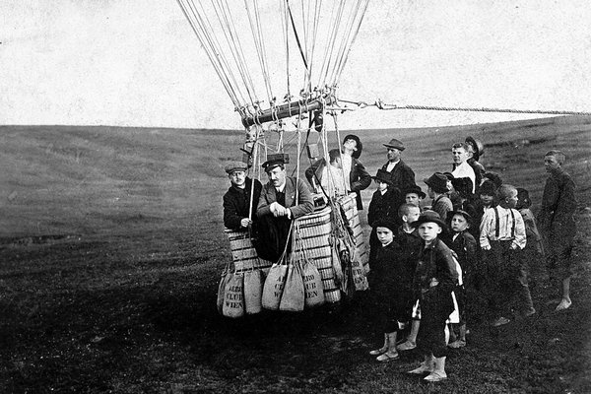
August 7, 1912 – Victor F. Hess
Most decisive results starting coming in by the 7th flight
Took off near Aussig, Austria and flight lasted 6 hours
Balloon elevation ~ 16,400ft (5 km)
Conclusively correlated increasing radiation with increasing altitude
Notes:
-An electroscope is a device used to detect electric charge. You may have seen it in an intro physics course.
-This event is thought of as the birth of the study of Cosmic Rays
-Nobel Price in 1936 for discovery of cosmic rays. Shared with Carl David Anderson for discovering positrons in the cosmic rays.
NEXT SLIDE: Wind speed at alititude

Slide 7
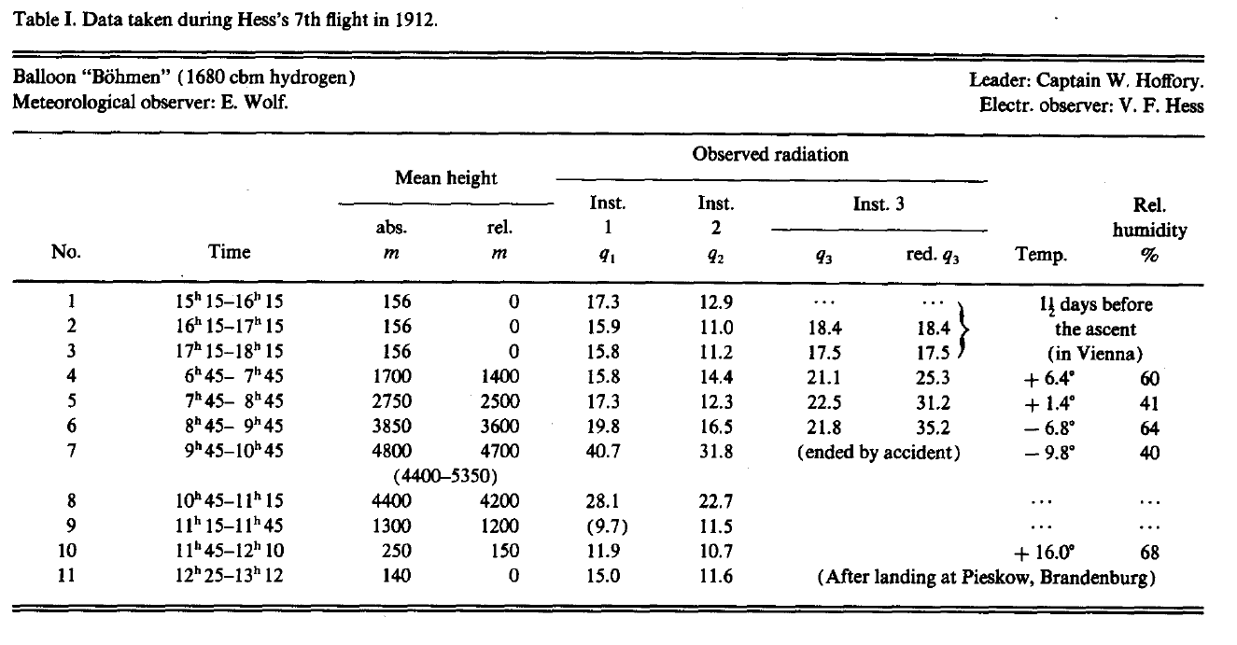

Slide 8
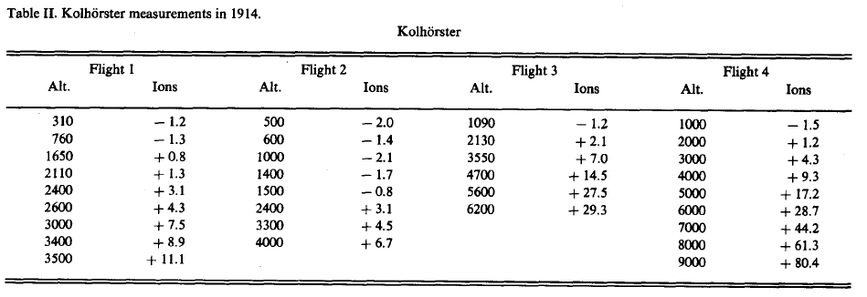
Confirmation by Werner Kolhorster
Notes:
Discuss wind speed, jet stream, and temperature at altitude.
Also, the NAME is still uncertain:
Egon Von Schweidler used the term “Hess Rays”
Hess himself preferred “ultragamma radiation”
Kolhorster called it “Hohenstrahlung” or “cosmic radiation,” but literally “radiation from the heights”

Slide 9
The Millikan Debacle
Extraterrestrial origin of cosmic rays was difficult for some to believe
Robert Millikan would work for years in an attempt to disprove Hess’ claims
Conducted experiments in San Antonio, Pasadena, at Mt. Whitney, and Pikes Peak
“The results then… constitute definite proof that there exists no radiation of cosmic origin having such characteristics as we had assumed.”

Slide 10
1925 – Lake Muir and Arrowhead Lake
Submerged electroscopes to depths as deep as 20m
Readings decreased steadily to 15m
Atmosphere has absorbing power of 7m of water
Radiation levels off at 15m at Lake Muir and does not decrease further
Millikan confirms that this radiation definitely originates from outside the Earth’s atmosphere

Slide 11
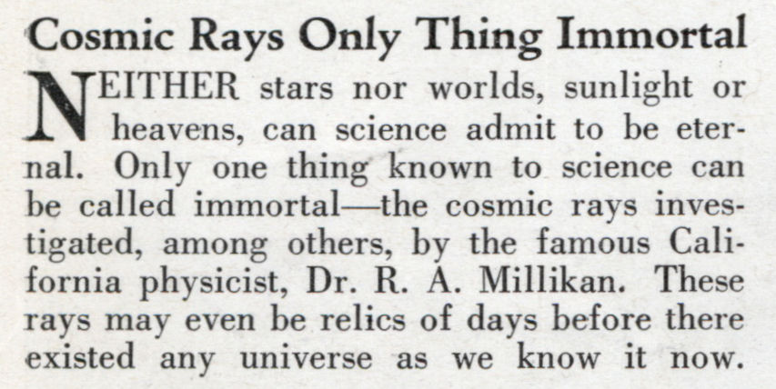
“Cosmic Rays”
It is Millikan who named this radiation “Cosmic Rays”
After his 1923 Nobel Prize, he is already the most respected physicist in America
The New York Times names this radiation “Millikan Rays” and claims Millikan “discovered” them
Notes:
NYT: “Dr. R. A. Millikan has gone out beyond our highest atmosphere in search for the cause of a radiation mysteriously disturbing the electroscopes of the physicists… His patient adventuring observations through twenty years have at last been rewarded… He found wild rays more powerful and penetrating than any that have been domesticated or terrestrialized, traveling toward the Earth… The mere discovery of these rays is a triumph of the human mind that should be acclaimed among the capital events of these days. The proposal that they should bear the name of their discoverer is one upon which his brother-scientists should insist… ‘Millikan rays’ ought to find a place in our planetary scientific directory all the more because they would be associated with a man of such fine and modest personality.”
Millikan writes Hess:
“I made no claims of any sort about the discovery of penetrating radiations… If anybody has suffered from misrepresentation so far, it seems to me that I am the sufferer… The really important thing is that between all of us we have been able to make pretty certain the existence of a radiation which comes to the earth from outside… “

Slide 12
What are cosmic rays?
A large variety of particles including:
Electrons
Positrons
Protons
Muons
Other nuclei like carbon, oxygen, neon, magnesium, silicon, iron, nickel, and more.
Gamma rays (~0.1%)
Can be split into “Primary” and “Secondary” rays

Slide 13
Primary and Secondary Cosmic Rays
Primary rays are the first to interact with Earth’s atmosphere
They collide with air molecules and create an “air shower” of secondary particles
Can even convert Nitrogen into Carbon-14
Notes:
Over a million secondary rays pass through our bodies every minute!
CARBON DATING

Slide 14
Generally characterized by extremely high energies
Lower energies appear to be more abundant
Typical energies between ${10}^{7}$ and ${10}^{20}$eV
Compare to LHC ~${10}^{13}$eV, cosmic rays can be up to 1 million times more energetic
GZK Limit: Greisen–Zatsepin–Kuzmin limit
Due to interaction with CMB, theorized upper limit on energy from “distant” cosmic rays is ${10}^{18}$eV
(“Distant” meaning > 160 million light-years)
Notes:
-”Ankle” is found at the low right end

Slide 15
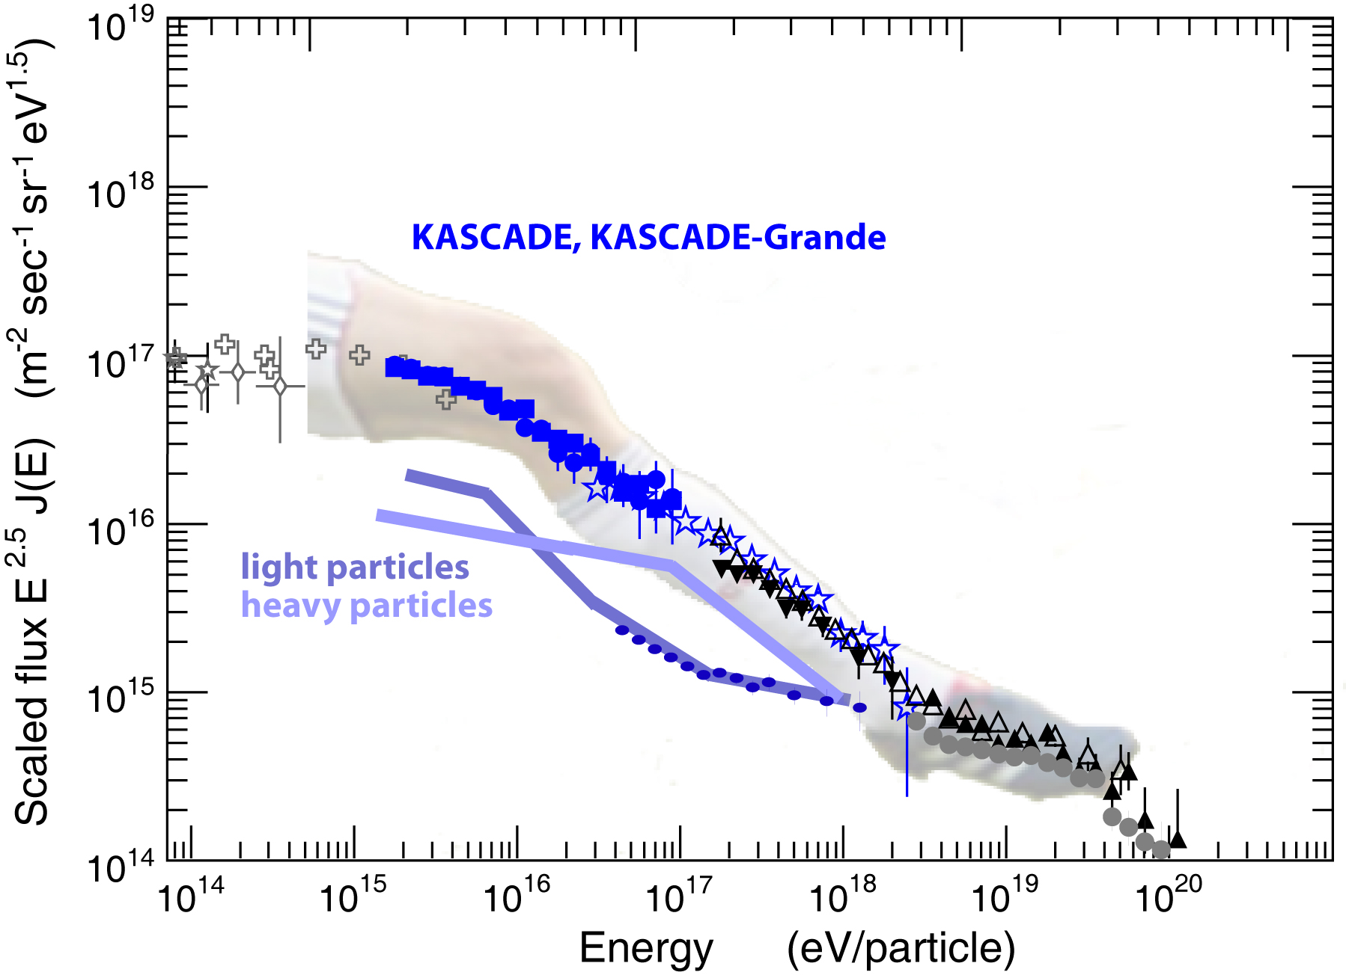
Notes:
-Better diagram with lower energies cut off
-”Knee” refers to bend in spectrum from previously flat or power law spectrum
-”Ankle” used to be called “Anti-knee”

Slide 16
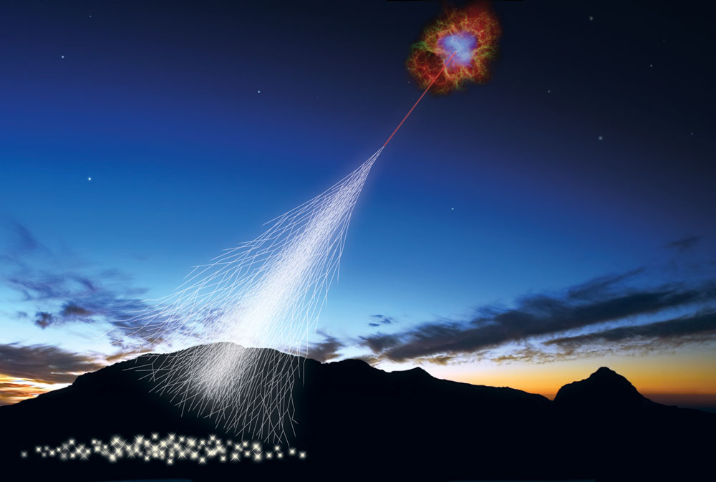
How do we detect cosmic rays?
High energy cosmic rays can be detected from their air showers
Air Shower Arrays are created to detect particles and their direction
In general, there are more particles in the center of the air shower
Scintillator detectors and water Cherenkov detectors are used on Earth
Notes:
And more importantly, how do we know they’re not something else?

Slide 17
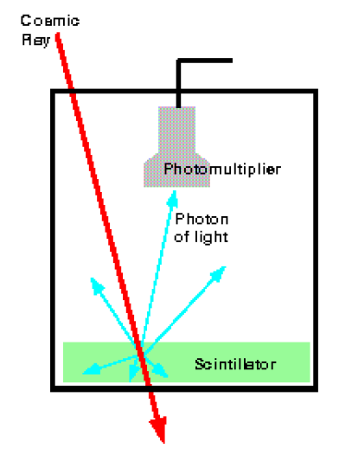
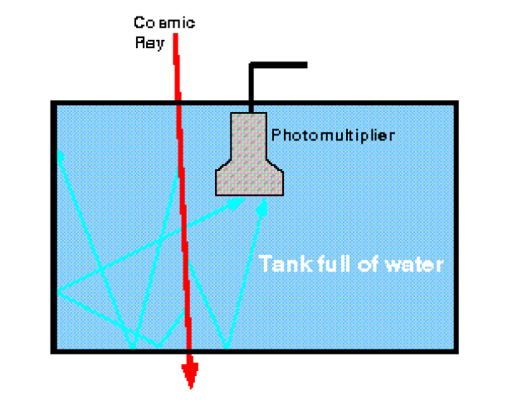
Scintillator Detector
Water Cherenkov Detector
Notes:
-SPASE-2 array uses scintillator detectors (South Pole Air Shower Experiment)
-Haverah Park Experiment (UK) used a 12 km^2 water detector, operated by University of Leeds

Slide 18
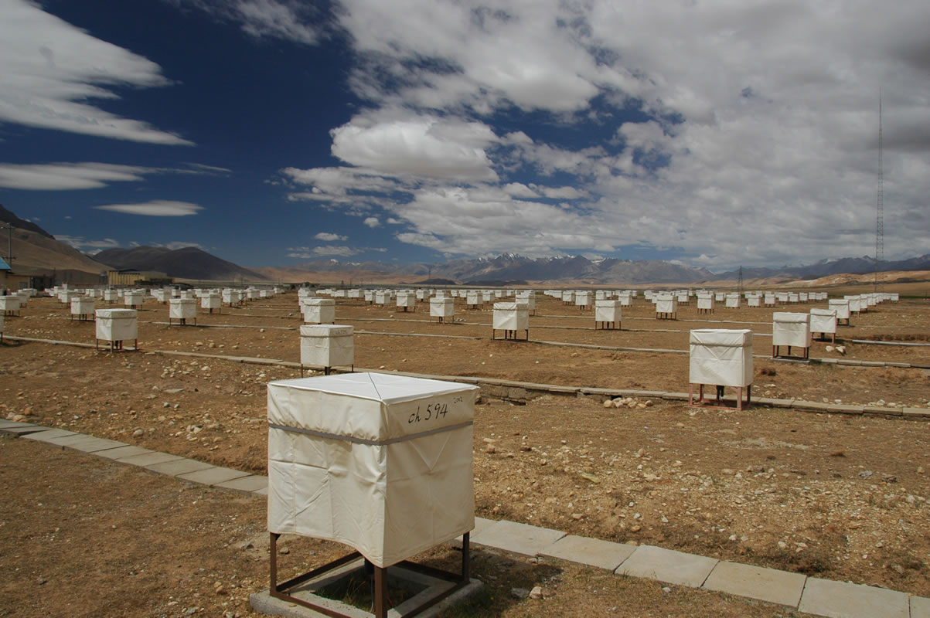
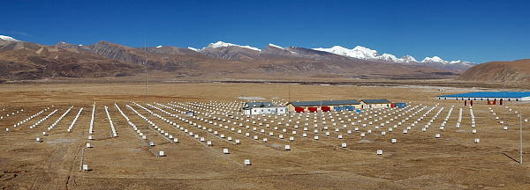
Tibet Air Shower Experiment
Effective area of 36,900 $m^{2}$
Comprised of 533 plastic scintillation counters
Finds 1700 events/sec
Detects only secondary particles

Slide 19
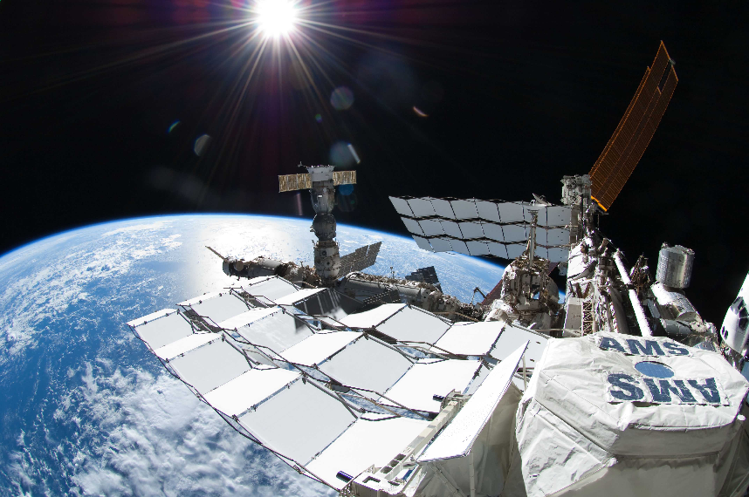
Alpha Magnetic Spectrometer
Capable of detecting primary cosmic rays
5 detectors onboard
Notes:
Costs 10x LHC?? ($2 billion from a first estimate of $33 million)
Texas’ SSC would have been $4.4 B (2 were actually spent)
LHC was $5.5 B (4.4 for accelerator, 1.1 for CERN spending)
The Transition Radiation Detector (TRD) measures particles passing at speeds nearly that of the speed of light.
The Time of Flight (TOF) measures the charge and velocity of passing particles.
The Silicon Tracker measures the coordinates of charged particles in the magnetic field.
The Ring Image Cerenkov Counter (RICH) measures both the velocity and charge of the particles and
the Electromagnetic Calorimeter (ECAL) measures the energy and coordinates of electrons, positrons and gamma rays.

Slide 20
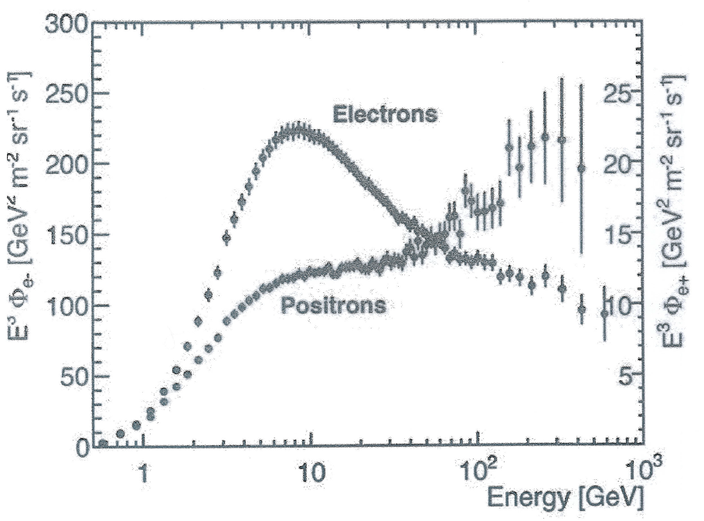
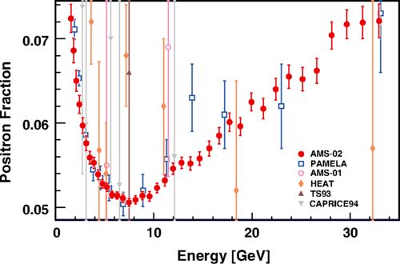
Recent AMS Results
Positron fraction is higher than previously assumed
Two popular theories:
1. Positrons generated by pulsars
2. Positrons are generated by dark matter collisions
Further data collection up to 1TeV is needed to test

Slide 21
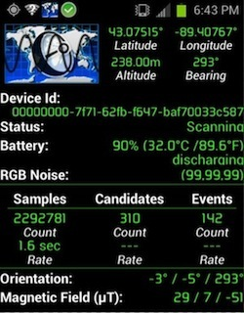
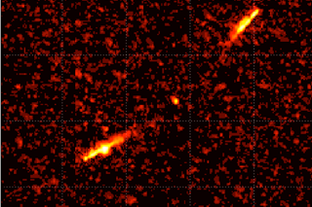
There’s an app for that!
DECO: The Distributed Electronic Cosmic-ray Observatory
Detects muons that interact with the camera’s sensor
Muons come from the upper atmosphere at 100 mouns/$m^{2}$/sec
http://wipac.wisc.edu/learn

Slide 22
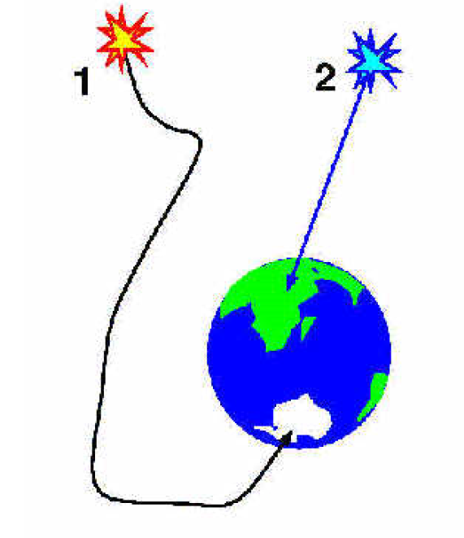
Sources of Cosmic Rays
This is still a highly contested issue
Gamma rays travel in “straight” lines and might point close to their source (Particle 2)
However, most cosmic rays are charged particles, and are subject to having trajectories bent by magnetic fields
Measuring trajectory may not, in fact, reveal the original source (Particle 1)
Higher energy particles should be deflected less, and would be more reliable for measuring origin
But these are very rare: a cosmic ray with energy ~${10}^{20}$eV hits a square km on Earth once per century!
Notes:
Higher energy particles: They are very rare. At 10^20 eV, only 1 cosmic ray hits a square km every CENTURY… so very LARGE arrays are needed to get a large sample of data.

Slide 23
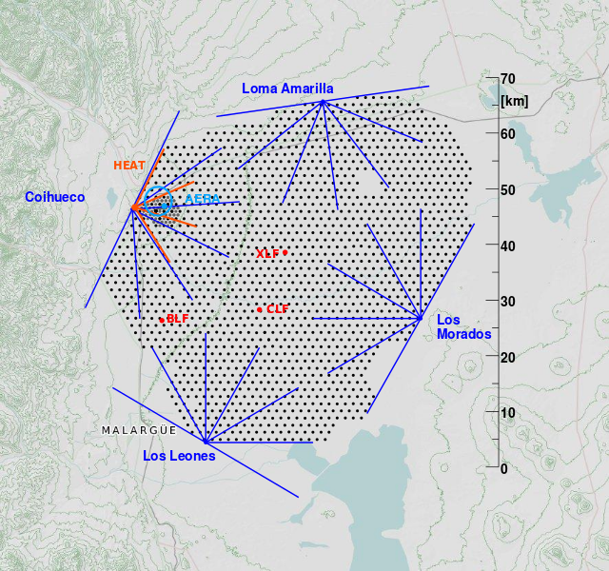
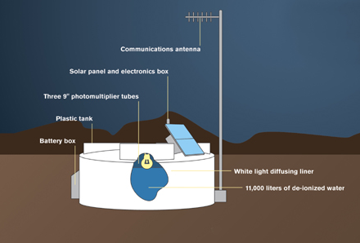
Pierre Auger Observatory
Detection area of 3,000 ${km}^{2}$
Located near the Andes mountains in Argentina
Elevation ~4600ft

Slide 24
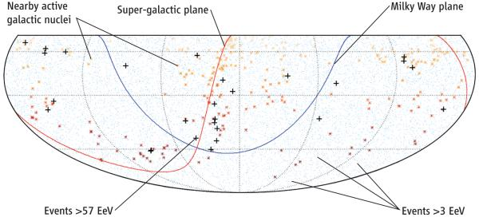
Blue dots (very hard to see) represent evenly distributed sources of lower energy cosmic rays (less than ${10}^{18}$eV)
Red dots represent higher energy sources
Black crosses indicated AGN
1 EeV = ${10}^{18}$eV
Notes:
2007 Article in Science correlated AGN with source of highest energy cosmic rays
Science 9 November 2007: vol. 318 no. 5852 pp. 938-943 DOI: 10.1126/science.1151124
AGN – briefly define

Slide 25
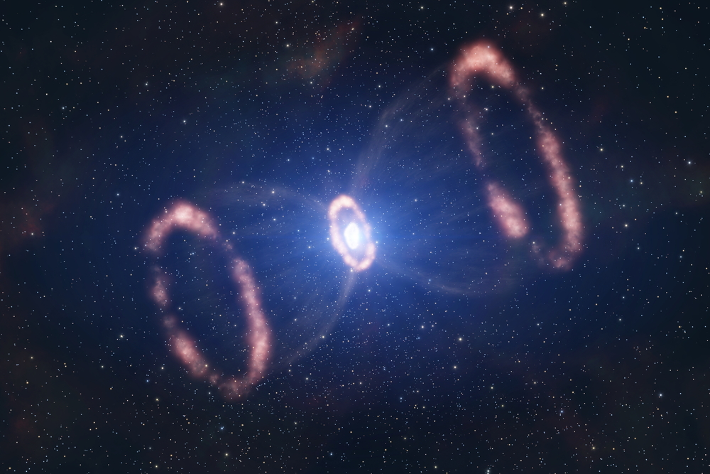
Supernovae as sources
Shock front and magnetic field of supernovae can accelerate protons to cosmic ray energies
Upper limit for this, as proton will escape at some minimum energy
Recently confirmed (Science, 2013) by examining pion-decay gamma rays
Fermi Large Area Telescope aboard the Fermi Gamma-ray Space Telescope looked at cosmic rays with energies ~${10}^{9}$eV

Slide 26
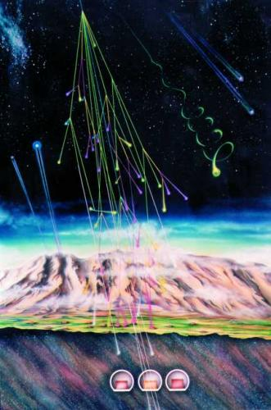
Cosmic Rays
First significant finding came in 1912 from Hess’ balloon flight
Cosmic rays are a variety of very high energy particles; the highest known to exist
Air showers form when primary cosmic rays interact with the upper atmosphere
Detecting these primary particles can be done in space, as in the case of the AMS
Charged particles are difficult to determine the source unless at the very highest energy levels
All cosmic rays probably originate within ~160,000 light years
Sources are supernovae for low energy cosmic rays, and AGN for high energy cosmic rays

Slide 27
Resources
Abraham, J., et al. "Correlation of the Highest-Energy Cosmic Rays with Nearby Extragalactic Objects." Science 318.5852 (2007): 938-43.
Ackermann, M. et al. "Detection of the Characteristic Pion-Decay Signature in Supernova Remnants." Science 339.6121 (2013): 807-11.
Amenomori, M., et al. "Tibet Air Shower Array: Results and Future Plan." Journal of Physics: Conference Series 120.6 (2008): 062024.
Bauleo, Pablo M., and Julio Rodríguez Martino. "The Dawn of the Particle Astronomy Era in Ultra-high-energy Cosmic Rays." Nature 458.7240 (2009): 847-51.
Carroll, Bradley W., and Dale A. Ostlie. An Introduction to Modern Astrophysics. 2nd ed. San Francisco: Pearson Addison-Wesley, 2007. Print.
Cronin, James W., Thomas K. Gaisser, and Simon P. Swordy. "Cosmic Rays at the Energy Frontier." Scientific American 276.1 (1997): 44-49.
Griffiths, David J. Introduction to Elementary Particles. 2nd ed. Weinheim: Wiley-VCH, 2008. Print.
Matthiae, Giorgio. "The Cosmic Ray Energy Spectrum as Measured Using the Pierre Auger Observatory." New Journal of Physics 12.7 (2010): 075009.
Xu, Qiaozhen. "The Early History of Cosmic Ray Research." American Journal of Physics 55.1 (1987): 23.

Slide 28
Sun Spots and the Maunder Minimum
Cosmic rays that are charged particles interact with the Sun’s magnetic field
Sun spots can have large affect on the overall magnetic field
There is an anticorrelation between sun spot activity and cosmic ray interaction frequency in Earth’s atmosphere

Slide 29
Sun Spots and the Maunder Minimum
Carbon-14 is created from cosmic ray interaction with Nitrogen
Can be absorbed by plant life as ${CO}_{2}$
Carbon dating trees shows a correlation between solar activity and Carbon-14
Notes:
Only lower energy cosmic rays would be deflected by sun’s increase in magnetic field

