Slide 1
Explanations for questions from last week
Coupling constants
Asymptotic freedom

Slide 2
Coupling constant in QED
This energy dependence of the coupling constant is called running coupling and it can be calculated in
The quantum field theory by an increasing with energy number of Feynman diagrams with loops of the type
The summation of the leading terms gives the dependency on the energy Q as
$$α\left(Q\right)= \frac{α(Q_{0})}{1−\frac{2}{3π}α\left(Q_{0}\right)log\frac{Q}{Q_{0}}}$$

Slide 3
Details: Running coupling in QED
(leading log approximation)
Full calculations give
The expression blows up when the ln(Q²/m²_{e}) = 3π/α(0) which occurs at
astronomical scale of Q²_{max} = 10²⁸⁰ MeV²

Slide 4
A process is analogous but more complex in case of the gluons. The strong coupling constant is defined as
$$α_{s}=\frac{g^{2}}{4π}$$
The effect of virtual gluons is complicated by the fact that gluons can couple not only to quarks but
also to themselves.
The mathematics of the calculation is quite involved and earned two Nobel prizes: one for t’Hooft and Veltman
who had showed how to handle renormalization of infinities that arise there and second to Gross, Wilczek and
Politzer for development of the necessary perturbative approach leading to the so-called asymptotic freedom.
The surprising result for the energy dependence of the strong coupling constant
$α_{s}\left(Q\right)=\frac{α_{s}(Q_{0})}{1+\frac{α_{a}\left(Q_{0}\right)}{2π}\left(11−\frac{2n_{f}}{3}\right)log\frac{Q}{Q_{0}}},$
where n_{f} is the number of quark flavors energetically allowed at a given energy (max= 6). As the energy Q the
probe increases, the $α_{s}$ approaches zero, i.e., at very high energies quarks interact more and more weekly
becoming non-interacting free particles.

Slide 5
A process is analogous but more complex in case of the gluons. The strong coupling constant is defined as
$$α_{s}=\frac{g^{2}}{4π}$$
The effect of virtual gluons is complicated by the fact that gluons can couple not only to quarks but
also to themselves.
The mathematics of the calculation is quite involved and earned two Nobel prizes: one for t’Hooft and Veltman
who had showed how to handle renormalization of infinities that arise there and second to Gross, Wilczek and
Politzer for development of the necessary perturbative approach leading to the so-called asymptotic freedom.
The surprising result for the energy dependence of the strong coupling constant
$α_{s}\left(Q\right)=\frac{α_{s}(Q_{0})}{1+\frac{α_{a}\left(Q_{0}\right)}{2π}\left(11−\frac{2n_{f}}{3}\right)log\frac{Q}{Q_{0}}},$
where n_{f} is the number of quark flavors energetically allowed at a given energy (max= 6). As the energy Q the
probe increases, the $α_{s}$ approaches zero, i.e., at very high energies quarks interact more and more weekly
becoming non-interacting free particles.

Slide 6
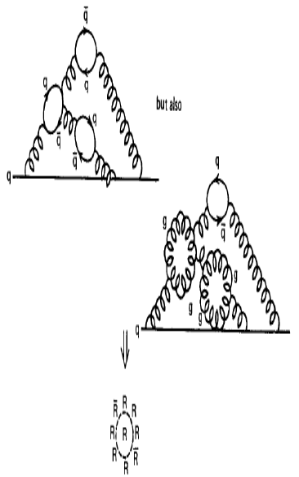
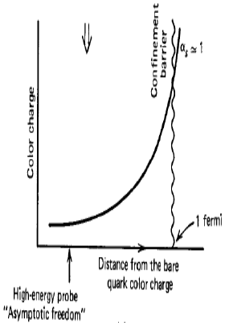
It turns out that the negative contribution wins over the positive contribution, so that the QCD beta function is negative, and the effective strong coupling becomes small a short distances.

Slide 7
Charge screening in QED (screening) and QCD (anti-screening)
leads to the concept of a running coupling when summed over al corrections.
In QED the coupling, becomes large at (very) short distance but its effect is small.
In QCD, the anti-screening effect causes the strong coupling to become
small at short distance (large momentum transfer). This causes the quarks inside hadrons to behave more or less as free particles, when probed at large enough energies. This property of the strong interaction is called
asymptotic freedom. Asymptotic freedom allows us to use perturbation theory (applicable only for small deviations), and by this arrive at quantitative predictions for hard scattering cross sections in hadronic interactions.
On the other hand, at increasing distance the coupling becomes so
strong that it is impossible to isolate a quark from a hadron (it becomes
cheaper to create a quark-antiquark pair). This mechanism is called confinement. Confinement is verified in Lattice QCD calculations but, since it is non-perturbative, it is not mathematically proven from first principles.

Slide 8
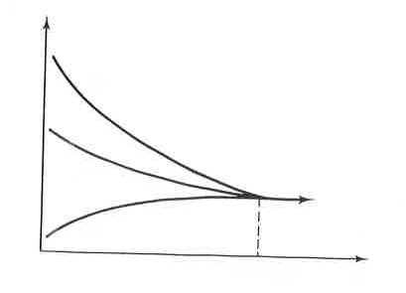
Ideal extrapolation of running constants to high energy
i.e., short distance
q
e
q
g
γ
W,Z
W,Z
q
e
q’
strong electromagnetic weak
α_{s}
α_{W}
α_{em}
E
10¹⁶ GeV

Slide 10
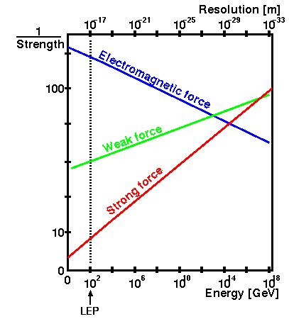
circa 2011

Slide 11
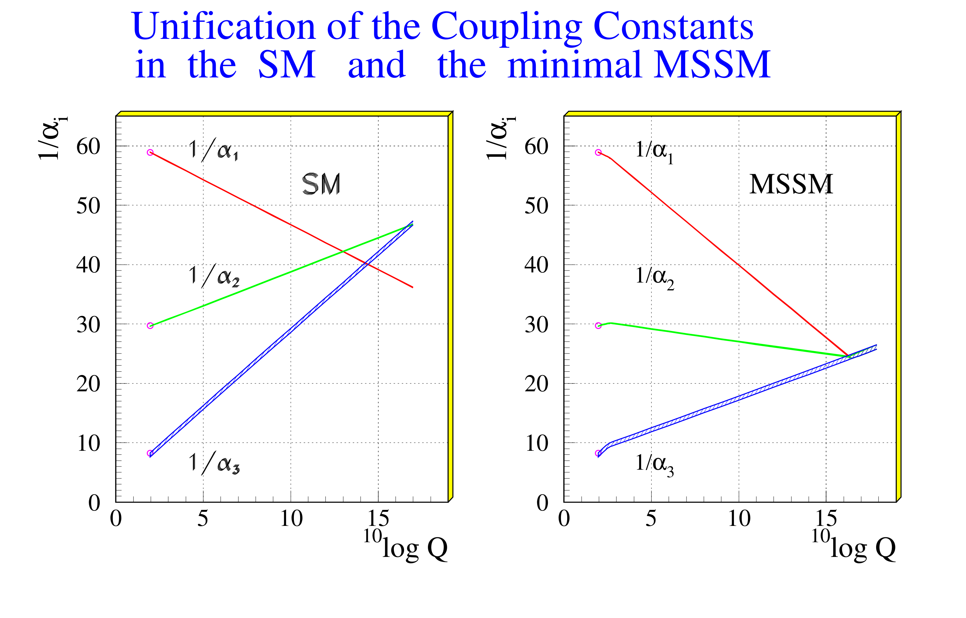
circa 2016

Slide 12
Theoretical expectations of the Higgs Boson properties
It is important to remember that Higgs boson is an effect of the spontaneous symmetry breaking of
the electroweak force. It has no direct connection to strong interactions and the carriers of the internal
symmetry of color, i.e., gluons. It does couple, however, to everything else that is involved in electroweak
interactions: quarks, leptons, photons, vector bosons and even to itself.
Mass
Within the Higgs mechanism, the Higgs boson acquires its mass through its potential.
The expansion of the scalar field about its vacuum expectation value v gives an interpretation
of Higgs mass as a fluctuation with the mass m_{H} as a coefficient of the quadratic term of the field expansion
$$m_{H}= \sqrt{2λ} v$$
with the parameter $λ$ completely unconstrained.

Slide 13
Couplings
The strength of the Higgs coupling to quarks is proportional to the fermion mass and is given by the Yukawa
coupling
$$y_{f}=\frac{\sqrt{2 } m_{f}}{v}$$
where v is the vacuum expectation value v = 246 GeV.
Higgs self-coupling is proportional to m_{H}².
In general, the Higgs couples to particles via the
Standard Model Lagrangian $L\sim −\frac{m_{f}}{v}Hff+2g_{W}m_{W}HW_{μ}^{+}W^{−μ}+\frac{\sqrt{g_{w}^{2}+g_{y}^{2}}}{2}m_{z}HZ_{μ}Z^{μ}$
Here, f are fermions, W and Z are weak bosons.
The expansion of the Higgs potential includes in addition to the quadratic term also terms leading to
triple and quartic couplings $L \sim −\frac{m_{H}^{2}}{2} H^{2}−\frac{m_{H}^{2}}{2v^{2}}vH^{3}−\frac{m_{H}^{2}}{8v^{2}}H^{4}$
Once the Higgs was discovered and its mass, m_{H}, was precisely measured we could estimate the values of the s
elf-coupling of Higgs to a pair of Higgs and also of the quartic coupling.

Slide 14
You will see that in the studies of Higgs decays a modified formulation of the Higgs couplings become
popular in the last couple of years. It involves an arbitrary modification of the Higgs couplings by scaling
the Standard Model expectations by a constant $κ$ where one looks for the deviation of the scale factor
from unity.
The coupling term used in cross section calculation takes the following form for fermions and vector mesons:
This formulation works for the lowest order QCD calculation but cannot be consistently extended to higher order.
Remember that the estimate of the gluon cross section in NLO was about 100% larger that in LO and the
NNLO calculation increased the cross section further by another 20%. The difference of the constant
$κ$ from 1 will show deviation from the Standard Model up to a precision of theoretical calculations.
It will be the challenge for LHC Run 3.

Slide 15
Production mechanisms
In proton-proton collisions it is not the proton that generates the Higgs particle but rather interaction
of proton components i.e., quarks and gluons. The masses of quarks inside the proton, as we know them,
are very small: m_{u} = 2.16 MeV, m_{d} = 4.67 MeV, (m_{s} = 93 MeV).
So, the optimistic expectation for a direct Higgs production via, lets-say - d quark interaction, would have
the value of the Yukawa coupling
$y_{d}=\frac{\sqrt{2}m_{d}}{v} ≈ \frac{6.6 MeV}{246 GeV} ≈2.7×{10}^{−5}$
This would enter into matrix calculations and corresponding cross section as a square producing minuscule
result. On the other hand, gluons inside the proton couple to the top quark with mass equal 173 GeV,
and the Yukawa coupling to the top is
$y_{t}=\frac{ \sqrt{2} m_{t}}{v} ≅1$
As a result, the dominant diagram for the Higgs production at LHC is the “gluon fusion” diagram with a top
quark running along the triangular loop. The corresponding couplings of the Higgs to the W and Z bosons
are proportional to their masses squared.
Finally, the Higgs does not couple directly to a photon since the photon is massless.
Similar to the production in proton-proton collisions Higgs decays to photons are induced by loops of heavy
charged particles.

Slide 16
The production mechanisms considered in various data analyses are:
In the estimates the energy of the incoming quarks and gluons are coming from the pdf’s describing the
fractional probabilities of each proton component carrying a fraction of the parent proton momentum.
The gluon-fusion and vector-boson fusion diagrams allow to calculate
the energy dependence of the Higgs cross-section. These calculations became recently very involved
and reached NNNLO (next-to-next-to-next-to-leading order) for the QCD terms and NLO (next-to-leading order)
for the electroweak terms. At this stage the precision of theory calculations exceeds the experimental
capability. The experimental errors are still dominated by statistical rather than systematic components
of the data analyses.

Slide 17
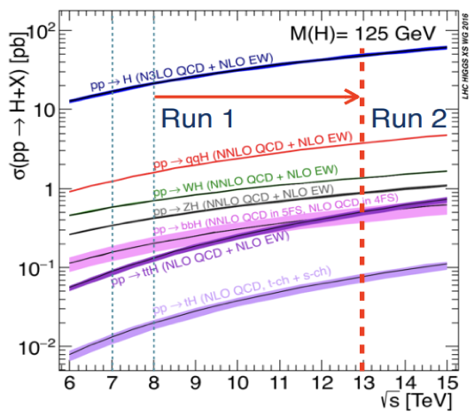

Slide 18
Should be mb
At the LHC energies one Higgs is produced for about
10,000 proton-proton collisions resulting in standard
QCD final states. This Higgs then decays and multiplication
of a specific decay branching ratio by the efficiency of the
detector further reduces that ratio. The experimenter
then tries to extract the Higgs decay signal from a huge
background of QCD final state particles.

Slide 19
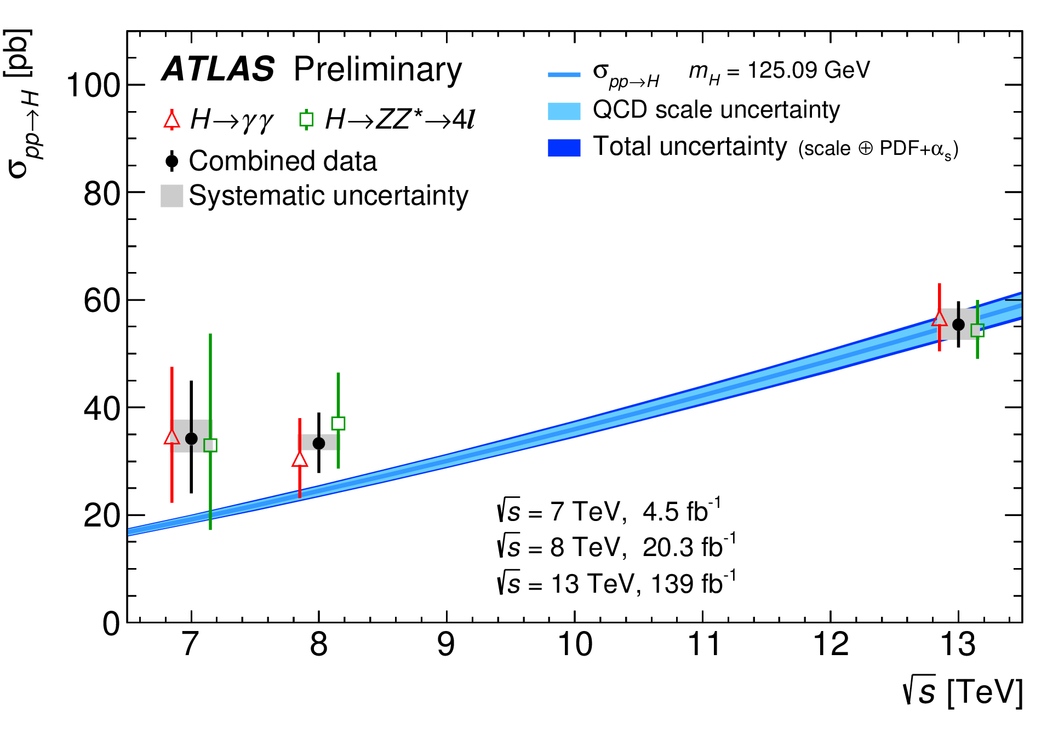
Comparison of measurements with the prediction for measured cross sections corrected f
or luminosity, acceptance, detector effects and branching fractions.

Slide 20
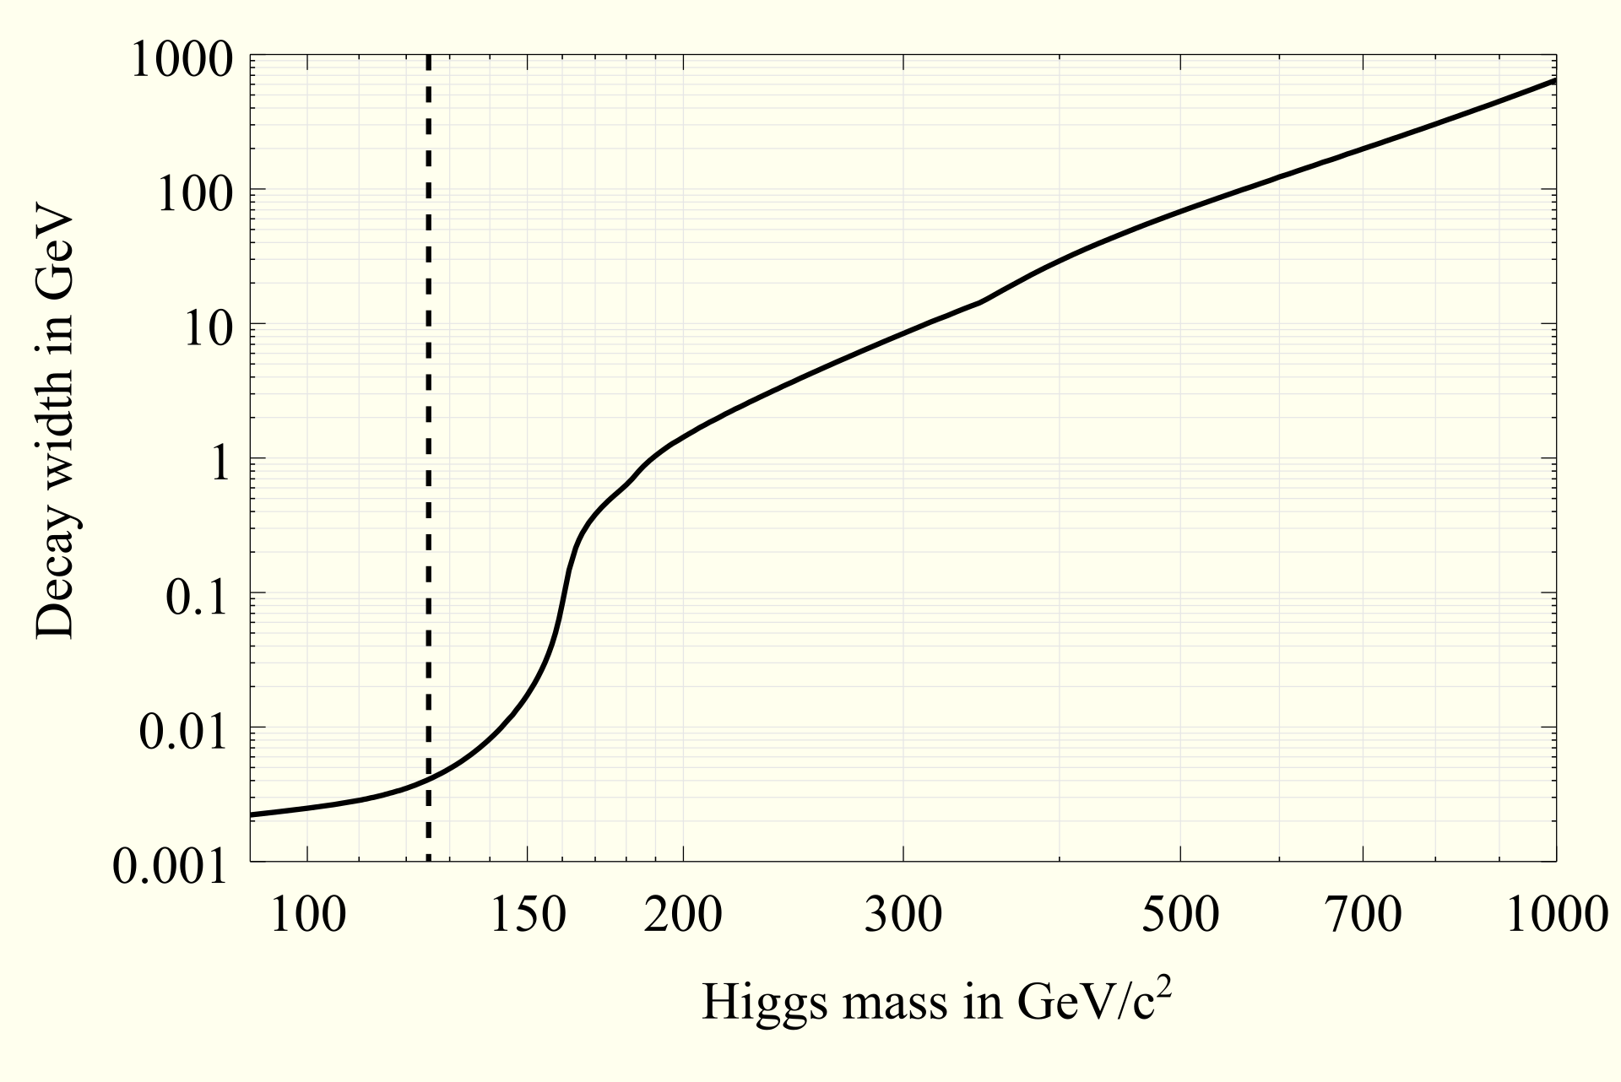
Width
Width of the Higgs boson (inverse of the life-time) from early estimates.
The more precise calculations now centered at the mass of 125 GeV give the value of $Γ<0.13 GeV$.
This cannot be verified at this time at a proton-proton collider like LHC as the uncertainties in beam
energy resolution and of the experimental measurements are much larger. This is one of the main
arguments used to justify electron-positron collider (either linear or circular),where the beam energy
is much better defined (free of pdf’s uncertainties) and the background can be minimized by tuning the
beam energy to the value of the Higgs mass.

Slide 21
Higgs Decays
Once the Higgs is produced its decays into many final states with the decay rates depending on the mass
of the Higgs i.e., available phase-space for the decay.

