Slide 1
The production mechanisms considered in various data analyses are:
In the estimates the energy of the incoming quarks and gluons are coming from the pdf’s describing the
fractional probabilities of each proton component carrying a fraction of the parent proton momentum.
The gluon-fusion and vector-boson fusion diagrams allow to calculate
the energy dependence of the Higgs cross-section. These calculations became recently very involved
and reached NNNLO (next-to-next-to-next-to-leading order) for the QCD terms and NLO (next-to-leading order)
for the electroweak terms. At this stage the precision of theory calculations exceeds the experimental
capability. The experimental errors are still dominated by statistical rather than systematic components
of the data analyses.

Slide 2
Reality check
Unfortunately we cannot observe neither gluons not quarks and must rely on the observations
of long-lived (10⁻¹⁰ – 10⁻⁸ s), charged particles that leave signals in the detectors.
These are: pions, kaons, protons, electrons and muons.
In addition, we can identify
photons via their electromagnetic showers
tau leptons in their hadronic decays and heavy mezons, eg., B⁺(ub), from the hadronic jet structure
and indications that the decay point can be distinguished from their production point
All energetic quarks kicked out from the parent protons in the interaction process “dress up” themselves into
jets of many particles . These jets contains many(several) separate reconstructed tracks and are
The objects used in data analyses objects used in data analyses.
We cannot distinguish jets produced by light quarks.
Due to slowness of weak interaction processes we do have ~50% efficiency of finding
jets coming from the hadronic tau decays and those containing b-quarks by their vertices displaced from origin.

Slide 3
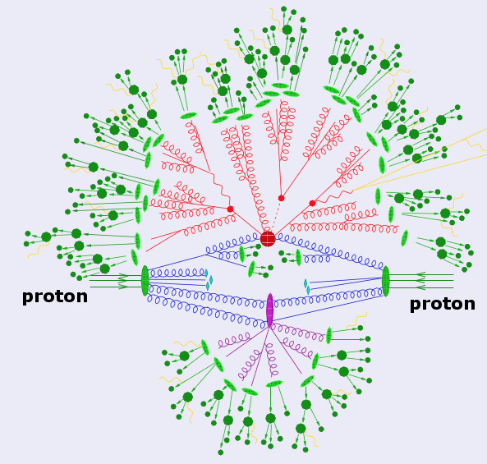

Slide 4
Detector design criteria
The Large Hadron Collider was built as a “discovery machine”. That meant that at the time of its construction
beginning we had a long list of possibilities that we wanted to study but we did not have a clear idea what to expect.
The only practical limitation was the energy of the machine that designed for 40 TeV at the Superconducting
Supercollider and 14 TeV at Large Hadron Collider. The energy was limited by the technical limitations of the size
of the tunnel (real estate and civil construction), magnets (10 T at SSC, and 8 T at LHC), power consumption and
money. Super-ambitious SSC was cancelled and the more conservative LHC was built over a dozen years but even
there the maximum energy reached so far is 13 TeV.
The designs of the LHC detectors reflect similar design limitations. They have been designed and built with technical
compromises that assure that a new physics would have a chance of being discovered. The two dominant ideas
of the origin of the electroweak symmetry breaking were, at that time, Higgs particle and supersymmetry.
Extensive studies of possible Higgs production and decay modes as function of proton-proton collision energy and
Higgs mass indicated a priority in identification of electrons, muons, photons and jets containing b quarks. These
were major signatures allowing to distinguish the Higgs particle from the QCD background. Supersymmetry added
one more specific characteristic to be included in the design – ability to search for existence of lowest mass neutral
supersymmetric particles, i.e., massive neutral, stable objects. In a “hermetic” detector these could be identified
by the imbalance of the transverse energy deposits called the “missing mass”.
Both leading LHC experiments adhered to those priorities, though small differences of emphasis and selection
of different technologies resulted in different, but complementary designs.

Slide 5
What do we want to measure
Electrons and photons can be measured using calorimetry. Uniform crystal calorimeters, like the one in CMS,
have very good energy resolution allowing for excellent invariant mass measurements while the segmented
calorimeters, like the one in ATLAS, have ability to establish a direction of the electromagnetic shower.
In the end, after 10 years of operations the resulting Higgs mass measurements from the two detectors are
comparable.
For all practical purposes the photon in the calorimeter looks like an electron except that there is a track
pointing to the front face of the devise. Thus, precision tracking is important.
Energetic muons are minimum ionizing particles. They and can be distinguished in the calorimeter by
the minimal deposit of the energy and must have a well measured trajectory in the magnetic field.
The precision of the trajectory measurement can be obtained either by a long path in the magnetic field
or by increasing strength of the magnetic field. ATLAS added toroidal magnets to increase the trajectory
overlap with the area of the field, while CMS built a large-bore magnet with twice the field of the one in ATLAS.

Slide 6
The most copiously produced hadrons at LHC are pions. These come mainly from the gluons produced in
the QCD processes in pp collisions. We need to measure them to form jets and estimate backgrounds.
Bottom quarks are rare and the fragmentation of the mesons containing b quark lead again mostly to pions,
but with strong correlations of their momenta vectors. These are b- jets. At high energies of the b-jets, one can
use as a signature the relatively long lifetime of the b-quark due to its weak interactions. That leads to separate
vertices of the production and decay.
A signature of new physics would be an observation of the missing energy, i.e., the total deposited energy
smaller than the sum of beam energies. Such effect is expected due to missing energy carried by the neutrinos
and thus the modeling of the all known Standard Model processes via extensive Monte Carlo models is a
necessary an computing expensive part of all experiments. In the LHC experiments it is very difficult to attain
precision of measurements in the “forward” direction where particles can stay in the beam pipe or do not bend in
the magnetic field. ATLAS and CMS concentrate on the transverse direction wrt the beam. If all products of the
collision are measured the sum of transverse momenta vectors should be equal to zero.
A heavy, neutral, non-interacting particle would carry significant amount of undetected energy creating
a signature of “missing mass”. Such signatures are extensively used in searches for new physics where the
predicted lowest mass new objects are expected to be neutral. Intrinsically almost all models of new physics
have a multitude of possible configurations. The empirical argument is that if the lowest mass new object
would be charged, we would already have seen it.

Slide 7
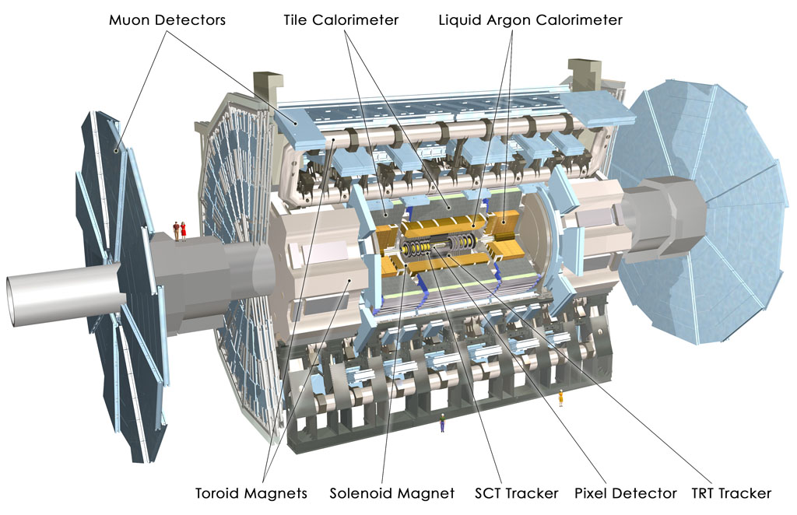

Slide 8
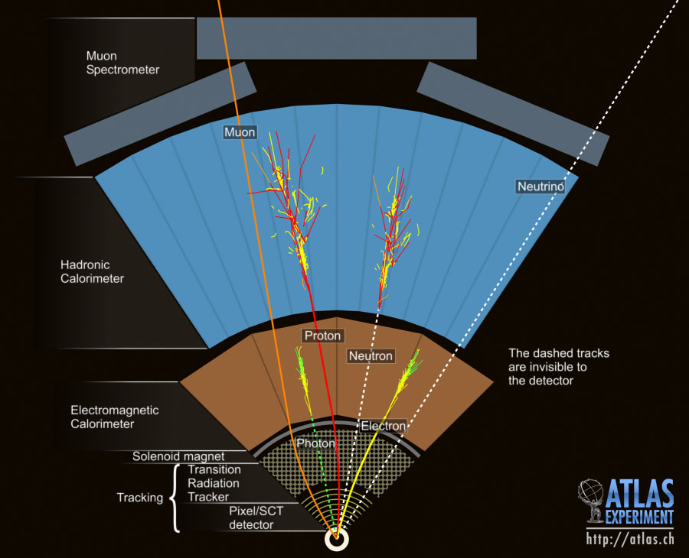

Slide 9
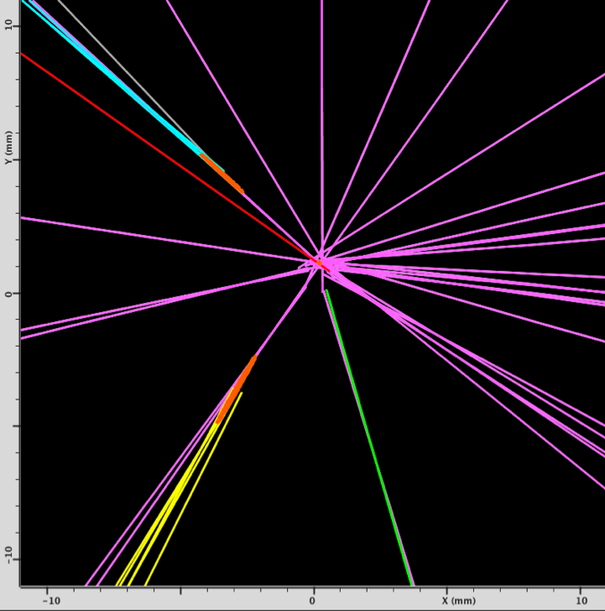
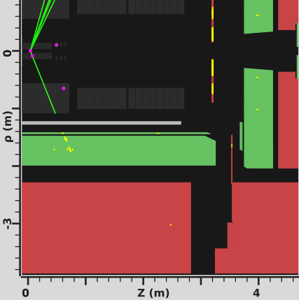
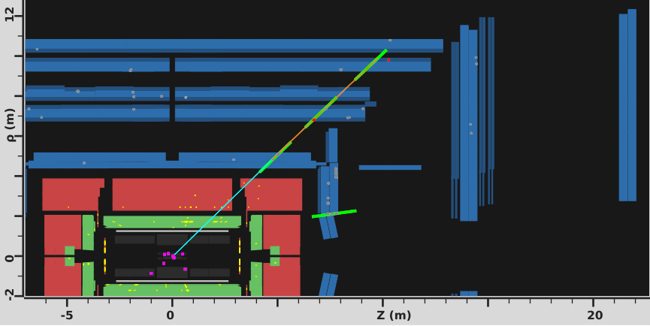
b-jet
muon
electron
muon

Slide 10
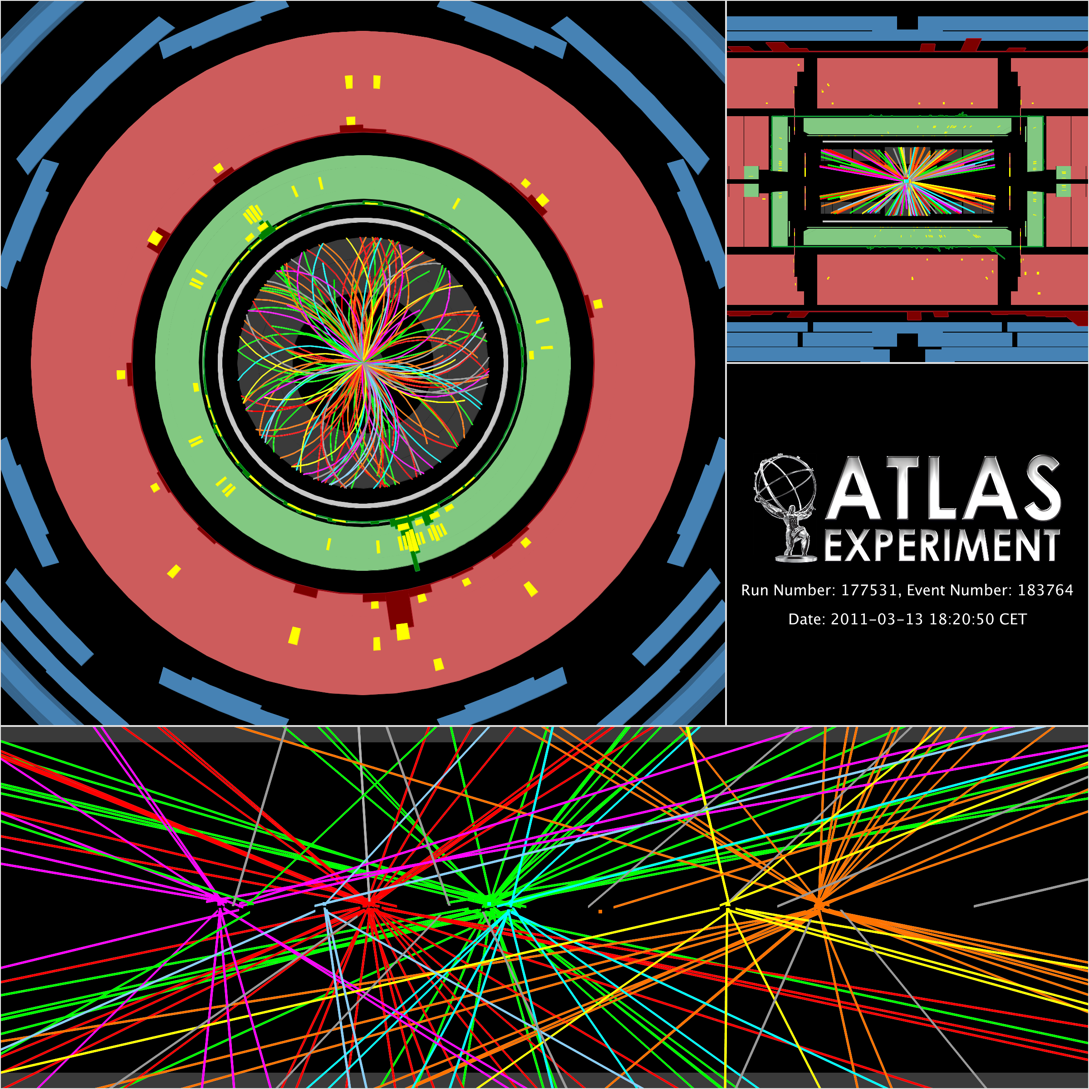
Tracking and pileup
Excellent tracking efficiency and precision.
7 interactions in one bunch crossing

Slide 12
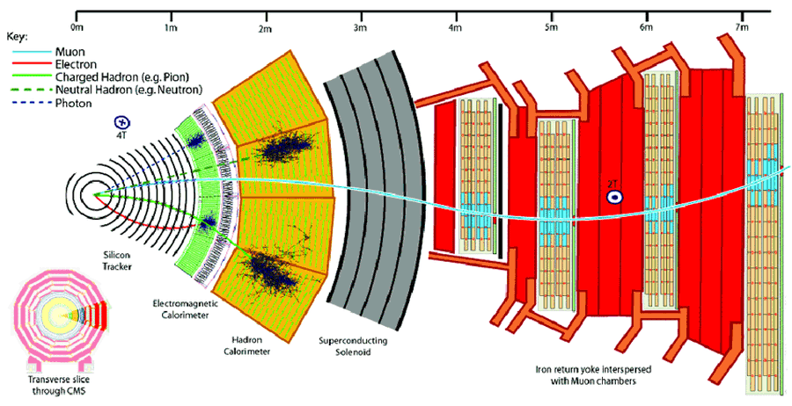
CMS Detector

Slide 13
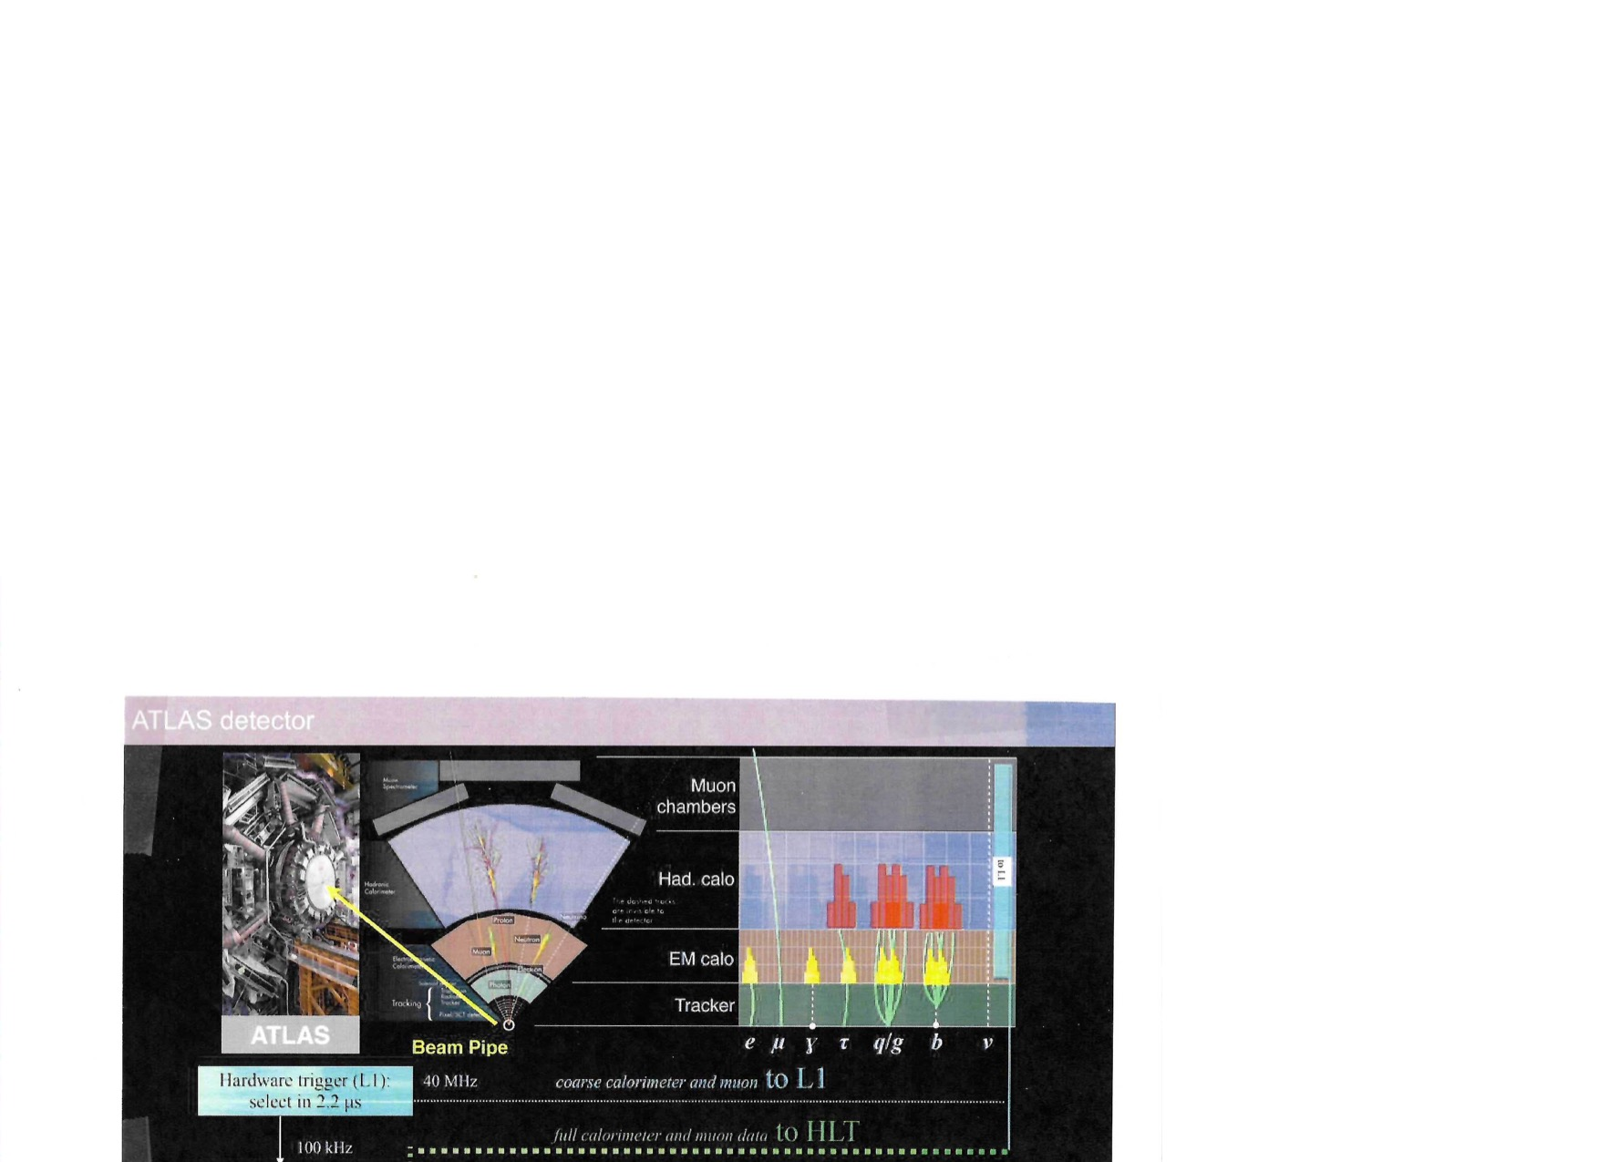

Slide 14
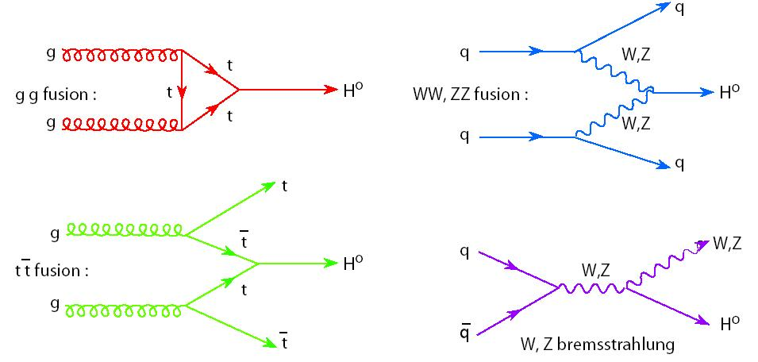
Dominant Higgs production processes

Slide 15
Mass measurement
The largest expected branching fraction of the Higgs is to a pair of bottom quarks.
The identification of the bottom quark dressed up in its hadronic final state is both difficult
to distinguish from that from the copious QCD production and subject to large mass uncertainty
due to the experimental resolution of the final state jets of hadrons.
The discovery was made in the decay channels that had either minimal background
or a background that was well understood and well modeled. These were Higgs decays to
pair of photons H->$γγ$ or to a pair of Z bosons. In the latter case, the mass of the Higgs is smaller
than the threshold for pair production of real Z bosons and the decays contains one real Z and one virtual Z
with virtual mass of about 35 GeV.
Real Z boson width is relatively small (~2 GeV) and relatively easy to measure in its decays to electron and
to muon pairs: H->ZZ*-> 4 charged leptons: 4e , 4$μ$, 2e$2μ$.
The mixed lepton mode includes actually two distinct final states: one with 2 electrons originating from
a real Z and 2 muons from a virtual Z and the other with opposite parental arrangement.

