Slide 1
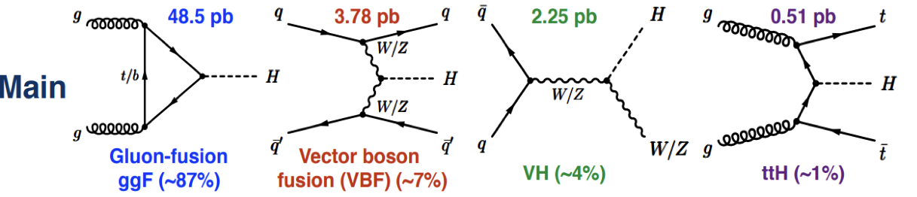
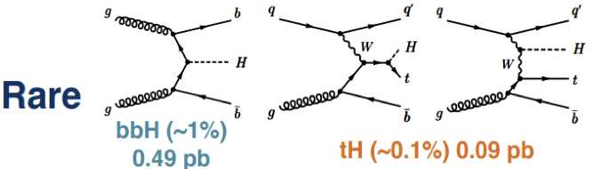
The production mechanisms considered in various data analyses are:
In the estimates the energy of the incoming quarks and gluons are coming from the pdf’s describing the
fractional probabilities of each proton component carrying a fraction of the parent proton momentum.
The gluon-fusion and vector-boson fusion diagrams allow to calculate
the energy dependence of the Higgs cross-section. These calculations became recently very involved
and reached NNNLO (next-to-next-to-next-to-leading order) for the QCD terms and NLO (next-to-leading order)
for the electroweak terms. At this stage the precision of theory calculations exceeds the experimental
capability. The experimental errors are still dominated by statistical rather than systematic components
of the data analyses.

Slide 2
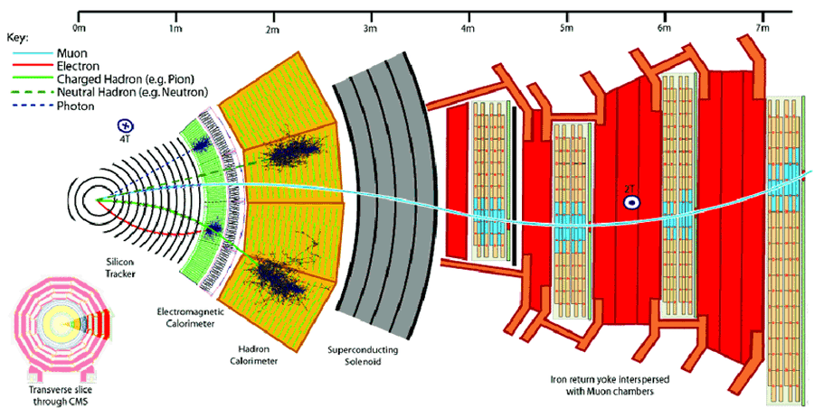
CMS Detector

Slide 3
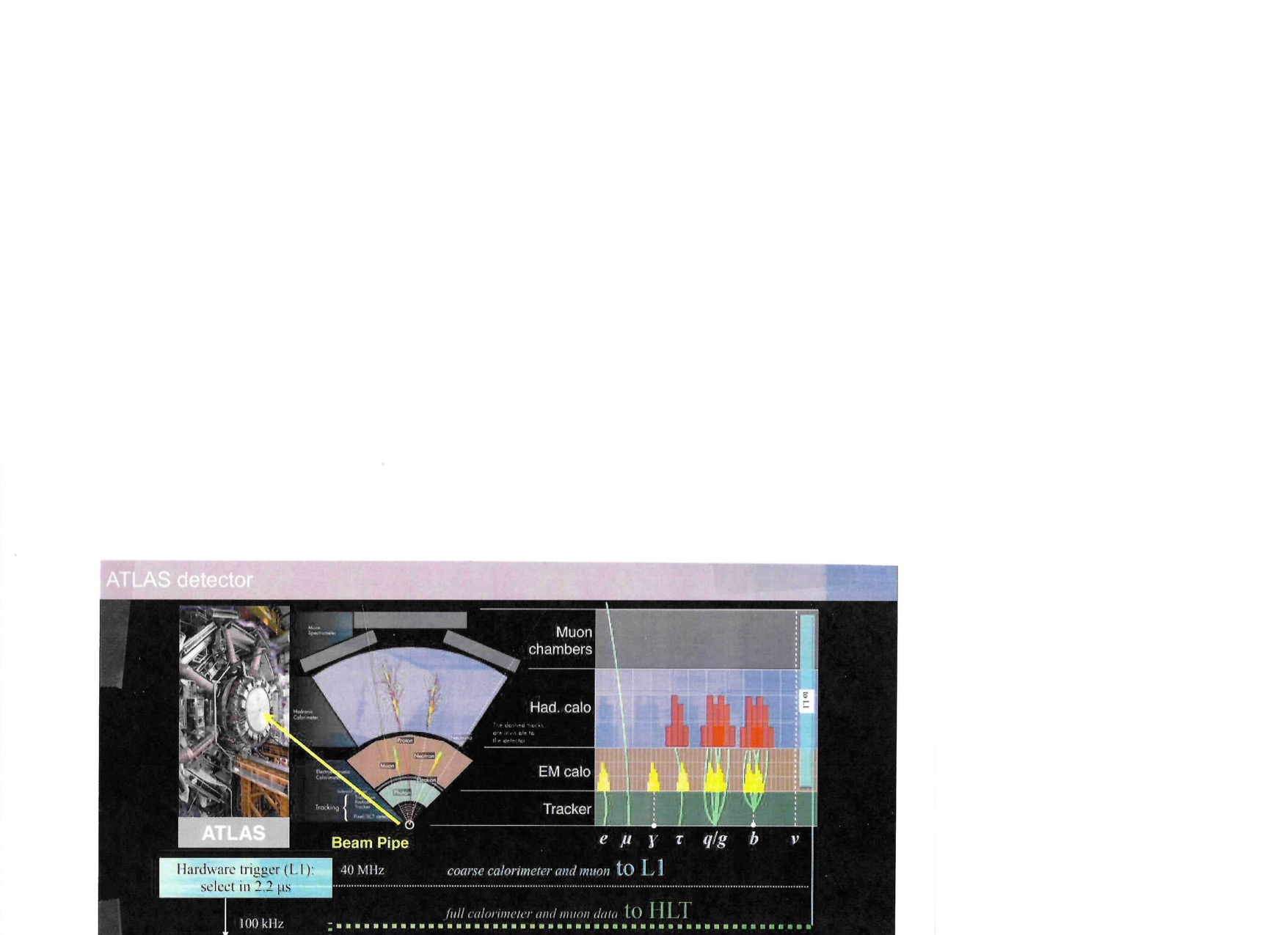

Slide 4
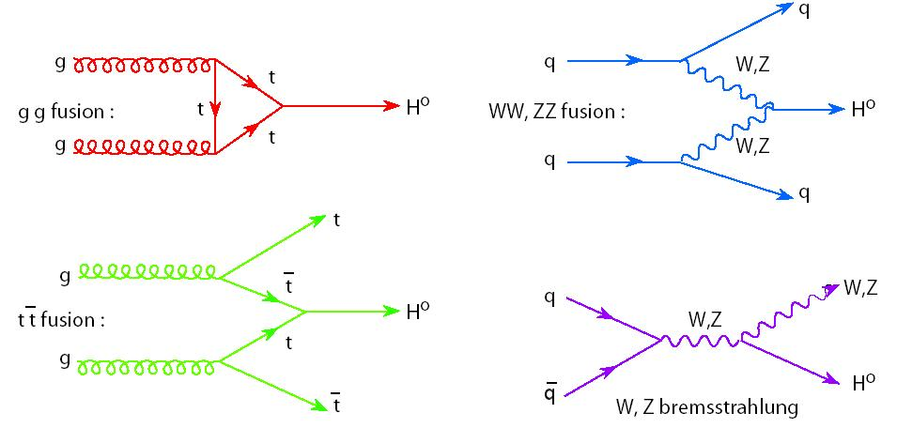
Dominant Higgs production processes

Slide 5
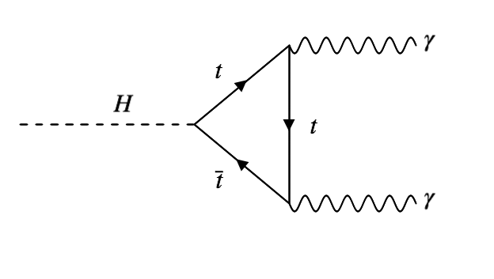
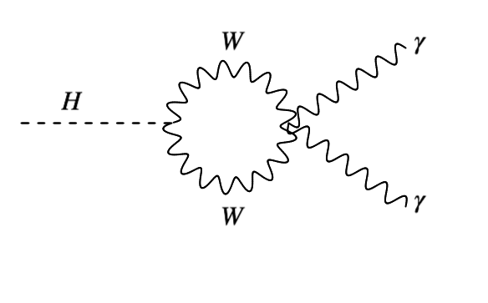
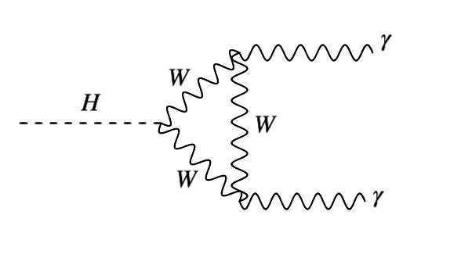
Decays
Photons
Vector bosons
All Higgs couplings are mass-dependent
Fermions
Gluons

Slide 6
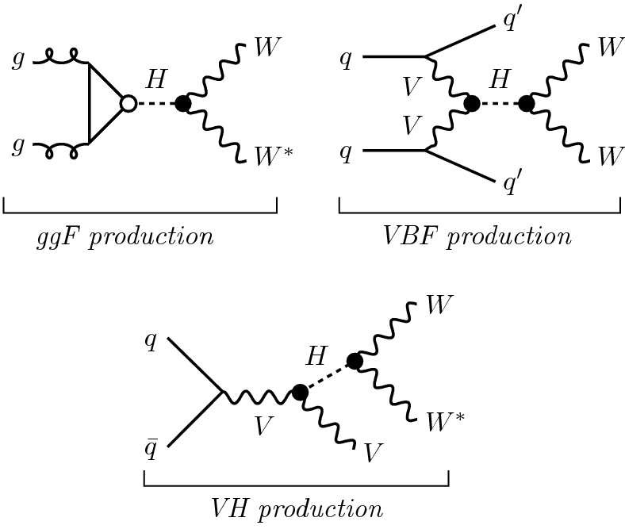
Example: WW Production + decay - theorist’s view

Slide 7
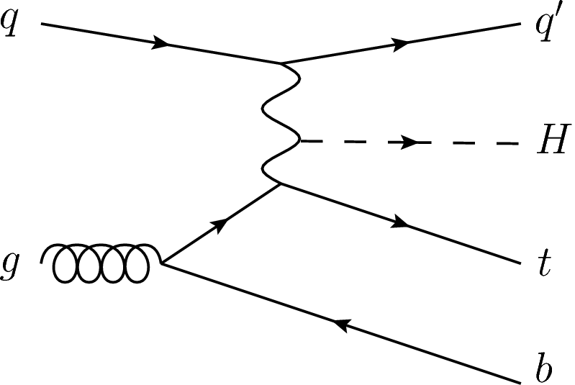
Production + decays – experimenter’s view
multiple jets
fragmentation
functions
proton
jet
γγ, 4l
proton
lepton + jet + E_{miss}
jet
multiple jets
parton distribution
functions

Slide 8

Higgs couplings to fermions and bosons, 2020 edition
Reminder: Standard Model expectations
  → Reduce to two coupling constants $κ_{f}$ and $κ_{V}$
$κ_{f}$ for fermions (quarks and leptons) proportional to fermion mass
$κ_{V}$ for weak gauge bosons (W⁺ W⁻ Z) proportional to boson mass squared
Higgs does not couple to photons and gluons
(massless boson), the decays proceed through a quark loop.

Slide 9
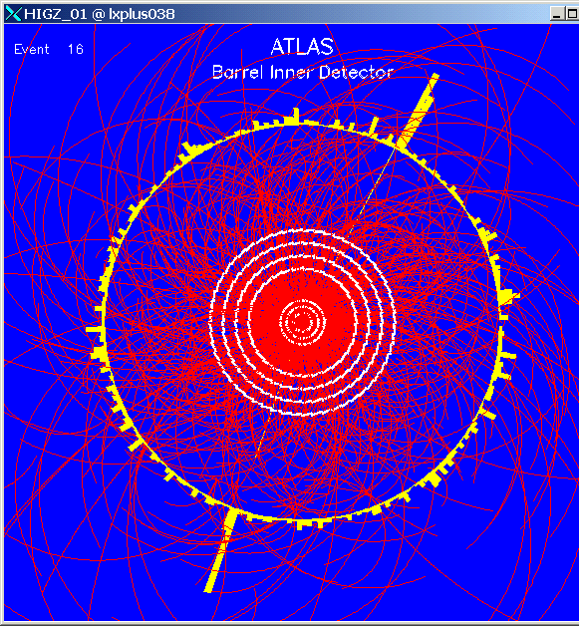
Two high energy photons.
Is that Higgs decay or background?

Slide 10
Data Analysis Philosophy
Generate expected signal eg., Higgs mass measured in a specific channel of production and decay
1. Theory modeling programs: MadGraph, POWHEG, Professy4f…
a. Calculate from theory the full amplitude for the process including kinematical and angular variables
(do not integrate over the angles or momenta variables)
b. Use Monte Carlo approach to generate momenta vectors of all final state particles emerging from that
particular process. Add multiple QCD interactions (pileup) using PYTHIA.
This is sufficient for initial optimization of a particular search or measurement
2. To include further experimental details one has to deal with detector acceptances, mis-alignments and efficiencies
a. Digitization – GEANT4: trace in small steps the trajectory of each particle momentum vector through the
full geometric description of the detector and generate simulated signals that the particle would
induce in each detector component. This includes losses of particles that miss active areas of the detector,
secondary interactions … Use parametrization if time becomes prohibitive
3. Reconstruction:
a. Format the digitization output in the same way as the real data coming out from the detector.
b. Process the simulated signals with the same pattern recognition software as the data.
This has the same efficiency of the pattern recognition software applied to the real data and to the
simulation.
4. Uncertainty of the simulation
Vary all uncertainties by +/- sigma.
Uncertainty of theory is usually obtained by comparison of two independent methods of signal calculations
Uncertainty of the detector effects is taken from detail test beam studies and calibrations

Slide 11
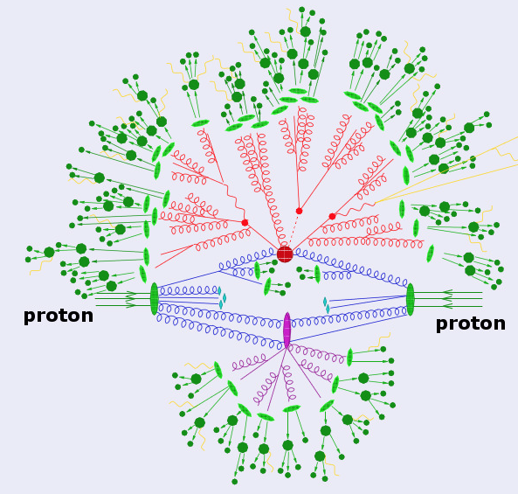

Slide 12
Estimates of the backgrounds
Identify all known processes that may create the same configuration of particles in the final state as
for the signal.
Use specialized generators to increase precision of the simulation using higher orders – PYTHIA, SHERPA, HERWIG,…
Apply for each background process the same identification and selection criteria as used in the study of the signal.
Apply normalization using measured cross sections for each background process.
Estimate uncertainties using the same procedure as for the signal data.
Strong preference – whenever possible use data driven methods for background and uncertainty estimates.
(We have data with large statistics)
Significance of the signal observation (hotly discussed subject)
Use statistical methods to estimate significance of the signal.
Use frequentist approach to study well established signals with large numbers of events
Use Baesian approach whenever comparing to Standard Model expectations (we know the prior).
Special approaches to interpretation of searches for signals “beyond the Standard Model”

Slide 13
Objects
The analysis also defines detailed characteristics of the measured ”objects” describing particles that are of interest
in a particular analysis.
Electrons are identified by the energy deposited in the cluster of cells of the calorimeter that must
match the momentum of the track pointing to that cluster , typically E/p > 0.8, and fulfill the criteria
of shower development in consecutive layers of the calorimeter.
Muons are identified by segments of the tracks reconstructed in the outer muon chambers matched to the tracks
reconstructed in the inner tracker. Matching must be consistent with the strength of the magnetic field throughout
the trajectory. Additional identification criterium is provided by the minimum energy deposited by
the trajectory segment passing through the electromagnetic calorimeter.
Photons are identified by energy deposits in a cluster of calorimeter cells that are isolated and have no track pointing to them.
Jets are identified by the track clustering algorithms, the momentum vector must be consistent withe origin from primary vertex.
Missing transverse momentum is defined as the magnitude of the vectorial sum matched of transverse momenta of
all identified objects plus tracks that are originating from primary vertex but were not included in the objects definitions.

Slide 14
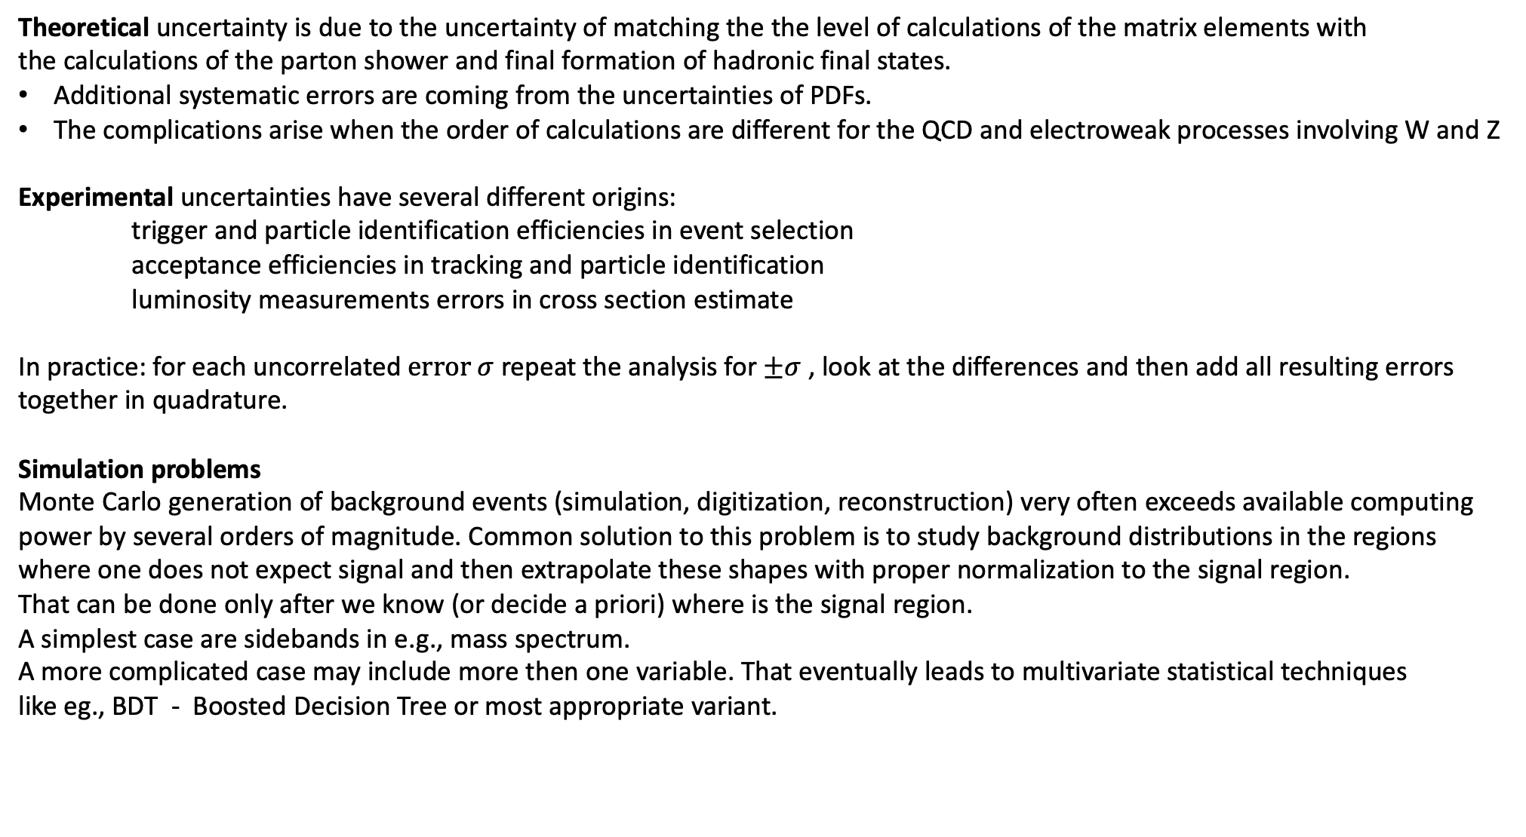
Systematic uncertainties
Theoretical uncertainty is due to the uncertainty of matching the the level of calculations of the matrix elements with
the calculations of the parton shower and final formation of hadronic final states.
Additional systematic errors are coming from the uncertainties of PDFs.
The complications arise when the order of calculations are different for the QCD and electroweak processes involving W and Z
Experimental uncertainties have several different origins:
trigger and particle identification efficiencies in event selection
acceptance efficiencies in tracking and particle identification
luminosity measurements errors in cross section estimate
In practice: for each uncorrelated $error σ$ repeat the analysis for $±σ$ , look at the differences and then add all resulting errors
together in quadrature.
Simulation problems
Monte Carlo generation of background events (simulation, digitization, reconstruction) very often exceeds available computing
power by several orders of magnitude. Common solution to this problem is to study background distributions in the regions
where one does not expect signal and then extrapolate these shapes with proper normalization to the signal region.
That can be done only after we know (or decide a priori) where is the signal region.
A simplest case are sidebands in e.g., mass spectrum.
A more complicated case may include more then one variable. That eventually leads to multivariate statistical techniques
like eg., BDT - Boosted Decision Tree or most appropriate variant.

Slide 15
Statistical method
Extended likelihood function for (signal + background): L(α,ν)
signal pdf
background pdf
ancillary pdfs
n_{s}, n_{b} - signal / background yields
x_{e} - observables
f_{s}, f_{b} - signal / background pdfs
α - parameter of interest (mass, couplings, cross-section,…)
ν - “nuisance parameters” (shape parameters, systematics,….)
π_{k} - pdfs obtained from auxiliary measurements
Many variables + many signal + background processes → many terms

Slide 16
Likelihood fits
Confidence intervals (value ± error), limits and significances are based on the
Profile Likelihood Ratio
likelihood for fixed α and profiled ν
maximum likelihood for free α, ν
is the conditional best fit for a particular value of α
is the best-fit α
To combine – multiply the likelihood terms
Test statistics: q_{α} = -2 ln Λ(α)
Wilks theorem: if α = α_{true}, then q_{α} follows a χ² distribution
compute confidence interval

Slide 17
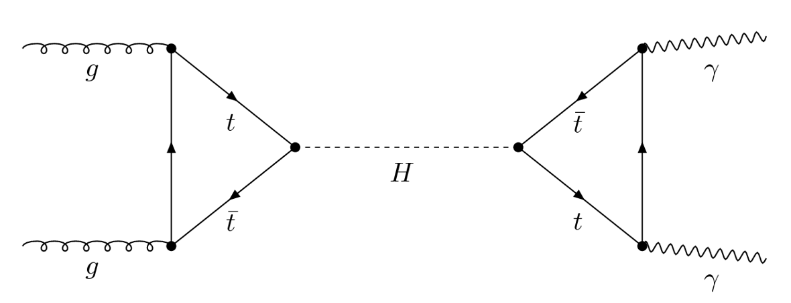
Higgs Couplings
ATLAS-CONF_2015-007
The coupling of Standard Model particle to Higgs boson scales with particle mass
Stress test: We know masses. Introduce coupling scale factor κ and signal strength μ, e.g.,
+bottom, etc.
+new particles
+bottom
+ W etc.
LO Standard Model
Destructive interference top-bottom in gg->H loop and W-top in H->γγ loop

Slide 18

$$H→γγ$$

Slide 19
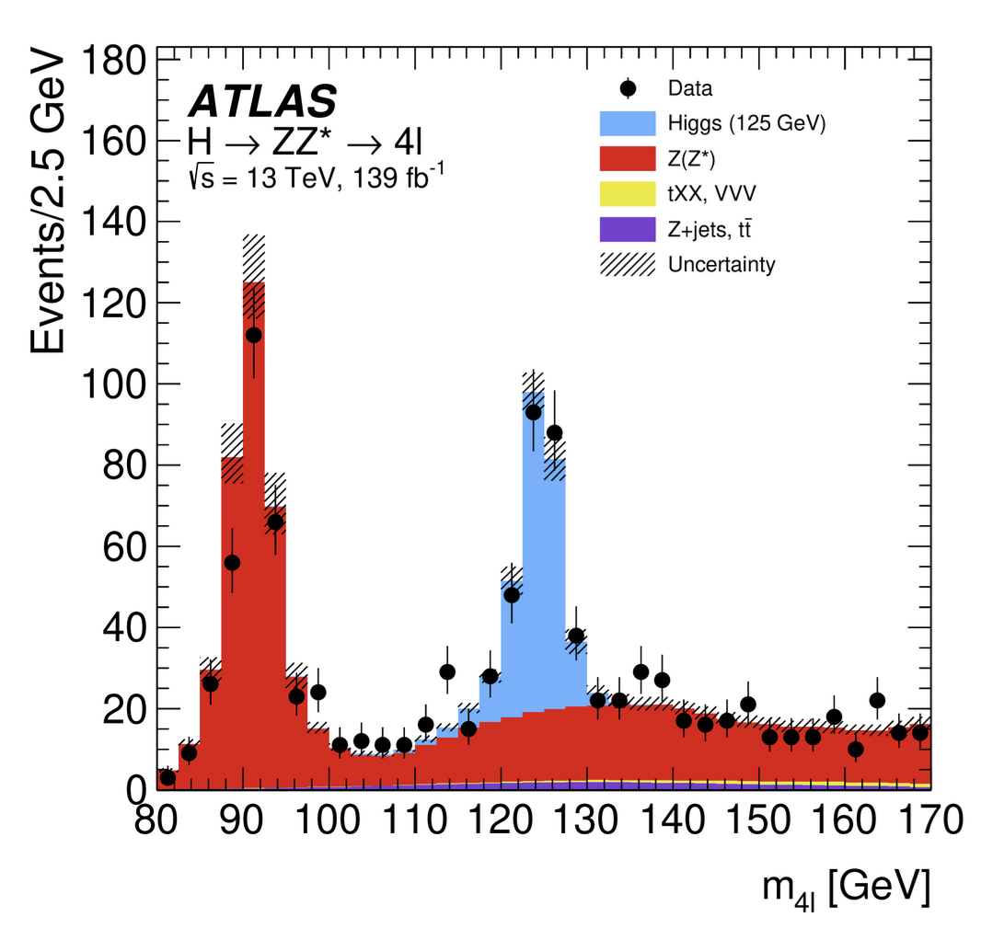
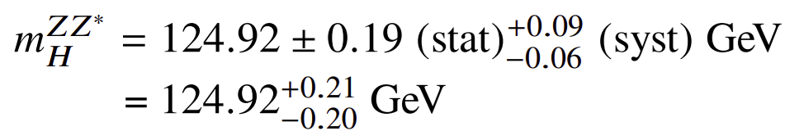
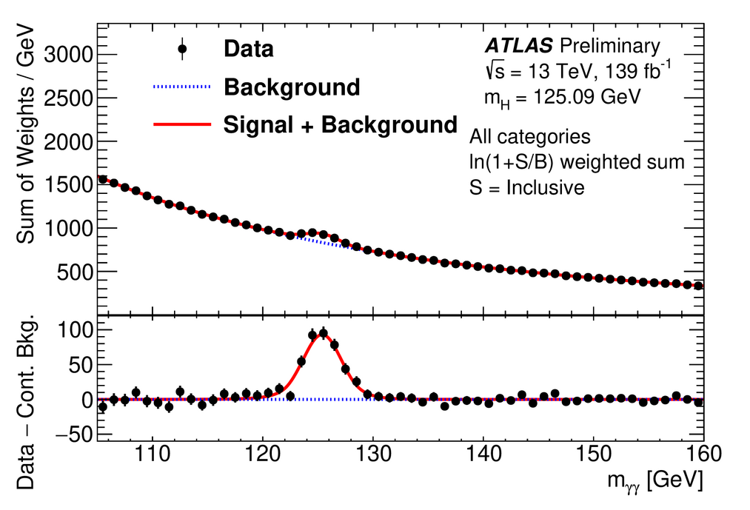
It looks like 125 GeV – I am offering a bottle of champagne for
a physics explanation why it is equal to 5³ GeV.

Slide 20
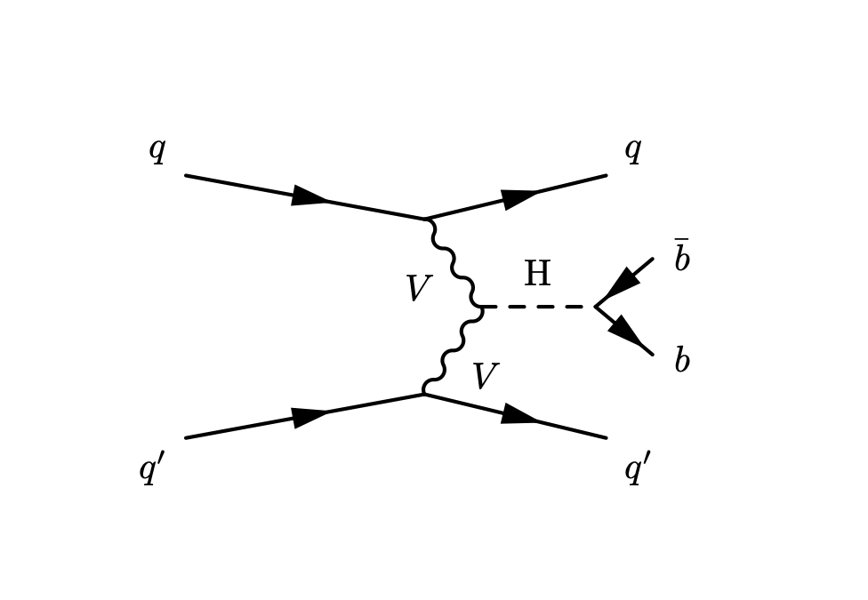
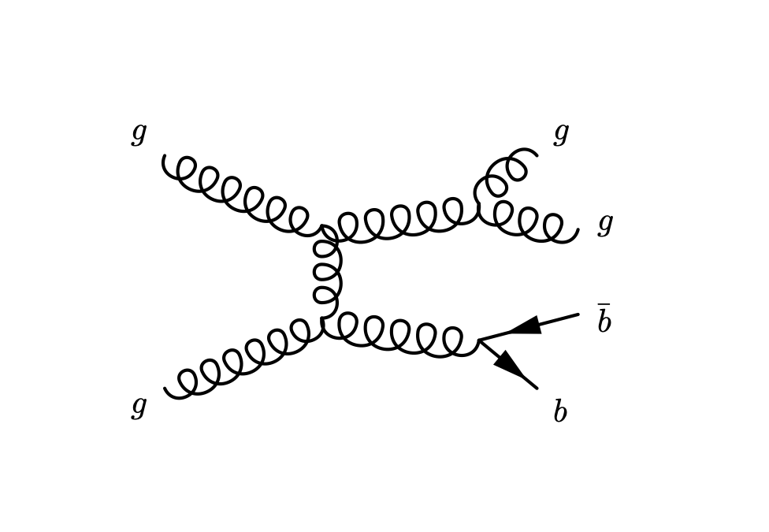
Signal
Background

Slide 21
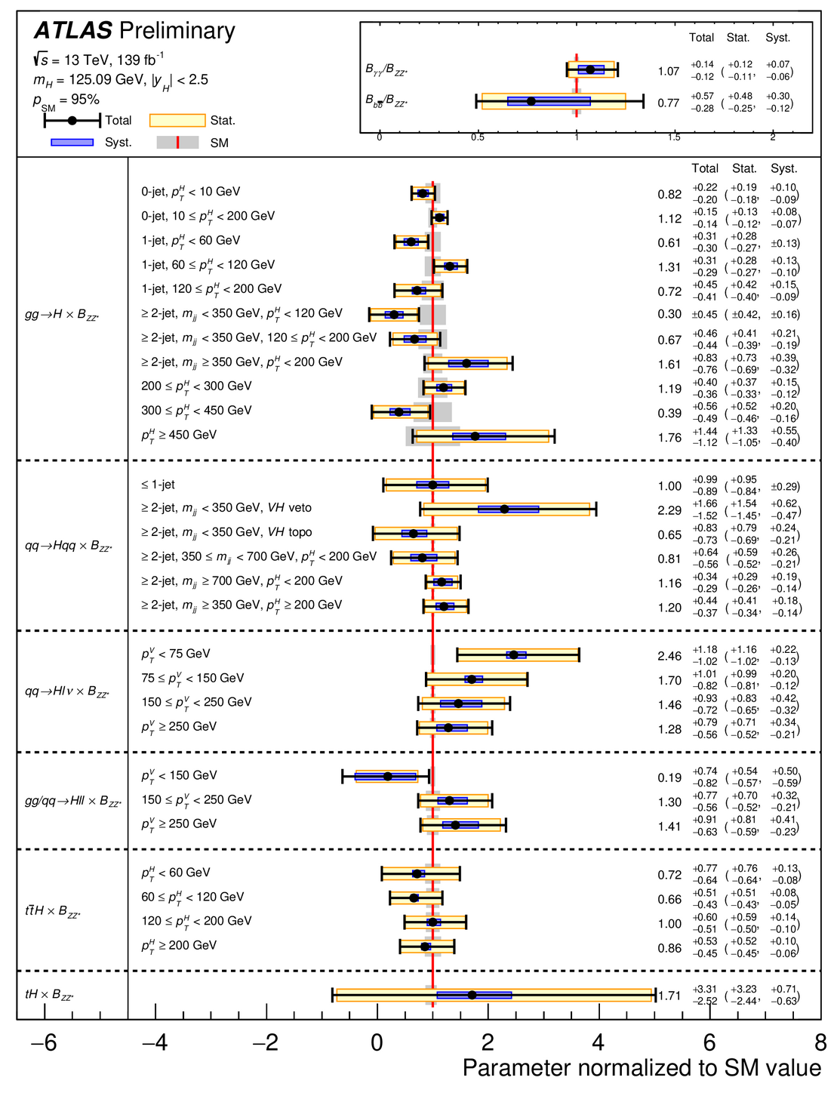
In Run 3 the LHC experiments succeeded in
reconstructing Higgs in several production modes
With different data selection conditions.
Measured rates of combined production and
decay show consistent agreement with the
expectations of the Standard Model
A combination of measurements by ATLAS and CMS
is given in Particle Data Tables as:
Mass m = 125.10 ± 0.14 GeV
Full width Γ < 0.013 GeV, CL = 95%

Slide 22
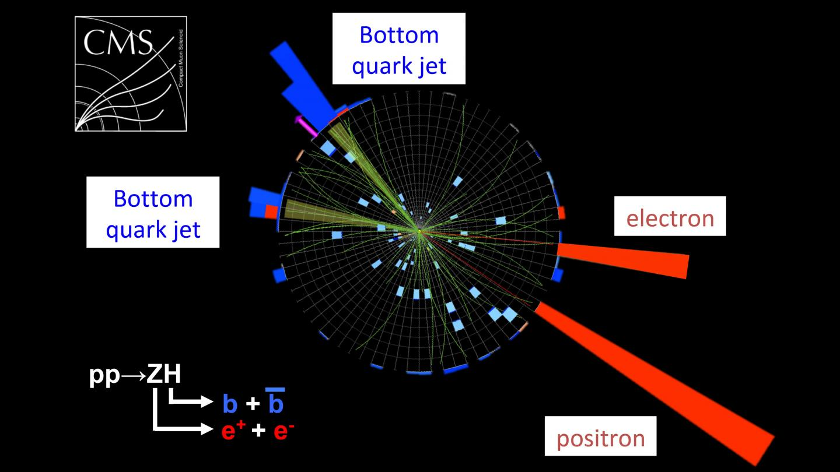
Example: di-boson production pp -> ZH

