Slide 1
WORK IN PROGRESS
Two Higgs searches for exotic decays of the Higgs: H->aa with a = 20 GeV

Slide 3
Higgs Spin and Parity Tests for J^{P} = 0⁺
Procedure:
Select kinematic variables sensitive to the J^{P} assignment of the Higgs.
Simulate distributions of the decay Higgs decay particles in the Higgs rest frame.
Construct a likelihood function for conditional probabilities over binned distribution of selected variables.
Use test statistics q to distinguish between two spin-parity hypotheses as a ratio of likelihoods.
Use BDT for various combination of spin-parity assignments
Kinematical variables in H->ZZ*->4 leptons

Slide 4
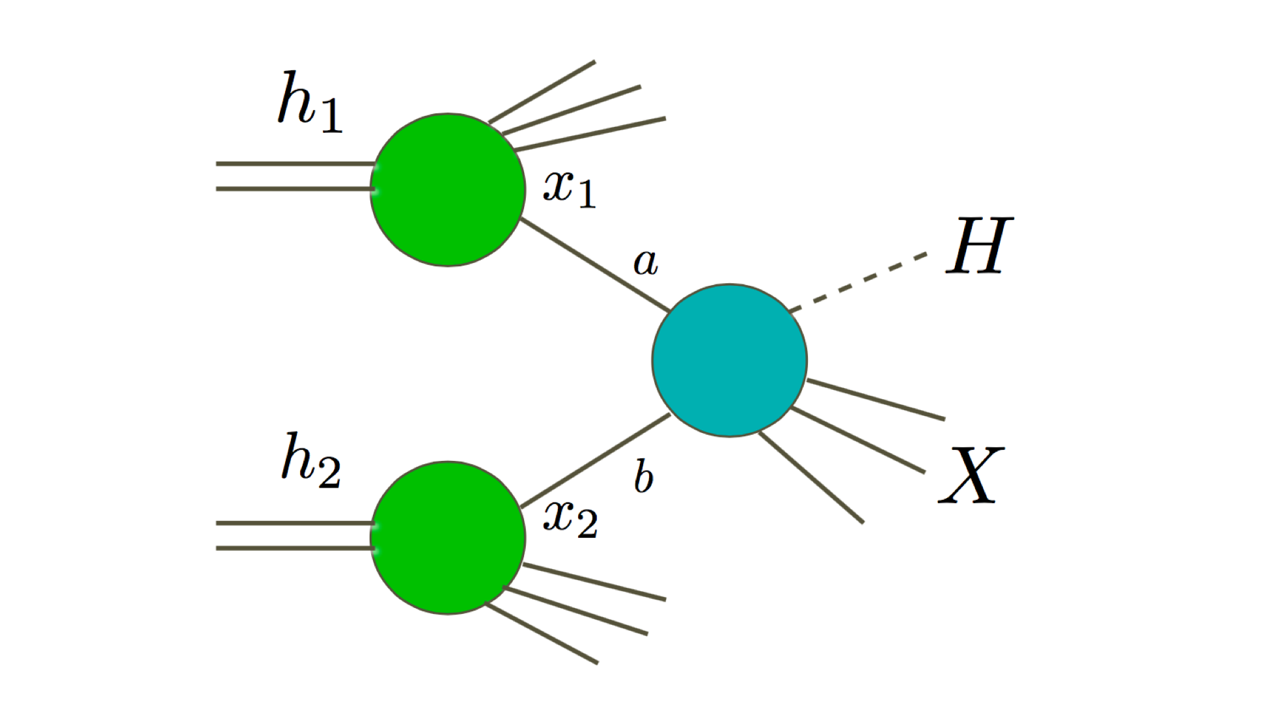
MEASUREMENTS COMPARED TO EXPECTATIONS
Why precision is needed
proton
Quarks, gluons
Parton distribution functions (fit from data)
Parton scattering cross section (calculated)
proton

Slide 5
Precision cross section measurements
Measurements compared to the data require precision of theoretical predictions
Progress in theory - higher order calculations.
Dominant production of Higgs boson is gluon fusions
g
t/b
H
$$σ\left(gg→H\right)=α_{s}^{2}\left(σ_{LO}+α_{s}δσ_{NLO}+α_{s}^{2}δσ_{NNLO}+α_{s}^{3}σ_{NNLO}+…\right)$$
g
Rate is power series in strong coupling constant, α_{s}~.118
1977 -> 1991 -> 2002 -> 2015
Higher order calculations require re-evaluation of the fragmentation models
to eliminate double counting of gluon splitting

Slide 6
Consistency of the Standard Model
In the Standard Model the masses of W, Z, top quark and H are correlated
$m_{W}^{2}$ = $\frac{πα}{\sqrt{2}G_{F}\left(1−\frac{m_{W}^{2}}{m_{Z}^{2}}\right)\left(1−∆r\right)}$
In Standard Model $∆r$reflects loop corrections and depends on m_{t}² and ln(m_{H})
Precise measurements of these masses provides limits on deviations from the Standard Model
and the estimate of the energy/mass scale of the new objects that we should be looking for.

Slide 7
Precision of Electroweak sector
The measurement of sin2θ_{W} tests this relation:
$$sin_{eff}^{2}θ_{w}=\left(1−\frac{m_{W}^{2}}{m_{Z}^{2}}\right)κ$$
where $κ$describes electroweak corrections.
± 20x10⁻⁵ error in sin² $θ_{eff }$corresponds to ±10 MeV error in m_{W}

Slide 8
THEORY IS CRITICAL FOR INTERPRETING DATA
Calculation of Higgs production to NNNLO required:
New analytic techniques
New computational techniques
Surprisingly large corrections to gluon fusion production:
LO NLO NNLO NNNLO
100%
increase
20%
increase
2%
increase
1977 ->1991 -> 2002 -> 2015

Slide 9
2021 Precision level - Higgs Decays
no exotic decays
Adding all together: Total cross section for Higgs production at NNNLO level of SM is
$$46.61 pb \begin{matrix}+4.27\% \\ −6.49\%\end{matrix}$$
$$±1.85\%±2.6\%$$
theory
PDF
$$α_{s}$$
From S. Dawson

Slide 10
Ongoing Theory Improvements for Run3
Within Standard Model – calculations of more complex diagrams and detailed prediction for 14 TeV
Example – 2 Higgs production including associated bosons or t quarks:
Leading order prediction of HH mass at 14 TeV

Slide 11
There is no doubt that a Higgs boson has been discovered
but what kind of Higgs is it?
Is it THE Higgs boson that explain the mass of fundamental particles?
~1% of all visible mass
Known properties according to Standard Model:
Spin-parity J^{P} = 0⁺
Neutral CP even component of a complex SU(2)_{L} doublet
Couples to weak gauge bosons as g_{WWH} /g_{ZZH} = m_{W}²/m_{Z}²
Couples to Standard Model fermions proportionally to their masses
Self coupling strength determines its mass (and v = 246 GeV)
It could look Standard Model - like and still partially do the job
Could be a mixture of more than one Higgs
Could be a mixture of CP even and CP odd states
Could be a composite particle
Could decay to exotic particles
……….
Could be part of extended theory or model

Slide 12
Initial status after the Higgs discovery. There is now >15,000 papers with the word Higgs in the title
CMS
ATLAS
Theorist
LHCb
Murayama

Slide 13
If there are more than one Higgs, the contribution of each is controlled by the propagator.
Their effects should average to those of the one we observe e.g., – one at lower mass and one at higher mass.
The effects of high mass new particles at the LHC energy are moderated by their propagators.
Propagator
In Feynman rules the propagator (red line) describes every
internal line.
For a massless photon in gauge field theory the propagator is
$\frac{−ig^{μν}}{p^{2}+iε}$
where $ε$implies $ε→0$ at the end of calculations.
For massive boson the propagator in the Feynman gauge is
$\frac{g_{μν}}{k^{2}−m^{2 }+iε}$
where k is the integration variable defining the integration range.
For Higgs details see
A. Ghinculov, J.J. van der Bij, Nucl. Phys. B436 (1995) 30.

