Slide 1
Challenges to Standard Model
Many observable effects are not described in Standard Model
Baryon-antibaryon asymmetry in the universe (observed)
Dark matter – possible explanation for observation
Dark energy – no explanation
Gravitational waves – observed, consistent with black hole mergers. Are they described by quantum theory
Neutron electric dipole moment – measured with high precision
Neutrino masses – must be non-zero to satisfy observed mixing
Particle physics has Standard Model - an extensive theoretical framework that describes
most of the observation of the structure of matter. It is natural to try to attach the
explanations for the observables that we do not quite understand to an extension of
Standard Model.
Beyond the Standard Model
New symmetries:
fermions-bosons (supersymmetry)
mirror symmetries (left-handed with right-handed)
GUT - Higher symmetry groups:
SO(5) - include spin 3/2 particles
Extra dimensions
string theory

Slide 2
Going Beyond the Standard Model - BSM
In practical terms - (too) many possible extensions
There are a large number of models which can be attached to the Standard Model and predict new physics at the TeV scale accessible at the LHC:
Supersymmetry (SUSY)
Extended Higgs Sector, e.g. in SUSY Models
Grand Uniﬁed Theories (SU(5), O(10), E6, …)
Leptoquarks (color triplet bosons that carry both lepton and baryon number (quark-lepton unification)
New Heavy Gauge Bosons
Technicolor (compositeness) related to the top quark
Most general approach is to say that the Standard Model is a part of Effective Field Theory (EFT) and study higher terms.

Slide 3
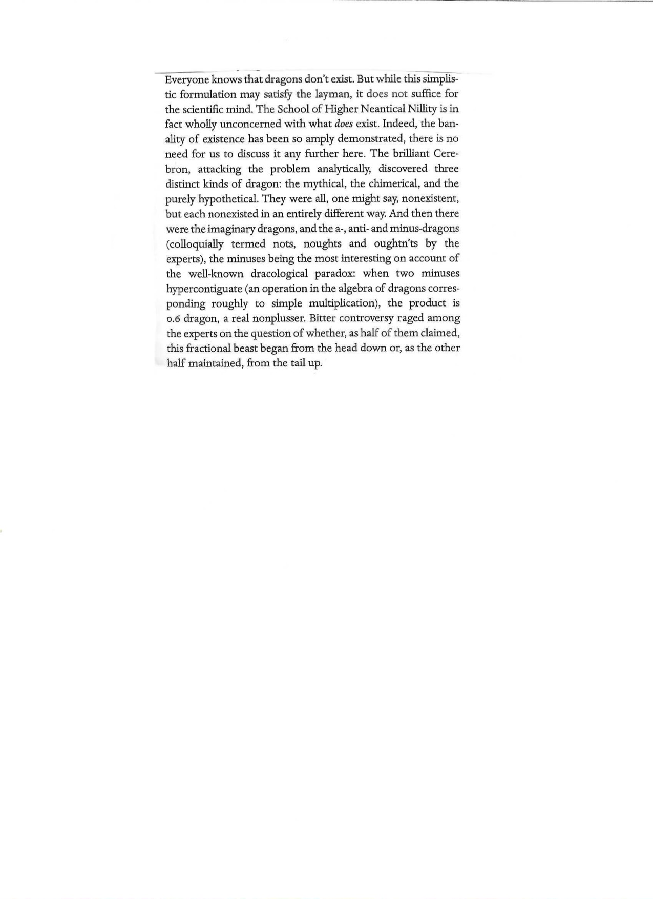
Stanislaw Lem
“The Cyberiad”

Slide 4
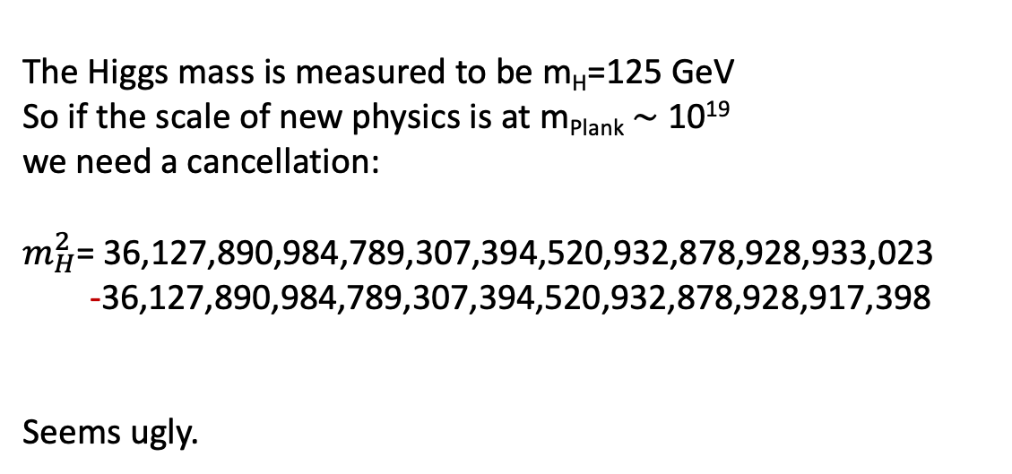
SUSY motivation
Main motivation is a quadratic divergence of the
loop contributions to the Higgs mass squared.
Unless there is a cancellation, the mass of the
Higgs boson should be at the grates energy scale
possible. This is so-called hierarchy or
naturalness problem.
The Higgs mass is measured to be m_{H}=125 GeV
So if the scale of new physics is at m_{Plank} $\sim$ 10¹⁹
we need a cancellation:
$m_{H}^{2}$= 36,127,890,984,789,307,394,520,932,878,928,933,023
-36,127,890,984,789,307,394,520,932,878,928,917,398
Seems ugly.

Slide 5
These days most of the extensions are based on introduction of additional symmetry
The most popular case: Supersymmetry
Introduce symmetry between fermions and baryons i.e., there must be quarks and
leptons with integer spin 0 and gauge particles with spin ½.
A perfect supersymmetry would have new partner particles with spin differing by ½
and with equal masses. Since they have not been seen, the symmetry must be
spontaneously broken with the new particles expected to have much larger masses.
The naming convention for supersymmetric partners of fermions is to add letter s
at the beginning of the name: e.g., squarks -- selectron, smuon, sbottom,…
the superpartners of gauge bosons are called gauginos - gluino, photino, wino,
higgsino…→ these are somewhat more complicated since spontaneously symmetry
breaking generate changes among the standard gauge particles.
In general there is a huge number of ways that the symmetry can be broken leading to
about 120 free parameters. The most tested and popular is the MSSM –
Minimal Supersymmetric Standard Model with just a few free parameters (~20)
not counting the masses of new particles in the theory. It imposes restriction on all
CP violating interactions (non-diagonal terms in flavor transformation matrix are set to zero).

Slide 6
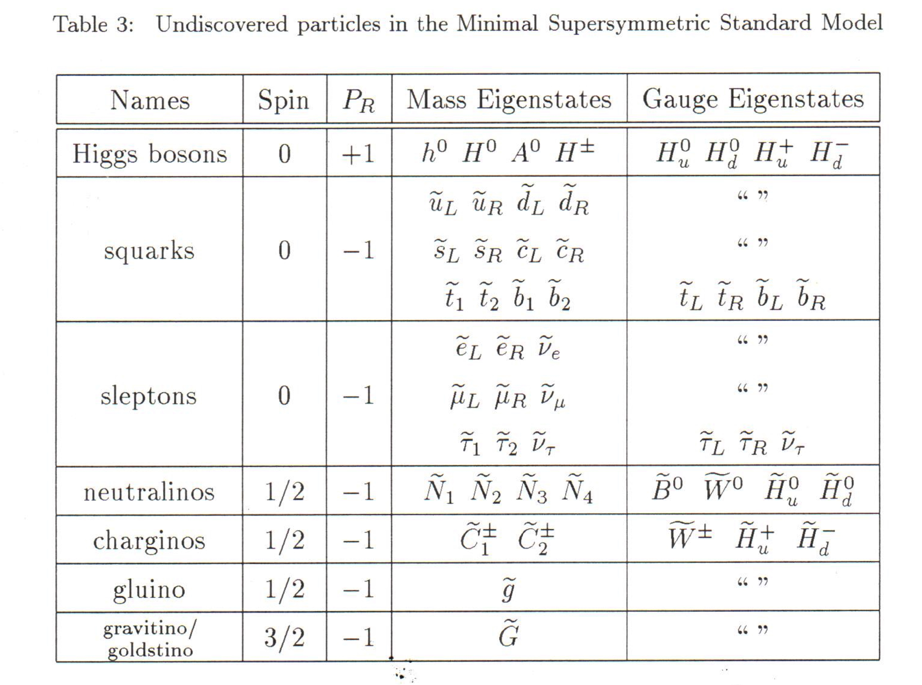
The attraction of supersymmetry for theorists is that provides candidates to solve
several major calculational problems.
Since there is no mixing between Standard Model particles and their supersymmetric
partners, the lowest mass sparticle is stable. The neutral stable sparticle would be a
candidate for dark matter.
In the MSSM there are 32 distinct masses corresponding to undiscovered particles not
counting gravitino and two complex Higgs doublets i.e., 5 gauge bosons.

Slide 7
The attraction of supersymmetry for theorists is that provides candidates to solve
several major problems.
Since there is no mixing between Standard Model particles and their supersymmetric
partners, the lowest mass sparticle is stable. The neutral stable sparticle would be a
candidate for dark matter.
In the MSSM there are 32 distinct masses corresponding to undiscovered particles not
counting gravitino and two complex Higgs doublets i.e., 5 gauge bosons.
Squarks and sleptons are scalar fields without spin. In MSSM, "left" or "right" squarks are eigenstates
of different mass obtained by the SUSY transformation from a left or right fermion, and they carry
the same SU(N) charges as their SM partners.

Slide 8
In MSSM the heavy sparticles would decay to the lighter ones in processes
analogous to the Standard Model particles, but their connection to the
Standard Model world would be weak . Thus they earned the nickname of
WIMPs – Weakly Interacting Massive Particles.
The signatures of the supersymmetry are either processes that are forbidden
in the Standard Model but that can proceed via loops involving virtual sparticles
e.g., lepton flavor violating decays μ → eγ, proton decays or/and enhanced rates for other rare process
due to the virtual loops, etc
At LHC we also look for direct production of supersymmetric particles whose decay
chain ends with a lowest mass, neutral sparticle. Such particle would interact
only weakly with regular matter and thus it would leave the detector without
producing detectable signal. The signature of such particle is, therefore, missing
energy or more precisely in ATLAS – missing transverse energy MET.
Another consequence of supersymmetry is that there are 5 Higgs particles: 2 charged
and 3 neutral. In such scenario the object that has been discovered few years ago is only
one of the neutral Higgs bosons.
It also gives experimentalists a goal for searching for a new channel A→ ZH via observation of associated Z and Higgs

Slide 9
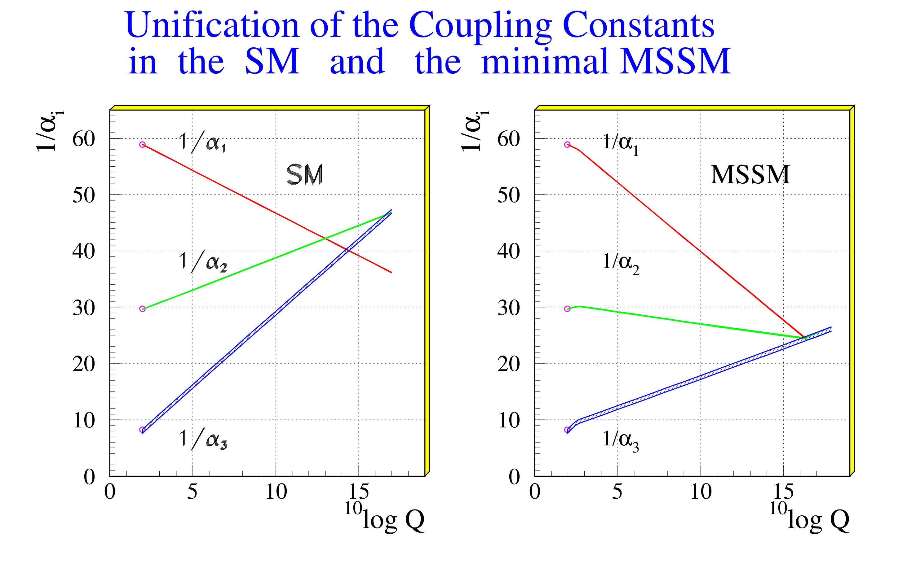

Slide 10
If the new physics is at 1 TeV, the Higgs coupling will be affected very little
 | Coupling to W/Z | Coupling to b | Coupling to γ
Singlet | ~6% | ~6% | ~6%
2HDM | ~1% | ~10% | ~1%
MSSM | ~.001% | ~1.6% | ~-­‐.4%
Composite | ~-­‐3% | ~-­‐(3-­‐9)% | ~-­‐9%
Top Partner | ~-­‐2% | ~-­‐2% | ~1%
We need precision measurements of these couplings !!

Slide 11
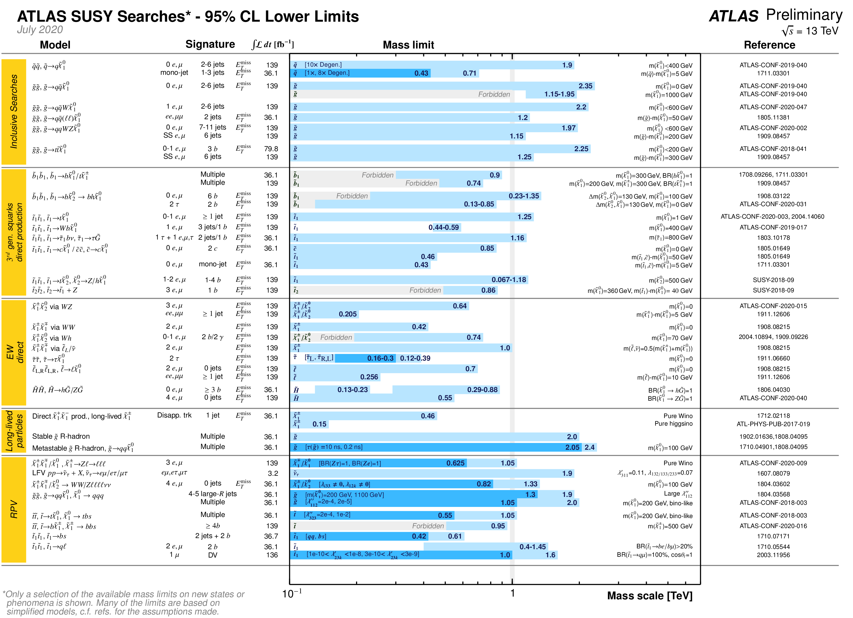

Slide 12
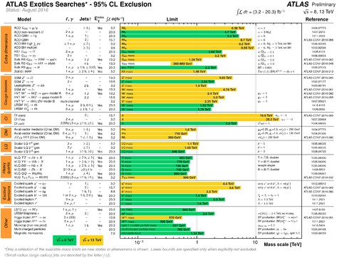

1 TeV

Slide 13
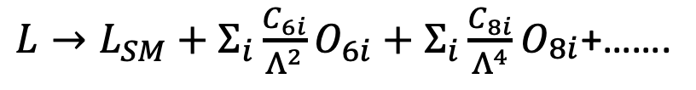
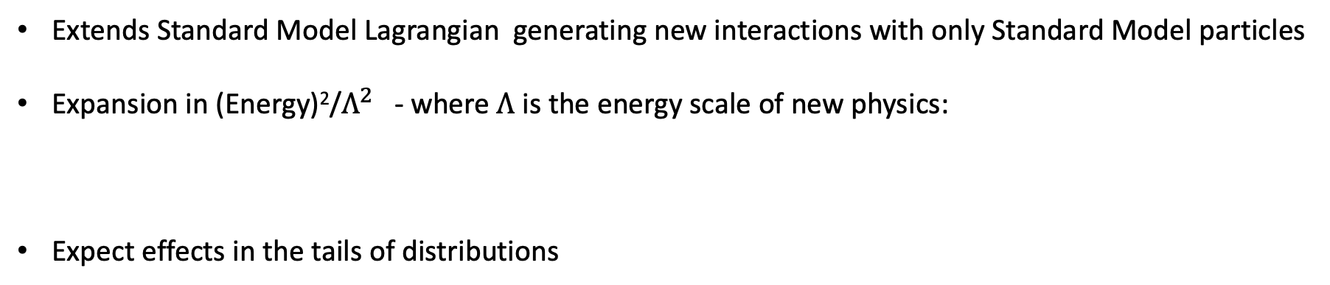
Back to basics - EFT - Effective Field Theory
Extends Standard Model Lagrangian generating new interactions with only Standard Model particles
Expansion in (Energy)²/$Λ^{2}$ - where $Λ$ is the energy scale of new physics:
Expect effects in the tails of distributions
$L→L_{SM}+Σ_{i}\frac{C_{6i}}{Λ^{2}}O_{6i}+Σ_{i}\frac{C_{8i}}{Λ^{4}}O_{\begin{aligned}8i \\ \end{aligned}}$+…….

Slide 14
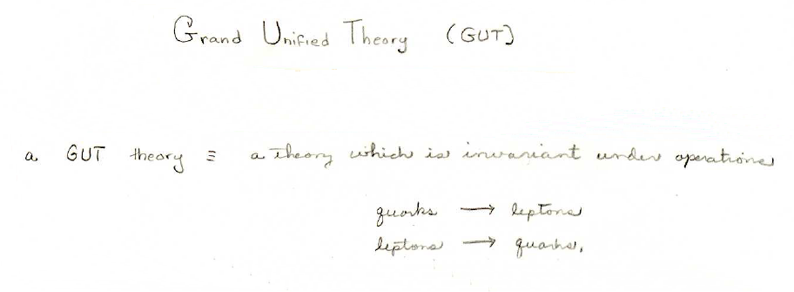
We have incorporated into the Lagrangian density invariance under
rotations in U(1) x SU(2)_{flavor} space and SU(3)_{color} space, but these were
not really unified. That is, the gauge bosons, (photon, W, and Z, and
gluons) were not manifestations of the same force field. If one were
to “unify” these fields, how might it occur? The attempts to do so are
called Grand Unified Theories.
Grand Unified Theory (GUT)
GUT includes invariance under U(1) x SU(2)_{flavor} space and SU(3)_{color}
and invariance under the following transformations:
quarks → leptons
leptons → quarks

Slide 15
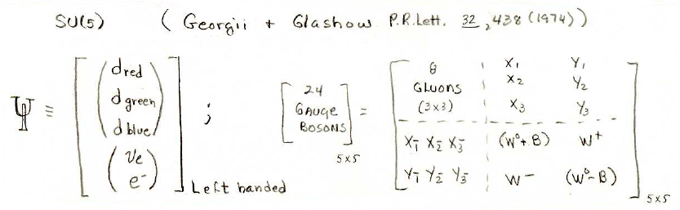
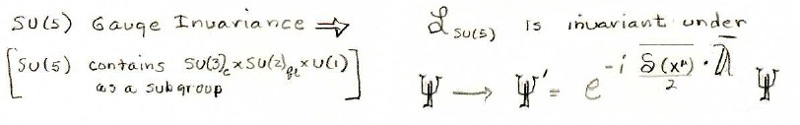
Grand Unified Theory - SU(5)
Phenomenology not sufficiently developed for experimental tests
SU(5)
Georgii & Glashow, Phys. Rev Lett. 32, 438 (1974).
Quarks
& leptons
in same
multiplet
m_{x} ≈ 10¹⁵GeV
d red
8
gluons
rgb
d_{green}
;
24
Gauge
bosons
L
d blue
e⁻
(W ⁰+B)
W⁺
-υ
W⁻
(W ⁰ +B)
Left handed
SU(5) gau
Gauge invariance
L _{SU(5)} is invariant under
e^{-iδ(x,y,t)⋅λ}
For symmetry under SU(5), the x and y particles must be massless!

Slide 16
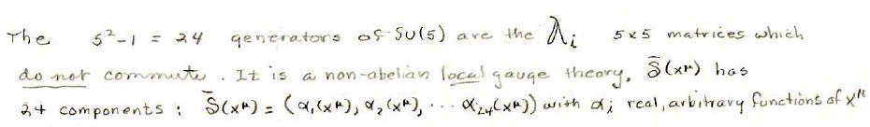
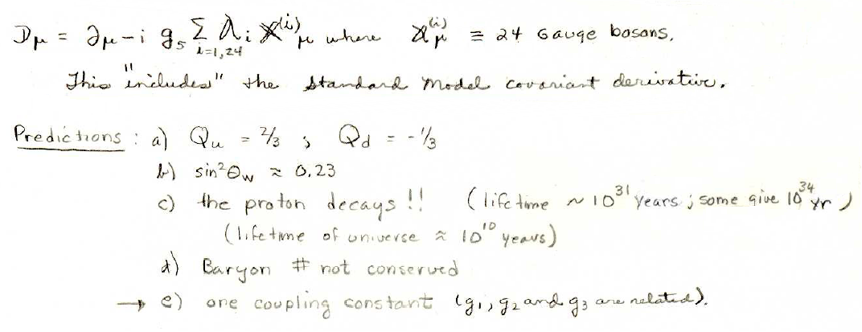
SU(5) generators and covariant derivative
λ_{i}
The 5² -1 = 24 generators of SU(5) are the
5x5 matrices which
do not commute. SU(5) is a non-abelian local gauge theory.
δ_{i}(x,y,t) has
24 components: δ_{i}(x,y,t) =
all real, continuous functions
D_{μ} = ∂_{μ}- i g₅/2Σ_{j=1,24}λ_{j}X^{i} where X^{i} = the 24 gauge bosons
This includes the Standard Model covariant derivative (couplings are different).
^{λ}
Predictions:
a) q_{up} = 2/3 ; q_{d} = -1/3
b) sin²θ_{W} ≈ 0.23
c) the proton decays!
> 10³⁴ years
d) baryon number not conserved
e) only one coupling constant, g₅ (g₁, g₂, and g₃, are related)
So far, there is no evidence that the proton decays. But note that the
lifetime of the universe is 14 billion years. The probability of detecting
a decaying proton depends a large sample of protons!

Slide 17
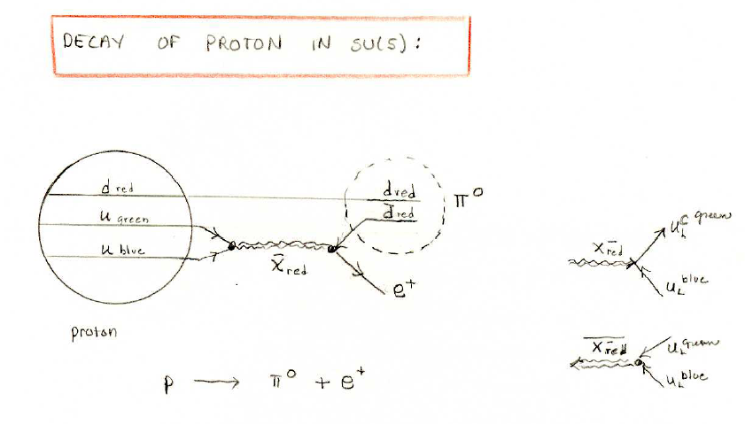
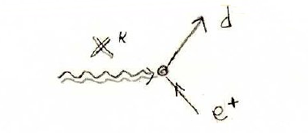
Decay of proton in SU(5)
d _{red}
d _{red}
anti-up
-
0
u _{green}
d _{red}
-
green
u _{blue}
X^{red}
X⁺ _{red}
blue
3-color
vertex
e⁺
proton
X ^{+red}
green
blue

Slide 18
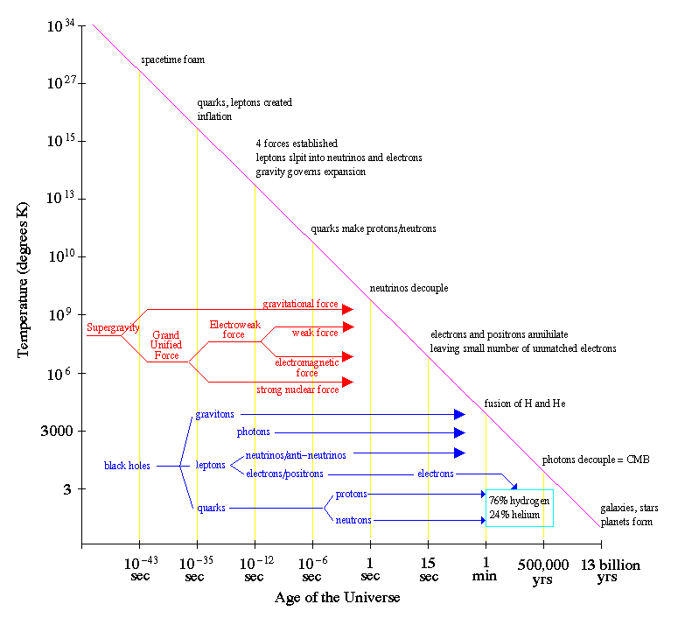
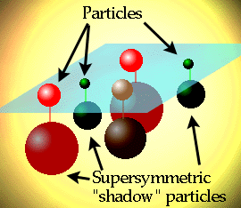
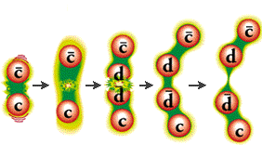
GUT Picture Beyond the Standard Model

Slide 19
What we know and what do not know
Higgs is a new type of a particle but is this The Higgs particle ?
All parameters seem to be as expected, but there is no indication of new physics effects required by the formalism of unification of forces at early stages of the universe. The mathematics breaks down in extrapolation to higher energies.
Perhaps it is one of several such ne particles and the other ones have much higher masses
Do we really know the shape of the Higgs potential. Perhaps the particle we have discovered represents not a true but a false vacuum during the Big Bang and the true Higgs has much larger mass.
Why do we care? Cosmologist claim that if this is a true Higgs, its mass and the mass of the heaviest quark indicate that our universe may be unstable and would
disappear in a future (may be few or few hundred billions of years)
Plenty of time to build bigger machine and study.

Slide 20


Higgs and neutrino mass
In general, the Standard Model provides a mechanism for particles to acquire mass through interactions with Higgs boson. Higgs boson has spin zero thus it is neither left‐handed nor right‐handed. Quantum Field Theory plus Lorenz invariance shows that a particle interaction with Higgs boson results in a left‐handed particle becoming right‐handed and then again left‐handed over the second interaction with Higgs and so on. The frequency of such interactions is proportional to particle mass.
γ
Extensions od the Standard Model with Dirac right handed neutrinos → right-handed W is heavy and has weak coupling,
e
L
⋅
⋅
e
R
e
e
⋅
e
R
L
∝_{L}
⋅
∝_{R}
∝
⋅
∝
26
10 weaker then with ordinary neutrino
∝
L ⋅
∝
R
⋅
R
⋅
⋅
∝_{L}
→Arkani‐Hamed, Dimopoulos, Dvali – superstring theory: – right‐handed neutrinos may move in extra dimensions while all other particles do not
t
L
⋅ ⋅ t_{R}
⋅
t
_{t} ⋅ ⋅⋅
L
R _{⋅ t}
ν_{L}
ν
Majorana neutrinos – are their own antiparticles. The left‐handed neutrino interacting with Higgs produces a very heavy right‐handed allowed by Heisenberg uncertainty principle. That one interacts right away with Higgs producing another left‐handed state. → left-handed neutrinos are very heavy
ν_{L}
⋅
ν_{R}
ν_{L}
ν
⋅
ν_{L}
⋅⋅
1/M
ν_{L}
ν
time

Slide 21
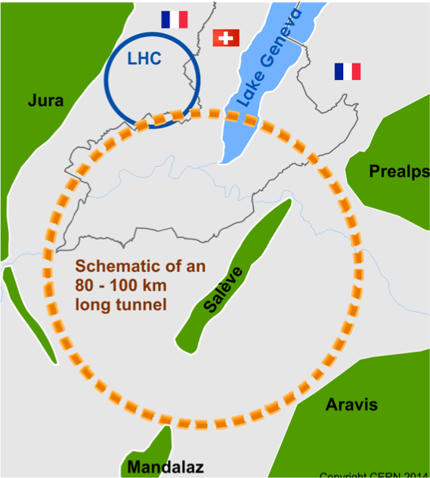
E=mc²
Looking for heavy new particles requires higher energy colliders
Many ideas mostly centered at CERN or in China
  Build higher energy electron positron machine to make precision measurements of Higgs properties
  Build higher energy proton proton collider (100 TeV?) to look for new states of matter
LHC
NEW collider
2019
2040
2050

