Slide 1
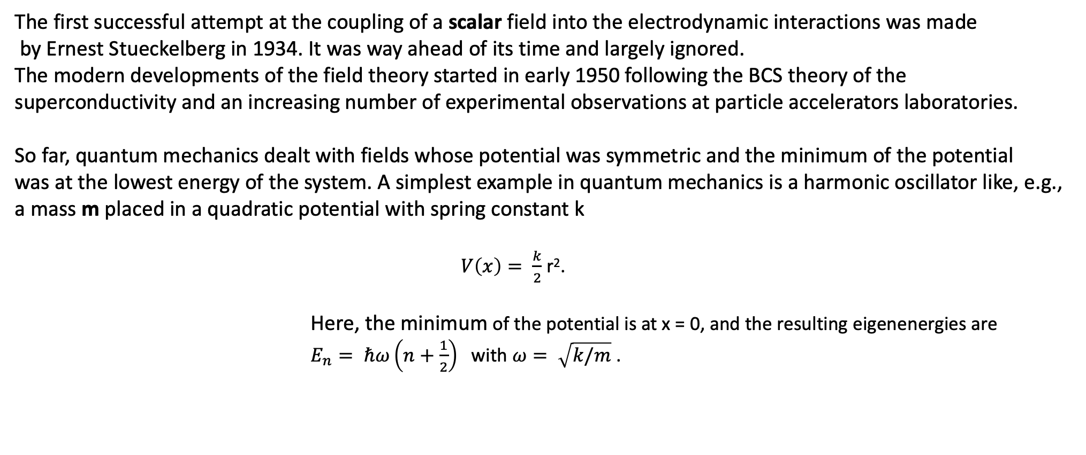
Spontaneous symmetry breaking – the Higgs mechanism
The first successful attempt at the coupling of a scalar field into the electrodynamic interactions was made
by Ernest Stueckelberg in 1934. It was way ahead of its time and largely ignored.
The modern developments of the field theory started in early 1950 following the BCS theory of the
superconductivity and an increasing number of experimental observations at particle accelerators laboratories.
So far, quantum mechanics dealt with fields whose potential was symmetric and the minimum of the potential
was at the lowest energy of the system. A simplest example in quantum mechanics is a harmonic oscillator like, e.g.,
a mass m placed in a quadratic potential with spring constant k
$V\left(x\right)= \frac{k}{2}$ r².
Here, the minimum of the potential is at x = 0, and the resulting eigenenergies are
$E_{n}= ℏω\left(n+\frac{1}{2}\right)$ with $ω= \sqrt{k/m}$ .

Slide 2
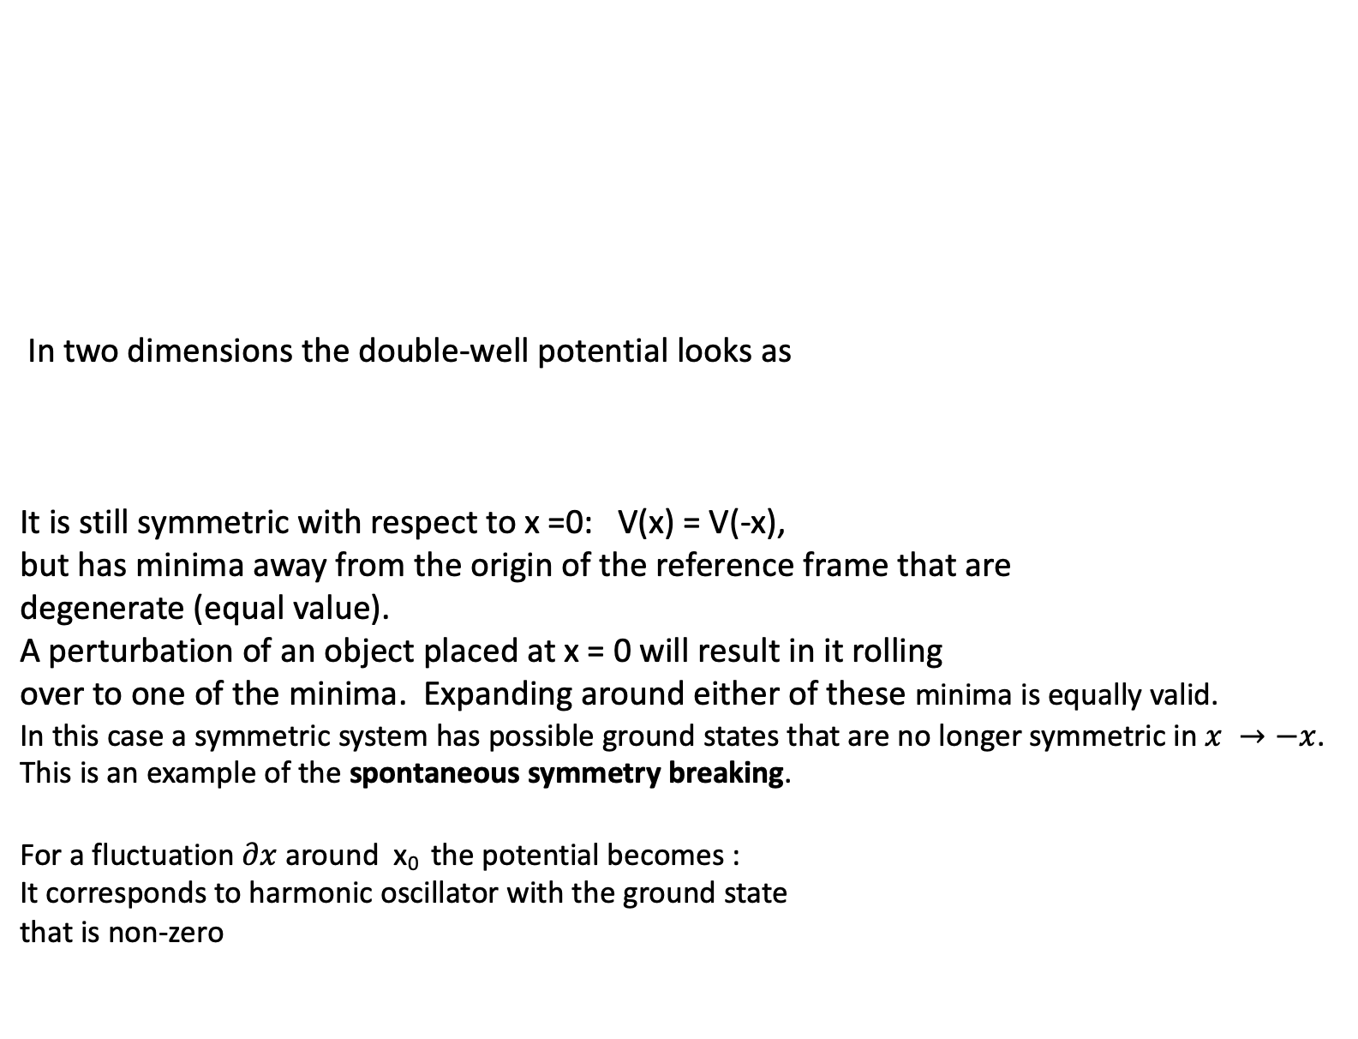
In two dimensions the double-well potential looks as
It is still symmetric with respect to x =0: V(x) = V(-x),
but has minima away from the origin of the reference frame that are
degenerate (equal value).
A perturbation of an object placed at x = 0 will result in it rolling
over to one of the minima. Expanding around either of these minima is equally valid.
In this case a symmetric system has possible ground states that are no longer symmetric in $x →−x$.
This is an example of the spontaneous symmetry breaking.
For a fluctuation $∂x$around x₀ the potential becomes :
It corresponds to harmonic oscillator with the ground state
that is non-zero
The transfer from one minimum to another requires work.

Slide 3
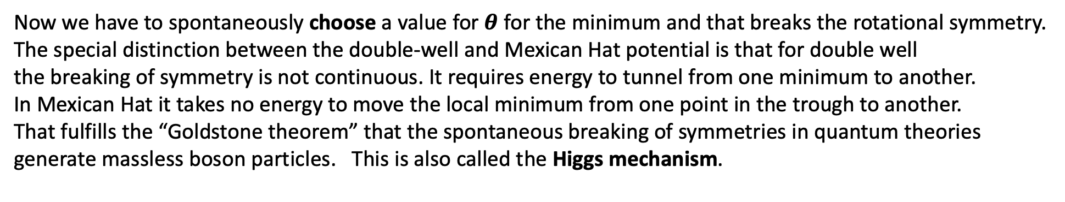
In three dimensions the corresponding potential will have a shape often called a Mexican Hat.
Now we have to spontaneously choose a value for $θ$ for the minimum and that breaks the rotational symmetry.
The special distinction between the double-well and Mexican Hat potential is that for double well
the breaking of symmetry is not continuous. It requires energy to tunnel from one minimum to another.
In Mexican Hat it takes no energy to move the local minimum from one point in the trough to another.
That fulfills the “Goldstone theorem” that the spontaneous breaking of symmetries in quantum theories
generate massless boson particles. This is also called the Higgs mechanism.

Slide 4
During several years of early1960ties there had been many authors working in the area of field theory,
who tried to reconcile the gauge invariance requirements of the massless vector bosons as the carriers
of the force with the observed short range of weak force indicating the existence of the massive bosons.
The earlies paper that I could find discussing what is now called the Higgs Mechanism was a discussion
by P.W. Anderson of the superconductivity effect called plasmons that avoided massless excitations providing
that Coulomb interactions were taken into account.
It appeared, that combining the weak and electromagnetic interactions provided a promising direction.
The particle physics considerations were made by a long list of authors including among others:
Robert Brout, Francois Englert, Gerald Guralnik, C.R. Hagen, Tom Kibble and so on.
In two paper published in 1964 in the same volume of Physical Review Letters by Engler and Brout
and by Peter Higgs these authors have shown that a combination of the U(1) symmetry with spontaneous
symmetry braking introduced by adding self-interactions of the new two-component scalar field will
generate quadratic and quartic terms in the Lagrangian and result in the longitudinal polarization
of the massive vector bosons. This explained the existence of the Z⁰.
At the same time the new field contained new particle – the scalar Higgs boson.

Slide 5
Electroweak symmetry breaking
In the Standard Model with no Higgs mechanism, interactions are symmetric and particles do not have mass
Electroweak symmetry is broken:
  Photon does not have mass
  W, Z have a large mass
Add Higgs mechanism:
  mass of W and Z results from the Higgs mechanism

Slide 6
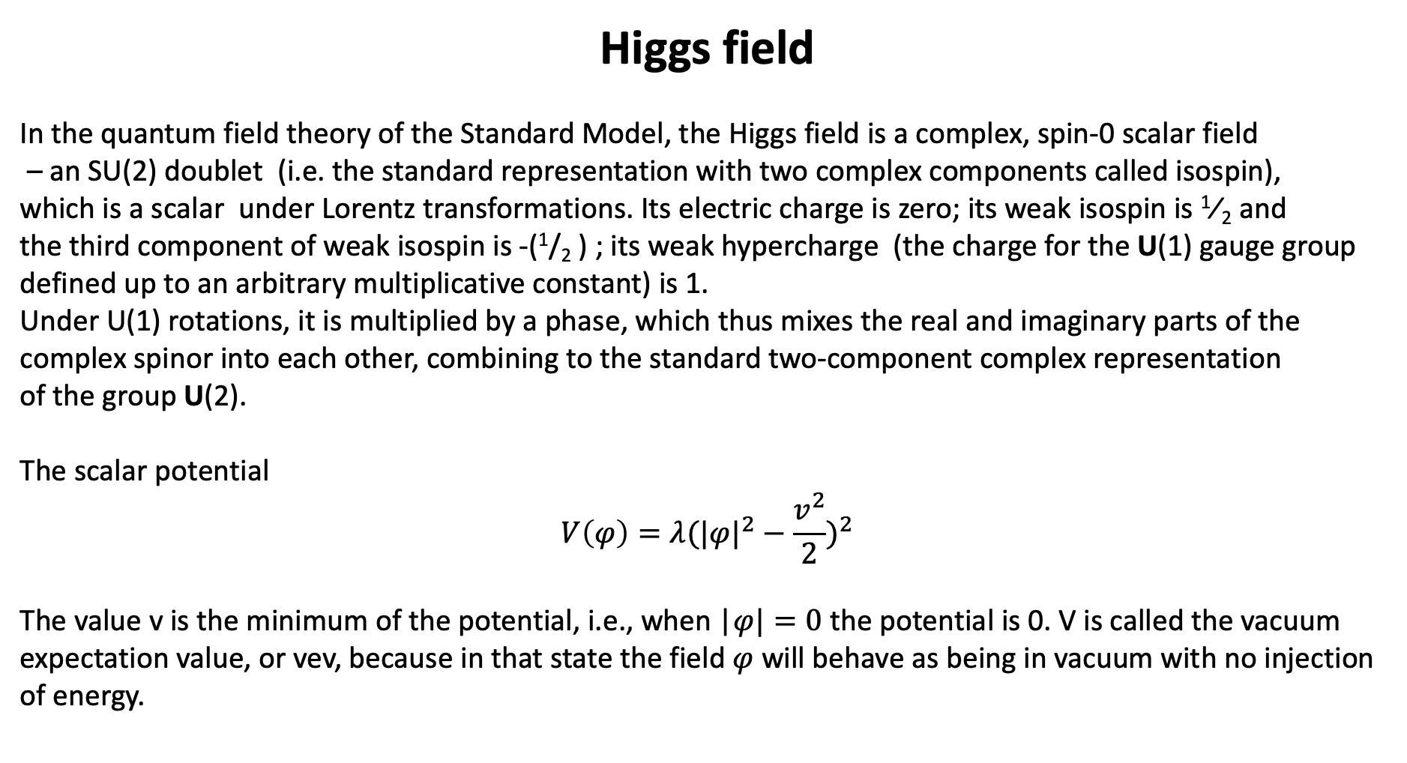
Higgs field
In the quantum field theory of the Standard Model, the Higgs field is a complex, spin-0 scalar field
– an SU(2) doublet (i.e. the standard representation with two complex components called isospin),
which is a scalar under Lorentz transformations. Its electric charge is zero; its weak isospin is ​¹⁄₂ and
the third component of weak isospin is -(¹/₂ ) ; its weak hypercharge (the charge for the U(1) gauge group
defined up to an arbitrary multiplicative constant) is 1.
Under U(1) rotations, it is multiplied by a phase, which thus mixes the real and imaginary parts of the
complex spinor into each other, combining to the standard two-component complex representation
of the group U(2).
The scalar potential
$$V\left(φ\right)=λ(|φ|^{2}−\frac{v^{2}}{2})^{2}$$
The value v is the minimum of the potential, i.e., when |$φ|=0$ the potential is 0. V is called the vacuum
expectation value, or vev, because in that state the field $φ$ will behave as being in vacuum with no injection
of energy.

Slide 7
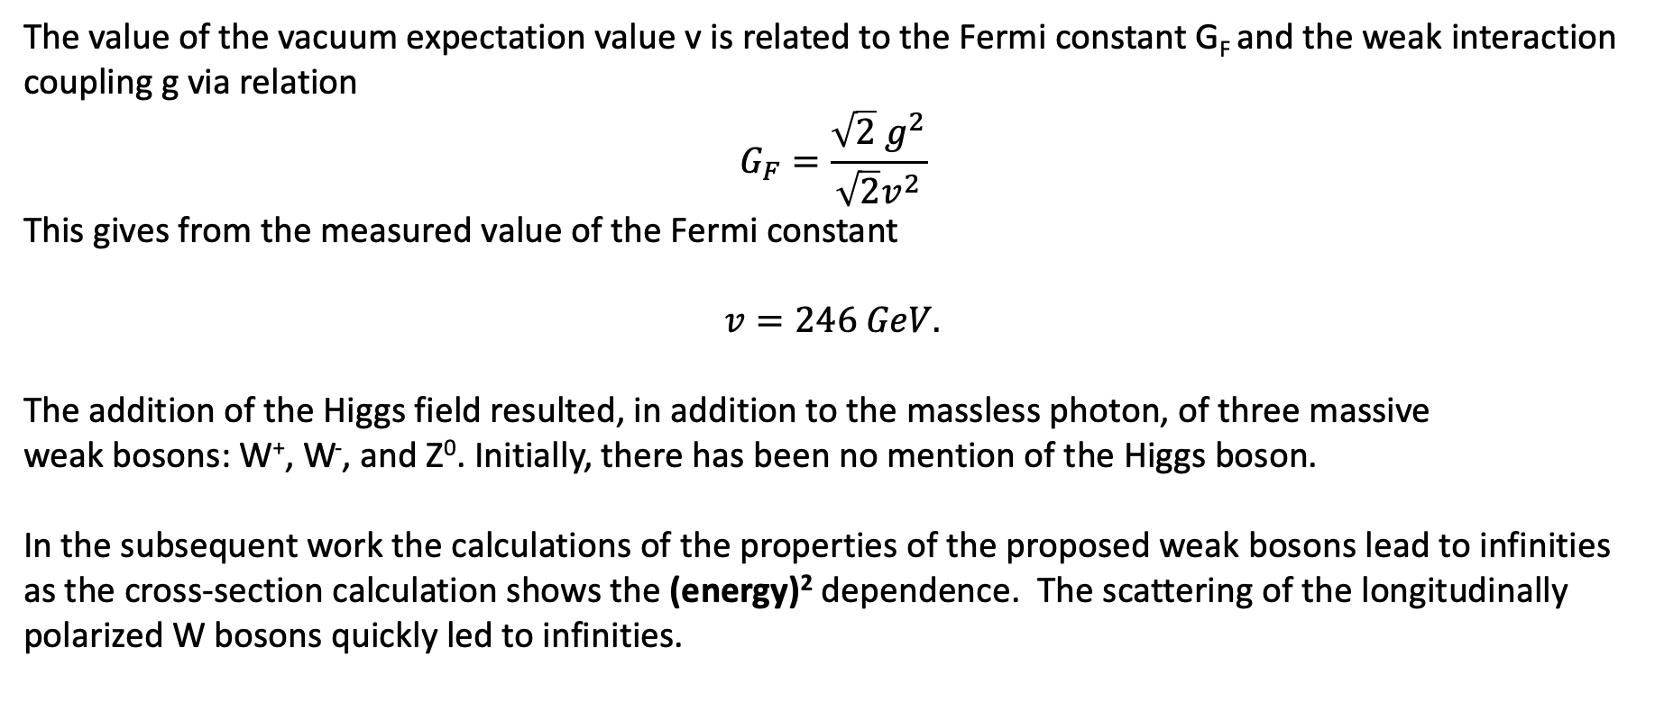
The value of the vacuum expectation value v is related to the Fermi constant G_{F} and the weak interaction
coupling g via relation
$$G_{F}=\frac{\sqrt{2} g^{2}}{\sqrt{2}v^{2}}$$
This gives from the measured value of the Fermi constant
$$v=246 GeV.$$
The addition of the Higgs field resulted, in addition to the massless photon, of three massive
weak bosons: W⁺, W⁻, and Z⁰. Initially, there has been no mention of the Higgs boson.
In the subsequent work the calculations of the properties of the proposed weak bosons lead to infinities
as the cross-section calculation shows the (energy)² dependence. The scattering of the longitudinally
polarized W bosons quickly led to infinities.

Slide 8
The attempt to add the calculations with the quartic coupling helped, but was not sufficient.
The solution was to postulate a new particle, the Higgs boson H as a spinless, neutral particle
with a coupling to W boson tuned to produce the needed compensation.
It turns out that in order to remove the infinites the Higgs particle must couple to the vector boson
with strength proportional to the boson mass.

Slide 9
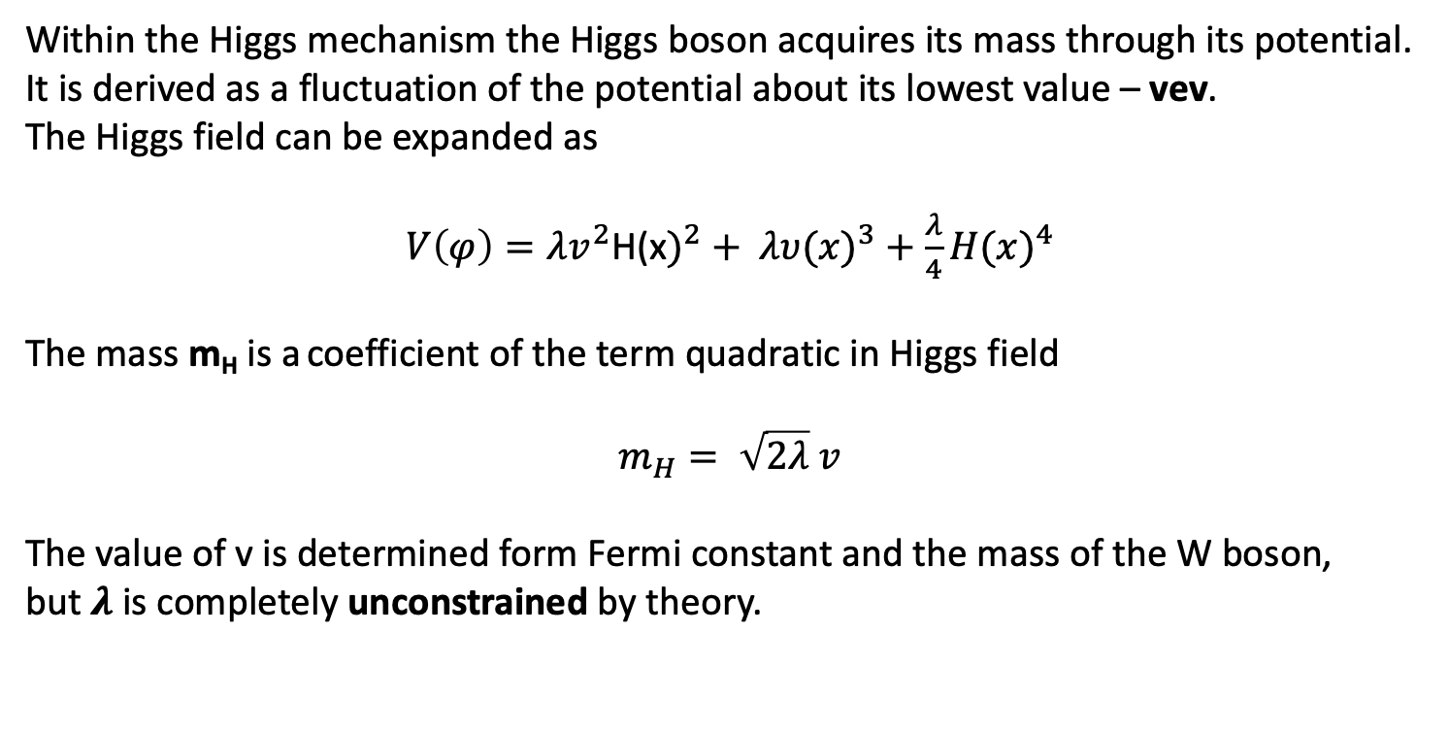
Within the Higgs mechanism the Higgs boson acquires its mass through its potential.
It is derived as a fluctuation of the potential about its lowest value – vev.
The Higgs field can be expanded as
$V\left(φ\right)=λv^{2}$H(x$)^{2}+ λυ(x)^{3}+\frac{λ}{4}H(x)^{4}$
The mass m_{H} is a coefficient of the term quadratic in Higgs field
$$m_{H}= \sqrt{2λ} v$$
The value of v is determined form Fermi constant and the mass of the W boson,
but $λ$ is completely unconstrained by theory.

Slide 10
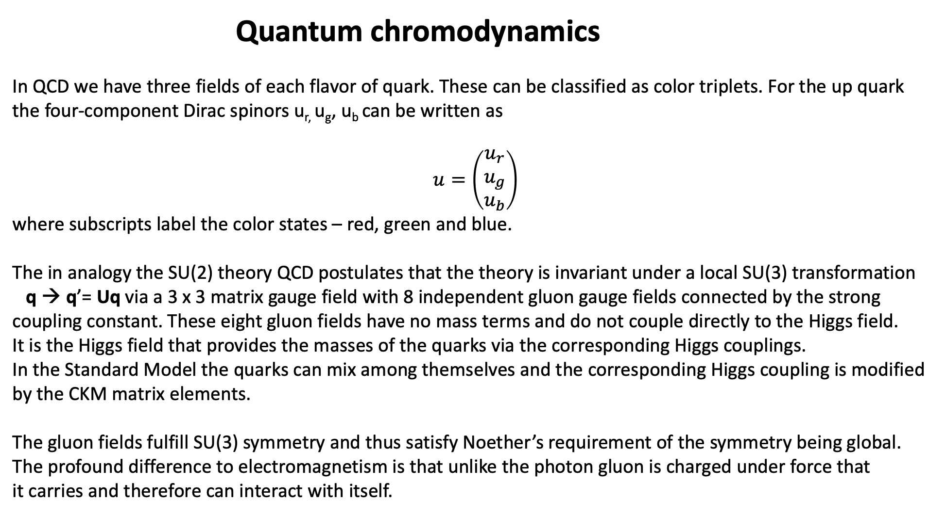
Quantum chromodynamics
In QCD we have three fields of each flavor of quark. These can be classified as color triplets. For the up quark
the four-component Dirac spinors u_{r,} u_{g}, u_{b} can be written as
$$u=\left(\begin{matrix}u_{r} \\ u_{g} \\ u_{b}\end{matrix}\right)$$
where subscripts label the color states – red, green and blue.
The in analogy the SU(2) theory QCD postulates that the theory is invariant under a local SU(3) transformation
q → q’= Uq via a 3 x 3 matrix gauge field with 8 independent gluon gauge fields connected by the strong
coupling constant. These eight gluon fields have no mass terms and do not couple directly to the Higgs field.
It is the Higgs field that provides the masses of the quarks via the corresponding Higgs couplings.
In the Standard Model the quarks can mix among themselves and the corresponding Higgs coupling is modified
by the CKM matrix elements.
The gluon fields fulfill SU(3) symmetry and thus satisfy Noether’s requirement of the symmetry being global.
The profound difference to electromagnetism is that unlike the photon gluon is charged under force that
it carries and therefore can interact with itself.

Slide 11
Hypercharge
Hypercharge Y is a quantum number conserved under strong interactions.
It a single operator that accounts for the properties of isospin, electric charge and flavor.
The mathematical definition of hypercharge
Y = S (strangeness) + C (charm) + B’ (bottomness) + T (topness) + B (baryon number)
The electric charge is related to isospin and hypercharge
Q = I₃ + ½ Y
In Quantum Chromodynamics SU(3) the isospin generates multiplets of particles with the same
Hypercharge and average isospin equal to zero.

Slide 12
Running coupling constant
The mathematics of the calculations:
If you want to have a compute cross-section answer for a specific process, you should, in principle,
establish and calculate all amplitude terms contributing to the particular problem. In local field theories
we can have an infinite number of higher order terms including infinite number of various virtual loop
diagrams. This is a numerical problem. For electrodynamics, with small coupling constant, each
higher order term is smaller than the contribution of the previous order terms and at some point it can
be neglected. Nevertheless, the number of diagrams grows extremely fast and reaches tens of thousands
very quickly. The common approach for wave like formulas is to expand them into a logarithmic series and
consider only the leading logarithms. One can, in such case, extract all higher order corrections into the
coupling constant and as a result the coupling constant “runs”, i.e., becomes energy dependent.
There is also a pictorial visualization related to the size/distance to the “point” mass of the charge.

Slide 13
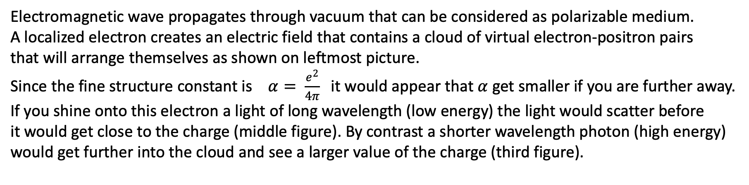
Electromagnetic wave propagates through vacuum that can be considered as polarizable medium.
A localized electron creates an electric field that contains a cloud of virtual electron-positron pairs
that will arrange themselves as shown on leftmost picture.
Since the fine structure constant is $α= \frac{e^{2}}{4π}$it would appear that $α$ get smaller if you are further away.
If you shine onto this electron a light of long wavelength (low energy) the light would scatter before
it would get close to the charge (middle figure). By contrast a shorter wavelength photon (high energy)
would get further into the cloud and see a larger value of the charge (third figure).
As a result, the fine structure constant depends on the wave-length, i.e., energy of the measuring probe.

Slide 14
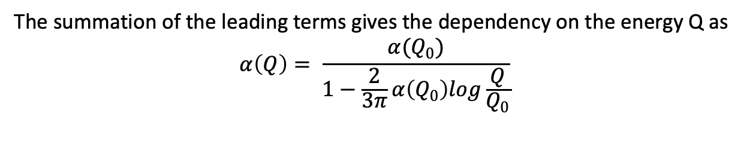
This energy dependence of the coupling constant is called running coupling and it can be calculated in
The quantum field theory by an increasing with energy number of Feynman diagrams with loops of the type
The summation of the leading terms gives the dependency on the energy Q as
$$α\left(Q\right)= \frac{α(Q_{0})}{1−\frac{2}{3π}α\left(Q_{0}\right)log\frac{Q}{Q_{0}}}$$

Slide 15
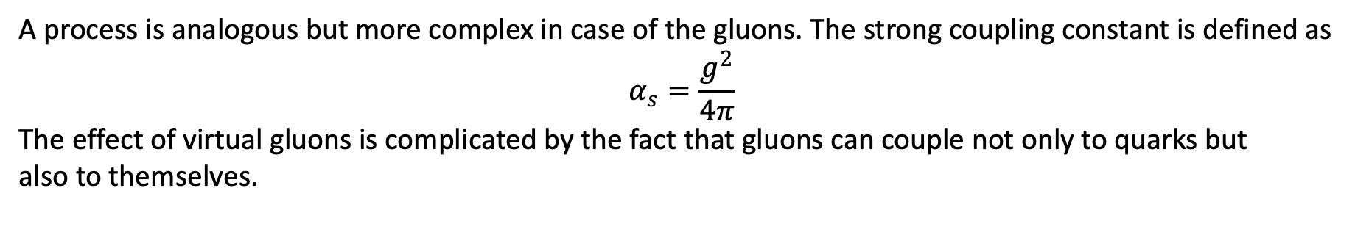
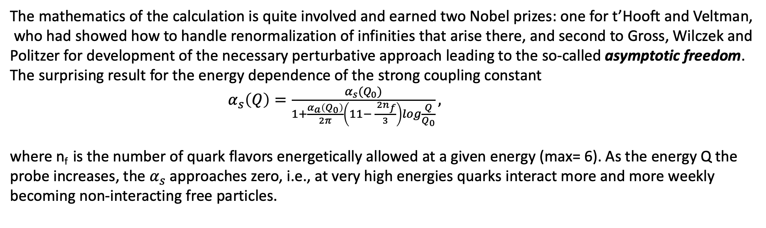
A process is analogous but more complex in case of the gluons. The strong coupling constant is defined as
$$α_{s}=\frac{g^{2}}{4π}$$
The effect of virtual gluons is complicated by the fact that gluons can couple not only to quarks but
also to themselves.
The mathematics of the calculation is quite involved and earned two Nobel prizes: one for t’Hooft and Veltman,
who had showed how to handle renormalization of infinities that arise there, and second to Gross, Wilczek and
Politzer for development of the necessary perturbative approach leading to the so-called asymptotic freedom.
The surprising result for the energy dependence of the strong coupling constant
$α_{s}\left(Q\right)=\frac{α_{s}(Q_{0})}{1+\frac{α_{a}\left(Q_{0}\right)}{2π}\left(11− \frac{ 2n_{f}}{3}\right)log\frac{Q}{Q_{0}}},$
where n_{f} is the number of quark flavors energetically allowed at a given energy (max= 6). As the energy Q the
probe increases, the $α_{s}$ approaches zero, i.e., at very high energies quarks interact more and more weekly
becoming non-interacting free particles.

Slide 16
We have seen now most of the elements of the “Standard Model” as depicted in works of Weinberg, Salam and Glashow with many collaborators. It is now represented even on coffee mugs.
It is consistent with U(1) x SU(2) x SU(3) symmetry group, includes Higgs field and Higgs particle as a necessary elements and so far is in excellent, though disappointing agreement with every measurement made to date. The disappointment is due to the fact that we have not yet seen any deviations from simple expectations of the model and thus we have no definite idea where the new physics effect will show up.

Slide 17
First line:
Description of the forces: em, strong and weak
Second line:
Interaction of fermion matter particles (quarks and leptons)
Transmitted by force carriers
(all of chemistry and most of physics)
Third line:
Higgs generation of particle masses (no neutrinos)
Fourth line:
Cleanup- removal of redundancies in Higgs interactions
Full Standard Model Lagrangian is quite messy. It takes over two pages to write it out and it contains a number of “ghosts”.
Ghosts are a result of the formalism that describe unphysical degrees of freedom. For example in electrodynamics, in order
to maintain Lorentz invariance one uses a four component vector potential, while the photon has only two polarizations.
Introducing fictitious fields, the ghosts, is one way of achieving this goal.

Slide 18
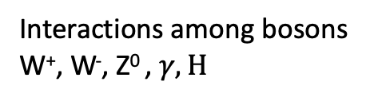
Specific to gluons
Standard Model
unpacked
Interactions among bosons
W⁺, W⁻, Z⁰ , $γ, H$
Weak bosons interactions with
quarks and leptons
Higgs interactions with ghosts
Fadeeyev-Popov ghosts
providing cancelation of
duplicate terms

