Slide 1
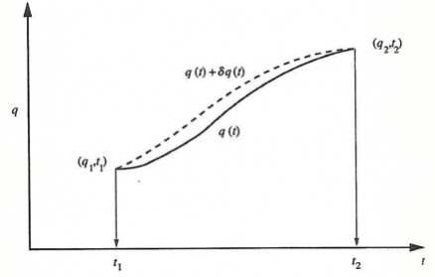
Another way to derive this is via an action S.
The action S between two spacetime points is defined as
(Use example of a ball falling down onto the floor)
The principle of least action is a variational technique
to derive the equation of motion from the Lagrangian.
Since the variations are arbitrary
In non-relativistic mechanics this is the Newton’ equation
Path variation
(In classical mechanics and optics – least action is equivalent to least time)

Slide 2
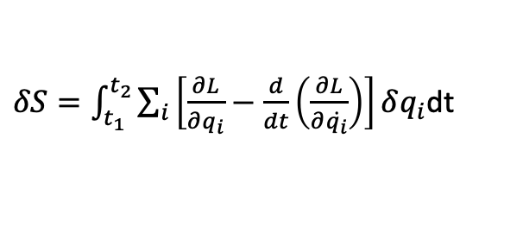

The action S between two spacetime points is defined as
$δ\dot{q}$ $=d(δ$q)/dt
→ can integrate second term by parts
$δS=\int_{t_{1}}^{t_{2}}{\sum_{i}{\left[\frac{∂L}{∂q_{i}}−\frac{d}{dt}\left(\frac{∂L}{∂\dot{q_{i}}}\right)\right]}}δq_{i}$dt
The end points are fixed and their contributions from the integration by parts are zero. Since the variations are arbitrary, the condition that the derivative f the action S is zero requires
i=1,2….
These are Euler-Lagrange equation of motion for discrete particle
In non-relativistic mechanics this is the Newton’ equation
(In classical mechanics and optics – least action is equivalent to least time)

Slide 3
One can generalize this to the case of conservation of energy.
For a closed system physics does not depend on the origin of time.
We need a Lagrangian that does not explicitly depends on time
Substitute
Energy is conserved

Slide 4
Classical mechanics
particles are defined by spatial coordinates
dynamics is defined by motion with respect to time
→ Newtons laws
origin of time is arbitrary
for isolated system energy must be conserved
Quantum mechanics
particle (electron) is described as wave that has amplitude and phase
Quantum mechanics + relativity
time becomes unified with space. Particle position is defined by 4 independent coordinates
→ need to include time in Lorentz invariant description and maintain energy conservation
Quantum mechanics + relativity + spin
--> must include angular momentum conservation in Lorentz transformations

Slide 5
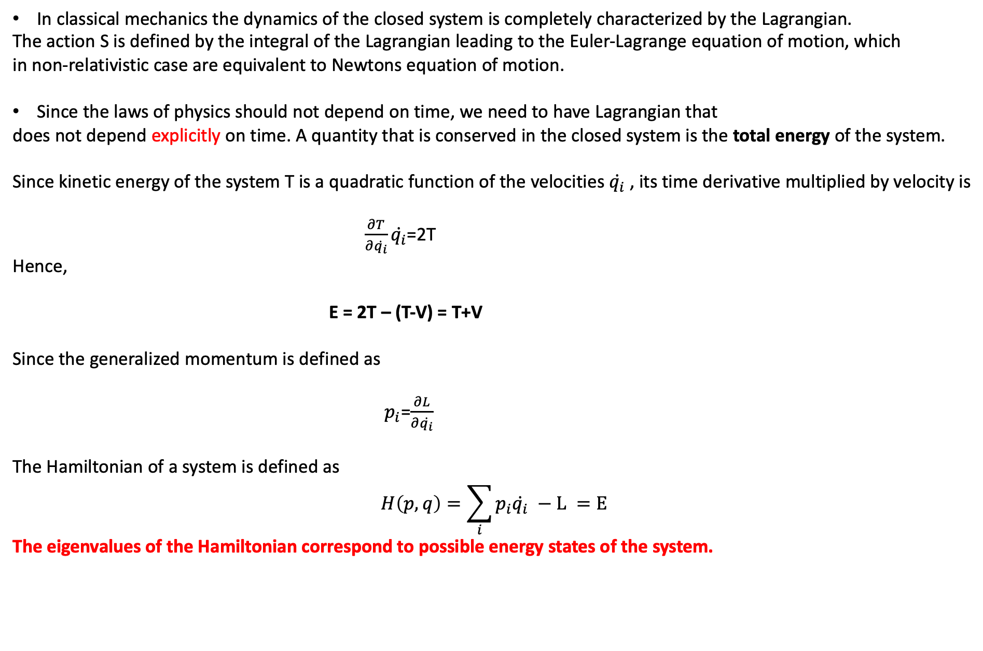
In classical mechanics the dynamics of the closed system is completely characterized by the Lagrangian.
The action S is defined by the integral of the Lagrangian leading to the Euler-Lagrange equation of motion, which
in non-relativistic case are equivalent to Newtons equation of motion.
Since the laws of physics should not depend on time, we need to have Lagrangian that
does not depend explicitly on time. A quantity that is conserved in the closed system is the total energy of the system.
Since kinetic energy of the system T is a quadratic function of the velocities $\dot{q_{i}}$, its time derivative multiplied by velocity is
$\frac{∂T}{∂\dot{q_{i}}}\dot{q_{i}}$=2T
Hence,
E = 2T – (T-V) = T+V
Since the generalized momentum is defined as
$p_{i}$=$\frac{∂L}{∂\dot{q_{i}}}$
The Hamiltonian of a system is defined as
$$H\left(p,q\right)=\sum_{i}{p_{i}\dot{q_{i}}} −L =E$$
The eigenvalues of the Hamiltonian correspond to possible energy states of the system.

Slide 6
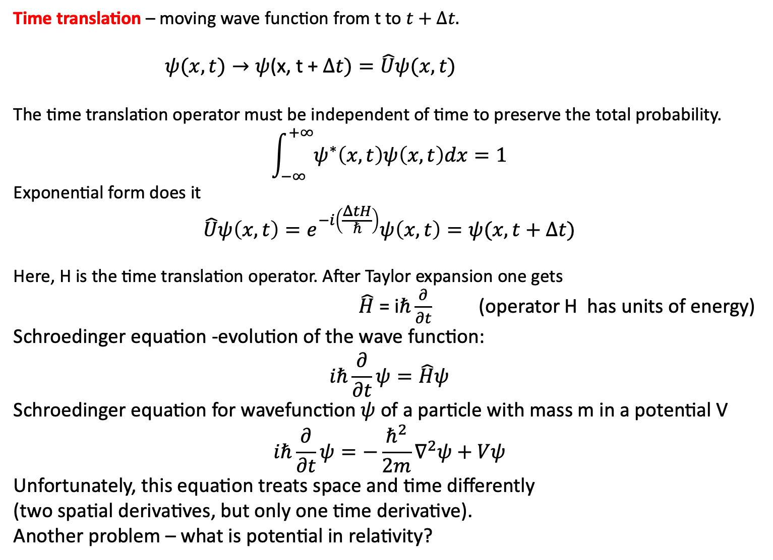
Time translation – moving wave function from t to $t+∆t.$
$ψ(x,t)→ψ$(x, t + $∆t)=\hat{U}ψ(x,t)$
The time translation operator must be independent of time to preserve the total probability.
$$\int_{−∞}^{+∞}{ψ^{∗}\left(x,t\right)ψ\left(x,t\right)dx=1}$$
Exponential form does it
$$\hat{U}ψ\left(x,t\right)=e^{−i\left(\frac{ΔtH}{ℏ}\right)}ψ\left(x,t\right)=ψ(x,t+∆t)$$
Here, H is the time translation operator. After Taylor expansion one gets
$\hat{H}$ = i$ℏ\frac{∂}{∂t}$ (operator H has units of energy)
Schroedinger equation -evolution of the wave function:
$$iℏ\frac{∂}{∂t}ψ=\hat{H}ψ$$
Schroedinger equation for wavefunction $ψ$ of a particle with mass m in a potential V
$$iℏ\frac{∂}{∂t}ψ=−\frac{ℏ^{2}}{2m}∇^{2}ψ+Vψ$$
Unfortunately, this equation treats space and time differently
(two spatial derivatives, but only one time derivative).
Another problem – what is potential in relativity?

Slide 7
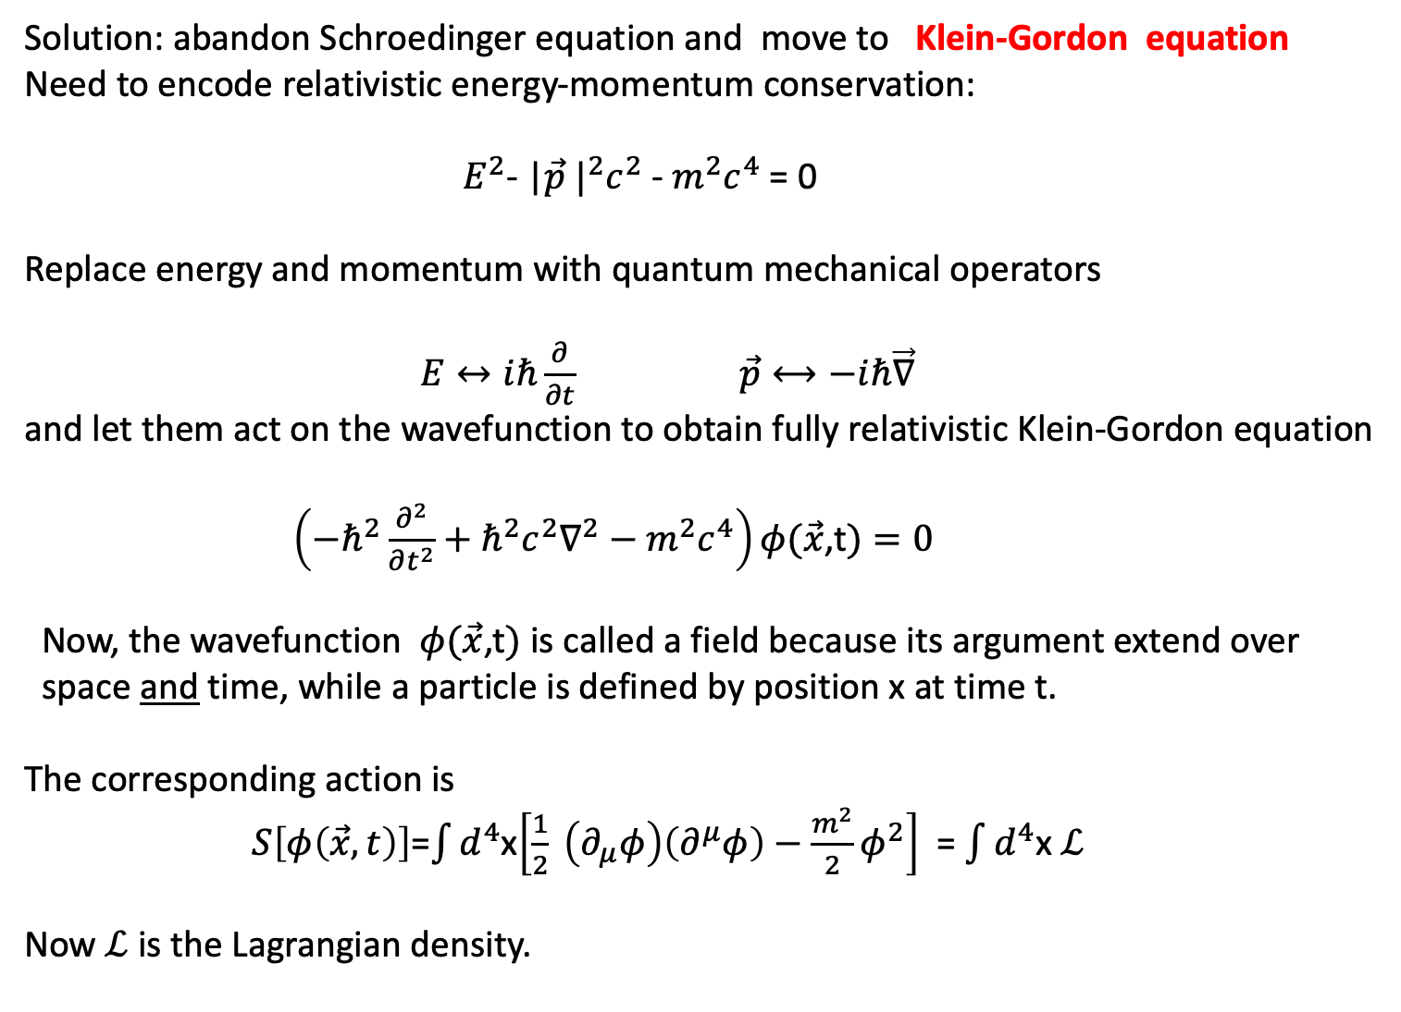
Solution: abandon Schroedinger equation and move to Klein-Gordon equation
Need to encode relativistic energy-momentum conservation:
${ E}^{2}$- |$\vec{p}$ $|^{2}c^{2}$ - $m^{2}c^{4}$ = 0
Replace energy and momentum with quantum mechanical operators
$E↔iℏ\frac{∂}{∂t}$ $\vec{p}⟷−iℏ\vec{∇}$
and let them act on the wavefunction to obtain fully relativistic Klein-Gordon equation
$\left(−ℏ^{2}\frac{∂^{2}}{∂t^{2}}+ℏ^{2}c^{2}∇^{2}−m^{2}c^{4}\right)φ(\vec{x}$,t$)=0$
Now, the wavefunction $φ(\vec{x}$,t$)$is called a field because its argument extend over
space and time, while a particle is defined by position x at time t.
The corresponding action is
$S\left[φ\left(\vec{x},t\right)\right]$=$\int{d^{4}}$x$\left[\frac{1}{2} \left(∂_{μ}φ\right)\left(∂^{μ}φ\right)−\frac{m^{2}}{2}φ^{2}\right]$ = $\int{d^{4}}$x$ℒ$
Now $ℒ$ is the Lagrangian density.

Slide 8
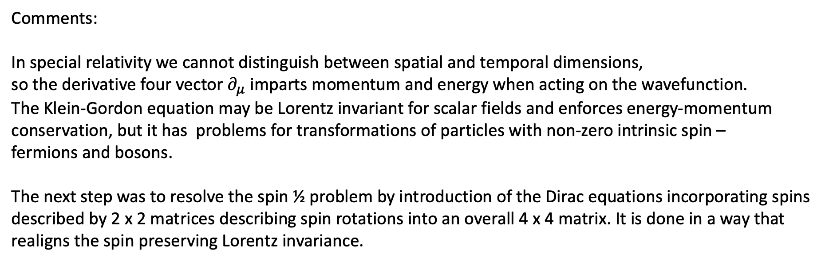
Comments:
In special relativity we cannot distinguish between spatial and temporal dimensions,
so the derivative four vector $∂_{μ}$ imparts momentum and energy when acting on the wavefunction.
The Klein-Gordon equation may be Lorentz invariant for scalar fields and enforces energy-momentum
conservation, but it has problems for transformations of particles with non-zero intrinsic spin –
fermions and bosons.
The next step was to resolve the spin ½ problem by introduction of the Dirac equations incorporating spins
described by 2 x 2 matrices describing spin rotations into an overall 4 x 4 matrix. It is done in a way that
realigns the spin preserving Lorentz invariance.

Slide 9
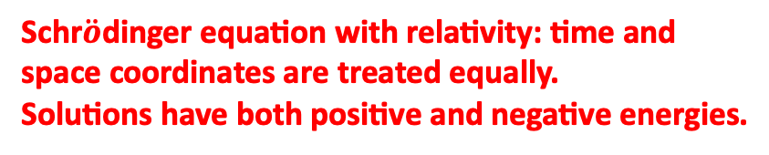
Quantum Mechanics for free particle
-Quantum counterpart of Newtons 2nd law
-Time evolution of the wave function
-Not Lorentz invariant: time and space are not
treated in the same way.
Schr$\ddot{o}$dinger equation with relativity: time and
space coordinates are treated equally.
Solutions have both positive and negative energies.
Details in Quantum-2 course

Slide 10
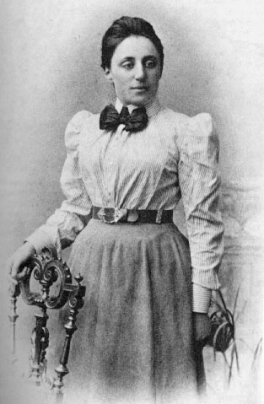
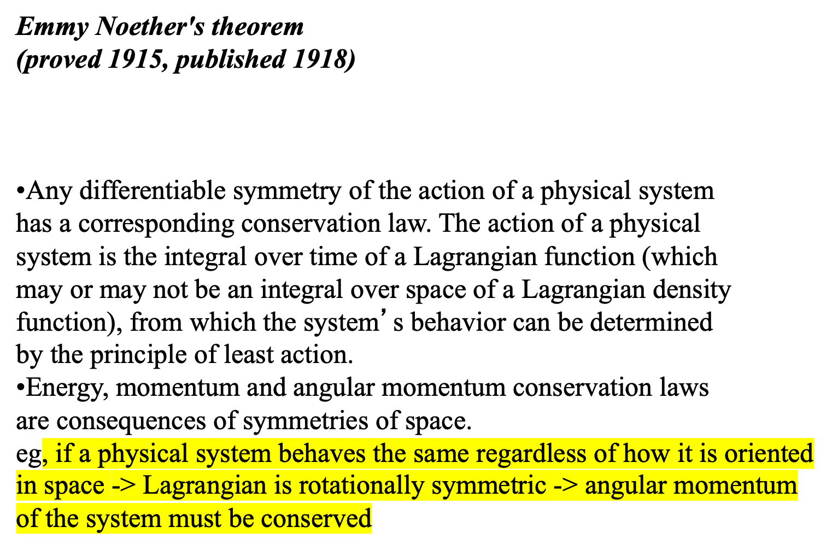
Aside from PHYS 5380 useful later
(original work aimed at inclusion of relativity into quantum mechanics
Conservation laws came out as bonus))
Symmetry of the system – in our case symmetry of the Lagrangian under the transformation in time –
leads to a conservation law.

Slide 11
Subtle nuances
So far we have considered a Lagrangian of the system of discrete particles ( eg., planetary system of the Sun)
In quantum mechanics a particle is described as a wave and the equations of motion describe wave propagation.
In quantum field theory also the currents are transformed as waves.
This derivation is using a Lagrangian density that depends on its derivatives at a specific
points in space-time. Such field theory is called “local”. There is continuity of derivative
in the vicinity of the point. There is no “action at a distance”. The standard Model is an
example of theory based on local symmetry that allows for variation from point to point
in space time. For example “local reference frame” can be used to describe small region
of the gravitational field. In such local fields a system of objects can be treated as being
under an “effective gravitational field”.
This is in contrast to the General Relativity describing a “global symmetry” that holds at
all points in space. Global symmetries require conservation laws but not forces.
A global symmetry respects the transformation U(1) = e^{iθ} for constant θ.
An example of global symmetry is charge. Once we define the charge of a proton as positive
it becomes the same throughout the universe.
General Relativity requires global symmetry to preserve the gauge of e.g., length.

Slide 12
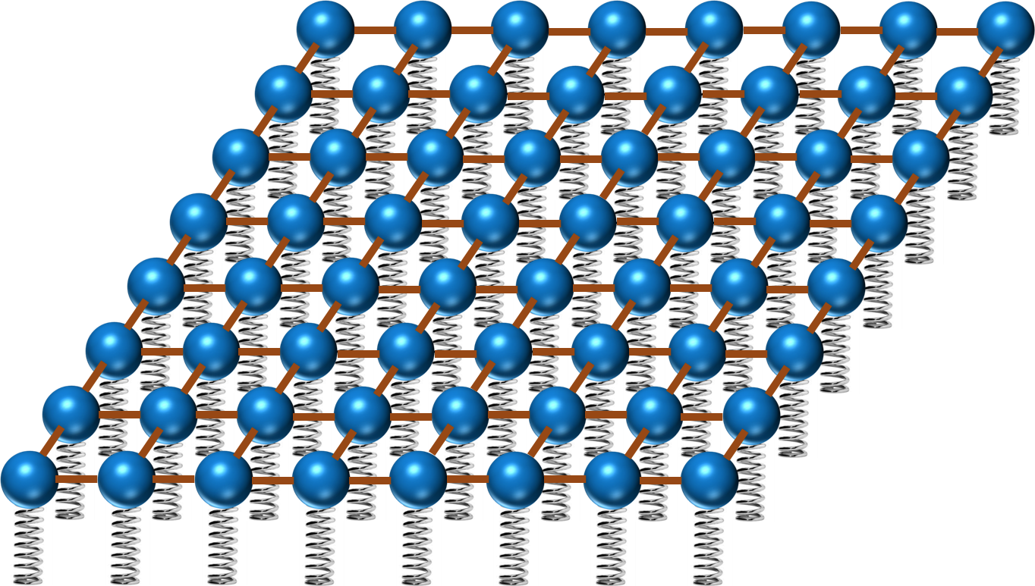
Quantum Field Theory
Imagine space as an infinite space of balls and springs,
where each ball is connected to its neighbors by elastic bands.
Particles are perturbations in that field and are represented as waves.
On quantization, the fields become operator fields acting
on the states of the system. The classical total field energy
becomes the Hamiltonian operator that determines the
dynamics of the system.
Quantum Electrodynamics is the foundation of the Standard Model
at energies high enough that the bound states of charged objects (electrons and positron) can be neglected in their interactions with photons.

Slide 13
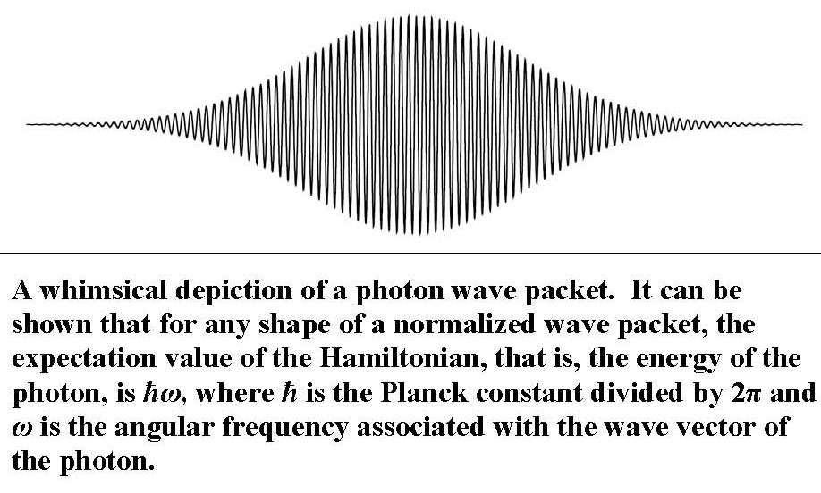
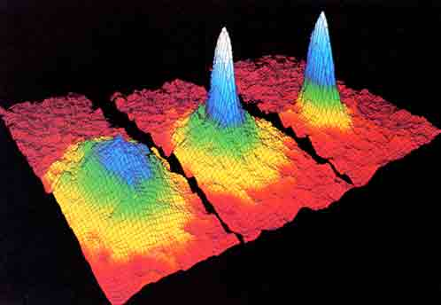

Slide 14
Aside:
The transition to quantum field theory requires “second quantization” –
Dirac equation for relativistic quantum wave function are quantized along with the field.
In quantum mechanic matter particles are considered as excited states of the field.
In field theory the particles of Feynman diagrams are now described as currents.

Slide 15
The Lagrangian is now the integral of the Lagrangian density.
It becomes a function of the field and of its space and time derivatives.

Slide 16
The extension of the Lagrangian approach for a discrete system of particles
to a continuous system is most convenient and often used in quantum field theory using the
Hamiltonian based approach.
Here we have generalized momenta p_{i}
Under assumption of the homogeneity of time
The Hamiltonian is a sum of the kinetic energies of all particles of the system plus their potential energy
In quantum mechanics the Hamiltonian operator is usually expressed as a sum of the kinetic and potential energies operators of the system:
H = T + V
The potential energy operator
V = V(r,t)
The kinetic energy operator
Momentum operator

Slide 17
Hamiltonian formulation of quantum fields
Dynamical calculations can be viewed as the calculation of the unitary operator e^{-iHt} acting on some initial state. The coupling between the radiation field and the electron (Dirac) field is determined by the charge of the electron e. It is usually described by the dimensionless parameter α called the fine structure constant
Here e is the charge of the electron

Slide 18
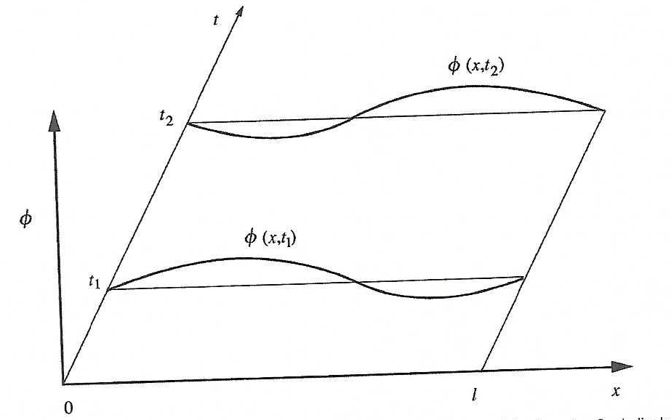
We can apply the Hamiltonian to a system describe by a wave function Ψ(Φ,t).
Consider a string attached to two points in x, but subject to small transverse displacement in the plane.
A small displacement of string element dx is Φ(x,t).
The Lagrangian density is
the Lagrangian L = T – V
the action
The motion of the string initial and final displacements
generate surface in space-time.
The kinetic term describing the string depends now
on mass.

Slide 20
Yukawa Interactions
1930 observations in nuclear physics and electrodynamics
Atomic nucleus had a large number of tightly packed protons and neutrons.
There are many nuclei with equal number of p and n
An addition of a extra neutron did not significantly affect characteristic of the nucleus.
How to describe beta decays – emission of electron from a nucleus with the corresponding
change of the number of protons
What keeps the nucleus together against the repulsive Coulomb force?
Is proton really different from a neutron except for electric charge?
-> Heisenberg proposed that proton and neutron are two different states of the same particle
that can “migrate” from one to the other.
-> Fermi studied interactions between 4 leptons and introduced a concept of an exchange of a vector
virtual particle identified as a photon
These ideas were combined by Yukawa in 1935.

Slide 21
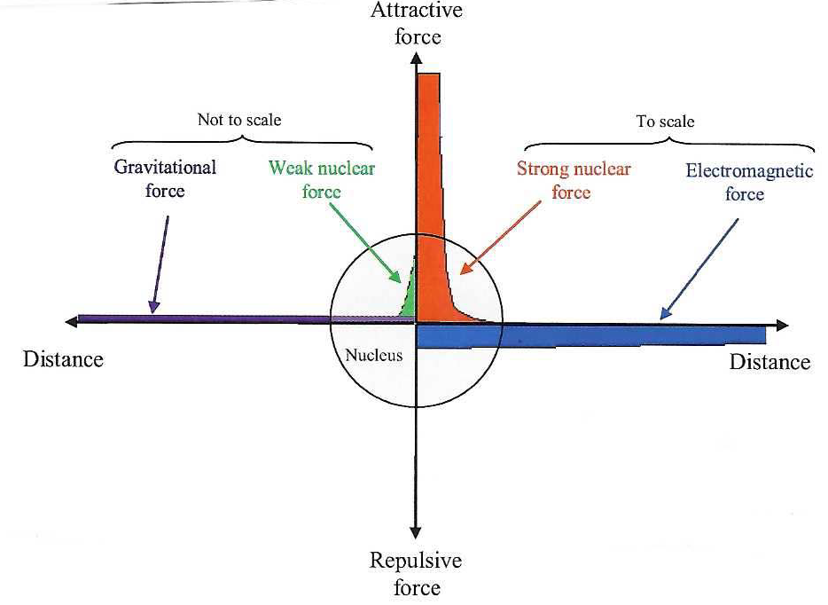

Yukawa proposed a potential between proton and neutron that was a modified Coulomb potential
mediated by an exchange of the spin 0 particle. He estimated the mass of such particle needed to keep
the nucleus together to be ~200 MeV. It was in 1950ties identified with a pion (mass ~140 MeV).
If two particle interact via exchange of a scalar particle of mass μ, the potential between them is:
$V\left(r\right)=− \frac{e^{2}}{4πr}$ $\frac{1}{r}$ $e^{−μr}$
To avoid confusion coupling is sometimes denoted by g
Similar to Coulomb potential except for the sign (attraction) and exponential factor limiting
the range of interactions. Negative sign gives final range.
In quantum theory, the exchange of even spin always gives an attractive force.
Odd spin gives attractive force between opposite charges and repulsive force between like charges
Chemistry 101 – nuclear forces

Slide 22
Aside:
As for other forces, the form of the Yukawa potential has a geometrical interpretation in terms of
the field line picture introduced by Faraday :
The 1/r part results from the dilution of the field line flux in space.
The force is proportional to the number of field lines crossing an elementary surface.
Since the field lines are emitted isotropically from the force source and since the distance r between
the elementary surface and the source varies the apparent size of the surface as 1/r², the force also follows
the 1/r² dependence. This is equivalent to the 1/r part of the potential.
In addition, the exchanged mesons are instable and have a finite lifetime.
The disappearance of the mesons causes a reduction of the flux through the surface that results in the additional
exponential factor e^{−μr} of the Yukawa potential.
Massless particles such as photons are stable and thus yield only 1/r potentials.
Note, however, that other massless particles such as gluons or gravitons do not generally yield 1/r potentials
because they interact with each other, distorting their field pattern.
When this self-interaction is negligible, such as in weak-field gravity or for very short distances for
the strong interaction asymptotic freedom, the 1/r potential is restored.

