Slide 2
Development of the Standard Model
We have now all the components of theory that led to the Standard Model
The quantum electrodynamics as a V– A theory by addition of the axial field into the Lagrangian
Field theory that treats currents(particles) and fields on equal basis i.e., adding field-field interactions
to the Lagrangian (fields can interact in the absence of particles)
An idea proposed by Yang and Mills that by adding a scalar doublet U(1) to the Lagrangian of weak interactions
one can obtain a theory that restores global symmetry allowing for eventual rotation of the system in the
isospin - charge space coordinates
Renormalization technique that eliminates infinities form the calculations
Experimental observations of quark mixing, eventually described by the CKM (Cabbibo-Kobayashi-Maskava)
mixing matrix -> rotation of coordinates between color filed and physical observables.
We can now try to put them together

Slide 3
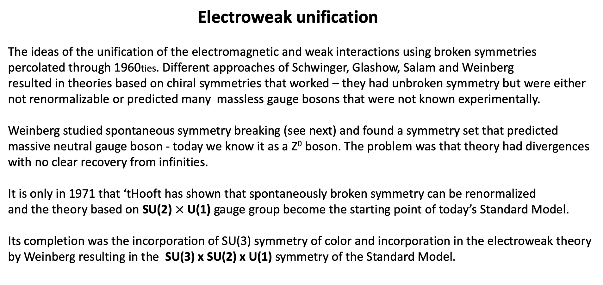
Electroweak unification
The ideas of the unification of the electromagnetic and weak interactions using broken symmetries
percolated through 1960ties. Different approaches of Schwinger, Glashow, Salam and Weinberg
resulted in theories based on chiral symmetries that worked – they had unbroken symmetry but were either
not renormalizable or predicted many massless gauge bosons that were not known experimentally.
Weinberg studied spontaneous symmetry breaking (see next) and found a symmetry set that predicted
massive neutral gauge boson - today we know it as a Z⁰ boson. The problem was that theory had divergences
with no clear recovery from infinities.
It is only in 1971 that ‘tHooft has shown that spontaneously broken symmetry can be renormalized
and the theory based on SU(2) $×$ U(1) gauge group become the starting point of today’s Standard Model.
Its completion was the incorporation of SU(3) symmetry of color and incorporation in the electroweak theory
by Weinberg resulting in the SU(3) x SU(2) x U(1) symmetry of the Standard Model.

Slide 4
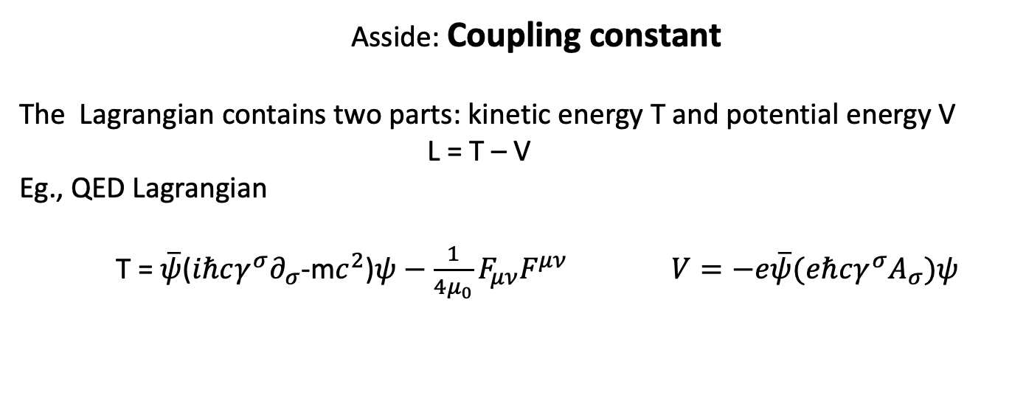
Asside: Coupling constant
The Lagrangian contains two parts: kinetic energy T and potential energy V
L = T – V
Eg., QED Lagrangian
T = $\overline{ψ}$($iℏcγ^{σ}∂_{σ}$-m$c^{2}$)$ψ−\frac{1}{4μ_{0}}F_{μν}F^{μν}$ $V=−e\overline{ψ}(eℏcγ^{σ}A_{σ})ψ$
In field theory, the potential term V always contains 3 fields terms or more,
expressing for example that an initial electron (field 1) interacted with a photon (field 2) producing
the final state of the electron (field 3).
In contrast, the kinetic part T always contains only 2 fields, expressing the free propagation of an initial
particle (field 1) into a later state (field 2).
The coupling constant determines the magnitude of the kinetic part T with respect to the potential part V.
The coupling constant is always dimensionless.
In QED the electric charge characterizes the coupling between two charged particles (two fields)
and one photon field.
In quantum field theory when the coupling is much smaller than 1, the theory is weekly coupled and well
described by the expansion in powers of coupling constant – the perturbation theory.

Slide 5
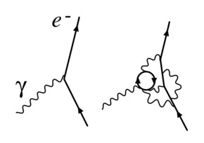
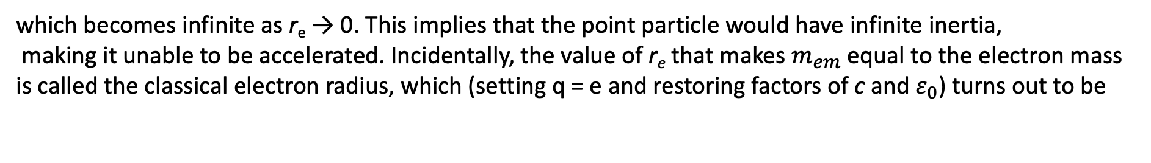
Aside #2: Renormalization is a technique to deal with infinites by taking into account screening of infinite charge
by virtual particles produced near the point particle. The cloud of these virtual states produces an effective
size of a particle and screens the original charge.
Example why need it:
The mass of a charged particle should include the mass-energy in its electrostatic field (electromagnetic mass).
Assume that the particle is a charged spherical shell of radius r_{e}. The mass–energy in the field is
which becomes infinite as r_{e} → 0. This implies that the point particle would have infinite inertia,
making it unable to be accelerated. Incidentally, the value of r_{e} that makes $m_{em}$ equal to the electron mass
is called the classical electron radius, which (setting q = e and restoring factors of c and $ε_{0}$) turns out to be
where α≈1/137 is the fine structure constant, and $ℏ/(m_{e}c)$ is the Compton wavelength of the electron .

Slide 6
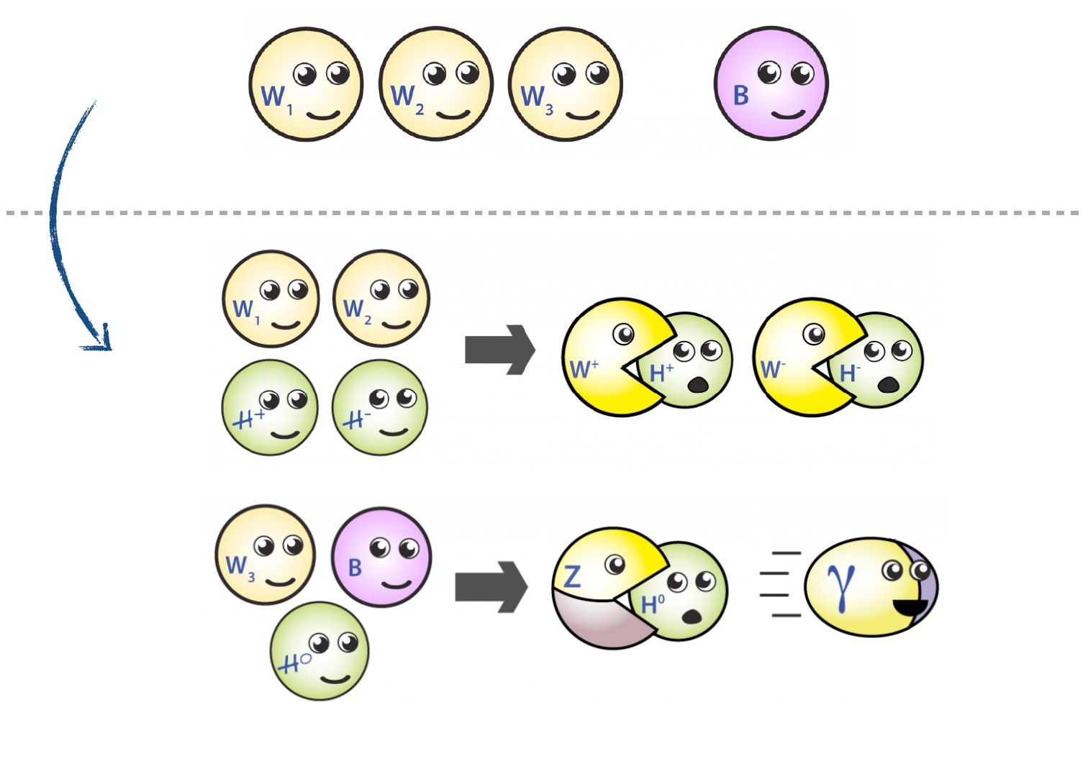
The generators of the electroweak theory SU(2) x U(1) are weak isospin T and weak hypercharge Y.
The hypercharge is a quantum number relating electric charge to the third component of weak isospin
Q = T₃ + ½ Y_{W} (weak charge)
The Yang-Mills prescription generates 3 week isospin fields and one weak hypercharge field giving
raise to the four corresponding gauge bosons – W₁, W₂, W₃ for the weak isospin and B for hypercharge.
The spontaneous symmetry breaking makes W₃ and B boson coalesce into Z⁰ and a photon via a
rotation (mixing) matrix.
Picture from Quantum Diaries.org

Slide 7
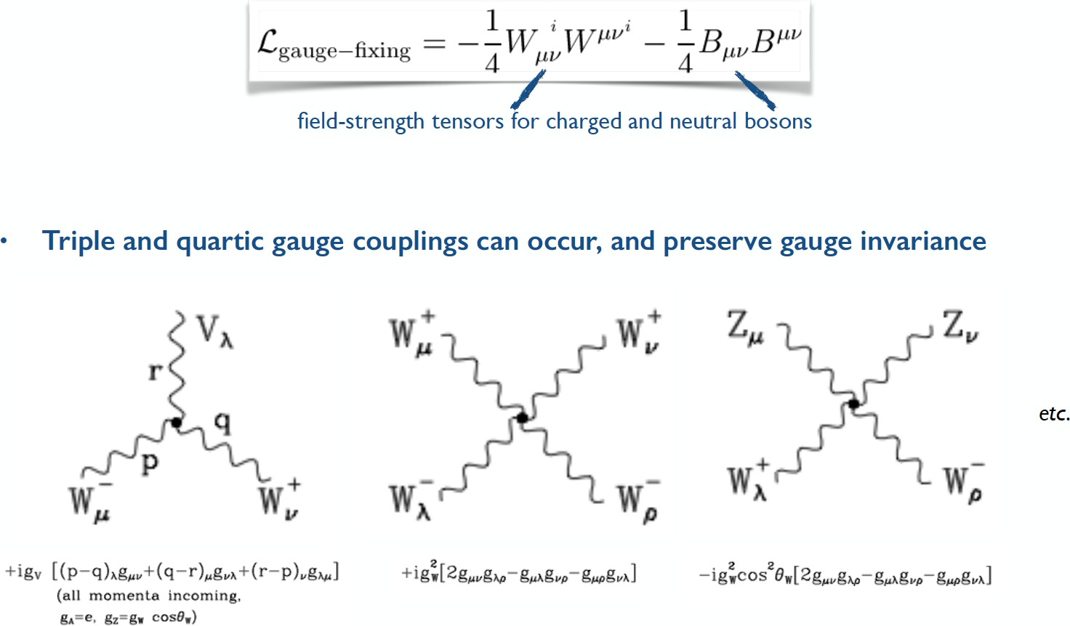
Problem: Pure gauge-boson interactions exist in SM

Slide 9
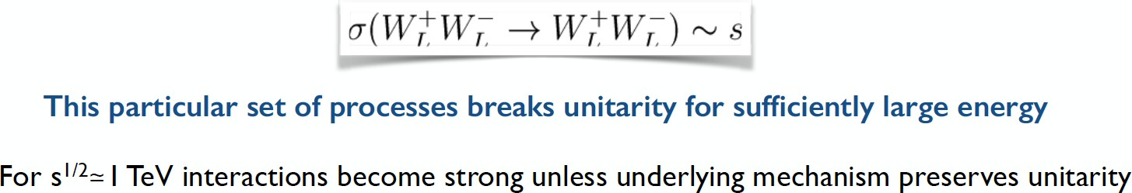
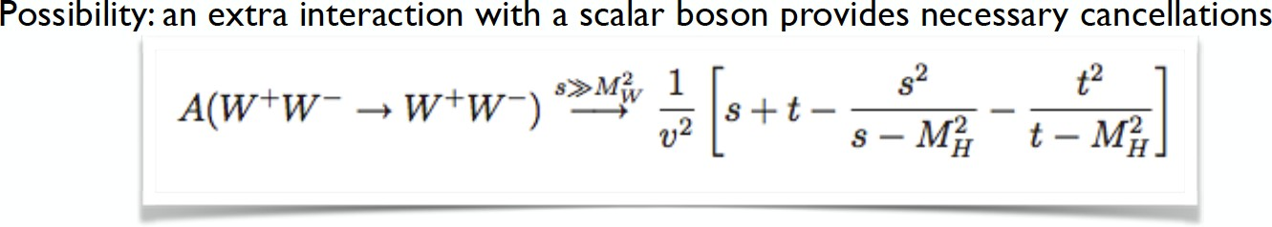
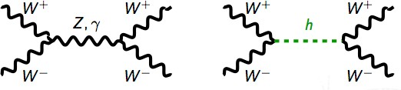
Gauge boson interactions may have strange results!
The cross section for the scattering of longitudinally polarized W bosons grows with energy until it becomes unphysical

Slide 10
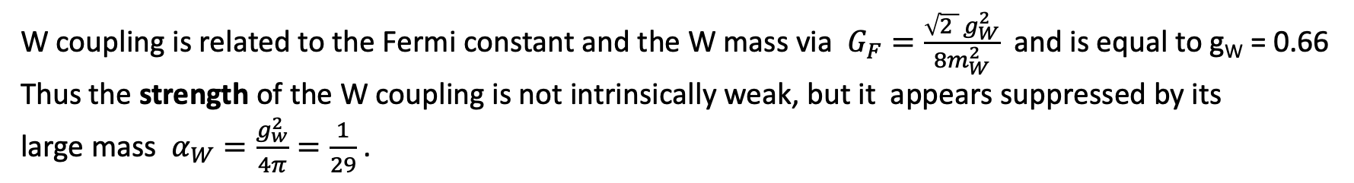
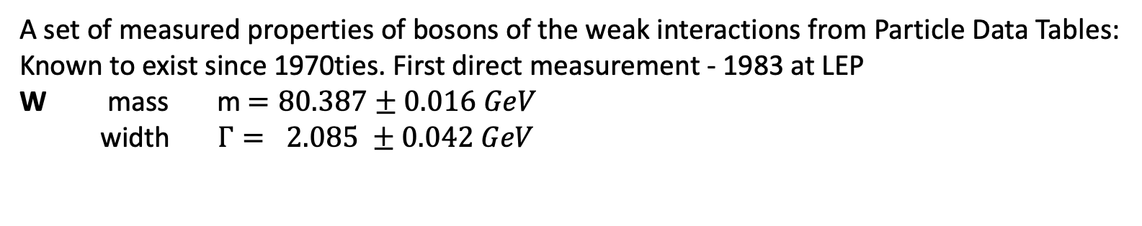
Properties of weak gauge bosons
A set of measured properties of bosons of the weak interactions from Particle Data Tables:
Known to exist since 1970ties. First direct measurement - 1983 at LEP
W mass m $=80.387±0.016 GeV$
width $Γ= 2.085 ±0.042 GeV$
W coupling is related to the Fermi constant and the W mass via $G_{F}=\frac{\sqrt{2 } g_{W}^{2}}{8m_{W}^{2}}$ and is equal to g_{W} = 0.66
Thus the strength of the W coupling is not intrinsically weak, but it appears suppressed by its
large mass $α_{W}=\frac{g_{w}^{2}}{4π}=\frac{1}{29}$ .

Slide 11
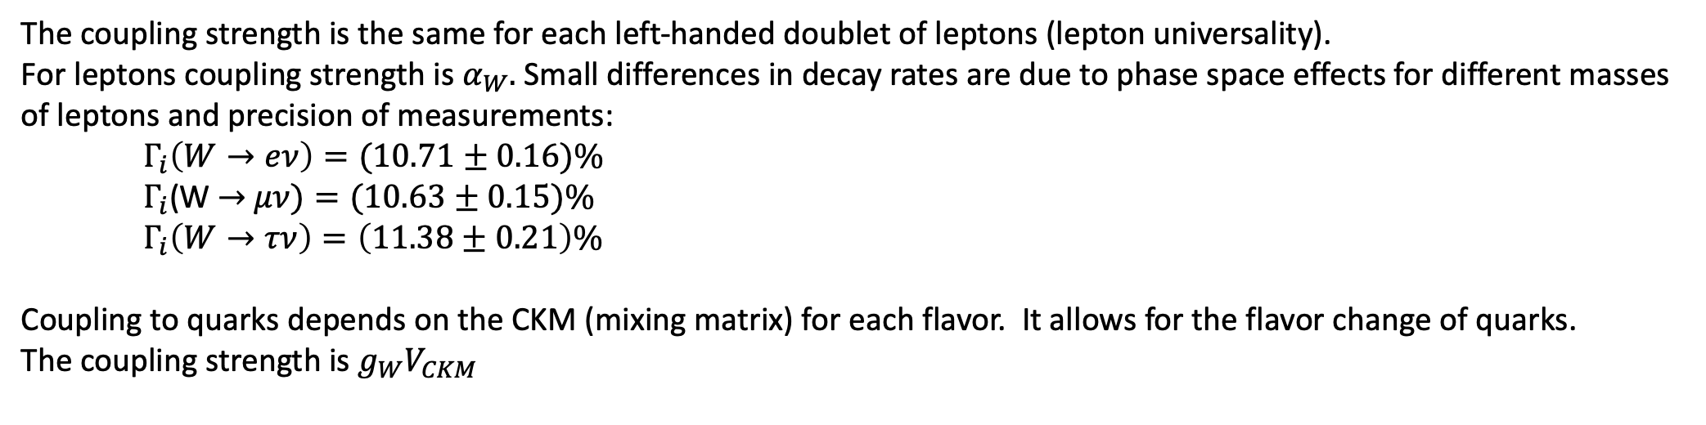
The coupling strength is the same for each left-handed doublet of leptons (lepton universality).
For leptons coupling strength is $α_{W}.$ Small differences in decay rates are due to phase space effects for different masses
of leptons and precision of measurements:
$Γ_{i}\left(W→eν\right)=(10.71±0.16)\%$
$Γ_{i}$(W $→$ $μν)=(10.63±0.15)\%$
$Γ_{i}\left(W→τν\right)=\left(11.38±0.21\right)\%$
Coupling to quarks depends on the CKM (mixing matrix) for each flavor. It allows for the flavor change of quarks.
The coupling strength is $g_{W}V_{CKM}$
The total hadronic decay rate is $Γ_{i}\left(W→hadrons\right)=\left(67.41±0.27\right)\%$

Slide 12
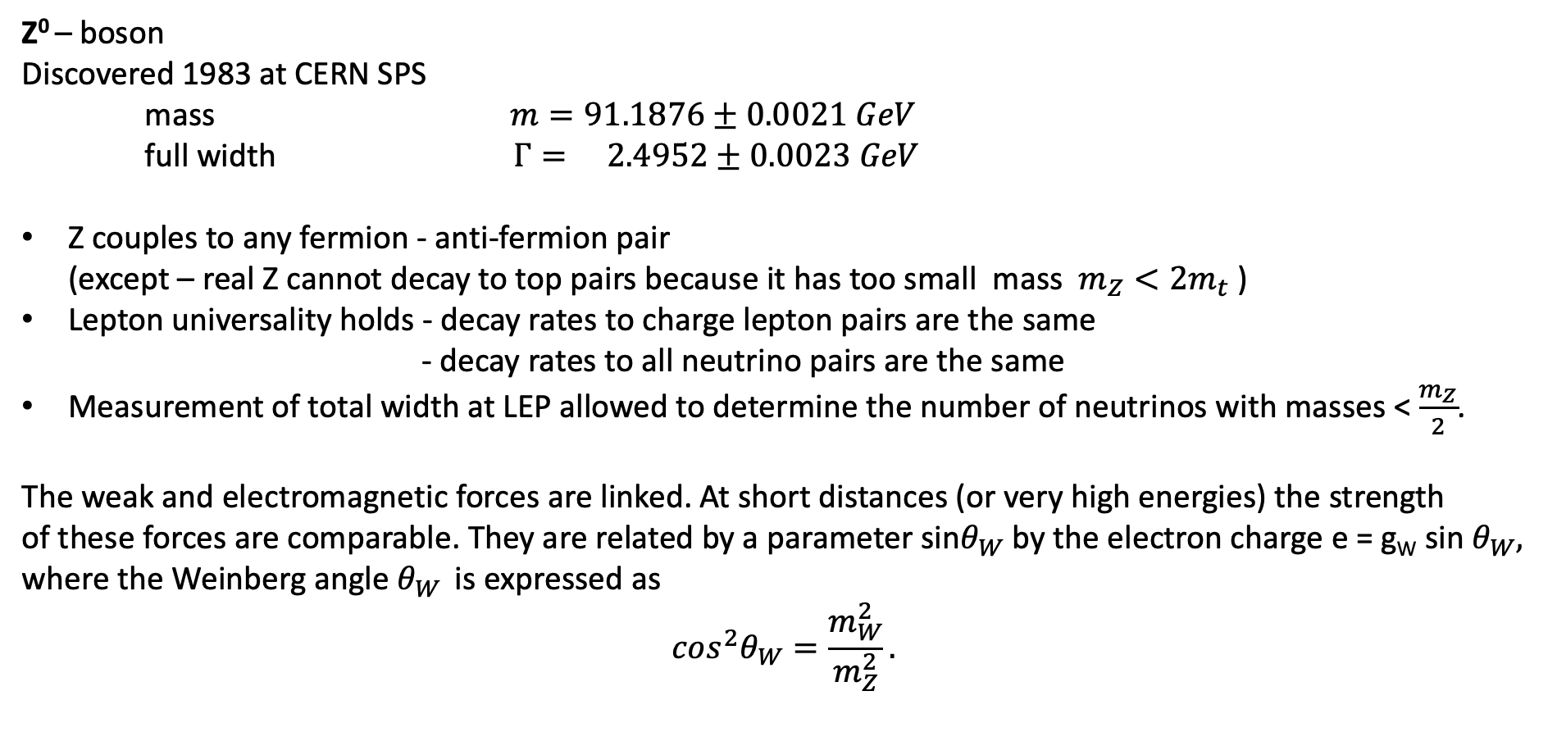
Z⁰ – boson
Discovered 1983 at CERN SPS
mass $m=91.1876±0.0021 GeV$
full width $Γ= 2.4952±0.0023 GeV$
Z couples to any fermion - anti-fermion pair
(except – real Z cannot decay to top pairs because it has too small mass $m_{Z}<2m_{t}$ )
Lepton universality holds - decay rates to charge lepton pairs are the same
- decay rates to all neutrino pairs are the same
Measurement of total width at LEP allowed to determine the number of neutrinos with masses < $\frac{m_{Z}}{2}$.
The weak and electromagnetic forces are linked. At short distances (or very high energies) the strength
of these forces are comparable. They are related by a parameter sin$θ_{W}$ by the electron charge e = g_{W} sin $θ_{W},$
where the Weinberg angle $θ_{W }$ is expressed as
$$cos^{2}θ_{W}=\frac{m_{W}^{2}}{m_{Z}^{2}}.$$

