Slide 1
Symmetry again
Quantum electrodynamics is a gauge theory with the symmetry group U(1).
It is a unitary group with dimension n = 1.
It has one-gauge field with electromagnetic potential in 4-dimensions and a gauge boson – a photon.
The weak interactions obey symmetry group SU(2) – Special Unitary group of degree 2 ,
i.e., consisting of 2 x 2 unitary matrices.
Naively, it should produce 4 massless gauge bosons. These are named in the literature as Goldstone bosons.
To be consistent with facts of nature, i.e., experimental observations, there must be a mechanism
to provide a mass to those bosons. This has been provided by the Higgs mechanism.
The strong interactions are described by the SU(3) symmetry described by 8 independent traceless hermitian
matrices (Gell-Mann matrices) corresponding to 8 gauge bosons called gluons.
Each gluon is distinguished by its color-anticolor content.
All of these must be vectors.
You can already see that the Higgs, with its spin = 0, is not a gauge boson.

Slide 2
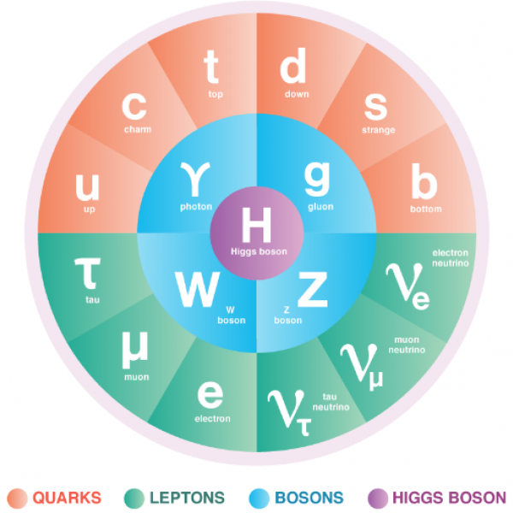
Particle content of the Standard Model
Before we go further, lets review the known matter content of the Standard Model.

Slide 3
quarks
leptons
Each quark comes in 3 colors, traditionally named red, blue and green.
Color is an internal symmetry of strong interactions. It is not affecting electromagnetic and weak
interactions and the quark doublets maintain the internal color assignments.

Slide 4
Finally, fermions (spin = ½) may have two chiralities (the orientation of third component of spin with
respect to the direction of motion): left and right.
These chiralities describe the direction of rotation on the spin of the particle.
Perfect symmetry would indicate existence of both left-handed and right-handed spin orientations.
That has been observed experimentally for quarks and charged leptons.
However, the experiments have identified only left-handed neutrinos and there has been no evidence
of the right-handed ones so far.
This led to the statement that P – symmetry of parity – is maximally violated in weak interactions.
In practical calculations and older text books you will find description of right-handed charged leptons as
singlets in weak interactions.
The observation of neutrino mixing indicates a non-zero neutrino masses resulting in one of the most important
problems in present day theory (mass term destroys gauge symmetry).
A massive neutrino must move with velocity smaller than c, and thus you can find a reference frame moving
with velocity greater that the velocity of the neutrino (but smaller than c).
A transformation to such reference frame flips the helicity of the neutrino spin, (if an observer is moving faster,
then the neutrino is moving away from the observer) -> the right-handed neutrinos must exist, or…….

Slide 5
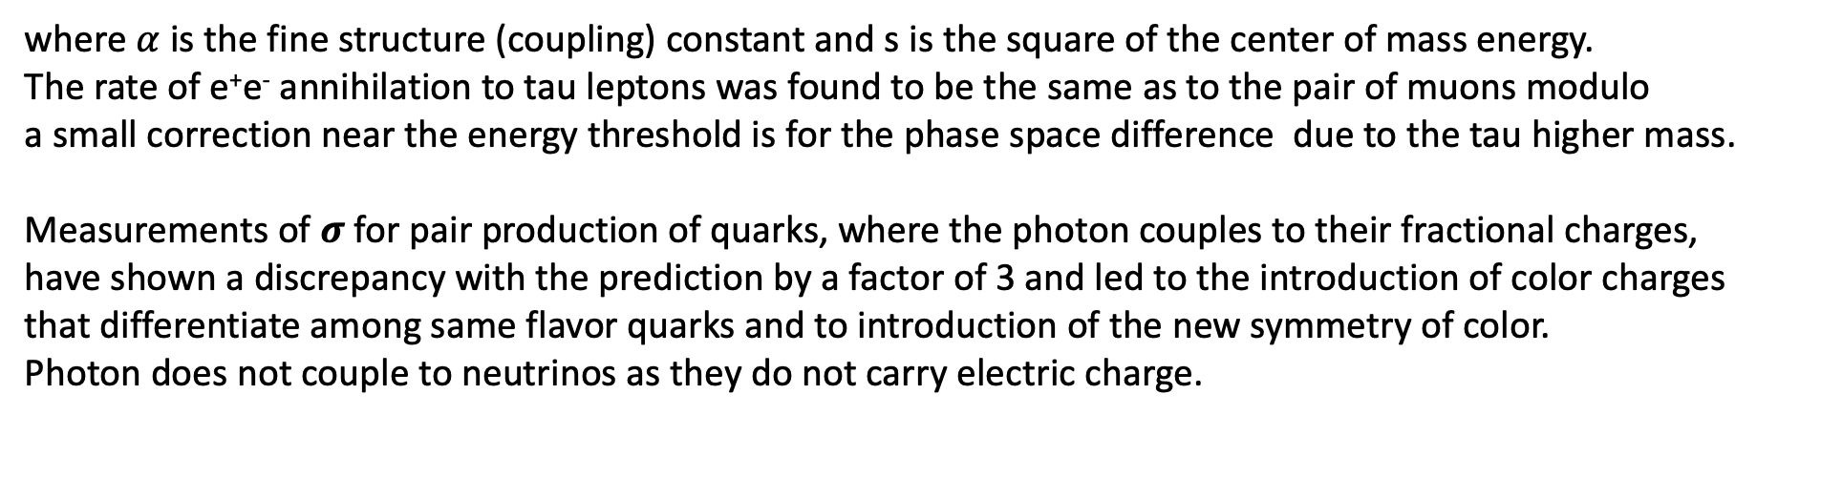
The quantum electrodynamics provided us with a carrier of force named photon.
Photon couples to a particle with a strength proportional to its charge.
The Feynman diagram for the leading order process of electron-positron annihilation into a pair of oppositely
charged muons was calculated and measured to have a cross section
where $α$ is the fine structure (coupling) constant and s is the square of the center of mass energy.
The rate of e⁺e⁻ annihilation to tau leptons was found to be the same as to the pair of muons modulo
a small correction near the energy threshold is for the phase space difference due to the tau higher mass.
Measurements of 𝝈 for pair production of quarks, where the photon couples to their fractional charges,
have shown a discrepancy with the prediction by a factor of 3 and led to the introduction of color charges
that differentiate among same flavor quarks and to introduction of the new symmetry of color.
Photon does not couple to neutrinos as they do not carry electric charge.

Slide 6
In addition to quarks and leptons, there are in a typical Feynman diagram also the carriers of forces.
In addition to the photon that carries the “current’ of the electromagnetic field, we have 3 carriers of
the week forces with W⁺ and W⁻ called “charged current” and Z⁰ called neutral current
and 8 gluons of strong interactions each carrying a color-anticolor current.
The central element is the Higgs that is unlike the contents of the inner ring
on the propaganda figure – it is not a carrier of the field.
Only electron and a photon can be detected directly by our devices.
Among the “fundamental” particles in this circle we can identify short-lived
muon, tau and the W and Z bosons from their decays.
All hadrons, including stable proton, long-lived neutron and mesons (pion, kaon,….) are composite.
We deduce and identify unseen neutrinos from the conservation laws.

Slide 7
Experimentally, in addition to a photon, only long-lived charged particles with sufficient lifetime leave ionization
signatures in our detectors that can be measured with present technologies.
Among the charged particles only the electron and proton are stable.
All other particle decay and have finite path length through our devices. The mean path length depends
on velocity.
The amount of ionization is proportional to a mass of the particle but it is useful for particle
identification only in the momentum range below few GeV.
We identify electron and a photon via their interaction with matter generating electromagnetic showers.
Pions can be separated from kaon and protons only below ~5-8 GeV.
Muons have mean lifetime of about 2 ms and at LHC can travel for many meters before the decay.
They are about 200 times heavier than electrons and show only minimal Coulomb scattering. They do not produce
electromagnetic showers. We identify them via “minimum ionization”.
Most of other particles have short life times and appear to decay practically at the point of production.
We reconstruct them via invariant mass of their decay products, but in that process we always need
to identify the background of random combination of particles that come from other processes.
Among the “fundamental” particles in this circle we can identify short-lived muon, tau and the W and Z bosons
from their decays.
All hadrons, including stable proton, long-lived neutron and mesons (pion, kaon,….) are composite.
We deduce and identify unseen neutrinos from the conservation laws.

Slide 8
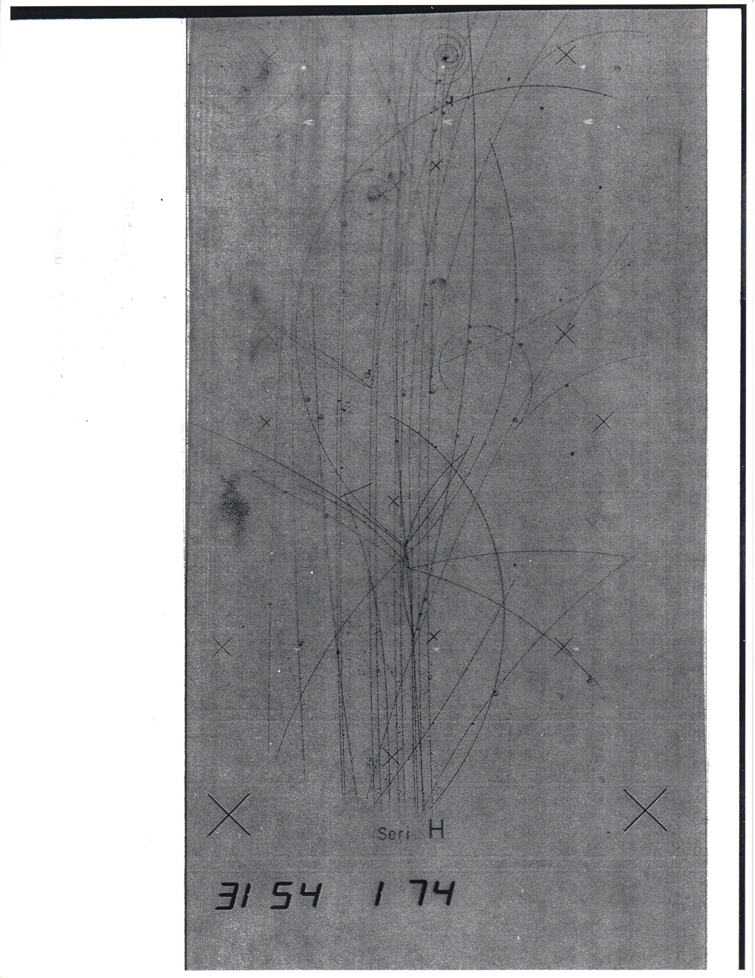

Slide 9

ATLAS data for $pp→μμ$

Slide 10
Weak interactions once again
The relativistic quantum theory of weak interactions become a major problem in 1950ties.
Weak interactions had clearly short interaction range, roughly of the order of the nucleus radius.
That would indicate that the weak current carrier has a substantial mass.
There was also a problem of explaining maximal violation of parity in weak interactions.
The seminal paper was published in 1954 by C. N. Yang and R. L. Mills,
who proposed that the issue of invariance in case of maximal parity violation can be solved by introduction
of not one but two fields to describe the rotational symmetry required by the field theory.
They have proposed that the overall weak field has two components:
vector V and a corresponding axial-vector A aligned with an opposite sign.
You may remember parity as a discrete Lorentz transformation used to classify elementary particles.
Parity is conserved in electromagnetic and strong interactions but it is maximally violated in weak interactions.
For example, all particles produced in neutron decays appear to be left-handed, i.e., their spin is always opposite
to the direction of their motion.
To describe the experimental observation, one introduces a V-A theory (vector – axial vector)
for which the parity transformation P
P(V-A) = -V – A = - (V+A).

Slide 11
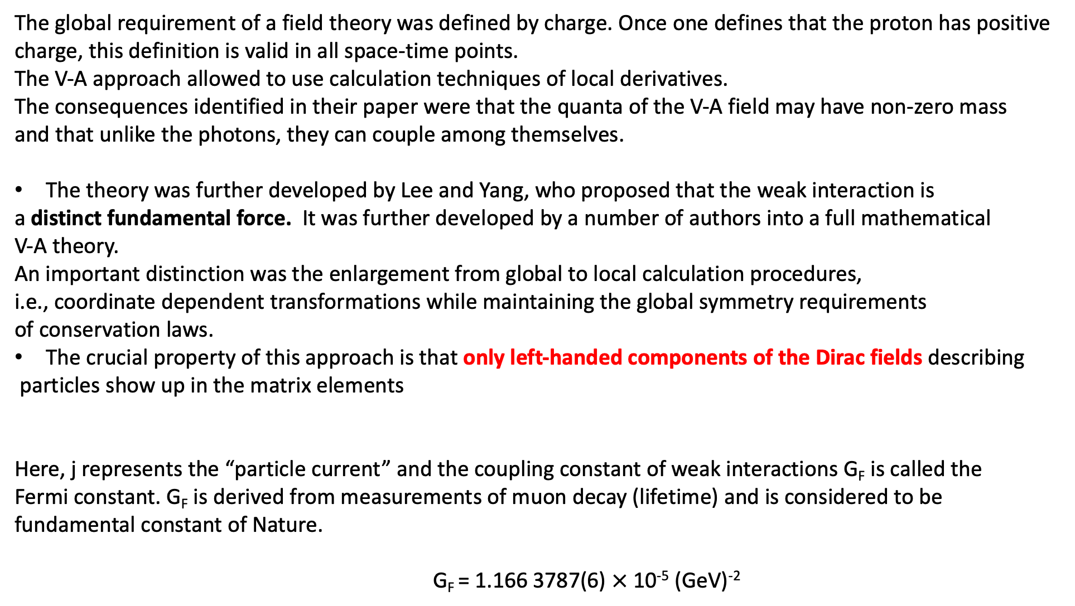
The global requirement of a field theory was defined by charge. Once one defines that the proton has positive
charge, this definition is valid in all space-time points.
The V-A approach allowed to use calculation techniques of local derivatives.
The consequences identified in their paper were that the quanta of the V-A field may have non-zero mass
and that unlike the photons, they can couple among themselves.
The theory was further developed by Lee and Yang, who proposed that the weak interaction is
a distinct fundamental force. It was further developed by a number of authors into a full mathematical
V-A theory.
An important distinction was the enlargement from global to local calculation procedures,
i.e., coordinate dependent transformations while maintaining the global symmetry requirements
of conservation laws.
The crucial property of this approach is that only left-handed components of the Dirac fields describing
particles show up in the matrix elements
Here, j represents the “particle current” and the coupling constant of weak interactions G_{F} is called the
Fermi constant. G_{F} is derived from measurements of muon decay (lifetime) and is considered to be
fundamental constant of Nature.
G_{F} = 1.166 3787(6) $×$ 10⁻⁵ (GeV)⁻²

Slide 12
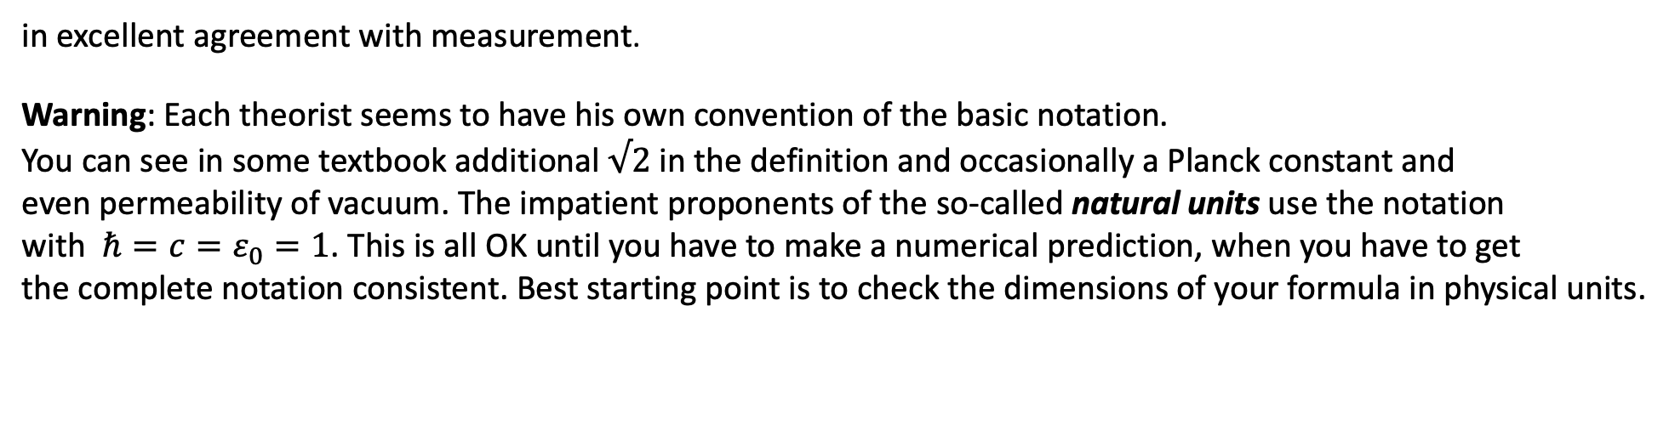
This coupling constant is universal for all fermions in weak interactions.
Since the Lagrangian used to calculate physical processes includes mass of the particle, this allows us
to estimate relative rates of the same processes for different particle masses.
For example, the decay rate of the muon
allows us to estimate tau lepton decay rate for similar weak process
in excellent agreement with measurement.
Warning: Each theorist seems to have his own convention of the basic notation.
You can see in some textbook additional $√2$ in the definition and occasionally a Planck constant and
even permeability of vacuum. The impatient proponents of the so-called natural units use the notation
with $ℏ=c=ε_{0}=1$. This is all OK until you have to make a numerical prediction, when you have to get
the complete notation consistent. Best starting point is to check the dimensions of your formula in physical units.

Slide 13
The Feynman diagrams for charged current for the muon and pion decays are shown here
Both processes are mediated by the charged weak boson W.
But, only left-handed W acts in the muon decay, and both left-handed and right-handed W
can act in pion decay.

Slide 14
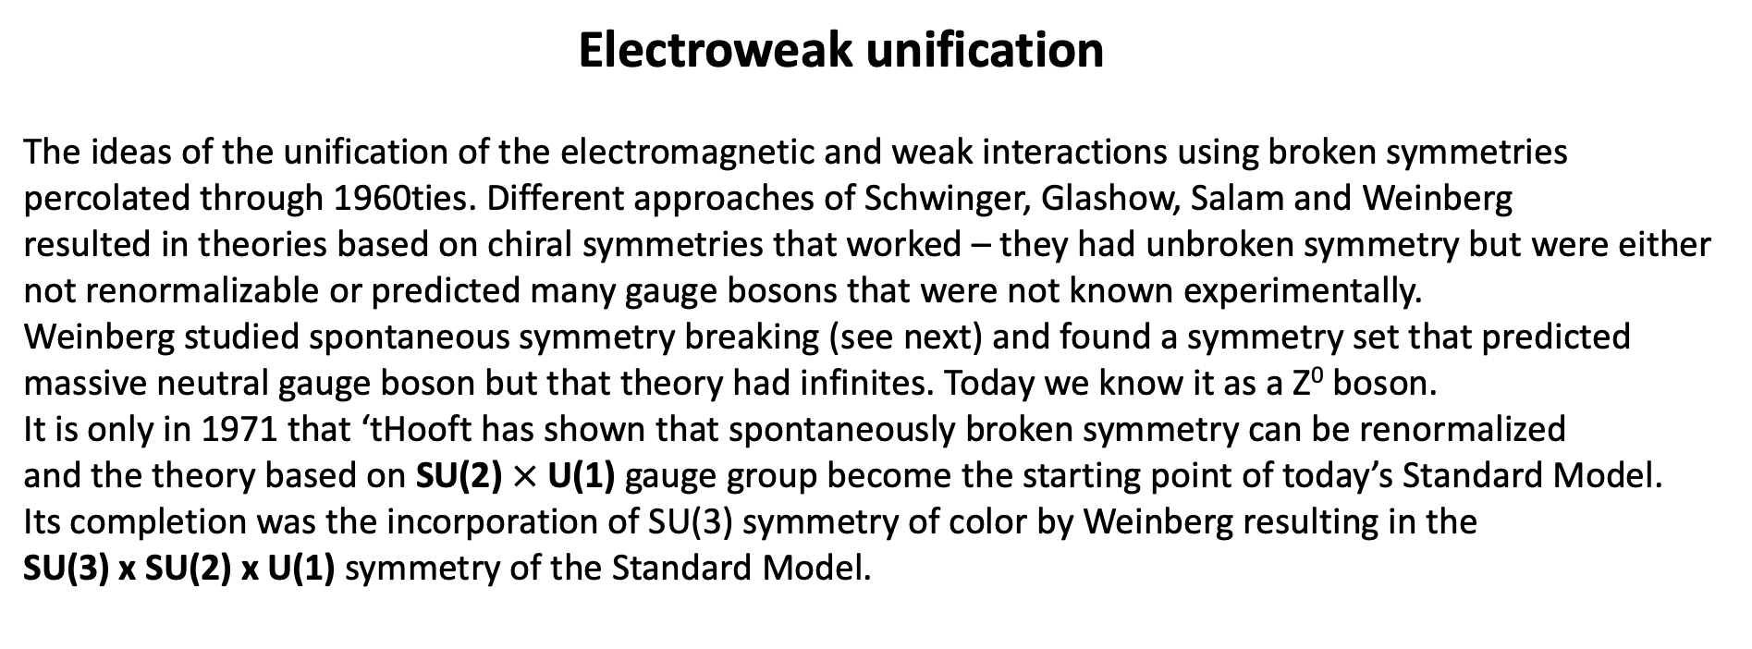
Electroweak unification
The ideas of the unification of the electromagnetic and weak interactions using broken symmetries
percolated through 1960ties. Different approaches of Schwinger, Glashow, Salam and Weinberg
resulted in theories based on chiral symmetries that worked – they had unbroken symmetry but were either
not renormalizable or predicted many gauge bosons that were not known experimentally.
Weinberg studied spontaneous symmetry breaking (see next) and found a symmetry set that predicted
massive neutral gauge boson but that theory had infinites. Today we know it as a Z⁰ boson.
It is only in 1971 that ‘tHooft has shown that spontaneously broken symmetry can be renormalized
and the theory based on SU(2) $×$ U(1) gauge group become the starting point of today’s Standard Model.
Its completion was the incorporation of SU(3) symmetry of color by Weinberg resulting in the
SU(3) x SU(2) x U(1) symmetry of the Standard Model.

