Slide 1
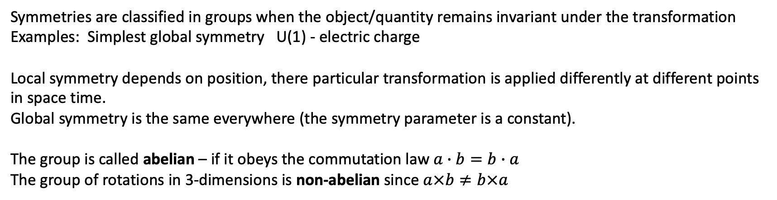
Symmetries are classified in groups when the object/quantity remains invariant under the transformation
Examples: Simplest global symmetry U(1) - electric charge
Local symmetry depends on position, there particular transformation is applied differently at different points
in space time.
Global symmetry is the same everywhere (the symmetry parameter is a constant).
The group is called abelian – if it obeys the commutation law $a∙b=b∙a$
The group of rotations in 3-dimensions is non-abelian since $a×b≠b×a$

Slide 2

Homework problem vs data
$E_{p}$ = $\frac{1}{ 4E_{γ}}$($m_{π}^{2 }+ m_{p}m_{π}$) = 1.08 $×$10¹⁵

Slide 3
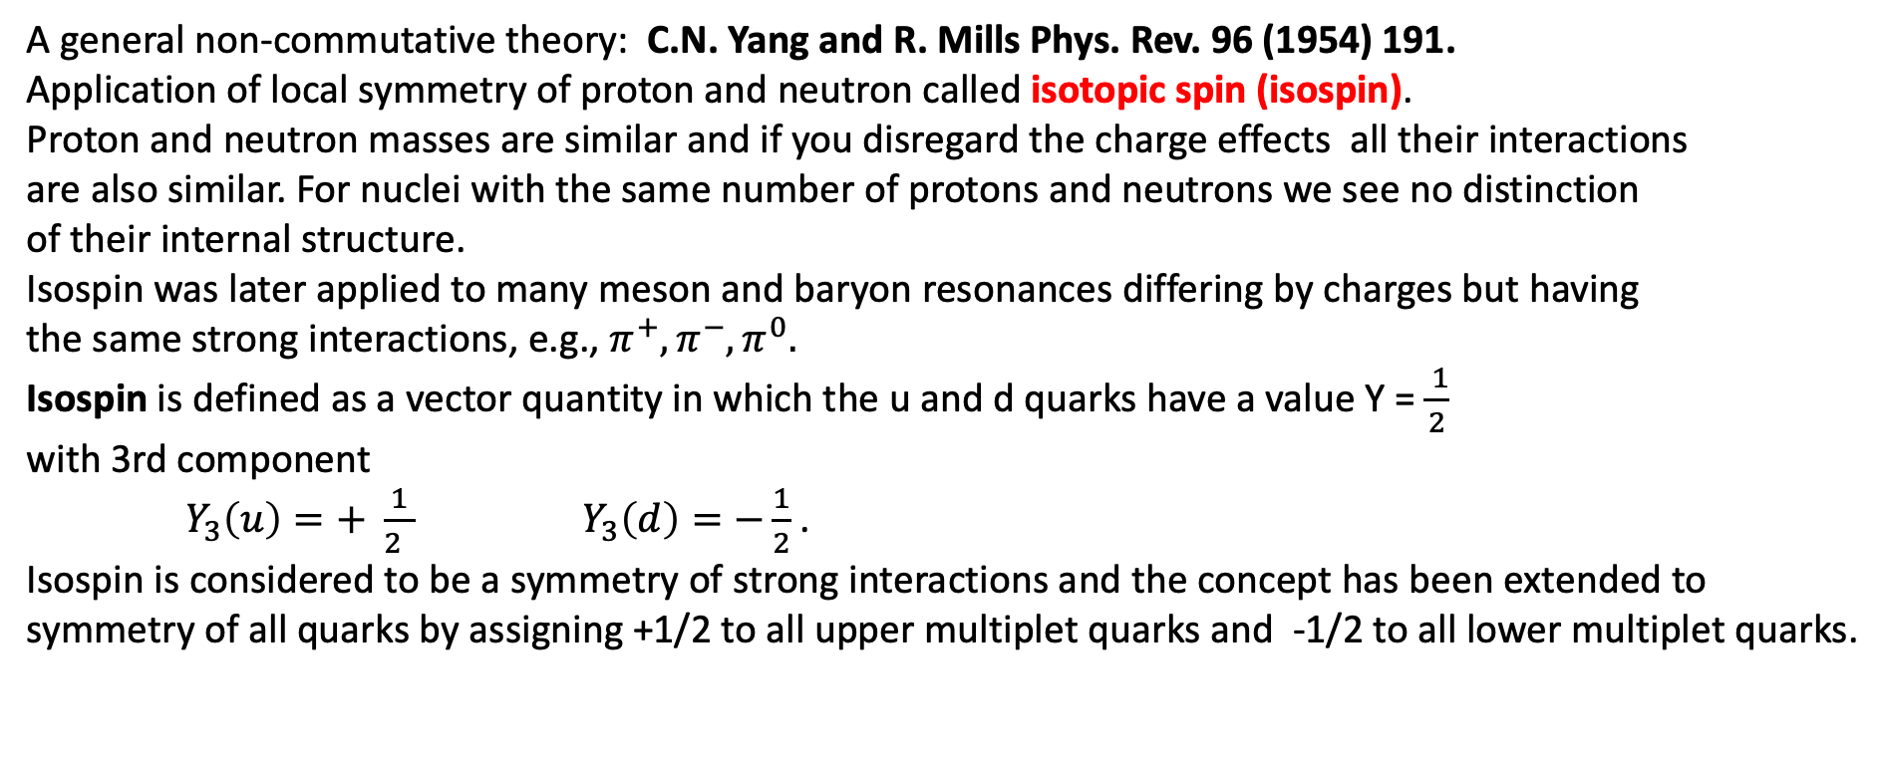
Yang-Mills theories
A general non-commutative theory: C.N. Yang and R. Mills Phys. Rev. 96 (1954) 191.
Application of local symmetry of proton and neutron called isotopic spin (isospin).
Proton and neutron masses are similar and if you disregard the charge effects all their interactions
are also similar. For nuclei with the same number of protons and neutrons we see no distinction
of their internal structure.
Isospin was later applied to many meson and baryon resonances differing by charges but having
the same strong interactions, e.g., $π^{+},π^{−}, π^{0}.$
Isospin is defined as a vector quantity in which the u and d quarks have a value Y = $\frac{ 1}{2}$
with 3rd component
$Y_{3}\left(u\right)=+ \frac{1}{2 }$ ${ Y}_{3}\left(d\right)=−\frac{1}{2}$ .
Isospin is considered to be a symmetry of strong interactions and the concept has been extended to
symmetry of all quarks by assigning +1/2 to all upper multiplet quarks and -1/2 to all lower multiplet quarks.

Slide 4
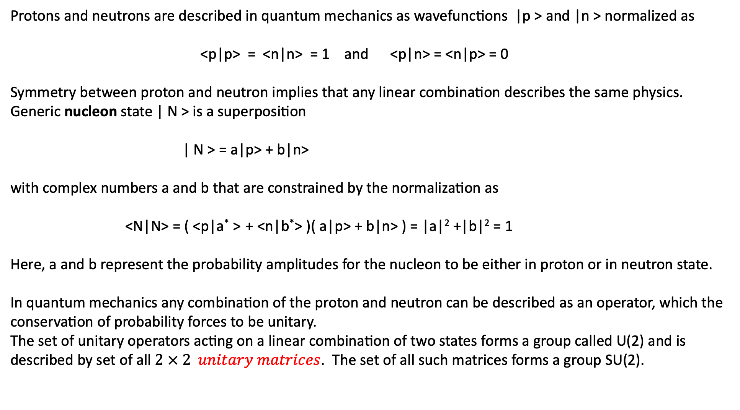
What is Isospin
Protons and neutrons are described in quantum mechanics as wavefunctions |p > and |n > normalized as
<p|p> = <n|n> = 1 and <p|n> = <n|p> = 0
Symmetry between proton and neutron implies that any linear combination describes the same physics.
Generic nucleon state | N > is a superposition
| N > = a|p> + b|n>
with complex numbers a and b that are constrained by the normalization as
<N|N> = ( <p|a* > + <n|b*> )( a|p> + b|n> ) = |a|² +|b|² = 1
Here, a and b represent the probability amplitudes for the nucleon to be either in proton or in neutron state.
In quantum mechanics any combination of the proton and neutron can be described as an operator, which the
conservation of probability forces to be unitary.
The set of unitary operators acting on a linear combination of two states forms a group called U(2) and is
described by set of all $2 × 2 unitary matrices$. The set of all such matrices forms a group SU(2).

Slide 5
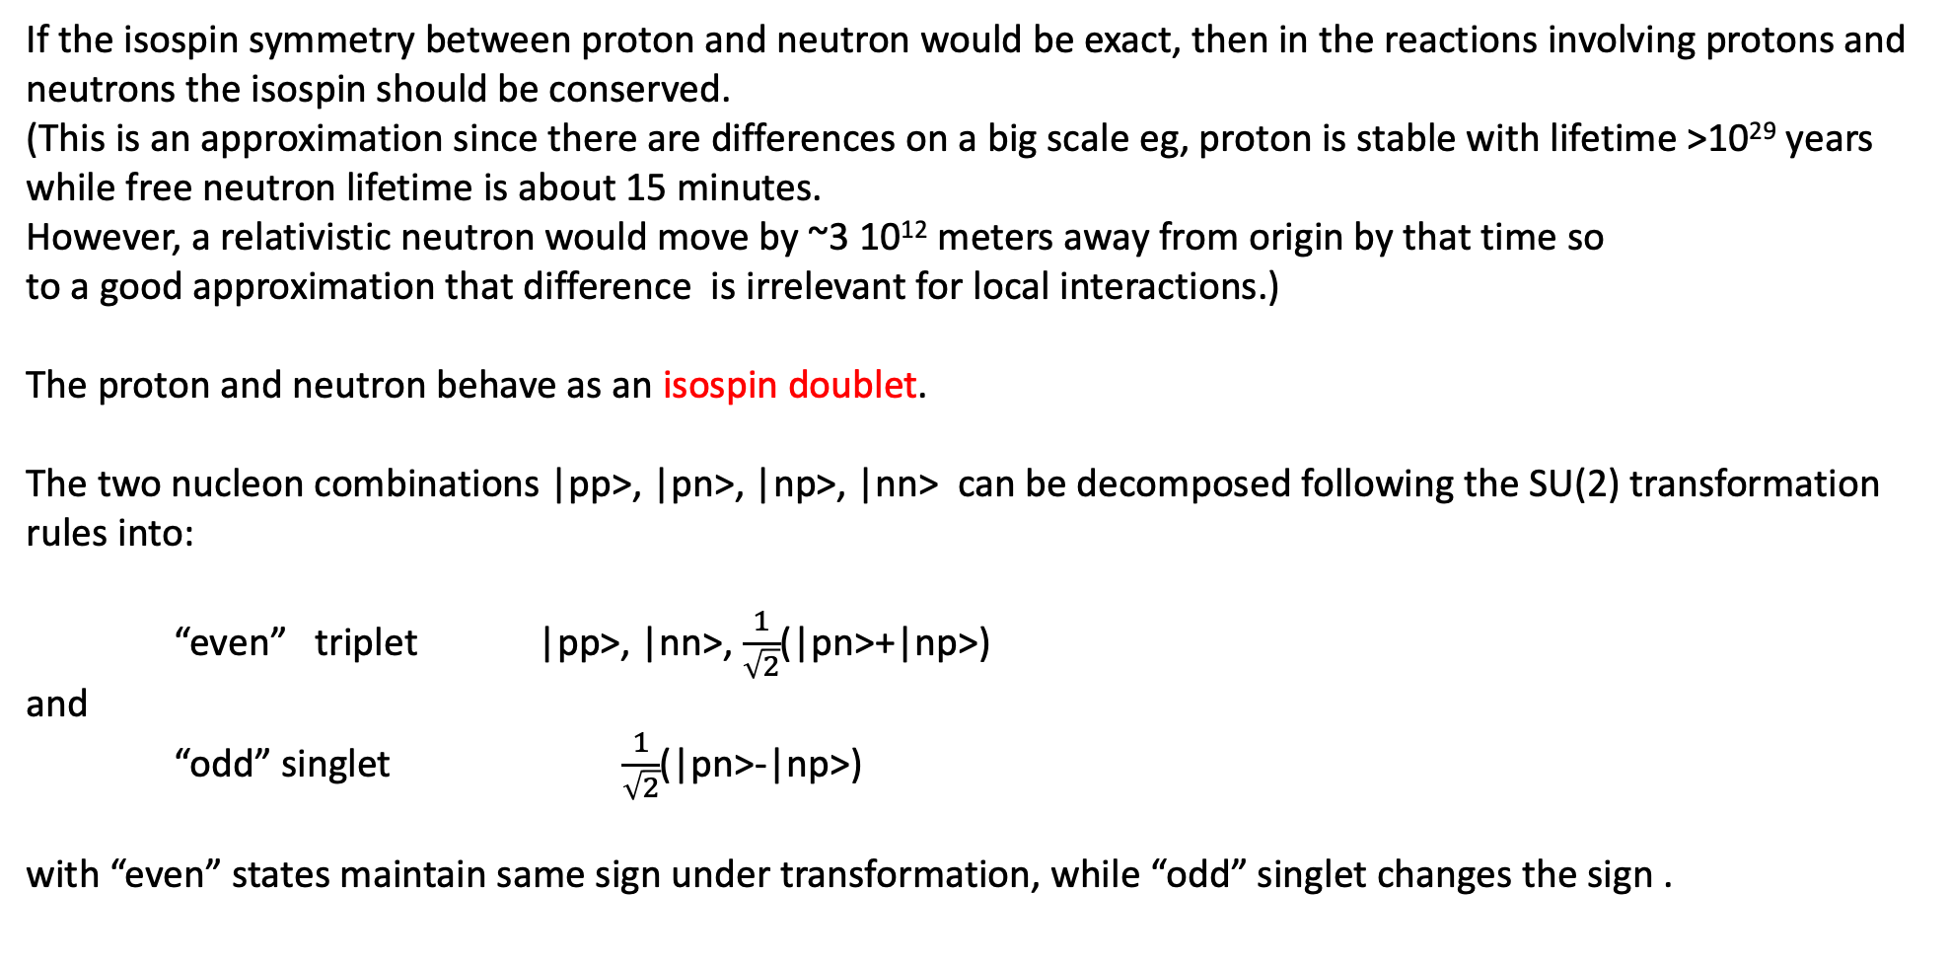
If the isospin symmetry between proton and neutron would be exact, then in the reactions involving protons and
neutrons the isospin should be conserved.
(This is an approximation since there are differences on a big scale eg, proton is stable with lifetime >10²⁹ years
while free neutron lifetime is about 15 minutes.
However, a relativistic neutron would move by ~3 10¹² meters away from origin by that time so
to a good approximation that difference is irrelevant for local interactions.)
The proton and neutron behave as an isospin doublet.
The two nucleon combinations |pp>, |pn>, |np>, |nn> can be decomposed following the SU(2) transformation
rules into:
“even” triplet |pp>, |nn>, $\frac{1}{\sqrt{2}}$(|pn>+|np>)
and
“odd” singlet $\frac{1}{\sqrt{2}}$(|pn>-|np>)
with “even” states maintain same sign under transformation, while “odd” singlet changes the sign .

Slide 6
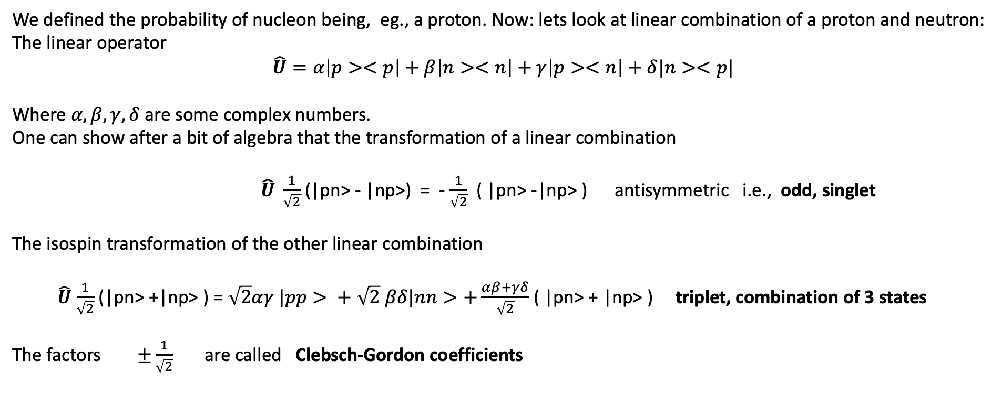
We defined the probability of nucleon being, eg., a proton. Now: lets look at linear combination of a proton and neutron:
The linear operator
$$\hat{U}=α\left|p><p\right|+β\left|n><n\right|+γ\left|p><n\right|+δ|n><p|$$
Where $α,β,γ,δ$ are some complex numbers.
One can show after a bit of algebra that the transformation of a linear combination
$\hat{U} \frac{1}{\sqrt{2}}$(|pn> - |np>) = - $\frac{1}{\sqrt{2}}$ ( |pn> -|np> ) antisymmetric i.e., odd, singlet
The isospin transformation of the other linear combination
$\hat{U}$ $\frac{1}{\sqrt{2}}$ (|pn> +|np> ) =$\sqrt{2}αγ |pp> + \sqrt{2}$ $βδ|nn>+\frac{αβ+γδ}{\sqrt{2}}$ ( |pn> + |np> ) triplet, combination of 3 states
The factors $±\frac{1}{\sqrt{2}}$ are called Clebsch-Gordon coefficients

Slide 7
Reminder
Axial vector (pseudovector) is a quantity that transforms as a vector in 2 dimensions but in 3-diemsions
acquires a sign flip under reflection. In 3-dimensions axial vector is associated with cross product of
two polar vectors, (eg. angular momentum, spin,…)
ν
μ⁺
ν
μ⁺
π⁺
P
π⁺
ν spin
μ spin
ν spin
μ spin
YES
C
CP
C
NO
NO
YES
ν
μ–
ν
μ–
π–
P
π–
ν spin
μ spin
ν spin
μ spin

Slide 8
Yang-Mills prescription:
Introduce a new component of the field with a very specific potential that keeps the full
Lagrangian invariant under SU(2)_{L} x U(1)_{Y} , but makes the vacuum not invariant under this symmetry.
This new field components has to have axial symmetry and the negative sign to cancel problematic terms.
The process spontaneously breaks down the symmetry of local gauge invariant theory by making rotations
of the isospin independent of space-time point.
A gauge theory has force carriers. All known carriers of forces are bosons with spin = 1 for the electromagnetic,
weak and strong forces and spin =2 for the hypothetical carrier of gravitational force, called a graviton.

Slide 9






Gauge invariance
Take the Dirac Lagrangian (for spinor ﬁelds ϕ representing fermions)
It is invariant under global gauge transformations like:
Where θ is a constant. Now, what about local gauge transformations?
If θ=θ(x) then the ﬁeld derivative gives us extra terms:
or
(with and q - the charge of the particle)
But we can now make the Lagrangian local-gauge invariant by adding an
interaction term with a new gauge ﬁeld A_{μ}:

Slide 10

For this to work, the new ﬁeld needs to transform like
So that the last term cancels the change in the ϕ terms due to gauge transformations. But what has just happened? We have added a new ﬁeld, and so a new particle to the Lagrangian. For this to make sense we also need a new free term for this ﬁeld. We end up with:
Where
Now, the last 2 terms in the new Lagrangian correspond to Maxwell’s Lagrangian
and give all of electrodynamics!!
Demanding local gauge conservation resulted in obtaining a new ﬁeld (the photon) and its interactions with the fermion ﬁelds. This is the blueprint of all Standard Model theories (called “Gauge theories”).
Gauge theories are automatically renormalizable (‘t Hoot & Veltman’s Nobel prize).
BUT: notice there is no term depending on the square of the A_{μ} ﬁeld:
è There is no mass term for the photon – this is the beginning of the Higgs story!

Slide 11
Problem: Symmetry breaking
You have already seen the modern approach to particle theory with a handy pictorial shorthand called
the Feynman diagrams.
In this approach the external legs of the diagram represent matter particles and the internal lines represent the
carriers of the forces.
In field theory these carriers are representations of the fields of force acting on the wave function of the particle.
The basic assumption of the theory is its application throughout the Universe, i.e., the assumption that the
physics rules established on Earth are valid in any other galaxy out there and at any other time. This assumption
requires invariance, i.e., independence of scale (gauge of transformation) and rotation in space.
The common feature of the electromagnetic, weak and strong forces is that mediators of the force have spin 1.
The gauge theories symmetries predict that these carriers should be massless because the mass term
in the Lagrangian is not invariant under the gauge transformation.
This created a problem, since the experimental observations indicated a short range of the weak force and
consequently the expectation and later observation that the carriers W⁺, W⁻, Z⁰.

Slide 12
Symmetry again
Quantum electrodynamics is a gauge theory with the symmetry group U(1).
It is a unitary group with dimension n = 1.
It has one-gauge field with electromagnetic potential in 4-dimensions and a gauge boson – a photon.
The weak interactions obey symmetry group SU(2) – Special Unitary group of degree 2 ,
i.e., consisting of 2 x 2 unitary matrices.
Naively, it should produce 4 massless gauge bosons. These are named in the literature as Goldstone bosons.
To be consistent with facts of nature, i.e., experimental observations, there must be a mechanism
to provide a mass to those bosons. This has been provided by the Higgs mechanism.
The strong interactions are described by the SU(3) symmetry described by 8 independent traceless hermitian
matrices (Gell-Mann matrices) corresponding to 8 gauge bosons called gluons.
Each gluon is distinguished by its color-anticolor content.
All of these must be vectors.
You can already see that the Higgs, with its spin = 0, is not a gauge boson.

