Slide 1
lecture 33

Slide 2
Lagrangian function, also called Lagrangian, is a quantity that characterizes the state of a physical system.
In mechanics, the Lagrangian function is just the kinetic energy (energy of motion) minus the potential energy (energy of position).
This applies also if every element of the system has its own motion characteristics.
In quantum mechanics this is replaced by the fields equations.

Slide 3
Unification
The push for the unification of the mathematical description of forces and interactions has its origin in Maxwell’s equations that unified the description of electric and magnetic forces into one elegant electromagnetic theory.
-> 150 years later our entire civilization and technology depends on understanding that changing current will generate changing magnetic field and changing magnetic field will induce current.
An extension of the unification concept to include nuclear forces run into a problem:
The range of the electromagnetic force is infinite and the corresponding quantum of the
force (its carrier) photon moves with the speed of light.
On the other hand the force that keeps protons and neutrons together in the nucleus
has a finite range – the diameter of the nucleus (otherwise it would keep accumulating
additional protons and neutrons).
Thus, the symmetry between electromagnetic and week forces is broken.
The early attempt to explain the broken symmetry was made by Stuckelberg in 1934
who introduced scalar fields. It was ahead of the time, people considered it as speculative
mathematics and it was completely ignored.

Slide 4
Unification
Weak interactions
In 1932 Heisenberg noted that proton and neutron have similar charges, differ by the
electric charge, but overall have similar properties. Moreover, stable even nuclei have
equal number of them. It was then noticed that p-p and n-p interactions are about the same.
He proposed that proton and neutron are just two different states of the same particle.
In 1937 Wigner introduced a concept of isotopic spin (isospin) that is conserved in
nucleon-nucleon interactions. In such approach the conservation of isotopic spin is equivalent
to a requirement that interactions are invariant under isospin rotation and thus orientation
of the isospin vector has no physical significance and the difference between proton and
neutron is a purely arbitrary process.
In mathematics once you select what you call proton and what you call neutron that fixes
the choice globally (throughout the space-time). A big difference from the “local” theories
that use perturbative approach to all calculations.
In 1954 C.N. Yang and R.L Mills introduced the first consistent theory by proposing an
isotopic gauge field for the weak interactions with two-components wave function describing
a field with isotopic spin ½. In quantum mechanics the wave transformation proceed by
$ψ=S ψ′$,
where S is the 2 x 2 unitary matrix with determinant equal to 1.
This represents SU(2) “Special Unitary symmetry group of rank 2“.

Slide 5
A special feature of the theory is that the interactions are now vectorial in the isospin space.
Its carriers are massive vector bosons of spin 1 providing limited range. The interaction is
describe by exchange of two vectors : the usual vector and axial vector. (Axial vector behaves
as a mirror image under a reflection.)
There is now a major difference from electromagnetic U(1) symmetry, where photon can couple
to charged quarks and leptons only: In SU(2) we have additional options:
Here, dashed line represent field quanta,
Solid line represent matter particle.
As a result, carriers of the weak force can couple to themselves with triple and quartic couplings.
As a result, we have a consistent SU(2) x U(1) theory of electroweak interactions .
The cross product provides the axial symmetry. The problem of origin of mass remains.
Details of the field theory are beyond the scope here. The Young-Mills approach is,
however, considered to be the first consistent quantum field theory of particle physics.
The SU(3) has been introduced with the corresponding 3 x 3 unitary matrix
corresponding to the 3 colors of the strong interactions field.

Slide 6
The issue of the Lorentz invariance of the theory (independence of rotation of the axes
and of translation) remained a dominant problem for the theorists for the next 20-30 years.
Weinberg, Salam and Glashow have added the SU(3) symmetry of strong fields with
colored gluons as force quanta. These were again massless and their limited range
was solved by Gross, Politzer and Wiczek by postulating strength of interactions to increase
rather then decrease with distance (asymptotic freedom).
Still there was a need to explain the symmetry breaking of electroweak interactions
as manifested by massless photon and massive weak bosons W+, W- and Z.
I mentioned already before, the original proposal of Stueckelberg was to introduce
one more field as an option to field theory. At that time a scalar field was ignored and
forgotten. The concept of a solution to the symmetry breaking using an additional field
was resurrected in 1950ies.
It would add a new set of parameters that can be arranged to deal with the problem and
can maintain symmetry by making the new field orthogonal to field describing the charge
and isospin.

Slide 7
Higgs Field
In 1950ties a number of people have independently proposed the hypothetical
and very unusual field that could in practice break the symmetry
of electromagnetic and weak forces. If such field existed throughout
the universe it could also be responsible for masses of all fundamental
particles. The mathematical formulation also indicated that there must
be a real particle associated with that field.
In final analysis the credit went to Peter Higgs who has
derived all the properties of the particle associated
with the field, except of its mass.
A special feature of the Higgs field is that it
takes less energy to have non-zero value than
a zero value so the non-zero value if this field is everywhere
and it is sometimes called energy of the vacuum. So the scalar field can start as
fully symmetric, but due to the funny shape of its potential the related carriers of the
weak force can become massive. Once the Higgs particle is in the trough, the
direction along an axis is established and symmetry is broken.

Slide 8
The Higgs field couples directly to all particles’ masses.
It can couple to quarks, leptons, photons and carriers of weak interactions W+, W-, Z

Slide 9
The general symmetry of the fields verify the mathematical approach resulting in
the Standard Model of Particle Physics. It is important to remember that
mathematicians claim that there is something fundamentally wrong with
the model because the massive particle cannot have velocity of light and
because the Standard Model vacuum has an energy of 246 GeV/c² and not zero.
Experimentally, however, we have a measurement of electron magnetic moment
(electron has charge and spin, spinning charge make a tiny magnet) with a precision
of 1 part in a trillion: g/2 = 1.00115965218085(76). Here the theorists succeeded
in calculating first 8 digits and they agree with the measurements.
In practice, however, we neglect this discussion and use in practical
applications a “bottom-up” type arguments. Something that the theorists called
not a “Field Theory” but an “Effective Field Theory”. Namely, If we describe the data
that we have now, what are the predictions for interactions at higher energies.
These lead to the concept of running coupling constants.
Lets start with the Coulomb force
$$F=k_{e}\frac{q_{1}q_{2}}{r^{2}}$$
What happens when r → 0 ? Can we get there?
We know from LHC that electron is smaller than 10⁻¹⁸ m, but it’s a long way from
there to 0 (especially in logarithmic scale).

Slide 10
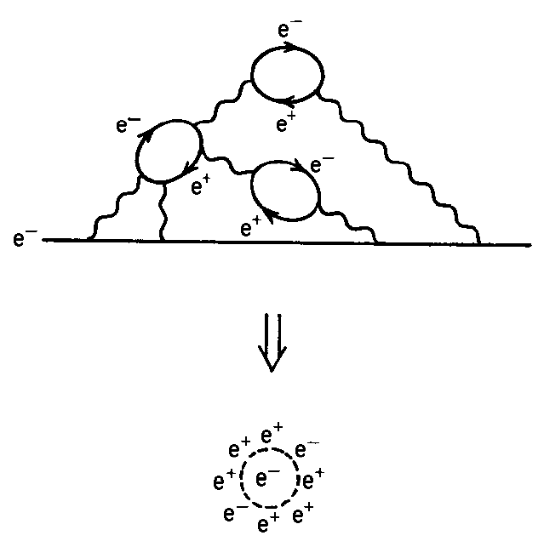
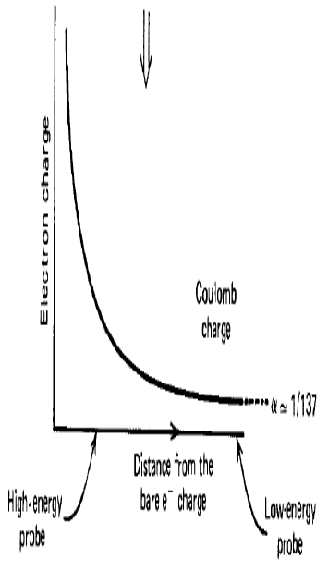
Charge screening in QED
In QED, a charged particle like the electron is surrounded by a cloud of virtual photons and e+e− pairs continuously popping in and out of existence. Because of the attraction of opposite charges, the virtual positrons tend to be closer to the electron and screen the electron charge. This is analogous to the polarization of a dielectric medium in the presence of a charge and is called vacuum polarization.

Slide 11
Details: Running coupling in QED
(leading log approximation)
Full calculations give
The expression blows up when the ln(Q²/m²_{e}) = 3π/α(0) which occurs at
astronomical scale of Q²_{max} = 10²⁸⁰ MeV²

Slide 12
This gives rise to the notion of an effective charge e(r) that becomes
smaller with larger distance. One can says that the beta function
is positive in QED.
Likewise, the QCD vacuum consists of virtual quark-antiquark pairs, and if this
would be all, the charge screening mechanism would be the same as in QED, with a positive beta function.
However, due to the gluon self coupling, the vacuum will also be filled with virtual gluon pairs. Because the gluon cloud carries color charge, it turns out that the effective charge becomes larger with larger distance; the beta function is negative. This effect is called anti-screening.

Slide 13
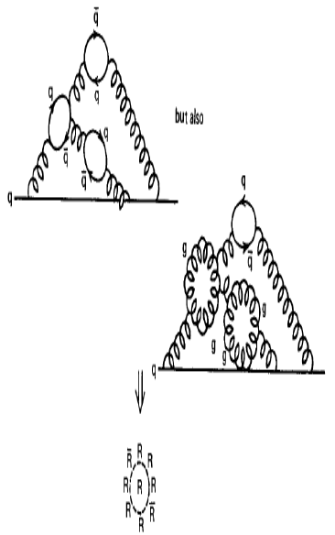
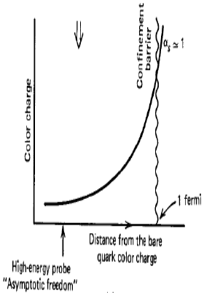
It turns out that the negative contribution wins over the positive contribution, so that the QCD beta function is negative, and the effective strong coupling becomes small a short distances.

Slide 14
Charge screening in QED (screening) and QCD (anti-screening)
leads to the concept of a running coupling when summed over al corrections.
In QED the coupling, becomes large at (very) short distance but its effect is small.
In QCD, the anti-screening effect causes the strong coupling to become
small at short distance (large momentum transfer). This causes the quarks inside hadrons to behave more or less as free particles, when probed at large enough energies. This property of the strong interaction is called
asymptotic freedom. Asymptotic freedom allows us to use perturbation theory (applicable only for small deviations), and by this arrive at quantitative predictions for hard scattering cross sections in hadronic interactions.
On the other hand, at increasing distance the coupling becomes so
strong that it is impossible to isolate a quark from a hadron (it becomes
cheaper to create a quark-antiquark pair). This mechanism is called confinement. Confinement is verified in Lattice QCD calculations but, since it is non-perturbative, it is not mathematically proven from first principles.

Slide 15
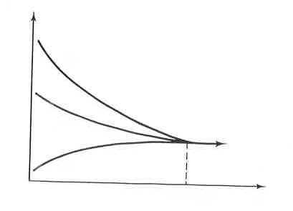
Ideal extrapolation of running constants to high energy
i.e., short distance
q
e
q
g
γ
W,Z
W,Z
q
e
q’
strong electromagnetic weak
α_{s}
α_{W}
Strength of coupling
α_{em}
E
10¹⁶ GeV

Slide 16
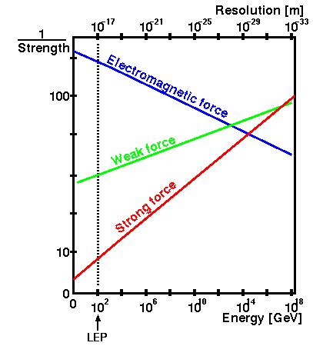
circa 2011
LHC

Slide 17
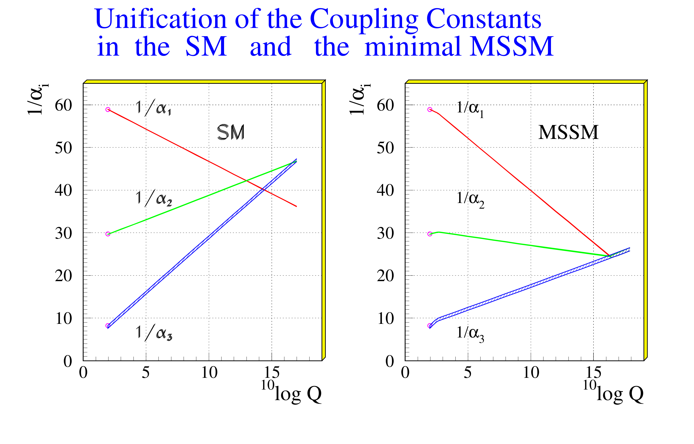
circa 2016

Slide 18
What we know and what do not know
Higgs is a new type of a particle but is this The Higgs particle ?
All parameters seem to be as expected, but there is no indication of new physics effects required by the formalism of unification of forces at early stages of the universe. The mathematics breaks down in extrapolation t higher energies.
Perhaps it is one of several such ne particles and the other ones have much higher masses
Do we really know the shape of the Higgs potential. Perhaps the particle we have discovered represents not a true but a false vacuum during the Big Bang and the true Higgs has much larger mass/
Why do we care? Cosmologist claim that if this is a true Higgs, its mass and the mass of the heaviest quark indicate that our universe may be unstable and would
disappear in a future (may be few or few hundred billions of years)
Plenty of time to build bigger machine and study.

Slide 20
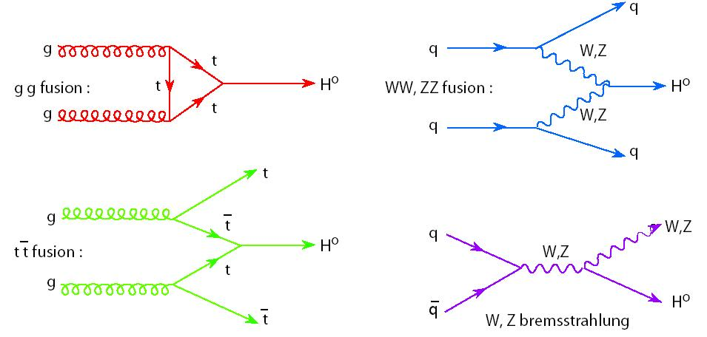
Dominant Higgs production processes

