Slide 1
Lecture 32

Slide 2

Cosmology I: Measuring and weighing the Universe
Following CERN lectures for summer students
by Ruth Durrer

Slide 3


Contents
1
The size of the Universe
2
The Expansion of the Universe

Slide 4

Distances
Radius of the Earth: ~ 6000km

Slide 5
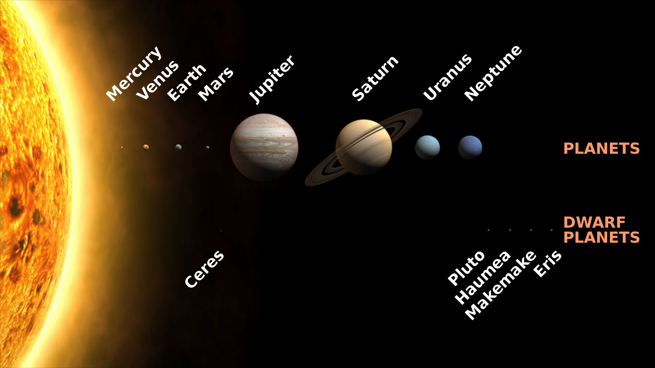
Distances
The solar system ~7 × 10⁹km ( ~50au =50 ’astronomical units’)
1 au ~ 1.5 × 10⁸km - the average distance between the earth and the sun
source: wikipedia

Slide 6
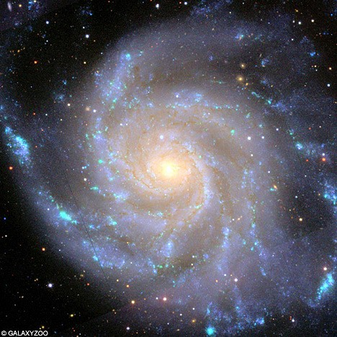
Distances
The Milky Way (visible part) ~10¹⁸km ~10⁵ light years ~30^{t}000 parsec
Not an actual image
Sun lies in the plane
of our galaxy

Slide 7
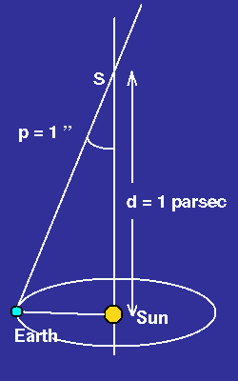
Distances
The Milky Way (visible part) ~10¹⁸km ~10⁵ light years ~30^{t}000 parsec
1” = 1º/3600 = 1arc second
1 parsec ~ 3.26 light years

Slide 8
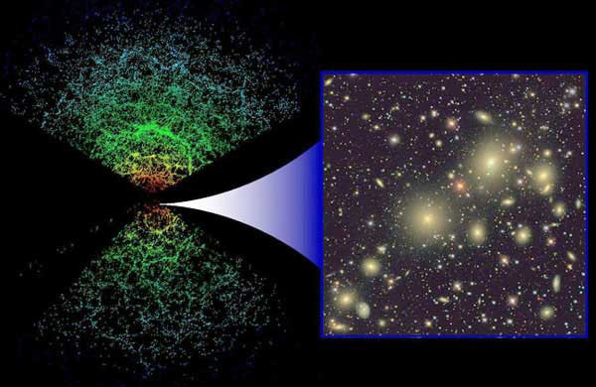
Distances
The size of the ’visible Universe’ (Hubble scale) ~ 28000 Mpc = 2.8 × 10¹⁰ parsec
Contains about 0.5 × 10¹² galaxies like the Milky Way with mass of about 10¹² M(Sun)
Each point represents a galaxy (Sloan digital sky survey, SDSS)

Slide 9
The Universe is expanding
As you know, Newtonian gravity is an attractive force. Each mass is attracted by every other mass.

Slide 10
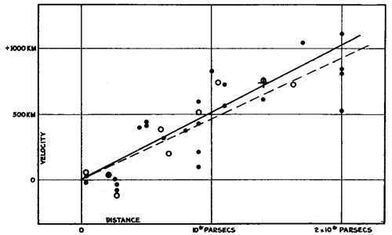
The Universe is expanding
As you know, Newtonian gravity is an attractive force. Each mass is attracted by every other mass.
Despite this fact, observations show that the Universe is expanding. Galaxies recede from each other with a speed proportional to their distance,
v = R˙ = H0 · R
(Hubble’s law, H0 ~ 70km/s/Mpc)
Velocity vs Distance
(Hubble 1932)

Slide 11
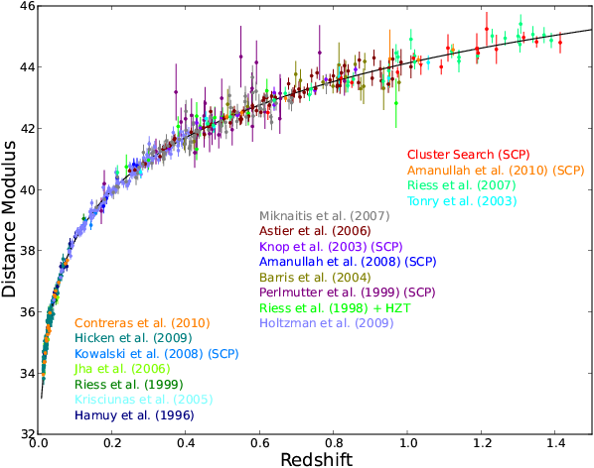
The Universe is expanding
(The Supernova Cosmology Project)

Slide 12

The Universe is expanding
To determine the ’Hubble diagram’ we have to measure two things: the speed and the distance of far away galaxies.

Slide 13
The Universe is expanding
To determine the ’Hubble diagram’ we have to measure two things: the speed and the distance of far away galaxies.
To measure the speed we measure the redshift. This is the Doppler effect for light:

Slide 14
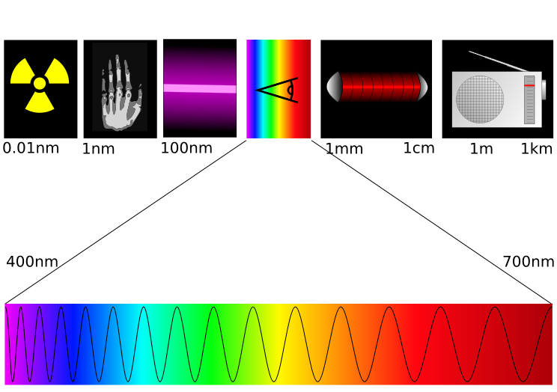
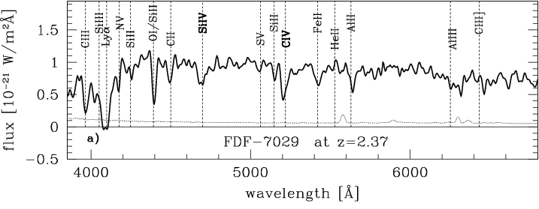
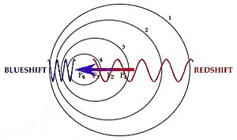

Redshift
Astronomical observations can be made in different wavelength bands
of the electromagnetic spectrum. In the optical band specific spectral lines due to atomic transitions are at fixed wavelength.
γ X-rays uv light ir radio

Slide 15
The Universe is expanding
To determine the ’Hubble diagram’ we have to measure two things: the speed and the distance of far away galaxies.
To measure the speed we measure the redshift. This is the Doppler effect for light:
To measure redshift is easy, but measuring distances is difficult. We need
“standard candles” or “standard rulers”. Here the assumption is that the intensity of the
light arriving at the Earth diminishes with distance as 1/r² and therefore the intensity is
a measure of the distance.

Slide 16
The Universe is expanding
To determine the ’Hubble diagram’ we have to measure two things: the speed and the distance of far away galaxies.
To measure the speed we measure the redshift. This is the Doppler effect for light:
To measure redshift is easy, but measuring distances is difficult. We need
“standard candles” or “standard rulers”. Here the assumption is that the intensity of the
light arriving at the Earth diminishes with distance as 1/r² and therefore the intensity is
a measure of the distance.
In cosmology, seeing far away objects means looking into the past.
We see the Andromeda galaxy as it was about 2 million years ago.

Slide 17
The Universe is expanding
To determine the ’Hubble diagram’ we have to measure two things: the speed and the distance of far away galaxies.
To measure the speed we measure the redshift. This is the Doppler effect for light:
To measure redshift is easy, but measuring distances is difficult. We need
“standard candles” or “standard rulers”. Here the assumption is that the intensity of the
light arriving at the Earth diminishes with distance as 1/r² and therefore the intensity is
a measure of the distance.
In cosmology, seeing far away objects means looking into the past.
We see the Andromeda galaxy as it was about 2 million years ago.
A moment in the past can be characterized by the redshift z (we know the speed of light).

Slide 18
The Universe is expanding
The present expansion rate of the Universe is H0 ~70km/s/Mpc. In the past it has been different. We want to determine the expansion rate as function of the redshift, H(z). For this we have to measure the redshift z and the distance d of far away galaxies.

Slide 19
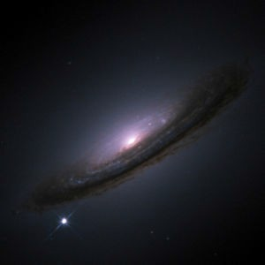
Standard candles
The most powerful standard candles are supernovae of type Ia.
SN1994D

Slide 20
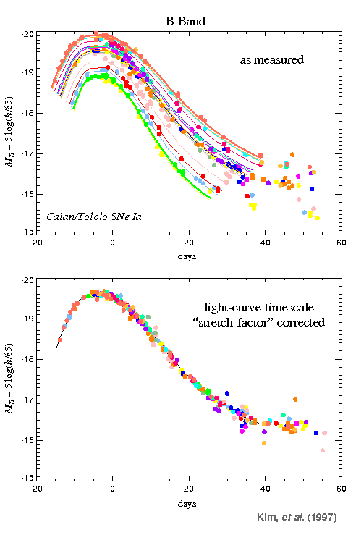
SNIa light curve
After application of a ’stretch factor’ the maximum of the light curve, i.e. the maximum of the luminosity is nearly the same for all supernovae Ia. The linear correction is for the time dilatation due to expanding universe.
Without correction.
After correction.

Slide 21
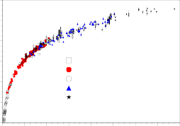
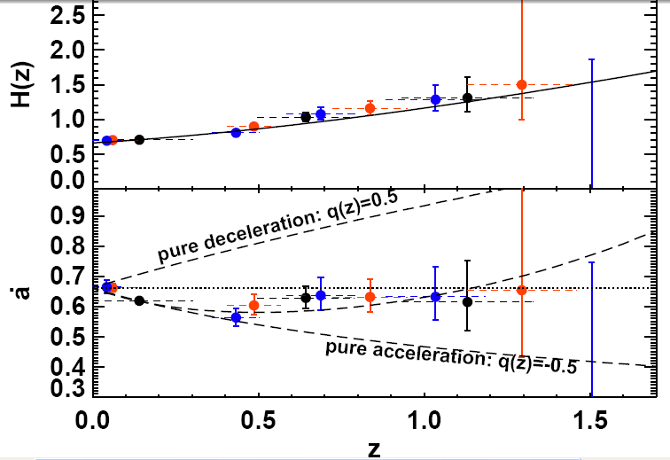
The Universe is in accelerated expansion
MLCS2k2 fitted distance modulus (mag)
46
44
42
Distance modulus
=log(apparent luminosity)+
constant
=log(1/d²) + constant
40
33 nearby (JRK07)
103 SDSS-II (this paper)
56 ESSENCE (WV07)
62 SNLS (Astier06)
34 HST (Riess07)
38
36
34
0 0.2 0.4 0.6 0.8 1 1.2 1.4 1.6
redshift

Slide 22
The Universe is in accelerated expansion
MLCS2k2 fitted distance modulus (mag)
46
44
42
Distance modulus
=log(apparent luminosity)+
constant
=log(1/d²) + constant
40
33 nearby (JRK07)
103 SDSS-II (this paper)
56 ESSENCE (WV07)
62 SNLS (Astier06)
34 HST (Riess07)
38
36
34
0 0.2 0.4 0.6 0.8 1 1.2 1.4 1.6
redshift

Slide 23


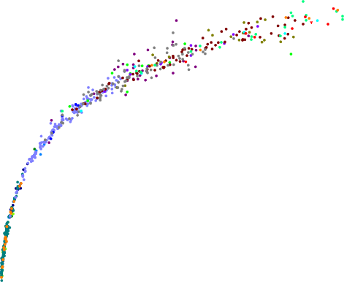



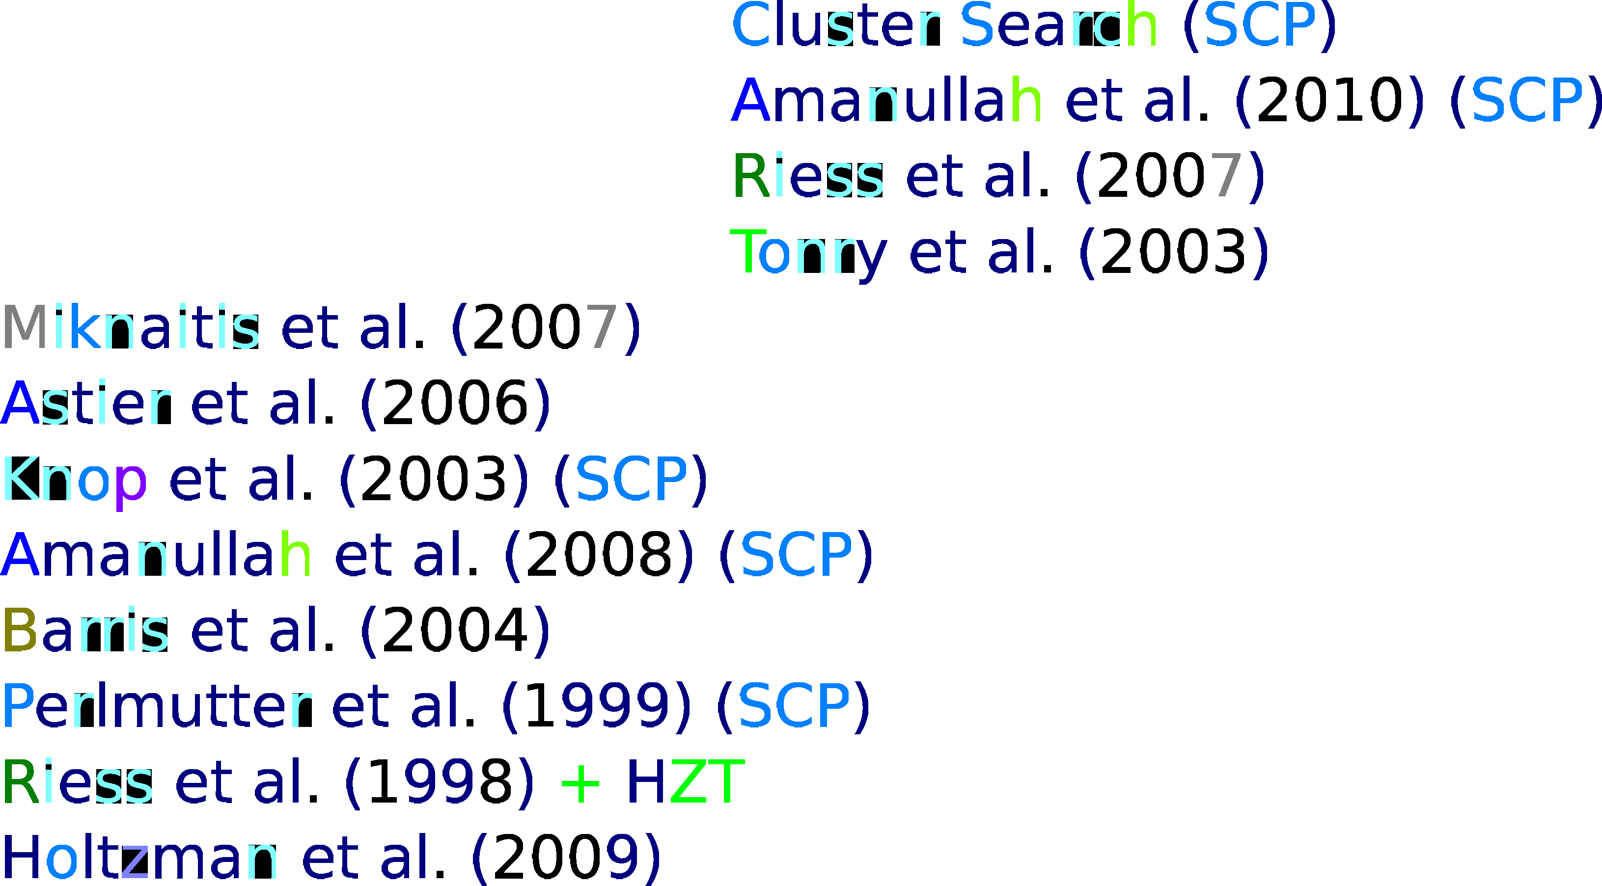


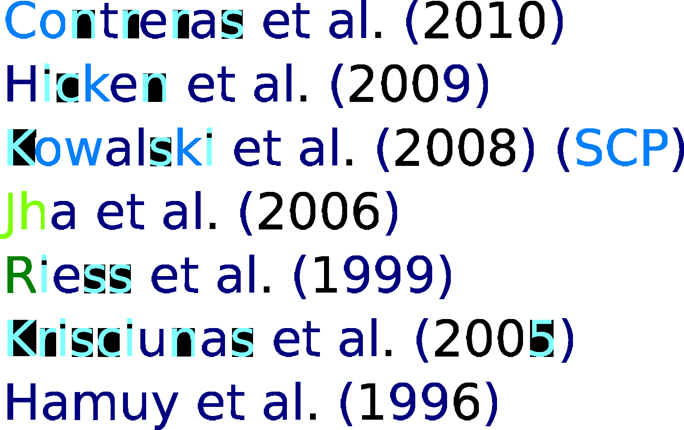









The Universe is in accelerated expansion
(Supernova Cosmology Project)
Latest Hubble diagram

Slide 24
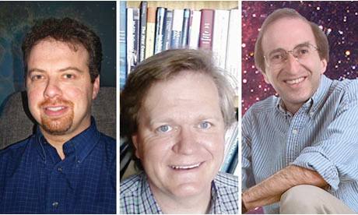

Nobel Prize in Physics 2011
Adam G. Riess Brian P. Schmidt Saul Perlmutter
The Nobel Prize in Physics 2011 was divided, one half awarded to Saul Perlmutter, the other half jointly to Brian P. Schmidt and Adam G. Riess "for the discovery of the accelerating expansion of the Universe through observations of distant supernovae".

Slide 25
Understanding the expansion of the Universe within Newtonian gravity
m
We consider a test mass m at the border of a homogeneous sphere of density ρ, which is expanding with velocity v = R˙ .
M
R
M = (4π/3)R³ρ
volume x density

Slide 26
Understanding the expansion of the Universe within Newtonian gravity
m
We consider a test mass m at the border of a homogeneous sphere of density ρ, which is expanding with velocity v = R˙ .
M
R
M = (4π/3)R³ρ
Its energy is
E = ^{m} v ² + U = ^{m} v ² − ^{GmM} = ^{m} v ² − ^{4πG} mρR²
2 2 R 2 3
kinetic energy
potential energy

Slide 27
Understanding the expansion of the Universe within Newtonian gravity
m
We consider a test mass m at the border of a homogeneous sphere of density ρ, which is expanding with velocity v = R˙ .
M
R
M = (4π/3)R³ρ
Its energy is
E = ^{m} v ² + U = ^{m} v ² − ^{GmM} = ^{m} v ² − ^{4πG} mρR²
2 2 R 2 3
As energy is conserved, 2E/m =: −K = constant = R^{˙ 2} − 8πGρR²/3.
With
we obtain the Friedmann equation (1922)
_{H2 +} K ₌ 8πG
ρ
Hubble rate
_{R}2
3
ρ – is the total energy density
(including massive objects and photons)

Slide 28
Understanding the expansion of the Universe within Newtonian gravity
Due to the expansion, the density decreases,
M
_{R}˙ R
ρ =
,
ρ˙ = −3ρ
4π
_{3 R}3
mass/volume
time dependence
during expansion

Slide 29
Understanding the expansion of the Universe within Newtonian gravity
Due to the expansion, the density decreases,
M
_{R}˙ R
ρ =
,
ρ˙ = −3ρ
4π
_{3 R}3
If we insert this in the derivative of the Friedmann equation we find
We get the second Friedmann equation (1922). It requires that expansion decelerates.
second derivative = acceleration → Newtonian gravity implies deceleration
of expansion (not supported by recent observations)

Slide 30
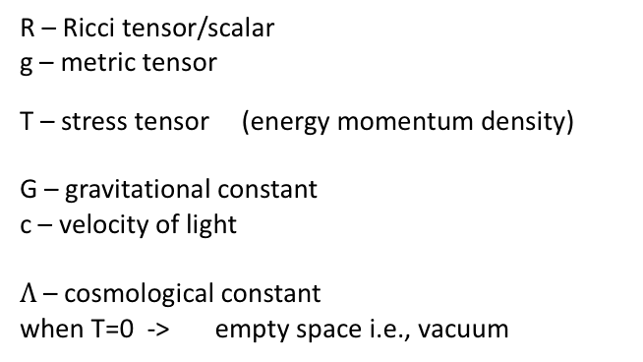
Einstein Equation
$Rμν$ - $\frac{1}{2}$ Rg$μν$ + $Λgμν= \frac{8πG }{c4}$ T$μν$
R – Ricci tensor/scalar
g – metric tensor
T – stress tensor (energy momentum density)
G – gravitational constant
c – velocity of light
$Λ$ – cosmological constant
when T=0 -> empty space i.e., vacuum
spacetime
conversion factors

Slide 31
Wikipedia:
In differential geometry, the Ricci curvature tensor,
named after Gregorio Ricci-Curbastro, represents the amount
by which the volume of a narrow conical piece of a small
geodesic ball in a curved Riemannian manifold deviates from
that of the standard ball in Euclidean space.
As such, it provides one way of measuring the degree to which
the geometry determined by a given Riemannian metric might
differ from that of ordinary Euclidean n-space. The Ricci tensor
is defined on any pseudo-Riemannian manifold, as a trace
of the Riemann curvature tensor. Like the metric itself,
the Ricci tensor is a symmetric bilinear form on the
tangent space of the manifold

Slide 32
The expansion of the Universe within General relativity
Including general relativity these equations are modified:
3 terms
P is the pressure and Λ is the cosmological constant, pressure contributes to gravity
ρE is the energy density. For ordinary matter ρE = c²ρ, and c is the speed of light.
K now has a new interpretation. It is the curvature of 3-dimensional space.
Introducing “density parameters” we get contributions to the expansion of the universe:
the first Friedmann equation becomes
matter
(includes radiation)
curvature
cosmological
constant

Slide 33
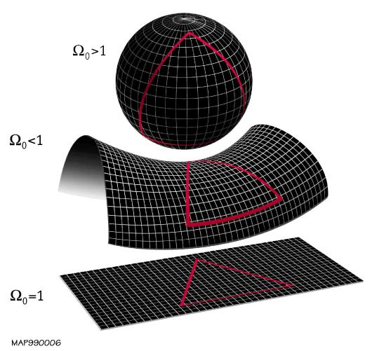
Curvature
K > 0 (ΩK < 0): spherical space,
K < 0 (ΩK > 0): pseudo-spherical space (saddle),
K = 0 (ΩK = 0): flat space.
Thee are 3-D representation of a 4-D space

Slide 34
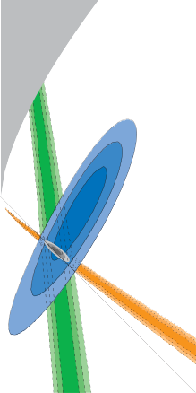
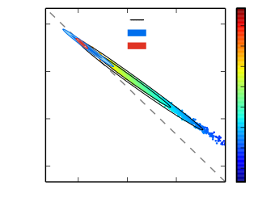
The Universe is in accelerated expansion
2.0
No Big Bang
1.5
Matter, Ωm , and cosmological constant, ΩΛ (dark energy).
1.0
1.0
SNe
0.75
+TE+EE
+lensing
+lensing+BAO
68
64
0.60
60
0.5
D\
56
H0
0.45
52
CMB
48
BAO
Flat
44
curvature effect
very small !
0.30
40
0.0
0.0 0.5
Supernova Cosmology
0.30
0.45 0.60
Dm
0.75
(solid red ometry of
contours). The red contours tightly constrain the ge- th our Universe to be nearly flat. d

Slide 35
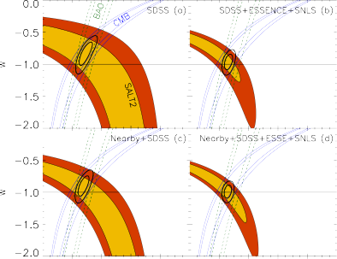
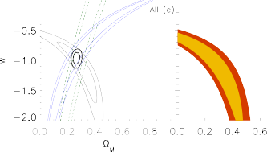
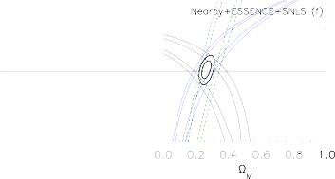
The Universe is in accelerated expansion
If pressure is negative,
P = wρE with w < −1/3 we can have accelerated expansion (R¨> 0) without a cosmological constant. Such a com- ponent is called dark energy. A cosmo- logical constant corresponds to a dark energy component with w = −1.
The matter fraction and the parameter
w of dark energy (Kessler et al. ’09).
One can get accelerating expansion of the universe without the
cosmological constant. The negative pressure becomes dark energy.

Slide 36

Conclusions
We can not observe space
We can never observe universe at a constant time
Looking at far away objects in the Universe we are looking into the past.

Slide 37

Conclusions
Looking at far away objects in the Universe we are looking into the past.
The Universe is expanding. More distant galaxies recede from us faster than more close by ones.

Slide 38

Conclusions
Looking at far away objects in the Universe we are looking into the past.
The Universe is expanding. More distant galaxies recede from us faster than more close by ones.
The distance to a galaxy, or the time at which its light which is currently reaching us has been emitted is determined by its redshift.

Slide 39

Conclusions
Looking at far away objects in the Universe we are looking into the past.
The Universe is expanding. More distant galaxies recede from us faster than more close by ones.
The distance to a galaxy, or the time at which its light which is currently reaching us has been emitted is determined by its redshift.
The Hubble diagram gives the distance of objects as function of their redshift.

Slide 40

Conclusions
Looking at far away objects in the Universe we are looking into the past.
The Universe is expanding. More distant galaxies recede from us faster than more close by ones.
The distance to a galaxy, or the time at which its light which is currently reaching us has been emitted is determined by its redshift.
The Hubble diagram gives the distance of objects as function of their redshift.
Recent observations have shown that the expansion of the Universe is accelerated. Understanding this within general relativity requires ’dark energy’.

