Slide 1
Lecture 31

Slide 2

Cosmology II: The CMB, dark matter and dark energy

Slide 3





Contents
1
Recombination
2
The cosmic microwave background
3
Dark matter
4
Dark energy models
5
Conclusions

Slide 4
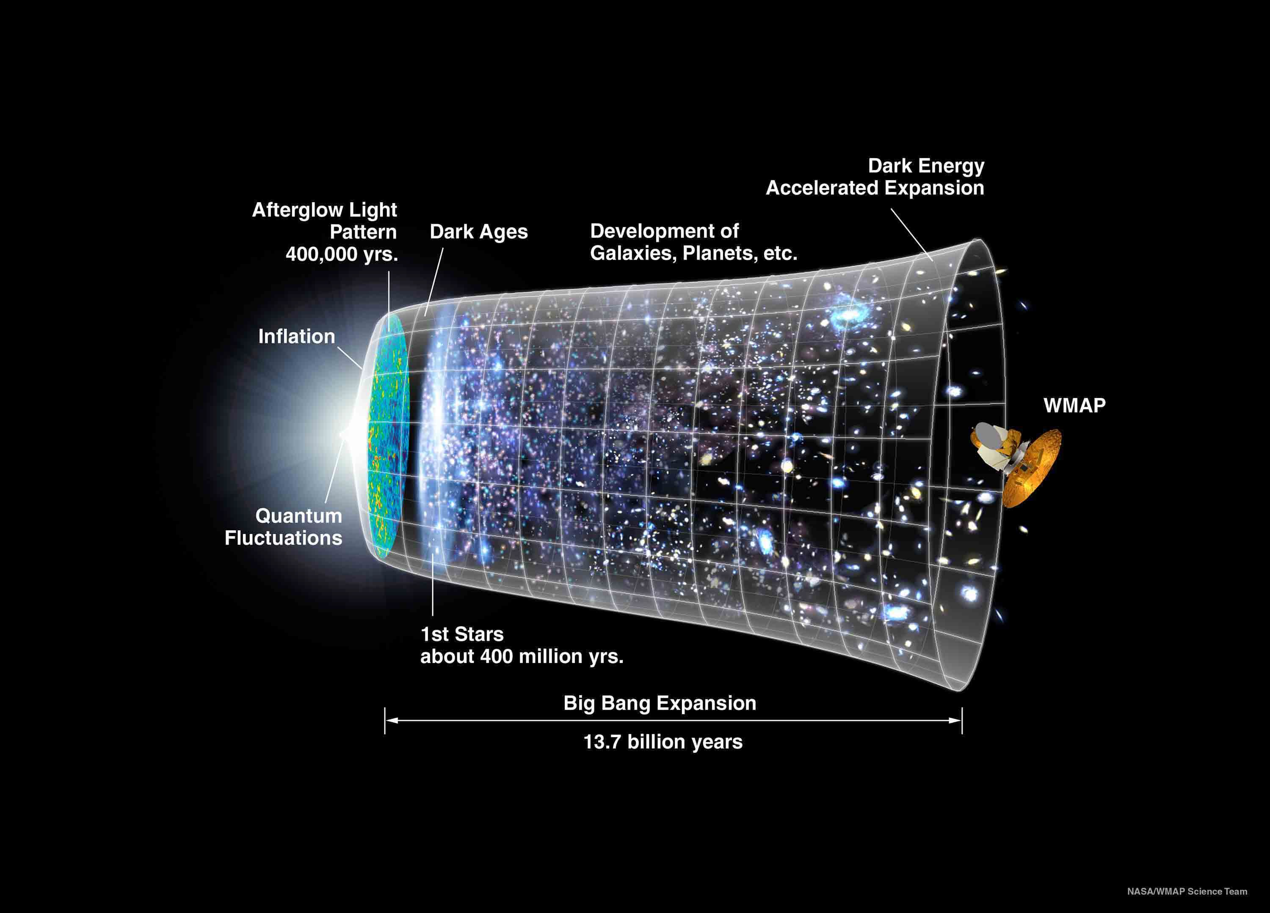
Thermal history
In the past the Universe was not only much denser than today but also much hotter
If the expansion is adiabatic. The matter could not stay neutral, because when electron and proton formed an atom, a high energy photon would strike it ionizing again.
The most remarkable events of the hot Universe:
-Recombination (electrons and protons combine to neutral hydrogen).
When the matter became neutral, the photons could travel freely
Age of the Universe: t0 ~13.7 billion years

Slide 5
Thermal history
In the past the Universe was not only much denser than today but also much hotter.
The most remarkable events of the hot Universe:
-Recombination (electrons and protons combine to neutral hydrogen).
-Nucleosynthesis (the formation of Helium, Deuterium, ...)
Age of the Universe: t0 ~13.7 billion years

Slide 6
Thermal history
In the past the Universe was not only much denser than today but also much hotter.
The most remarkable events of the hot Universe:
-Recombination (electrons and protons combine to neutral hydrogen).
-Nucleosynthesis (the formation of Helium, Deuterium, ...)
-Inflation ?
Age of the Universe: t0 ~13.7 billion years

Slide 7
Recombination
Since the photon (radiation) energy density scales like T ⁴ ∝ R⁻⁴ ∝ (z + 1)⁴ while
the matter density scales like mn ∝ R⁻³ ∝ (z + 1)³, at very early time, the
Universe is radiation dominated (at red shift z > 4000, time t < 10⁴ years).
This is derived running equations backwards in time.
Note the large number of simplifying approximations.
(Aside - Spherical cow joke):
Milk production at a dairy farm was low, so the farmer wrote to the local university
asking for help from academia. A multidisciplinary team was assembled,
headed by a theoretical physicist, performed on-site investigation. The scholars
then returned to the university to analyze data. The final report was left to the team
leader. Shortly thereafter the physicist returned to the farm, saying to the farmer:
"I have the solution, but it works only in the case of spherical cows in a vacuum".)

Slide 8
Recombination
Since the photon (radiation) energy density scales like T ⁴ ∝ R⁻⁴ ∝ (z + 1)⁴ while
the matter density scales like mn ∝ R⁻³ ∝ (z + 1)³, at very early time, the
Universe is radiation dominated (z > 4000, t < 10⁴ years).
At T ~ 3000K (t ~ 300 000years) the Universe is ’cold’ enough that protons and electrons can combine to neutral hydrogen.

Slide 9
Recombination
Since the photon (radiation) energy density scales like T ⁴ ∝ R⁻⁴ ∝ (z + 1)⁴ while
the matter density scales like mn ∝ R⁻³ ∝ (z + 1)³, at very early time, the
Universe is radiation dominated (z > 4000, t < 10⁴ years).
At T ~ 3000K (t ~ 300 000years) the Universe is ’cold’ enough that protons and electrons can combine to neutral hydrogen.
After this, photons no longer scatter with matter but propagate freely. Their energy (and hence the temperature) is redshifted to T0 = 2.728K today, corresponding to a density of about 400 photons per cm³.
Expansion of the universe implied
a lowering of the energy of the photons
via increase of their wavelength

Slide 10
Recombination
Since the photon (radiation) energy density scales like T ⁴ ∝ R⁻⁴ ∝ (z + 1)⁴ while
the matter density scales like mn ∝ R⁻³ ∝ (z + 1)³, at very early time, the
Universe is radiation dominated (z > 4000, t < 10⁴ years).
At T ~ 3000K (t ~ 300 0years) the Universe is ’cold’ enough that protons and electrons can combine to neutral hydrogen.
After this, photons no longer scatter with matter but propagate freely. Their energy (and hence the temperature) is redshifted to T0 = 2.728K today, corresponding to a density of about 400 photons per cm³.
This cosmic microwave background can be observed today in the (1– 400)GHz range. It has a perfect blackbody spectrum.

Slide 11
Recombination
Since the photon (radiation) energy density scales like T ⁴ ∝ R⁻⁴ ∝ (z + 1)⁴ while
the matter density scales like mn ∝ R⁻³ ∝ (z + 1)³, at very early time, the
Universe is radiation dominated (z > 4000, t < 10⁴ years).
At T ~ 3000K (t ~ 300 0years) the Universe is ’cold’ enough that protons and electrons can combine to neutral hydrogen.
After this, photons no longer scatter with matter but propagate freely. Their energy (and hence the temperature) is redshifted to T0 = 2.728K today, corresponding to a density of about 400 photons per cm³.
This cosmic microwave background can be observed today in the (1– 400)GHz range. It has a perfect blackbody spectrum.
It represents a ’photo’ of the Universe when it was about 300’000 years young, corresponding to a redshift of z ≃ 1100.
The universe density was z³ time denser then now !

Slide 12
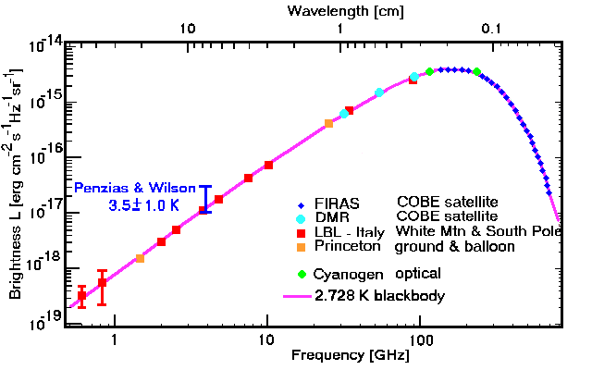
The cosmic microwave background: the spectrum
(Fixen et al. 1996)
Nobel Prize 1978 for Penzias and Wilson, Nobel Prize 2006 for Mather (Kobe satelite)
T0 = 2.728K ~ −270.5º C
Best measurement of a black body spectrum, not achievable in the lab

Slide 13
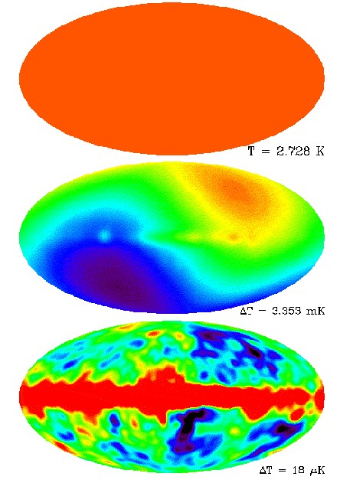
The cosmic microwave background: anisotropies
Map of the CMB temperature:
perfectly isotropic. Galaxy is in the middle.
After subtraction of the constant blackbody radiation of 2.7K we see a dipole behavior. This dipole comes from a motion wrt of the sphere of emission of the radiation (motion of Earth wrt center of galaxy and around a Sun)

Slide 14
The cosmic microwave background: anisotropies
Map of the CMB temperature:
perfectly isotropic.
Subtracting the monopole and dipole of amplitude ∼ 10⁻³ becomes visible. It is mainly due to the motion of the solar system with respect of the sphere of emission (last scattering surface).
This is an origin of an estimate that Earth is moving around the center of the galaxy with velocity of ~300 km/s
10⁻³ x velocity of light.

Slide 15
The cosmic microwave background: anisotropies
Map of the CMB temperature:
perfectly isotropic.
Subtracting the monopole and dipole amplitude ∼ 10⁻³ becomes visible. It is mainly due to the motion of the solar system with respect of the sphere of emission (last scattering surface).
And what is this? Left over after subtracting the dipole. Fluctuations of amplitude ∼ 10⁻⁵.
These remaining fluctuations come from our galaxy but also from outside sources.

Slide 16
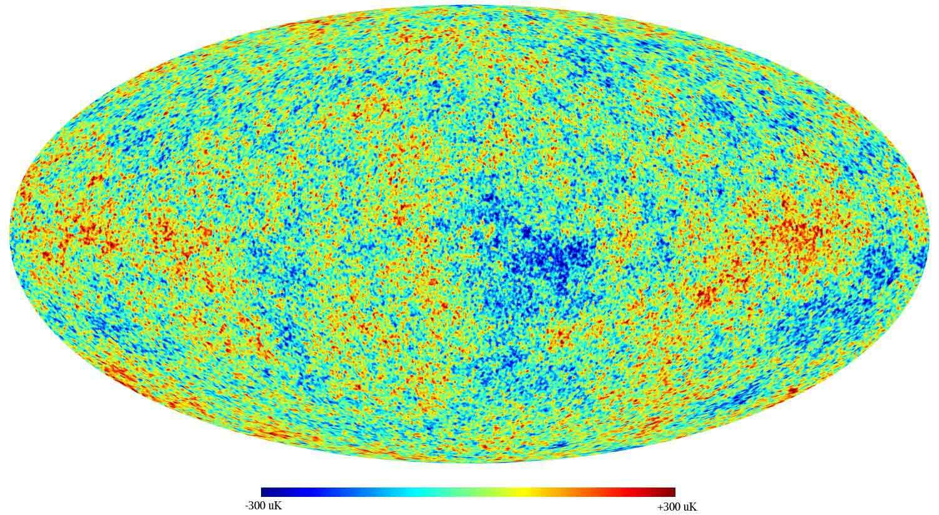
The cosmic microwave background: anisotropies
ESA/Planck (2015)
After subtraction of monopole, dipole and our galaxy

Slide 17
Fourier transform on the sphere – spherical harmonic functions Y_{lm}
Spectrum fitted to the Planck TT+lowP likelihood is plotted in the upper panel. Residuals with respect to this model are shown in the lower panel. The error bars show ±1 error uncertainties.

Slide 18
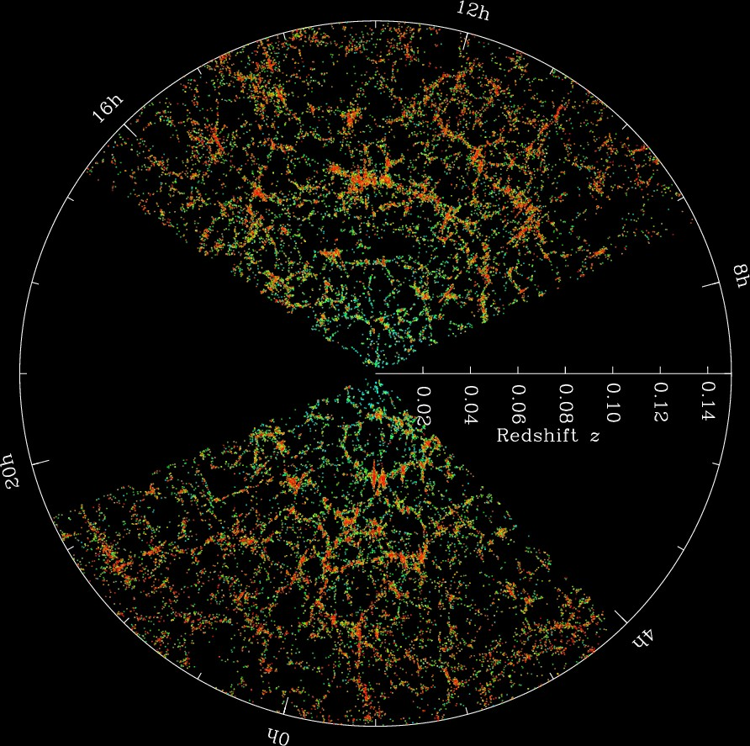
The cosmic microwave background: anisotropies
- The matter distribution in the observed Universe is not very homogeneous and isotropic. It is in form of galaxies, clusters, filaments, voids.
The idea is that these large scale structures formed by gravitational instability from small initial fluctua- tions which have been set up very early in the Universe (during inflation).

Slide 19
The cosmic microwave background: anisotropies
- The matter distribution in the observed Universe is not very homogeneous and isotropic. It is in form of galaxies, clusters, filaments, voids.
The idea is that these large scale structures formed by gravitational instability from small initial fluctua- tions which have been set up very early in the Universe (during inflation).
These initial fluctuations are also imprinted in the CMB.

Slide 20
The cosmic microwave background: anisotropies
- The matter distribution in the observed Universe is not very homogeneous and isotropic. It is in form of galaxies, clusters, filaments, voids.
The idea is that these large scale structures formed by gravitational instability from small initial fluctua- tions which have been set up very early in the Uni- verse (during inflation).
- These initial fluctuations are also imprinted in the CMB.
- Once a given scale enters the horizon, fluctuations on this scale begin to oscillate like acoustic waves (sound). The first peak corresponds to fluctuations which have had time to make exactly 1 contraction since horizon entry until decoupling.

Slide 21
The cosmic microwave background: anisotropies
- The matter distribution in the observed Universe is not very homogeneous and isotropic. It is in form of galaxies, clusters, filaments, voids.
The idea is that these large scale structures formed by gravitational instability from small initial fluctua- tions which have been set up very early in the Uni- verse (during inflation).
- These initial fluctuations are also imprinted in the CMB.
- Once a given scale enters the horizon, fluctuations on this scale begin to oscillate like acoustic waves (sound). The first peak corresponds to fluctuations which have had time to make exactly 1 contraction since horizon entry until decoupling.
- The second peak peak corresponds to fluctuations which have had time to make exactly 1 contraction and 1 expansion since horizon entry until decoupling (under density).
The third peak corresponds to fluctuations which have had time to make exactly 2 contractions (and 1 expansion) since horizon entry until decoupling.

Slide 22
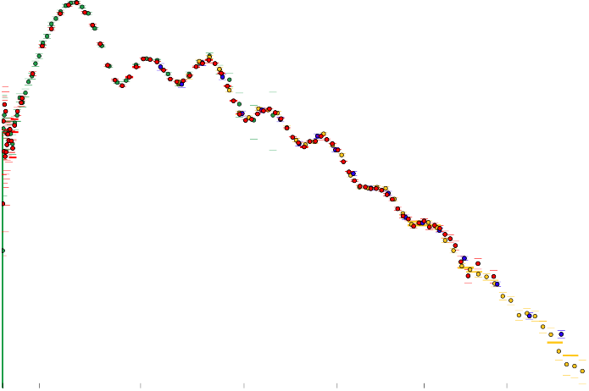
Combined CMB data
10⁴
Planck WMAP9 ACT SPT
10³
D_{l}[µK²]
10²
2 100 500
1000 1500 2000 2500 3000
l
August 3, 2016 10 / 23

Slide 23
The cosmic microwave background: parameters from Planck (2015)
r
The patches of peak amplitude temperature fluctuations are standard rulers. Their size is given by the age of the Universe at the time of decoupling (re- combination). The angle under which we see these patches determines the distance to the surface of last scattering. (z = zdec ~ 1100), d = r/θp .
The amplitude of the peaks depends on
the matter density (h = H0/100km/s/Mpc)
ρm ∝ Ωmh² = 0.1417 ± 0.00097
and the difference of the amplitude of even and odd peaks depends strongly on the density of electrons and hence baryons,
ρb ∝ Ωbh² = 0.02230 ± 0.00014 < Ωmh²
Most of the matter in the Universe is dark and non-baryonic!
d
θ

Slide 24
The cosmic microwave background: parameters from Planck (2015)
The angle subtended by the 1st peak is (together with the CMB temperature) the best measured number in cosmology,
rs
−2 −4
θ =
= (1.04093 ± 0.00030) × 10 δθs/θs = 2.8 × 10
s
d (z )
A s

Slide 25
The cosmic microwave background: parameters from Planck (2015)
The angle subtended by the 1st peak is (together with the CMB temperature) the best measured number in cosmology,
rs
−2 −4
θ =
= (1.04093 ± 0.00030) × 10
δθs/θs = 2.8 × 10
s
d (z )
A s
3ωb
r = .
4ω
γ
(Ωx h² ≡ ωx )
rs = (144.81 ± 0.24)Mpc .

Slide 26
The cosmic microwave background: parameters from Planck (2015)
The angle subtended by the 1st peak is (together with the CMB temperature) the best measured number in cosmology,
rs
−2 −4
θ =
= (1.04093 ± 0.00030) × 10
δθs/θs = 2.8 × 10
s
d (z )
A s
3ωb
r = .
4ω
γ
(Ωx h² ≡ ωx )
rs = (144.81 ± 0.24)Mpc .

Slide 27
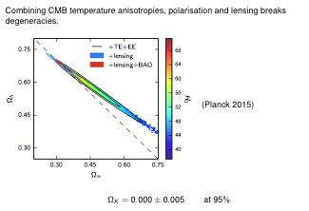

Slide 28
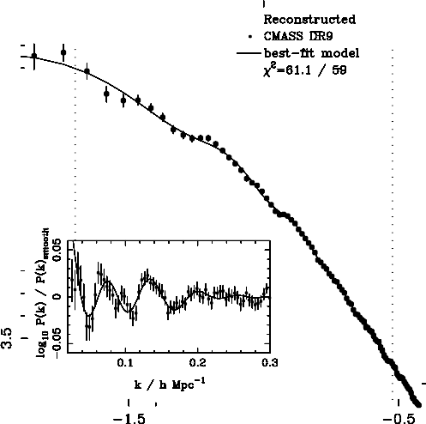
Baryon acoustic oscillations
The acoustic peaks are also visible in the matter power spectrum. (= The mean square amplitude of fluctuations of a given size.)
from Anderson et al. ’12
SDSS-III (BOSS)
power spectrum.
H0 = (68.11 ± 0.86)km/s/Mpc (Cheng & Huang, 2014)

Slide 29
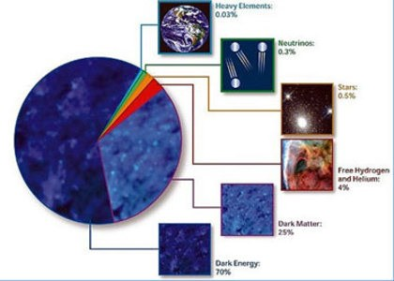
The cosmological composition
Data: CMB + BAO + SN Ia
H0 | = = | (67.7 ± 0.5)km/s/Mpc h100km/s/Mpc
Ωm Ωbh² | = = | 0.3 ± 0.01 0.0223 ± 0.00016
ΩK | = | 0.00 ± 0.005 (95%)
ΩΛ Ωradh² | = = | 0.7 ± 0.01 0.48 × 10⁻⁵
age | = | (13.81 ± 0.026)Gyr

Slide 30
Dark matter
Most of the matter in the Universe is in the form of an unknown non-baryonic component which does not interact with photons (dark).

Slide 31
Dark matter
Most of the matter in the Universe is in the form of an unknown non-baryonic component which does not interact with photons (dark).
Also most of the baryonic matter is in the form of gas which does not emit visible light.

Slide 32
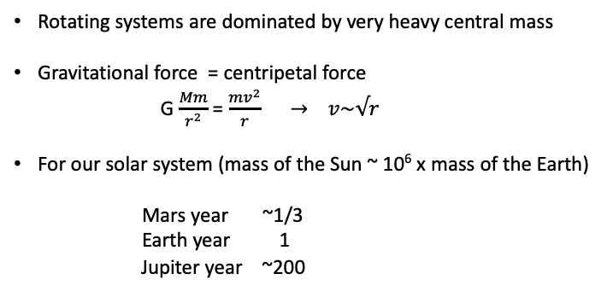
Rotating systems are dominated by very heavy central mass
Gravitational force = centripetal force
G $\frac{Mm}{r^{2}}$ = $\frac{mv^{2}}{r}$ $→$ $v\sim √r$
For our solar system (mass of the Sun ~ 10⁶ x mass of the Earth)
Mars year ~1/3
Earth year 1
Jupiter year ~200

Slide 33
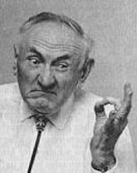
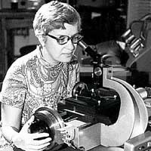
Dark matter
Most of the matter in the Universe is in the form of an unknown non-baryonic component which does not interact with photons (dark).
Also most of the baryonic matter is in the form of gas which does not emit visible light.
The first to postulate dark matter was the Swiss astronomer Fritz Zwicky. He realized that binding galaxy clusters gravitationally, requires about 100 times more mass than the mass of all its visible stars (HPA, 1933).
In the 70ties, the American astronomer Vera Rubin has shown that also galaxies are dominated by dark matter which contributes about 10 times more to their mass than the stars.

Slide 34
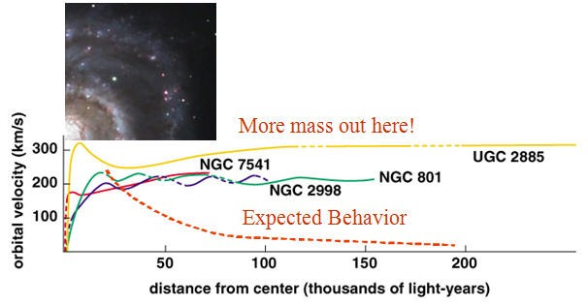
Dark matter
Rubin found that the rotation curves of test particles (stars, hydrogen atoms) rotating around galaxies do not show the expected decay of the velocity,
(G M m) / r² = m v² / r → v ~ √r
but have v = constant. Kepler’s law then requires that M ∝ r .

Slide 35
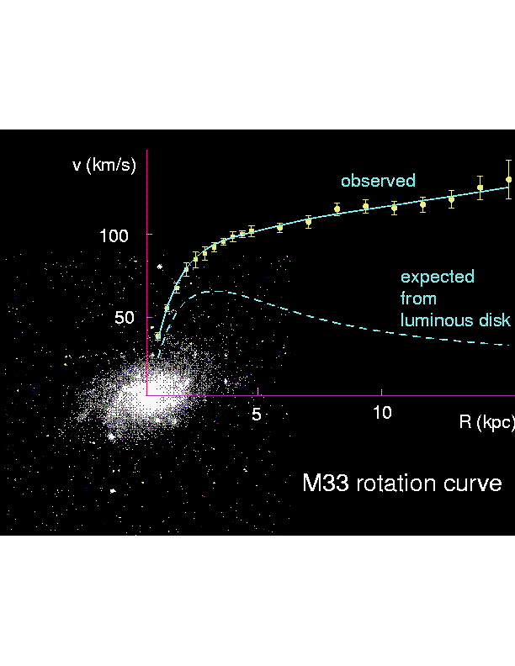

Dark Side of the Universe: Dark Matter
Dark (invisible) matter!
Gaseous Matter
Dark Matter appears to be weakly interacting massive particle
Lightest SUSY particle has these properties !
Dark Matter
WIMPs ?
35
Notes:
35

Slide 36
Dark matter is non-baryonic
These original discoveries do not shed any light on the nature of dark matter except that it does not emit visible photons.

Slide 37
Dark matter is non-baryonic
These original discoveries do not shed any light on the nature of dark matter except that it does not emit visible photons.
X ray observations show that a part (about 10% ) of dark matter in clusters is in the form of hot gas emitting X rays.

Slide 38
Dark matter is non-baryonic
These original discoveries do not shed any light on the nature of dark matter except that it does not emit visible photons.
X ray observations show that a part (about 10% ) of dark matter in clusters is in the form of hot gas emitting X rays.
Estimations of cluster masses (and CMB and LSS observations) yield
Ωmh² ,.. 0.14

Slide 39
Dark matter is non-baryonic
These original discoveries do not shed any light on the nature of dark matter except that it does not emit visible photons.
X ray observations show that a part (about 10% ) of dark matter in clusters is in the form of hot gas emitting X rays.
Estimations of cluster masses (and CMB and LSS observations) yield
Ωmh² ,.. 0.14
CMB anisotropies (and nucleosynthesis) require Ωbh² ,.. 0.02

Slide 40
Dark matter is non-baryonic
These original discoveries do not shed any light on the nature of dark matter except that it does not emit visible photons.
X ray observations show that a part (about 10% ) of dark matter in clusters is in the form of hot gas emitting X rays.
Estimations of cluster masses (and CMB and LSS observations) yield
Ωmh² ,.. 0.14
CMB anisotropies (and nucleosynthesis) require Ωbh² ~ 0.02
Hence most of dark matter (env. 85%) is non-baryonic.

Slide 41
New limits for particle-like dark matter (low mass)

Slide 42
Dark matter : Candidates
What could this dark matter be? A stable particle which do not couple to photons.
- Neutrino (cannot be bound in dwarf galaxies, too little small scale structure).
- Sterile Neutrino which is more massive but less abundant ?
- Neutralino (stable particle in most simple models of super-symmetry ⇒ LHC) ?
- Axion (Hypothetical stable particle required to solve the ’strong CP problem’) ?
- Primordial black holes ?
-Wimpzillas ? - Gravitinos ?
All these candidates require physics beyond the standard model!

Slide 43
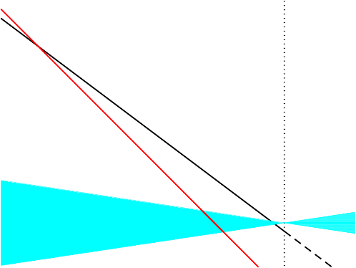
Dark energy models
Cosmological constant / vacuum energy
Provides a good fit to the data, but nobody understands its value at which it comes to dominate exactly ’now’.
Log [energy density (GeV )]
4
-36
-40
radiation
matter
-44
dark energy
-48
4
3
2 1
Log [1+z]
0
-1

Slide 44
Dark energy models
Quintessence
A scalar field which first follows the scaling of matter and radiation and has started to dominate recently.

Slide 45
Dark energy models
Quintessence
A scalar field which first follows the scaling of matter and radiation and has started to dominate recently.
Can reproduce the data if its behavior is close to a cosmological constant.

Slide 46
Dark energy models
Quintessence
A scalar field which first follows the scaling of matter and radiation and has started to dominate recently.
Can reproduce the data if its behavior is close to a cosmological constant.

Slide 47
Dark energy models
Modification of gravity at large scales, e.g. massive gravity, degravitation, extra dimensions.

Slide 48
Dark energy models
Modification of gravity at large scales, e.g. massive gravity, degravitation, extra dimensions.
Backreaction: If structure formation leads to relevant modifications of the geometry, this could modify the relation between distance and redshift...

Slide 49
Conclusions
Observations SN
15 years after the discovery of the accelerated expansion of the Universe, observations of several 100 supernovae of type Ia confirm it at more than 7σ.

Slide 50
Conclusions
Observations SN
15 years after the discovery of the accelerated expansion of the Universe, observations of several 100 supernovae of type Ia confirm it at more than 7σ.
Other data also require dark energy CMB, BAO, ....

Slide 51
Conclusions
Observations SN
15 years after the discovery of the accelerated expansion of the Universe, observations of several 100 supernovae of type Ia confirm it at more than 7σ.
Other data also require dark energy CMB, BAO, ....
Cosmological constant
A cosmological constant or vacuum energy which contributes about 70% to the energy density of the Universe is in good agreement with data.

Slide 52
Conclusions
Observations SN
15 years after the discovery of the accelerated expansion of the Universe, observations of several 100 supernovae of type Ia confirm it at more than 7σ.
Other data also require dark energy CMB, BAO, ....
Cosmological constant
A cosmological constant or vacuum energy which contributes about 70% to the energy density of the Universe is in good agreement with data.
Dark matter
25% of the energy density of the Universe is in the form of non-baryonic dark matter. Even if several reasonable candidates exist, we still have not been able to identify dark matter 85 years after it has been first postulated by Fritz Zwicky.

Slide 53
Conclusions
Observations SN
15 years after the discovery of the accelerated expansion of the Universe, observations of several 100 supernovae of type Ia confirm it at more than 7σ.
Other data also require dark energy CMB, BAO, ….
Cosmological constant
A cosmological constant or vacuum energy which contributes about 70% to the energy density of the Universe is in good agreement with data.
Dark matter
25% of the energy density of the Universe is in the form of non-baryonic dark matter. Even if several reasonable candidates exist, we still have not been able to identify dark matter 80 years after it has been first postulated by Fritz Zwicky.
Baryons
Only about 5% of the energy density of the present Universe is in the form of matter as we find it in our solar system, ordinary atoms made out of baryons and electrons.

Slide 54
Conclusions
Cosmological constant
A cosmological constant or vacuum energy which contributes about 70% to the energy density of the Universe is in good agreement with data.
Dark matter
25% of the energy density of the Universe is in the form of non-baryonic dark matter. Even if several reasonable candidates exist, we still have not been able to identify dark matter 80 years after it has been first postulated by Fritz Zwicky.
Baryons
Only about 5% of the energy density of the present Universe is in the form of matter as we find it in our solar system, ordinary atoms made out of baryons and electrons.

Slide 55

The thermal history of the Universe
In the past the Universe was not only much denser than today but also much hotter. Going back in time:
Important events in the early Universe
Recombination
Age of the Universe: t0 ,.. 13.7 milliards d’anne´es

Slide 56
The thermal history
In the past the Universe was not only much denser than today but also much hotter.
Important events in the early Universe
Recombination
Nucleosyhthesis (formation of Helium, Deuterium...)
Age of the Universe: t0 ,.. 13.7 billion years

Slide 57
The thermal history
In the past the Universe was not only much denser than today but also much hotter.
Important events in the early Universe
Recombination
Nucleosyhthesis (formation of Helium, Deuterium...)
Neutrino decoupling
Age of the Universe: t0 ,.. 13.7 billion years

Slide 58
The thermal history
In the past the Universe was not only much denser than today but also much hotter.
Important events in the early Universe
Recombination
Nucleosyhthesis (formation of Helium, Deuterium...)
Neutrino decoupling Phase Transitions?
Age of the Universe: t0 ,.. 13.7 billion years

Slide 59
The thermal history
In the past the Universe was not only much denser than today but also much hotter.
Important events in the early Universe
Recombination
Nucleosyhthesis (formation of Helium, Deuterium...)
Neutrino decoupling Phase Transitions? Inflation ?
Age of the Universe: t0 ,.. 13.7 billion years

Slide 60
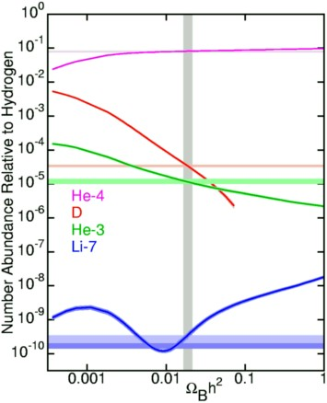
Nucleosynthesis
At Tnuc ~ 0.08MeV ~ 10⁹K,
znuc
~ 4 × 10⁸, Deuterium
(p + n) becomes stable. At this moment virtually all the neutrons present in the Uni- verse are ’burned’ into He⁴. Only traces of Deuterium, Helium³ and Lithium⁷ remain. Their abundance depends strongly on the baryon den- sity.

Slide 61
Neutrino decoupling
At Tdec ~ 1.4MeV ~ 1.6 × 10¹⁰K, zdec ~ 6 × 10⁹, weak interactions are no longer sufficiently frequent to keep the neutrinos in thermal equilibrium with the rest of the matter (baryons, electrons, photons, dark matter) neutrinos decouple.

Slide 62
Neutrino decoupling
At Tdec ,.. 1.4MeV ,.. 1.6 × 10¹⁰K, zdec ,.. 6 × 10⁹, weak interactions are no longer sufficiently frequent to keep the neutrinos in thermal equilibrium with the rest of the matter (baryons, electrons, photons, dark matter) neutrinos decouple.
Subsequently they interact only gravitationally. They are neither generated nor destroyed but simply loose energy due to the expansion of the Universe (redshift).

Slide 63
Neutrino decoupling
At Tdec ~1.4MeV ~ 1.6 × 10¹⁰K, zdec ~ 6 × 10⁹, weak interactions are no longer sufficiently frequent to keep the neutrinos in thermal equilibrium with the rest of the matter (baryons, electrons, photons, dark matter) neutrinos decouple.
Subsequently they interact only gravitationally. They are neither generated nor destroyed but simply loose energy due to the expansion of the Universe (redshift).
Later, at T~ 0.5 MeV, electrons and positrons decay into photons and heat up the photons but not the decoupled neutrinos.

Slide 64
Neutrino decoupling
At Tdec ,.. 1.4MeV ,.. 1.6 × 10¹⁰K, zdec ,.. 6 × 10⁹, weak interactions are no longer sufficiently frequent to keep the neutrinos in thermal equilibrium with the rest of the matter (baryons, electrons, photons, dark matter) neutrinos decouple.
Subsequently they interact only gravitationally. They are neither generated nor destroyed but simply loose energy due to the expansion of the Universe (redshift).
Later, at T ,.. 0.5MeV, electrons and positrons decay into photons and heat up the photons but not the decoupled neutrinos.
( )
1/3
A neutrino background at a ’temperature’ T =
4
T ,.. 1
.9K should exist in
ν
11
0
the Universe.

Slide 65
Neutrino decoupling
At Tdec ,.. 1.4MeV ,.. 1.6 × 10¹⁰K, zdec ,.. 6 × 10⁹, weak interactions are no longer sufficiently frequent to keep the neutrinos in thermal equilibrium with the rest of the matter (baryons, electrons, photons, dark matter) neutrinos decouple.
Subsequently they interact only gravitationally. They are neither generated nor destroyed but simply loose energy due to the expansion of the Universe (redshift).
Later, at T ,.. 0.5MeV, electrons and positrons decay into photons and heat up the photons but not the decoupled neutrinos.
( )
1/3
A neutrino background at a ’temperature’ T =
4
T ,.. 1
.9K should exist in
ν
11
0
the Universe.
But even if these neutrinos have a density of about 300 particles per cm³ they have not been detected directly so far due to their extremely weak interaction. Neutrinos are however ’observed’ indirectly by their gravitational effects: They constrain the abundance of He_{4.} _{I}from the measurement of helium we get a constraint on the number of neutrino species to be N ~ 3

Slide 66
Neutrino number, sterile neutrinos
In the Standard Model (particle physics)
N(light neutrinos) = 3
In the standard model (cosmology) Neff = 3.046.
The Planck + BAO data requires
Neff = 3.04 ± 0.33
An additional sterile neutrino with ∆N ,.. 0.3 and mass 0
.5 eV m 5 eV can
<
<
eff
∼ ∼
νsterile
actually reduce the tension of Planck with lensing data.
A much heavier, ∼ keV, sterile neutrino could be warm dark matter.

