Slide 1
Lecture 31

Slide 2
Probability and Statistics
Following A. Hoecker, H. Voss and K. Cranmer
Popular textbooks
Machine learning
C.M. Bishop, Pattern Recognition and Machine Learning, Springer 2006
T. Hastie, R. Tibshirani, J. Friedman, The elements of Statistical Learning, Springer 2001

Slide 6
Terms (Cranmer, Cowan)
Random variables / “observables” x
Probability (mass) and probability density function (pdf) p(x)
Parametrized Family of pdfs / “model” p(x|α)
Parameter α
Likelihood L(α)
Estimate (of a parameter) α^ (x)

Slide 7
Random variable / observable
“Observables” are quantities that we observe or measure directly
They are random variables under repeated observation
Discrete observables:
number of particles seen in a detector in some time interval
particle type (electron, muon, ...) or charge (+,-,0)
Continuous observables:
energy or momentum measured in a detector
invariant mass formed from multiple particles

Slide 8

Statistical Distributions
Measurements/Results typically follow some probability distribution
i.e. data is not at a fixed value, but “spreads out” in a particular way
Which type of distribution it follows depends on the particular case
important to know the different distributions
  be able to pick the correct one when doing the analysis
.. and know their characteristics
  be able to extract the “information” in the data
Note: in statistical context:
instead of “data” that follows a distribution,
one often (typically) speaks of a “random variable”

Slide 9

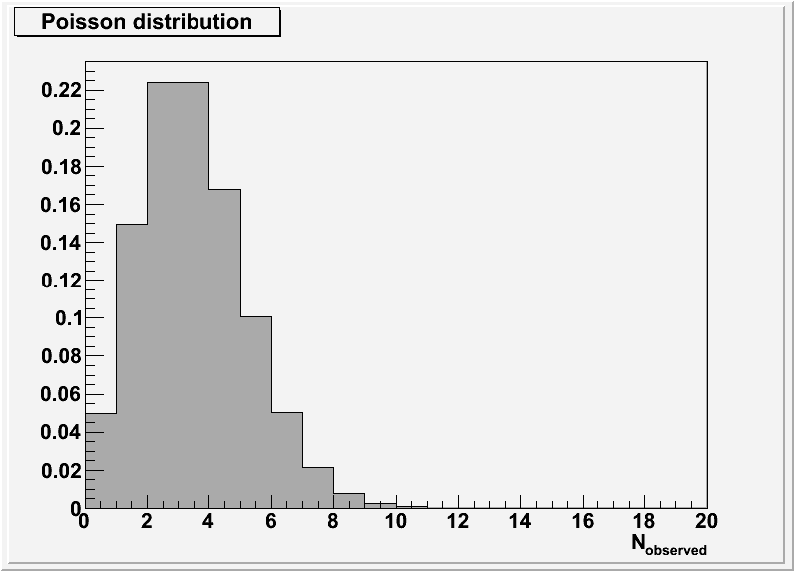
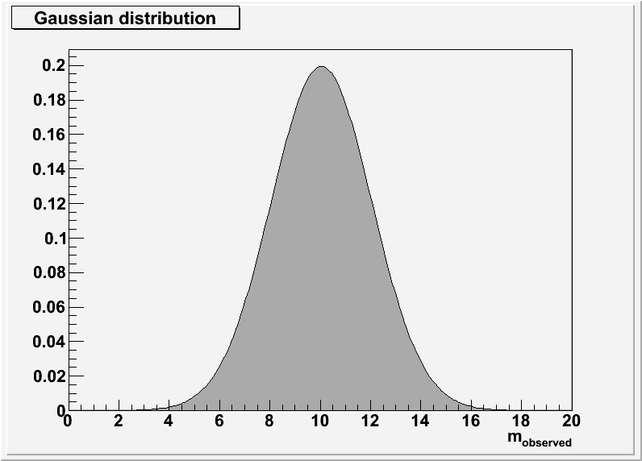
Probability Distribution/Density of a Random Variable
random variable x or k :
characteristic quantity of a point in sample space
discrete variables
𝑷 𝒌_{𝒊} = 𝒑_{𝒊}
continuous variables
𝑷 𝒙 ∊ 𝒙, 𝒙 + 𝒅𝒙 = 𝒑 𝒙 𝒅𝒙
normalisation (your parameter/event space covers all possibilities - unitarity )
^{𝒌}𝒊 ^{= 𝑵}𝒐𝒃𝒔.
^{𝒙 = 𝒎}𝒐𝒃𝒔.

Slide 12


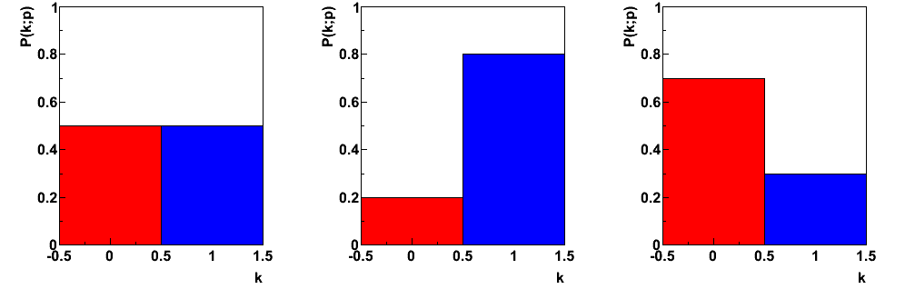
2 possible outcomes:
Yes/No Head/Tail
….
• (fair) coin: 𝑷 𝒉𝒆𝒂𝒅 = 𝒑 𝒆. 𝒈. = ^{𝟏}
, 𝑷 𝒕𝒂𝒊𝒍 = 𝟏 − 𝑷 𝒉𝒆𝒂𝒅
= 𝟏 − 𝒑
𝟐
Different values of probability p
p=0.5
p=0.8
p=0.7

Slide 14

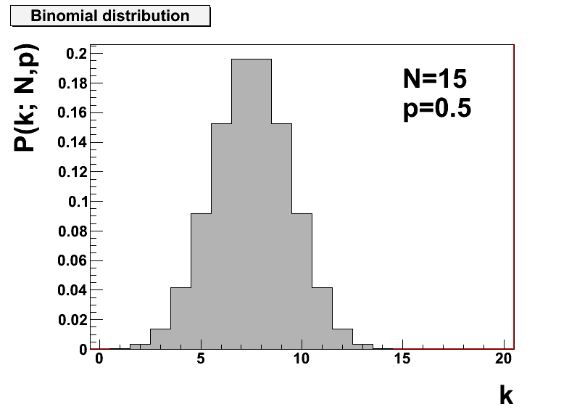
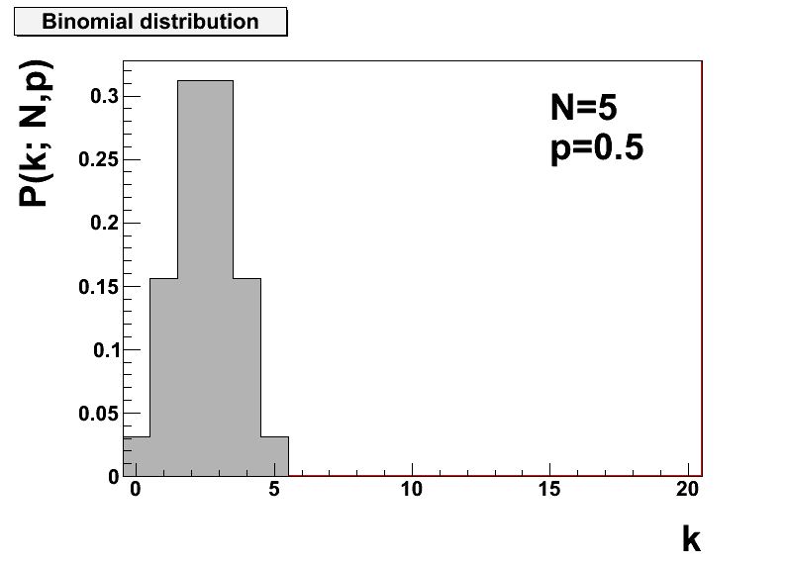
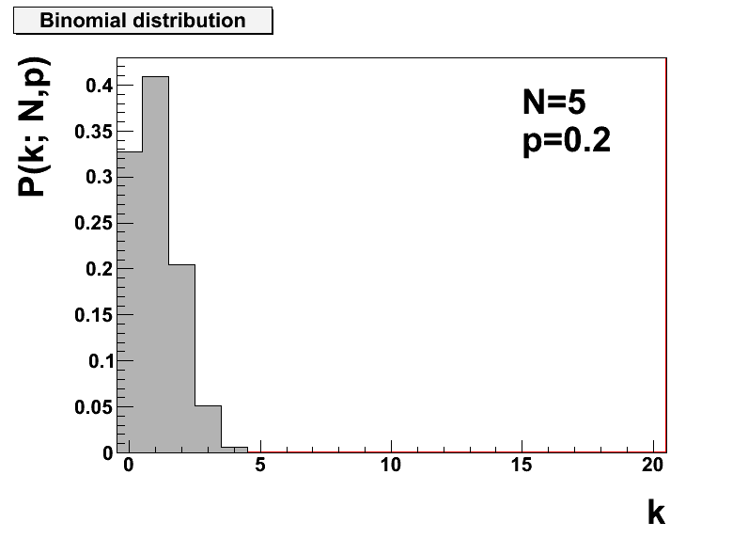
Examples:
Expectation value: sum over all possible outcomes and “average”
Variance:
• 𝑽 𝒌 = 𝑵𝒑(𝟏 − 𝒑)

Slide 15
Characteristic Quantities of Distributions
discrete variables
continuous variables
Expectation value E (mean value):
  Note: mean/expectation of 𝒇 𝒙 :
E[x] = 𝒙 = ∫ 𝒙𝑷 𝒙 𝒅𝒙
→ 𝑬 𝒇 𝒙 = ∫ 𝒇 𝒙 𝑷 𝒙 𝒅𝒙
Variance (𝑽 = 𝝈^{𝟐}, with 𝝈: “spread”) : 𝑬
𝒙 − 𝒙
𝟐
= 𝑬 𝒙^{𝟐} − (𝑬 𝒙 )^{𝟐}
𝒙 − 𝒙 ^{𝟐}𝑷 𝒙 𝒅𝒙
𝐕 𝒙 = ∫
𝒙 ^{𝟑}] ….
higher moments: Skew: 𝑬[ 𝒙 −
Note: expectation and variance are properties of the full population. Unbiased estimates, derived from samples taken from the distribution:

Slide 18
Poisson distribution applies when:
each event is independent of all other events
-> there are no correlations
you know the mean/average value
It allows you to estimate the probability of a given fluctuation
Examples
Number of decays of radioactive nuclei per unit time
Number of junk email you receive per day
Probability of weather occurrences
Number of supernova star explosion within Milky Way (our) galaxy
On a particular river, overflow floods occur once every 100 years on average.
Calculate the probability of k = 0, 1, 2, 3, 4, 5, or 6 overflow floods in a 100-year interval,
assuming the Poisson model is appropriate.
Because the average event rate is one overflow flood per 100 years, λ = 1

Slide 19










































The table below gives the probability for 0 to 6 overflow floods in a 100-year period.
k | P(k overflow floods in 100 years)
0 | 0.368
1 | 0.368
2 | 0.184
3 | 0.061
4 | 0.015
5 | 0.003
6 | 0.0005
Ugarte and colleagues report that the average number of goals in a World Cup soccer match is approximately 2.5 and the Poisson model is appropriate.^{[3]}
Because the average event rate is 2.5 goals per match, λ = 2.5.

