Slide 1
Foods that Deceive:
Food Additives and Their Role in the Feingold Diet
Kristin Harrington

Slide 2
A Quick Survey

Slide 3
Introduction

Slide 4
ADHD Basics
Attention Deficit Hyperactivity Disorder
  Inattentive
  Aggressive
  Excess Energy
Found in 3 – 6 % of school aged children¹⁰
Persistent into adulthood¹⁰

Slide 5
Feingold’s Hypothesis
And A Critical Analysis of It

Slide 6
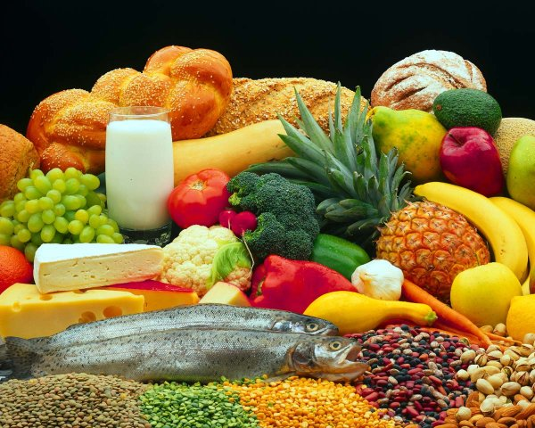
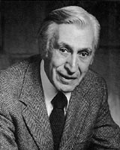
The Feingold Diet
“Additive-Free” Food⁷
Dr. Benjamin Feingold⁴

Slide 7
Additives Are Bad!
Stated over 3,000 food additives contributed to hyperactivity
Based off of treatment of aspirin-senstivie individuals
  Symptoms eliminated with removal of salicylates, along with other additives
Salicylates – chemical similar to aspirin

Slide 8
Some Problems with the Hypothesis
Salicylates Experiment
No published works in journals
  Diet seen in a book
  Feingold featured on Phil Donahue
Cold Fusion?

Slide 9
Testing the Hypothesis

Slide 10
Looking at the Evidence
Little evidence to validate food additives¹
Experiments should verify results
  Should be double-blinded
  Should be randomized
Sample size should be large enough
Two Common Studies:
  Crossover Study
  Challenge Study

Slide 11
Two Studies
Crossover³
Challenge¹⁶
Put on an additive free diet
Put on placebo or additive being tested
  One to two weeks out of trial time
Parents should be blinded
Also diet without additives
Challenged with placebo or offending additive
  Happens once a day for a certain amount of time

Slide 12
Pseudoscientific Traits
Demonstrated by Some Advocates of the Feingold Diet

Slide 13
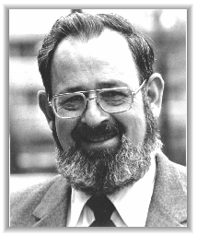
Dr. Bernard Rimland²⁰
Other scientists are vilifying Feingold¹⁴
Does not understand definitions of hypothesis & theory
How legitimate was Feingold’s assertion?

Slide 14
Dr. Rimland’s Very Pseudoscientific Arguments
Burden of Proof
  Always lies with the “claimant”
  “Weak” nature of tests “speaks strongly for … robustness of the Feingold effect”
Ad hoc Excuse
  Copper¹⁴
Correlation vs. Causation¹⁴
  SAT scores
  Correlation ≠ Causation

Slide 15
The Feingold Association of the Unites States

Slide 16
Use of Testimonials
Case of a mother and a son¹²
  ^{Anti-mildew products}
Problems with testimonials¹²
Dangers of public belief

Slide 17
Categorized Additives¹²
Food Coloring
Food Flavoring
Preservatives
Artificial Sweetener
Salicylates
Sometimes Refined Sugar

Slide 18
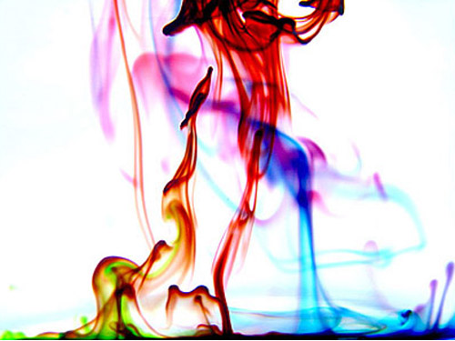
Food Coloring⁶

Slide 19
Basics of Food Coloring
Natural vs. Synthetic
Certified vs. Not Required to be Certified⁹
Considered safe⁹
  “Well-controlled studies conducted since [the 1970s] have produced no evidence that food additives cause hyperactivity or learning disabilities in children”¹⁷

Slide 20
Schwab’s Review Article¹⁷
No significance in professional and teacher ratings
Significant statistics in parental ratings
Does knowledge of sensitivity affect ratings
Strange that article thought the two were correlated
  Arrived at through statistical manipulation

Slide 21
Artificial Food Flavorings & Preservatives

Slide 22
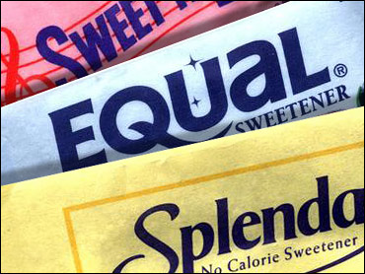
Artificial Sweetener²

Slide 23
Aspartame
Allergic reaction to phenylalanine¹⁶
Experiment using¹⁶:
  High sugar diet
  Low sugar, high aspartame diet
  Low sugar, low aspartame diet (control)
Resulted in no significant changes¹⁶

Slide 24
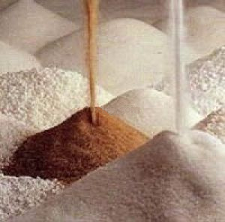
Refined Sugar⁵

Slide 25
Sugar and Its Controversies
How Parents May Misinterpret
Dr. Parris M. Kidd
Parent rating often only indication of behavior change
Can be caused by predetermined belief¹⁹
Correlation vs. Causation Problem¹⁹
  Candy & Excited at Holidays
Stated test by Wolraich setting baseline too high¹⁰
Sources verify Wolraich’s baseline within reason¹⁹
  Tested 53 grams / day¹⁰
  Average 84 grams / day¹⁹

Slide 26

Salicylates⁸

Slide 27
Basics of Salicylates
Made from plants for self protection¹²
Toxic if past threshold¹⁵
Found in^{12,15}:
  Fruits
  Vegetables
  Herbs
  Spices
  Over the counter cold medication

Slide 28
Two Differing Viewpoints
Feingold Diet Claims¹²
Scientific Research Claims¹³
Can cause:
  Asthma
  Hyperactivity
  Eczema
  And everything in between
Reduce risk of developing colon cancer
Historically significant

Slide 29
Conclusion

Slide 30
Works Cited
1. Anastopoulos, Arthur D. , and Russel A. Barkley. "Biological Factors in Attention Deficit-Hyperactivity Disorder." the Behavior Therapist 11 (1988): 47 - 52. Print.
2. "Artificial Sweeteners 101 Â« Live. Love. Laugh. Eat. Learn.." Live. Love. Laugh. Eat. Learn.. N.p., n.d. Web. 9 Dec. 2009. <http://livelovelaugheatlearn.wordpress.com/2009/03/30/artificial-sweeteners-101/>.”
3. Bateman, B, J O Warner, E Hutchinson, T Dean, P Rowlandson, C Gant, J Grundy, C Fitzgerald, and J Stevenson. "The effects of a double blind, placebo controlled, artificial food colourings and benzoate preservative challenge on hyperactivity in a general population sample of preschool children." Arch Dis Child 89 (2004): 506- 511. Print.
4. Benjamin Feingold ." AbsoluteAstronomy.com . N.p., n.d. Web. 9 Dec. 2009. <http://www.absoluteastronomy.com/topics/Benjamin_Feingold>.
5. "Candy - a knol by Tom Hoeck." Knol - a unit of knowledge: share what you know, publish your expertise.. N.p., n.d. Web. 9 Dec. 2009. <http://knol.google.com/k/candy#>.
6. "Color dance - Snapshots: Evon Lim - CNET Asia." Tech product reviews for mobile phones, notebooks, handhelds, digital cameras - CNET Asia. N.p., n.d. Web. 9 Dec. 2009. http://asia.cnet.com/reviews/digitalcameras/0,39001469,39294428-12,00.htm.

Slide 31
Works Cited (continued)
7. Feingold Hypothesis -- Food Additives Cause Hyperactivity." Healing With Nutrition. N.p., n.d. Web. 9 Dec. 2009. <http://www.healingwithnutrition.com/adisease/add-adhd/feingoldstudy.html>.
8. File:Phenyl salicylate structure.svg - Wikimedia Commons." Wikimedia Commons. N.p., n.d. Web. 9 Dec. 2009. <http://commons.wikimedia.org/wiki/File:Phenyl_salicylate_structure.svg>.
9. "Food Ingredients and Colors." U S Food and Drug Administration Home Page. N.p., n.d. Web. 7 Dec. 2009. http://www.fda.gov/Food/FoodIngredientsPackaging/ucm094211.htm
10. Kidd, Parris M.. "Attention Deficit/Hyperactivity Disorder (ADHD) in Children: Rationale for Its Integrative Management." Alternative Medicine Review 5.5 (2000): 402 - 428. Print.
11. "Old and New Controversies in the Alternative Treatment of Attention-Deficit Hyperactivity Disorder." MRDD Research Reviews 11 (2005): 116 - 130. Print.
12. "Overview of Feingold Program." The Feingold Diet Program for ADHD. N.p., n.d. Web. 4 Dec. 2009. http://www.feingold.org/pg-overview.html.

Slide 32
Works Cited (continued)
13. Paterson, John, Gwen Baxter, James Lawrence, and Garry Duthie. "Is there a role for dietary salicylates in health?." Proceedings of the Nutrition Society 65 (2006): 93 - 96. Print.
14. Rimland, Bernard. "The Feingold Diet: An Assessment of the Reviews By Mattes, By Kavale and Forness and Others." Journal of Learning Disabilities 16.6 (2001): 331 - 333. Print.Rojas, Neal L., and Eugenia Chan.
15. "Salicylates." California Poison Control System. N.p., n.d. Web. 4 Dec. 2009. <http://www.calpoison.org/hcp/2009/callusvol7no4.htm>.
16. Schnoll, Roseanne, Dmitry Burshteyn, and Juan Cea-Aravena. "Nutrition in the Treatment of Attention-Deficit Hyperactivity Disorder: A Neglected but Important Aspect." Applied Pyschophysiology and Biofeedback 28.1 (2003): 63 - 75. Print.

Slide 33
Works Cited (continued)
17. Schwab, David W, and Nhi-Ha T. Trinh. "Do Artificial Food Colors Promote Hyperactivity in Chidren with Hyperactive Syndromes?." Developmental and Behavioral Pediatrics 25.6 (2004): 423 - 434. Print.
18. Shermer, Michael. Why People Believe Weird Things. New York: Holt Paperbacks, 2002. Print.
19. White, J Wade, and Mark Wolraich. "Effect of sugar on behavior and mental performance." Am J Clin Nutr 62 (1995): 242S - 249S. Print.
20. "Why We Walk." Autism is Treatable. N.p., n.d. Web. 9 Dec. 2009. <https://www.ariautism.com/zoowalk/phoenix/html/why_we_walk.html>.
21. Williams, J Ivan, Douglas M. Cram, Frances T Tausig, and Evelyn Webster. "Relative Effects of Drugs and Diet on Hyperactive Behaviors: An Experimental Study." Pediatrics 61.6 (1978): 811 - 817. Print.

Slide 34
Any Questions?

