Slide 1
Variations in Muon Flux:
Four Years from Dallas Regionals to SNO Lab
Thomas A. Catanach
3 August 2009
Notes:
Define what grand stands for

Slide 2
Introduction
Cosmic rays, subatomic particles or nuclei, fly through space at close to the speed of light with very high energies and collide with the earth’s atmosphere triggering a cascade of particles which creates muons.
The flux of muons varies over time due to a variety of environmental and solar factors, many of which exhibit periodicity.
Over the past four years I have explored these periodic variations beginning with the Dallas Regional Science Fair with a detector made at SMU and continuing with my involvement with Project GRAND and SNO Lab.

Slide 3
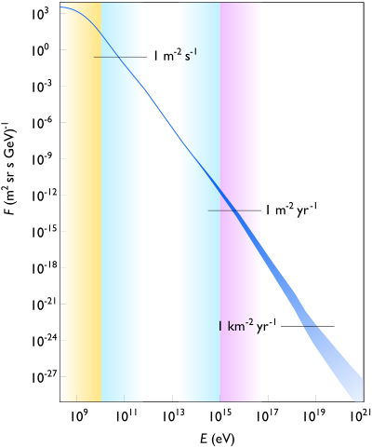
Cosmic Rays
Categories of cosmic rays
  Solar cosmic rays
  Galactic cosmic rays
  Extragalactic cosmic rays.
Cosmic rays are made of 90% protons (p⁺), 9% alpha-particles ( α²⁺), and 1% heaver nuclei or electrons (e⁻).
Cosmic rays interact with the magnetic field of the galaxy and the solar system.

Slide 4
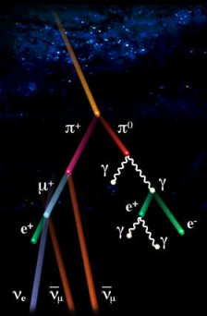
Muons
The muon is in the second generation of the lepton family
  Mass: 106 MeV/c²
  Charge: -1
  Lifetime at rest: 2.2 µsec
Cosmic rays hit the atmosphere creating a cascade of particles at about 15km in the atmosphere.
Underground, muons can be produced by neutrinos
On average 1 event occurs per cm² per minute.
http://livefromcern.web.cern.ch/livefromcern/antimatter
/history/historypictures/cosmic-80.jpg
Notes:
Clarify that muons for cosmic rays mean both muon and anti muon
Production of pions about 20km

Slide 5
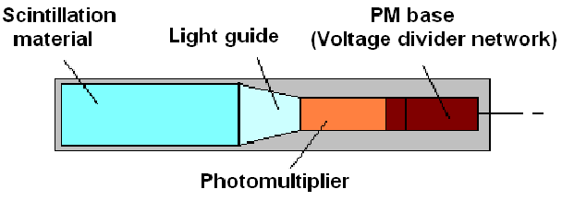
Muon Detection
Plastic Scintillator detectors
  Uses a PMT to detect scintillation light from muons entering the plastic
Proportional Wire Chamber (PWC)
  Similar to Geiger-Muller detectors
  A gas filled chambers with large potential differences.
Heavy Water Chambers
  Cherenkov light from the muons can be detected by a ball of PMTs so tracks can be constructed through the D₂O.
http://research.fit.edu/hep/Cosmic_Ray_Muon_Detection.pdf

Slide 6
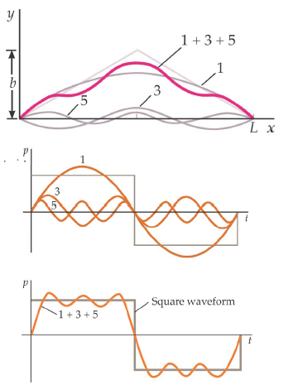

Fourier Analysis
Discrete Fourier Transform
  Converts a series in time domain into a series in the frequency domain
  Power Spectral Density (PSD)
    The spectra of the power at each frequency in frequency space for the function
Sliding Fourier Transform
…
FFT
4
n
n+1
n+2
n+3
1
2
3
n+1
n+2

Slide 7
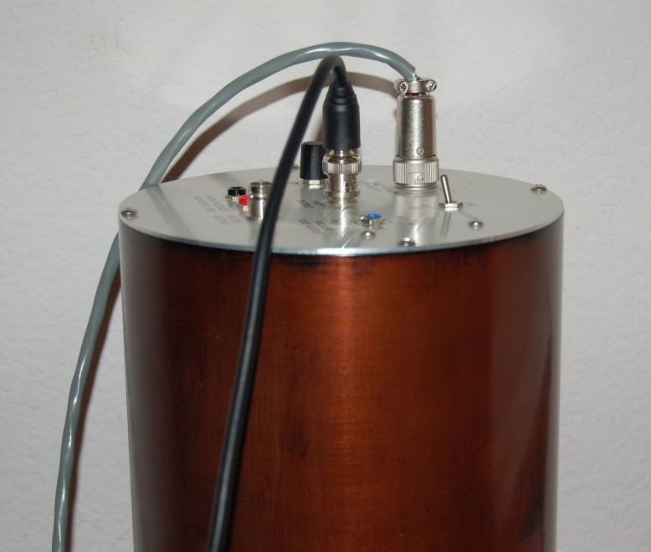
Science Fair
Using a Plastic Scintillator Detector I conducted muon flux measurements for three years during High School
Objectives:
  Research sensor bias
  Correlate different samples in order to isolate probable trends
  Determine the affect of climate on muon flux

Slide 8
Selection of Data
*This data was collected by SMU and was divided into
several files causing the data to be discontinuous at several points.

Slide 9
Sensor Comparison
Notes:
Here the two datasets are observed to be tracking each other well
The SMU detector appears to be more sensitive than the Winston detector, probably due to variations within their different scintillators.
They appear to be following the same tends and rise and fall with each other, while the deviation within the data is also about the same.

Slide 10
Detector Correlation
Low Frequency Trends
Areas of High
Correlation
Filter Width
Notes:
This graph shows how the correlation of the two sensors varies at different frequencies.
The two detectors seem correlated for low frequencies from just above DC to below .5 cycles per day, indicated by the wider surface.
The overall curve is positive except for a few points, and there are many thinner correlations; this indicates that the two datasets have a great deal in common.
However, it does appear that there is a lot of noise influencing the detector.

Slide 11
Power Spectral Density
1 Cycle Per Day
Trend
Relative Intensity (dB)
Relative Intensity (dB)
2 Cycle Per Day
Trend
Notes:
When the three correlation sets were compared all had peaks around 1 and 2 cycles per day.
There are definitely factors effecting muon flux over time, based on the analysis of the PSDs, long term data collections, and the PDF.

Slide 12
Temperature
Notes:
Temperature and muon flux do not seem to be related, because of the low R² value.

Slide 13
Atmospheric Pressure
Notes:
Pressure and muon flux have an inverse correlation because of the downward sloping trend line and the higher R² value.

Slide 14
Spring 2006 Pressure and Flux
Notes:
Pressure and muon flux behave inversely for when one has a maximum the other has a minimum.

Slide 15
Pressure PSD
1 Cycle Per Day
Trend
2 Cycle Per Day
Trend
Notes:
This PSD shows the various cycles in atmospheric pressure based on data from NOAA. This demonstrates that pressure varies on a 1 cycle per day and 2 cycle per day trend.
Talk about how appeared that maybe pressure caused two cycle per day as the psd does not show phase
Look later at phase information of the pressure, IMF, and muon flux

Slide 16
Precipitation
Decrease In Flux
Before Rain
Stabilizes After Rain
Increase In Flux
During Rain
Notes:
Precipitation might have locally minor effect on flux as the amount of water vapor in the atmosphere changes, making it less difficult for muons to penetrate the atmosphere during a rain storm.
Within the margin of error, did not really think about those things at the time

Slide 17
Discussion
Observations
  Minor sensor bias
  Correlations did exist between the samples revealing possible low frequency trends along with a one and two cycle per day trend
  Climatic factors particularly pressure have an appreciable influence on muon flux
Lessons
  Datasets are never pretty which requires the development of different approaches to tackle the problems
    Understanding sensor bias
    Finding methods to fuse data
  Computing skill are essential for any level of research
  Mentors and networks were very important to so that I could discuss my ideas and problems
Notes:
Ideas for future work
Plug Tom and SMU

Slide 18
Project GRAND
Project GRAND uses proportional wire chambers (PWC) to detect muons to find individual events and showers.
The flux of muons varies over time due to a variety of environmental and solar factors, many of which exhibit periodicity.
Through Project GRAND large continuous datasets can be used to isolate these trends
Objectives:
  Analyze the effects of temperature and pressure on muon flux and identify seasonal trends so that a calibration factor can be determined.
  Research the character of the daily mean variation in muon flux

Slide 19
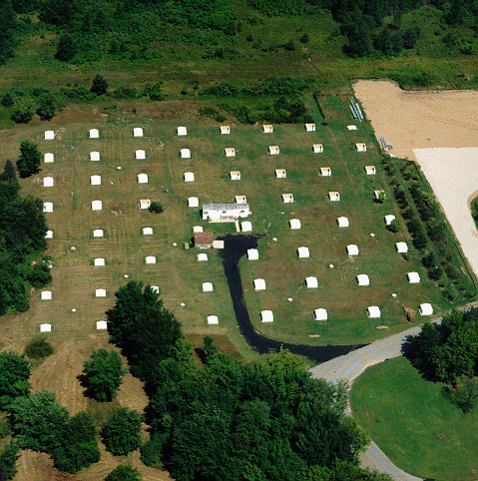
Project GRAND Experiments
Low Energy Experiment
  30 – 300 GeV
  Single Track Muon Data
  Looks for variations in individual muon flux due to solar phenomena such as a Solar Energetic Proton
High Energy Experiment
  100-100000 TeV
  Shower Data
  Analyze high energy cosmic ray events
Project Grand Setup
  8x8 array of PWCs with total area of 83 m²
  Muon threshold of .1 GeV
  ±63º cutoff angle from zenith with ±.26º precision
Notes:
Look into shower data to analyze the ultra high energy

Slide 20
Hut Construction
8 Proportional Wire Chambers
  4 x-planes (NS)
  4 y-planes (EW)
Chamber Details
  Each plane has 80 cells
  .01 m separation high voltage plates
  1.25 m² in area
  Uses 80% Argon 20% CO₂ gas mixture
  .05 m steel plate before the bottom two planes
Hut temperature and humidity are held within normal levels
.014 m
.2 m
.05 m
1.1 m
Notes:
Distance between two high voltage plates 10 mm and the width of cell is 14 cm
--------------------
……………….
--------------------
Electrons released when the gas is ionized by the particle are accelerated by the electric field and are collected on the signal wire at ground potential
Steel weights 1300 lbs

Slide 21
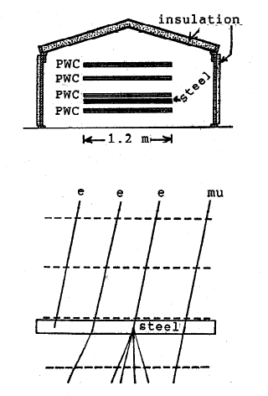
Muon and Shower Detection
Muon Detection
  For coincidence the planes must register an interaction within 400 nano seconds
  These interactions must form a straight path within the detector
  There is a 4% chance that an e will be miss identified as a muon
  There is a 4% chance a muon will be miss identified as an e
Shower
  Several (>3) huts must show a track within 400 ns
  This path does not have the same restrictions as a muon path as many more interactive particles could be produced by a shower

Slide 22
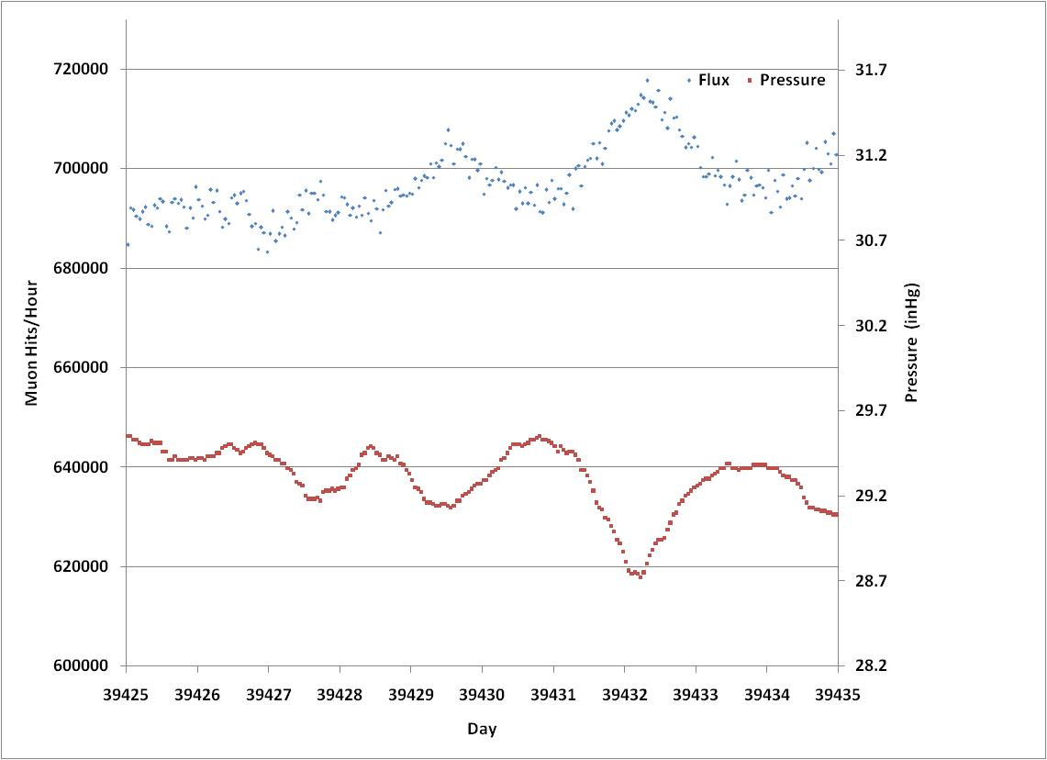
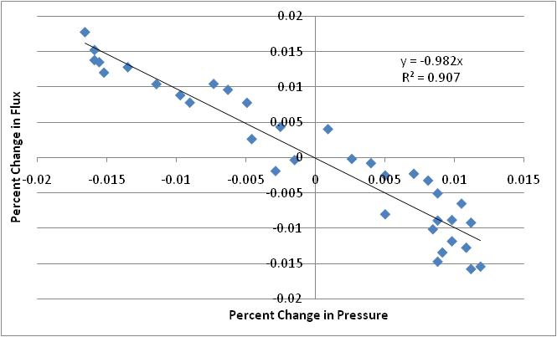
Pressure Correction

Slide 23
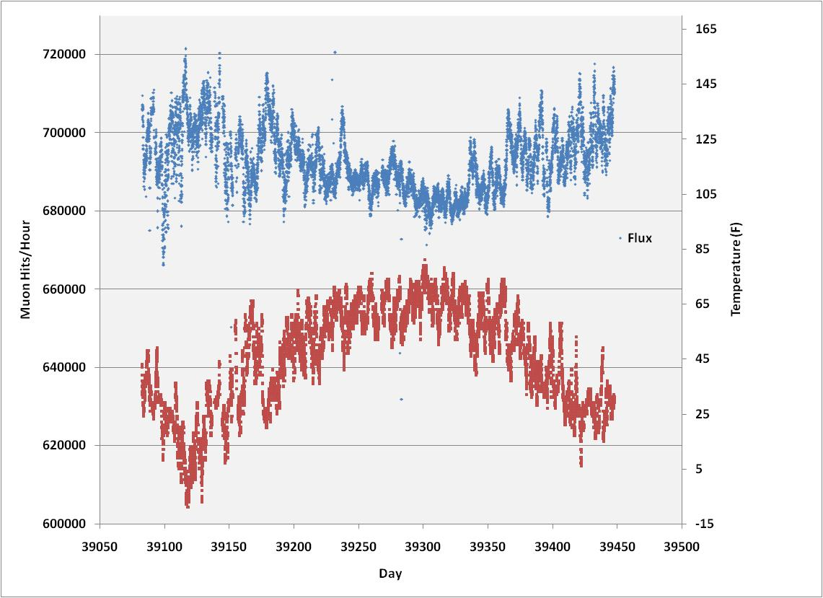
Seasonal Variations
Notes:
Talk about different between temperature of land and atmosphere where pions produced
Discuss affect for the lower energy cosmic rays how inverse as the atmosphere expands so more distance to travel more likely to decay

Slide 24
July 2007 - January 2008
Statistically corrected data set using a good hut vector
Notes:
Work out how the statistical correction is done

Slide 25
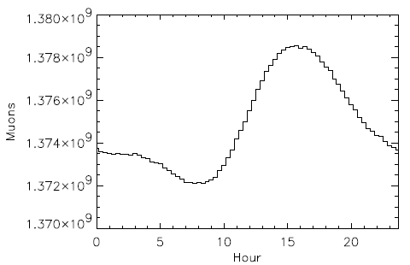
Histogram Method
Binned Muon flux over 170 Days
Exhibits a 1 and 2 cycle/day component
Notes:
.44% from max to min look in the paper
Eastern Time
~.64% for my data

Slide 26
Power Spectral Density
Power Spectrum of the first 110 Days
Peaks around 1 and 2 cycles per day
Periodicity possibly due to the Interplanetary Magnetic Field
Pressure correction further uncovers the peaks especially the 2 cycle per day
Muon Flux PSD
Pressure Corrected
Muon Flux PSD

Slide 27
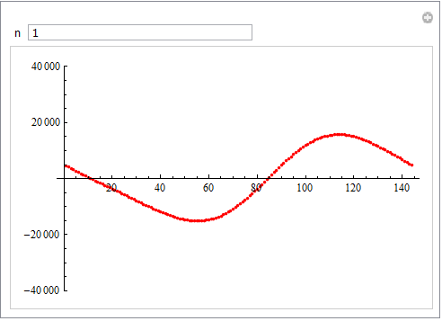
1 and 2 cycle per day
A 8192 element Fourier Transform was slid over the 171 day data set
Significant seasonal variations are observed
  1 cycler per day variation initially increases plateaus then decrease in mid November
  2 cycle shows significant increase into December then decreases
Days Since September 12
Days Since September12

Slide 28
Discussion
Observations
  Pressure has an observable influence on muon flux and tests yield a correction factor around 1
    Other climatic factors make pinning down this value difficult
  Seasonal variations in flux can be observed
  These seasonal variations influence the DMV changing the phase and amplitude of the 1 and 2 cycle per day trends
Lessons
  Working on a research project reveals all the work that goes into modern science from engineering and physics to manual labor, but this allows you to truly understand the project.
  Developing skills working with data analysis software really helped to advance my research
Notes:
Look for correlation with IMF strength
Theses analyses would require more continuous data and also data which is weather corrected
Reducing detector shutdown
Interpolation method
Pressure and Temperature correction

Slide 29
SNO Lab
The Sudbury Neutrino Observatory uses a very large sphere of heavy water with 9600 PMTs to detect particles traveling 2 km underground. It was designed to look for neutrino oscillation in solar neutrinos.
The muon dataset was reconstructed by Joseph Formaggio at MIT using a variety of criteria to separate muons from other particles
  nhits must be greater than 250
  Reconstruct tracks
Objectives
  Study variations in High Energy Cosmic Rays >3 TeV
  Look for the shadowing effects of the moon and sun
Notes:
152K events

Slide 30
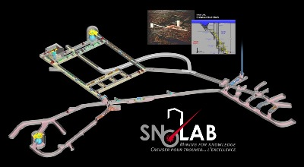
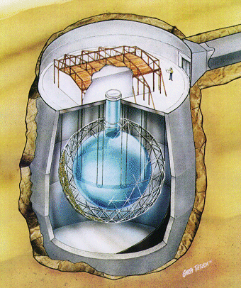
SNOLAB

Slide 31
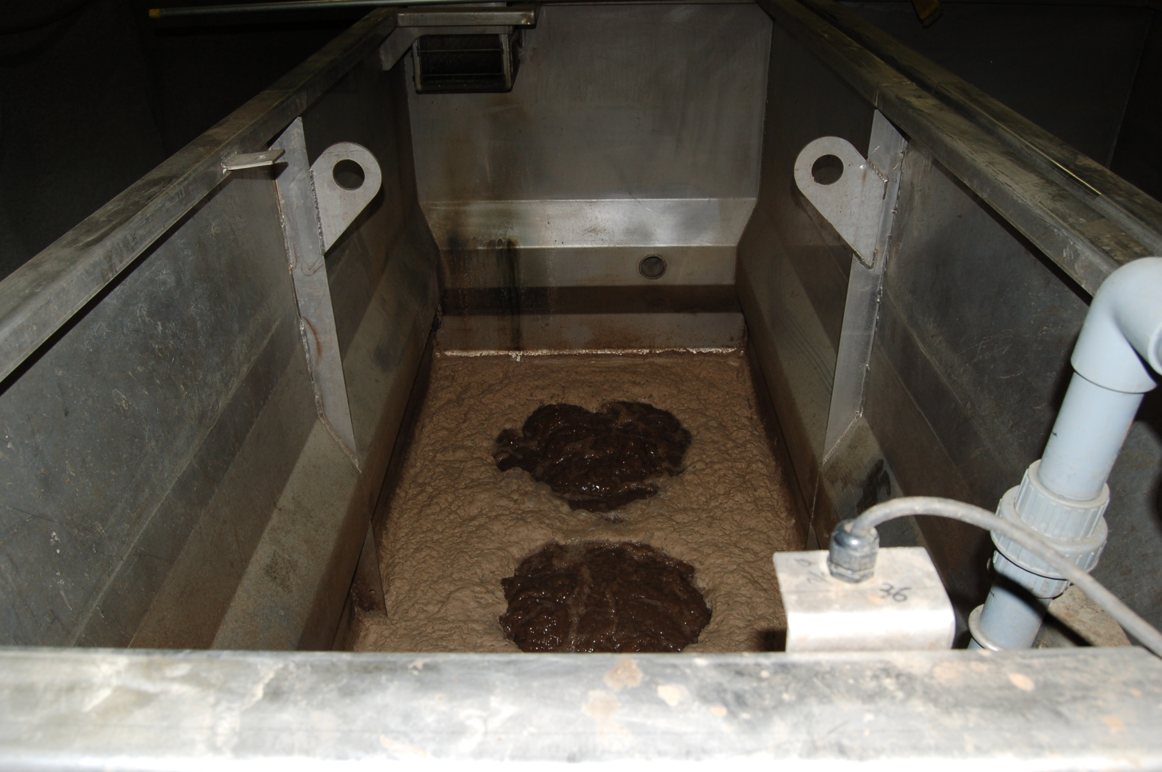
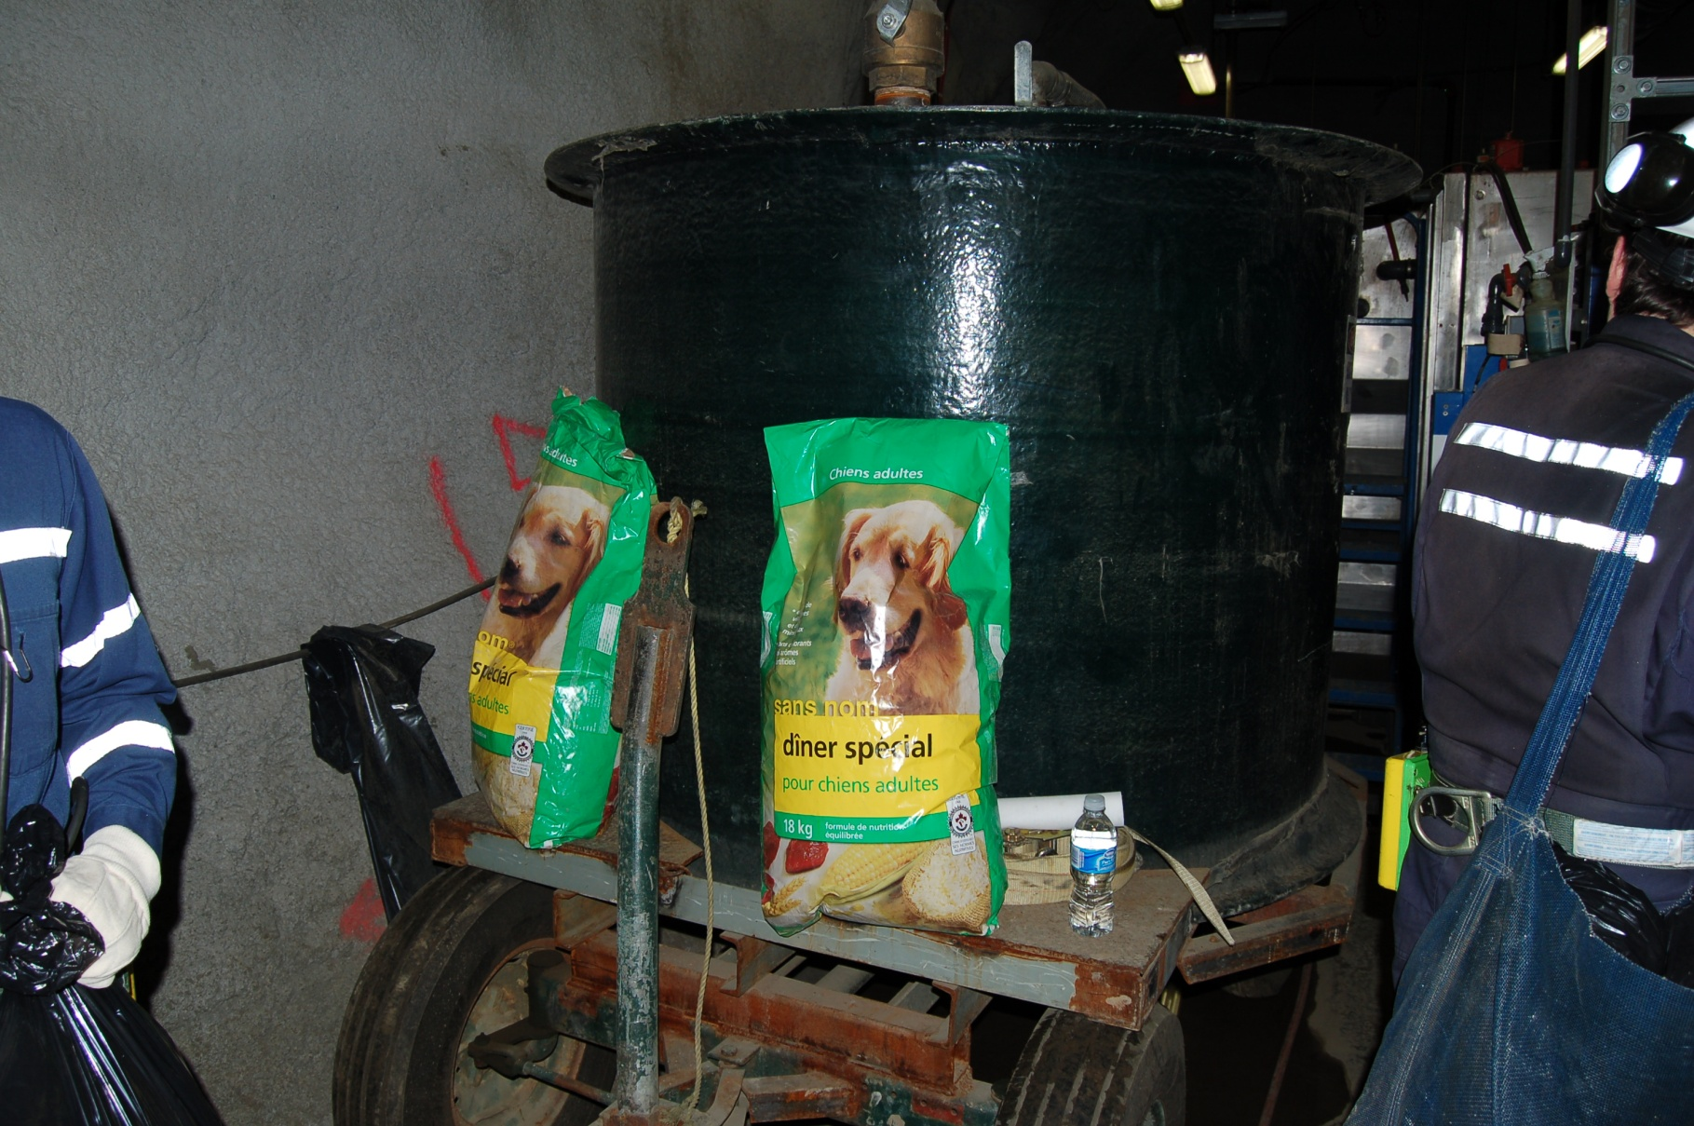
SNO Lab

Slide 32
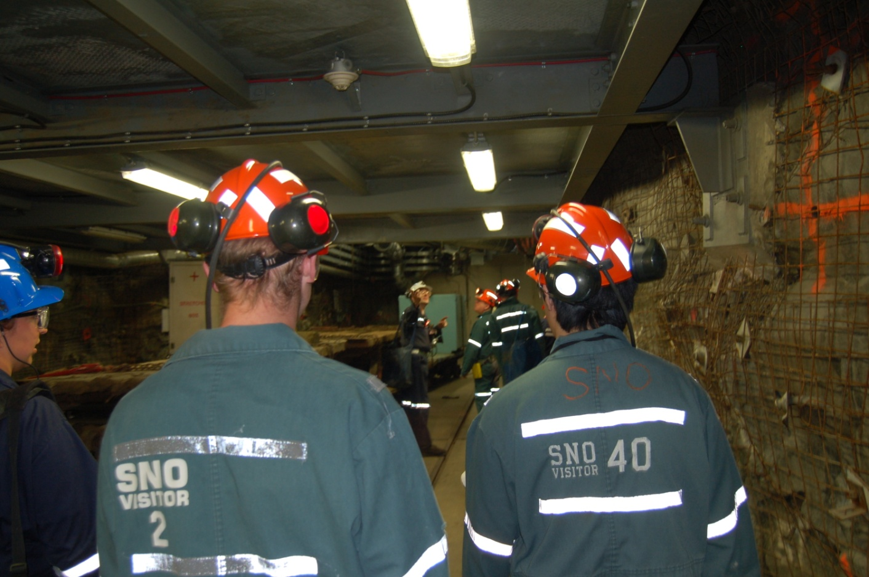
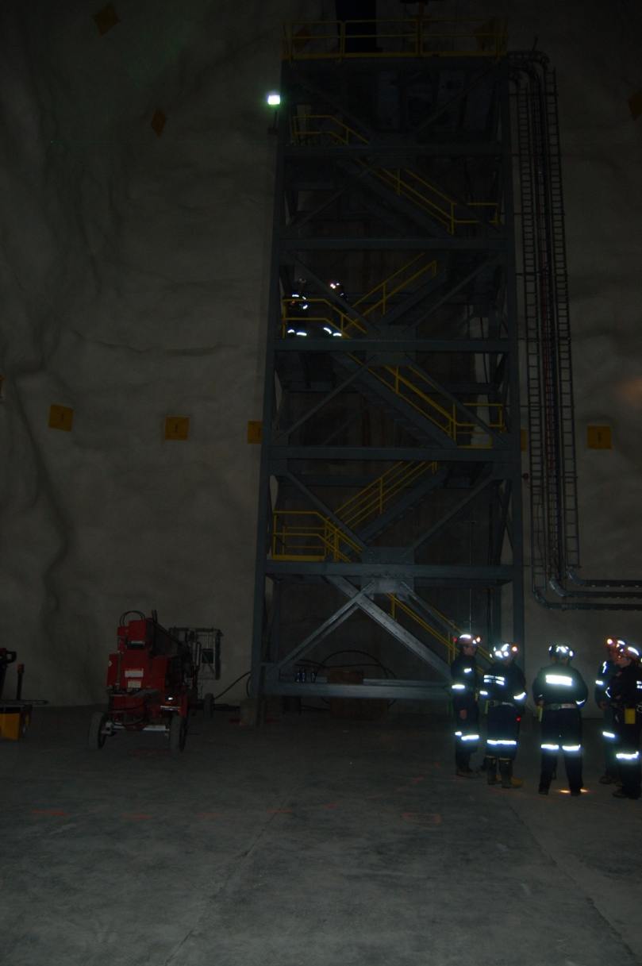
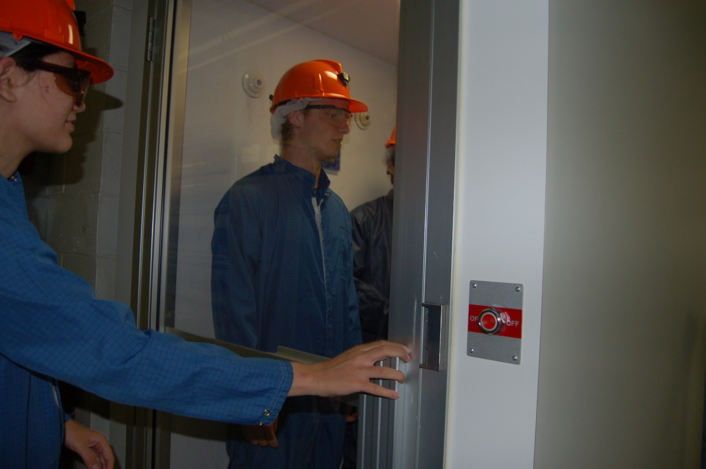
SNO Lab

Slide 33
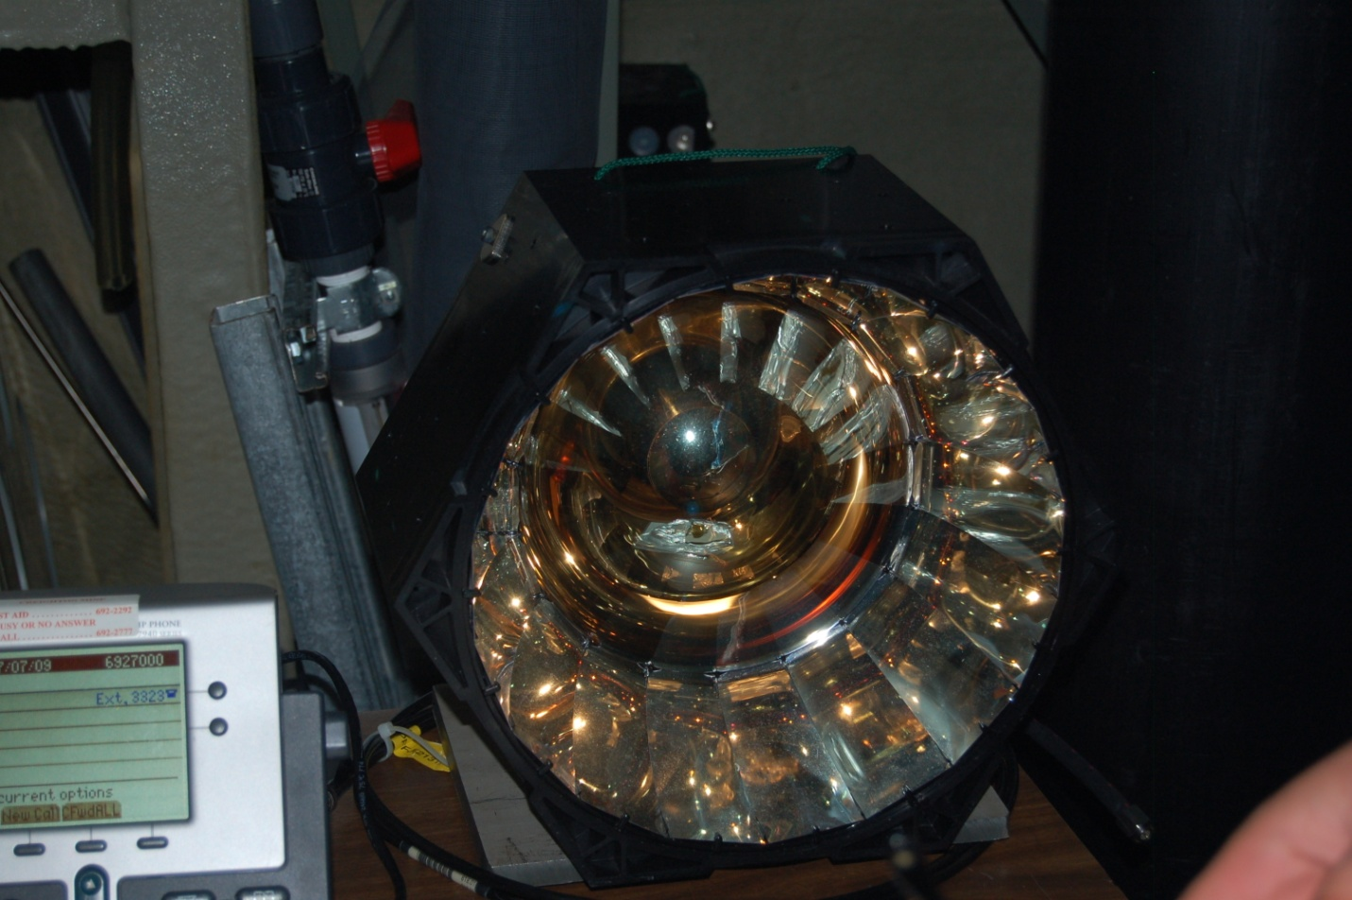
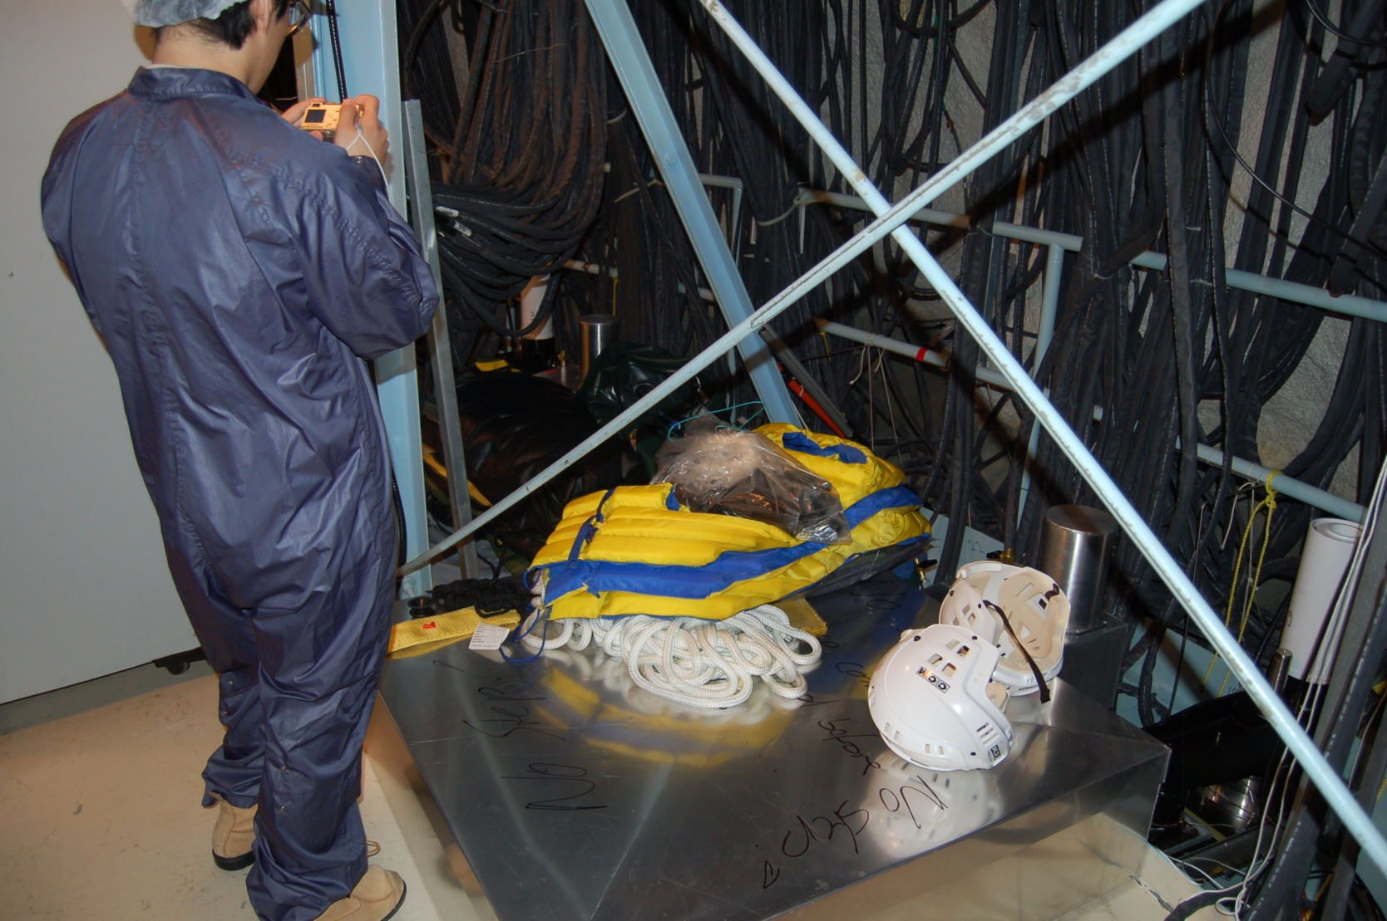
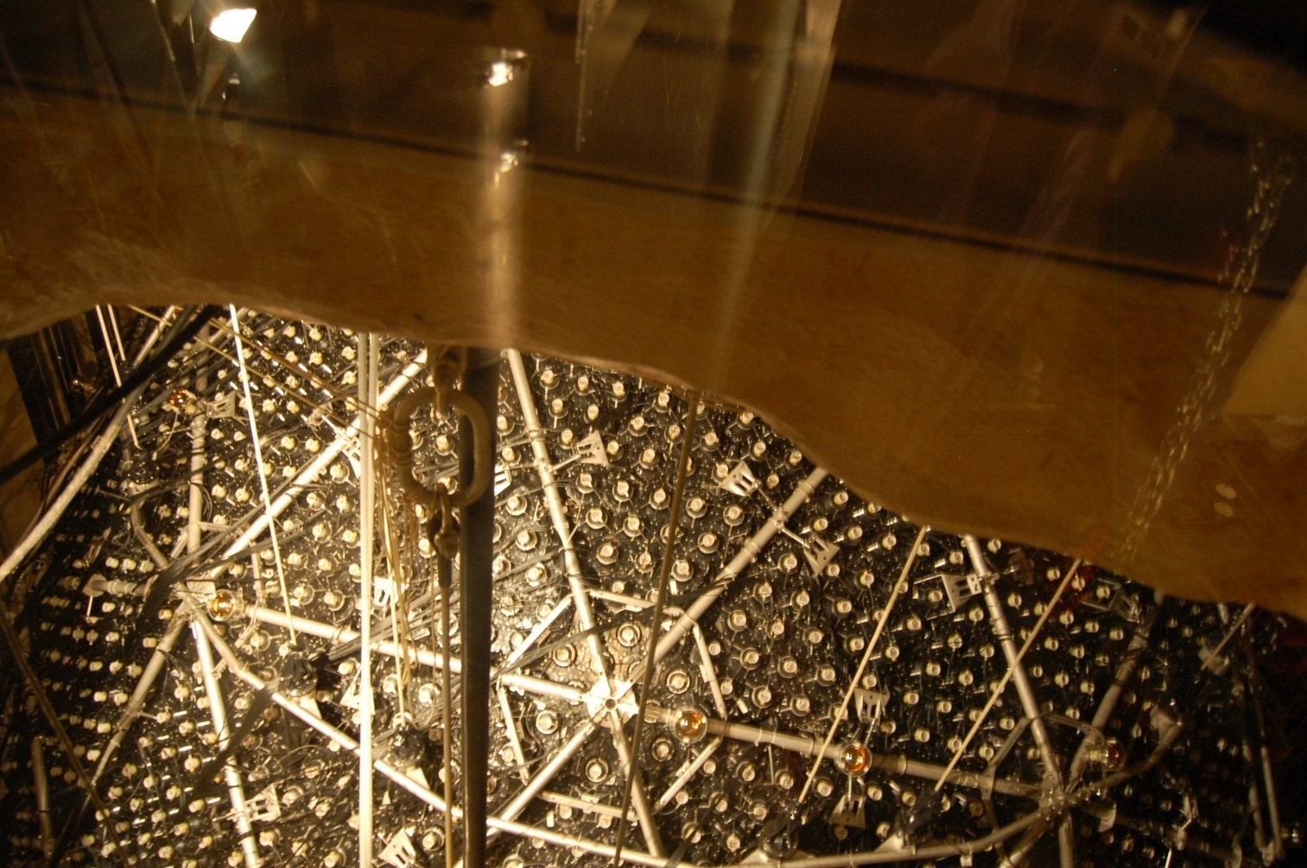
SNO Lab

Slide 34
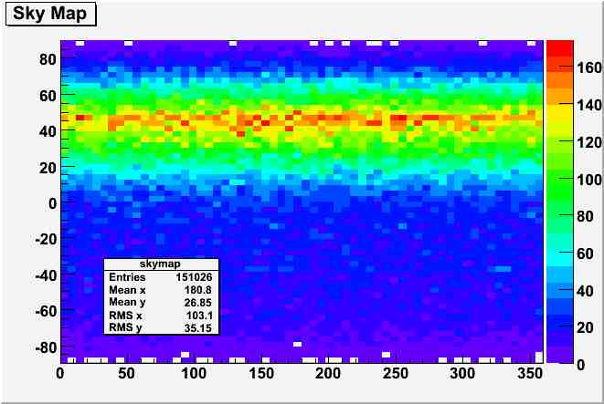
Complete Dataset Sky Map
Declination
Right Ascension

Slide 35
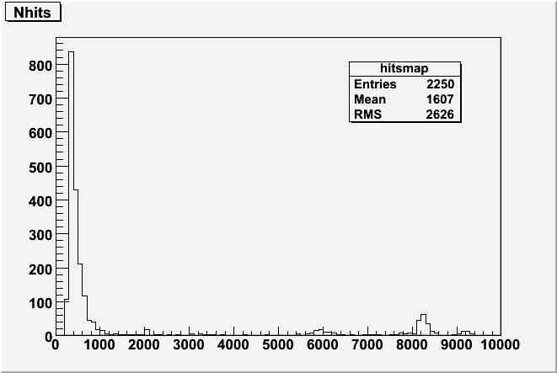
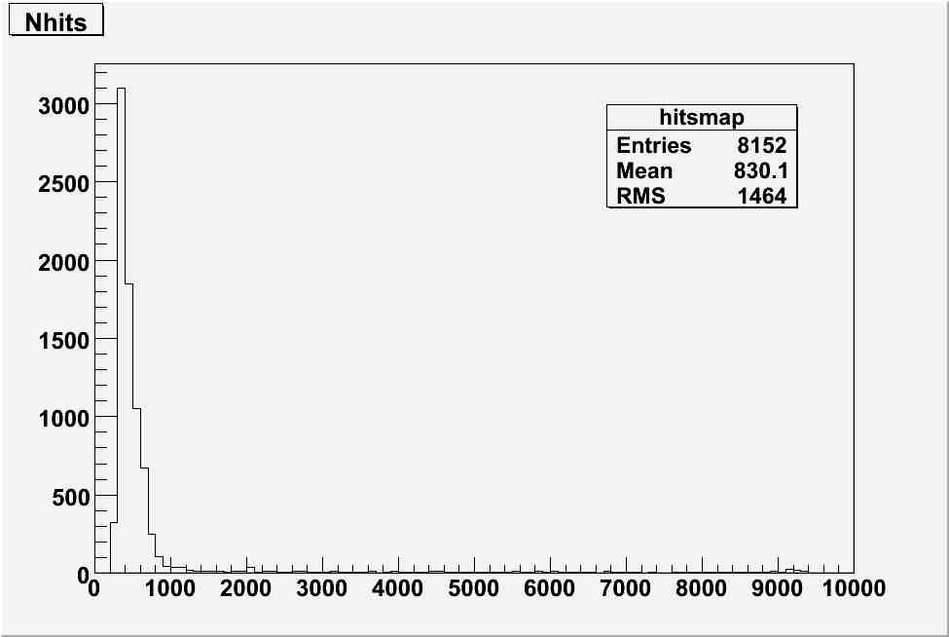
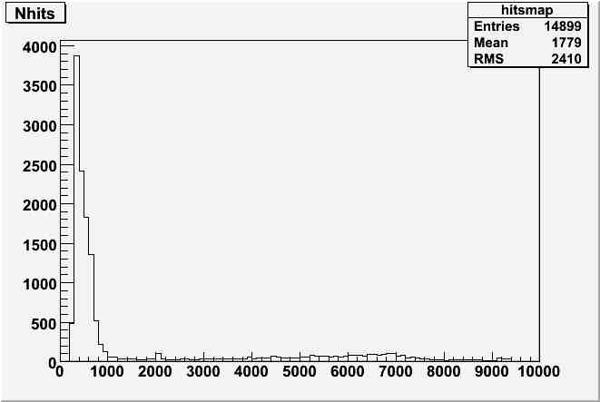
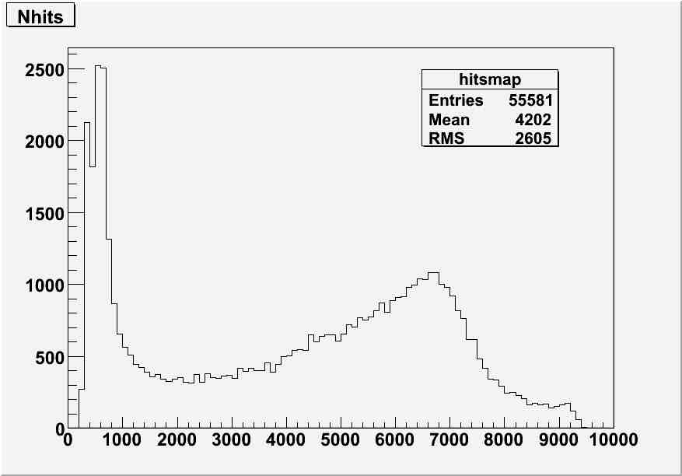
Nhits Distributions
eta <.125π
.4375 π <eta <.5625π
.625 π <eta <.75π
.875 π <eta
Notes:
Look to see about the nhits distribution whether just zomed in more

Slide 36
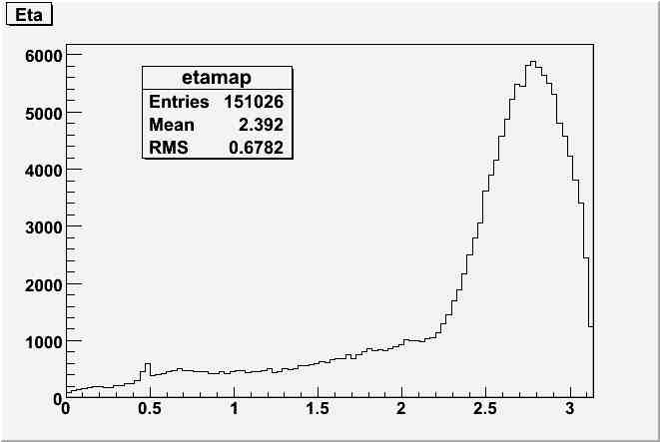
Eta Distribution
Events
Eta (radians)
Notes:
Not normalized for surface area differential
Eta > 2.25 are muon secondary particles
Eta < 2.25 are induced muons

Slide 37
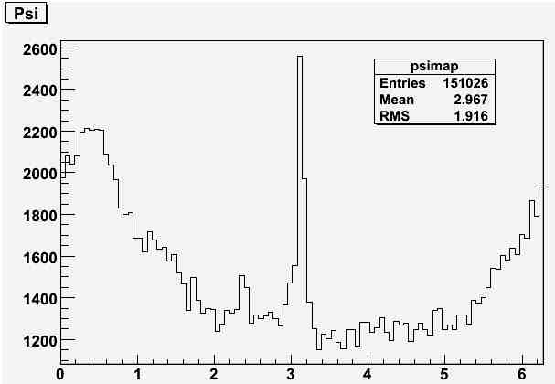
Psi Distribution
Events
Psi (radians)
Notes:
Central Peak does not show in d2o phase
Very interesting and not understood

Slide 38
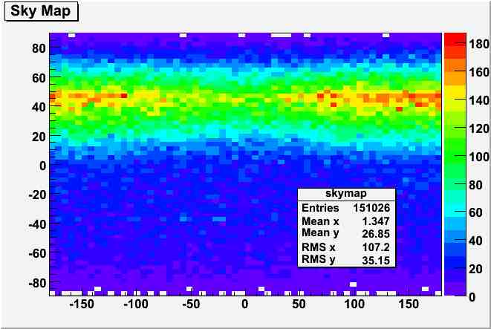
Solar Analysis
Declination
Right Ascension

Slide 39
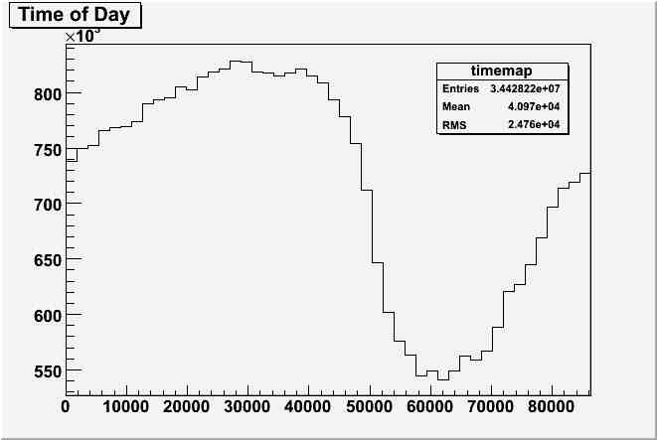
Time of Day Exposure
Seconds Exposure
Seconds
Time of Day
(Seconds in Julian Time)

Slide 40
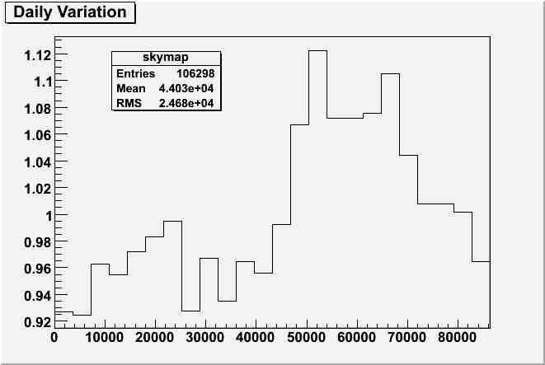
Daily Variation
Normalized Intensity
Time of Day
Notes:
Talk about simulation

Slide 41
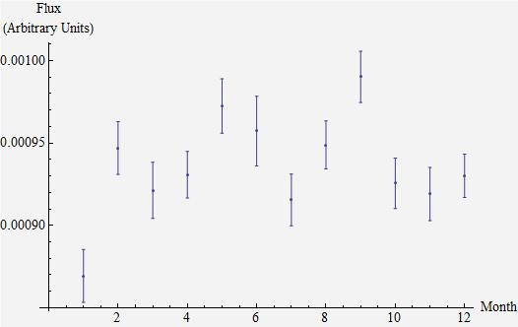
Seasonal Variations:
High Energy Muons
Notes:
Hazama, Ryuta. Seasonal variations of muon flux by SNO in the deepest underground

Slide 42
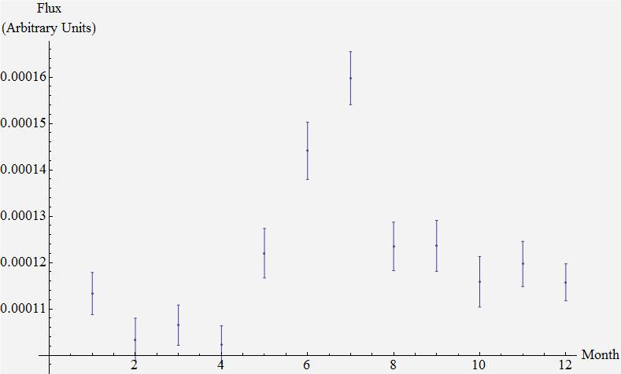
Seasonal Variation:
Induced Muons

Slide 43
Discussion
Observations
  Shadowing effects were not able to be observed probably because of inadequate data
  The observed daily variation in muon flux appears significantly higher than anticipated
  Seasonal variations were observed in both the high energy muons and induced muons
Lessons
  Working on a large collaboration like SNO has provide me an excellent opportunity to grow and experience true physics research
  My research projects have been cumulative allowing me to use my past experiences to help face the unique challenges of each project

Slide 44
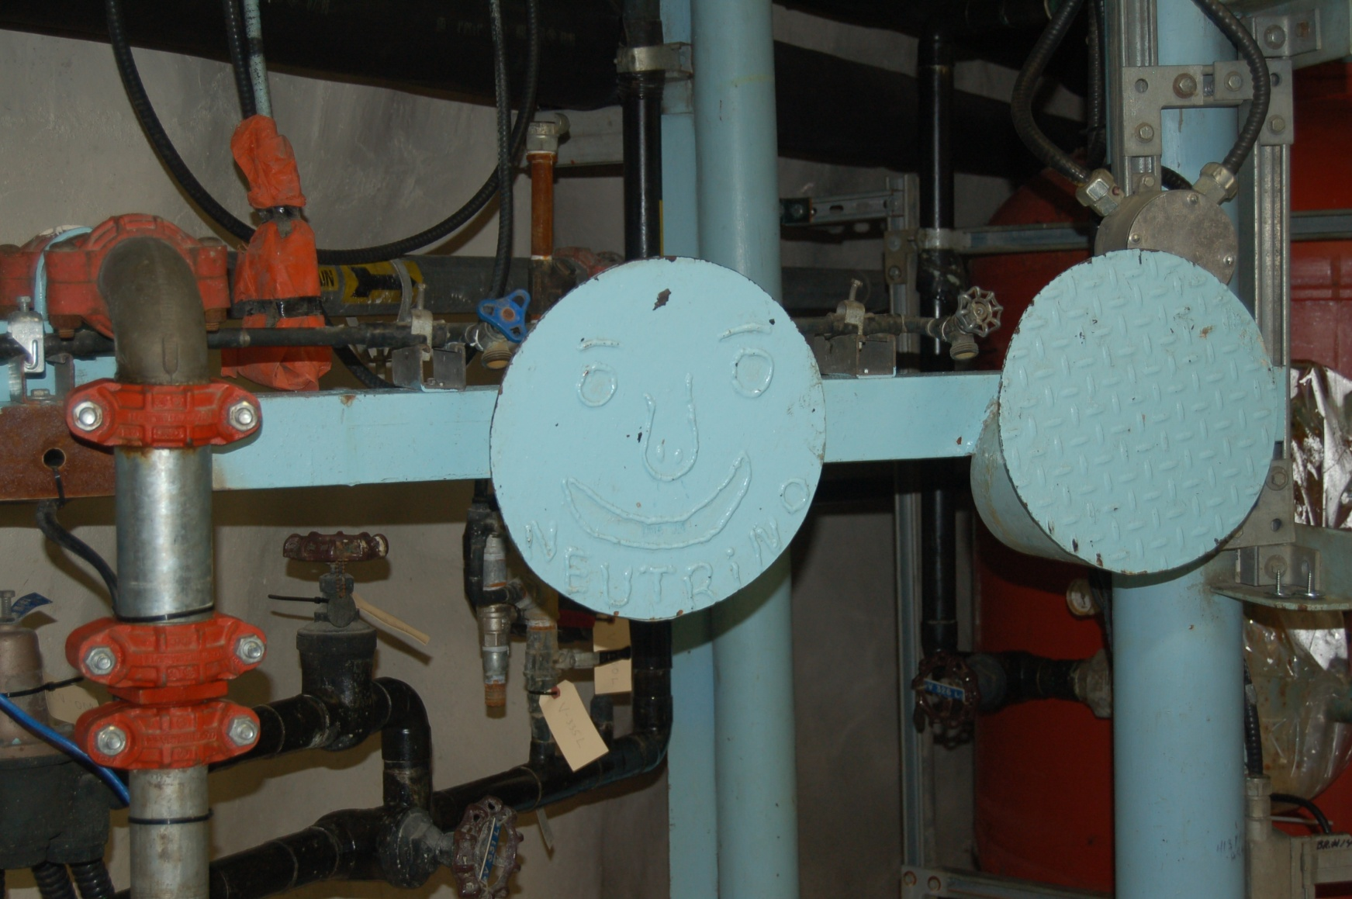
Questions?

