Slide 1
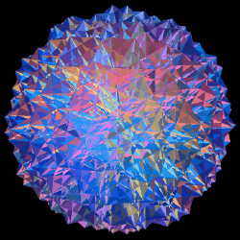
Spacetime Curvature & Extra Dimensions
S. Dalley
Department of Physics
Southern Methodist University

Slide 2
General Relativity
1915 Einstein publishes his theory of gravity.
Space (3 dimensions) and Time (1 dimension) are viewed as a unified
4-dimensional space.
The effects of gravity are described by intrinsic `curvature’ of this
4-dimensional space.

Slide 3
Dimensions
Before we get to curvature we need to think about dimensions.
We cannot easily picture extra dimensions beyond 3, whether they be the 4th dimension Time in general relativity or extra dimensions of space (we’ll look at that later).
Often it’s helpful to think by analogy with lower dimensions we can imagine – for example , how 3-dimensional things would look in 2 dimensions (surfaces).
The following video was suggested by an SMU non-science major taking my Ideas of Modern Physics course to help visualize dimensions.
http://www.youtube.com/watch?v=0ca4miMMaCE

Slide 4
CURVATURE
Two kinds:
Extrinsic – curved relative to space in which things are viewed (embedded).
Intrinsic – rules of `flat’ geometry (Euclid) do
not hold true.
Example for 2-dimensional
space (surfaces):
Cylinder

Slide 5
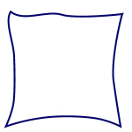
Triangles
On a piece of paper, draw any triangle, measure and then sum the interior angles. What is the result?
Roll the paper into a cylinder, without tearing, so the triangle shows on the outside.
Measure the angles again. Have they changed?
A cylinder `looks’ curved when viewed (embedded) in 3 dimensional space – it has extrinsic curvature. The embedded triangle sides are not straight lines.
But… the rule for sum of angles (180º) and every other rule of Euclidean
geometry holds true on the cylinder surface – it is intrinsically flat. The cylinder could be made from flat paper without tearing or stretching.

Slide 6
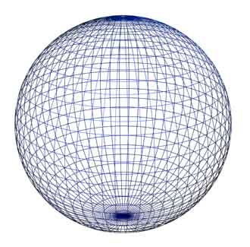
Examples of intrinsic curvature
2-dimensional sphere:
Inflate a pear-shaped balloon.
Mark three, well-separated points on
the head of the balloon (see mine).
Join the points with lines of shortest
distance* t0 make a triangle (use string
to help mark the shortest lines).
*Geodesic – line of shortest distance in curved space
(in flat space this is a straight line)
Measure and sum the interior angles.
Is you result larger or smaller than 180º ?

Slide 7
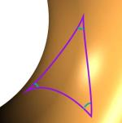
Examples of intrinsic curvature
2-dimensional saddle:
Mark three well-separated points
on the concave part of the tail.
(this is the saddle).
Join the points with lines of shortest
distance, measure and sum the
interior angles.
Is your result larger or smaller than 180º ?

Slide 8
The general rule
Σ angles > 180º Σ angles < 180º Σ angles = 180º
The first 2 shapes cannot be made from a flat
piece of paper without tearing or stretching

Slide 9
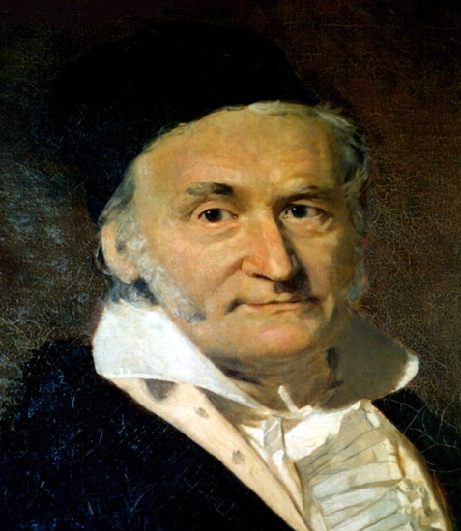
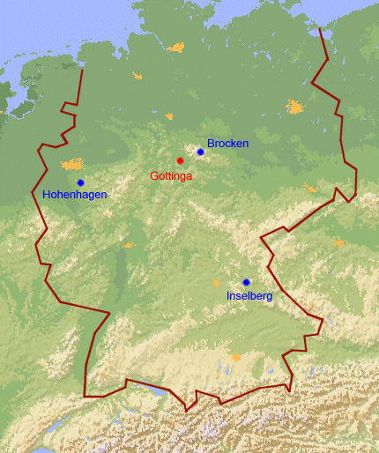
Gauss
Mathematician Carl Gauss discovered idea of intrinsic curvature (of surfaces).
Gauss was charged to compile the geodetic net for the region around Gottingen. A story (false) says that he triangulated 3 local mountains to test the curvature of space
Gauss was well aware that the experimental errors were too big: they would have masked the small systematic deviation from 180º

Slide 10
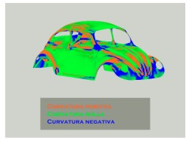
Curvature
Generalization of curved space to more than 2 dimensions was developed by Bernard Riemann and others in 19th Century (Einstein later used their work).
Curvature can vary from place to place in space…..
… and in time… ripples of
curvature fluctuation in
Spacetime are gravitational
waves.

Slide 11
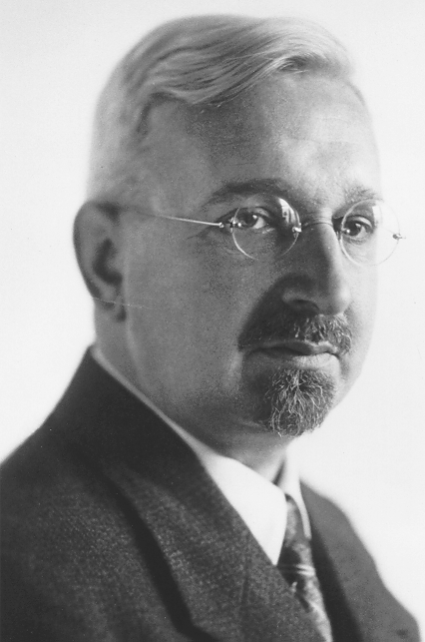
Extra Dimensions
Soon after Einstein published, Theodore Kaluza suggested a 4th space dimension
(5th spacetime dimension).
WHY ?
He recognised that gravity in the
extra dimension would look like
electromagnetism in regular space!
But wouldn’t we notice another dimension?

Slide 12
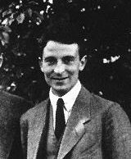
Compactification
Oskar Klein improved
Kaluza’s idea: Extra
dimension C is
wrapped around on
itself, small-enough
`not to notice’.
Gravitational waves polarized in the extra dimension C
are mathematically indistinguishable from
electromagnetic waves in the regular dimension M.
Alas, the details of this idea did not work out … but extra
dimensions remained intriguing

Slide 13
How Small ?
How to test for a small (i.e. compact) extra dimension?
Detour to ….Ye Olde Newtonian gravity force law
Force ≡ Field x mass_{test}
Flux ≡ Field x Boundary Area = 4 G x mass_{source}
(Gauss’ s law)
Example: Sphere of area 4 r²
G x mass_{source}
Field = “1/r² force law”
r²

Slide 14
Exercises
What is the force law in flatland (2 space dimensions)?
Mass_{source} is surrounded by a circle now and Gauss law is
Field x boundary length = 4 G x mass_{source}
Circumference 2 r :
G x mass_{source}
Field = “1/r force law”
2r

Slide 15
Exercises
What is the force law in lineland (1 space dimension)?
r
r
Field x boundary ?point? = 4 G x mass_{source}
Note: `Size’ of boundary does not change with distance r
Constant force law Field  r⁰ x G x mass_{source}
Aside: QCD force field is like this due to confinement of flux into
narrow 1-dimensional tubes.
And so… what is the force law in 4 space dimensions?

Slide 16
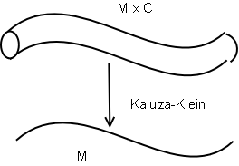
Leaking flux
If flux leaks into an extra dimension, expect a `weakening’ of force (falls faster with distance).
How does compactification affect argument?
1/r² law of gravity has been tested down to mm scales.
r
1/r² law
r
1/r³ law

Slide 17
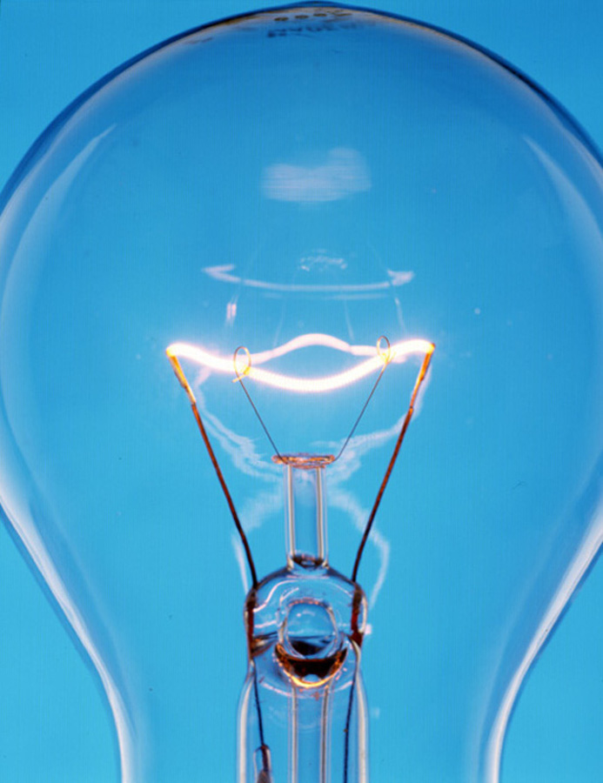
Can we `see’ extra dimensions?
If mm-sized extra dimensions exist, we should see them with light? (We can’t)
1/r² law for electromagnetism
checked to sub-nuclear scales,
so if compactification larger,
light must somehow be
forbidden from leaking at all.
Modern Kaluza-Klein models
do this; only allow gravity to
propagate in extra dimension(s).

Slide 18
Waves & Particles
Imagine gravity field flux as a superposition of gravity waves.
Particle Physicists think in terms of PARTICLES rather than waves – the GRAVITON is the particle (localized disturbance) of the gravity field
Free gravity waves (in regular 3-dimensional space) move at light speed…..
……….. so the regular Graviton must too.
Therefore the Graviton is massless. Doesn’t cost ANY energy to make.
But you never know whether you made one or where they are as they interact
so weakly (much worse that neutrinos) ….. Gravity is a very very weak force .

Slide 19
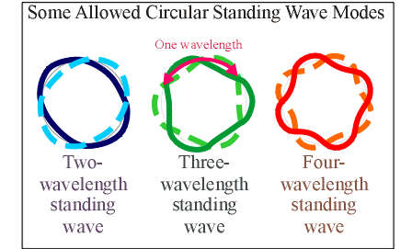
Standing Waves
Gravity Waves propagating in a compact extra dimension must be STANDING WAVES
Smaller compactification
=> smaller wavelengths
larger wave energy
A certain minimum energy is needed to propagate a
gravity field wave in the compact extra dimension.

Slide 20
Heavy Gravitons
Gravity standing waves, therefore Gravitons, that propagate in a compact extra dimensions require a minimum energy to make. Due to E = mc² they look like massive particles in the regular (3 dimensional) space .
Production rate depends on this mass, the force strength,
and multiplicity of new types of graviton (number of allowed standing waves). Modern Kaluza-Klein models predict we may be able to detect them at….
!! LHC !!

Slide 21
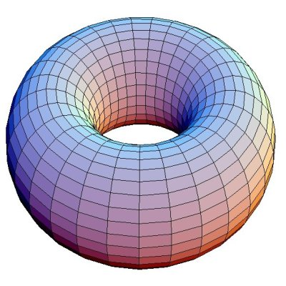
Modern Theories
Seek to explain the incredible weakness of gravity in 3-space dimensions, compared to the other forces of nature, in terms of higher dimensions.
Popular Model #1:
Kaluza-Klein on a torus
(> 2 extra flat dimensions)
Extra dimensions are flat and big (could be ~ mm).
Extra dimensional gravitons are light and numerous

Slide 22
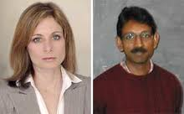
Popular Model #2: Randall-Sundrum
Extra dimension is
curved and small,
stretches between
two branes (one is ours).
Extra-dimensional
gravitons are heavy and
easy to produce.

Slide 23
Experimental Tests
Fermilab (Tevatron) has been and CERN (LHC) will be searching for heavy gravitons as evidence of extra dimensions.
It’s a long shot but, if found, it will be…
greatest scientific discovery ever
If found, their character will tells us the details:
how many extra dimensions, curved or flat, etc.

Slide 24
Summary
The spacetime of Einstein’s general relativity can be generalized further by adding more space dimensions
If extra space dimensions exist, they must be compact, because gravity’s 1/r² force law works so well.
Graviton particles that transmit that force will appear to have a mass if moving in the extra dimension(s).
We may be able to detect such massive gravitons at the LHC.
The theory behind this may then explain why gravity is so much weaker than other forces in nature.

Slide 25
Swiss Atom Smasher Finds
New Space Dimension
US to seek oil there

