Slide 2
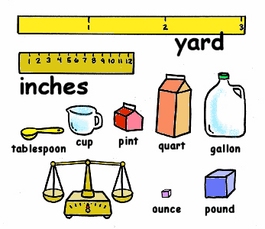
What is a Measurement?
Without measurement, quantum mechanics is actually pretty simple
Wave function evolves by Schrödinger’s equation
Trying to understand the causes and reactions is what creates the complexity
Measurement causes
Indeterminacy
Nonlocality
Collapse of wave function
Conceptual difficulties
So what is a measurement?
i.imgur.com/DlBlieQ.gif

Slide 3
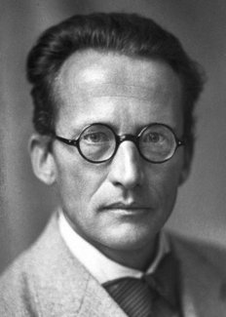
Schrödinger
Erwin Schrödinger
August 12, 1887 to January 4, 1961
Created the Schrödinger wave equation due to dissatisfaction with Niels Bohr’s orbit theory
Believed atomic spectra were eigenvalue problems
1933 Nobel Prize for Physics (with Paul Dirac)
Disliked the idea of atomic phenomena being described by both waves and particles, theorized as waves only
www.nobelprize.org/images/schrodinger-12988-content-portrait-mobile-tiny.jpg

Slide 4
Cat Paradox
“A cat is placed in a steel chamber, together with the following hellish contraption…”
Tiny bit of radioactive material in a Geiger counter
In an hour, equally probably one or no atom decays
astronimate.com/wp-content/uploads/2017/03/schrodingers-cat-explained-setup.jpg?x70168

Slide 5
Cat Paradox
If atom decays, the Geiger counter triggers
Activates a hammer to break container of cyanide
Alive: no atom decayed
Dead: first decay poisoned the cat
astronimate.com/wp-content/uploads/2017/03/schrodingers-cat-explained-setup.jpg?x70168

Slide 6
Cat Paradox
The wave function of the system contains equal parts of the living and dead cat
$$ψ=\frac{1}{\sqrt{2}}(ψ_{alive}+ψ_{dead})$$
astronimate.com/wp-content/uploads/2017/03/schrodingers-cat-explained-setup.jpg?x70168

Slide 7
Cat Paradox
The “measurement” is when you look in the box
Observation forces the result: alive or dead
Thus you kill it (or don’t) by looking
astronimate.com/wp-content/uploads/2017/03/schrodingers-cat-explained-setup.jpg?x70168

Slide 8
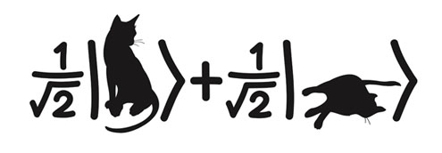
Nonsense?
Schrödinger considered this to be nonsense, trying to make a point
A macroscopic object like a cat cannot be in a linear combination of alive and dead
How do we reconcile with our understanding of quantum mechanics?
agenda.infn.it/conferenceOtherViews.py?view=standard&confId=13169

Slide 9
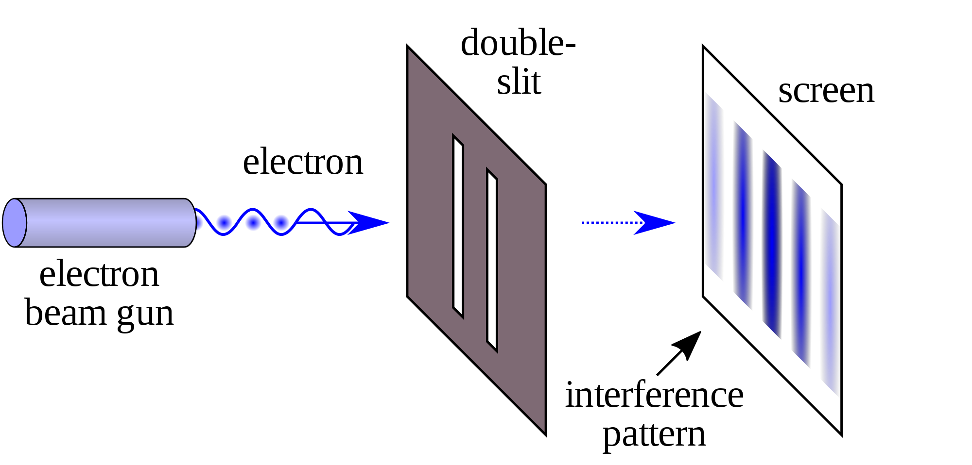
Measurement
The triggering of the Geiger counter is the measurement, not the observer
Measurement occurs when the microscopic (QM) interacts with the macroscopic (classical)
Leaves permanent record
commons.wikimedia.org/wiki/File:Double-slit.svg

Slide 10
Measurement
An electron can be in a linear combination of spin up and spin down
The wave function contains all the possibilities
Spin
Position
Momentum
Energy levels
Observation reveals one of the many possible states
Macroscopic system itself not allowed to occupy a linear combination of distinct states

Slide 11
www.youtube.com/watch?v=UjaAxUO6-Uw

Slide 12
www.youtube.com/watch?v=g_IaVepNDT4

Slide 13
Sources
Erwin Schrödinger – Biographical. NobelPrize.org. Nobel Media AB 2018. Thu. 29 Nov 2018. www.nobelprize.org/prizes/physics/1933/schrodinger/biographical/.
Griffiths, David J. Introduction to Quantum Mechanics. 2nd ed. (Indian Subcontinent Adaptation), Pearson, 2015.
Title Slide Graphic: image.shutterstock.com/image-vector/cartoon-black-cat-drawing-skeleton-260nw-1166254330.jpg

