Slide 1
SCIENTIFIC DISCOVERY
    Scientific Models
    Example: Gravity

Slide 2
Science, Arts, Humanities -> MODELS
Characteristics of Scientific Model
Valorized by experiment and observation
Refutable, not provable
Not absolute truth – quantify uncertainty
Evolve, replaced over time
…….

Slide 3
Example of Evolution by Refutation: Gravity
Observation
Ptolemy’s Geocentric model, 1stC - Circular orbits around Earth
Refuted by
Copernicus’s Heliocentric model, 16thC- Circular orbits around Sun
Refuted by
Kepler’s Heliocentric model, 17thC- Elliptical orbits around Sun

Slide 4
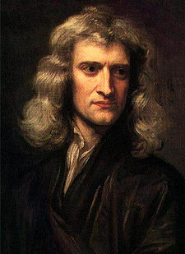
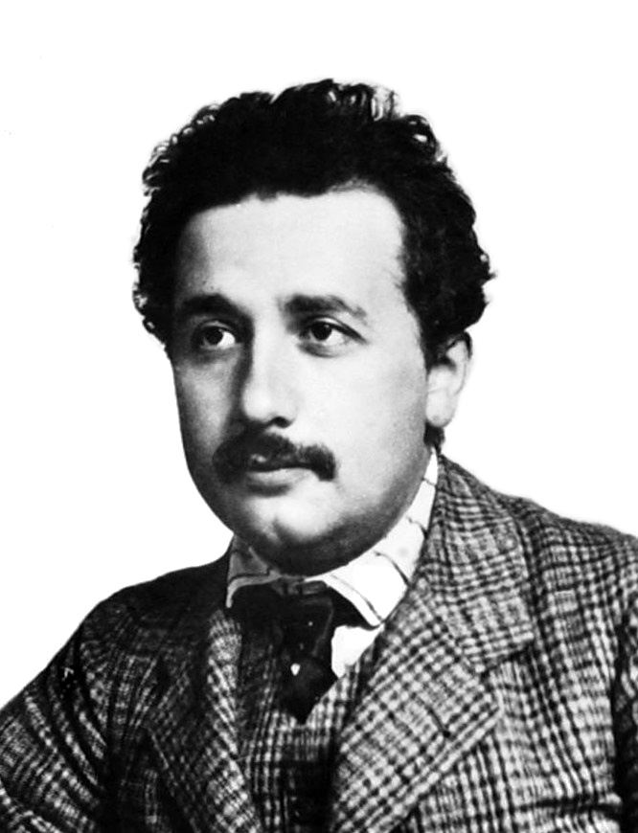
Mathematical Models
Relate disparate observations in universal framework
(Aristotle, 300 B.C. – Philosophy)
Newton, 17thC
First universal model of motion
Einstein, 20thC
Models of motion refute Newton’s
Perihelion of Mercury
Newton 99.2 % accurate
(disproved, but good approx).
Einstein accurate within
experimental error.

