Slide 1
CLASSICAL PHYSICS
Space, Time, Motion
    Space, time, velocity, acceleration
    Relative motion
    Inertial reference frames
    Newtons laws of motion

Slide 2
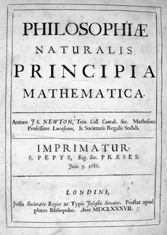
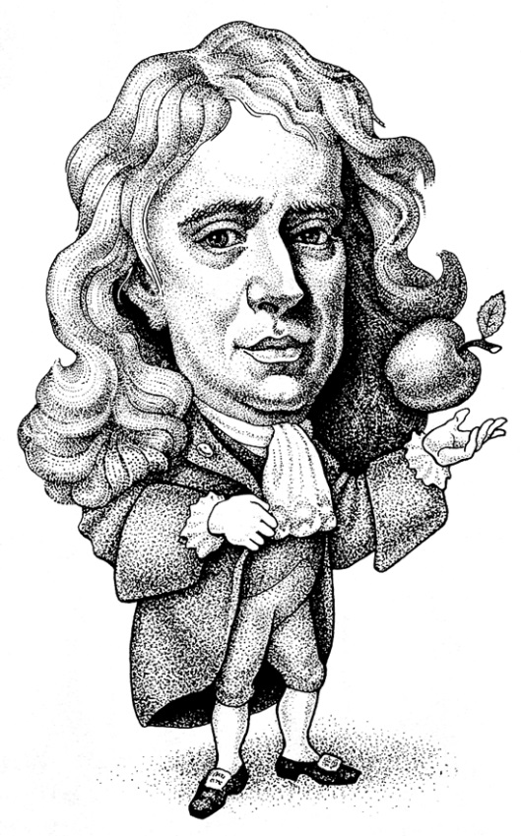
Classical physics of space,
time, & motion established
in Newton’s book Principia
Some definitions:
Speed = Distance divided by Time
Velocity = Speed and Direction of motion
Or rerragne it…
Distance = Speed times Time
Acceleration = Rate of change of Velocity

Slide 3
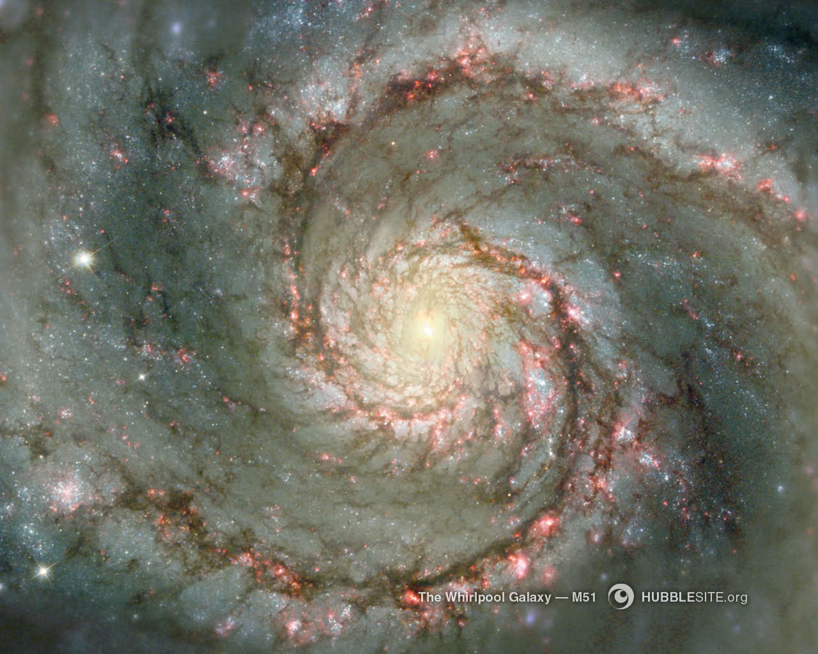
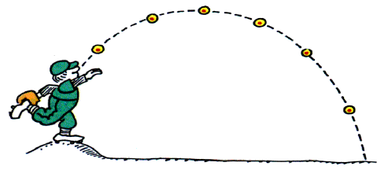
`See’ speed (velocity)
`Feel’ acceleration
Uniform motion = unchanging velocity
Only relative uniform motion has objective meaning
Path of object depends
on who’s looking at it
(the Observer)

Slide 4
Reference Frames
Frame in uniform motion (no feeling of acceleration inside it) is called INERTIAL
All Inertial Reference Frames (IRF) are equally fundamental, no one is preferred
No measurement can detect `absolute’ rest

Slide 5

Newton’s Laws of Motion
An object continues with the same speed and in the same direction unless acted upon by an unbalanced force
Note: This law applies only in
inertial reference frames

Slide 6


Force = Rate of Change of Momentum*
Definitions:
* Momentum = mass x velocity
Velocity = speed & direction
Mass = amount of matter
So… force can change
Speed of Motion
Direction of Motion
=> Force causes acceleration
Force = mass x acceleration
F = m a

Slide 7

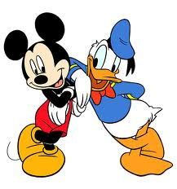
If Donald exerts a force on Mickey, Mickey will exert an equal but opposite force on Donald
Or….forces always come in a pairs:
Action & Reaction
Summary – Newton’s Laws for cyclists

