Slide 1
CLASSICAL PHYSICS
Gravity
    Forces of nature
    Gravity force
    Free fall

Slide 2
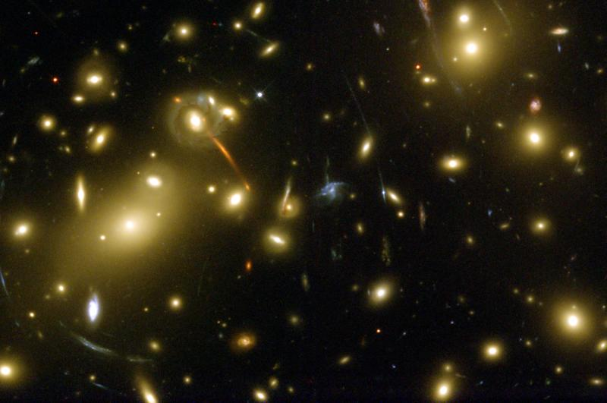
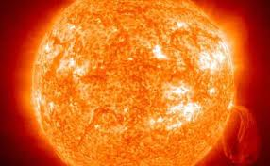
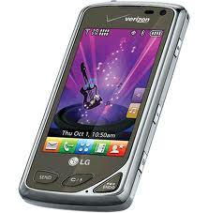
Forces of nature
Gravity
Nuclear
(Strong & Weak)
Electromagnetism
Projectiles
Planets
Galaxies
Universe
Light Atoms Technology
Nucleus
Radioactivity
Stars

Slide 3
Same rules everywhere in the universe
Gravity Force
Attraction between objects with mass
Increases with mass of object(s)
Decreases with distance between objects

Slide 4
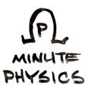
Gravity Force (=> acceleration)
Constant Direction, increasing speed
e.g. Dollar Drop – How long for a $ bill to fall ½ its length?
Changing Direction, constant speed
e.g Gravity Orbit

Slide 5

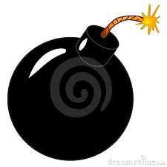
Mass
All objects free
fall* with same
acceleration
(Galileo)
Inertial mass = Gravitational mass
Source of
gravity force
Resistance to
acceleration (F=ma)
*Free Fall
Only force of gravity, neglect air resistance, etc.
Constant acceleration g = 9.8 m/s²

