Slide 1
CLASSICAL PHYSICS
Electricity & magnetism
    Electricity
    Magnetism
    3. Electromagnetism

Slide 2
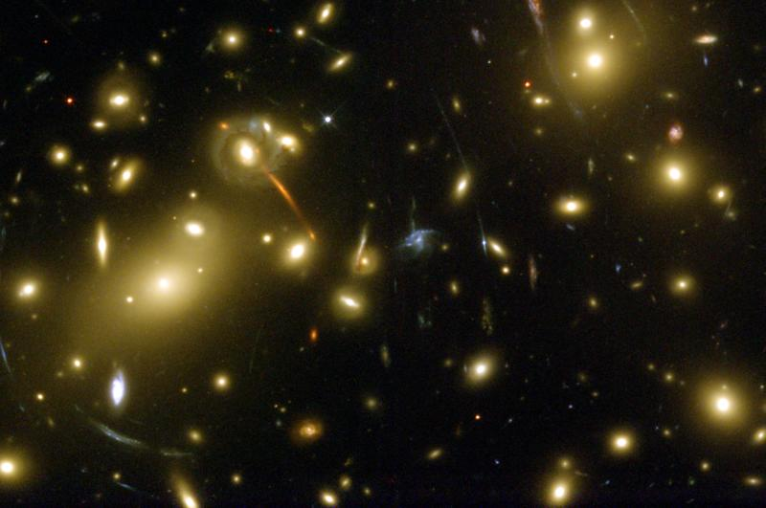
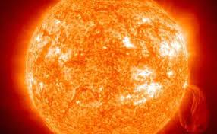
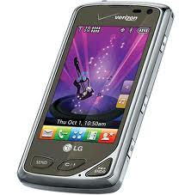
Forces of nature
Gravity
Nuclear
(Strong & Weak)
Electromagnetism
Projectiles
Planets
Galaxies
Universe
Light Atoms Technology
Nucleus
Radioactivity
Stars

Slide 3
Same rules everywhere in the universe
Electric Force
Attraction or repulsion between objects with charge
Increases with charge of object(s)
Decreases with distance between objects

Slide 4
Electric Force (=> acceleration)
Constant Direction, increasing speed
e.g. Light bulb activation by electric current
Changing Direction, constant speed
e.g. atomic stability from orbiting charge

Slide 5
Same rules everywhere in the universe
Magnetic Force
Attraction or repulsion between moving
objects with charge
Increases with relative speed of object(s)
Decreases with distance between objects

Slide 6
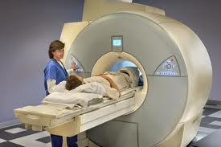
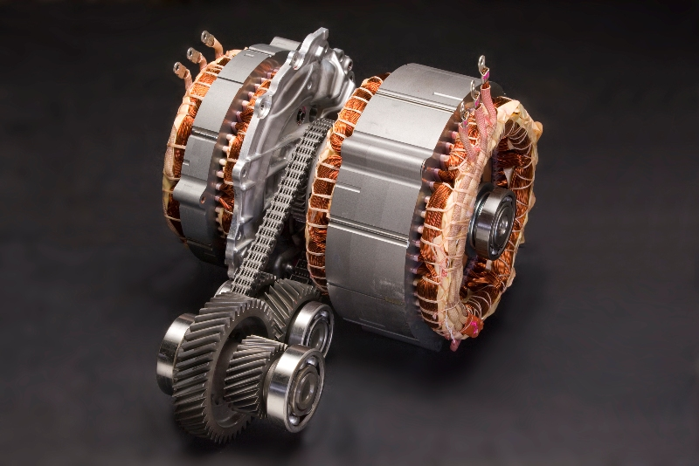
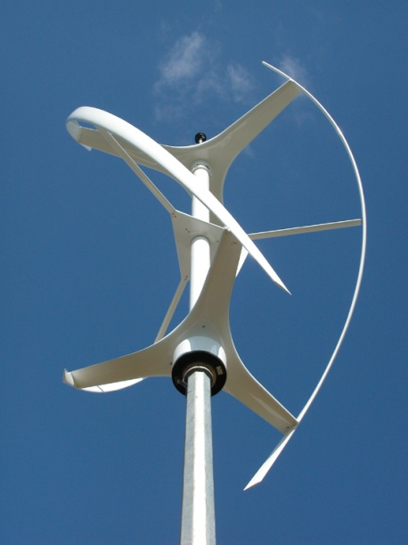
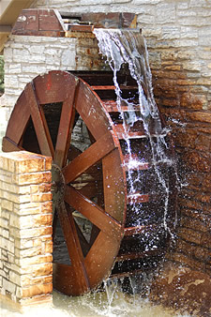
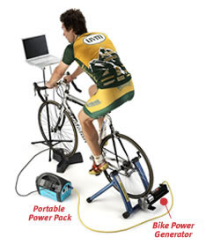
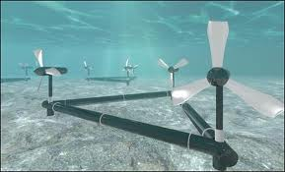
Magnetism inside atoms
Magnetism from electric current
Electric current
from magnetism

Slide 7
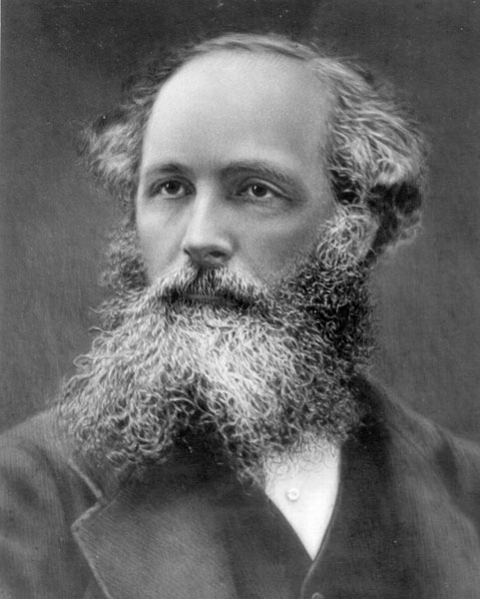

Maxwell’s equations encapsulate
all electric and magnetic phenomena
(still)
Who is really moving?
Relative motion --> Electricity = Magnetism
Electromagnetism
Einstein: Maxwell’s equations inconsistent with Galilean Relativity (1 ± 1 rule for speeds)
--> Beginning of modern physics

