Slide 1
CLASSICAL PHYSICS
Light: Into the modern era
    Electromagnetic waves
    Wave media
    Michelson & Morley

Slide 2

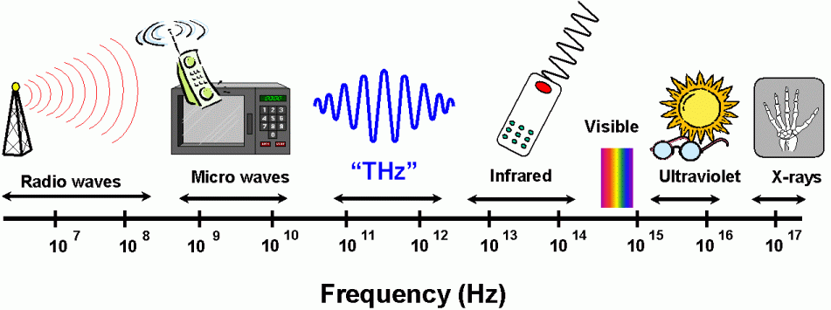
L
I
G
H
T
Electric & Magnetic
Vibrations
`Electromagnetic Waves’
All travel at the same speed:
186,000 miles each second

Slide 3
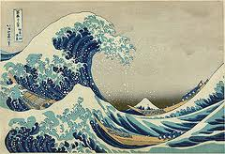
Examples of Waves
Waves -> Medium (what vibrates?)

Slide 4
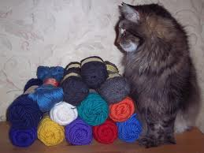
????? Luminiferous Ether ??????
Name given to purported medium of light waves
Must fill universe (we see light from stars)
Must have no viscosity (planets do not slow down)
Must be very stiff (light waves travel very fast)
…. in summary
BIZARRE
BIG PROBLEM
Could define Absolute Motion
relative to the Ether…

Slide 5

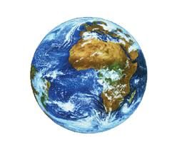
Michelson-Morley
Speed of light same
in all directions !!!
experiments fail to detect
motion of the Earth in Ether
Speed of light independent of
Inertial Reference Frame !!!

