Slide 1
SPECIAL RELATIVITY
Energy & E = M C²
    Energy and mass
    The ultimate speed
    Rest energy

Slide 2
What is Energy?
Capacity to perform work
Lift heavy object
Run very fast
Melt some ice
…
Sources of energy come from forces of nature
(electromagnetic, gravitational, nuclear)
Different kinds convertible one into the other

Slide 3
E = m c²
Special Relativity relates:
inertial mass m (resistance to acceleration)
and Energy E (of any kind)
Consequence # 1. Mass increases with Energy
E.g. Kinetic Energy
(energy of motion)
Mass grows
without bound
as speed of light
is approached

Slide 4
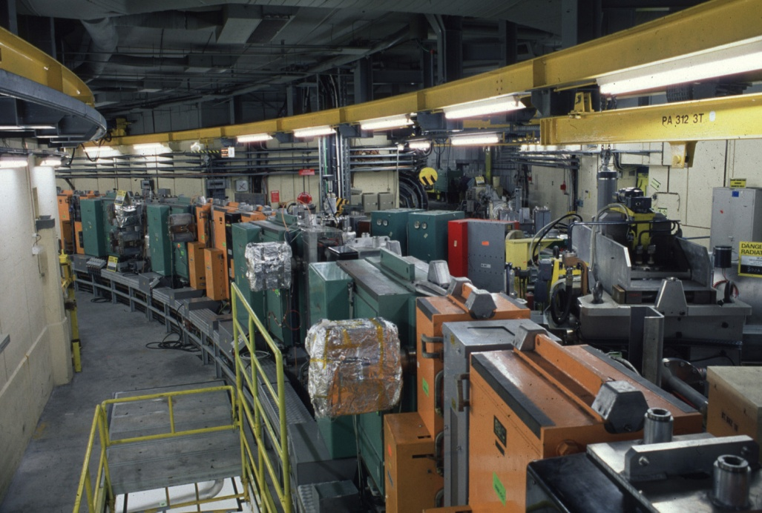
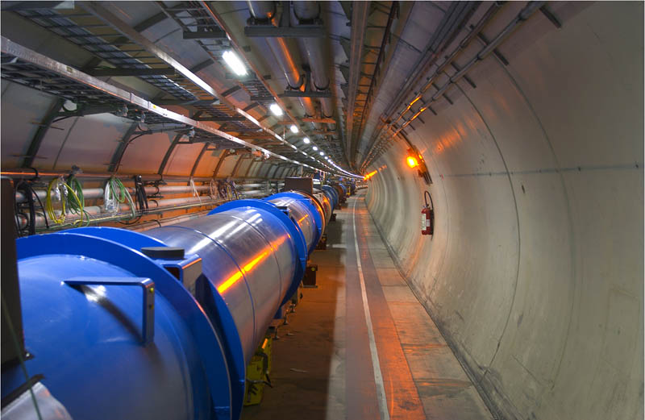

Particle Accelerators at CERN
Ye Olde Proton Synchrotron
Brand New Large Hadron Collder
99.9999% of c
99% of c
100 times more energy
Ultimate Speed
Nothing can reach the speed of light
(infinite energy is required)

Slide 5
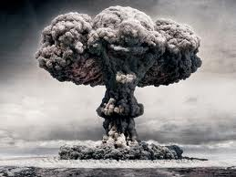
Consequence # 2. Mass at rest has huge* rest energy
*c is large number = 3 x 10⁸ m/s
c² even larger = 9 x 10¹⁶ m²/s²
E.g. Nuclear reactions
Convert mass of nuclei into energy
How much mass for equivalent
21,000 tons of TNT explosion?
Uranium with approx.same mass as a peanut

Slide 6
Can anything reach the speed of light ?
YES ! Light itself always travels at c
HOW ?
Light has no rest mass
Cannot exist at rest
Must travel at exactly c
0 x ∞ = undefined…. any (finite) energy allowed

Slide 7
QUIZ

Slide 8
What happens to the mass of an object as its speed increases?
It gets smaller
It stays the same
It gets larger
It gets smaller or larger depending on the direction of motion

Slide 9
What happens to the mass of an object as its speed increases?
It gets smaller
It stays the same
It gets larger
It gets smaller or larger depending on the direction of motion

Slide 10
An object which has mass when at rest can
Never reach the speed of light
Just reach the speed of light
Surpass the speed of light
Never move

Slide 11
An object which has mass when at rest can
Never reach the speed of light
Just reach the speed of light
Surpass the speed of light
Never move

Slide 12
The energy typically released in an atomic bomb is roughly equivalent to the mass of
An atom
A peanut
A car
A planet

Slide 13
The energy typically released in an atomic bomb is roughly equivalent to the mass of
An atom
A peanut
A car
A planet

Slide 14
Light can travel at the speed of light because
a) It has infinite energy
b) It has no rest mass
c) It has zero energy
d) It does not really exist

Slide 15
Light can travel at the speed of light because
a) It has infinite energy
b) It has no rest mass
c) It has zero energy
d) It does not really exist

