Slide 1
GENERAL RELATIVITY
Equivalence Principle
    Equivalence principle
    Free Fall

Slide 2
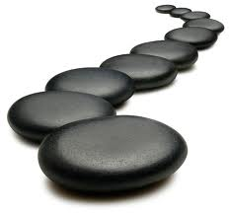
General Relativity extends first postulate
Laws of Physics are same for observers in any
frame of reference, including non-inertial*
*accelerating, which can be felt
without reference to other frames
Stepping stone to implement idea
Principle of
Equivalence

Slide 3
Effect of acceleration = effect of gravity when stationary
Small freely falling frame = local inertial reference frame
General
Relativity =
Model of
gravity
Inside Aircraft
freely falling dog

Slide 4

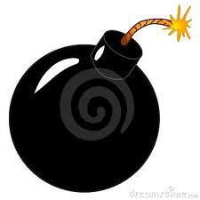
Mass
All objects free
fall with same
acceleration
(Galileo)
WHY?
Inertial mass = Gravitational mass
Source of
gravity force
Resistance to
acceleration (F=ma)

Slide 5
There is no force of gravity!
In free fall, no forces are felt
Earth’s surface is non-inertial frame
Projectiles are freely moving yet follow
a curved path relative to Earth’s surface:
Not due to gravity force
Due to “acceleration” of Earth’s surface

