Slide 1
GENERAL RELATIVITY
Time Dilation & Light Bending
    Time Dilation
    Light Bending
    Black Holes

Slide 2
Acceleration causes time dilation:
consider increments of travelling twin’s journey
Elapsed time t, distance travelled l, measured
in inertial (rest) frame of stay-at-home twin
Proper time τ elapsed on travelling twin’s clock
valid for SR (IRF)
τ is less than t (time dilation)
τ² = t² - l ²

Slide 3

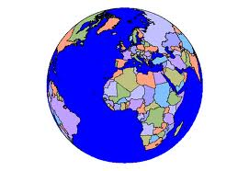
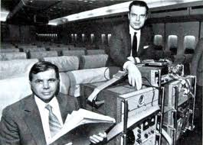
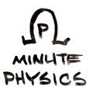
Equivalence principle
implies gravity dilates
time
Gravity
Ticks faster
Ticks
slower
weaker
stronger
E.g. One mile high
= 15 billionths sec / day faster
Important for GPS
Hafele & Keating 1971
Atomic clocks on airline

Slide 4
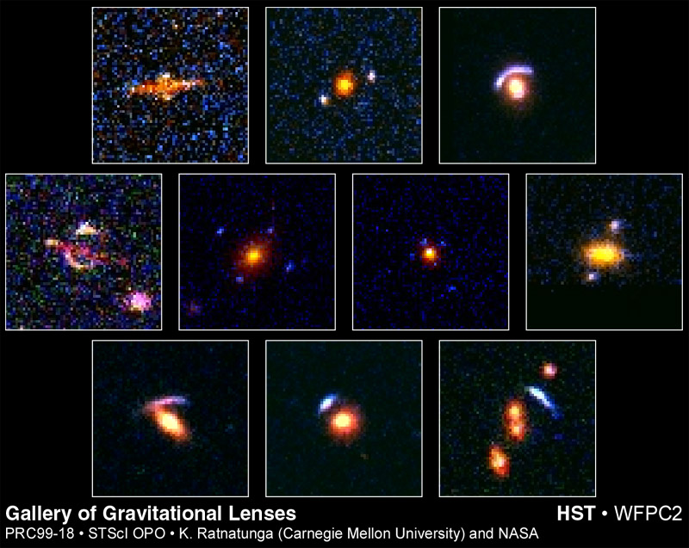
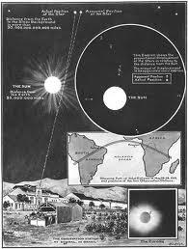
Light
Equivalence principle implies bending of
light by gravity Gravitational Lensing
First seen by Eddington’s 1919 eclipse expedition

Slide 5
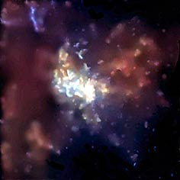
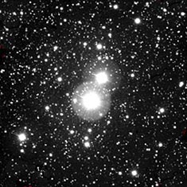
Black Holes
Sufficiently strong gravity could create an
Event Horizon
Time stands still at EH relative to far away clocks
Nothing can escape once past the EH
Stellar collapse, galaxy centers, may produce Black Holes
Milky Way Cygnus X-1
Center in orbiting a
X-rays black hole

