Slide 1
GENERAL RELATIVITY
Curved Space-Time
    Intrinsic curvature
    Curvature of Spacetime
    Geodesic motion

Slide 2
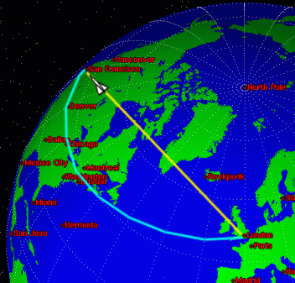
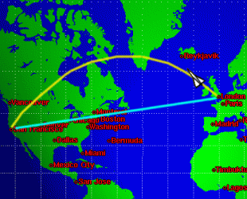
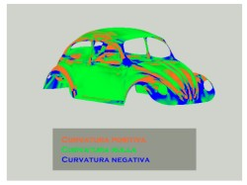
Intrinsic Curvature
Airlines follow the shortest path
This is not a straight line because the Earth’s surface is intrinsically* curved
*Cannot be made flat without
stretching or tearing

Slide 3
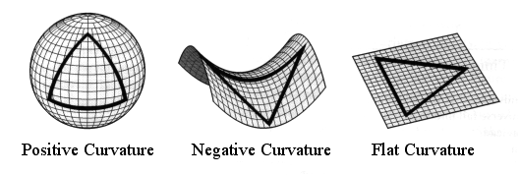
Intrinsic curvature measured by triangulation
Draw any triangle = 3 points joined by geodesic paths
*Geodesic – path of shortest or longest travel in curved space
(in flat space this is a straight line)
Σ angles > 180º Σ angles < 180º Σ angles = 180º
The first 2 shapes cannot be made from a flat
piece of paper without tearing or stretching

Slide 4

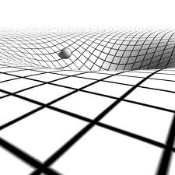
Generalization of curved space to more than 2 dimensions Mathematician -> Riemann, Einstein used this work for GR.
General Relativity’s
BIG IDEA
Space-time is intrinsically
curved by mass.
This alters motion of other
masses `as if by’ gravity force
(but there isn’t any)
…And it dilates time

Slide 5
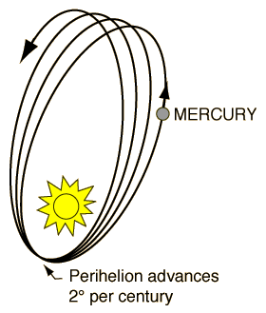
General Relativity’s Law of Motion
In Free-fall (IRF, no forces) the world-line
is a geodesic path in curved space-time
Geodesics have longest
proper-time elapsed
-> forced motion suffers
time dilation
Reminiscent of Newton’s First Law
Straight line in flat space
-> geodesic in space-time
Curved Space-time agrees precisely with
change of Mercury’s perihelion
….and many, many of other measurements of gravity

Slide 6
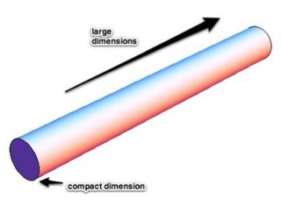
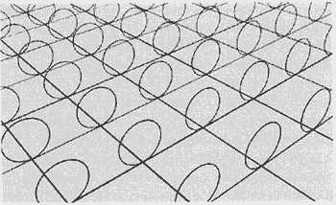
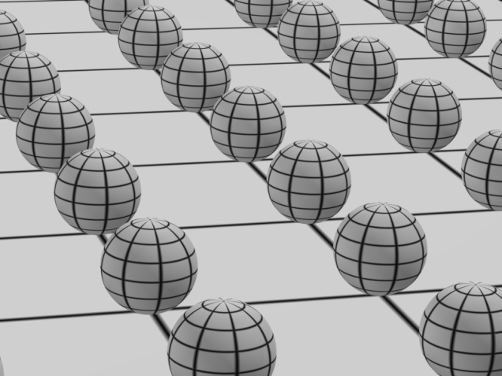
Speculation…..what about the other forces of nature (nuclear and electromagnetic)?
Are they real?
Or are they also an illusion of space-time?
Could there be more dimensions of space representing these forces?
WE DON’T KNOW THE ANSWER YET.
WE ARE SEARCHING FOR EXTRA DIMENSIONS…. Looking for particles that are travelling them

