Slide 1
GENERAL RELATIVITY
Structure of the Universe
    Stars and Galaxies
    Expansion of the Universe
    Creation of the Universe

Slide 2
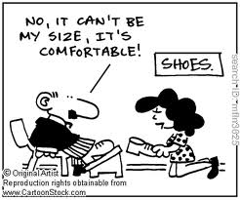



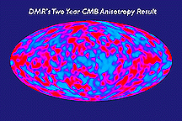
Sizes
Enormous distances measured in
= Distance travelled by light in one year
(1 light second = 186,000 miles)
Light Years
Earth-Sun = 8 light minutes
Milkyway = 100,000 light years
Universe = billions of light years

Slide 3
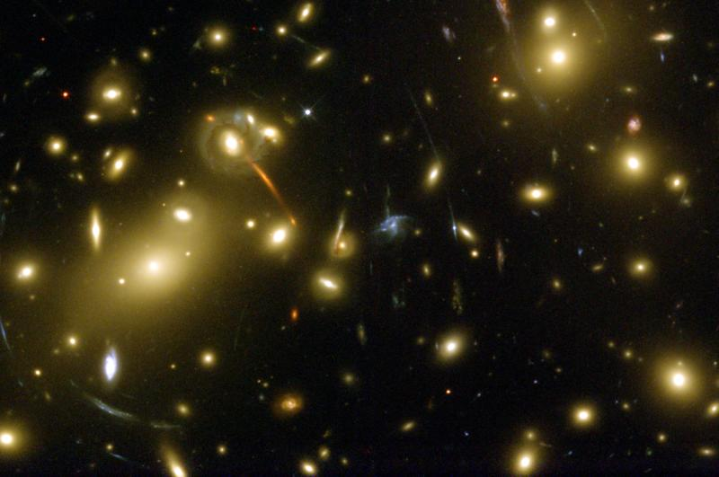
The Universe
Stars like the Sun collect in (typically) rotating spiral galaxies
Each galaxy contains billions of stars, dust, and Dark Matter
There are billions of galaxies in the universe

Slide 4
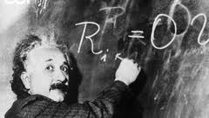

According to GR, mass/energy of matter determines geometry of space-time.
Apply to entire universe:
Curvature = Mass of Matter
- Vacuum Energy
Gravity attracts galaxies
(matter) to one another
Empty space acts to push
matter apart
So what does our universe do?

Slide 5
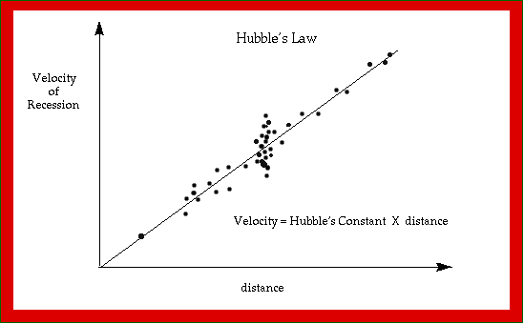
Hubble
first discovered galaxies are moving
away from us (receding)
Speed of recession
grows with distance
from us (linearly)
Universe is expanding

Slide 6

Where is the center, edge of the expansion ?
Need have no answer
Imagine space is surface of sphere:
As surface expands,
galaxies move apart
There is no center
There is no edge
(finite but unbounded)
Space is `created’
Universe could be infinite or finite, with or without boundary
(we haven’t seen a boundary yet)

Slide 7
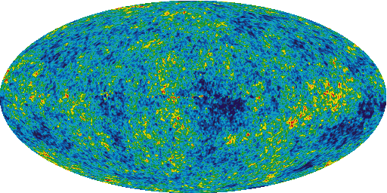
Imagine rewinding expansion….. GR retrodicts there was a beginning of space-time
GR describes a
singularity
at which all
Space*
Time***
Matter***
was created.
Microwaves fill the universe from the initial heat of the
BIG BANG
*Not created
`inside’ anything.
**No `before’.
***No cause.

Slide 8
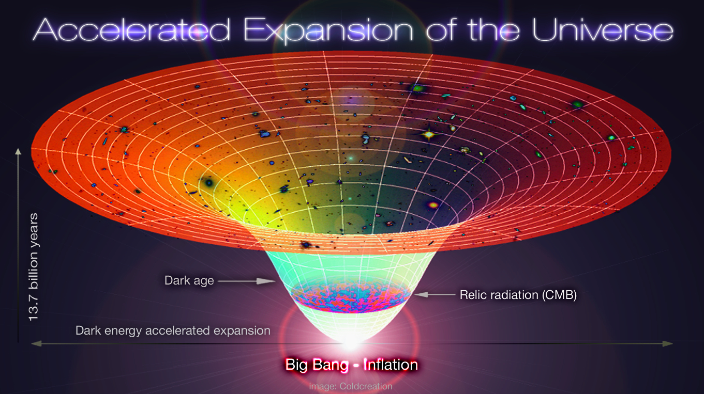
Imagine fast-forwarding the expansion…..
GR predicts it will expand for ever
Energy of empty space (Dark Energy) is now stronger
than gravity pulling galaxies back together
expansion of
universe is
accelerating

