Slide 1
QUANTUM MECHANICS
Wave-Particle Duality of Light
    Our story so far…
    Light as a wave
    Light as a particle (quantum)

Slide 2
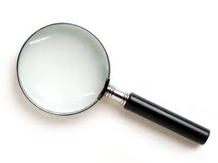
Our Story So Far ….
1600/1700s: Classical Mechanics (Galileo, Newton)
Describes motion on human scale or larger
1800s: Electromagnetism (Maxwell)
Relates light to electricity & magnetism
(Early) 1900s: Relativistic Mechanics (Einstein)
Describes motion near light speed, gravity
Also (early) 1900s: ATOMS, NUCLEI, MOLECULES
discovered.
Very s ma ll
Quantum Mechanics
describes these

Slide 3

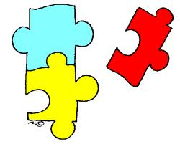
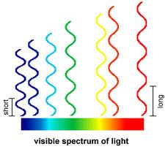
Health Warning: Do not try too
hard to `picture’ very small things
The puzzle of
LIGHT
Maxwell’s equations
Describe light as a
wave motion
Evidence for light as a wave
Peak-to-peak distance = wavelength λ
Rate of vibration = frequency f
Wave speed v = f λ
Wave height squared h² = Intensity I
ASIDE
ASIDE

Slide 4
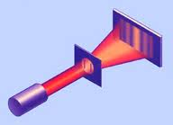
E.g. Young’s double slit experiment
Bright and dark
Interference Fringes
seen on observation
screen
Light spreads (diffracts)
from each slit
Light source
Screen with 2 slits

Slide 5


Same interference pattern seen in water waves
..
…
Bright
Dark
Bright
Dark
Bright
…
..
One `slit’
Two `slits’

Slide 6
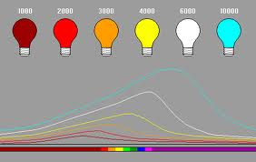
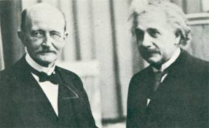
Evidence for light as particles
Max Planck explains colors of hot objects
with new idea of
`quanta’ of light energy.
Energy of one quantum
E = h x f
( h = Planck’s constant )
( f = light frequency )
Light energy always a multiple
of basic quantum h f

Slide 7
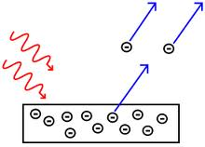
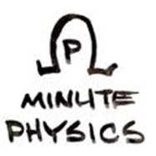
Einstein goes further, suggests these quanta are actual
particles (photons), explains Photoelectric Effect
Electrons
High (not low)
frequency light
ejects electrons
from metals
Photons
Each electron absorbs
one particle of light,
whose energy depends
on frequency as E= h f

Slide 8
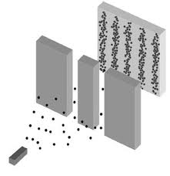
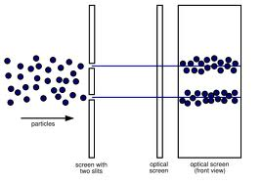
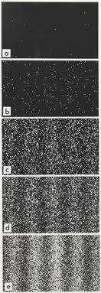
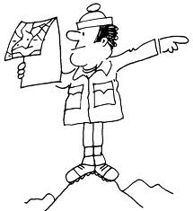

Wave patterns from particles?
Light waves hit observation screen as point-like hits
-> photon particles
What guides
each photon ?
Hits build up interference
pattern over time
Even when only one photon
at-a-time in apparatus

