Slide 1
QUANTUM MECHANICS
Probability & Uncertainty
    Probability
    Uncertainty
    Double-slit photons

Slide 2
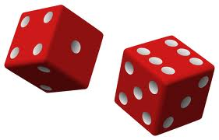
Probability
P(S) = Probability of getting sum S
THEORY
EXPERIMENT
# ways to get S
# all possible outcomes
# times S occurs
# all throws
Experiment approaches Theory after more &
more throws, but always fluctuates.

Slide 3

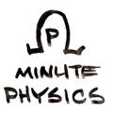
Quantum Mechanics
Big Idea
Wave represents
probability of particle
detection at a particular
place and time (Max Born)
Solves wave-particle
duality paradox
Wave = THEORY
Particle = EXPERIMENT (compare to dice)
Quantum Waves: P = h²
Wave Height h Intensity => Probability P
Double Slits – Location of bright bands has
high probability of photon hits

Slide 4
New kind of scientific model
Probability : Cannot predict result of any one detection
Detection : No objective
reality before measurement
U C
N E R
T A Y
I N T
Classical physics deterministic
Can predict future position & speed
with arbitrary precision
Quantum physics probabilistic
Can predict only probability of observing certain
future speed or position

Slide 5

How is position of an object detected?
Observe (e.g. with light)
X ?
Increasing certainty of
position X, decreases
certainty of momentum P
(momentum = mass times velocity )
A photon
bounces off
(detection)
Object gets
an uncertain `kick’
(changes velocity)
Observe

Slide 6
Measure X ± ΔX Measure P ± ΔP
QM says can make either ΔX or ΔP arbitrarily
small (not zero) by better experiment
BUT… there is a theoretical limit on both simultaneously:
Heisenberg
Uncertainty
Principle
ΔX times ΔP is always more than h
h = Planck constant
(very small)
Smaller ΔX implies larger ΔP ….and vice versa
Limit only noticeable at atomic sizes
Uncertainty Principle applies to everything, including us

Slide 7
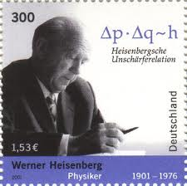

Slide 8
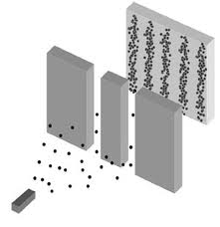

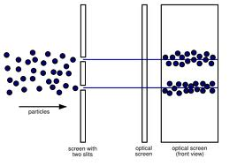
Revisit….Double slit photons:
Quantum mechanics
-> wave represents probability of particle detection
-> measurement uncertainty
Paradox ?
Interference pattern result of two slits,
but each particle must go through only one slit (surely?)
QM : before detection,
cannot say which slit
particle went through
(no definite path)
Act of
looking
alters
the
wave..
If detect which slit each particle passes through
-> no interference pattern

