Slide 1
QUANTUM MECHANICS
Matter Waves
    De Broglie and Schrodinger
    Electron microscopes
    Quantum Tunneling (microscopes)

Slide 2
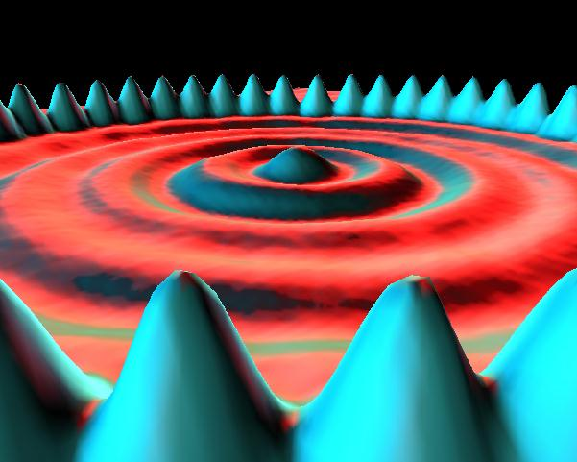

Matter Waves
Everything (photons, electrons, SMU students, planets, ..)
has a probability wave - de Broglie
Wavelength λ = h = Planck’s constant
p momentum
Q. What is your wavelength?
About 10⁻³⁵ m
(Practically Unobservable)
Electron Waves
But… photons, electrons, other elementary particles
can have very small p, hence observable wavelength

Slide 3
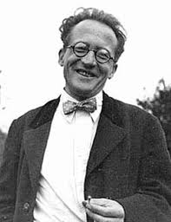

Schrodinger’s Equation
Based on Conservation of Energy principle
Describes how probability waves move
Output is `wavefunction’ Ψ - height of the wave at any one place and time (probability is Ψ²)

Slide 4

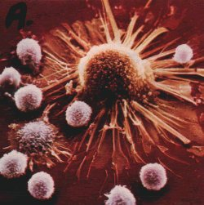
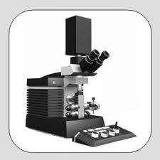
Visible light -> Microscopes
use lenses and mirrors to guide
Electrons -> Electron microscopes
use electricity to guide
Momentum larger than for visible photons,
wavelength smaller,
see more details
E.g. cancer
cell

Slide 5
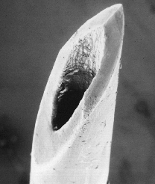
Hypodermic needle

Slide 6
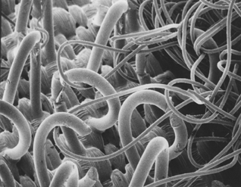
Velcro

Slide 7
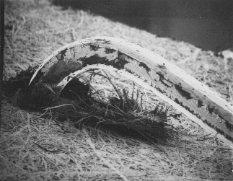
Staple

Slide 8
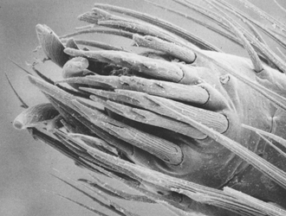
Spider’s foot

Slide 9
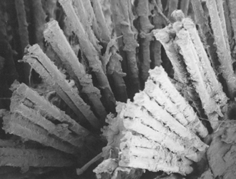
Mascara brush

Slide 10
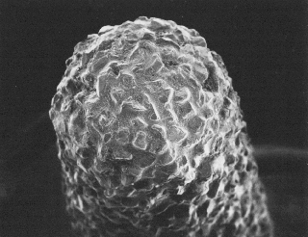
Dental drill tip

Slide 11
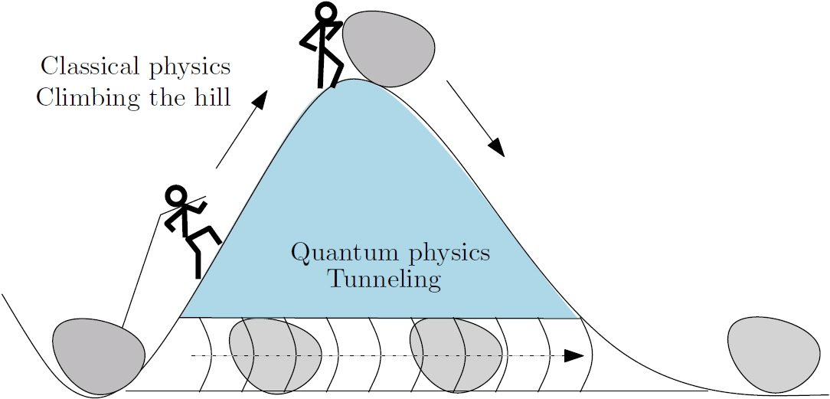
Energy Barriers
Classical physics – Energy needed to surmount barrier
Quantum Physics – Small probability to pass through

Slide 12
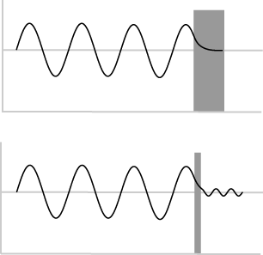
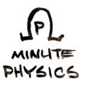
How?
Waves can pass through `forbidden’ regions
Quantum wave exists
within and beyond
energy barrier
Probability to `tunnel’
through grows rapidly
as width/height of barrier
decreases

Slide 13
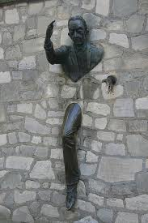
QM applies to everything … including you
Very (very) small
probability that
you can walk through walls

Slide 14
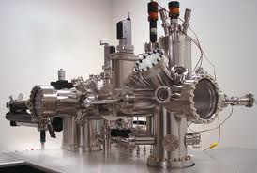
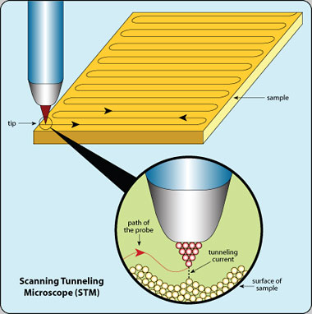
Scanning Tunneling Microscope (STM)
Electrons quantum tunnel
from tip to sample through
(air) barrier
Tunneling rate (current)
extremely sensitive to
tip-sample separation
Measured current
provides topographical
map of sample surface

Slide 15
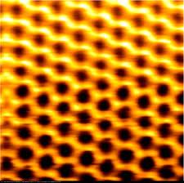

Slide 16
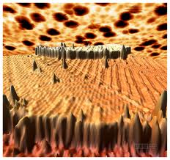

Slide 17
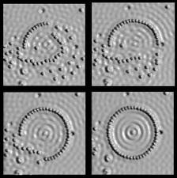

Slide 18
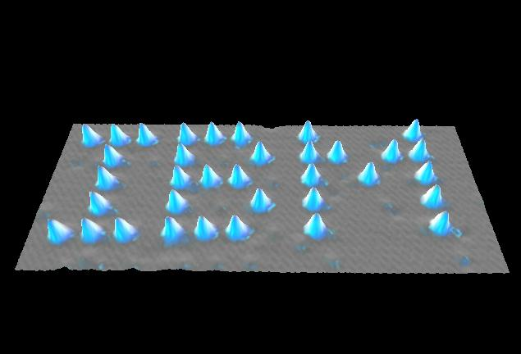

Slide 19
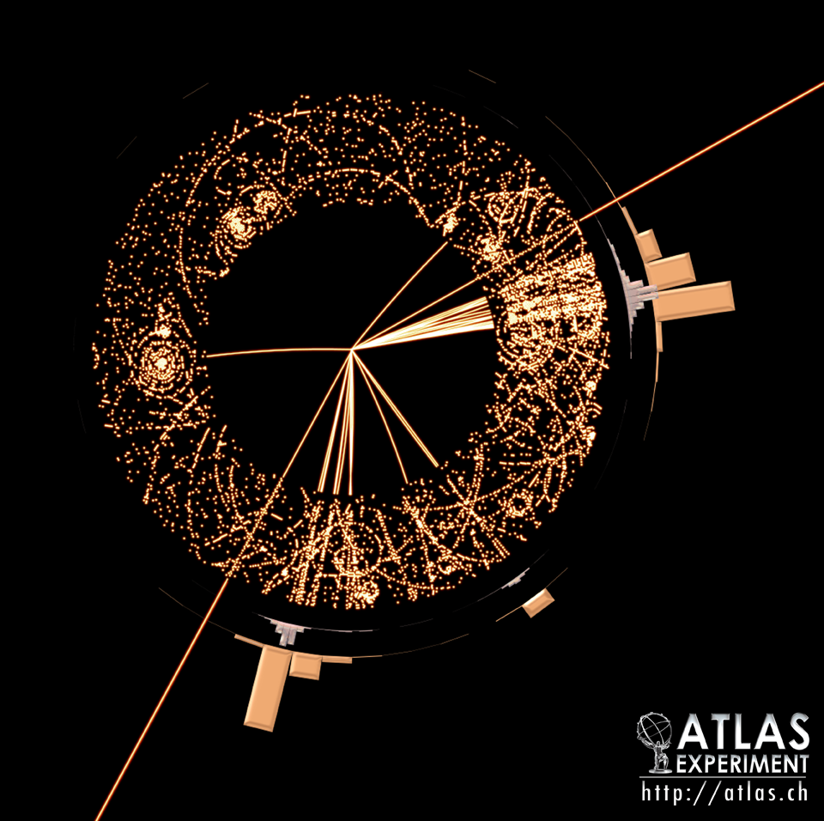
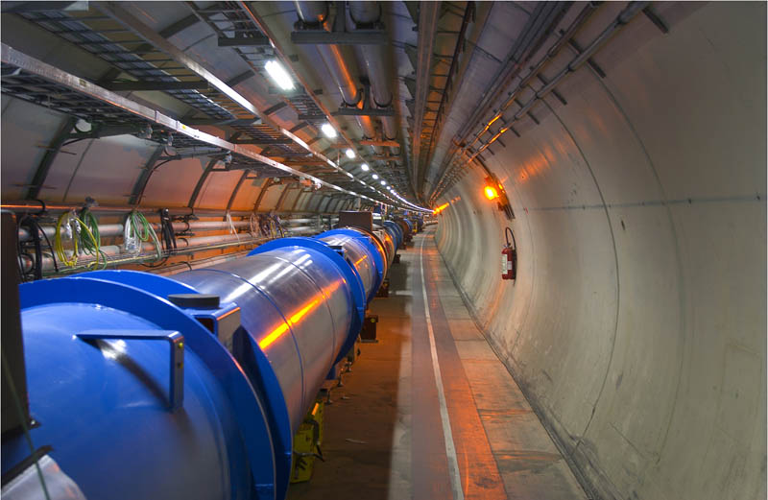
Particle Colliders
Accelerate to very large p and collide Quark particles
“Image” smallest, simplest things known
Elementary particles – characterized by a few numbers
Atlas Detector
E.g. Large Hadron Collider

