Slide 1
QUANTUM MECHANICS
Quantum Measurements
    Quantum measurement problem
    Schrodinger’s cat
    Possible interpretations

Slide 2

Schrodinger Wave Equation:
Describes movement of quantum waves -> DETERMINISTIC
Wave height squared is probability of particle detection
(Born)
QUANTUM MEASUREMENT
PROBLEM
Before Measurement
– Only probability known
After Measurement
– `Exact’ result known
How to describe measurement
process in quantum mechanics?

Slide 3
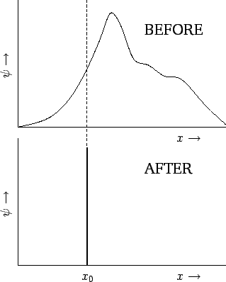
E.g. Position measurement of a subject
“Collapse of the
Wavefunction”
at instant of
measurement
Process not described
by Schrodinger
equation of subject

Slide 4
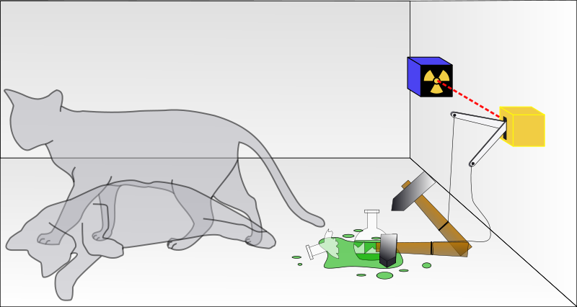

Schrodinger’s Cat in a box
Radioactive
atom has
probability
½ of decay
IF atom decays, cat is poisoned
Before we observe, cat’s quantum wave is
½ Alive
½ Dead with equal probability
Before we look, cat is neither dead nor alive!

Slide 5
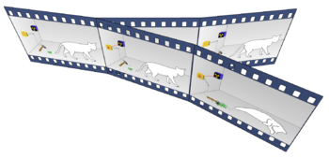
Interpretations…
Standard interpretation used today:
Other interpretations:
COPENHAGEN (Bohr)
Observer causes wavefunction collapse
Problems: Observer made of atoms, must obey QM
No objective reality
MANY WORLDS (Everett)
Each possible result realised
in a different universe
Problems: Untestable
Cannot know the past

Slide 6
DECOHERENCE (Zurek)
Include measuring device and environment
in quantum system
HIDDEN VARIABLES (Einstein)
Yet undiscovered quantities determine
objective reality
Einstein: "I think that a particle must have a separate
reality independent of the measurements….I like to
think that the moon is there even if I am not looking at it!”

