Slide 1
ATOMS
Structure & Properties
    Atomic structure
    Periodic table
    Problem of atomic spectra

Slide 2
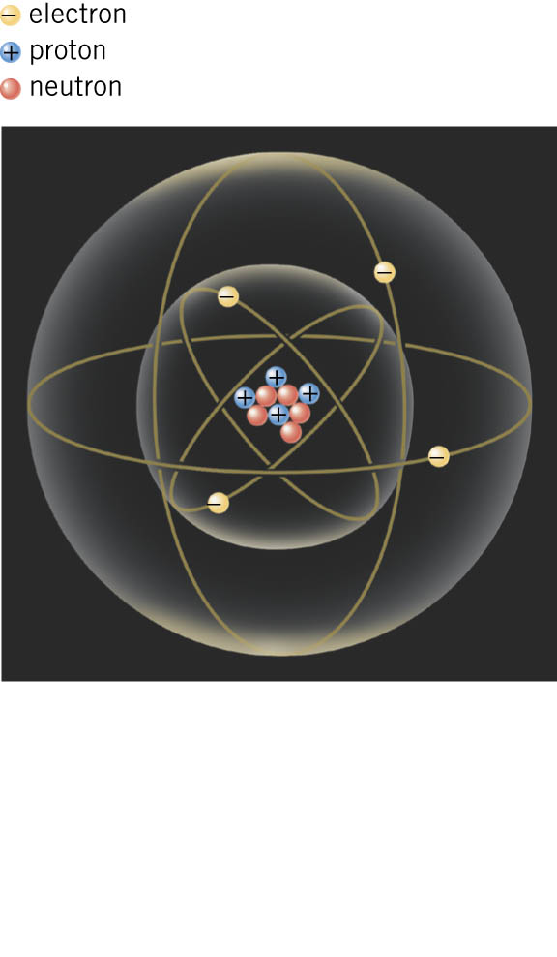
Democritus 4th Century B.C.
Atoms as elementary blocks
of matter
Thomson discovers electron (1900)
-> Plum Pudding Model of atom
(a guess)
Plums (electrons)
= negative electric charge centers
Pudding = positive electric charge
Rutherford (1911)
Atoms as small nucleus of positive charge,
surrounded by orbiting electrons

Slide 3
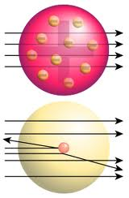
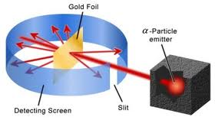

Rutherford’s experiment
Plum
Pudding
Model
Nuclear
Model
Note: Nucleus later found to be composed of
protons (positive charge particles)
and
neutrons (electrically neutral particles)

Slide 4
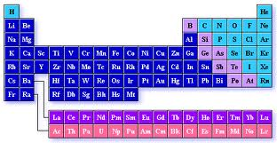
Properties of atoms
# electrons = # protons (electrical neutrality)
# electrons determines chemical properties
Hydrogen –>1 electron Z=1
Helium –> 2 electrons Z=2
Lithium –> 3 electrons Z=3
……
Uranium –> 92 electrons Z=92
92 natural
`elements’
Explains the
Periodic Table of Chemistry

Slide 5
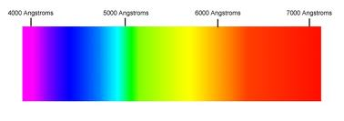

Trouble with Rutherford’s Model!
Electron always accelerating
Accelerating charge radiates light (Maxwell)
Electron would lose its energy,
spiralling into nucleus
-> atoms unstable
Also, radiated light from an atom
would have all wavelengths (colors)
But real atoms emit/absorb
light of a few discrete wavelengths
E.g. Balmer lines of Hydrogen

