Slide 1
ATOMS
Quantized Energy
    Bohr model of the atom
    Standing waves
    Quantum energy of colors

Slide 2
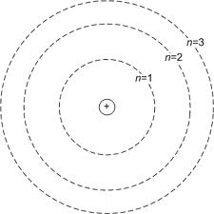
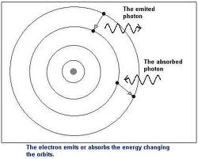
Bohr Model (particle picture)
Assumptions
Nuclear model
Discrete electron orbits n = 1,2,3,..
Light absorbed/emitted as quantum
of energy when electron jumps orbit
Energy change = h f
      = Planck constant x light frequency*
* Speed = frequency x wavelength
c = f λ
Bohr’s Hydrogen Formula

Slide 3
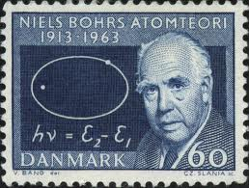
Explains Hydrogen visible colors (Balmer spectrum, jumps to n=2)
Predicted Hydrogen UV spectrum
(jumps to n=1)
Led to atomic understanding of
Chemistry… and huge fame for Bohr
Standing
Waves
WHY discrete orbits?
Electrons as Matter waves

Slide 4
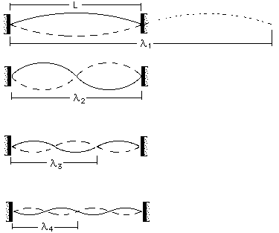
Analogy: Standing waves on a string
Wavelength
λ = 2L
λ = L
λ = 2L/3
λ = L/2
.
.
λ = 2L/n
1st Harmonic
(Fundamental)
2nd Harmonic
3rd Harmonic
.
.
.
Sound waves –
Origin of character of musical notes

Slide 5
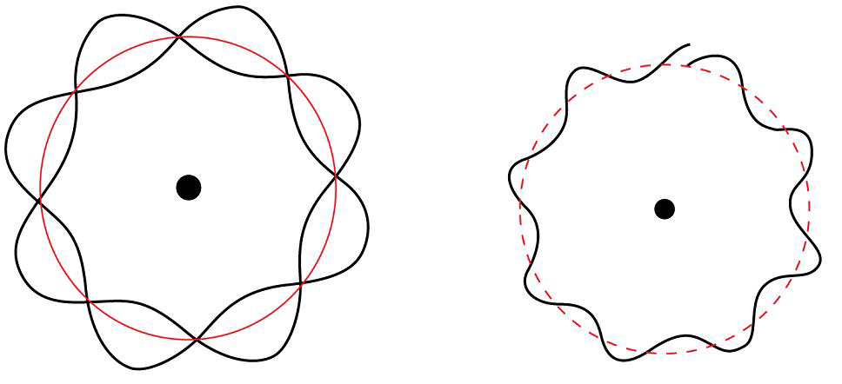

Answer
Electron Standing Waves (3 dimensional)
Only discrete electron λ fits* in atom
*Fit =
constructive
interference
De Broglie p = h / λ
Discrete electron momentum & energy
Discrete photon frequency when
electron jumps between energy

Slide 6

Schrodinger’s Equation for atoms
Electron (probability) standing waves
Discrete energy changes -> discrete
photon wavelengths emitted/absorbed
Characteristic colors of materials
(analogy to sounds of musical notes)
Lowest (fundamental, n=1 )
standing wave -> atomic stability

