Slide 1
ATOMS
The Nucleus
    Radioactivity
    Artificial nuclear reactions
    Fission & fusion

Slide 2
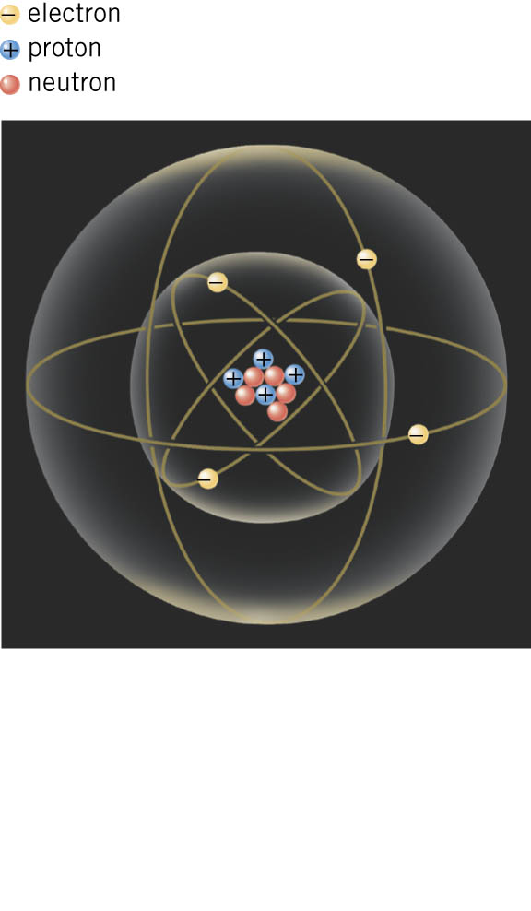
Radioactivity - quantum tunneling from atomic nucleus
3 types of natural nuclear decay:
α - Nucleus emits a Helium nucleus
β - Nucleus emits an electron
γ - Nucleus emits a (gamma) photon
Emission is random
QM predicts probability emission
will happen (per second)

Slide 3
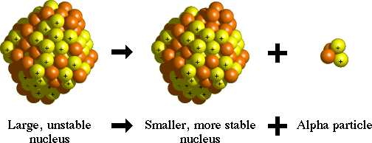
α Decay
Alpha particle quantum tunnels out of large nucleus
Random process – wait long enough and it will happen
Example of natural nuclear reaction - radioactivity

Slide 4
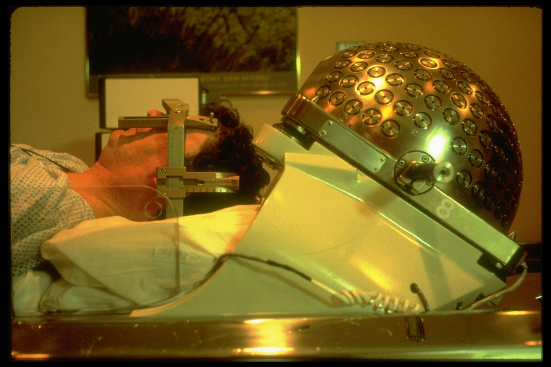
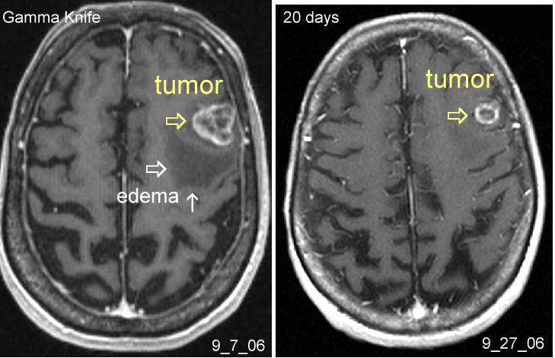
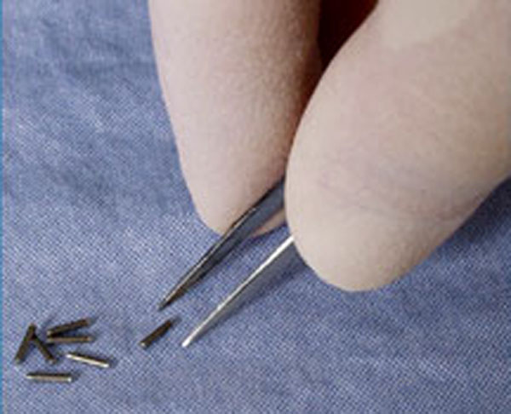

Applications of Radioactivity
Radiometric Dating: age of rocks, e.g. organic matter (carbon dating).
Nuclear Medicine: non-invasive
imaging of tissue e.g. Gamma knife
Radiation Therapy: ionizing
damages cancer cell DNA
e.g. Brachytherapy
Murder: poisoning
e.g. Alexander Litvinenko

Slide 5
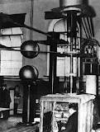
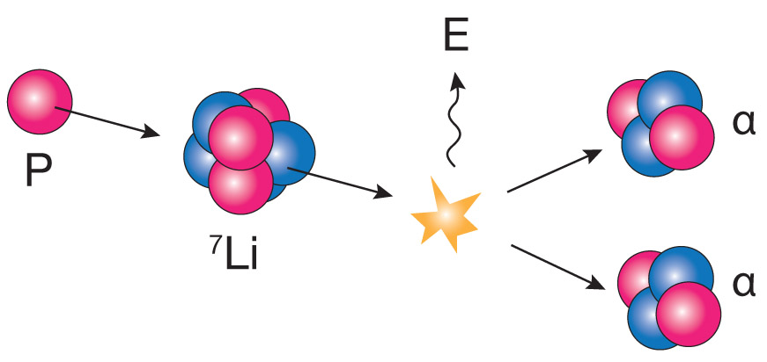

Artificial Nuclear reactions
Cockcroft & Walton (1930s)
First to `split the atom’ (nucleus)
Early particle accelerator
P = proton (also denoted ¹H, nucleus of Hydrogen)
⁷Li = nucleus of Lithium, 7 = # nucleons = protons + neutrons
E = Energy

Slide 6
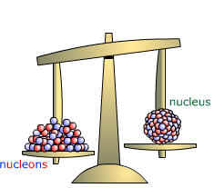
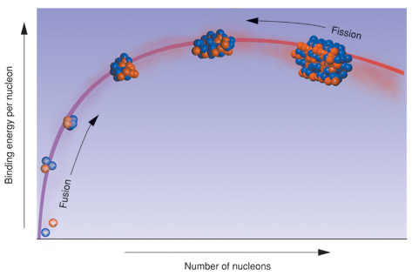
Mass - Energy
Mass of a nucleus less than total
mass of its nucleon constituents
Via E=mc²
Mass difference
is binding energy
to hold nucleons
inside nucleus
Middle-sized nuclei are most stable (e.g. Iron ⁵⁶Fe)

Slide 7
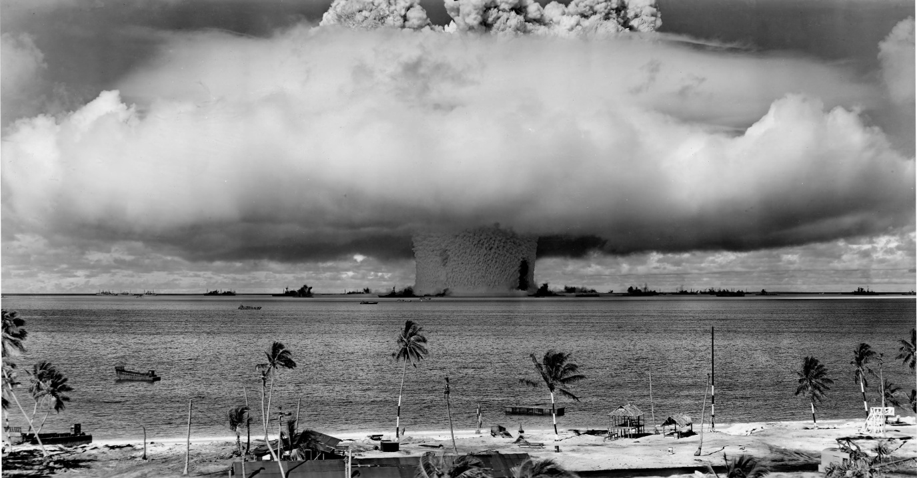
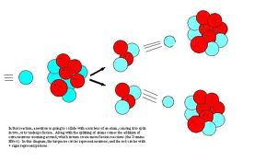
Larger nuclei can release energy and become more stable by:
FISSION
Baker test equals
14,000 tonnes TNT
A chain reaction is needed for large energy release:
U + n --> Rb + Cs + 2n
Uranium neutron Rubidium Cesium two neutrons
2 -> 4 -> 8 -> 16 - > 32 -> 64 -> 128 -> 256 -> 512 -> 1024 -> . .
Nuclear power stations `moderate’ chain reaction by absorbing some neutrons

Slide 8
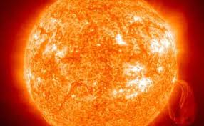
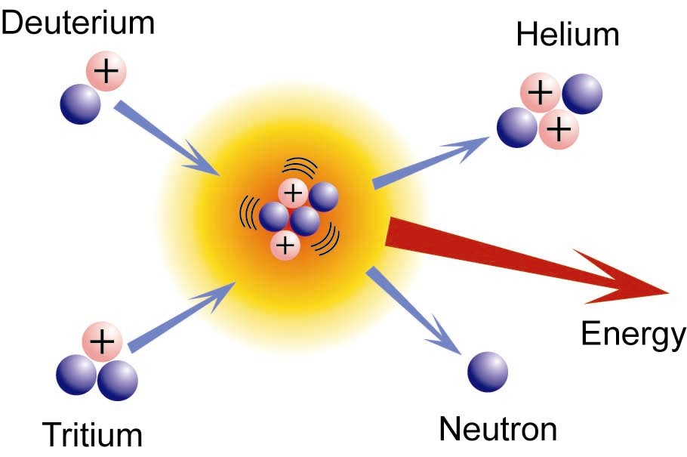
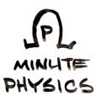
Smaller nuclei can release energy and become more stable by:
FUSION
Sun loses 4 million
tonnes of mass per sec
Isotopes
of Hydrogen
Thermonuclear Weapons

